Slide 1

thrombotic complications in inherited bleeding disorders the problem of aging population?
Peter Kubisz
National Centre for Haemostasis and Thrombosis
Department of Haematology and Transfusion Medicine
Jessenius Faculty of Medicine of the Comenius University
University Hospital in Martin
Martin, Slovak Republic

Slide 2
basic characteristics case report
61-year old male
moderate haemophilia A (FVIII:C 0.02-0.03 IU/mL) without inhibitor treated on demand with pdFVIII
history:
bleeding | gastrointestinal, intra-abdominal rec. joint bleeds  arthropathy (right hip and ankle, left knee, elbows)
medical | arterial hypertension, gr. II, very high added CV risk obesity (BMI 30), dyslipidaemia heavy smoker (30 cigarettes / day for 40 years) chronic hepatitis C HP-positive gastritis with gastric ulcer in the past
family | no serious bleeding / thrombotic events
medication | Perindopril, Bisoprolol, Alprazolam, FVIII on demand

Slide 3
problem case report
problem
constant moderate abdominal pain in the mesogastrium radiating to the back for 5 days, started after dietary excess
recurrent nausea and vomitus
chronic dyspepsia → similar but less intense symptoms intermittently in the last 2 years; repeated exams, not revealing
working diagnosis: acute dyspepsia (gastritis / acute pancreatitis / haemorrhage)
initial workout
treatment: symptomatic (diet, parenteral nutrition, antiemetics, analgetics)
examination: physical examination, laboratory testing, ultrasound of the abdomen, endoscopic examination

Slide 4
initial workout case report
physical examination
no signs of bleeding (skin, mucous membranes) cardiopulmonary stable, ECG without ischemic changes abdomen: no pathological findings and no peritoneal irritation; digital rectal examination: no signs of bleeding extremities: arthropathy, no signs of thrombosis or acute ischemia
laboratory testing
blood count: mild anaemia, otherwise normal serum: no significant changes; stool: negative for occult bleeding
abdominal ultrasonography
pancreas: hyperechoic body, but no other changes; other organs normal
;
upper gastrointestinal endoscopy
erythematous pangastritis, but no ulcer / active bleeding
no findings to explain
the clinical problem

Slide 5
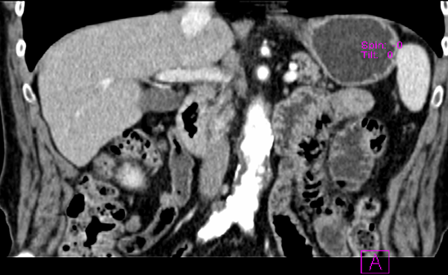
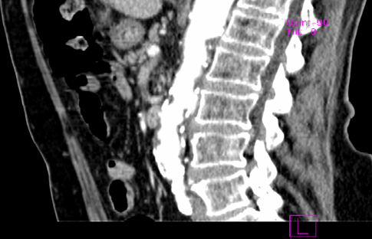
additional examination case report
CT of the abdomen
pancreas lipomatous, but otherwise normal irregular, circular thrombus, 2-5 mm, in the entire length of the abd. aorta
definitive diagnosis: abdominal ischemia caused by the partial aortic thrombosis with atherosclerosis

Slide 6
additional examination (cont.) case report
thrombophilia testing
included tests: antiphospholipid antibodies; homocysteine; resistance to activated protein C, protein C, protein S and antithrombin activity, genetics: F2 rs1799963, F5 rs6025, MTHFR rs1801131, MTHFR rs1801133 clinically relevant inherited thrombophilia identified  resistance to activated protein C (heterozygosity for FV Leiden)
the thrombotic event likely due to the presence of
inherited and acquired prothrombotic risk factors
(age, dyslipidaemia, obesity, smoking, inherited thrombophilia)

Slide 7
?
arterial thrombotic event
in elderly PWH:
UNUSUAL
or
EXPECTED FINDING

Slide 8
thrombo-embolic events vs. age (general p.)
incidence of both
arterial and venous TE events increased with age
American Heart Association, Prevalence of stroke, http://www.heart.org/idc/groups/heart-public/@wcm/@sop/@smd/documents/downloadable/ ucm_449858.pdf; Kissela BM et al., Stroke 2012;79:1781-7; American Heart Association, Prevalence of myocardial infarction by age and sex, http://www.heart.org/idc/groups/heart-public/@wcm/@sop/ @smd/documents/downloadable/ucm_449846.pdf; Parikh NI et al., Circulation 2009;119:1203-10; Naess IA et al., J Thromb Haemost 2007;5:692-9

Slide 9
PWH - life expectancy vs. treatment
life expectancy of PWH improved with treatment developement
present: life expectancy of PWH only slightly  in developed countries
HIV
HBV
HCV
cryoprecipitate,
pd coag. factors
pd: ↑ safety,
r coag. factors
treatment
whole blood
plasma
Mejia-Carvajal C et al., J Thromb Haemost 2006;4:507-9; Darby SC et al., Blood 2007;110:815-25; U. S. Statistics, Life Expectancy by Age, 1850–2004, www.infoplease.com/ipa/A0005140.html; www.worldlifeexpectancy.com/history-of-life-expectancy

Slide 10






PWH - age distribution
haemophilia A
73 countries (13 from the EU), year 2014
počet pacientov [%]
cca 1/3 of PWH
in developed countries
are 45+
haemophilia B
72 countries (13 from the EU), year 2014
years
World Federation of Hemophilia, World Federation of Hemophilia Global Survey 2014, http://www1.wfh.org/publications/files/pdf-1627.pdf

Slide 11

haemopilia effect
?
haemophilias provide life-long protection against TE events
risk of thromboembolism
not changed in elderly PWH
haemophilias do not affect age-related changes of hemostasis
 risk of thromboembolism
in elderly PWH
occurence of TE (CAD, stroke, VTE) events in haemophilic population
risk factors

Slide 12
CVD in PWH
authors | study design | studied population | results
Rosendaal et al., 1989 ¹ | retrospective; mortality data | 717 PWH population data (NL) |  mortality due to CVD (80%)
Bilora et al., 1999 ² | prospective | 50 PWH (S, Mo; 41.7 ys) 50 age-m. controls (ITA) |  prevalence of asympt. ATS in PWH (12 vs. 30%)
Fransen van de Putte et al., 2012 ³ | retrospective | 408 PWH (53.7 ys) population data (NL) |  prevalence of MI in PWH (2.5% vs. 4.8%), AP comparable
Fransen van de Putte et al., 2012 ⁴ | retrospective | 709 PWH (49.8 ys) population data (NL, UK) | trend towards a  prevalence of MI in PWH (1.7% vs. 4.0%), AP comparable
Pocoski J et al., 2013 ⁵ | retrospective | 2506 PWH (HA) 7518 age-m. controls (USA) MarketScan |  prevalence of CVD (CAD, MI) in PWH, CVD in earlier age in PWH
Minuk et al., 2015 ⁶ | retrospective (ARCHER study) | 294 PWH (54 ys) population data (CAN) | similar incidence, relatively common (14.0 per 1000 patient years)
Wang et al., 2015 ⁷ | retrospective | 1054 PWH 1054 age-m. controls (Taiwan) | similar prevalence, CVD in earlier age in PWH (49,0 vs. 55.8 ys, p = 0.019)
Humphries et al., 2016 ⁸ | retrospective | 1050 PWh 3150 age-m. controls (USA) PharMetricsVR LifeLink claims |  prevalence of CVD (CAD, MI) in PWH, CVD in earlier age in PWH
ATS, atherosclerosis; CVD, cardio-vascular disease; MI, myocardial infarction; S, severe; Mo, moderate
1 Rosendaal Fr et al., Br J Haematol. 1989;71:71-6; 2 Bilora F et al., Clin Appl Thromb Hemost. 1999:5:232-5; 3 Fransen van de Putte DE et al., Eu J Haematol 2012;89:336-9; 4 Fransen van de Putte DE et al., Thromb Res 2012;130:157-62; 5 Pocoski J et al., Haemophilia 2013;9:1-7; 6 Minuk L et al., Haemophilia 2015;21:736–41; 7 Wang J et al., Thromb Res 2015;135:502–7; 8 Humphries TJ et al., Am J Hem 2016;91:E298-9
Notes:
¹

Slide 13
aging vs. CVD
0.000
stat. significance
infarction
0.01
0.019
<0.001
prevalence [%]
angina pectoris
<0.001
<0.001
0.017
retrospective
2506 PWH (USA), 7518 age-matched controls
PWH: 1282 ≤ 29 ys, 251 30-39 ys, 255 40-49 ys, 307 50-59 ys, 251 60-69 ys, 160 ≥ 70 ys
1 Pocoski J et al., Haemophilia 2013;9:1-7

Slide 14
severity of haemophilias vs. CVD
0.000
stat. significance
infarction
<0.05
prevalence [%]
angina pectoris
retrospective ¹
408 PWH (NL)
365 (89%) HA, 43 (11%) HB
severe: 204 (50%)
mean age: 53.7 (24-94) ys
retrospective ²
709 PWH (NL, UK)
594 (84%) HA, 115 (16%) HB
severe: 344 (49%)
mean age: 49.8 (30-94) ys
1 Fransen van de Putte DE et al., Eu J Haematol 2012;89:336-9; 2 Fransen van de Putte DE et al., Thromb Res 2012;130:157-62

Slide 15
ischaemic stroke in PWH
0.000
stat. significance
0.001
pevalence [%]
retrospective ¹
408 PWH (NL)
mean age: 53.7 (24-94) ys
retrospective ²
709 PWH (NL, UK)
mean age: 49.8 (30-94) ys
retrospective ³
2506 PWH (USA)
1282 (51.2%) ≤ 29 ys
1 Fransen van de Putte DE et al., Eu J Haematol 2012;89:336-9; 2 Fransen van de Putte DE et al., Thromb Res 2012;130:157-62
3 Pocoski J et al., Haemophilia 2013;9:1-7

Slide 16
aging vs. ischaemic stroke
0.000
stat. significance
0.03
prevalence [%]
0.005
0.024
retrospective
2506 PWH (USA), 7518 age-matched controls
PWH: 1282 ≤ 29 ys, 251 30-39 ys, 255 40-49 ys, 307 50-59 ys, 251 60-69 ys, 160 ≥ 70 ys
1 Pocoski J et al., Haemophilia 2013;9:1-7

Slide 17
severy of haemophilias vs. ischaemic stroke
0.000
stat. significance
<0.05
prevalence [%]
retrospective ¹
408 PWH (NL)
365 (89%) HA, 43 (11%) HB
severe: 204 (50%)
mean age: 53.7 (24-94) ys
retrospective ²
709 PWH (NL, UK)
594 (84%) HA, 115 (16%) HB
severe: 344 (49%)
mean age: 49.8 (30-94) ys
1 Fransen van de Putte DE et al., Eu J Haematol 2012;89:336-9; 2 Fransen van de Putte DE et al., Thromb Res 2012;130:157-62

Slide 18
DVT in PWH
all
orthopaedic surgery
CVD
prevalence [%]
meta-analysis (prospective) ¹
5168 PWH severe: 4402
retrospective ²
72 HB
major surgery
retrospective ³
30 PWH
total knee replacement
31 (24-42) ys
prospective ⁴
20 PWH major surgery
43 (18-74) ys
retrospective ⁵
36 PWH
25 (3–189) m.
retrospective ⁶
25 PWH 'tunneled' CVD
CVD, central venous device
1 Coppola A et al., Haemophilia 2012;18:e173-e187; 2 Kasper CK, N Engl J Med 1973;289:160
3 Rodriguez-Mer-chan EC, Joint Surg Br 2007;89:186-8; 4 Hermans C et al., J Thromb Haemost 2010;8:138-40
5 Cost CR, Journey-cake JM, Haemophilia 2011;17:890-4; 6 Nowak-Göttl U et al., Hämostaseologie 2003;23:36-40

Slide 19
epidemiology of TE events in PWH: summary
data on arterial events in PWH are limited and conflicting, but the thromboses do not seem to be significantly  in comparison to the general population
VTE in PWH is rare with a possible exception of patients with CVD
CAD and ischaemic stroke in PWH increased with age (> 50 years) in a trend similar for the general population
severe, but not mild and moderate haemophilias are associated with  prevalence of arterial events (MI, ischaemic stroke)
presence of CVD seems not to be influenced by haemophilia severity

Slide 20
possible causes of thrombosis in PWH
'traditional' risk factors
for ATS / CAD
  smoking
  obesity
  arterial hypertension
  metabolic disorders
  DM
  dyslipidemia
   cholesterol
trombophilia
multifactorial
pathogenesis
specific risk factors
intensive substitution therapy ( FVIII)
bypassing agent therapy
long-term use of CVD
 mobility due to haemophilic arthropathy
Ruiz-Sáez A. Hematology 2012;17(Suppl. 1):156-8; Sharathkumar AA et al., Haemophilia 2011;17:597-604
Berntorp E, Minerva Med 2013;104:169-73

Slide 21
risk factors for ATS / CAD in PWH
occurrence [%]
NR
NR
NR
retrospective ¹
1054 PWH (Taiwan)
10540 age-matched controls
retrospective ²
185 PWH (USA)
compared with official data for gen. population
retrospective ³
701 PWH (NL, UK)
compared with official data for gen. population
1 Wang J et al., Thromb Res 2015;135:502–7; 2 Sharathkumar AA et al., Haemophilia 2011;17:597–604
3 Fransen van de Putte DE et al., Thromb Haemost 2013;109:16-23

Slide 22
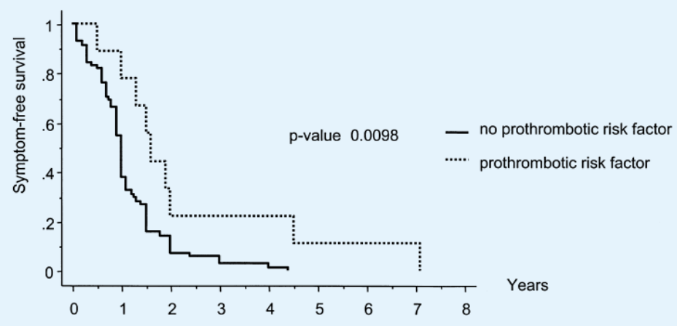
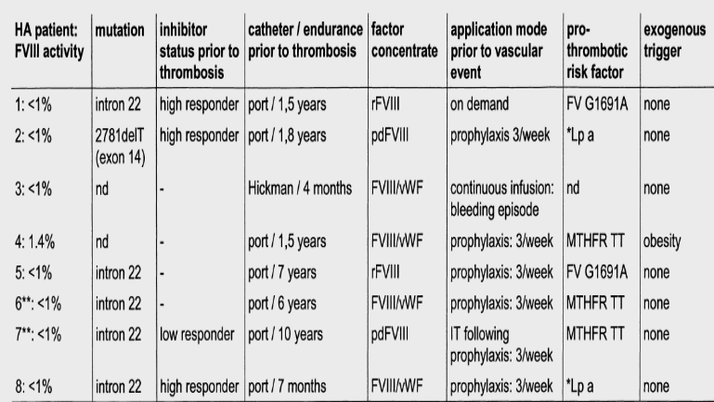
effect of thrombophilia on PWH
135 PUPs (GER)
limitované klin. údaje
trombofilná porucha však pravdepodobne modifikuje klinický obraz hemofílie a môže viesť v rizik. situáciách (prítomnosť získaných rizik. faktorov) k vzniku trombózy
the onset of clinical symptoms and diagnosis of haemophilia made later in those with prothrombotic risk factor
25 PWH with CVD  thrombosis in 8  thrombophilia identified in 7 (87.5%) (FV Leiden / ↑ homocystein /
↑ lipoprotein a)
modifying effect of prothrombotic risk factors on haemophilia phenotype
Nowak-Göttl U et al., Hämostaseologie 2003;23:36-40

Slide 23
thrombotic events in haemophilias: summary
TE events appear to be a serious problem in aging PWH
the risk of arterial events (CAD, MI, ischaemic stroke) is more prominent, whereas venous events are rare
arterial TE events are rather common in the elderly PWH
the severity of the disorder influences the likelihood of the event: persons with mild / moderate haemophilia have a higher risk, severe haemophilia provides protection
risk factors for ATS / CAD are frequent in PWH  prevention?
concomitant prothrombotic factors are likely to increase the risk

Slide 24
for attention
thank you

