Slide 1




Pharmacogenetic kit for individual correction of Warfarin and Clopidogrel dosage in the Central Asian population
Pavel Tarlykov, PhD
General Genetics LTD
Astana, Kazakhstan
Raleigh, 2014

Slide 2
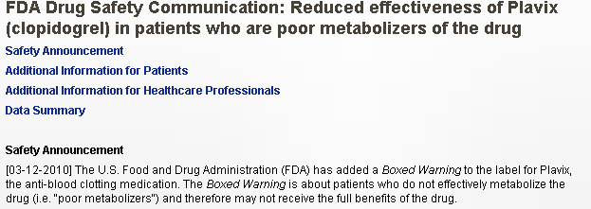

Pharmacogenetics and adverse drug reactions
106,000 deaths and 2.2 Million serious events caused by adverse drug reactions occur in the US each year
Information on the patient’s pharmacogenetic status minimizes occurrence of side effects and complications after the appointment of drugs
FDA has approved usefulness of genetic information for prescription of Warfarin and Plavix in 2007 and 2010, respectively.
http://www.fda.gov

Slide 3

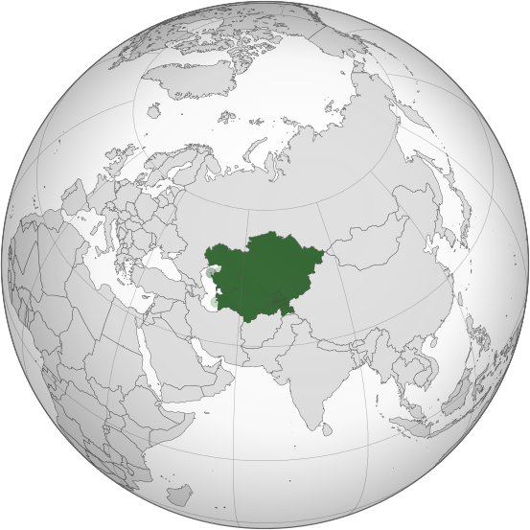
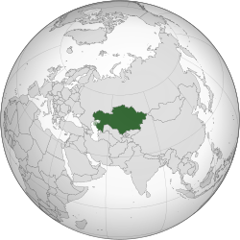
Central Asia Kazakhstan
Population – 66 M Population – 17 M
PHARMACOGENETIC TESTING IS NOT CONDUCTED IN
THE CENTRAL ASIA REGION

Slide 4
General Genetics LTD
General Genetics is a young start-up company (est. in 2012) with a focus on pharmacogenetics.
Problem to solve – unawareness about pharmacogenetic testing in the region, absence of genetic testing
Our goal is introduction of pharmacogenetic testing to healthcare system of Kazakhstan (health centers, hospitals)
We received funding from the World Bank and Ministry of Education and Science of the Republic of Kazakhstan to develop pharmacogenetic kit for individual dosage correction of Warfarin and Plavix
Starting in 2013 our pharmacogenetic services were provided to the National Cardiosurgery Center (Astana, Kazakhstan) and National Medical Research Center (Astana, Kazakhstan)

Slide 5
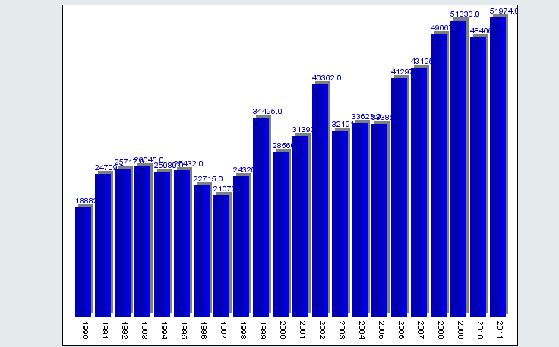
Focus on pharmacogenetics of cardiovascular drugs
  Cardiovascular disease is the leading cause of morbidity and mortality in Kazakhstan and Central Asia.
  Introduction of genetic testing will minimize side effects and complications after the appointment of the CVD drugs (Warfarin and Plavix).
Morbidity of CVD increases by ~50,000 new cases every year
http://medinfo.kz/

Slide 6

Pharmacogenetics of cardiovascular drugs
Social impact: Increase of lifespan and decrease in mortality when the dosing of CVD drugs is corrected individually. Warfarin is cheap and efficient; however, there is a high risk of hemorrhages.
Economic impact: correction of individual dosage will decrease treatment price twofold. Warfarin is prescribed for lifetime what makes decrease in treatment price very significant.
Application: First of all, our product will be applied in healthcare institutions of Kazakhstan and clinical diagnostic labs.
We are planning gradual expansion of the product market to the Central Asia region.

Slide 7
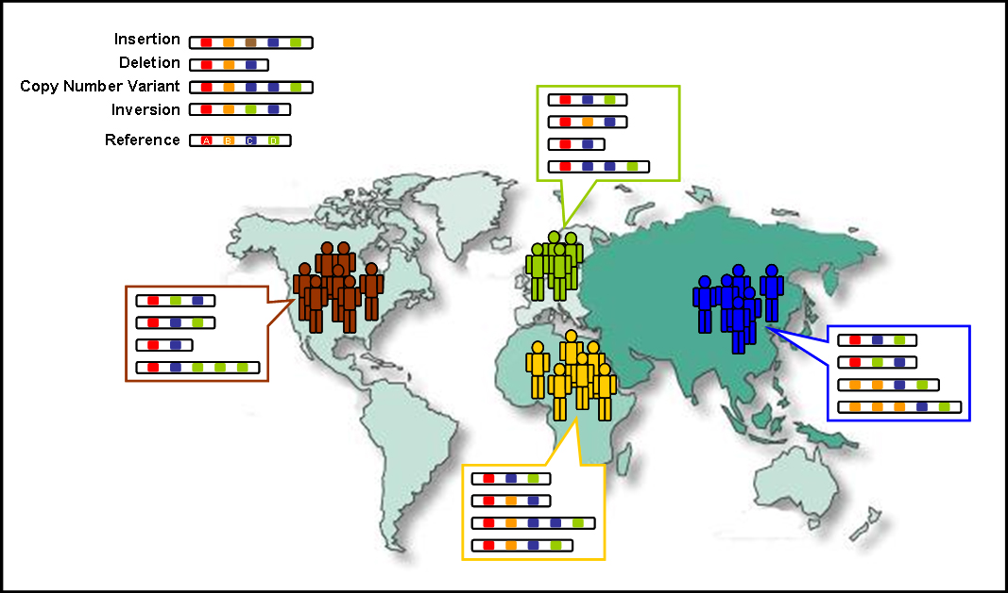

Ethnic Differences and Pharmacogenetics
Sensitivity of various ethnic groups to the drugs is different

Slide 8
Ethnic Differences in Central Asia
Central Asia and its population is one of the least-studied regions of the world
Historically, Central Asia has always been a crossroad between West and East leading to the current high population genetic admixture and diversity
The studies of the region indicate that population of Central Asia has a mixed genetic composition intermediate between those of Asian and European populations

Slide 9
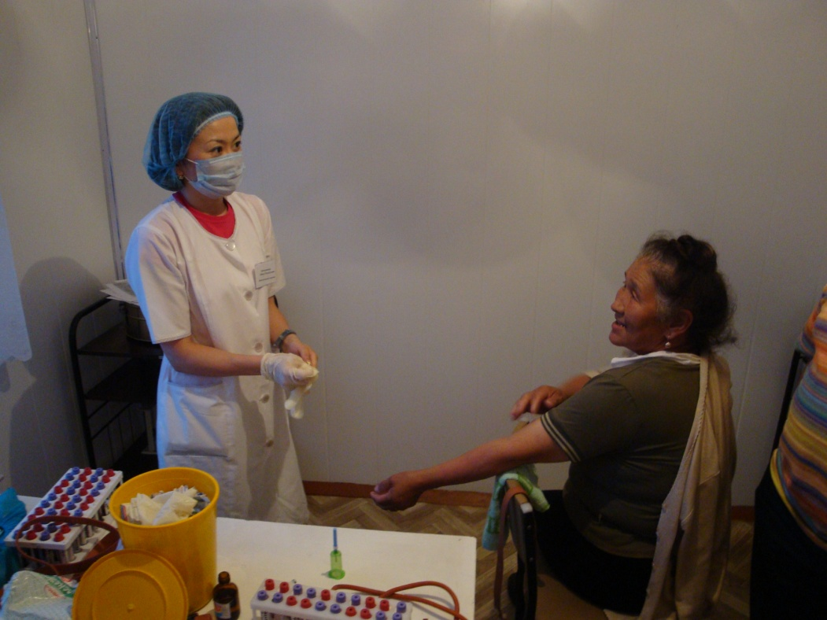
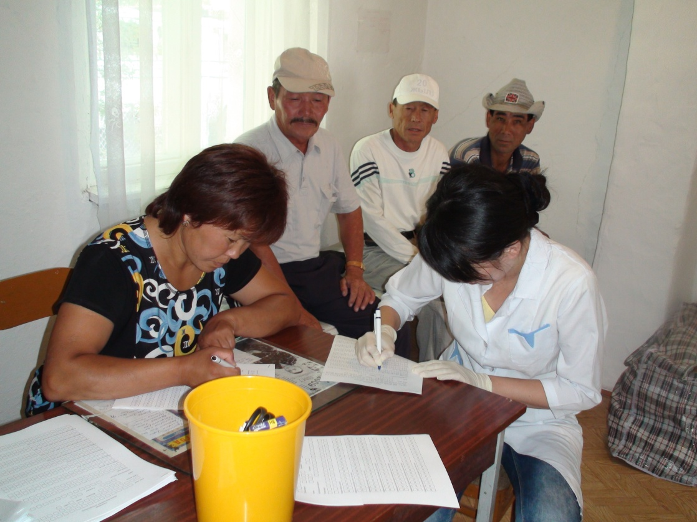
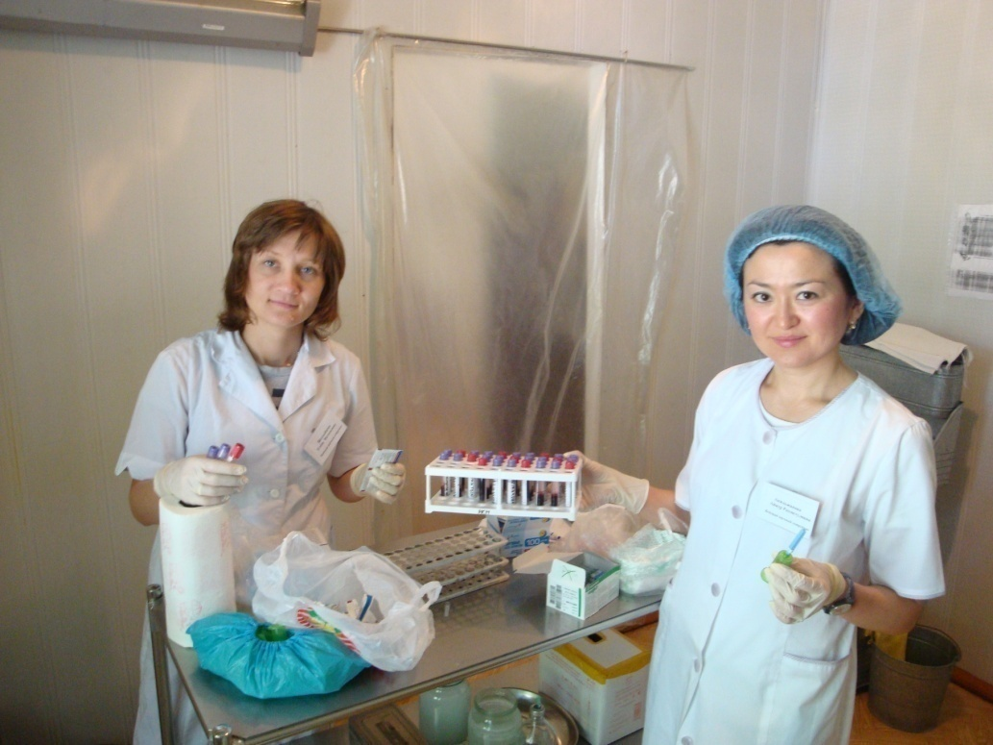
Population study of the Central Asian population
9

Slide 10
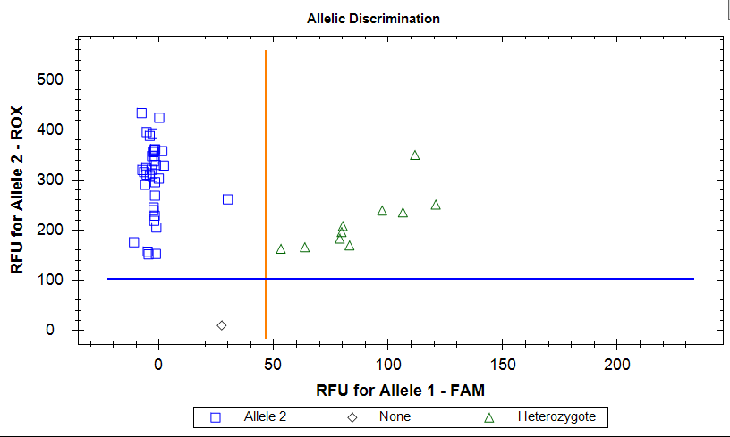
Genotyping of drug biotransformation enzymes
Example of cluster analysis for CYP2C19*2 variant with real-time PCR
Kazakh population sample was genotyped to study genetic variability of the drug biotransformation enzymes and compare to other populations

Slide 11
Allele frequency and genotype distribution
in Kazakh population
Polymorphisms | Number of samples | Hardy – Weinberg equilibrium | Allele | nª | Frequency | Genotype | n^{b} | Frequency
CYP2C9*2 | 437 | p=0.66 | C T | 856 18 | 0.98 0.02 | СС СT TT | 419 18 0 | 0.96 0.04 0.00
CYP2C9*3 | 444 | p=0.54 | A C | 863 25 | 0.97 0.03 | AA AC CC | 419 25 0 | 0.94 0.06 0.00
VKORC1 1173 | 286 | p=0.76 | C T | 162 410 | 0.28 0.72 | CC CT TT | 24 114 148 | 0.08 0.4 0.52
VKORC1 1542 | 259 | p=0.65 | G C | 142 376 | 0.28 0.72 | GG GC CC | 18 106 135 | 0.07 0.41 0.52
CYP4F2 | 284 | p=0.26 | G A | 396 172 | 0.70 0.31 | GG GA AA | 134 128 22 | 0.47 0.45 0.08
CYP2D6*3 | 287 | p=0.86 | A del | 568 6 | 0.99 0.01 | AA A/del del/del | 281 6 0 | 0.98 0.02 0
CYP2D6*4 | 343 | p=0.15 | G A | 637 49 | 0.93 0.07 | GG GA AA | 294 49 0 | 0.86 0.14 0.00
CYP1A2*1F | 257 | p=0.63 | A C | 332 182 | 0.65 0.35 | AA AC CC | 109 114 34 | 0.42 0.44 0.13
^{а} number of chromosomes; ^{b} number of alleles

Slide 12
Frequencies of biotransformation genes
in different populations
 | 2с9*2 | 2с9*3 | VKORC rs9934438 | VKORC rs8050894 | CYP4F2 | 2d6*3 | 2d6*4 | 1a2*1F
Kazakh | 0.02 | 0.03 | 0.72 | 0.72 | 0.31 | 0.01 | 0.07 | 0.35
African-American (1000 Genomes) | 0.02 | 0.01 | 0.07 | 0.21 | 0.09 | 0.0 | 0.06 | 0.46
African-American* | 0.01-0.027 | 0.005-0.02 | 0.02-0.13 | 0.19-0.28 | 0.05-0.1 | 0.0-0.01 | 0.01-0.12 | 0.35-0.54
Caucasians (1000 Genomes) | 0.12 | 0.06 | 0.4 | 0.41 | 0.27 | 0.02 | 0.19 | 0.31
Caucasians* | 0.11-0.2 | 0.06-0.16 | 0.39-0.48 | 0.37-0.41 | 0.23-0.32 | 0.0-0.04 | 0.07-0.21 | 0.22-0.52
Asians (1000 Genomes) | 0.0 | 0.02 | 0.92 | 0.92 | 0.21 | 0.0 | 0.0 | 0.37
Asians* | 0.0-0.05 | 0.02-0.1 | 0.9-0.95 | 0.89-0.94 | 0.19-0.34 | 0.0 | 0.0-0.15 | 0.33-0.61
* - different sources with a population sample of more than 100 people (including HapMap data)

Slide 13
Conclusion from population data
Contribution of the genetic component to drug sensitivity in Kazakh population has Asian-specific pattern with several European traits.
Pharmacogenetic diagnostics of the following polymorphic markers, namely, CYP2C9*2, CYP2C9*3, VKORC1 (1639) C>T, СYP4F2 (G23454A) and GGCX (G1958) should be carried out to determine sensitivity to Warfarin in the Kazakh population.
Genotyping of the following polymorphic markers: CYP2C19*2, CYP2C19*3, CYP2C19*17 and CYP2C19*4 is required to determine sensitivity to Plavix in the Kazakh population.

Slide 14
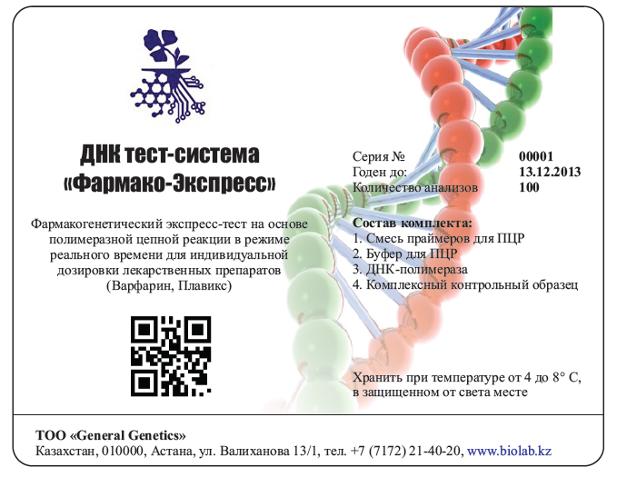
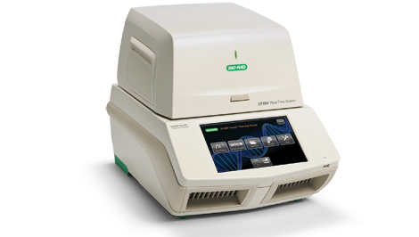
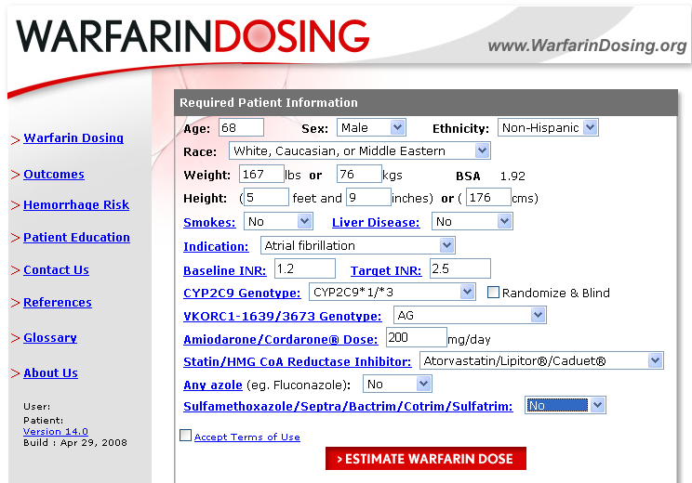
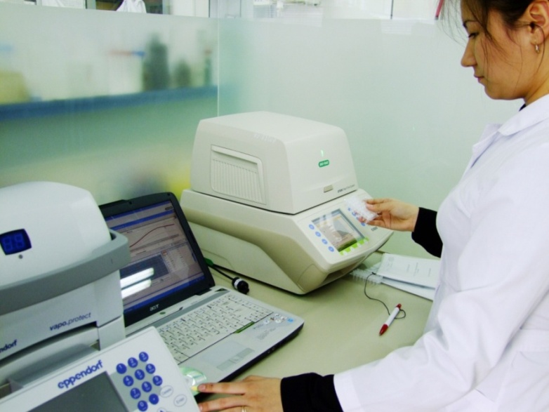
Pharmacogenetic kit
for diagnostics
Composition:
PCR master mix
Primer/probe mix
Taq polymerase
Control samples Real-time PCR
Genetic testing of 136 clinical samples was carried out with the selected SNPs
14

Slide 15

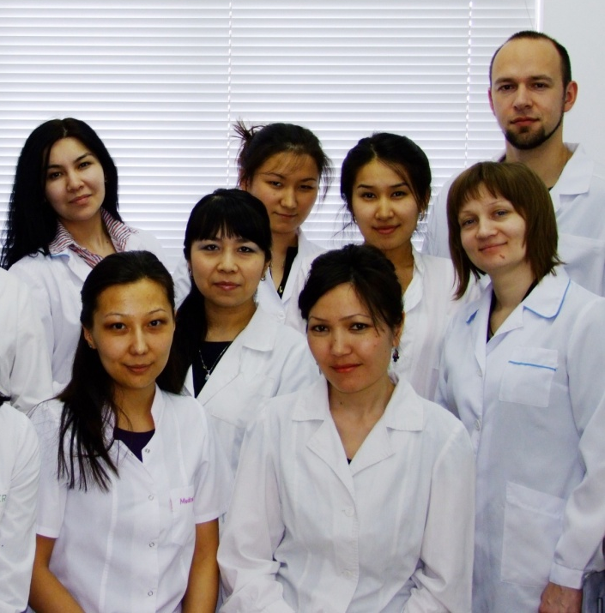
Thank you for your attention!

