Slide 1
DIFFERENTIAL EFFECTS OF (LENTI)VIRUS INFECTION ON AKT SIGNALLING IN CD4+ T CELLS
Pavel Bostik
FMHS
Charles University Medical School
University Hospital
Hradec Kralove
Czech Republic

Slide 2



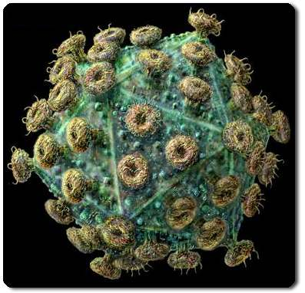
ORIGIN OF HIV
Cercocebus atys
SIVsm
Pan troglodytes)
SIVcpz
Macacca mulata
HIV-2
HIV-1 (M,N, O)

Slide 3

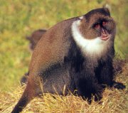





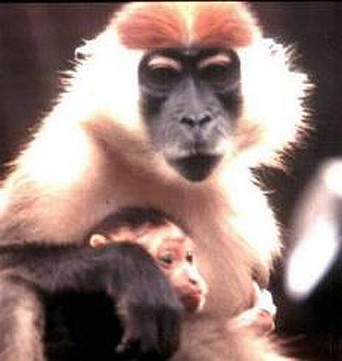
NATURALLY SIV INFECTED NHP
SIVcol
SIVsyk
SIVmnd
SIVsm
Colobus monkey
Sykes monkey
Mandrill
Sooty mangabey
SIVver
SIVlho
SIVcpz
SIVrcm
Vervet
L-Hoestova monkey
CHimpanzee
Red-capped mangabey

Slide 4
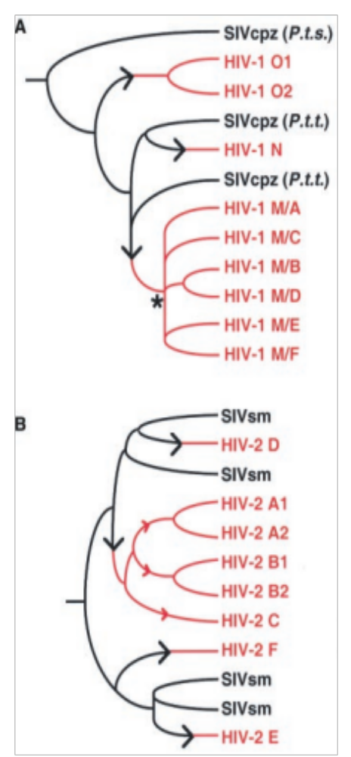
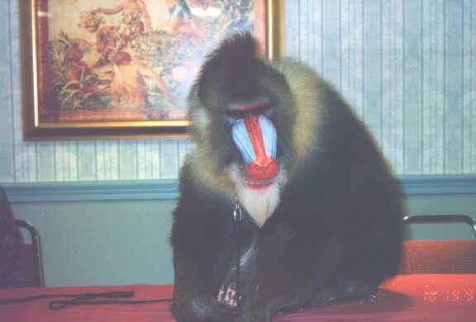
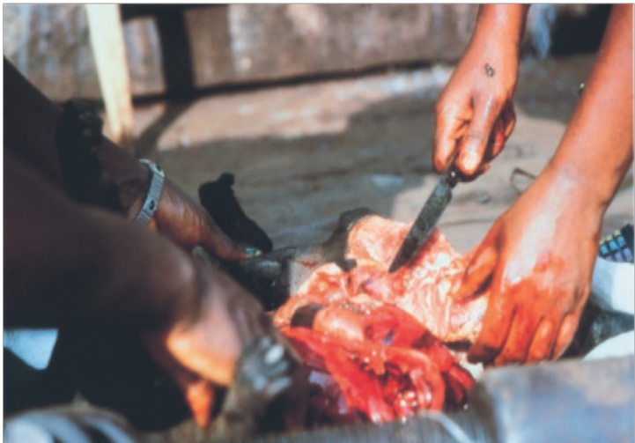

Slide 5
LENTIVIRUS INFECTION IN DISEASE SUSCEPTIBLE AND DISEASE RESISTANT SPECIES
1. High levels of acute viremia and significant chronic viral loads
2. Replication predominantly in short lived T cells; poorly controlled
3. Significant antibody responses
HIV/SIV – DISEASE SUSCEPTIBLE
SIV - DISEASE RESISTANT
4. Apoptosis of bystander cells
5. Chronic immune hyperactivation
6. Acute depletion of CD4⁺ T cells in mucosal tissues
7. CTL responses
8. Progressive loss of CD4⁺ T cells
9. Loss of CD4⁺ T cell help
4. Low levels of apoptosis
5. Normal immune activation
6. Initial acute depletion followed by rebound
7. Poorly detectable CTL responses
8. Slight loss, preserved homeostasis
9. Maintained CD4⁺ T cell help
10. Low levels of CCR5 expression

Slide 6
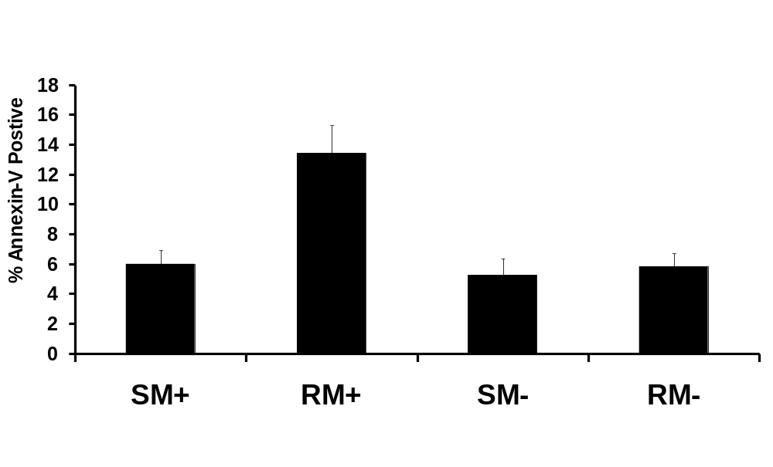
APOPTOSIS OF CD4+ T CELLS
**
GSK3b is one of the kinases identified to be dysregulated in SIV+ RM
Bostik et al.,J Virol 2001.
Notes:
Here we measured apoptosis in CD4+ T cells from each of our cohorts via Annexin-V binding to phosphatidylserine expressed on the surface of cells. This is an indicator of early-stage apoptosis.

Slide 7
AKT INVOLVED IN MULTIPLE T CELL FUNCTIONS
APC
TCR/
Cytokine
CD28
CD4
CD3
Receptor
lck
ZAP
Thr308
p
p
70
Ser473
PDK1
Akt
PTEN
PI3K
PIP3
Cot
GSK3
COX2
MAPK
PGE2
NFkB
p53
Cell death
Transcription
Notes:
So now I investigated what happened when the T cells were stimulated.

Slide 8
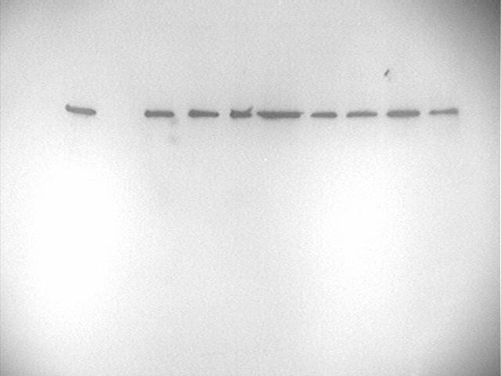
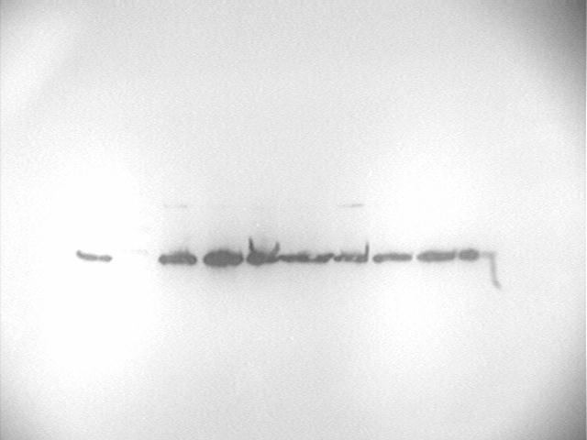
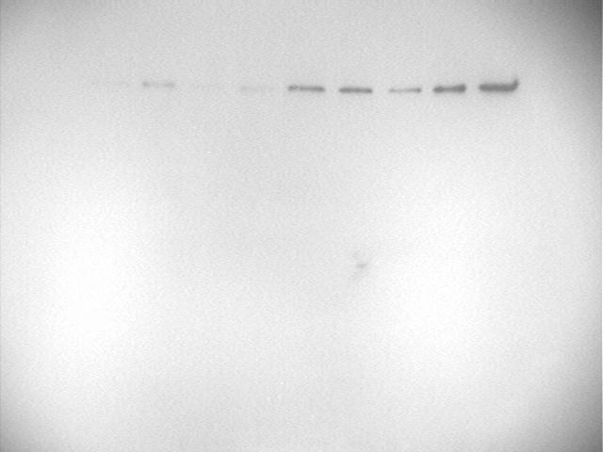
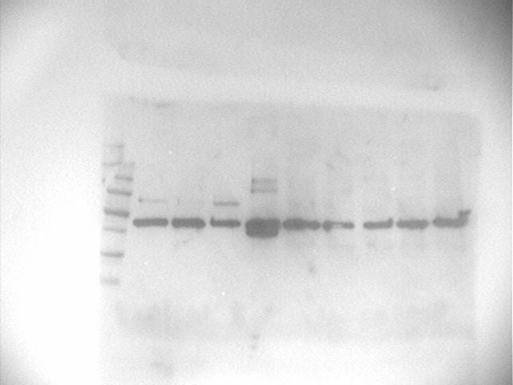
EXPRESSION OF GSK3b
SM
1
2
3
4
5
6
GSK-3β
β-actin
NS
Act
Act
LiCl
NS
Act
Act
LiCl
RM
7
8
9
10
11
12
GSK-3β
β-actin
NS
Act
Act
LiCl
NS
Act
Act
LiCl
SIV+
SIV-

Slide 9
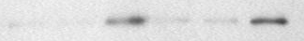
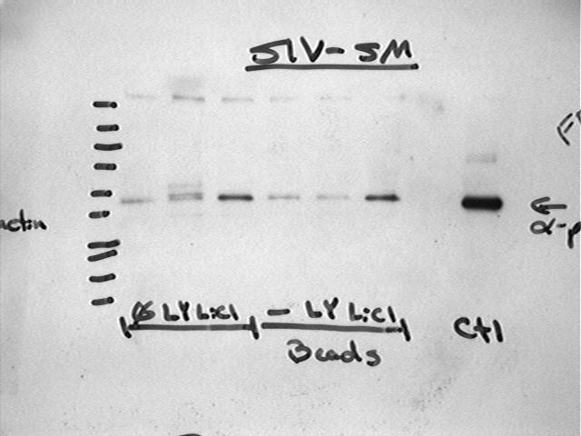
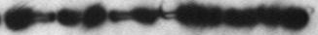
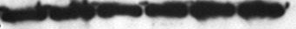
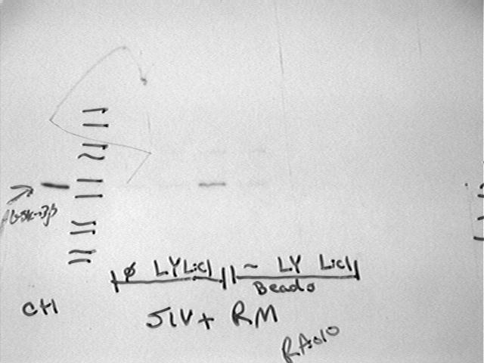
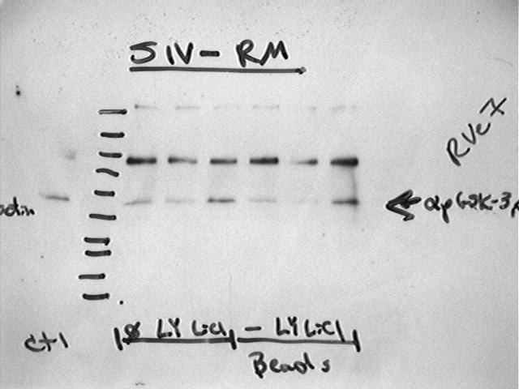
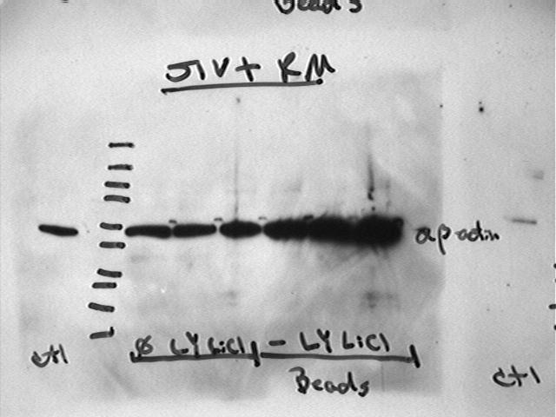
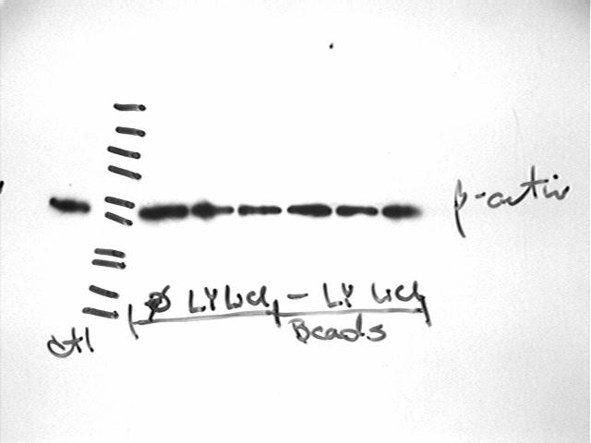
PHOSPHORYLATION OF GSK3b
SM
1
2
3
4
5
6
7
8
9
10
11
12
*pGSK-3β
β-actin
RM
13
14
15
16
17
18
19
20
21
22
23
24
*pGSK-3β
β-actin
NS
LY
LiCl
Act
Act
LY
Act
LiCl
NS
LY
LiCl
Act
Act
LY
Act
LiCl
SIV+
SIV-

Slide 10
FRACTION OF CD4+ T CELLS EXPRESSING pAKT
p<0,001

Slide 11
EFFECT OF ACTIVATION ON pAKT
p<0,005
p<0,005

Slide 12
AKT Thr308 phosphorylation in CD4+ T cells from SIV+ RM
Central memory CD28⁺CD95⁺,
Effector memory CD28⁻CD95⁺ Naïve CD28⁺CD95⁻

Slide 13
AKT Thr308 phosphorylation in CD4+ T cells from SIV+ RM
p<0,01
p<0,01
p<0,02
p<0,01

Slide 14
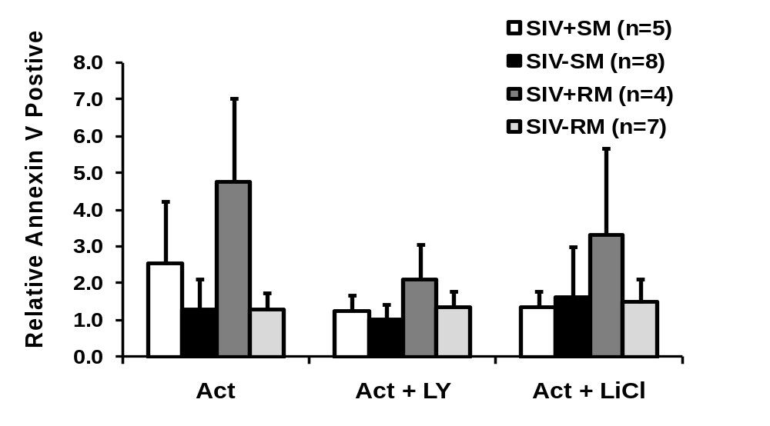
AICD
p<0.05
p<0.001
***
p<0.05
p<0.05
**
**
*
No Change

Slide 15
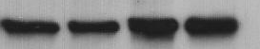
EFFECT OF IN-VITRO INFECTION
GSK-3β
U
I
U
I
Monkey 1
Monkey 2

Slide 16
CONCLUSIONS
GSK-3b transcription IS markedly reduced not only at the message level but also at the level of protein expression in CD4⁺ T cells from SIV+RM
Baseline levels of Akt and p-Akt_{Thr308} are comparable, the levels of phosphorylated Akt_{Ser 473} are significantly lower in cells from SIV+ SM compared to the SIV+ RM
Stimulation of CD4⁺ T cells leads to a marked increase in both total Akt and *p-Akt_{Thr308} in the SIV+RM, which correlates to increased susceptibility for AICD
Phosphorylation differences of Akt at Ser₄₇₃ and Thr₃₀₈ in anti-CD3/CD28 activated CD4⁺ T cells are both species and CD4⁺ T cell sub-population specific

Slide 17

Thank you for your attention
FMHS
M. Schmidt
V. Bostik
Emory University
S. Stephenson
F. Villinger
Support:
GACR
NIH

