Slide 1

Food Safety and Regulatory Measures 2016
Analytics is the key to safe food – Challenges and the way forward
Pauline Titchener
Business Development Executive

Slide 2
Role of Food Allergen Testing
Documented Food Allergen Risk Assessment
Internal and External Audits
Food Allergen Action Plan
Training
Review and validation of GMP procedures
Allergen Testing

Slide 3
ALLERGEN | TEST METHODS |  |  | SERVICE
 | Hand-held test | ELISA | DNA | External Lab
Celery |  |  | ✓ | ✓
Crustacea / Shellfish | ✓ | ✓ | ✓ | ✓
Egg | ✓ | ✓ |  | ✓
Fish |  |  | ✓ | ✓
Gluten | ✓ | ✓ | ✓ | ✓
Lupin |  | ✓ | ✓ | ✓
Milk | ✓ | ✓ |  | ✓
Mustard | ✓ | ✓ | ✓ | ✓
Peanuts | ✓ | ✓ | ✓ | ✓
Sesame | ✓ | ✓ | ✓ | ✓
Soya | ✓ | ✓ | ✓ | ✓
Sulphites |  |  |  | ✓
 | Tree Nuts
- Almond | ✓ | ✓ | ✓ | ✓
- Hazelnut | ✓ | ✓ | ✓ | ✓
- Walnut | ✓ | ✓ | ✓ | ✓
- Others | ✓ | ✓ | ✓ | ✓
Insufficient test kits to detect all the regulated food allergens
A combination of test kits and analytical service required

Slide 4
Current options for allergen analysis
ELISA | PCR | LCMS:MS
High throughput, minimal equipment or training required. Most ELISA microwell report results in less than 1 hour, lateral flows in 5-10 minutes | Laboratory method requiring specialist equipment & training. Results in 5-6 hours to 24 hours depending on method. | Laboratory method requiring specialist equipment & training. Highly skilled staff required for method development and data interpretation. Results in approx 48 hours.
Commercially available kits to cover majority of allergens in lateral flow and ELISA microwell formats | Methods available to cover majority of allergens. Not suitable for egg or milk. | Some laboratories able to offer analysis for validated matrices, multi-analyte capabilities
Antibodies designed to detect protein from target allergen | Detects DNA | Detects target peptides following digestion extraction

Slide 5
Current options for allergen analysis
ELISA | PCR | LCMS:MS
Sensitivity <1 ppm LOD | Sensitivity >10 ppm single copy methods, newer multi-copy methods <10 ppm | 10-100 ppm (matrix dependant)
Cross reactivity can be seen for some assays against closely related species such as: Prunus species e.g. almond/peach stones/cherry pits Mustard/Brassica sp. seeds | Very high specificity | Very high specificity

Slide 6
Key Factors to consider for testing
What is the physical nature of food allergen?
What to consider when sampling for food allergens and where to test for environmental monitoring?
Effect of processing on the allergen?
Matrix effects?
Which methods will be applicable for analysis?
Notes:
I mentioned test kits are an important diagnostic tool and have become the standard of care in the food industry. Equally as important as what you can test is what you can’t test.
Because of the science behind the kits, these tests are designed to detect whole, intact proteins. Once the structure of the protein changes, the detection of the antibody can become questionable.
Hydrolysis is one example of a process that alters the protein structure so antibody based test kits won’t recognize it. Fermentation is another. Not all fermented products won’t work, but generally fermentation substrates, such as wheat used in the development of gums, is an example of what won’t be detected.
Also, some allergenic proteins in processing aids are rendered unrecognizable by the kits.
Unfortunately, even though the kits won’t detect these types of proteins, they still can be allergenic, and, according to FALCPA, still must be labeled as an allergen

Slide 7



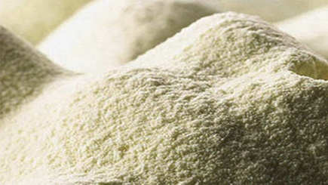
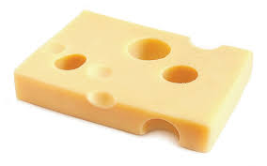
Physical nature of the food allergen
Naturally grown food commodities, degree of variability in protein profile due to agronomic conditions and plant varieties
For allergens present on-site are they particulate or readily dispersible materials? How much is in product recipes e.g. seasoning mixes?
Also consider the differing protein content of different types of allergen ingredients

Slide 8
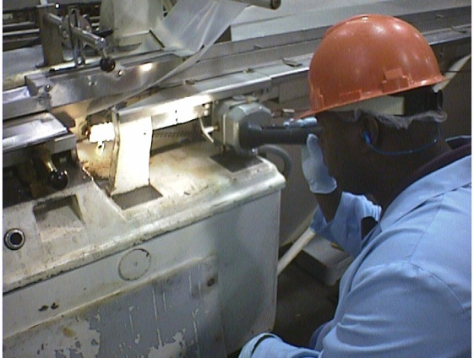
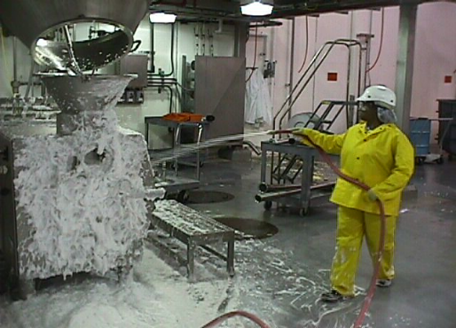
Sampling /Where to Test?
Be aware of potential for commodity co-mingling for raw materials e.g. wheat in oats, peanuts in other legumes
Analytical error is associated with sampling, important to ensure that the sample to be tested reflects the batch and that distribution of allergen can be random or in hot spots
For environmental samples, be sure to include splash zones, indirect product contact surfaces, utensils, employees and sampling equipment

Slide 9
Processing examples of troublesome matrixes
TYPES | EXAMPLES
Highly processed | Refined oils, heat processes e.g frying, curing
Tannin containing | Dark chocolate
High acidity | Pickled products
High salt | Stock cubes
High fat and / or High sugars | Dairy products
Concentrated extracts | Flavours
Use where possible:
spiked material
incurred samples
reference materials
proficiency samples
Need for Reference or agreed incurred Quality Materials
A perfect representative material rarely exists though a common reference point for data comparison purposes is needed between methods

Slide 10
All antibody-based tests
Factors for Consideration
Hydrolyzed proteins
  Example: HVP, hydrolyzed egg protein
Fermentation substrates
  Examples: guar gums, xanthan gums, starter cultures, soy sauce
Processing aids
  Examples: lecithin, enzymes
Proteins from these products are generally not detectable on the test kits. However, allergenicity may remain.
Notes:
I mentioned test kits are an important diagnostic tool and have become the standard of care in the food industry. Equally as important as what you can test is what you can’t test.
Because of the science behind the kits, these tests are designed to detect whole, intact proteins. Once the structure of the protein changes, the detection of the antibody can become questionable.
Hydrolysis is one example of a process that alters the protein structure so antibody based test kits won’t recognize it. Fermentation is another. Not all fermented products won’t work, but generally fermentation substrates, such as wheat used in the development of gums, is an example of what won’t be detected.
Also, some allergenic proteins in processing aids are rendered unrecognizable by the kits.
Unfortunately, even though the kits won’t detect these types of proteins, they still can be allergenic, and still must be labeled as an allergen

Slide 11
Matrix Effects
‘The detection limit of any test will vary
depending on the sample matrix to be tested’
 | * Detection limit
Lateral Flow | 1ppm | 5ppm | 10ppm | 20ppm | >50ppm
Gluten | Biscuit | Baby Formula | Dark Chocolate
Milk | Chocolate Cake | Margarine |  |  | Red wine
Hazelnut | Milk chocolate | Breakfast cereal |  | Dark chocolate
Peanut | Chocolate coated roll | Praline crispy bite bar | Chicken Nugget
Almond | Dark Chocolate | Yoghurt |  | Tomato Sauce
Shellfish |  | Vegetable Oil | Mayonnaise | Minced White Fish
Egg | Margarine / Dark Chocolate | Fish Cakes | Ice-cream
Soya |  | Pork Sausage | Margarine | Ice-cream
* Examples of data from Lateral Flow Validation

Slide 12
Key Messages
Sampling determines what you find or don’t find
Consider the nature and physical format of the allergens you wish to detect to help determine which tests will be most appropriate
ELISA is still the method of choice for most allergens, the limitations are acceptable if steps are taken to manage them e.g. validation to look at recovery factors, where possible
Questionable ELISA results should be confirmed using an alternative method
Sometimes allergen analysis can be very challenging and in these cases the combined use of all available analysis methodologies can be helpful

Slide 13
Thank you for your attention.
Questions?
Neogen Europe Ltd
www.neogeneurope.com info@neogeneurope.com
Tel: +44 (0) 1292 525600 Fax: +44 (0) 1292 525 601

