Slide 1

About OMICS Group
OMICS Group International is an amalgamation of Open Access publications and worldwide international science conferences and events. Established in the year 2007 with the sole aim of making the information on Sciences and technology ‘Open Access’, OMICS Group publishes 400 online open access scholarly journals in all aspects of Science, Engineering, Management and Technology journals. OMICS Group has been instrumental in taking the knowledge on Science & technology to the doorsteps of ordinary men and women. Research Scholars, Students, Libraries, Educational Institutions, Research centers and the industry are main stakeholders that benefitted greatly from this knowledge dissemination. OMICS Group also organizes 300 International conferences annually across the globe, where knowledge transfer takes place through debates, round table discussions, poster presentations, workshops, symposia and exhibitions.

Slide 2
About OMICS Group Conferences
OMICS Group International is a pioneer and leading science event organizer, which publishes around 400 open access journals and conducts over 300 Medical, Clinical, Engineering, Life Sciences, Pharma scientific conferences all over the globe annually with the support of more than 1000 scientific associations and 30,000 editorial board members and 3.5 million followers to its credit.
OMICS Group has organized 500 conferences, workshops and national symposiums across the major cities including San Francisco, Las Vegas, San Antonio, Omaha, Orlando, Raleigh, Santa Clara, Chicago, Philadelphia, Baltimore, United Kingdom, Valencia, Dubai, Beijing, Hyderabad, Bengaluru and Mumbai.

Slide 3

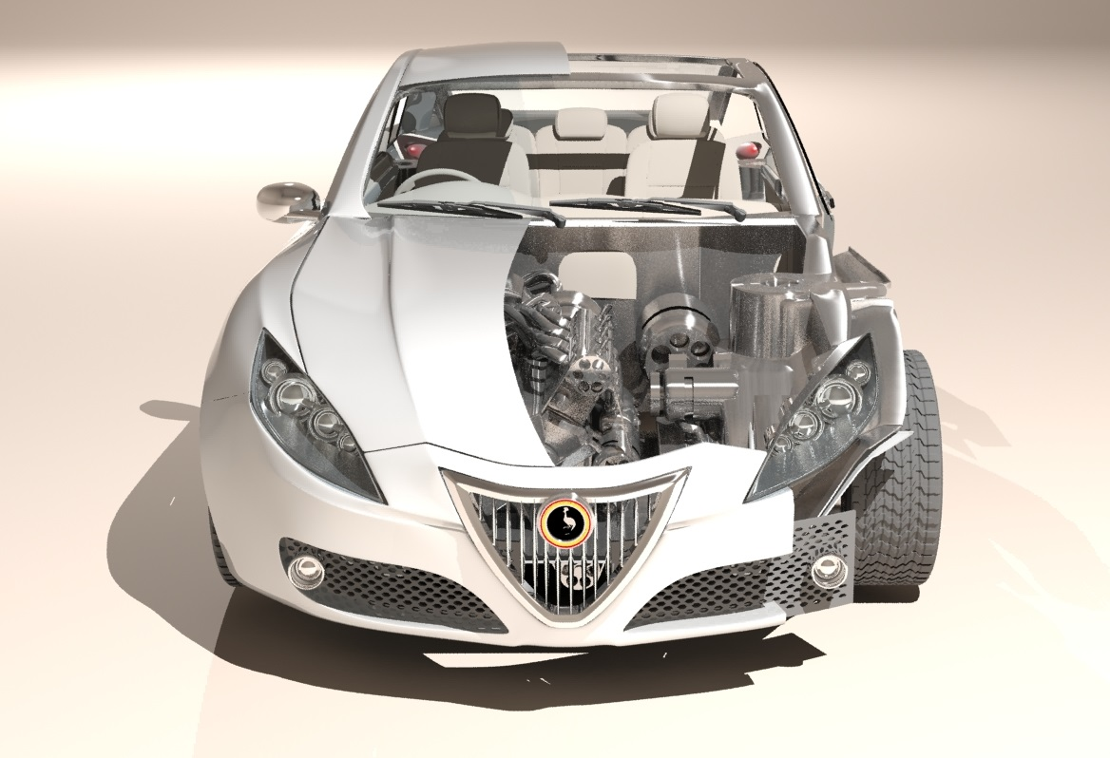
Development of the
Kiira EV SMACK Supervisory
Firmware
International Conference and Exhibition on AUTOMOBILE ENGINEERING
Valencia, Spain
1 -2 September 2015

Slide 4

Presentation Outline
Introduction
Requirements
Design Process
Energy Management
Thermal Management
Tests

Slide 5
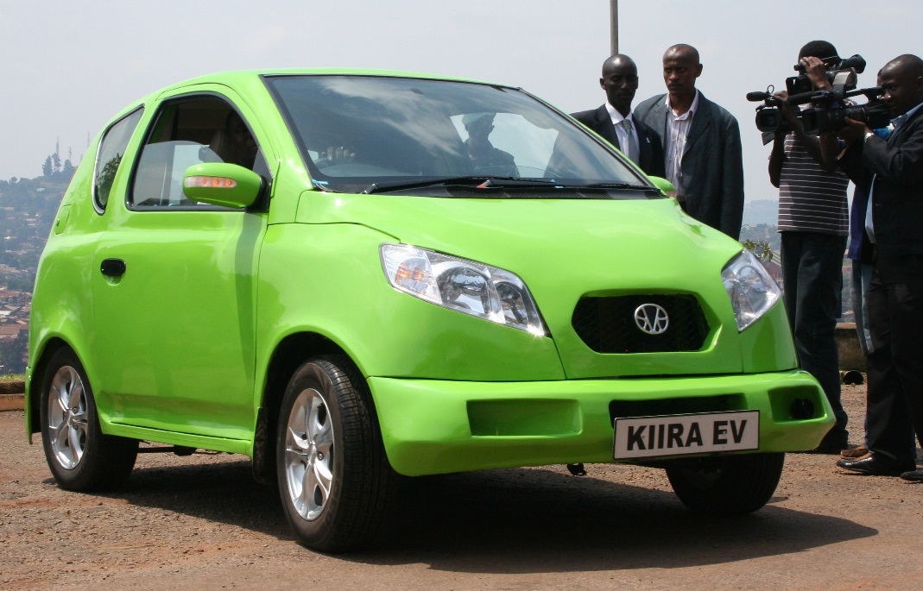
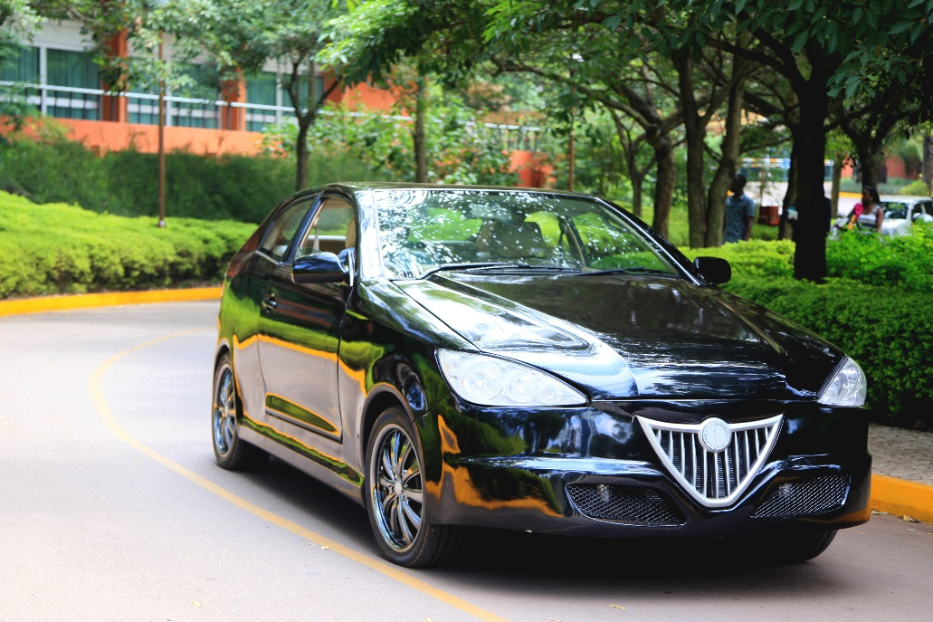

Kiira Motors - Uganda
Kiira Motors Project - Championing Automotive Development in Uganda
Products
  Kiira EV
  Kiira EV SMACK
Kiira SMACK Production 2018
Notes:
The Kiira Motors Project – Started in 2012 with the main aim of championing automotive development in Uganda.
The Kiira EV SMACK – series hybrid powertrain architecture, informs production
Kiira SMACK – positioned as flagship product for the pioneer Automotive Original Equipment Manufacturer in East Africa

Slide 6


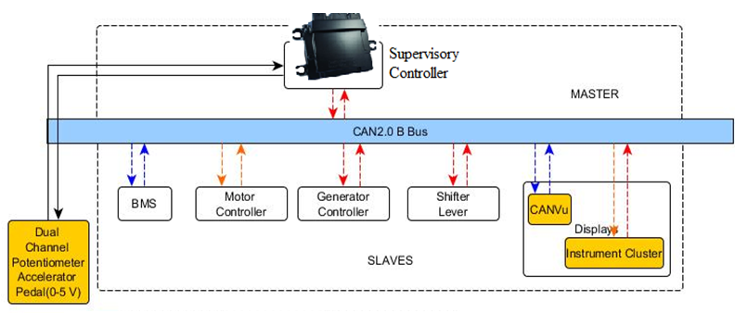
Requirements and Architecture
Switch Drive Regimes
SOC, Fuel Level
Battery, Motor Temp
Pedal Torque
Pedal
Position
Battery Params
Torque Requests
Position Messages
Torque-Speed Requests
Battery, Motor Params, Speed, Temp, Faults
Notes:
The SC in hybrid – Efficient Energy Mgt of energy resources is key, along other roles of interfacing to the other low level control units

Slide 7
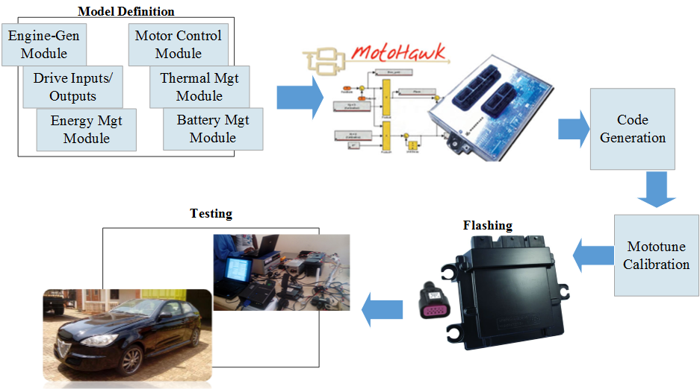
Design Process
Notes:
MotoHawk - Targets particular Woodward hardware platforms. It also has vehicle specific blocks such as specific engine control, analog and digital I/O, CAN, calibration, fault management and diagnostics, and automated documentation.

Slide 8
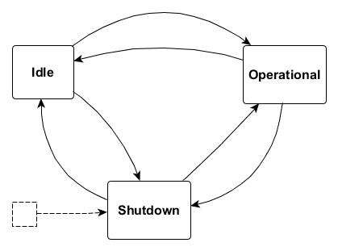
Design: Vehicle States
Notes:
Vehicle states - idle, operational and shutdown.
Battery Management System: The BMS monitors the battery cells for state of charge, battery temperature, battery voltage, current, battery pack health and fault status. The SC uses these parameters in motor operation, switching drive regimes, thermal management, fault mitigation, vehicle startup and shutdown.

Slide 9

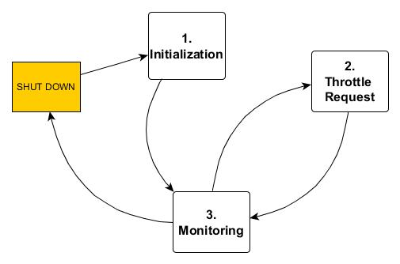
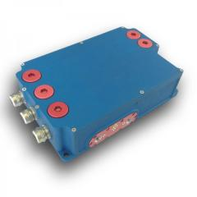
Design: Generator Control Unit
Notes:
Generator Control Unit: There are three use cases implemented by the SC for this module; Initialization, Throttle Request and Monitoring. The Initialization use case is characterized by the SC sending an Enable signal to initialize the engine-generator set start up, a Crank Engine signal and disabling torque requests. It then computes and sends throttle requests. When running, the SC logs status information from the generator control unit.

Slide 10
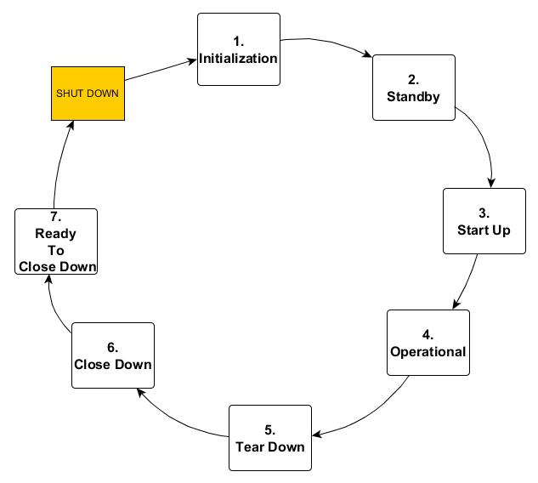
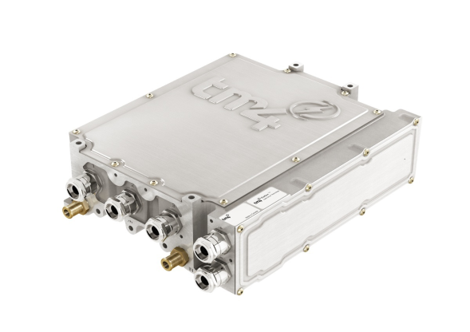
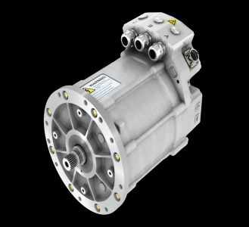
Design: Motor Controller
Notes:
Motor Control Unit: The motor controller and SC follow a strict handshaking protocol to transition between motor states. There are seven motor states as shown. In the Initialization state the SC sends an Enable signal to the motor control unit and initiates the motor pre-charge sequence by closing the HV (high voltage) contactors. The motor system moves into the Standby state during which the motor control unit sends a Standby Ready signal to the SC. The SC ensures that the shift selector is in the Park Position and sends 0 Nm Torque Request. In the Startup state, it ensures that the high voltage at the motor contactors is equal to the battery voltage, reported by the BMS. If , the minimum operating voltage of the motor, and the pre-charge sequence is complete it sends a Startup Ready signal to the motor control unit. When the motor goes into the Operational state, it readily responds to torque requests and drive selector changes between Reverse, Drive and Neutral. The SC initiates the shutdown sequence by sending a shutdown request and deactivating the Enable signal. The above control logic was implemented using Stateflow.

Slide 11
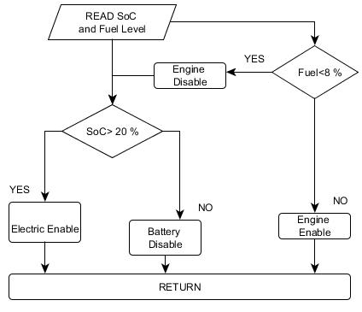
Energy Management Strategy
Purely Electric Mode
Notes:
Purely Electric. No engine charging is possible. This drive regime is operable when the battery SOC is above 80% and vehicle speed is below 50 km/hr. At such low speeds the power requirements can be sustained by the battery system. 50 km/hr is chosen because it is the speed limit for the Kampala city drive cycle, therefore operating the drive train at zero tail pipe emissions is desirable. When the fuel level is below 8 %, the engine cannot operate on an empty tank, therefore the only possible drive regime is purely electric.

Slide 12
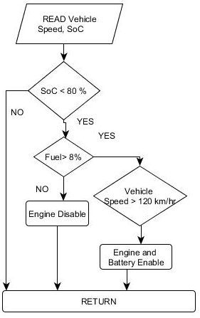
Engine Mode

Slide 13
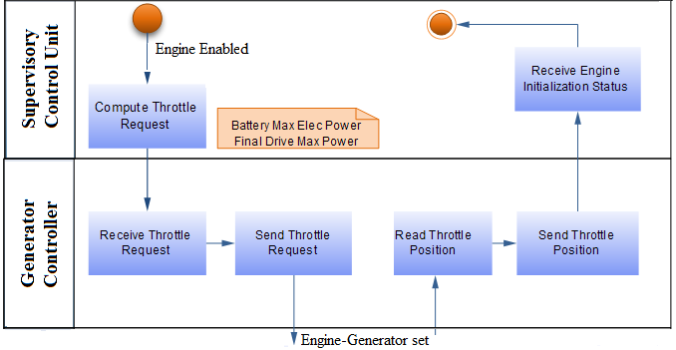
Engine Control Unit – Throttle Request

Slide 14
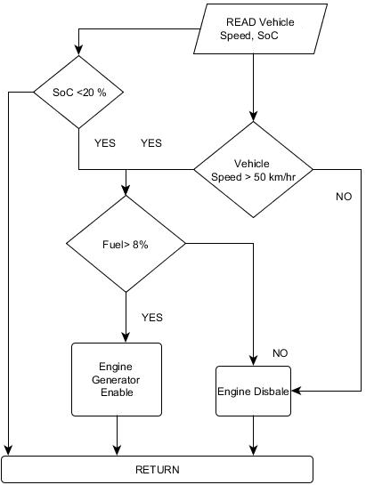
Hybrid Mode

Slide 15
Design: Thermal Management
Battery - Air cooled system using a blower fan controlled by the SC
Single speed fans
Fan Enable signal on BMS
ON/Off Strategy at 60 degrees Celsius
Control Strategy Prospects
  PWM Support for different fan speeds at different pack temperatures
  Battery cooling and heating for diverse operating conditions
Engine and Motors

Slide 16
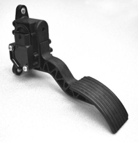
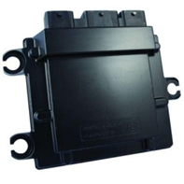
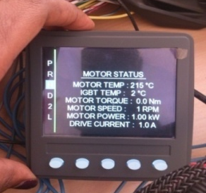


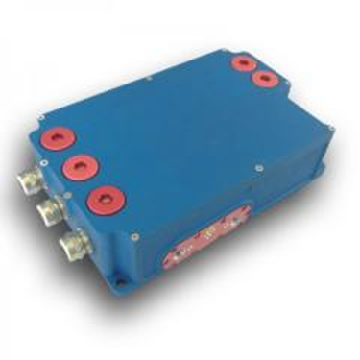
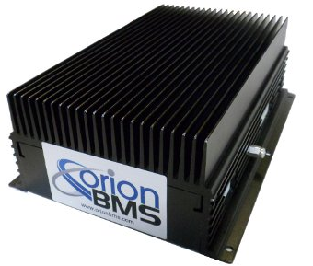
Component Specifications
Accelerator Pedal
Operating DC Voltage: 12 V
Sensor: Programmable Hall Effect SensorType: Dual Potentiometer
Supervisory Controller: Woodward: ECM-5554-112-0904-C00-M:112 Pin Platform,
Operating DC Voltage: 12 V
Calibratible Memory: 512K
CAN 2.0B Channels: 3
Communication: CAN 2.0
Active fault alarms
Motor Controller: TM4 MФTIVE: Series C060
Operating DC Voltage: 220-400 V
Minimum Operating DC Voltage: 180 V
Shift Lever
Operating DC Voltage: 12 V
Communication: CAN
Generator Control Unit: Rhinehart Motion Systems RMS-PM150DZ
Peak Power: 100 kW
Continuous Power: 70 kW Continuous Output Current: 300 A
Peak Output Current: 500 A
Battery Management System: Orion BMS L4275D05

Slide 17
System Tests
Off board system and On board tests
  Energy Management performance
  Switching – auto and manual
  Vehicle Performance

Slide 18


Pauline Korukundo
BSc. Telecommunications Engineering (MAK)
MSC. Electrical and Electronics Engineering (Nottingham)
For God and My Country

