Slide 1
Ciguatera Fish Poisoning: Past, Present, Future
Historical
Etiology /Ecology
Modern / Hawaiian Findings
Perspective for the Future
  Bad News
  Good News

Slide 2
Acknowledgements
GEOHAB/BHAB Initiative of the International Oceanographic Commission, Scientific Committee on Oceanographic Research (SCOR/UNESCO)
This research was funded by National Science Foundation Grants OCE004-32479, OCE08-52301, and OCE11-29119
Notes:
GEOHAB is an international program aimed at fostering and promoting cooperative research directed at improving the prediction of harmful algal bloom events.
The NSF support was largely in conjunction with its Ocean and Human Health initiative directed at improved understanding of the ways/means that the oceans effect human health.

Slide 3
Ciguatera Fish Poisoning
Occurs in tropical and subtropical regions
Vector is exclusively reef fish
Affects hundreds of thousands of people annually
Underreported; misdiagnosed

Slide 4
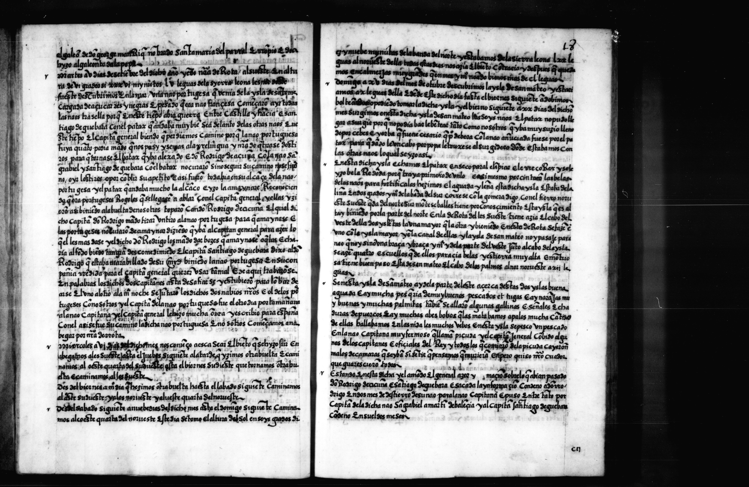

Autumn 1525
Urdaneta, 1580
Notes:
The first reported of case of ciguatera fish poisoning is probably form 1525 in a nearby area, the Gulf o Guinea. In this old manuscript a case that happened in a Spanish fleet sent for the second travel to the Pacific through the Magellan strait was also described. The same case was reported by other authors which demonstrate how important it was. I will read first this in Sapnish: “En esta isla se pesco un pescado en la nao capitana muy fermoso que se llama picuda…”
4

Slide 5
Benthic Hazardous Algae
Oceans & Human Health Perspective
Gambierdiscus ecophysiology
Ciguatoxin(s)
CFP Prevalence
CFP & Climate Change
Notes:
The health and welfare of humans residing in the coastal zone and in island communities are inextricably linked to the oceans and its foodwebs.
The fundamental importance of relationships of between human societies and the oceans requires high emphasis on understanding the interactions that lead to human dimensions of ocean issues and processes.
The effects of climate change, pollution, population increases, and the myriad of anthropogenic effects attendant increasing population are all related in various ways to the microbial organisms that are at the base of marine ecosystems.
Gambierdiscus spp. and Ciguatera Fish Poisoning
Gambierdiscus and its dinoflagellate relatives produce natural toxins that cause ciguatera fish poisoning (CFP) in humans.
In contrast to other noxious dinoflagellates known for their dense “red tide” aggregations, Gambierdiscus do not form conspicuous blooms that color the water.
They’re more like snipers rather than battalions of infantry.
These dinoflagellates normally grow epiphytically on various macroalgae in coral reef ecosystems within the 35°N – 35°S latitudinal band.
The dinoflagellates are consumed by herbivorous fish, beginning processes of bioaccumulation and biomodification through the reef food web, as the herbivores are consumed by carnivores and ultimately by humans.
Ciguatera is a food-borne disease that has affected coastal populations and travelers in tropical and subtropical regions throughout the world for centuries.
Ship logs as far back as the 16th century mention clinical symptomologies consistent with CFP, and during WWII, CFP was a serious problem for military troops stationed in many Pacific island locals.
There are at least 50,000 reported cases of CFP cases per year, but due to the high degree of misdiagnosis and underreporting it is estimated that the actual frequency of CFP cases is closer to 500,000 per year
It is now estimated that 25% -50% of the populations of small islands in the Caribbean and South Pacific respectively have suffered CFP.
CTX produces gastrointestinal, neurological, and cardiovascular symptoms. These normally develop within 12-24 hours of eating contaminated fish. Gastrointestinal effects may disappear in four days.
The normal progression of symptoms is (a) gastrointestinal symptoms (e.g., diarrhea, abdominal pain, nausea, and vomiting), followed by neurological symptoms (e.g., numbness and tingling of hands and feet, dizziness, altered hot/cold perception, muscle aches, low heart rates and low blood pressure).
Symptoms may persist in some form for weeks, months, or even years. Generally, feelings of weakness last ~1 week, and neurosensory manifestations (e.g., muscle aches, tingling extremities, and thermal reversals) commonly represent the most prolonged discomfort. The key pathonuemonic symptom is the neurological malady of reversal of hot/cold sensation. Fortunately, death is rare (i.e., <0.1%) and is most commonly the result of respiratory failure due to cardiovascular shock induced by severe dehydration.
An interesting feature is that CFP intoxication does not confer any immunity in its victims, and to the contrary it frequency results in heightened sensitivity to ciguatoxin.
The etiology of CFP was advanced when work in the Gambier Islands of French Polynesia by Yasumoto et al. revealed that the guts of toxic (herbivorous) fish contained significant numbers of a dinoflagellate that was designated as a new genus and species known as Gambierdiscus toxicus.
Since then several new species have been added to the genus and recent works using refined morphological and molecular sequencing techniques have caused substantial changes to the taxonomy of this genus.
Derived from gambiertoxins produced by the dinoflagellates, ciguatoxin, is a polar, lipid-soluble, polyether. The toxin is heat stable, tasteless, odorless, and effective at extremely low (i.e. sub-ppb) concentrations; the severe analytical challenges presented by these properties have been central to the slow progress in detection of ciguatoxin for prevention and/or research purposes.
A CDC report for a period in the 70’s indicted that reported CFP incidences accounted for 25% of all food-borne outbreaks, which was five times the reported incidence for paralytic shellfish poisoning and neurological shellfish poisoning combined ). Kite-Powell (2010) recently concluded that the economic impact from CFP exceeded that from any other form of hazardous algae bloom.
Additionally, CFP is associated with societal/public health impacts in island communities due to dietary changes in response to concerns over the quality of local seafood.
Chateau-Degat et al. (2005) showed correlations of Gambierdiscus abundance and CFP with sea surface temperature in the South Pacific. This has attracted particular concern because warming oceans would expand the range of Gambierdiscus into higher latitudes where population density is generally greater. Though potentially influenced by improved awareness, the recognition of CFP in new geographic areas (Perez-Arellano et al., 2005; Villareal et al., 2007; Bienfang et al., 2008) has been suggested as evidence of an expanded range for CFP. Because of the underreporting artifact, it is difficult to ascertain whether CFP incidence is increasing over time, though expansion of international trade in seafood from tropical regions and climatic warming make this a distinct probability.

Slide 6
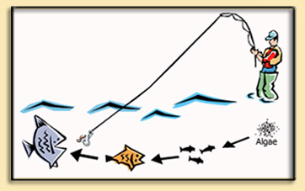
Ciguatera Sequence
Environmental conditions ➔ Gambierdiscus
Gambierdiscus ➔ Macroalgae ➔ Herbivorous Fish ➔ Carnivorous Fish ➔ Fishing Pressure
Fish ➔ Humans

Slide 7
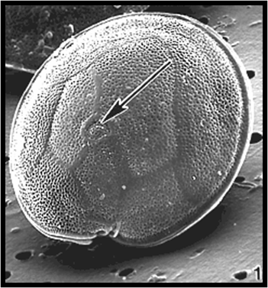
Gambierdiscus spp.

Slide 8
Why is Progress so Slow?
Detection
Diagnosis
Reporting
Societal Initiatives & Capabilities

Slide 9
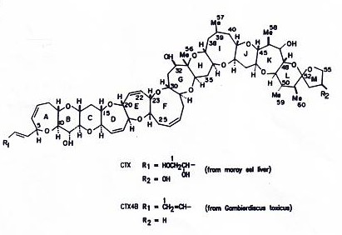
Ciguatoxin Molecule

Slide 10
Uncertainties in the CFP Cycle
Increased proportions of toxic fish?
Increased toxicity in the fish present?
Increased fish harvesting and consumption by humans?
Due to fish eating more toxic algal substrate?
Due to different grazing patterns?
Due to progressive toxin accumulation in older fish?
Due to increased G. toxicus biomass?
Due to increased specific toxicity of G. toxicus biomass present?
Due to specific G. toxicus clone that produces CTX?
Do certain conditions stimulate the growth of G. toxicus?
Do certain conditions change the macroalgae where the G. toxicus grows?
Do certain conditions stimulate the specific toxicity of G. toxicus?
CFP INCIDENCE
INCREASED TOXICITY
IN HERBIVOROUS
FISH
INCREASED TOXIC
ALGAL SUBSTRATE
TRIGGERING
ENVIRONMENTAL
CONDITIONS

Slide 11
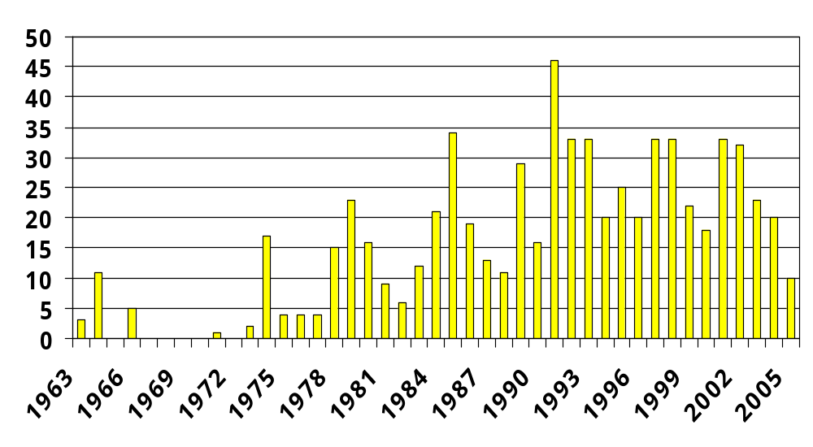
Reported Ciguatera Incidents
Hawaii – 1963 to 2005
N = 676
Notes:
676 separate incidents reported to the Department of Health over a 42 year period in Hawaii.

Slide 12
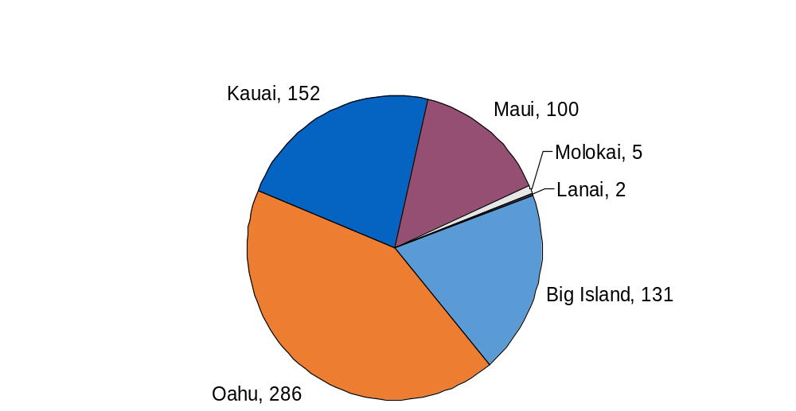
Ciguatera Incidents By Island
N = 676
Notes:
Number of incidents per island over the 42 year period.

Slide 13
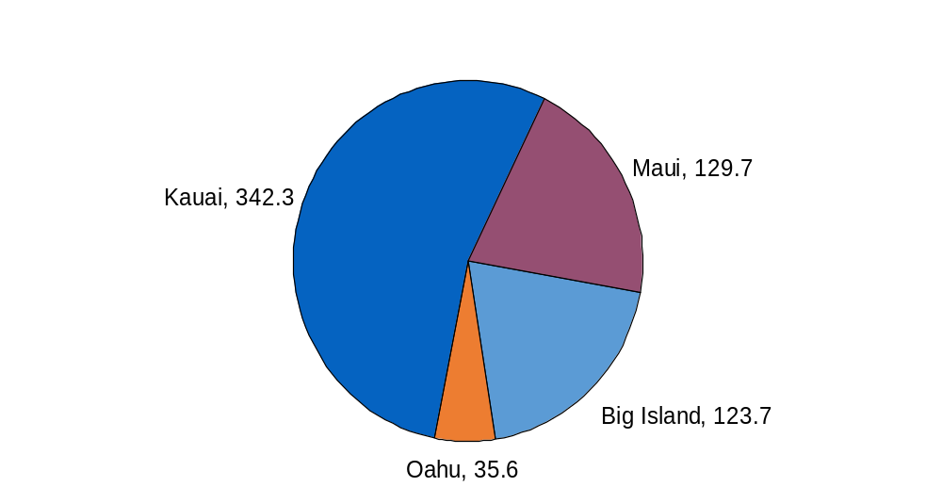
Ciguatera Incidence By Island
N = 676
Per 1985 100,000 resident population
Molokai and Lanai excluded
Notes:
Incidence – adjusting for each island’s resident population. Changes the picture.
Source: Hawaii State Department of Business, Economic Development and Tourism, The Population of Hawaii, 1990 (Statistical Report 219, July 1991), table 7; State of Hawaii Data Book, 1993-94 (June 1994), table 1.6; and Population Estimates Program, Population Division, U.S. Bureau of the Census, 03/17/98.

Slide 14
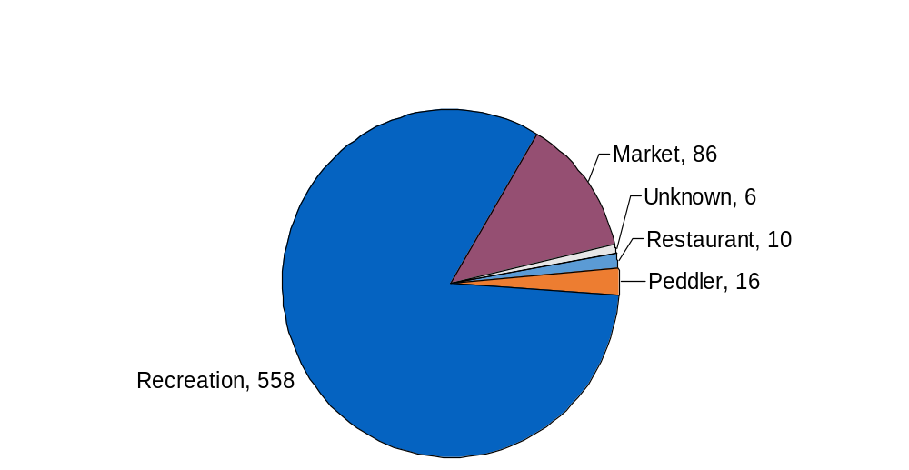
Fish Source for Ciguatera Incidents
N = 676
Notes:
Still primarily an illness associated with recreational fishing and private consumption. Recreational catch that may have been sold to a market or restaurant for re-sale is captured under those sources, market and restaurant.

Slide 15
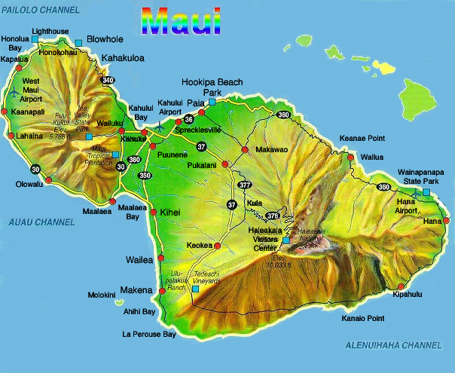
Catch Sites for Incident-Related Fish
Maui - 1963 to 2005
57 incidents associated with Maui catch sites
53 with specific location
Notes:
53 of 57 incidents associated with Maui catch sites had specific locating information.
Sites are predominantly Northwest and West.

Slide 16
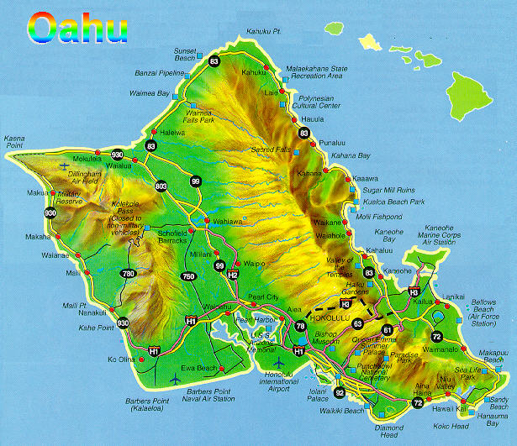
Catch Sites for Incident-Related Fish
Oahu - 1963 to 2005
127 incidents associated with Oahu catch sites
125 with specific location
Notes:
125 of 127 incidents with Oahu catch sites had specific location information.
Catch sites are primarily on the West and South sides.

Slide 17
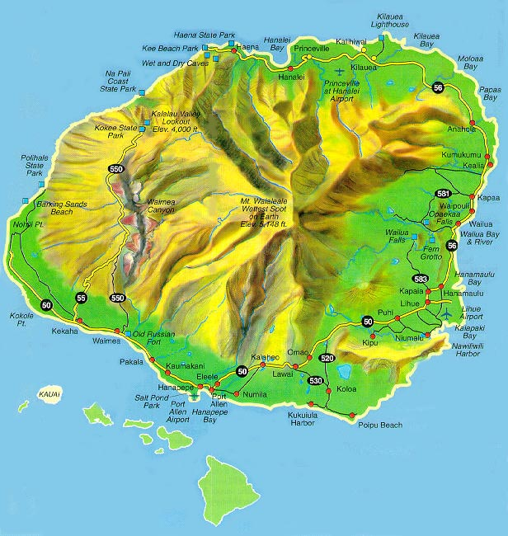
Catch Sites for Incident-Related Fish
Kauai - 1963 to 2005
118 incidents associated with Kauai catch sites
113 with specific location
Notes:
113 of 118 incidents had specific location.
Note the high concentration of incidents associated with catch sites along the north and northwest shores.

Slide 18
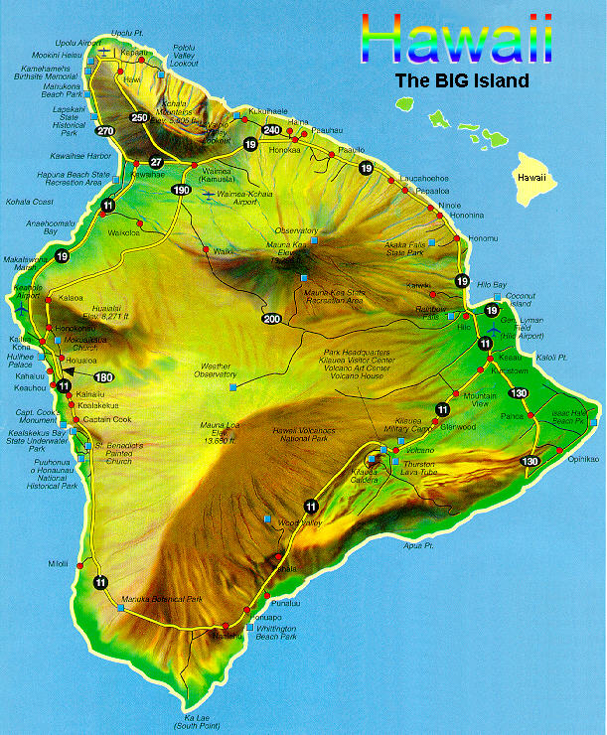
Catch Sites for Incident-Related Fish
Big Island - 1963 to 2005
136 incidents associated with Hawaii catch sites
131 with specific location
Notes:
131 of 136 Big Island catch sites had specific locations.
Incidents are heavily associated with catches along the West side of the island.
There were also 3 incidents associated with catches around Niihau and 2 incidents associated with catches around Kahoolawe.
There was no site specific information for these incidents.

Slide 19
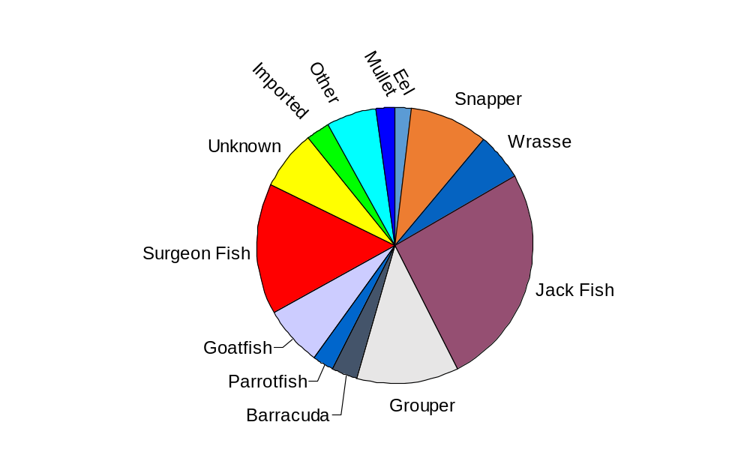
Ciguatera Incidents
By Type of Fish Consumed
N = 635
Incidents involving consumption of >1 fish type were excluded
Notes:
Of the 635 incidents involving only one type of fish exposure Jacks were the most common, followed by Surgeon Fish, Groupers, Snappers, then Wrasses.

Slide 20
Ciguatera Fish Poisoning
Top 5 Offenders – Locally Caught Fish
 | 1 | 2 | 3 | 4 | 5
Incident | Jack | Surgeon | Grouper | Snapper | Wrasse
Hospital | Wrasse | Jack | Snapper | Grouper | Surgeon
Notes:
# of reports and cases have fluctuated, but no real trend

Slide 21
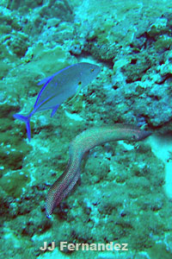
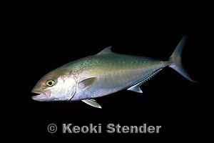
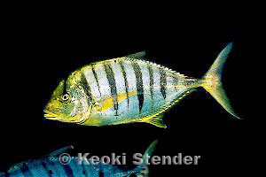
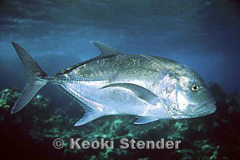
Jacks

Slide 22
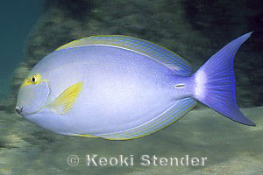
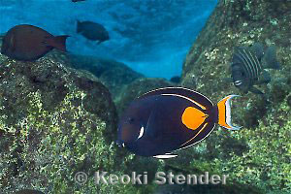
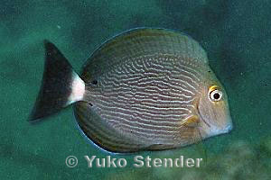
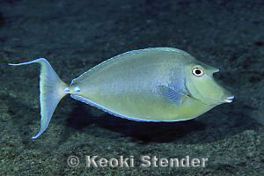
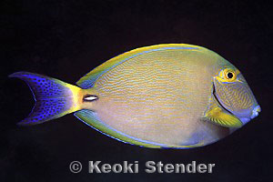
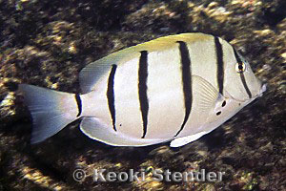
Surgeon Fish

Slide 23
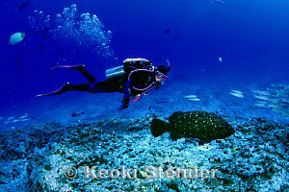
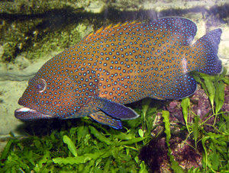
Grouper

Slide 24
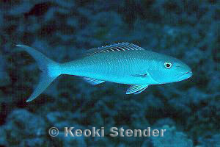
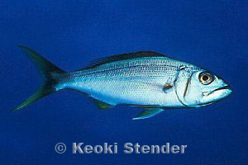
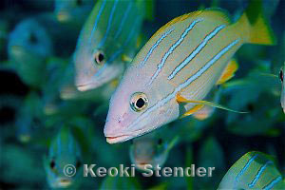
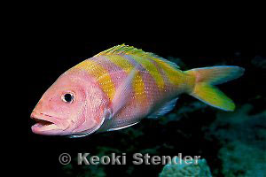
Snappers

Slide 25
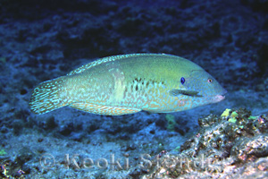
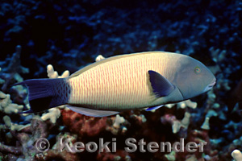
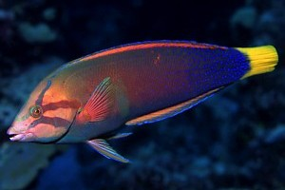
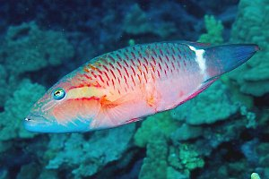
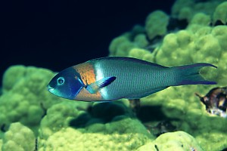
Wrasses

Slide 26
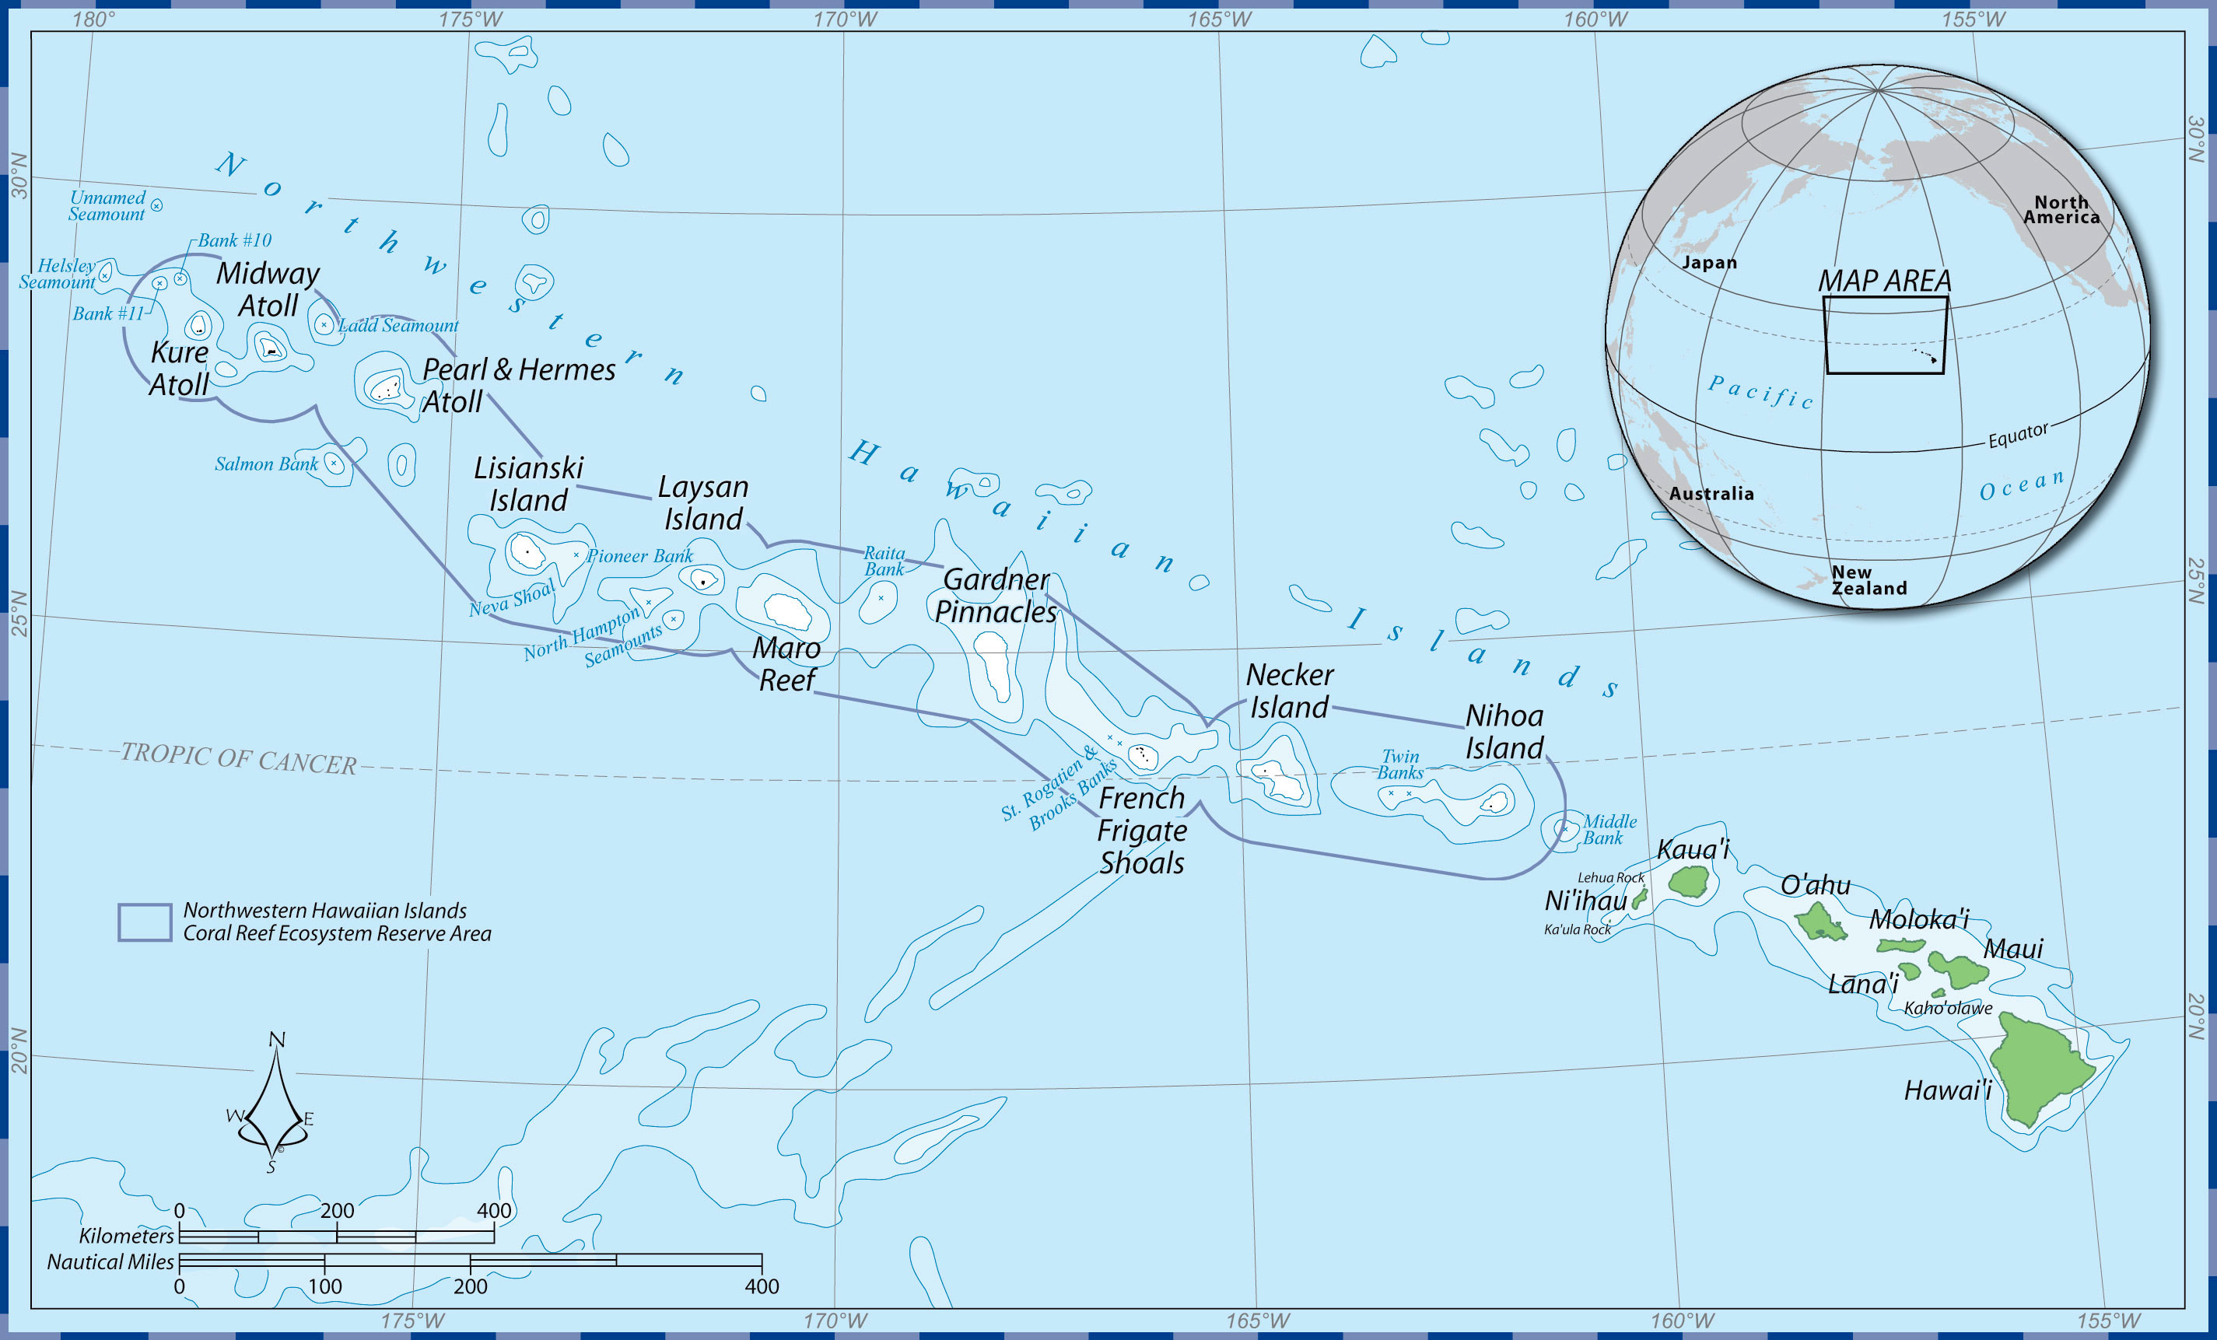
Interesting Results
Midway Atoll
n=57 39% hot
French Frigate Shoals
n=25 0% hot
Hawaii
n=59 10% hot
http://www.noaanews.noaa.gov/stories2006/s2644.htm

Slide 27
Summary of Results
N2a Bioassay
UHM HOT FISH | MHI n = 112 | NWHI n = 182 | TOTAL
CARNIVORES | 15% | 20% | 18%
HERBIVORES | 11% | 17% | 14%
ALL | 13% | 18% | 16%

Slide 28
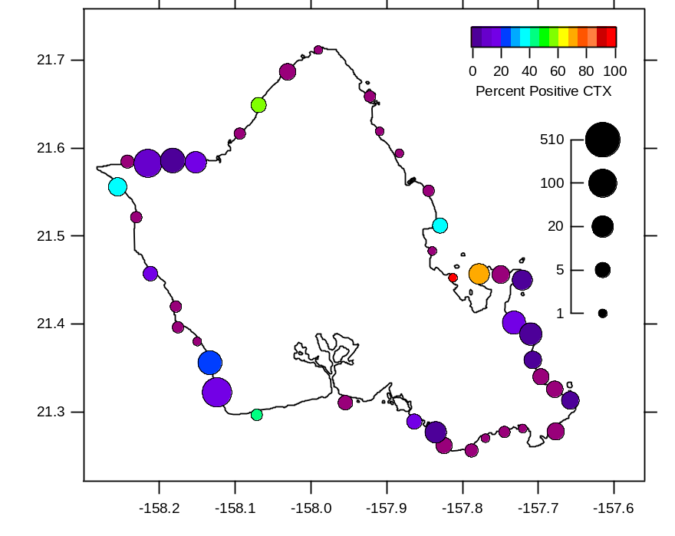
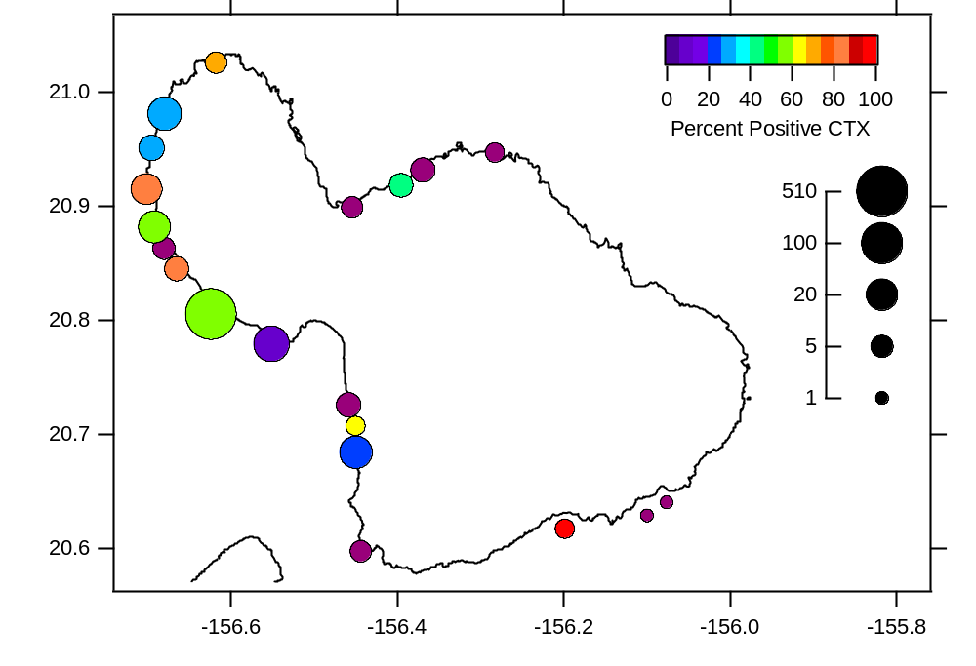
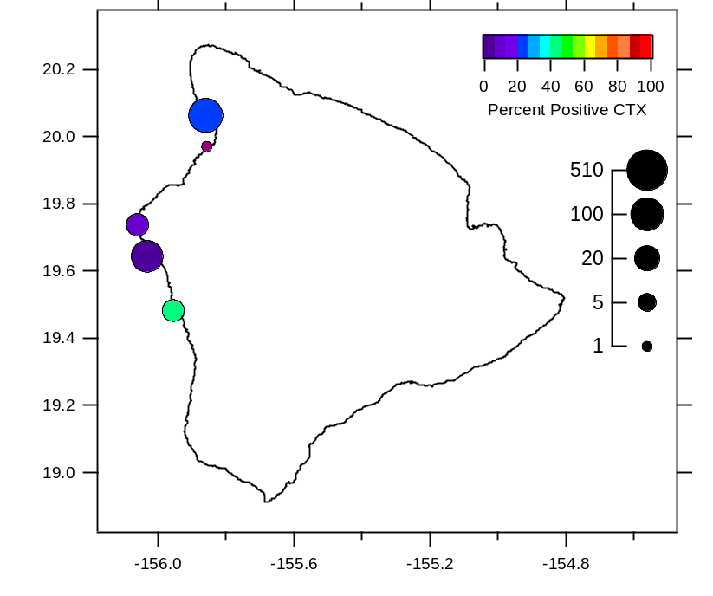
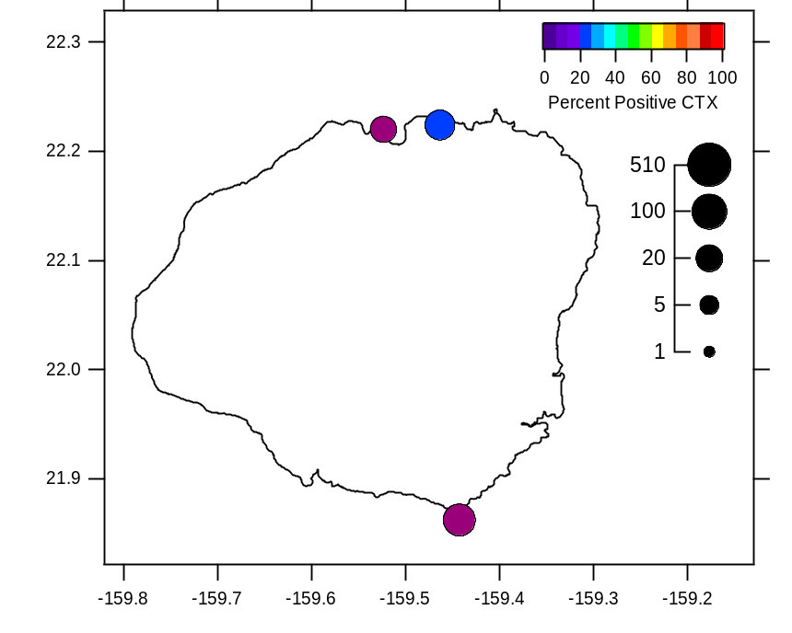
Oahu
Maui
Hawaii
Kauai

Slide 29
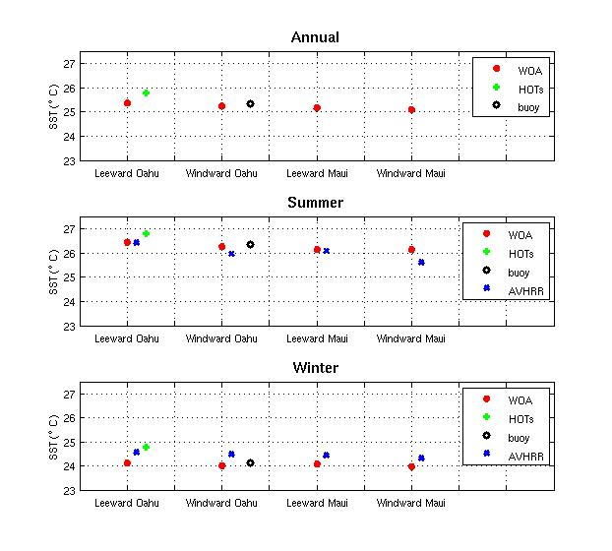

Slide 30
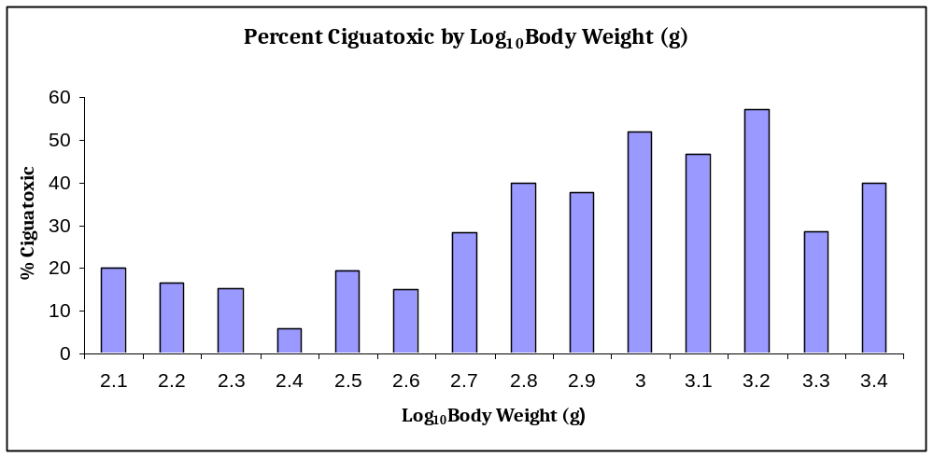

Slide 31
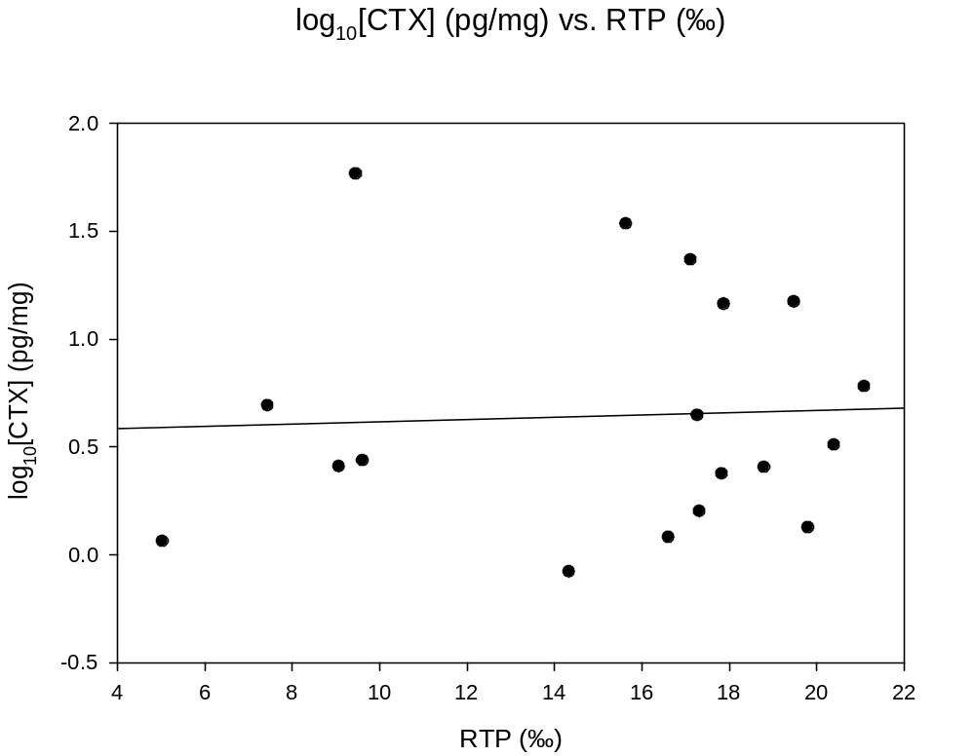
CTX Concentration vs Relative Trophic Position
Notes:
Via anecdotal information, it has been hypothesized that CTX are biologically magnified through coral reef food webs. This study quantified biomagnification of CTX via correlation between assessments of relative trophic position and relative CTX toxicity in individual wild-caught fish exhibiting a defined feeding relationship. This work examined the trophic position and relative CTX toxicity within the carnivorous grouper (Cephalopholis argus) and 22 species of its prey items.
Prevalence and concentration estimates of CTX within this predator-prey relationship were analyzed by performing the N2a mouse neuroblastoma bioassay on 157 samples of C. argus and its prey that were collected from nearshore reefs off Maui and Oahu, Hawaii USA. Assessment of trophic position via compound-specific nitrogen isotope analysis of amino acids (AA-CSIA) provided the correlative data needed to determine degree of biomagnification. AA-CSIA analyses were performed on 42 samples of C. argus and various prey. Results indicated that 36.4% of C. argus specimens and 35.0% of the prey specimens were positively ciguatoxic. There were correlationalculated relative trophic position (RTP ‰) vs. total body weight (g). for a) Cephalopholis argus and b) for all C. argus’ prey samples.No significant (p> 0.05) relationship was observed between relative CTX toxicity and body weight and for individual specimens of either C. argus or the prey species. Similarly, no significant (p> 0.05) relationship was found between estimated CTX concentration and quantified trophic position for individual samples of either C. argus or their prey species. Results of this study indicate that trophic position alone is not sufficient to explain variations in CTX toxicity observed in individual members of the reef fish communities.

Slide 32
CTX Potency, Threshold & Links
CTX Human Threshold Concentration 0.1 – 4 ppb
Upcoming EU & USFDA Limit ➔ 0.01ppb
BHAB Conference: New Zealand, October 2014
Link to Hawaii Research & Information
www.fish4science.com

Slide 33
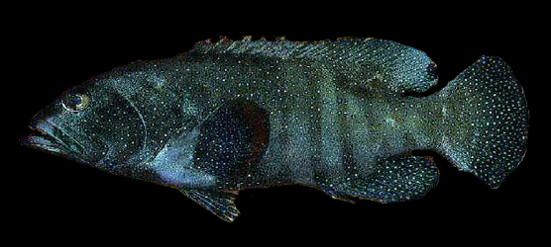
Muscle Tissue
0.2
Brain
0.6
Liver
1.5
Gonads
1.4
Figure 1.1 Distribution of average CTX
Concentration (ng/g) in ten samples of C. argus

Slide 34
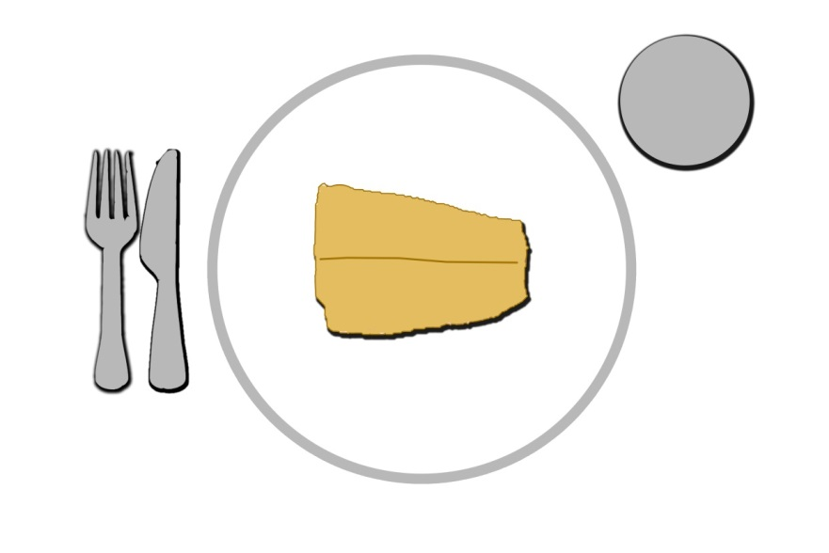
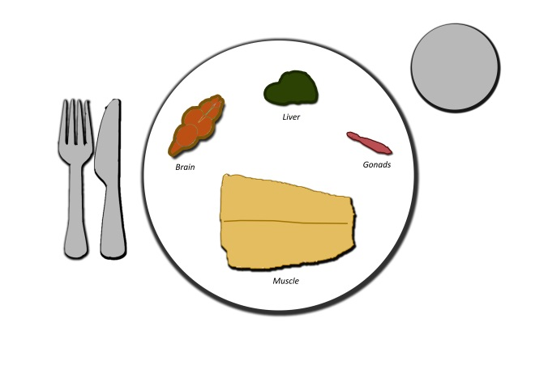
= 26.4 ng [CTX]
= 34.6 ng [CTX]
Replacing less than 5% of serving of muscle with an equivalent weight of internal
tissues yields a 24% increase in CTX load
Notes:
With 110 grams of muscle and 5 grams of other visceral parts, the [CTX] increased by 35%

Slide 35
Gambierdiscus Transport via Ships’ Ballast Water
Test Conditions: 4 T’s 22.C-29.0°C, Darkness
Findings
  Survival & Growth Rates: Controls = Tests
  No Gambierdiscus in Ballast Waters
  No Cyst Development
Conclusions
  Ballast Water Will Allow Oceanic Translocation of Gambierdiscus
  Current U.S. Protocols Prevent this Occurrence
Notes:
The ballast water in trans-oceanic shipping vessels has been implicated as a mode of transfer for invasive species, including the dinoflagellate, Gambierdiscus spp., the causative organism of ciguatera fish poisoning.
The dinoflagellate Gambierdiscus was exposed to ballast water from a trans-oceanic vessel, and maintained at a variety of temperatures in the dark to determine if viability would be maintained. Logarithmically growing Gambierdiscus inocula were admixed (1:6, vol:vol) with ballast water, maintained in the dark at 22.6°C, 24.6°C, 26.8°C and 29.0°C and assessed for numerical abundance over six days. Calculated growth rates from the biomass time series showed no indication that ballast water negatively impacted Gambierdiscus viability; accompanying microscopic inspections supported this conclusion. Filtration of large volumes of collected ballast water failed to show the presence of any Gambierdiscus cells contained therein. Recovery and microscopic examination of the experimental inocula after 10 weeks in the dark, failed to show cyst development at any temperature regime. This examination of ballast water showed no evidence of cytotoxicity to Gambierdiscus spp.
This work addressed the issue of Gambierdiscus transport and survival via ship ballast water. Like many other dinoflagellates, Gambierdiscus spp. have a reputation for being difficult to maintain in culture in vitro due to sensitivities to agitation, abrupt changes in temperature, salinity, light, and high silicate and metal levels, particularly copper (Guillard and Keller, 1984; Steidinger and Baden, 1984; Durand-Clement, 1986; Bomber et al., 1988). These attributes created interest to examine empirically if Gambierdiscus spp. would survive exposure to a ship’s ballast water. Following our contact, Matson Inc. offered to supply these experiments with ballast water from a vessel immediate after docking. The M/V Maunalei is four years old, carries a total ballast volume of 9652 metric tonnes in fourteen separate, lined tanks. Per requirements for docking in U.S. ports, vessels are required to purge/refill ballast tanks with deep sea water, defined as taken beyond 200 miles from land in ≥2000m of depth. At sea, ballast tanks are periodically purged, refilled, and transferred to stabilize vessels in transit. The objectives of this work were to examine the ballast water for the presence of Gambierdiscus spp., to determine if the growth response of Gambierdiscus following exposure to ballast water reflected toxicity to the cells, and to subsequently examine for evidence of cyst formation by Gambierdiscus following prolonged exposure to ballast water.
The likelihood for ballasted organisms to survive and become invasive in a new location depends on many factors, such as cell numbers entrained, ballast water quality, residence time, propensity for cyst formation, etc.(Hallegraeff, 1998, Verling et al., 2005; Collauti et al., 2006; Choi, 2009). The deterioration of Gambierdiscus cells after 6-9 days exposure to ballast water, and the absence of cyst formation after prolonged exposure decrease the likelihood for translocation of this genus under the conditions described. The numbers of Gambierdiscus spp., which favor a littoral habitat, likely decline significantly in oceanic regions; thus, the U.S. requirement that trans-oceanic vessels purge/refill ballast tanks with deep sea water (i.e., >200 miles from land, and ≥2000m of depth) seems very supportive of efforts to prevent the spread of this organism among tropical ports.

Slide 36
Neurotoxin Prevalence in Marine Turtle Tissues
TESTED
  Tissues: Muscle & Liver
  72 Samples, 38 individuals, 3 species
FOUND
  12 Samples (32%): Positive for Na⁺-Channel Neurotoxin Presence
  Feeding Behavior ➔ Grazing on Near-shore Macroalgae
  2 species: Green (10/29) > Hawksbill (2/4) > Olive Ridley (0/5)
  Livers (10/28) > Muscles (8/38) > Both (6/32)
  First Demonstration of Na⁺-Channel Neurotoxicity (CTX) in Marine Turtles
Notes:
Gambierdiscus spp., the dinoflagellate genera responsible for producing such Na⁺-channel neurotoxins, has been described as a common component of the benthic dinoflagellates community throughout the Hawaiian Archipelago [9] and a recent fish survey showed that approximately one third of roi (Cephalopholis argus), an obligate carnivorous fish, caught by recreational fishers in the main Hawaiian Islands between 2008-2010 were positive for CTX [10]. These observations and direct algal collections [9] indicate that Gambierdiscus spp. is present on the reefs around the Hawaiian Islands and that CTX is entering the marine food web. As green (Chelonia mydas) and hawksbill (Eretmochelys imbricata) turtles forage in similar habitats to those in which C. argus were captured, and as they feed on benthic substrates on which the dinoflagellates are likely to occur, we hypothesize that these turtles may also be exposed to the family of neurotoxins such as CTX via their diet.
Human intoxication that occurs after eating marine turtle meat is referred to as chelonitoxism. Chelonitoxism is most commonly reported in the Indo-Pacific, particularly in incidents involving hawksbill or green turtles [11]. Symptoms of chelonitoxism can be many and varied, with some similarities to those for ciguatera fish poisoning [12] including nausea, vomiting, dizziness, sweating, sore throat, burning sensation in the mouth, and chest pain. Most patients recover within a few weeks, however, deaths have been reported in a number of chelonitoxism cases [11].
Marine turtle meat has long been recognized as ephemerally toxic, suggesting that the compound(s) responsible for toxicity are not produced by the turtles, but are likely to be acquired through diet [11]. Turtle poisoning events are relatively rare, however when they occur they often effect a large number of people as it is customary for a turtle meal to be shared amongst whole families or communities. Intoxication events often occur in remote locations making analysis of the tissues difficult, thus, very little is known of the toxins responsible [11].
To our knowledge, this is the first study to demonstrate Na⁺-channel neurotoxicity, i.e., putative CTX activity, in marine turtle tissues; this indicates that turtles in Hawaii may be exposed to potent marine algal neurotoxins in their natural environment. These results reflect those of similar surveys of roi [10] and Hawaiian monk seals [39]. This also indicates that such neurotoxins are prevalent in neritic food webs around the Hawaiian Islands and are not limited to high trophic level fishes which generally receive the greatest attention.
Neurotoxicity in seafood, such as is most commonly associated with ciguatera poisoning, is generally associated with human consumption of contaminated fish. However, other marine organisms may also be exposed to this family of neurotoxins since the dinoflagellates that produce ciguatoxin (Gambierdiscus spp.), are found on many benthic substrates that form the basis of neritic tropical marine food webs. We assess the incidence of neurotoxicity of green (n=29), hawksbill (n=4) and olive ridley (n=5) turtles stranded in the main Hawaiian Islands or captured in the Hawaii-based pelagic longline fishery to using the sodium channel specific mouse neuroblastoma (N2a) bioassay. One third (31.6%) of turtle muscle and/or liver samples were found to be positive for Na⁺-channel neurotoxic activity with the relative toxicity of liver tissues higher than muscle. Positive neurotoxic results were found only in green (34.5%) and hawksbill (50.0%) turtles. No olive ridley samples showed Na⁺-channel neurotoxicity. Positive results for Na⁺-channel neurotoxicity were obtained from turtles across the four main islands as well as pelagic environment; no ‘hot spots’ appeared evident although our sample sizes to detect this were small. This is the first time that Na⁺-channel neurotoxicity, i.e., putative ciguatoxicty, has been described in marine turtle tissue and, while the structure of ciguatoxin per se was not confirmed, the neurotoxic activity indicates that similar regard should be given to the potential human health impacts of consuming turtle meat as is manifest for tropical reef fishes.
TW suggests using sodium channel blocking compound (SCBC) instead of CTX.

Slide 37
Neurotoxin Prevalence in Stranded Marine Cetaceans
TESTED
  Tissues: Muscle, Liver, Brain, Testes
  89 Samples, 34 individuals, 13 species
FOUND
  14 Samples (16%):Positive for Na-Neurotoxin Presence
  Feeding Behavior ➔ Grazing on Near-shore Fishes
  6 species
  Livers (7) > Muscles (4) > Brain (3) > Tests (0)
  Positive Association ≠ Causal Factor

Slide 39
Ciguatera: Societal Impacts
Reduction in primary food source
Increased health-related costs
Revenue Loss of reef-fish sales to extent markets
Loss of tourism
Depopulation via migration
  Rongo et al. (2009): Polynesian voyages of discovery
Societal changes in eating habits
Societal changes in family/festival activities

Slide 40
Ciguatera: Perspective with Climate Changes
Greater Geographic Range of Incidence
Probability for Higher Biomass of Toxin Producers
Greater Toxicity Quota from Gambierdiscus Biomass
Coming Good News: Technological Response from Science

Slide 41
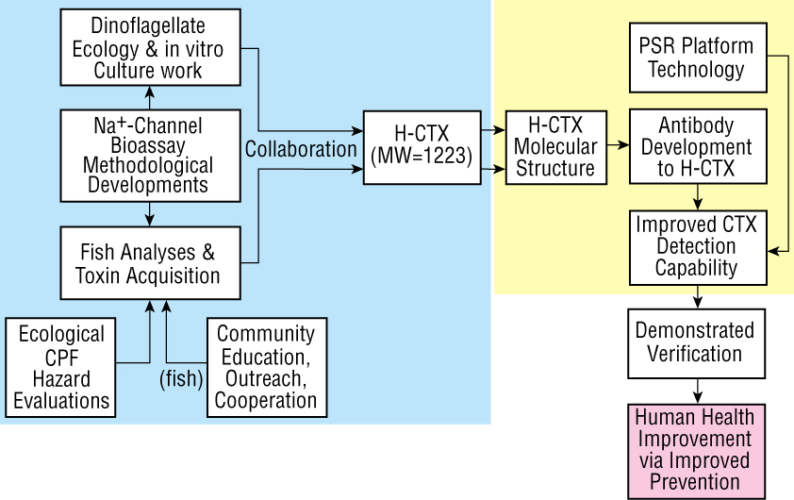
Overview of Research Design

