Slide 1
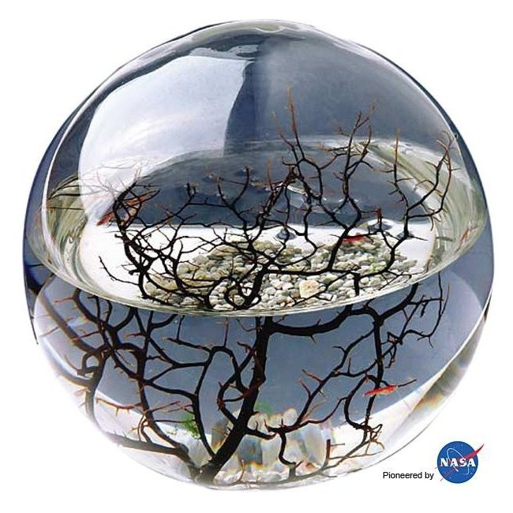
A “Lunatic” Model of Sustainability
Paul A. Comet, Consultant
Houston, Texas
19th Annual Green Chemistry & Engineering Conference. July 14 -16th 2015,
Betheseda, Maryland, USA

Slide 2
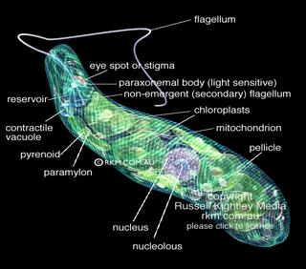
A model for a city, space ship or refugee camp?

Slide 3
Circulation of material in atmosphere biosphere and hydrosphere
Photosynthesis, Respiration, Decomposition control the Carbon and Nitrogen cycles. Material is circulated using solar energy (mainly). Energy is trapped by gas and vapor into plant tissue, that is then circulated into animals and decomposers to sustain them. In this “ecological model”, the role of waste is key. We live by breathing plant waste. Plants live by absorbing the CO2 waste etc. from decomposers and animals.
So almost nothing material is wasted; however solar energy is converted to lower frequency radiation, eventually lost to space. Some energy is trapped in plant detritus which eventually becomes fossil fuels. Much more carbon dioxide is removed from the atmosphere by the weathering of igneous and metamorphic rocks and finally sedimented as limestone. (rock cycle)

Slide 4
Model of a lunar base
Nothing can leave or enter the glass/plastic bubble(except for short intervals). Within a few days all oxygen would be converted to carbon dioxide and methane. All respiratory life would die. Only by planting seeds of legumes & other plants in the lunar “soil” could oxygen and food be available to support humans.
The “lunar base model” or “empty table” model where nothing but sunlight, rocks and sewage in a methane, carbon dioxide and nitrogen atmosphere could be transformed into a habitable environment simply by planting legumes. Methane from decomposing waste could be fed through fuel cells to create warmth and light through the long lunar night (2 weeks!) By this simple model “terraforming” of a small lunar area can be achieved. The energy of the sun is valorized by being trapped in food & waste & living organisms.

Slide 5
Terraforming a refugee camp?
Can the same principles be applied to a refugee camp in any impoverished state?
Can one survive purely by recycling trash and sewage?
If the sewage and plant debris is converted into fuel, fertilizer and water for drip irrigation, then this might be possible. A machine (prototype) devised by John Nistler might be mentioned here.

Slide 6
Lunar (lunatic) economics – an ecological model
No comprehensive model for the understanding of what capital “is”, or how it “works” has yet been formulated.
No one really knows what money “is” or even how it works.
The following model is proposed. Money today consists of a least two components a) Some kind of token or promissory note and b)“specie”, originally gold or some other commodity such as oil, now mainly debt. Understanding what capital “is” remains arcane.

Slide 7
Money as captured energy
Over the last century there have been repeated conflicts over access to petroleum reserves. WWI and WW2 being the largest, but also many others. Access to oil shale in the Eastern Ukraine and oil reserves in the South China sea probably play a large part in the growing geopolitical friction.
For many years one of the principal supports for the dollar has been oil – the “so called “petrodollar”. This requires much collaboration with the Middle East. I would like to offer the idea of an alternative energy currency, a “photonic dollar”. Usable (captured) energy from the waste stream and from the sun etc. might be the “specie” for a parallel currency.

Slide 8
A cellular model for city and state
If it is accepted that the best model for “sustainability” is an ecological one, then that model might include many biological strategies. The model of a single eukaryotic cell, perhaps one combining “plant” like features of energy retention by carbon fixation, with “animal like” features of heterotrophy might be a good model for a city, with ourselves and our infrastructure forming the organelles. Communication with adjacent “cells” might allow for differentiation of function (manufacturing of different articles in different states?). An entire state might be comparable to a “superorganism”: roads become “veins”, money the equivalent of “blood” (combining both energy and the means of liberating “it”) , the bank as the “heart”. Cognition of a “brain” might be analogous to political decisions by the entire population voting for particular policies. The “power station” as mitochondria etc.
By thinking of society as a “superorganism” certain problems can be approached using a new angle. Essentially mankind can be understood by using the same “entomological”, or other academic biological tools, to understand how a beehive or ants nest functions. Similarly medical tools for understanding the cellular mechanics of multicellular & unicellular organisms can be brought into play.

Slide 9
Energy as Money
Using an electrical grid “real” money can be created easily. When withdrawing energy, one obtains a debit from the electricity meter (and an eventual monthly bill). However, if one supplies energy to the grid one can obtain a credit. All over the world people are hitching up wind turbines and solar panels to the local electricity grid and receiving a check in the mail. Hence if “waste to energy” devices are connected to the grid, the energy is converted into a cash supply by using a credit card and appropriate metering technology. This joule/watt etc. currency can also be issued as “Municipal Energy Tokens”. If , say a local grid that connects both farm and city together, is fed energy from solar panels, municipal and agricultural waste; then this electrically - linked society may become self-sufficient in resources. Energy used in local manufacturing could form the basis of pricing in joules of these manufactured articles. Hence by adapting an electrical grid to accept external power supplies (from alternative energy), an independent, autonomous, “local” economy can be created; which is both carbon neutral and ancillary to the existing fossil fuel system. Articles manufactured using alternative energy may gain greater public acceptance as the fear of climate change increases.

Slide 10
Putting it all together
Carbon control, creation of wealth, regional development, municipal planning, housing of refugees, waste disposal, regulation of climate change, and “sustainability economics” can all be understood by the intellectual creation of a “multicellular superorganism”. This superorganism can exist, by virtue on an electrical grid that keeps it “alive” and regulates growth.
Neither the economic theories of Adam Smith nor Karl Marx address the waste problem, and hence sustainability, nor do they address what capital “is”. Perhaps by solving the waste problem we are better prepared for living on the moon and Mars. We are also in the position to be able to better create stable economic structures on earth.
In order to remove enough CO2 to stabilize climate change, a global cooperative of otherwise competing national entities, is required.

