Slide 1

Antibiotics from Bacillus, new compounds to solve an old problem
Prof. P. FICKERS
Microbial Processes and Interactions
Université de Liège
Belgium
Frankfurt, August 18th

Slide 2
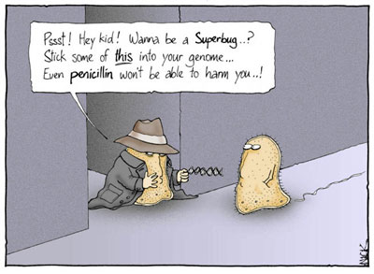
Context : antibiotic resistance
http://eemb40.blogspot.be/2011/01/antiotic-resistance.html

Slide 3
Context : antibiotic resistance
Antibiotic resistance is a serious and growing global problem
A World Health Organization (WHO) report released April 2014 stated, "this serious threat is no longer a prediction for the future, it is happening right now in every region of the world and has the potential to affect anyone, of any age, in any country”.
“Antibiotic resistance is now a major threat to public health.”
Source : WHO’s first global report on antibiotic resistance

Slide 4
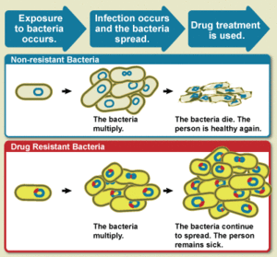
Context : antibiotic resistance
The WHO defines antimicrobial resistance as « a microorganism’s resistance to an antimicrobial drug that was once able to treat an infection by that microorganism ».
Bacterial death upon drug treatment for non-resistant bacteria
Bacterial growth upon drug treatment for resistant bacteria
"What is Drug Resistance?". www.niaid.nih.gov.

Slide 5
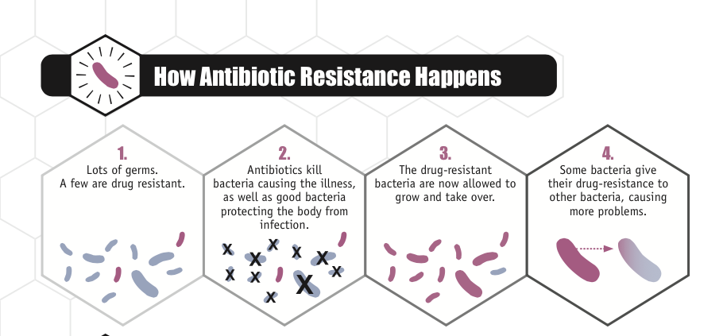
Context : antibiotic resistance
Antibiotic resistant bacteria predate the medical use of antibiotics. However, widespread and misuse of antibiotics (especially broad-spectrum antibiotics) in medicine and antibiotic use in livestock feed at low dose for growth promotion have generated a strong selective pressure for the emergence of multi-resistant strains that resulted to the selection of drug resistant bacteria.

Slide 6
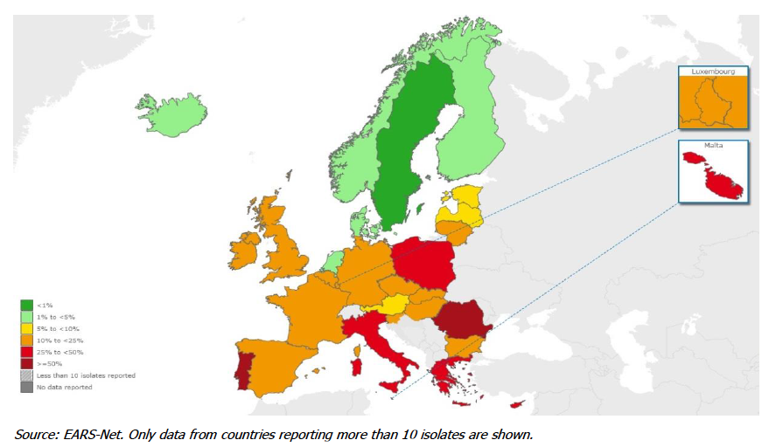
Context : antibiotic resistance
Example 1 : Percentage of Methicilin-resistance Staphylococcus aureus (MRSA, insensitive to beta-lactam antibiotics including penicillins and cephalosporins) in blood and cerebrospinal fluids.
Percentage of MRSA is above 25 % in several countries of Southern and Western Europe
Source : EARS-net

Slide 7
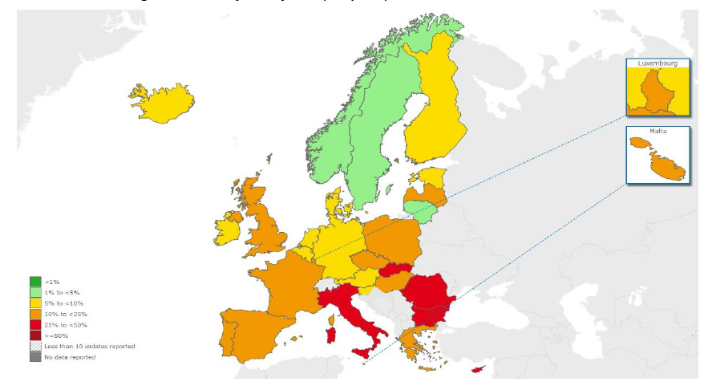
Context : antibiotic resistance
Example 2 : Percentage of Escherichia coli resistant to third-generation cephalosporins in blood and cerebrospinal fluids.
Source : EARS-net

Slide 8
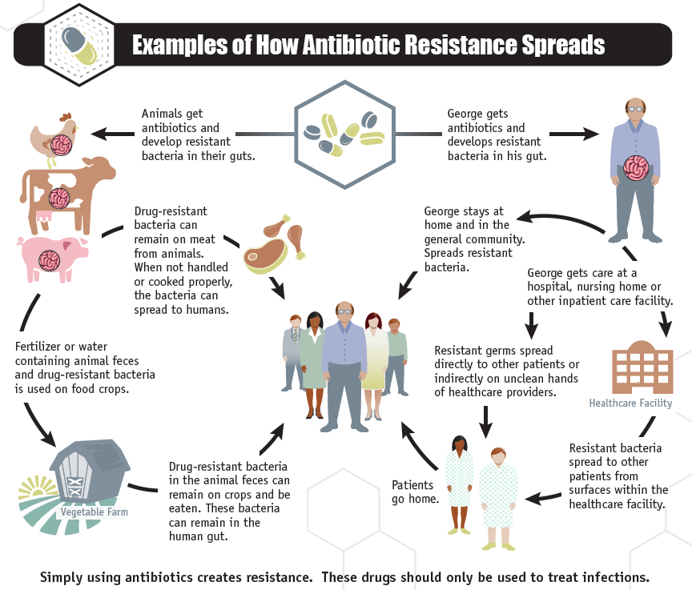
Context : antibiotic resistance

Slide 9
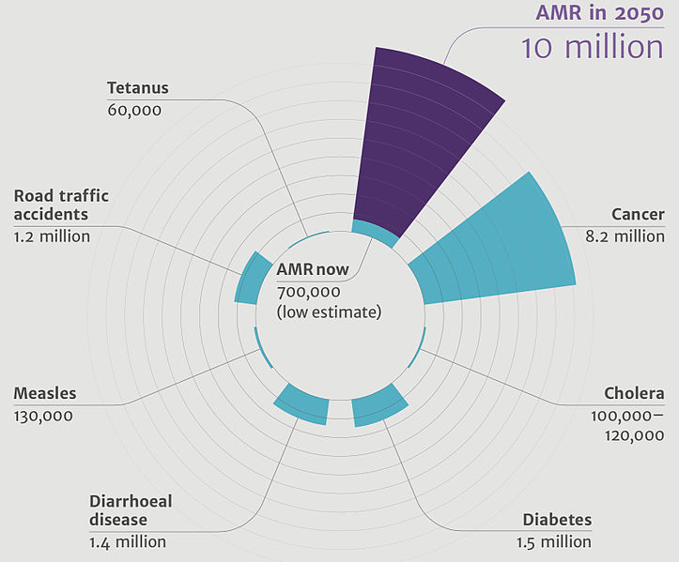
Context : antibiotic resistance
Deaths attributable to antimicrobial resistance (AMR) compared to other major causes of death.
AMR will cause 10 million of death by 2050 !

Slide 10
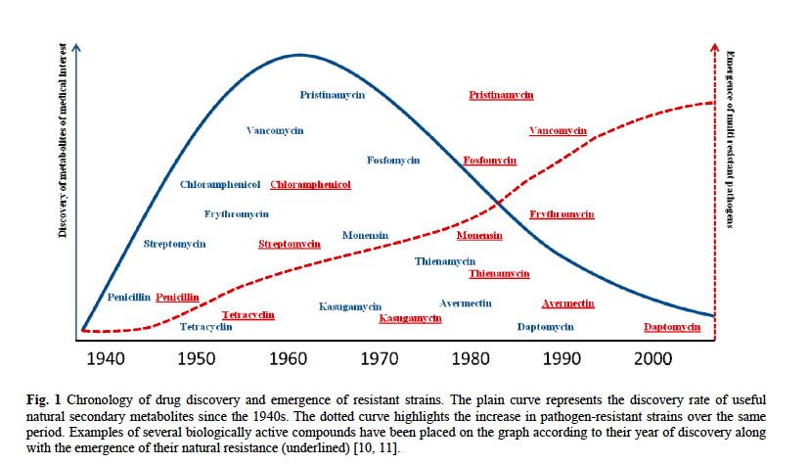
Context : antibiotic resistance
There is a paradox in this regard :
Increase of antibiotic resistant strains in hospital intensive helthcare units.
Decrease of novel drug discovery

Slide 11
Context : antibiotic resistance
There is a paradox in this regards :
Increase of antibiotic resistant strains in hospital intensive helthcare units.
Decrease of novel drug discovery
Need to discover alternative drugs from alternative producers to solve this problem !

Slide 12
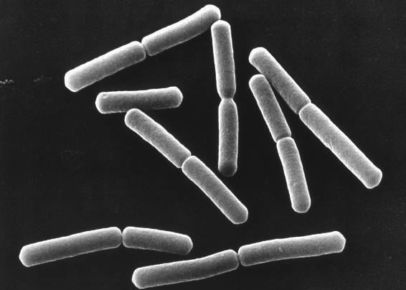
Alternative antibiotic producer microorganisms
Bacillus as a source of peptidic antibiotics

Slide 13
Why Bacillus ?
Soil bacteria and gut commensal
Used as model organism for research
Used in biotech industry for protein production

Slide 14
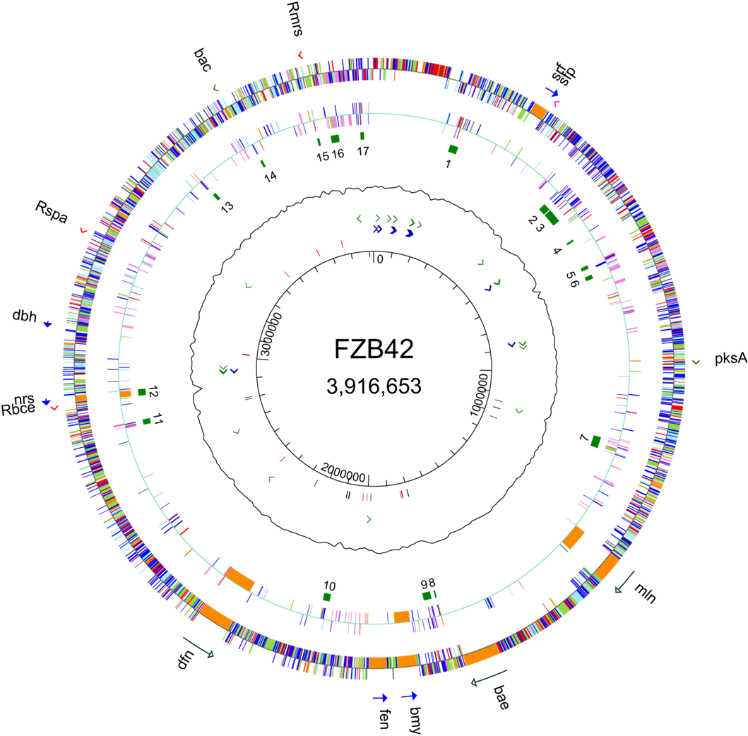
Why Bacillus ?
More than 10 % of its genome is devoted to the synthesis of bioactive compounds

Slide 15
Synthesis of peptidic antibiotics in Bacillus
- Lantibiotic, ribosomal modified peptides
- Bacteriocin, ribosomal unmodified peptides
- Lipopeptide as NRPS

Slide 16
Synthesis of peptidic antibiotics in Bacillus
- Lantibiotic, ribosomal modified peptides
- Bacteriocin, ribosomal unmodified peptides
- Lipopeptide as NRPS

Slide 17
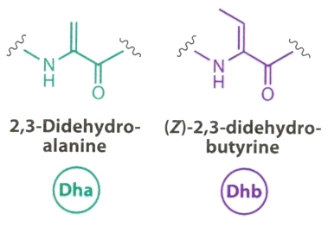
What are lantibiotics ?
Lanthionine containing peptides with antimicrobial activity
Undergo post-translational modifications :
Dehydration of Ser and Thr to form Dha and Dhb.
Knerr & van der Donck (2012) Annu. Rev. Biochem. 81, 479-505.

Slide 18
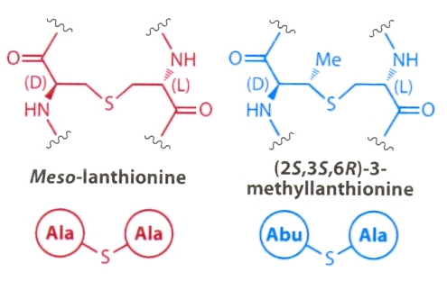
What are lantibiotics ?
Lanthionine containing peptides with antimicrobial activity
Undergo post-translational modifications :
Dehydration of Ser and Thr to form Dha and Dhb
Further Michael-type addition onto Cys residue lead to
thioether bridge formation of Lan and MeLan.
Knerr & van der Donck (2012) Annu. Rev. Biochem. 81, 479-505.

Slide 19
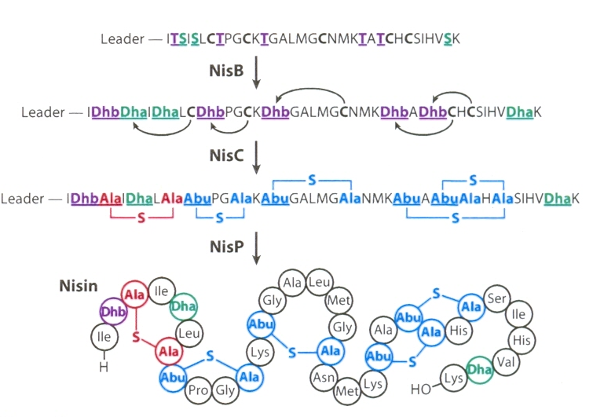
What are lantibiotics ?
Nisin is the model molecule used worldwide as food preservative.
Knerr & van der Donck (2012) Annu. Rev. Biochem. 81, 479-505.

Slide 20
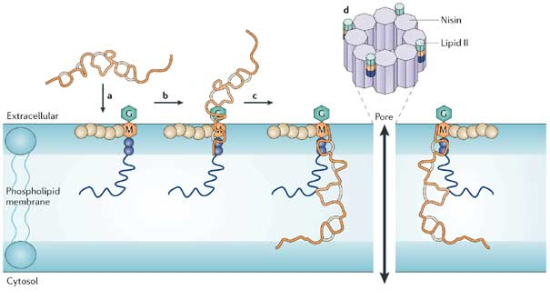
What are lantibiotics ?
Produced by Gram positive bacteria (Bacillus, Lactococcus, Streptomyces).
Heat stable, less than 5 kDa.
Toxin peptides designed specifically to kill Gram+ bacteria.
Inhibition of peptidoglycan synthesis and/or formation of pores by targetting lipid II.
Breukink & de Kruijff (2006) Nature Reviews Drug Discovery 5, 321-323

Slide 21
Biosynthesis pathways of nisin
nisA
Structure
Knerr & van der Donck (2012) Annu. Rev. Biochem. 81, 479-505.

Slide 22
Biosynthesis pathways of nisin
nisA
nisB
nisC
Structure
Modification
Knerr & van der Donck (2012) Annu. Rev. Biochem. 81, 479-505.

Slide 23
Biosynthesis pathways of nisin
nisA
nisB
nisC
nisP
Structure
Modification
Proteolysis
Knerr & van der Donck (2012) Annu. Rev. Biochem. 81, 479-505.

Slide 24
Biosynthesis pathways of nisin
nisA
nisB
nisT
nisC
nisP
Structure
Modification
Proteolysis
Transport
Knerr & van der Donck (2012) Annu. Rev. Biochem. 81, 479-505.

Slide 25
Biosynthesis pathways of nisin
nisA
nisB
nisT
nisC
nisP
nisR
nisK
Structure
Modification
Proteolysis
Transport
Regulation
Knerr & van der Donck (2012) Annu. Rev. Biochem. 81, 479-505.

Slide 26
Biosynthesis pathways of nisin
nisA
nisB
nisT
nisC
nisI
nisP
nisR
nisK
nisF
nisE
nisG
Structure
Modification
Proteolysis
Transport
Regulation
Immunity
Knerr & van der Donck (2012) Annu. Rev. Biochem. 81, 479-505.

Slide 27
Partial genome sequencencing of GA1 strain
Identification of a 0.8 kb DNA fragment with 37% identity with mrsM modification gene from the lantibiotic mersacidin biosynthesis gene cluster.

Slide 28
Partial genome sequencencing of GA1 strain
Identification of a 0.8 kb DNA fragment with 37% identity with mrsM modification gene from the lantibiotic mersacidin biosynthesis gene cluster.
Is B. amyloliquefaciens GA1 a producer of lantibiotic ?

Slide 29
Partial genome sequencencing of GA1 strain
Identification of a 0.8 kb DNA fragment with 37% identity with mrsM modification gene from the lantibiotic mersacidin biosynthesis gene cluster.
Is B. amyloliquefaciens GA1 a producer of lantibiotic ?
Highlight the antimicrobial activity of strain GA1.
Need to developp a production and purification scheme.
Perform biochemical and biological characterization.

Slide 30
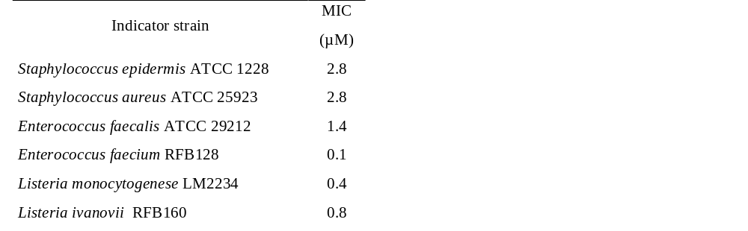
Biochemical and biological characterization
Preliminary experiments :
Heat stable and protease sensitive
Activity against Gram+ strains including MRSA and clinical isolates.
MRSA
Clinical isolate

Slide 31
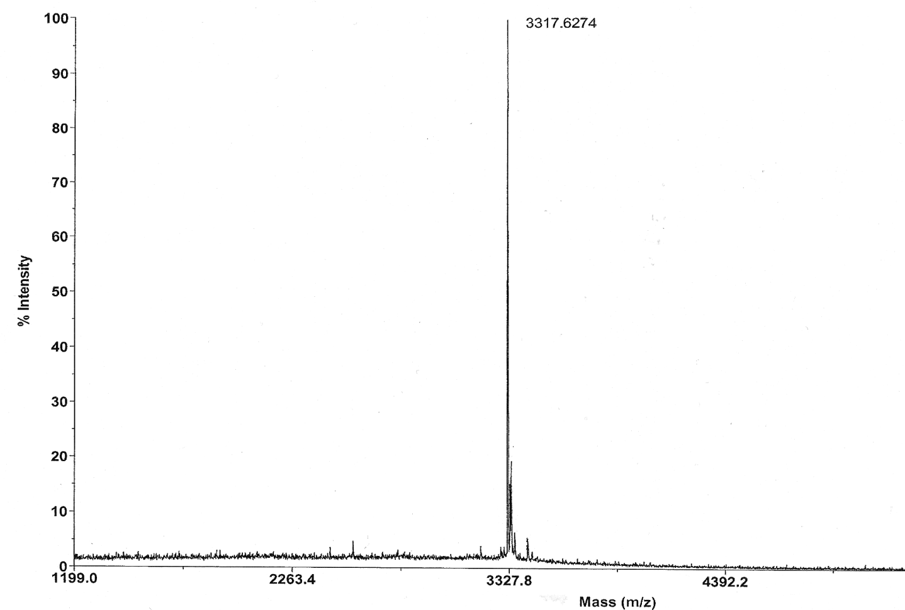
MALDI-TOF mass spectrometry
Maldi-Tof mass spectrometry highlighted that amylolysin is a novel peptide not described to date in databases.
3317,6 Da
Not present in mass spec bank Amylolysin is a novel antibiotic compound.

Slide 32
Amylolysin biosynthesis gene cluster
amlF
amlE
amlK
amlR
amlA
amlM
amlT
Immunity
Regulation
Modification / Protease
Transport
1 Kb

Slide 33
Amylolysin biosynthesis gene cluster
amlF
amlE
amlK
amlR
amlA
amlM
amlT
Immunity
Regulation
Modification / Protease
Transport
1 Kb
STRUCTURAL GENE (amlA)
MNEKMYRFAGDLREELEEISLSEFSGGGG AEQRGISQGNDGKLCTLTWECGLCPTHTCWC
Putative leader peptide of 29 amino acids (red).
Highly conserved motif, known to interact with lipid II (green).

Slide 34
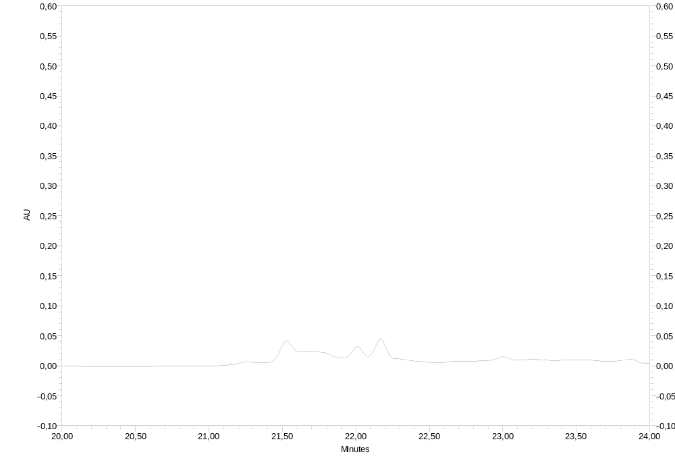
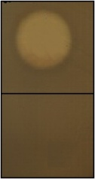
Disruption of the structural amlA gene
Growth inhibition
of Listeria sp
WT
Δ amlA
Disruption of amyA causes loss of amylolysin production and biological activity.
The identified locus is involved in amylolysin biosynthesis.

Slide 35
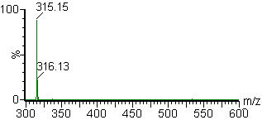
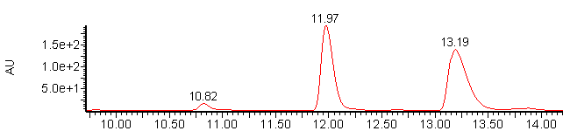
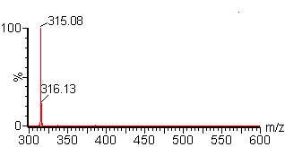
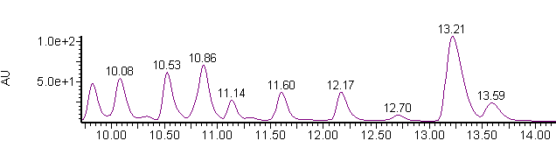
Amylolysin is a lantibiotic
Lanthionine standard
Amylolysin hydrolysat
Amylolysin belongs to class I bacteriocins, the so-called lantibiotics.

Slide 36
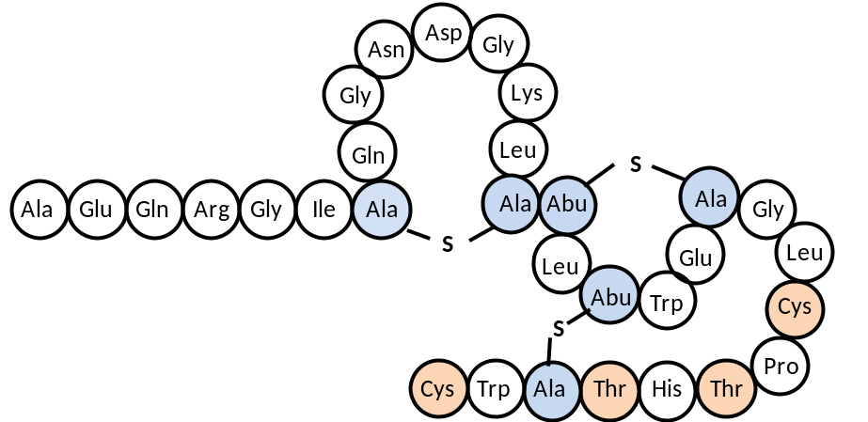
Amylolysin is a lantibiotic
Amylolysin strucure model
HalA1: CAWYNISCRLGNKGAYCTLTVECMPSCN 69
LtnA1: CSTNTFSLSDYWGNNGAWCTLTHECMAWCK 59
AmlA : AEQRGIS..QGNDGKLCTLTWECGL.CPTHTCWC 60
A
C
B
Leader peptide: MNEKMYRFAGDLREELEEISLSEFSGGGG 29

Slide 37
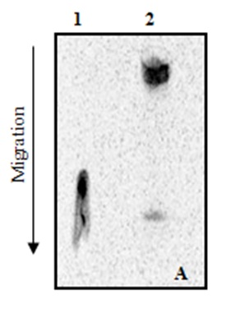
Molecular characterization of the biological activity.
1. Interaction with Lipid II by thin layer chromatography
Lipid II is involved in cell wall biosynthesis in Gram+ bacteria.
1 : [¹⁴C] lipid II
2 : [¹⁴C] lipid II + amylolysin
A retard of migration highlights a direct interaction between amylolysin and lipid II.

Slide 38
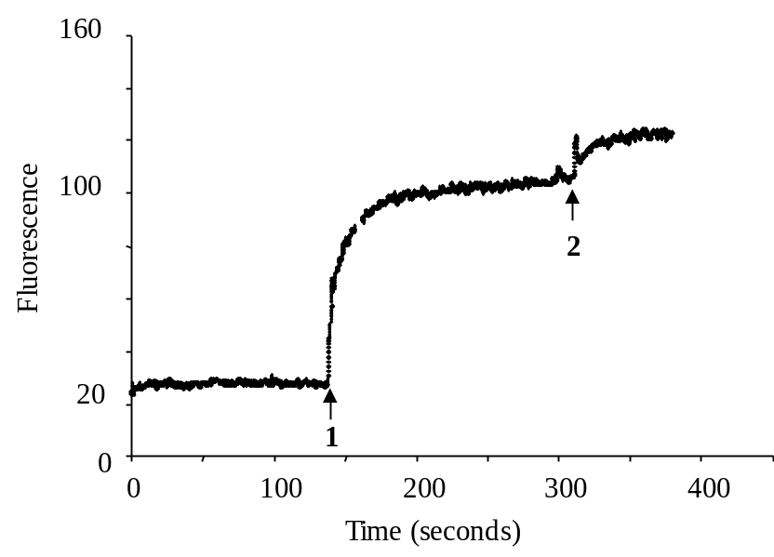
Molecular characterization of the biological activity.
2. Transmembrane electrical potential measurment (Δψ)
Fluorescent dye DiSC3,5 is sensitive to Δψ.
Low fluoresence in presnece of Δψ
High fluoresence in abscence of Δψ
Amylolysin causes an increase of fluorescence due to the collapse of Δψ.

Slide 39
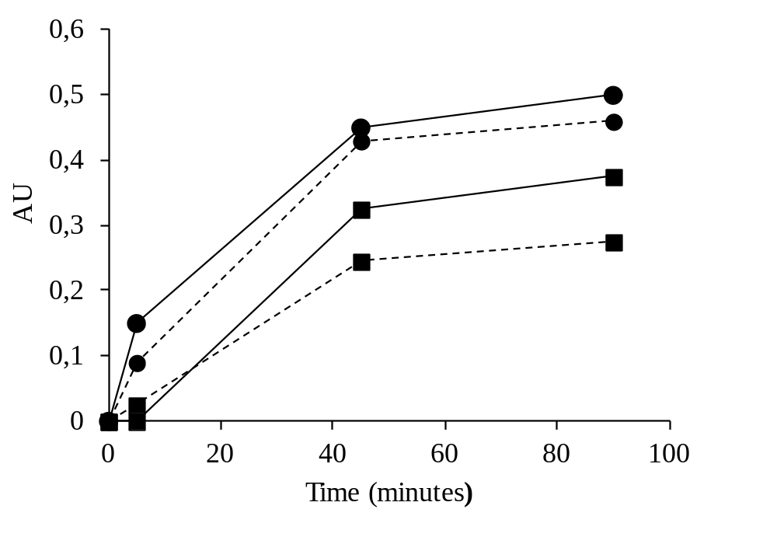
Molecular characterization of the biological activity.
3. Transmembrane pores formation
Determination of cell-leakage in the presence of amylolysin by absorbance measurment at 260 nm.
3 µg/mL (■)
6 µg/mL (●)
Nisin
Amylolysin
Leakage of UV-absorbing materials upon amylolysin treatment highlights that amylolysin induces transmembrane pores formation.

Slide 40
Molecular characterization of the biological activity.
Therefore, the biological mode of action of amylolysin is based both on direct interaction with lipid II, and thus peptidoglycan synthesis and membrane pore formation.

Slide 41
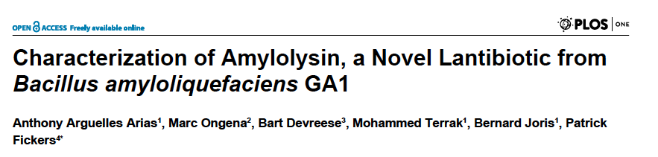
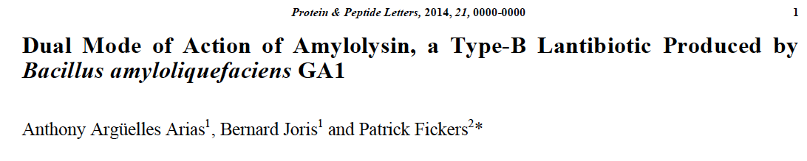
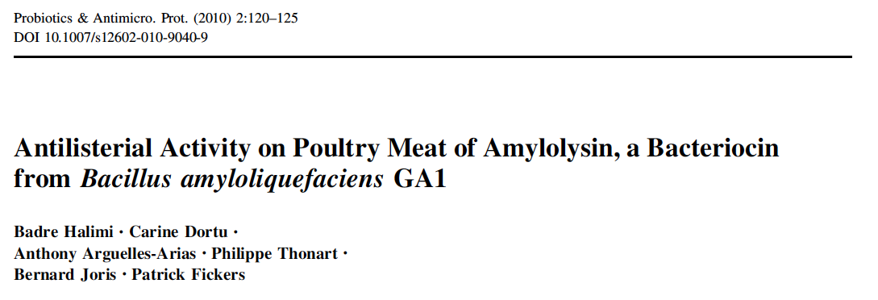
Further information

Slide 42
Synthesis of peptidic antibiotics in Bacillus
- Lantibiotic, ribosomal modified peptides
- Bacteriocin, ribosomal unmodified peptides
- Lipopeptide as NRPS

Slide 43
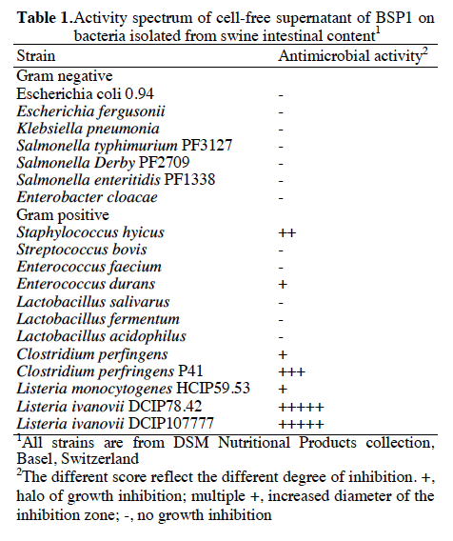
Subtilosin A from a gut associated B. subtilis strain BSP1
Antimicrobial activity of BSP1 culture supernatant against the food poisoning bacteria Clostridium perfingens (gas gangrene), Listeria monocytogenes and Listeria ivanovii (Listeriosis, focusing on the central nervous system)

Slide 44
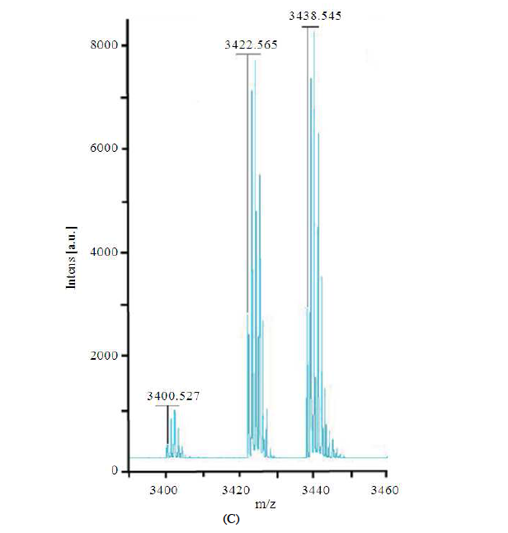
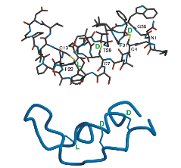
Subtilosin A from a gut associated B. subtilis strain BSP1
Maldi-TOF analysis of culture supernatant

Slide 45
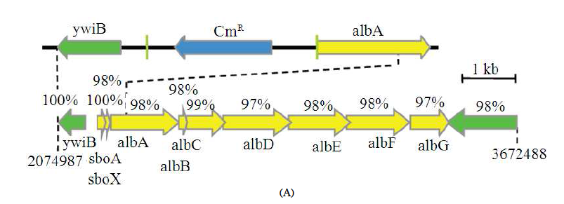
Subtilosin A from a gut associated B. subtilis strain BSP1
The BSP1 strain genome analysis revealed the presence of the sbo/alb gene cluster

Slide 46
Subtilosin A from a gut associated B. subtilis strain BSP1
Disruption of sbo/alb gene cluster to link phenotype to genotype

Slide 47
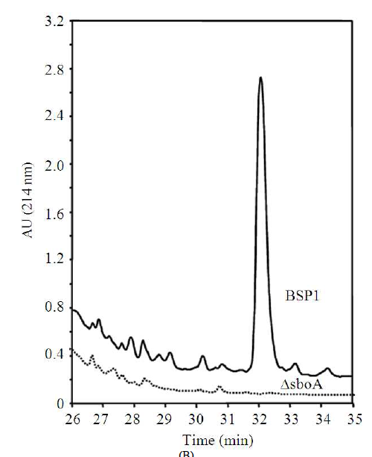
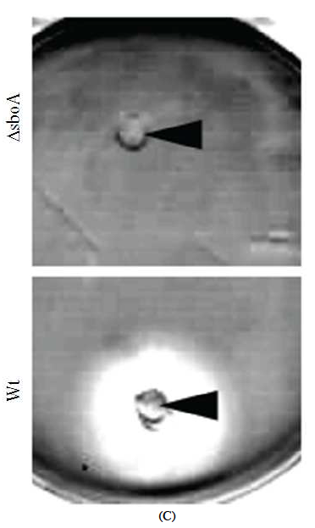
Subtilosin A from a gut associated B. subtilis strain BSP1
HPLC analysis of culture supernatant
Antimicrobial activity against L. ivanovii

Slide 48
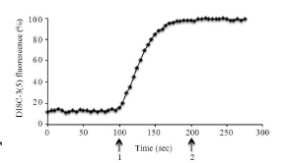
Subtilosin A from a gut associated B. subtilis strain
Determination of the biological activity by transmembrane electrical potential measurment (Δψ)
Fluorescent dye DiSC3,5 is sensitive to Δψ.
Low fluoresence in presnece of Δψ
High fluoresence in abscence of Δψ
Subtilosin A causes an increase of fluorescence due to the collapse of Δψ.

Slide 49
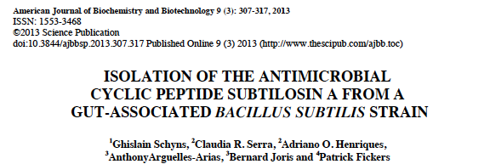
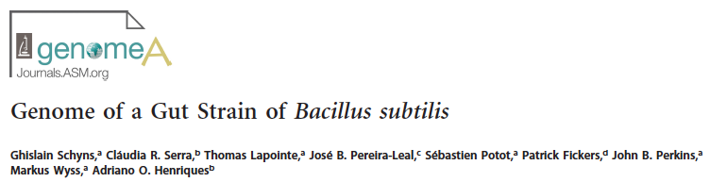
Further information

Slide 50
Synthesis of peptidic antibiotics in Bacillus
- Lantibiotic, ribosomal modified peptides
- Bacteriocin, ribosomal unmodified peptides
- Lipopeptide as NRPS

Slide 51
What are NRPS antibiotics ?
NRPS : Non ribosomal peptide synthesis

Slide 52
What are NRPS antibiotics ?
NRPS : Non ribosomal peptide synthesis
Ribosome
Gene
ARNm
ARNt
Ribosome
peptides
proteins

Slide 53
What are NRPS antibiotics ?
NRPS : Non ribosomal peptide synthesis
Ribosome
NRPS
Genes coding for a multi-enzymatic complex (synthetase)
Gene
ARNm
amino acid
ARNt
Peptide
synthetase
Ribosome
peptides
proteins
Peptides or
Modified peptide

Slide 54
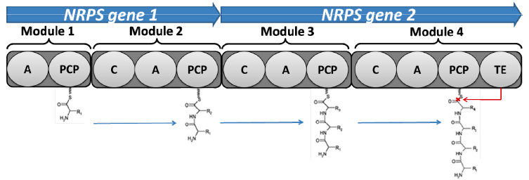
What are NRPS antibiotics ?
Multienzymatic complexes encoded by large operons (60-80 kb)
Organized in different modules responsible for amino acid incorporation
Each module contains at least three domains : adenylation (A), condensation (C), triolation (PCP).
- Specialized domains : epimerisation (E), methylation (M), thioesterase (Te) for cyclisation.
Fatty acid

Slide 55
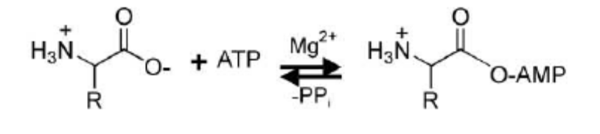
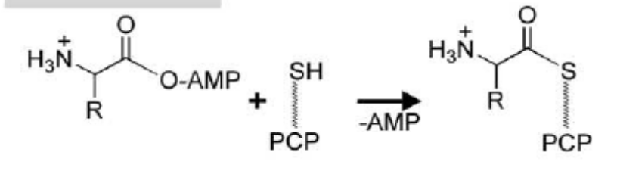
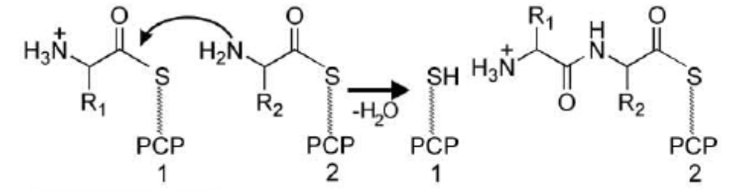
What are NRPS antibiotics ?
What is the function of each domain :
Recognition and activation of the corresponding amino-acid
Adenylation
Transport of the corresponding amino-acid
Thiolation
Peptidic bond formation
Condensation

Slide 56
Example 1 : Effect on NRPS compounds on biofilm formation
Biofilms consist of densely packed microbial cells embedded in a self-synthesized extracellular polymeric matrix, composed mainly of polysaccharides, that is attached to inert surfaces or biological tissues.
Biofilm is the predominant lifestyle of microorganisms, they are associated with high tolerance to exogenous stresses, including antibiotic treatments.
The ineffectiveness of currently available antibiotics toward pathogen-associated biofilms point to the need for antimicrobials with alternative modes of action.

Slide 57
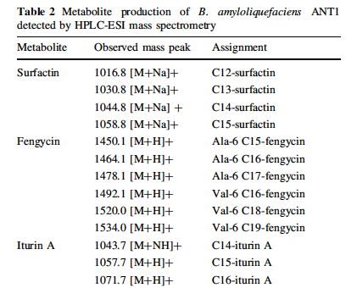
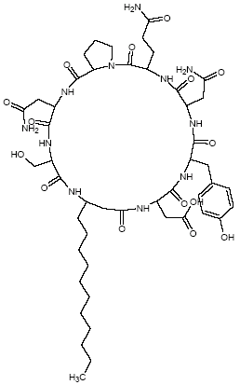
Effect on NRPS compounds on biofilm formation
LC-MS analysis of B. amyloliquefaciens ANT1 culture supernatant
Synthesis of lipopeptides of the surfactin, fengycin and Iturin A families

Slide 58
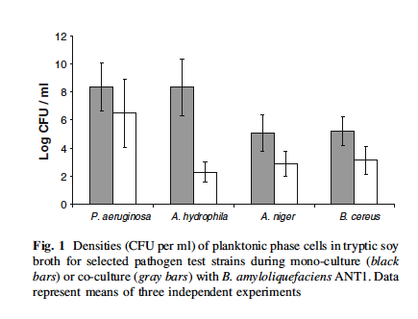
Effect on NRPS compounds on biofilm formation
These NRPS compounds have an antibiotic action against various microorganisms in planktonic culture

Slide 59
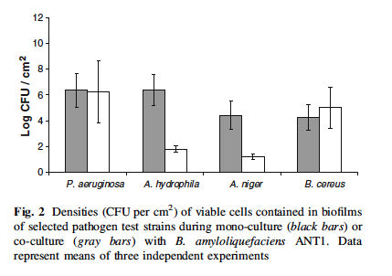
Effect on NRPS compounds on biofilm formation
But also on their biofilm !

Slide 60
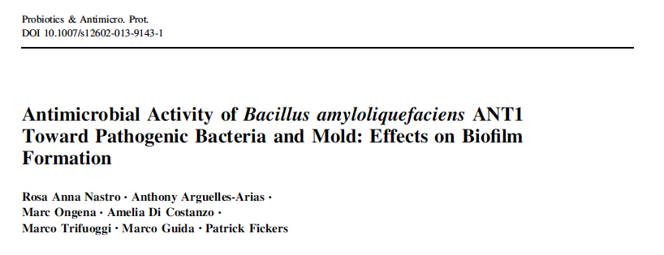
Further information

Slide 61
Example 2 : Mycosubtilin as a case study
Lipopeptide produced by B. subtilis ATCC6633
Synthetase encoded by the fenF mycABC operon (40 kb)
Cyclic peptide of 7 aa (Asn-Tyr-Asn-Gln-Pro-Ser-Asn)
Various homologues of fatty acid chain length (C15, C16, C17)
- Different fatty acid isomers : linear, iso, anteiso
Linear : CH₃-CH₂-CH₂-(CH₂)_{n}
Iso : CH₃-CH-CH₂-(CH₂)_{n}
CH₃
Anteiso : CH₃-CH₂-CH-(CH₂)_{n}
CH₃

Slide 62
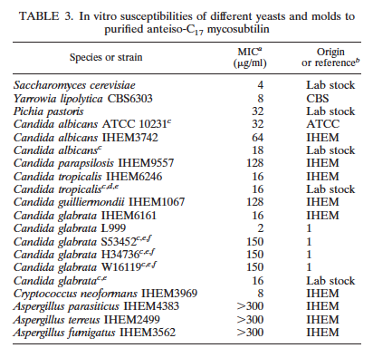
Mycosubtilin is active against pathogenic yeast
C17 anteiso homolog is the most biolicaly active compound
Fickers et al AEM (2009) 75:4636-4640

Slide 63
Mycosubtilin is active against pathogenic yeast
Two main goals:
Need to decrease the heterogeneity of production toward C17 antiso homologue
Need to increase level of production (too low in wild-type strain)

Slide 64
How to decrease heterogeneity of production ?
The facts from litterature :
- Incorporation of C15, C16, C17 fatty acids by synthesases is made from the predominant fatty acid present in the intacellular fatty acid pool.
- 80% of membrane lipids are odd numbered fatty acid (C15, C17).
- Their role is to maintain the membrane fluidity Vs temperature. Thus, membrane fatty acid composition is temperature dependant.
- At lower temperature, odd numbered anteiso fatty acids increase in proportion in the intracellular pool.

Slide 65
How to decrease heterogeneity of production ?
Our strategy :
- Perform cultures at lower temperature to favor synthesis of odd numbered anteiso fatty acid (C17) in the intracellular fatty acid pool.
- This in turn will favor synthesis of C17 anteiso mycosubtilin.

Slide 66
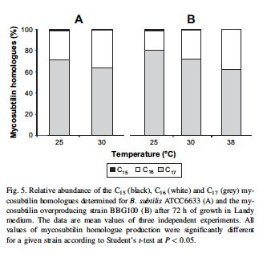
How to decrease heterogeneity of production ?
Constitutive mutant
BBG100
WT
C16
C16
C16
C16
C16
C17
C17
C17
C17
C17

Slide 67
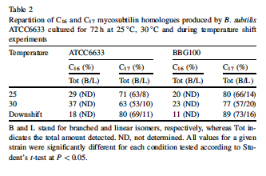
How to decrease heterogeneity of production ?
Confirmed by temperature downshift experiments
Downshift : 30 to 25 °C

Slide 68

How to decrease heterogeneity of production ?
And surprisingly :
BBG100
WT
A significant increase of production yield was observed at lower temperature for both wild-type and mutant strains

Slide 69

How to decrease heterogeneity of production ?
This is not due to a higher expression level of fenF mycABC as demonstrated by semi-quantitative RT-PCR

Slide 70

How to decrease heterogeneity of production ?
And by gene expression profiling using a pMyc-LacZ reporter construct

Slide 71

How to decrease heterogeneity of production ?
In fact, this higher productivity at lower temperature is due to a higher catalytic efficiency of synthetases as shown by ATP/PPi exchange experiments (adenylation activity of MycB).

Slide 72
How to increase production yield ?

Slide 73
How to increase production yield ?
By promoter exchange : pXylA promoter from xylose isomerase gene to drive Myc operon expression

Slide 74
How to increase production yield ?
By promotor exchange : pXylA promotor from xylose isomerase gene to drive Myc operon expression.
Characterisation of pXylA regulation in producing strain using a pXylA-LacZ reporter gene.
30
25
20
15
Induction factor
10
5
0
0
0,3
0,5
0,7
1
1.5
Xylose (%)
TY
MM

Slide 75
How to increase production yield ?
By promotor exchange : pXylA promotor from xylose isomerase gene to drive Myc operon expression.
Characterisation of pXylA regulation in producing strain using a pXylA-LacZ reporter gene.
30
25
optimal concentration : 1%
20
15
Induction factor
10
5
0
0
0,3
0,5
0,7
1
1.5
Xylose (%)
TY
MM

Slide 76
How to increase production yield ?
Need a carbon source to ensure cell growth before the xylose inducing phase
5
4
3
Repression factor
2
1
0
0
1
2
3
4
5
concentration (%)
Glucose
Glycerol
Sucrose
- Repressive effect of glucose.
- No significant influence of sucrose and glycerol on pXylA induction.

Slide 77
How to increase production yield ?
Expression level Vs xylose concentration in the presence of glycerol or sucrose
Glycerol
Sucrose
400
1600
350
1400
300
1200
250
1000
B-galactosidase (Miller units)
800
200
150
600
100
400
50
200
0
0
-5
0
5
10
15
20
25
30
-5
0
5
10
15
20
25
30
Time (h)
Time (h)
0,5 %
1 %
2 %
W/O
Biomass (A600 nm)
Concentration
Glycerol
Sucrose
0.5 %
0.4
1.8
1 %
0.5
1.7
2 %
0.5
2.0

Slide 78
How to increase production yield ?
pXylA induction on production medium : Landy medium + sucrose 0.5 % + xylose 1%
1000
900
High level of pXylA induction in those conditions
800
700
600
B-galactosidase (Miller units)
500
400
300
200
100
0
-2
8
18
28
38
48
58
Time (h)
+ 1 % xylose
+ 1% xylose

Slide 79
How to increase production yield ?
Promoter exchange was performed by double crossing-over using a XylR-pXylA construct.
pbp
fenf
mycA
mycB
mycC
pbp
spc
xylR
pXylA
fenF

Slide 80
How to increase production yield ?
WT : Landy at 37 °C
Overproducing mutant : Landy sucrose 0,5 % + xylose 1% at 25 °C
Mycosubtilin (mg/L)
- Yield : 100-fold increase
- Duration : reduced by 1.5
°C
Time
WT
Mutant
25
48h
-
960
37
72h
10
-

Slide 81

Mycosubtilin purification
- Concentration by SPE using ODS18 matrix
- Semi-preparative HPLC on C18-Nucleosile matrix
- Final step on chromafix C18ec
0,40
0,30
0,20
AU
0,10
0,00
-0,10
Un seul homologue en C17?
-0,20
-0,30
RP-HPLC
2,00
4,00
6,00
8,00
10,00
12,00
14,00
16,00
18,00
20,00
22,00
24,00
26,00
28,00
30,00
Minutes

Slide 82

Mycosubtilin purification
MALDI-TOF mass spectrometry : mainly C17 mycosubtilin homologue

Slide 83

Mycosubtilin purification
¹H -¹³C NMR highlight an anteiso-C17 mycosubtilin isomer

Slide 84
Biological activity of mycosubtilin on yeast
Measurment of transmembrane (ΔΨ) electrical potential using fluorescent probe
140
140
140
120
120
120
100
100
100
1 µM valinomycin
1 µM valinomycin
80
1 µM valinomycin
80
80
Disc(3)5 fluorescence
Collapse of the ΔΨ due to pores formation upon mycosubtilin addition
Disc(3)5 fluorescence
Disc(3)5 fluorescence
60
60
60
10 µg
mycosubtilin
10 µg mycosubtilin
40
10 µg mycosubtilin
40
40
20
20
20
0
0
0
0
0
200
200
400
400
600
600
800
800
1000
1000
1200
0
200
400
600
800
1000
1200
1200
Disc(3)5
Disc(3)5
Time (s)
Disc(3)5
Time (s)
Time (s)
Pores formation aross the cellular membrane in liquid medium
% release of UV absorbing material
Absorbance
260 nm
86
280 nm
51
100 % correspond to cell lysis with perchloric acid

Slide 85


Further information

Slide 86
Why this few examples, I hope you are now convince that Bacillus sp are a source of potent antimicrobial compounds

Slide 87

Acknowledgements
Prof. Bart Devreese (Ugent, Belgium)
Prof. Jacques (Poly’techLille, France)
Prof. Damblon (Ulg, Belgium)
Prof. Joris (Ulg, Belgium)
Pr. Marc Ongena (Gembloux AgroBioTech, Belgium)
Dr. Anthony Arguelles-Arias
FNRS and USTL for funding this project

