Slide 1
Mercury toxicity in fish eyes disclosed by oxidative stress and acetylcholinesterase profiles: Insights to neurosensory toxicology
Patrícia Pereira, Ricardo Pereira, Fátima Brandão, Sofia Guilherme, Maria Ana Santos, Mário Pacheco
Department of Biology and CESAM, University of Aveiro, Portugal

Slide 2
Background
Eyes have a central role in the perception of the surrounding medium and in maintaining organisms’ homeostasis.
Mercury (Hg) (including methylmercury - MeHg) is a ubiquitous contaminant in natural waters and a potent neurotoxicant that affects visual functions, but few studies are available concerning the ocular toxicity of Hg in wild fish.
The mechanisms that underlie functional alterations of fish eyes are still poorly understood. Oxidative stress has been widely accepted as one of the mechanism of Hg toxicity in other fish organs.
This study contributes to fill this knowledge gap by the evaluation of Hg accumulation in the eye wall of wild grey mullet (Liza aurata) together with the assessment of biochemical endpoints related with the oxidative stress status and neurotransmission.

Slide 3
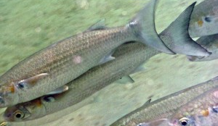
Background
Fish have an important role signaling water pollution, once they react with great sensitivity to changes in the aquatic environment.
Fish are also key components of the trophic chains.
The golden grey mullet (Liza aurata) has been largely chosen as biosentinel for metal contamination, including mercury, since it is commonly found in both unpolluted and metal contaminated environments.

Slide 4
Aim of the study
The current work was designed to clarify the occurrence of oxidative stress and acetylcholinesterase (AChE) activity inhibition in the eyes of the golden grey mullet (Liza aurata) after environmental exposure to Hg (Aveiro lagoon, Portugal).
Accumulation levels
Ocular toxicity
iHg and MeHg in water and sediment
Environmental levels
iHg and MeHg in eye wall
Enzymatic antioxidants
AChE activity
Non-enzymatic antioxidants

Slide 5
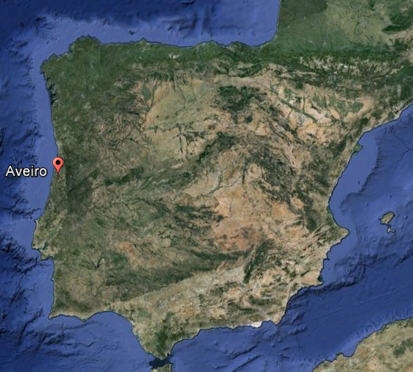
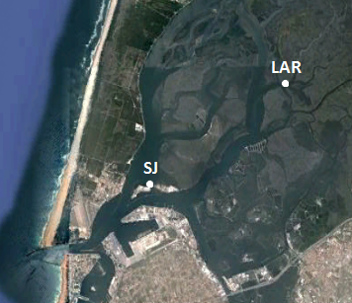
Study area
Aveiro lagoon
. Aveiro lagoon is a coastal system located on the northwest coast of Portugal.
It has an inner and enclosed area known as Laranjo that has received Hg effluents from a chlor-alkali plant during more than 4 decades (1950-1994).
High levels of Hg are still stored in sediments and can be found in the biota.
Laranjo basin is considered a ‘‘field laboratory”, offering a unique opportunity to assess Hg toxicity under realistic conditions.

Slide 6
Sampling strategy
Winter and Summer 2013
Aveiro lagoon
. Surface sediments
. Mid-Water
. Juveniles of golden grey mullets (n=10)
2 sampling sites:
One located in the most contaminated area: Laranjo (LAR)
A reference site located near the lagoon entrance: São Jacinto (SJ)

Slide 7
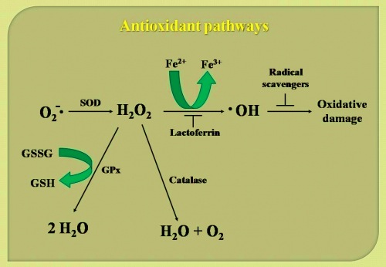
endpoints in eye wall of fish
Hg
i.e. iHg and MeHg
Oxidative stress profile
Antioxidant pathways
AChE

Slide 8
Main findings

Slide 9
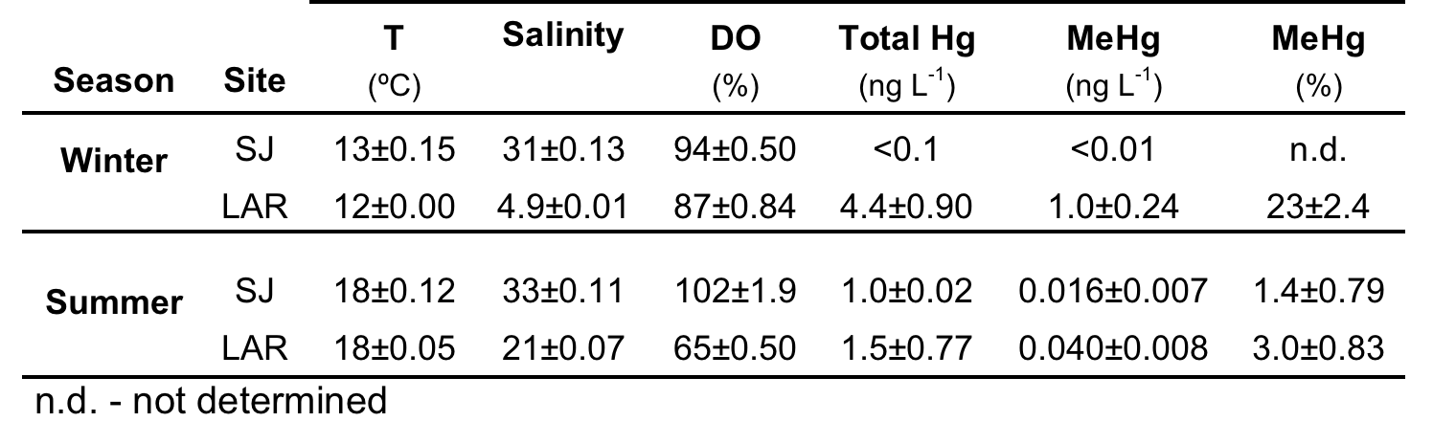
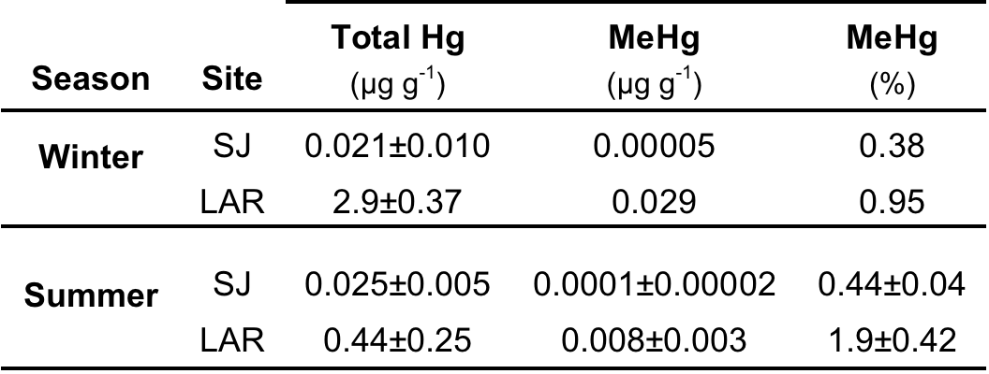
1. Environmental levels of Hg
WATER
. LAR presented higher levels of total dissolved Hg and MeHg in water than SJ, being these differences accentuated in winter.
SURFACE SEDIMENT
. Surface sediments from LAR exhibited higher levels of tHg and MeHg than SJ, both in winter and summer.
. Levels of tHg and MeHg in sediments were one order of magnitude higher in winter than summer at LAR.

Slide 10
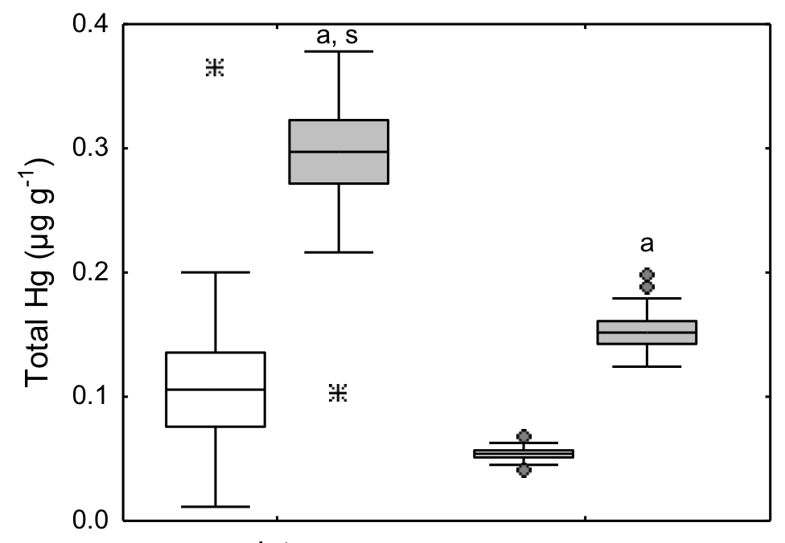
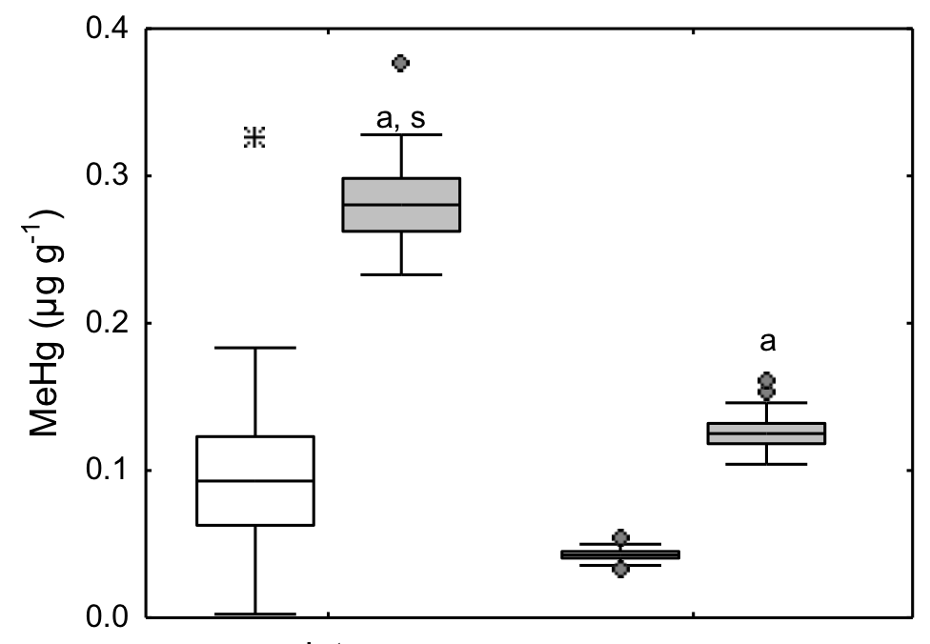
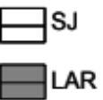
2. Hg levels in eye wall
Total Hg
Methylmercury
LAR
LAR
SJ
SJ
winter
summer
winter
summer
a – site differences
s – seasonal differences
Eye wall of fish from LAR showed significantly higher accumulation of tHg, MeHg and iHg than SJ in both seasons.
Differences between winter and summer were found for tHg and MeHg with higher levels in winter than summer at LAR.

Slide 11
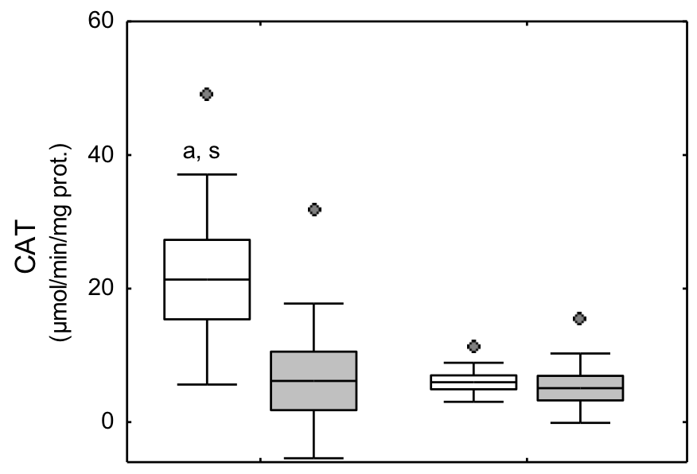
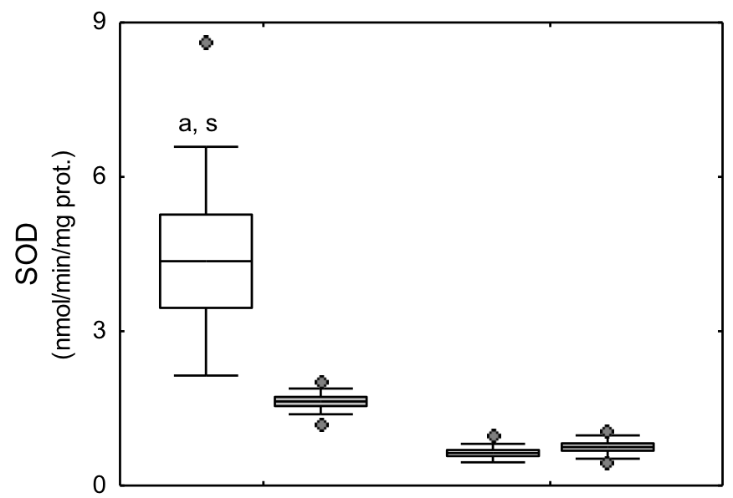
3. Oxidative stress profile
Catalase
Superoxide dismutase
SJ
SJ
LAR
LAR
winter
summer
winter
summer
a – site differences
s – seasonal differences
In winter, CAT and SOD activities decreased significantly in eye wall of fish from LAR.
No significant spatial changes were recorded for CAT and SOD in summer.
CAT and SOD activities were higher in winter than summer in fish from SJ.

Slide 12
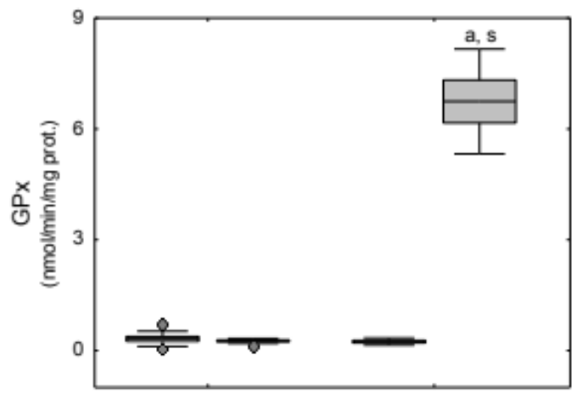
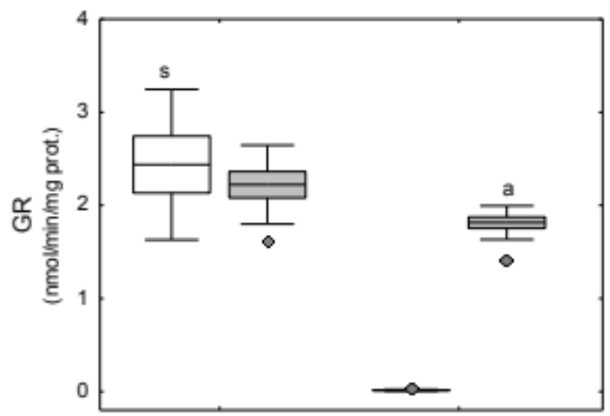
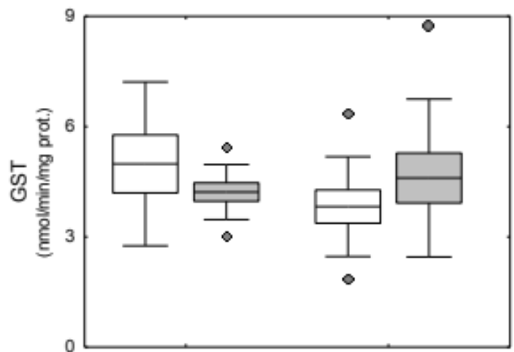
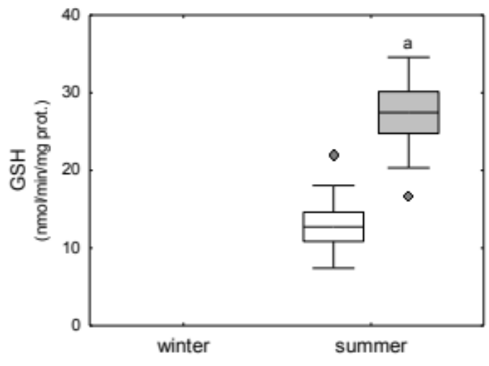
3. Oxidative stress profile
Glutathione peroxidase
Glutathione reductase
LAR
In summer, higher activities of GPx and GR were found at LAR, as well as higher GSHt content.
GR activities were higher in winter than summer in fish from SJ, while GPx was enhanced in summer at LAR.
SJ
LAR
SJ
LAR
SJ
Glutathione-S-transferase
Total glutathione
LAR
LAR
SJ
summer
SJ
winter
summer
winter
winter
summer
winter
summer
a – site differences
s – seasonal differences

Slide 13
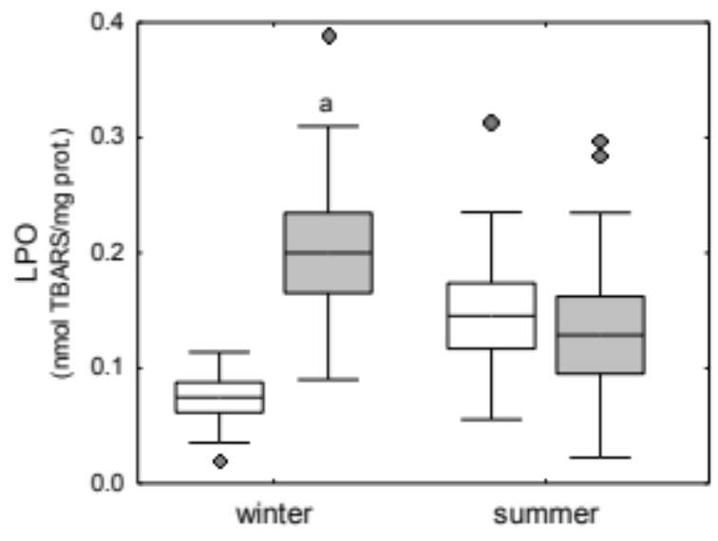
3. Oxidative stress profile
Lipid peroxidation
LAR
SJ
a – site differences
s – seasonal differences
winter
summer
In winter, LPO increased significantly at LAR, while no spatial differences were recorded in summer.
No seasonal differences were found for LPO in both sites.

Slide 14
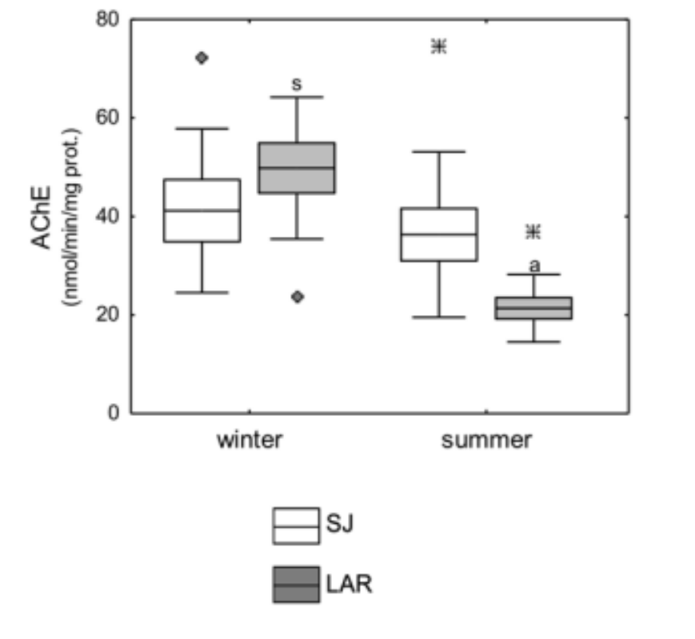
4. Acetylcholinestrase activity
Acetylcholinestrase activity
LAR
SJ
a – site differences
s – seasonal differences
winter
summer
In winter, AChE activity did not change significantly between sites while in summer it decreased considerably at LAR.
Moreover, AChE activity was significantly higher in winter than summer at LAR but no seasonal changes were recorded at SJ.
Notes:
Current data are aligned with several studies performed in fish muscle, brain and gills that also found an inhibition of AChE activity upon Hg exposure [Liao et al., 2006; Jesus et al., 2013]. The inactivation of AChE enzyme could result from the occupation of its active sites by Hg (in inorganic or organic forms), as widely accepted for pesticides [Roméo et al., 2006]. Moreover, the high lipophilic nature of MeHg promotes its association with the active phospholipid component of AChE and consequently the inhibition of its activity [Sihotang, 1976].
No artigo da Rodrigues et al. 2015 também tiveram um aumento de AChE, justificado como resposta hormetica. Hormesis is a dose-response phenomenon characterised by a low-dose stimulation and high-dose inhibition.

Slide 15
Results overview
Accumulation levels
Ocular toxicity
iHg and MeHg in water and sediment
Environmental levels
iHg and MeHg in eye wall
Enzymatic antioxidants
AChE activity
Non-enzymatic antioxidants
 | Environmental levels |  |  |  | Accumulation levels |  | Biochemical endpoints
 | tHgw | MeHgw | tHgs | MeHgs | iHg | MeHg | CAT | SOD | GPX | GR | GSH | GST | LPO | AChE
LAR winter | ⬆ | ⬆ | ⬆ | ⬆ | ⬆ | ⬆ | ⬇ | ⬇ | - | - | - | - | ⬆ | -
LAR summer | ⬆ | ⬆ | ⬆ | ⬆ | ⬆ | ⬆ | - | - | ⬆ | ⬆ | ⬆ | - |  | ⬇
- significant increases in comparison with SJ
⬇ - significant decreases in comparison with SJ
Small arrows indicate lower differences

Slide 16
Results overview
Environmental availability of Hg at LAR
WINTER
SUMMER
. Higher accumulation of Hg at LAR
. Inhibition of CAT and SOD at LAR
. Increasing of LPO at LAR
. Higher accumulation of Hg at LAR
. Induction of GPx and GR at LAR
. Increasing of GSHt at LAR
. Inhibition of AChE at LAR
Higher MeHg accumulation

Slide 17
Final remarks
Oxidative stress responses of L. aurata eye wall were able to detect inter-site differences, reinforcing that LAR is a critical area in the Aveiro lagoon. Higher bioaccumulation of both iHg and MeHg forms were likely on the basis of a pro-oxidant challenge at LAR.
Winter-summer changes were prevalent in eye wall of L. aurata, being characterized by a higher bioaccumulation of MeHg in winter than summer at LAR, together with oxidative stress evidences.
Mercury acted as an anticholinergic agent in fish eye, suggesting that disruption on neurotransmitter enzymes can mediate ocular toxicity after Hg exposure.
It is critical to evaluate changes in fish eye, at structural and functional levels, in order to examine in what extent bioaccumulated Hg could compromise neurosensory processes and visual performance.

Slide 18



Acknowledgements
NEUTOXMER (PTDC/AAG-REC/2488/2012) team
Institutional support:

