Slide 1



Chromosome instability in cancer:
Mechanisms and therapeutic
consequences
Pascal HG Duijf

Slide 2

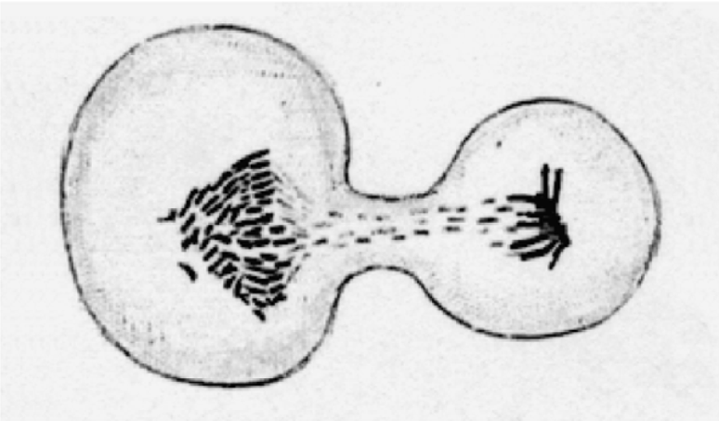
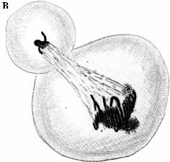
What is chromosome instability ?
Human skin cancer (1890)
David Paul von Hansemann
(1858-1920)
Cancer cells frequently missegregate chromosomes
Chromosome instability results in aneuploid cells.

Slide 3
Mechanisms of chromosome instability
G1/S (Rb)
Cell cycle progression
G1
S
G2
M
G1
P PM M A T
Chromosome segregation

Slide 4
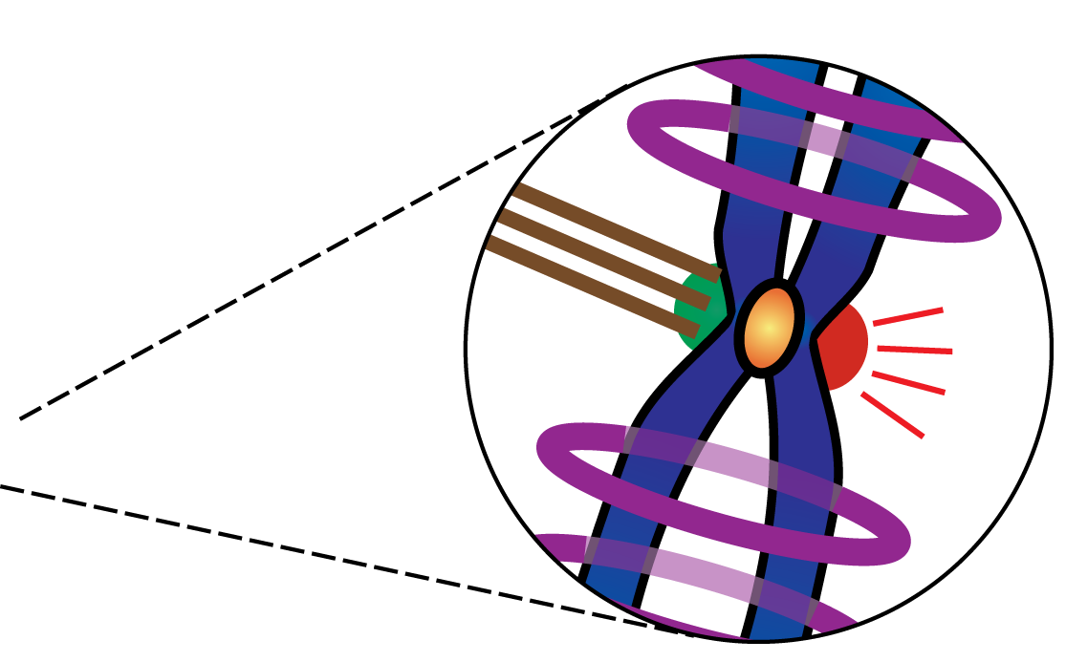
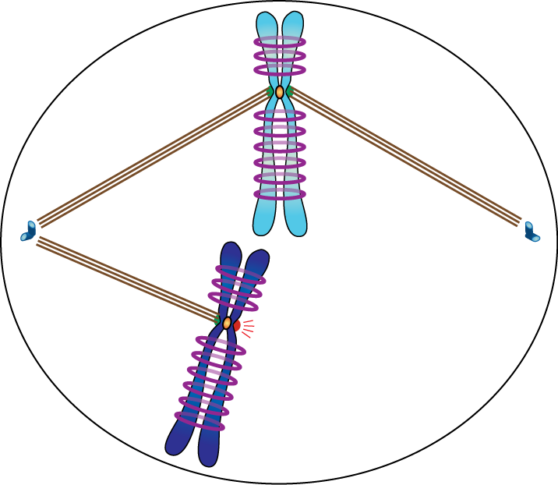

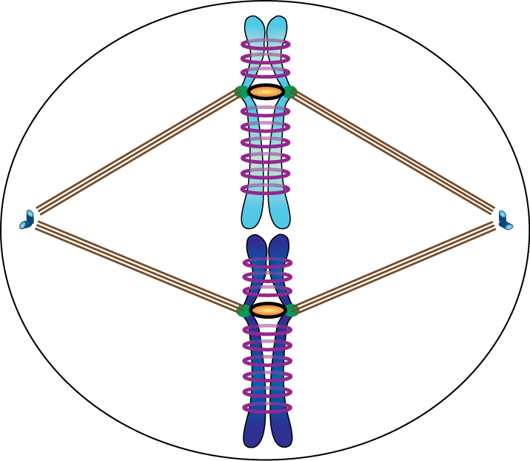
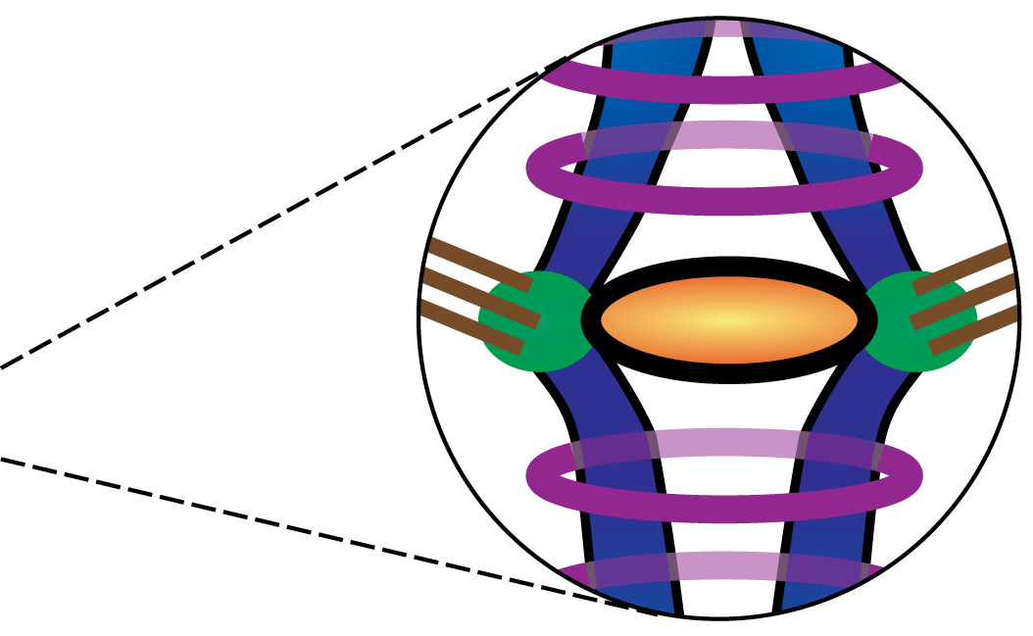
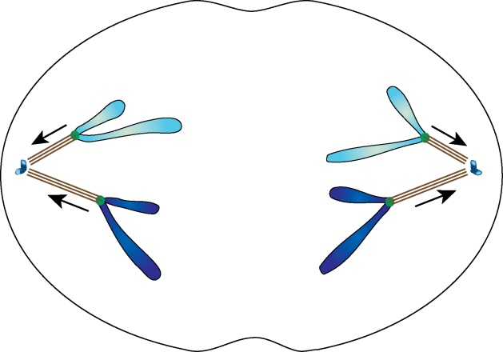
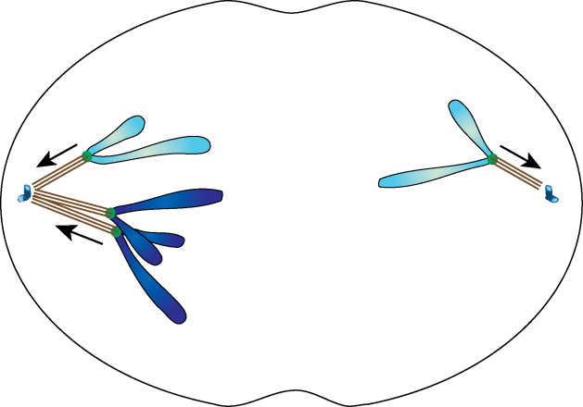
Chromosome segregation and mechanisms of instability
Chromosome instability is
promoted by defects in:
Prometaphase
“wait anaphase” signal
Mitotic checkpoint
Centrosome duplication
Sister chromatid cohesion
Metaphase
signal off
Cytokinesis
Chromosome
instability
Anaphase
anaphase onset
2n 2n
2n+1 2n-1

Slide 5
Mechanisms of chromosome instability
G1/S (Rb)
Mitotic checkpoint
Cell cycle progression
G1
S
G2
M
G1
P PM M A T
Chromosome
cohesion
defects
DNA
replication
stress
Mitotic
checkpoint
defects
Centrosome
duplication
defects
Cytokinesis
failure

Slide 6
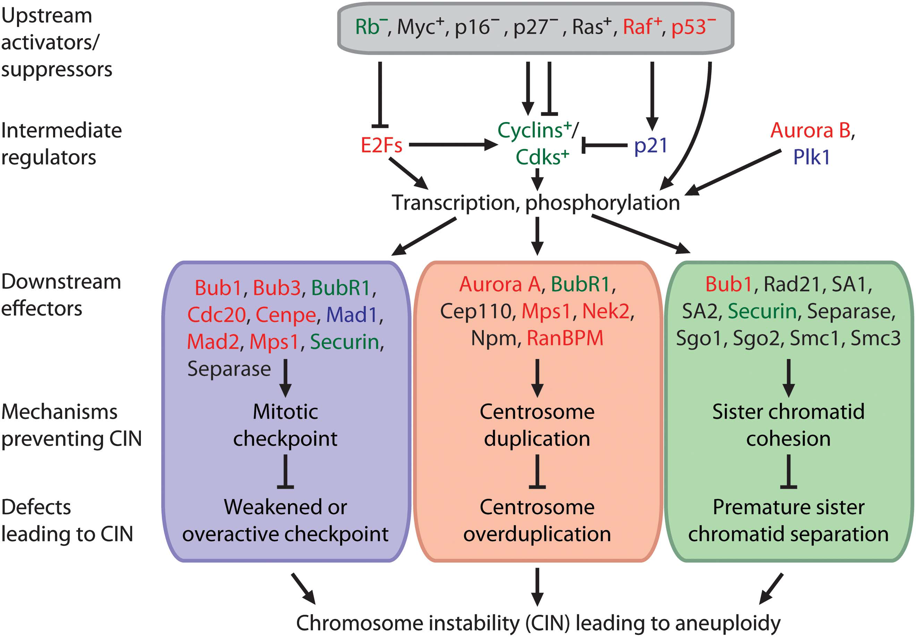
“Oncogene-induced mitotic stress”
Common defects
in cancer cells
Defective
Rb pathway
Emi1
overexpression
Oncogene-induced
mitotic stress
Chromosome
instability
Duijf & Benezra (2013) Oncogene 32:4727-36
Vaidyanathan et al, submitted

Slide 7
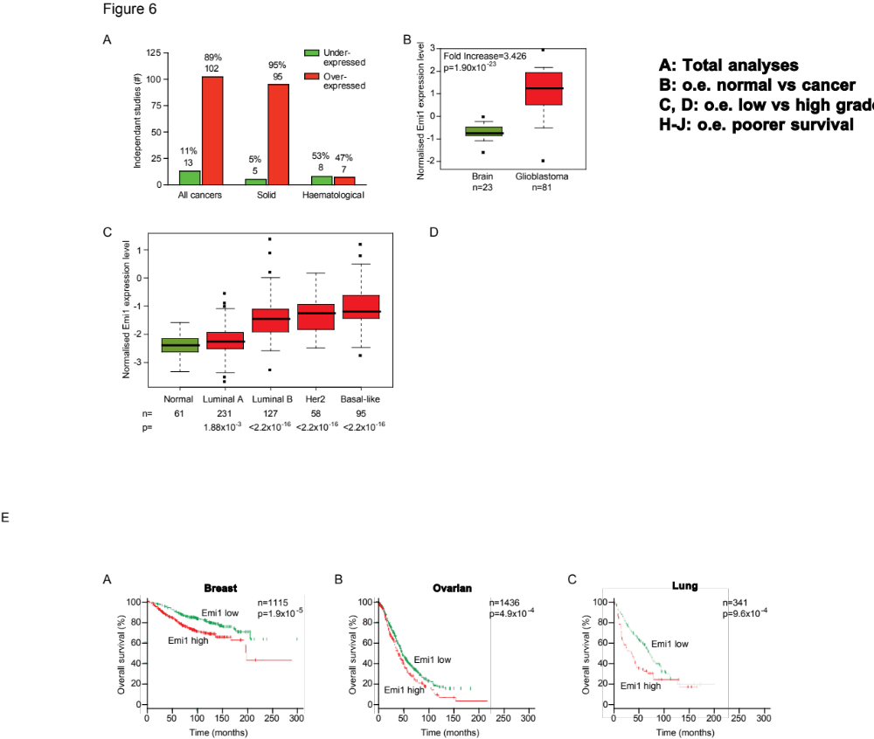
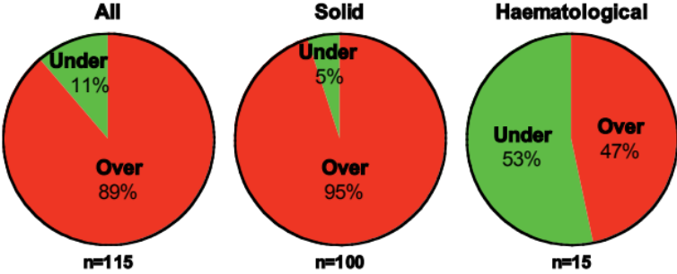
Emi1 is overexpressed in human tumors
Emi1 is a:
- cell cycle regulator
- E2F target gene
115 independent studies
Adipose tissue
Bladder
Bone Marrow
Brain
Breast
Buccal mucosa
Cervix
Colon
Esophagus
Intestine
Kidney
Liver
Lung
Nasopharynx
Oral cavity
Ovary
Pancreas
Rectum
Skin
Stomach
T-Lymphocytes
Testis
Vulva
7403 tumour samples
1467 matched normal samples
Normalized
Emi1
expression
level
p<0.0001
Emi1 is overexpressed in most human solid cancers

Slide 8
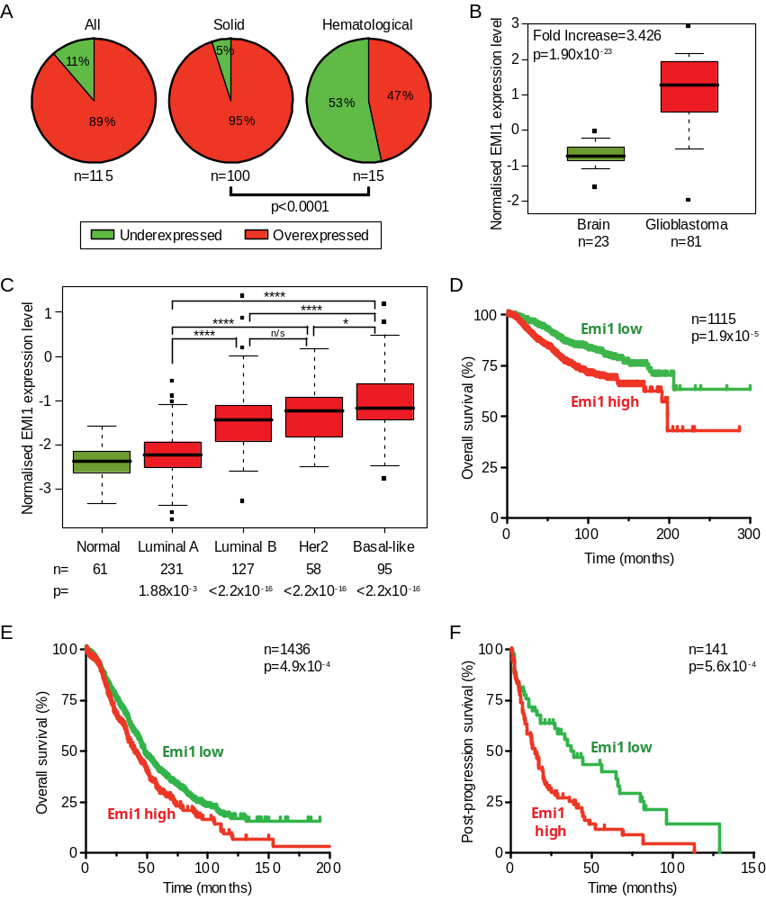
Emi1 overexpression is a marker for poor prognosis
Breast
Ovarian
Lung
Emi1 overexpression is a marker for poor patient prognosis
Vaidyanathan et al, submitted

Slide 9
Emi1 overexpression in vivo
A transgenic mouse model for Emi1 overexpression
Vaidyanathan et al, submitted

Slide 10
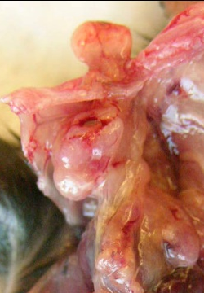
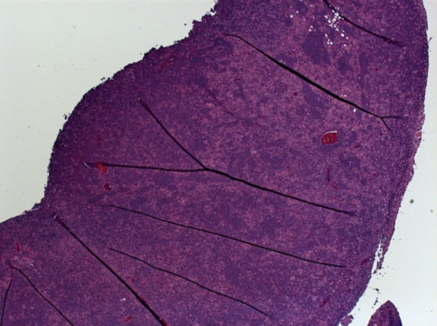
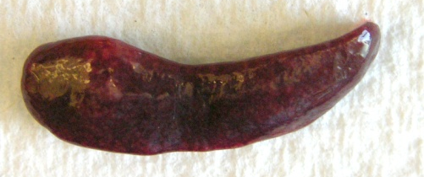
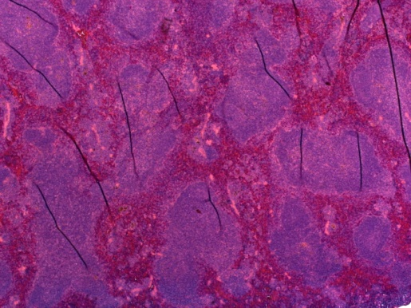
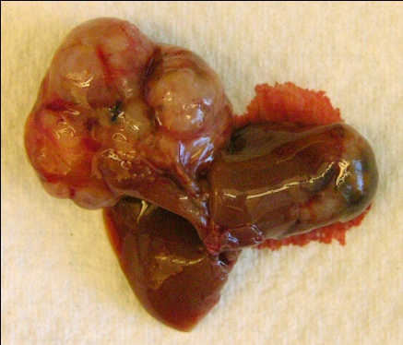
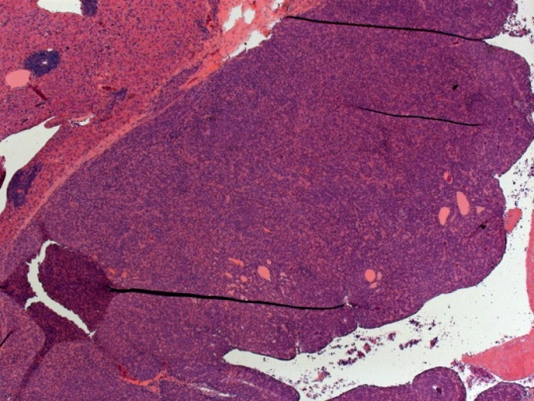
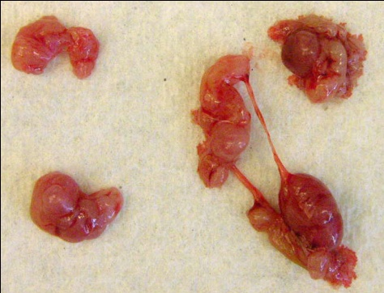
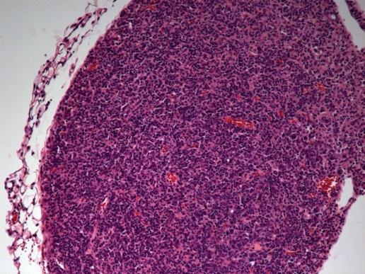
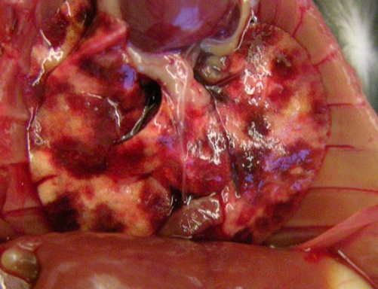
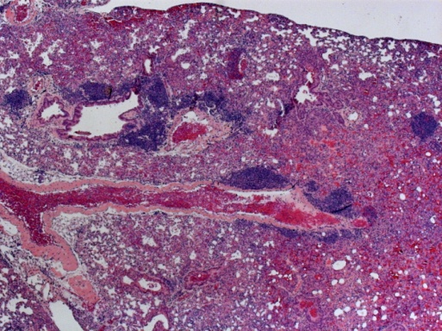
Emi1 overexpression promotes tumorigenesis
Emi1 overexpression promotes:
1) Tumorigenesis:
- various forms of cancer
Thymic lymphoma
Splenic sarcoma
1 cm
Hepatocellular carcinoma
1 cm
Lymph node sarcoma
1 cm
Lung adenoma
1 cm
1 cm

Slide 11
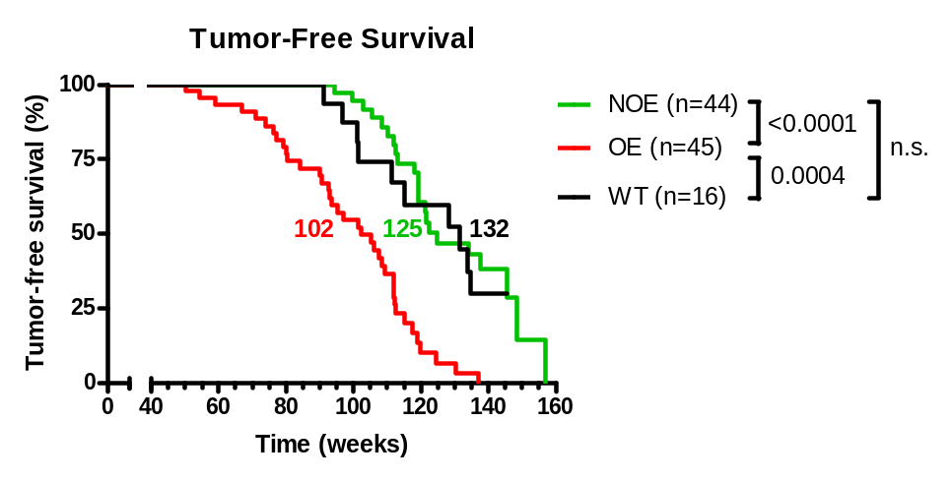
Emi1 overexpression promotes tumorigenesis
Emi1 overexpression promotes:
1) Tumorigenesis:
- various forms of cancer
- earlier than control mice
p values
Ctrl (n=44)
n/s
****
WT (n=16)
***
Emi1-OE
(n=45)
Vaidyanathan et al, submitted

Slide 12
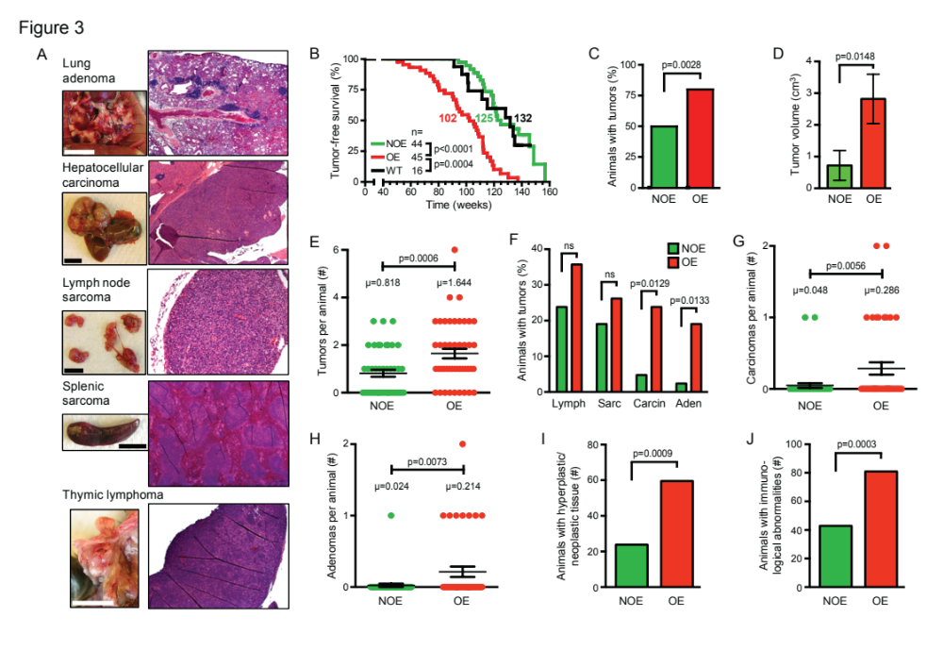
Emi1 overexpression promotes tumorigenesis
Emi1 overexpression promotes:
1) Tumorigenesis:
- various forms of cancer
- earlier than control mice
- with increased penetrance
Ctrl
Emi1-OE

Slide 13
Emi1 overexpression promotes tumorigenesis
Emi1 overexpression promotes:
1) Tumorigenesis:
- various forms of cancer
- earlier than control mice
- with increased penetrance
- larger tumours
Ctrl
Emi1-OE

Slide 14
Emi1 overexpression promotes tumorigenesis
Emi1 overexpression promotes:
1) Tumorigenesis:
- various forms of cancer
- earlier than control mice
- with increased penetrance
- larger tumours
- increased tumour burden
Ctrl
Emi1-OE

Slide 15
Emi1 overexpression promotes tumorigenesis
Emi1 overexpression promotes:
1) Tumorigenesis:
- various forms of cancer
- earlier than control mice
- with increased penetrance
- larger tumours
- increased tumour burden
- increased incidence of
each form of cancer
Ctrl
Emi1-OE

Slide 16
Emi1 overexpression promotes tumorigenesis
Emi1 overexpression promotes:
1) Tumorigenesis:
- various forms of cancer
- earlier than control mice
- with increased penetrance
- larger tumours
- increased tumour burden
- increased incidence of
each form of cancer
- increased carcinoma burden
Ctrl
Emi1-OE

Slide 17
Emi1 overexpression promotes tumorigenesis
Emi1 overexpression promotes:
1) Tumorigenesis:
- various forms of cancer
- earlier than control mice
- with increased penetrance
- larger tumours
- increased tumour burden
- increased incidence of
each form of cancer
- increased carcinoma burden
- increased adenoma burden
Ctrl
Emi1-OE

Slide 18
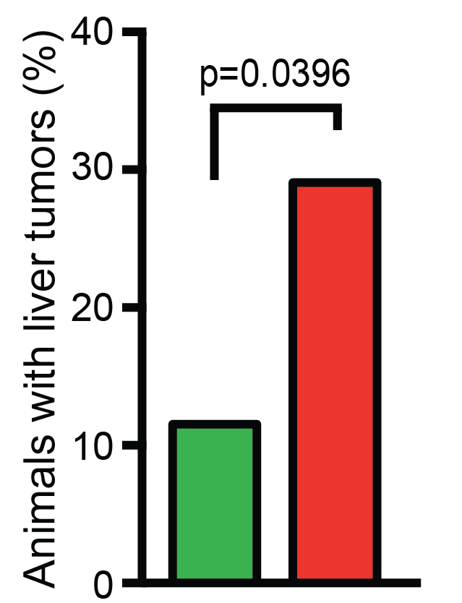
Emi1 overexpression promotes tumorigenesis
Emi1 overexpression promotes:
1) Tumorigenesis:
- various forms of cancer
- earlier than control mice
- with increased penetrance
- larger tumours
- increased tumour burden
- increased incidence of
each form of cancer
- increased carcinoma burden
- increased adenoma burden
- increased liver cancer
Ctrl
Emi1-OE

Slide 19
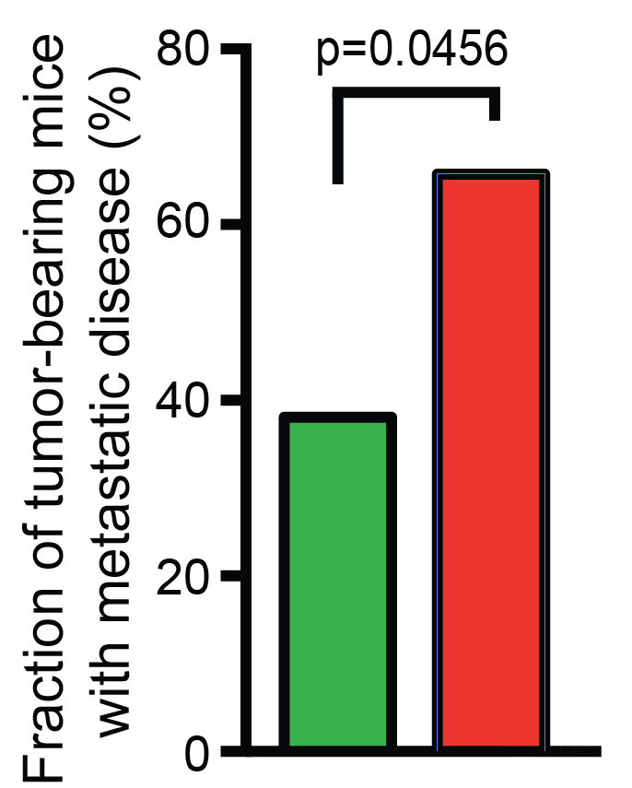
Emi1 overexpression promotes tumorigenesis
Emi1 overexpression promotes:
1) Tumorigenesis:
- various forms of cancer
- earlier than control mice
- with increased penetrance
- larger tumours
- increased tumour burden
- increased incidence of
each form of cancer
- increased carcinoma burden
- increased adenoma burden
- increased liver cancer
- increased metastasis
Ctrl
Emi1-OE

Slide 20
Emi1 overexpression promotes tumorigenesis
Emi1 overexpression promotes:
1) Tumorigenesis:
- various forms of cancer
- earlier than control mice
- with increased penetrance
- larger tumours
- increased tumour burden
- increased incidence of
each form of cancer
- increased carcinoma burden
- increased adenoma burden
- increased liver cancer
- increased metastasis
- increased hyper/neoplasia
Ctrl
Emi1-OE

Slide 21
Emi1 overexpression promotes tumorigenesis
Emi1 overexpression promotes:
1) Tumorigenesis:
- various forms of cancer
- earlier than control mice
- with increased penetrance
- larger tumours
- increased tumour burden
- increased incidence of
each form of cancer
- increased carcinoma burden
- increased adenoma burden
- increased liver cancer
- increased metastasis
- increased hyper/neoplasia
- increased immunological
abnormalities
Ctrl
Emi1-OE
In vivo Emi1 overexpression promotes tumorigensis

Slide 22
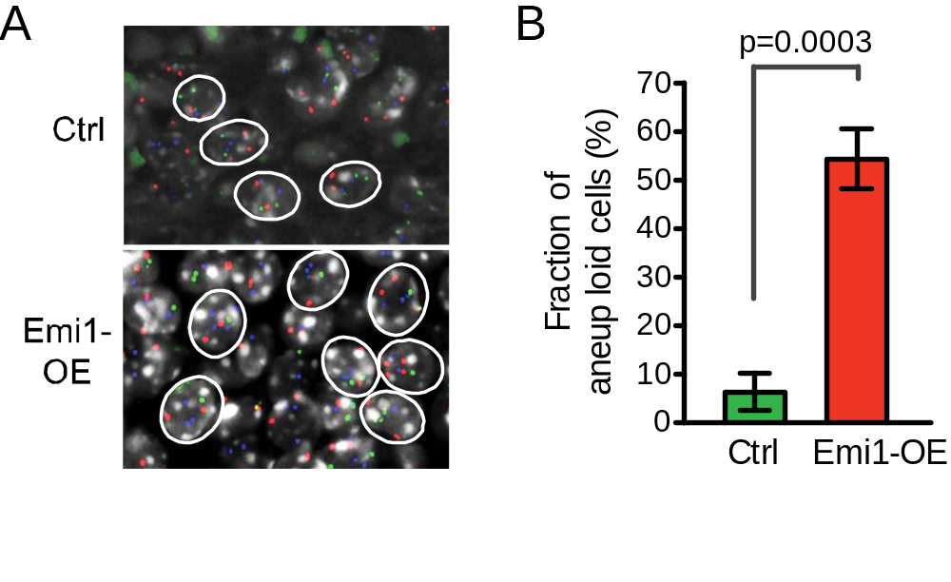
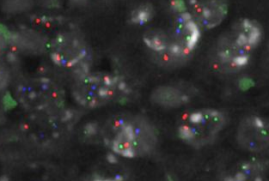

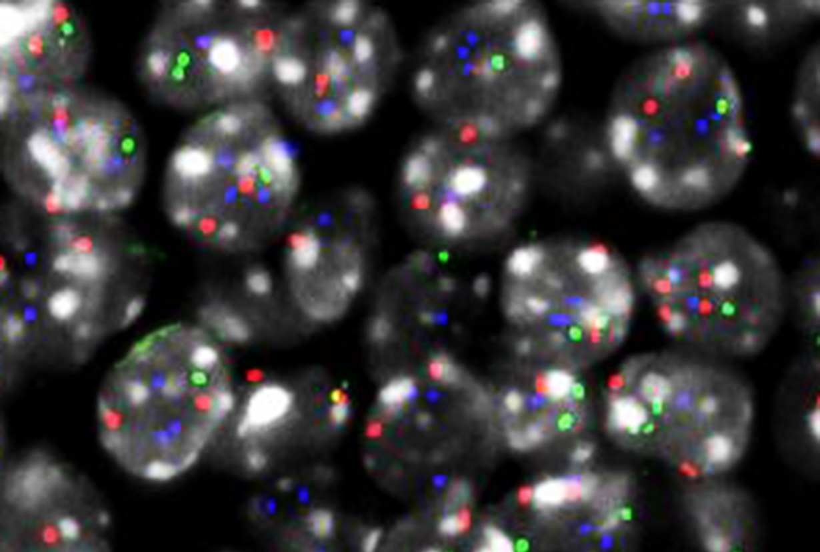










Emi1 overexpression promotes chromosome instability
Emi1 overexpression promotes:
1) Tumorigenesis:
- various forms of cancer
- earlier than control mice
- with increased penetrance
- larger tumours
- increased tumour burden
- increased incidence of
each form of cancer
- increased carcinoma burden
- increased adenoma burden
- increased liver cancer
- increased metastasis
- increased hyper/neoplasia
- increased immunological
abnormalities
2) Chromosome instability
- aneuploidy in tumours
Ctrl
Emi1-OE
FISH
80
p=0.0003
60
% of cells
aneuploid
40
20
0
Ctrl
Emi1-OE
Emi1-overexpressing tumours are aneuploid

Slide 23
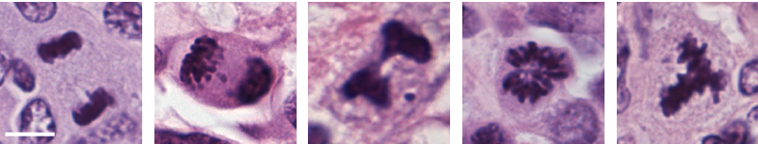
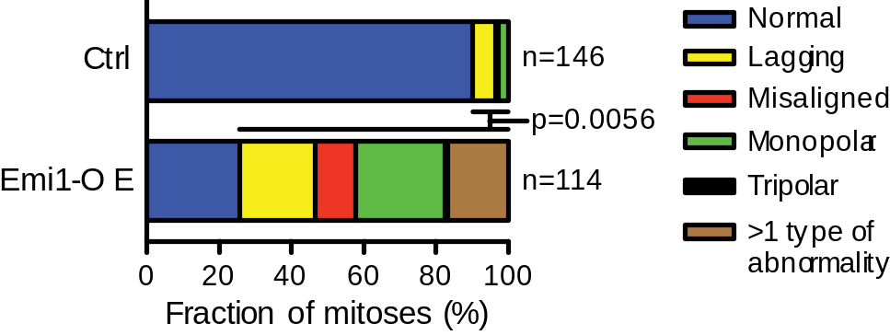
Emi1 overexpression promotes chromosome instability
Emi1 overexpression promotes:
1) Tumorigenesis:
- various forms of cancer
- earlier than control mice
- with increased penetrance
- larger tumours
- increased tumour burden
- increased incidence of
each form of cancer
- increased carcinoma burden
- increased adenoma burden
- increased liver cancer
- increased metastasis
- increased hyper/neoplasia
- increased immunological
abnormalities
2) Chromosome instability
- aneuploidy in tumours
- abnormal mitoses
normal
lagging
misaligned
monopolar
tripolar
Ctrl
Emi1-OE
p-value
90%
25%
**
6%
26%
*
1%
29%
**
3%
34%
*
0%
3%
n/s
p-value
Fraction of mitoses (%)
0
20
40
60
80
100
normal
**
lagging
*
Ctrl
n=146
misaligned
**
monopolar
*
Emi1-OE
n=114
tripolar
n/s
>1 type of
abnormality
*
Emi1 overexpression promotes lagging,
misaligned chromosomes, monopolar spindles

Slide 24
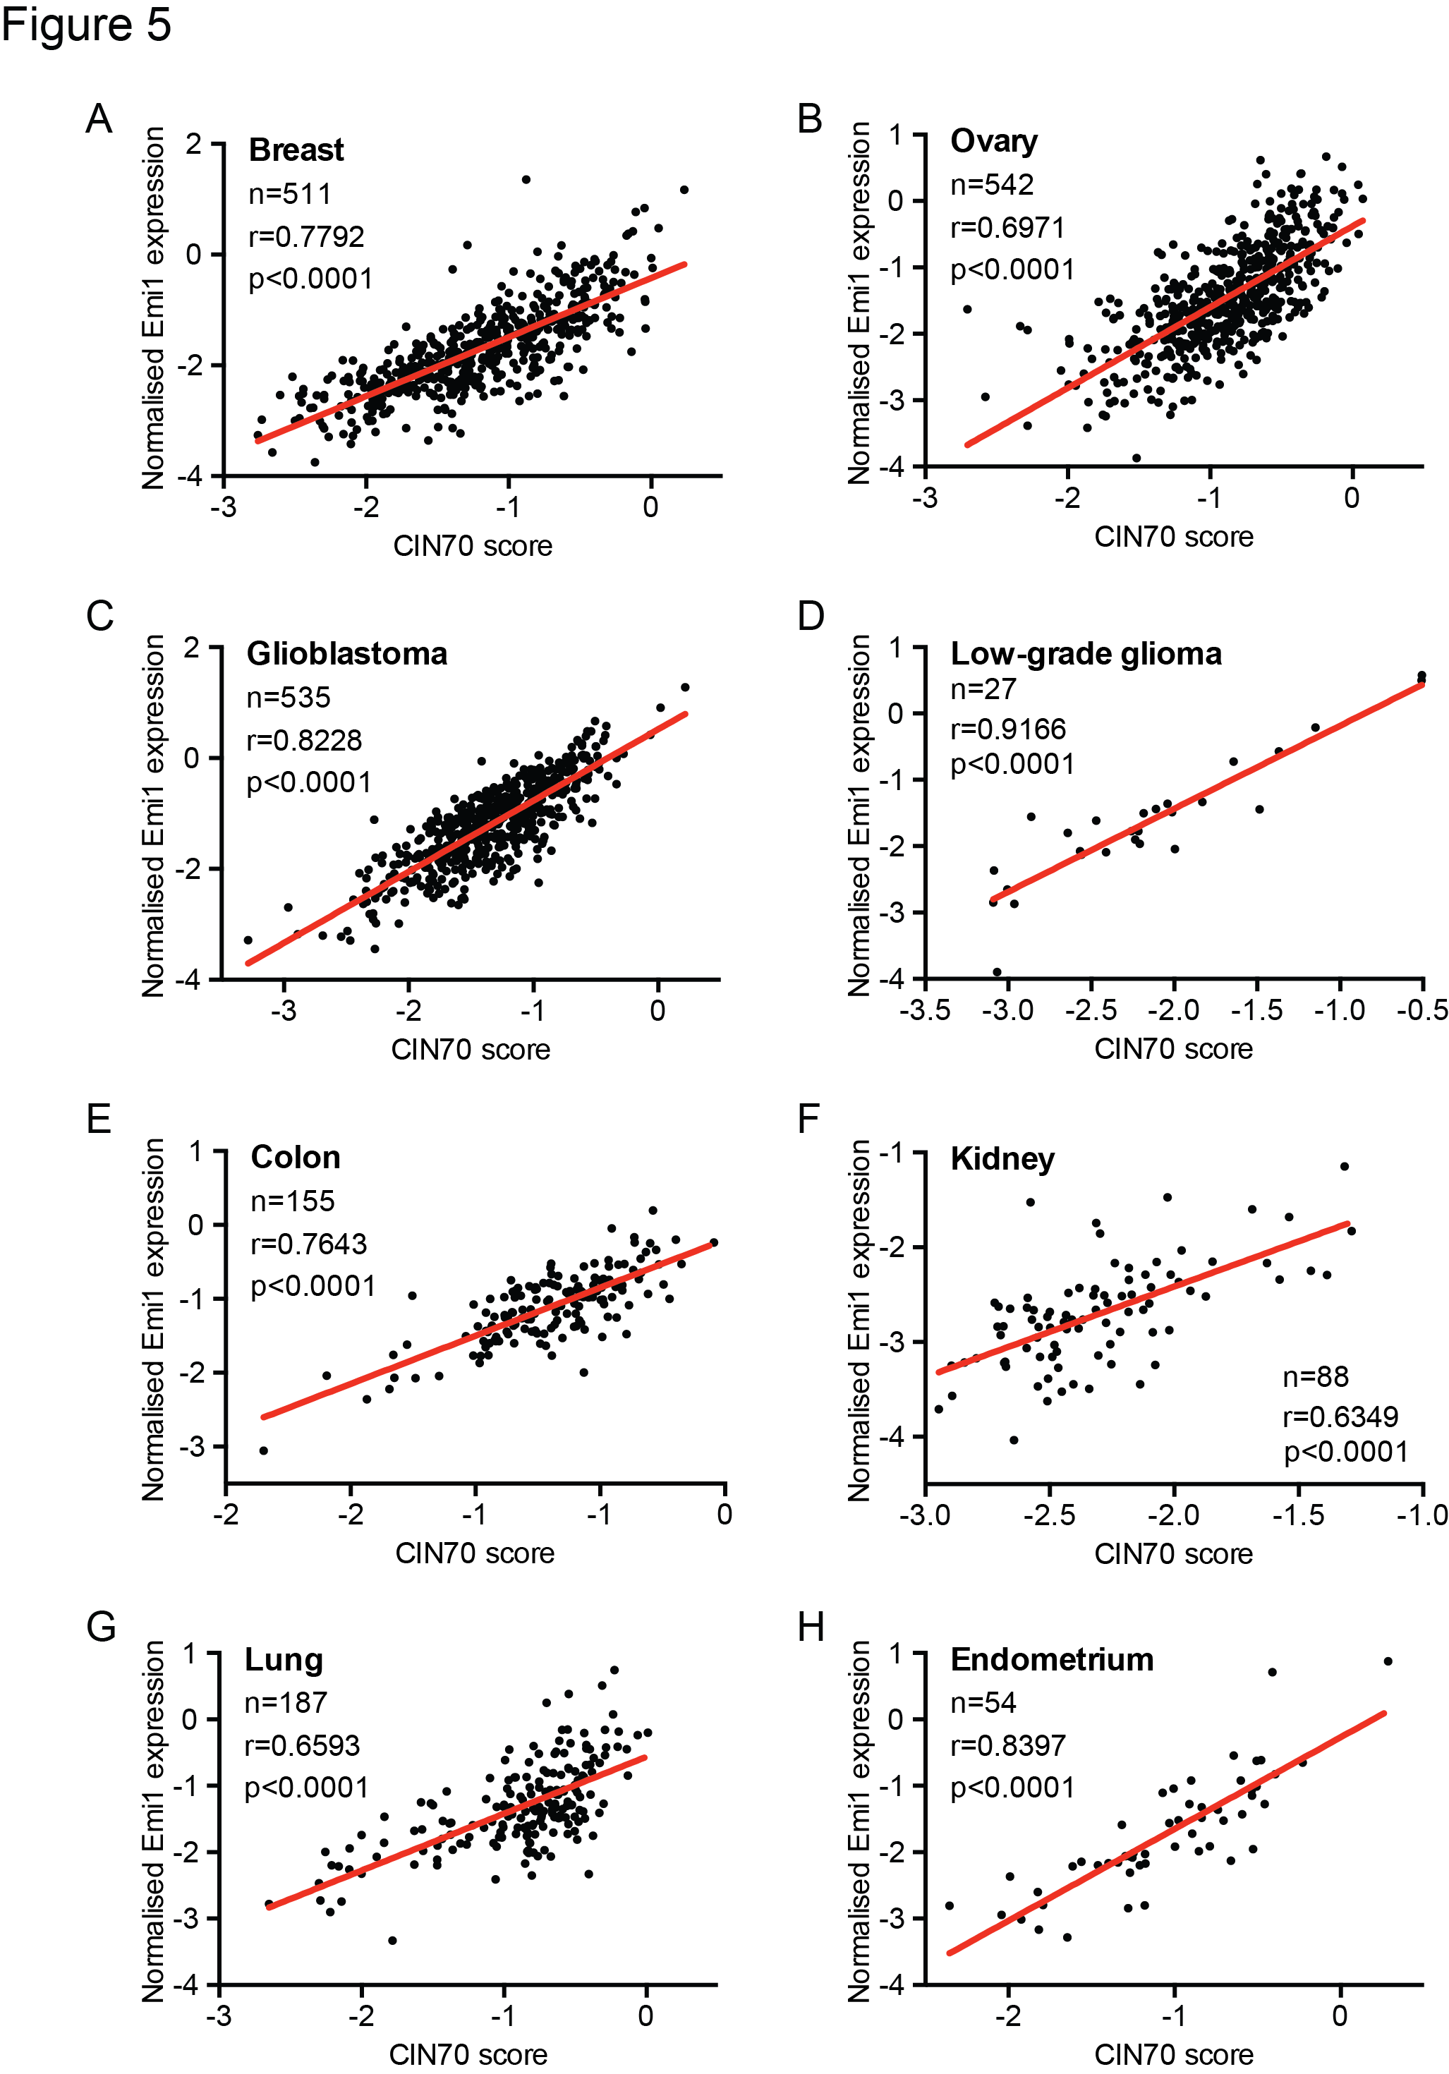
Emi1 correlates with CIN70 score
TCGA cancer analysis
Emi1 expression level correlates with aneuploidy level in human tumours

Slide 25
Emi1 overexpression promotes CIN and tumorigenesis
  Emi1 overexpression:
  - Occurs at high frequency in human solid tumors
  - Strongly correlates with poor patient prognosis
  - Promotes tumorigenesis in vivo
  - Promotes chromosome missegregation in vivo
  - Is a powerful marker for CIN in human tumors
Vaidyanathan et al, submitted

Slide 26
“Oncogene-induced mitotic stress”
Common defects
in cancer cells
Defective
Rb pathway
Emi1
overexpression
Oncogene-induced
mitotic stress
Chromosome
instability
Duijf & Benezra (2013) Oncogene 32:4727-36
Vaidyanathan et al, submitted

Slide 27
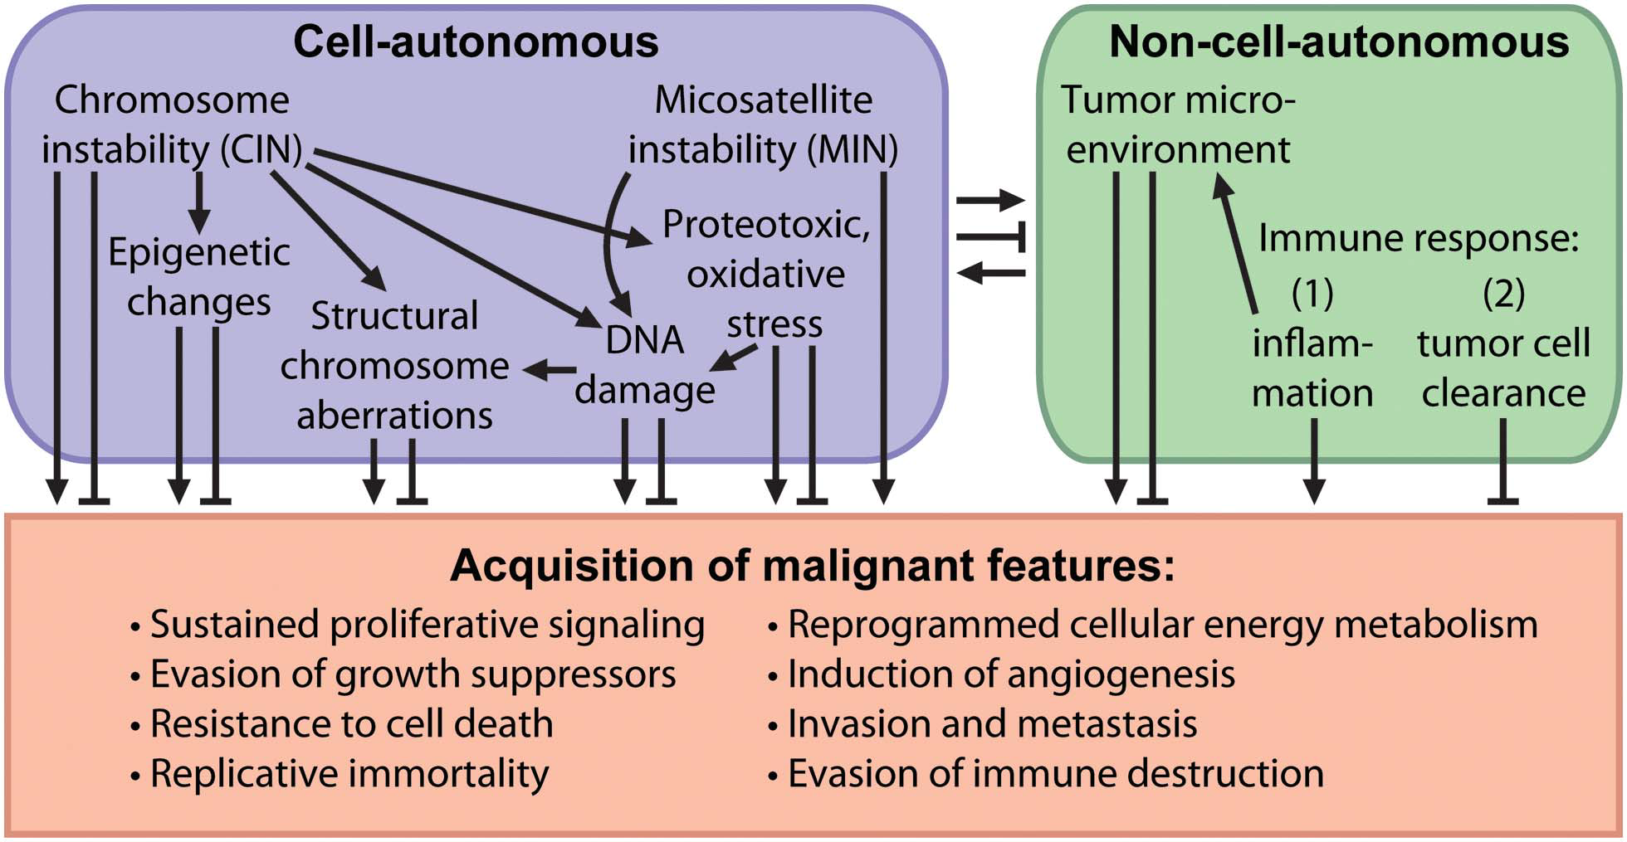
Consequences of chromosome instability
Duijf & Benezra (2013) Oncogene 32:4727-36

Slide 28
Consequences of chromosome instability
Chromosome segregation
gene expression/activity
Nil
Low
Normal
High
Extreme
Degree of
chromosome instability
n/a
Low/high
Low/high
Normal
Extreme
Patient prognosis
n/a
Poor
Good
Poor
Good

Slide 29


Acknowledgements
UQ Diamantina Institute
Srividya Vaidyanathan
Kathleen Cato
Lu Tang
Pulari Thangavelu
Mehlika Hazar-Rethinam
Mathias Nierman
Brian Gabrielli
Nikolas Haass
Sandra Pavey
p.duijf@uq.edu.au

