Slide 1
About OMICS Group
OMICS Group International is an amalgamation of Open Access publications and worldwide international science conferences and events. Established in the year 2007 with the sole aim of making the information on Sciences and technology ‘Open Access’, OMICS Group publishes 400 online open access scholarly journals in all aspects of Science, Engineering, Management and Technology journals. OMICS Group has been instrumental in taking the knowledge on Science & technology to the doorsteps of ordinary men and women. Research Scholars, Students, Libraries, Educational Institutions, Research centers and the industry are main stakeholders that benefitted greatly from this knowledge dissemination. OMICS Group also organizes 300 International conferences annually across the globe, where knowledge transfer takes place through debates, round table discussions, poster presentations, workshops, symposia and exhibitions.

Slide 2
About OMICS Group Conferences
OMICS Group International is a pioneer and leading science event organizer, which publishes around 400 open access journals and conducts over 300 Medical, Clinical, Engineering, Life Sciences, Phrama scientific conferences all over the globe annually with the support of more than 1000 scientific associations and 30,000 editorial board members and 3.5 million followers to its credit.
OMICS Group has organized 500 conferences, workshops and national symposiums across the major cities including San Francisco, Las Vegas, San Antonio, Omaha, Orlando, Raleigh, Santa Clara, Chicago, Philadelphia, Baltimore, United Kingdom, Valencia, Dubai, Beijing, Hyderabad, Bengaluru and Mumbai.

Slide 3
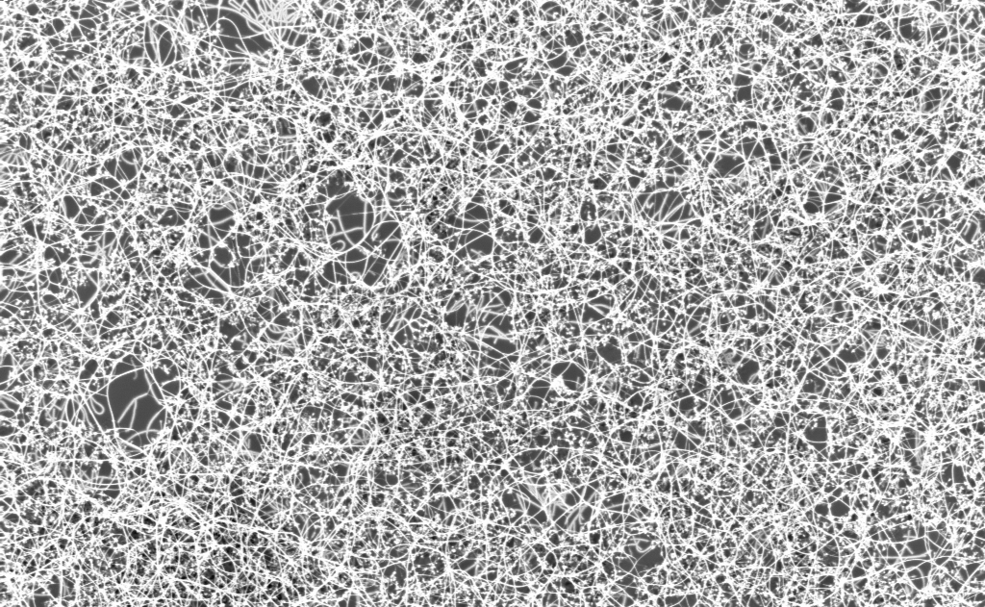

Carbon-Based Devices for THz Technology
Mohamed Rinzan, Abdel El Fatimy and Paola Barbara
Georgetown University
Collaborators:
Greg Jenkins and Dennis Drew
University of Maryland
Serhii Shafraniuk
Northwestern University
3RD International Conference on Material Science and Engineering, San Antonio, TX, USA, October 2014

Slide 4
T-Rays
T-rays
radio waves
microwaves
infrared
ultraviolet
X-rays
gamma rays
10⁶
10⁷
10⁸
10⁹
10¹⁰
10¹¹
10¹²
10¹³
10¹⁴
10¹⁵
10¹⁶
10¹⁷
10¹⁸
10¹⁹
10²⁰
Frequency (Hz)
T-rays
frequency
0.1 THz
30 THz
photon energy
0.414 meV
124 meV
wavenumber
3.3 cm ⁻¹
1000 cm ⁻¹
wavelength
3 mm
10 μm
3RD International Conference on Material Science and Engineering, San Antonio, TX, USA, October 2014

Slide 5
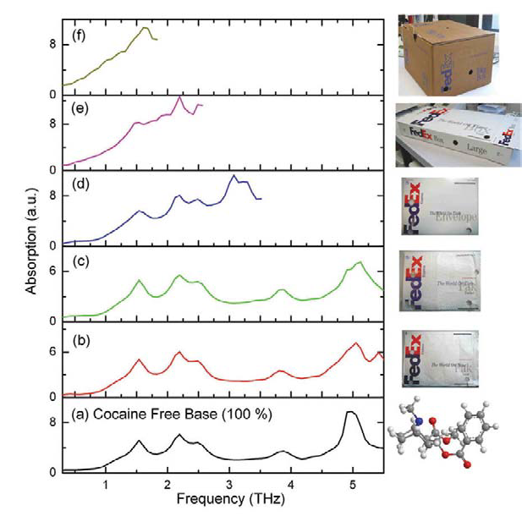
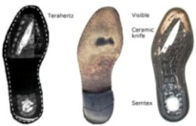
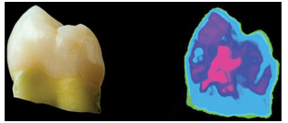
THz Applications
Imaging
Spectroscopy
Security applications
Chemical fingerprinting
Medical diagnostics
TeraView , www.teraview.com
A. G. Davies et al. Materials Today, 11, 18 (2008)
3RD International Conference on Material Science and Engineering, San Antonio, TX, USA, October 2014

Slide 6
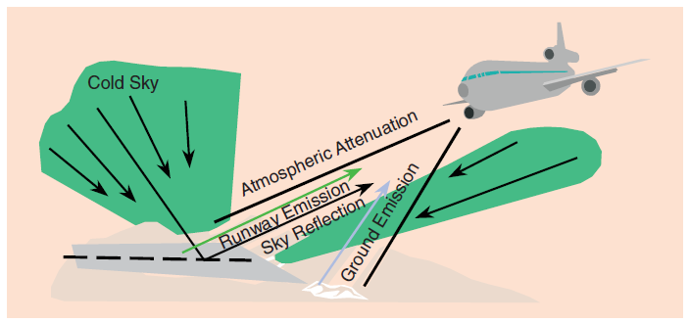
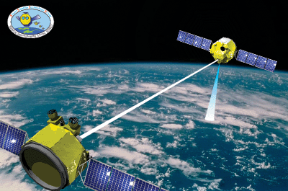
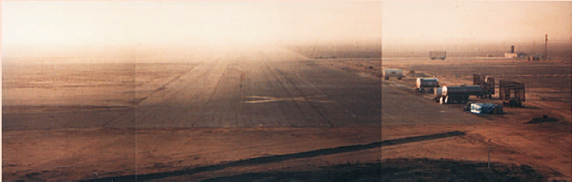


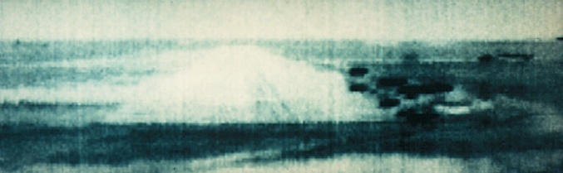
THz Applications
Communication
Passive Imaging
Satellite-satellite
Secure short-range
Dust and smoke conditions
visible image with fog
94 GHz image with fog
NICT, Tokyo, Japan
L. Yujiri, IEEE microwave magazine 4, 39-50 (2003)
3RD International Conference on Material Science and Engineering, San Antonio, TX, USA, October 2014

Slide 7
Quantum Dot Detectors
CNT
drain
Drain Current (pA)
top gate
source
M. Rinzan et al. Nano Letters 12, 3097 (2012)
Gate Voltage (V)
Pro
Contra
High Sensitivity (fW)
Spectral resolution (better than 0.1 THz)
Broad band detection (0.6 - 2THz)
Low-temperature operation (10K)
Non-linear response
3RD International Conference on Material Science and Engineering, San Antonio, TX, USA, October 2014

Slide 8
Carbon Q-dots
Basic properties:
Coulomb blockade and resonant tunneling
QD conductance – radiation off
T=4.2K
ΔE
E_{FS}
E_{FD}
U + ΔE
source
drain
gate
Charging energy: U = e²/C
C: dot capacitance
ΔE = spacing of energy levels
For a review: L. P. Kouwenhoven et al. Electron Transport in Quantum Dots,
Proc. of the Adv. Study Inst. on Mesoscopic Electron Transport, (Kluwer 1997)
3RD International Conference on Material Science and Engineering, San Antonio, TX, USA, October 2014

Slide 9
Carbon Q-dots
Basic idea:
Change in conductance due to absorption and emission of photons: PAT.
ΔE
E_{FS}
E_{FD}
U + ΔE
source
drain
gate
Charging energy: U = e²/C
C: dot capacitance
ΔE = spacing of energy levels
3RD International Conference on Material Science and Engineering, San Antonio, TX, USA, October 2014

Slide 10
Carbon Q-dots
Basic idea:
Change in conductance due to absorption and emission of photons: PAT.
QD conductance – radiation ON
ΔE
E_{FS}
E_{FD}
U + ΔE
αhf
source
drain
gate
Charging energy: U = e²/C
C: dot capacitance
ΔE = spacing of energy levels
D.V. Averin, et al., Phys. Rev. B 43, 6199 (1991).
P. K. Tien and J. P. Gordon, Phys. Rev. 129, 647 (1963).
3RD International Conference on Material Science and Engineering, San Antonio, TX, USA, October 2014

Slide 11
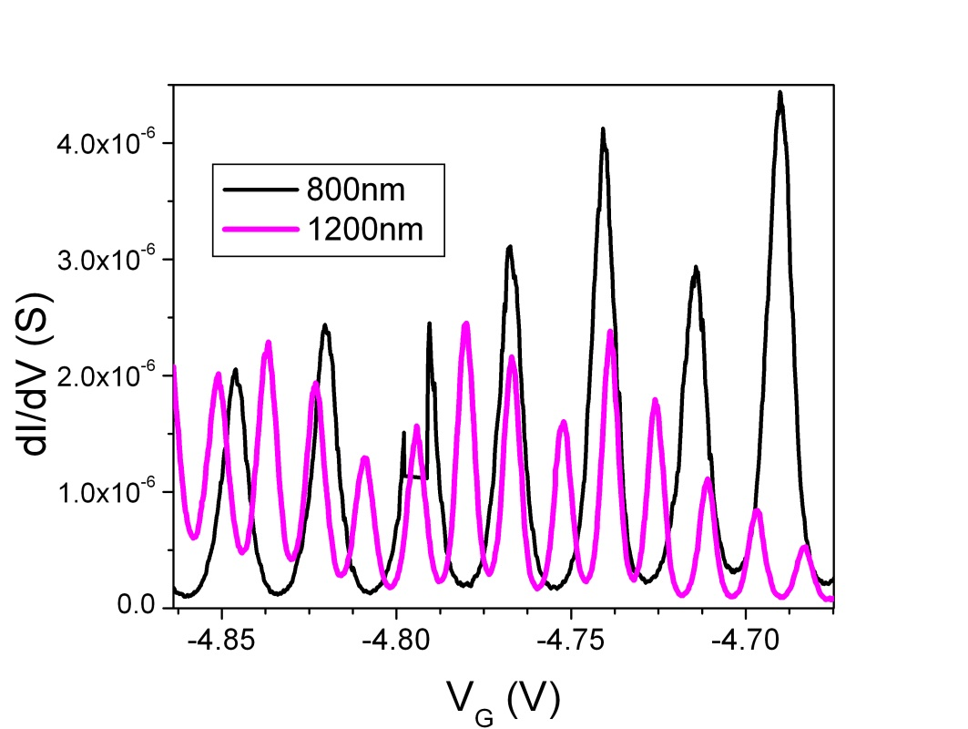
Why carbon quantum dots for THz detection
Main advantages:
U+ΔE larger than in 2DEG quantum dots
U+ΔE larger than typical Δ in SIS junctions
U+ΔE inversely proportional to L
ΔE
E_{FS}
E_{FD}
U + ΔE
source
drain
gate
U =charging energy
ΔE ~ 1.67 meV for L=1μm
For L < 1 μm,
U + ΔE ~ 10 meV (2.4 THz)!!
3RD International Conference on Material Science and Engineering, San Antonio, TX, USA, October 2014

Slide 12
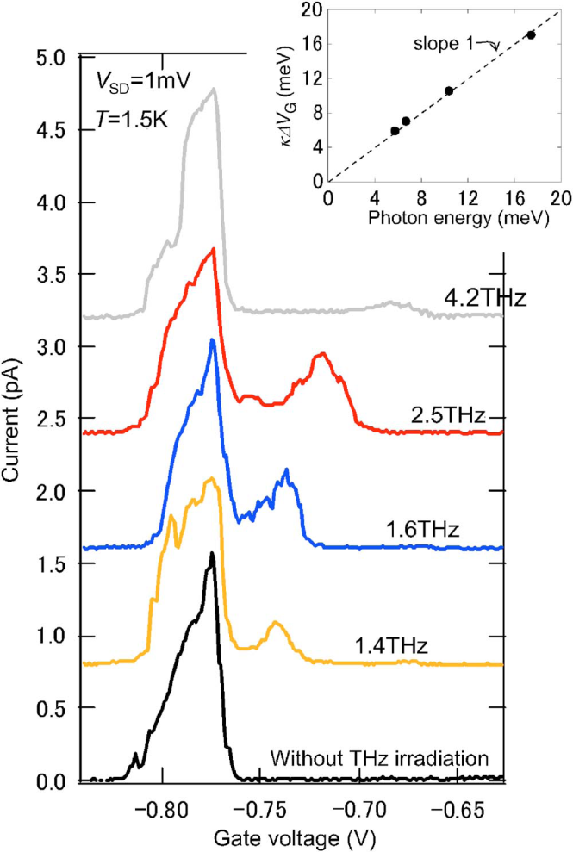
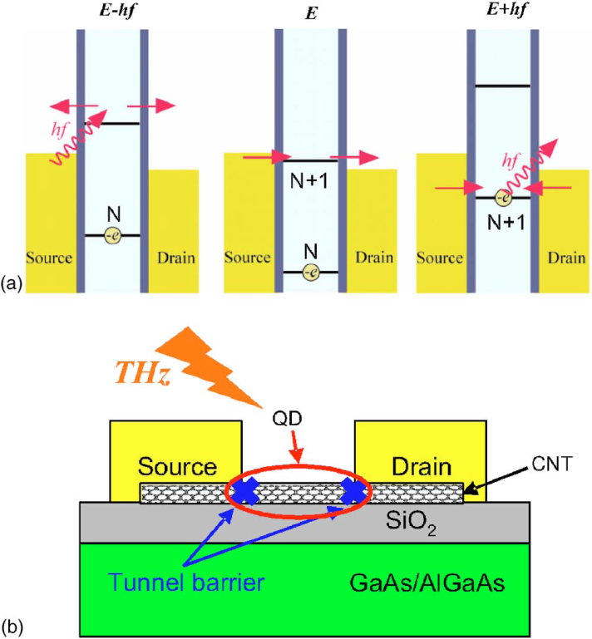
CNTs and THz detection by PAT
PAT detection demonstrated by
I. Kawano et al. (2008)!
10 mW laser
Problems:
Detected signal weak
Response from very few samples
I. Kawano et al., J. of Appl. Phys. 103, 034307 (2008)
3RD International Conference on Material Science and Engineering, San Antonio, TX, USA, October 2014

Slide 13
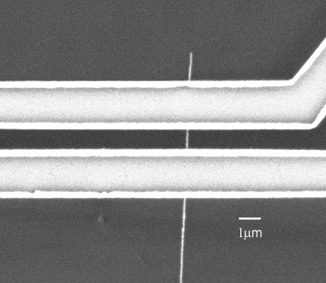
THz detection by PAT: Our approach
Main challenge:
Coupling THz radiation to quantum dots.
Typical Design:
Bottom gate and No THz Antenna → poor coupling
Drain (Ti/Au)
CNT
Source (Ti/Au)
Source
SiO₂
Drain
p-type Si (100)
CNT
Better coupling:
Impedance mismatch reduced
larger detection area
New Design :
Side or Top gate
Broadband THz Antenna
Top Gate
Al₂O₃ or SiO₂
Drain
Source
SiO₂
Intrinsic Si (100)
3RD International Conference on Material Science and Engineering, San Antonio, TX, USA, October 2014

Slide 14
New design: on-chip antenna
Log-periodic antenna for broad band
reception: 700 GHz to 2.5 THz
New design:
Source-drain electrodes shaped like antennas
Substrate: intrinsic silicon
Patterning of small gate electrodes
Cross-linked
PMMA
V_{GD}
Gate
CNT-dot
V_{SD}
Source
Drain
10 μm
Thermal SiO₂
Undoped Si substrate
3RD International Conference on Material Science and Engineering, San Antonio, TX, USA, October 2014

Slide 15
CNT quantum dot with top gate
Device A
2D plot:
Features not very sharp!
3RD International Conference on Material Science and Engineering, San Antonio, TX, USA, October 2014

Slide 16
CNT quantum dot with top gate
Device A
U+ΔE
U
3RD International Conference on Material Science and Engineering, San Antonio, TX, USA, October 2014

Slide 17
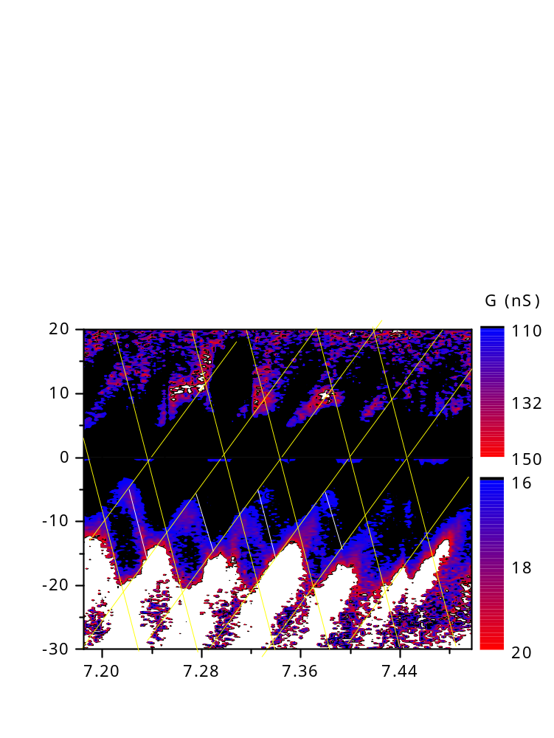
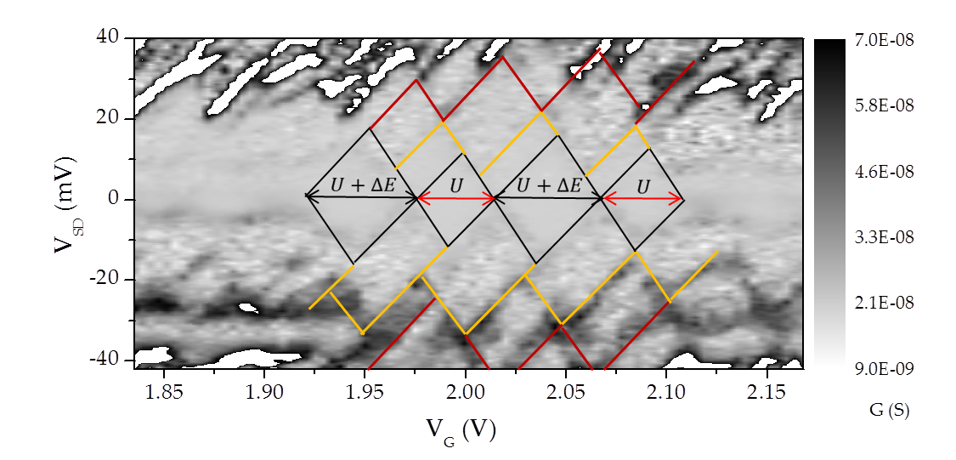
Characteristic parameters
Device A
Device B
V_{SD} (mV)
V_{G} (V)
Gate efficiency = 32%
Energy (meV) | Capacitance (aF)
U = 13.7 | C_{Dot} = 11.7
ΔE = 3.3 | C_{Source} = 3.7
U + ΔE = 17 | C_{Drain} = 4.4
Gate efficiency = 18%
Energy (meV) | Capacitance (aF)
U = 7.4 | C_{Dot} = 21.7
ΔE = 1.9 | C_{Source} = 11.8
U + ΔE = 17 | C_{Drain} = 6.1
3RD International Conference on Material Science and Engineering, San Antonio, TX, USA, October 2014

Slide 18
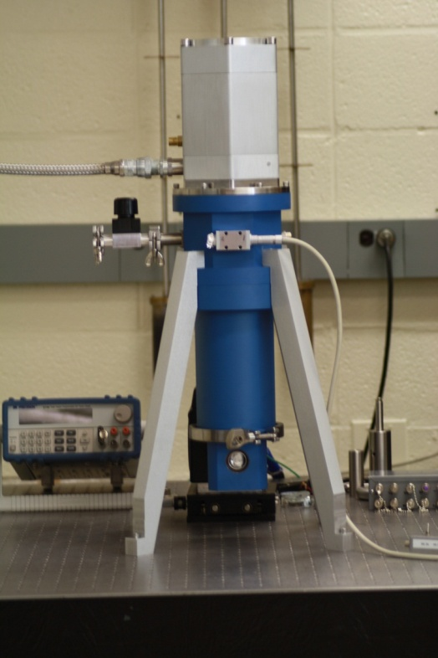

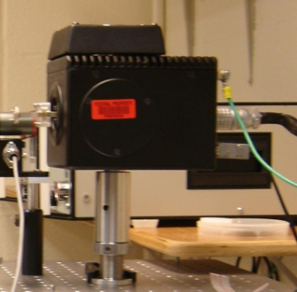
Experimental set-up
Sample cooled down to about 4K
BWO Supply
Closed-cycle optical cryostat
CNT-QDOT mounted
Cryogenic Dewar
Backward Wave
Oscillator
Shutter
Frequency Doubler and Tripler
Tunable BWO: 0.6 – 1THz (0.1 - 0.02 mW)
3RD International Conference on Material Science and Engineering, San Antonio, TX, USA, October 2014

Slide 19
Device B: BWO response and T dependence
Temperature dependence
No THz applied
Measured THz response
Expected THz response
αhf
D.V. Averin, et al., Phys. Rev. B 43, 6199 (1991).
P. K. Tien and J. P. Gordon, Phys. Rev. 129, 647 (1963).
3RD International Conference on Material Science and Engineering, San Antonio, TX, USA, October 2014

Slide 20
Device B: BWO response and T dependence
Temperature dependence
No THz applied
Measured THz response
3RD International Conference on Material Science and Engineering, San Antonio, TX, USA, October 2014

Slide 21
Device B: 1.3 THz response
(1 mW laser source at UMD)
ΔE = 1.9 meV
1₊
ΔE
1₀
U + ΔE
Source
Drain
0
Non-equilibrium cooling of electrons in the CNT-Dot when THz frequency exceeds ΔE
3RD International Conference on Material Science and Engineering, San Antonio, TX, USA, October 2014

Slide 22
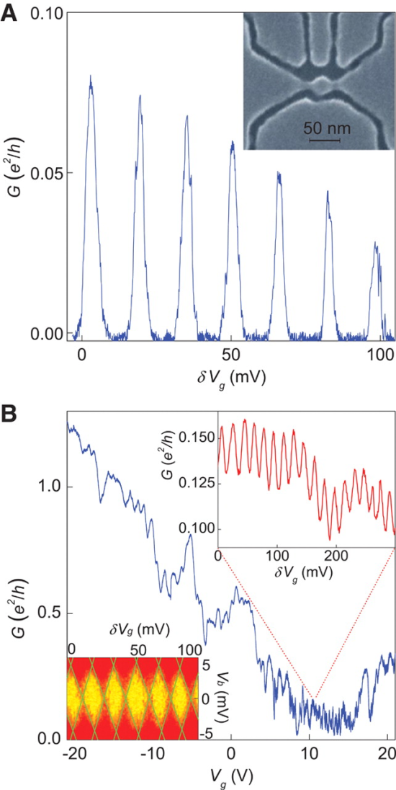
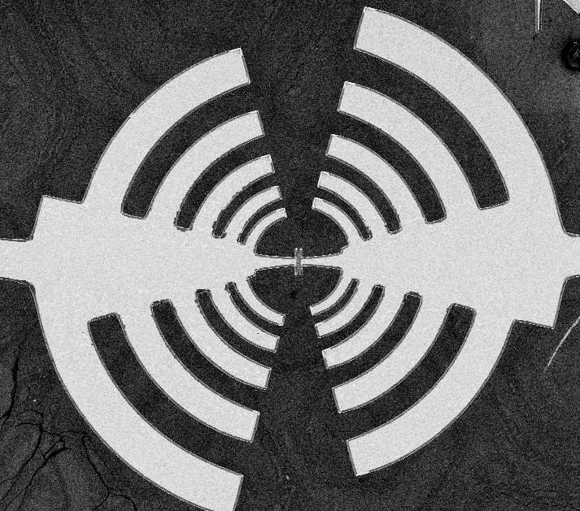
Graphene QDots
Our approach
Graphene on SiC from K. Gaskill’s group
L. A. Ponomarenko et al., Science 320, 5874 (2008)
3RD International Conference on Material Science and Engineering, San Antonio, TX, USA, October 2014

Slide 23


Summary
PAT in CNT quantum dots with on-chip antennas:
Broadband detection in the range 0.6 THz - 1.3 THz
High sensitivity (NEP < 10⁻¹⁵ W/Hz^{-1/2})
Spectral resolution (better than 0.1 THz)
Strong signal at 5K (source power 0.02 – 1 mW)
THz-induced cooling
M. Rinzan et al. Nano Letters 12, 3097 (2012)
Future and ongoing work:
Better quality quantum dots.
Quantum dots with tunable barriers
Extend process to graphene
Thank you!
3RD International Conference on Material Science and Engineering, San Antonio, TX, USA, October 2014

Slide 25
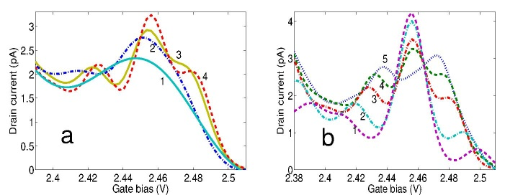
Simulations of cooling effect
THz off
Fixed frequency (1.26 THz)
Increasing field intensity from curve 2 to 4
Fixed field intensity. Decreasing frequency from curve 1 to 5.
NT13, Aalto University, Espoo, Finland, June 24-28, 2013

Slide 26

Graphene Q-dots
Our approach
Graphene on SiC from K. Gaskill’s group
L. A. Ponomarenko et al., Science 320, 5874 (2008)
NT13, Aalto University, Espoo, Finland, June 24-28, 2013

Slide 27
Device A : Broad band response
BWO tunable source
No clear PAT peaks
Main peak enhanced for frequencies above 0.880 THz
1.08 THz (4.46 meV)
0.980 THz (4.05 meV)
0.880 THz (3.65 meV)
0.770 THz (3.19 meV)
0.680 THz (2.83 meV)
Energy level spacing
ΔE = 3.3 meV
THz Blocked

Slide 28





Non-equilibrium cooling
Quantum kinetic equation for non-equilibrium distribution function g_{n} , the PASET current and the electron-phonon recombination

Slide 29




Non-equilibrium cooling
Power balance equation:
With the power PASET tunneling power:
And the power dissipated due to electron-phonon collision:
With the number of electrons in the dot given by:

Slide 30
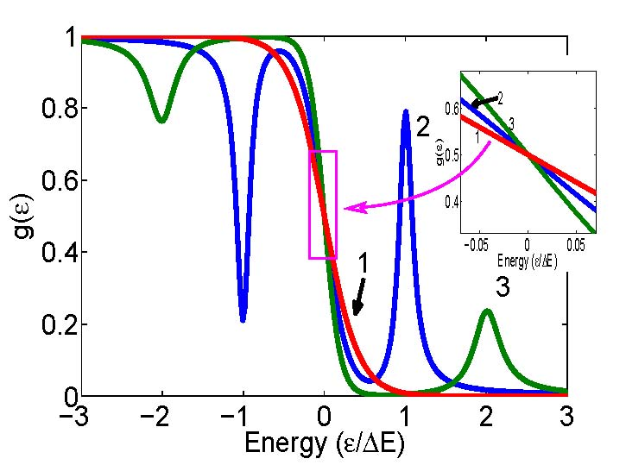
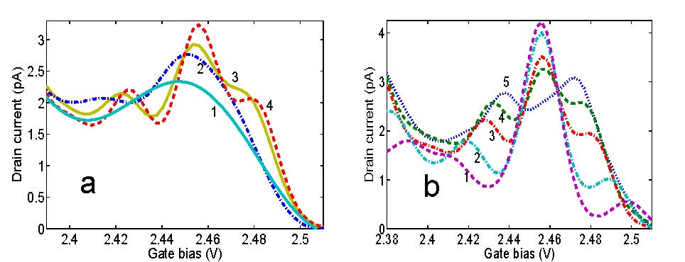
Non-equilibrium cooling

Slide 31
Laser source 1.3 THz: Device B

Slide 32
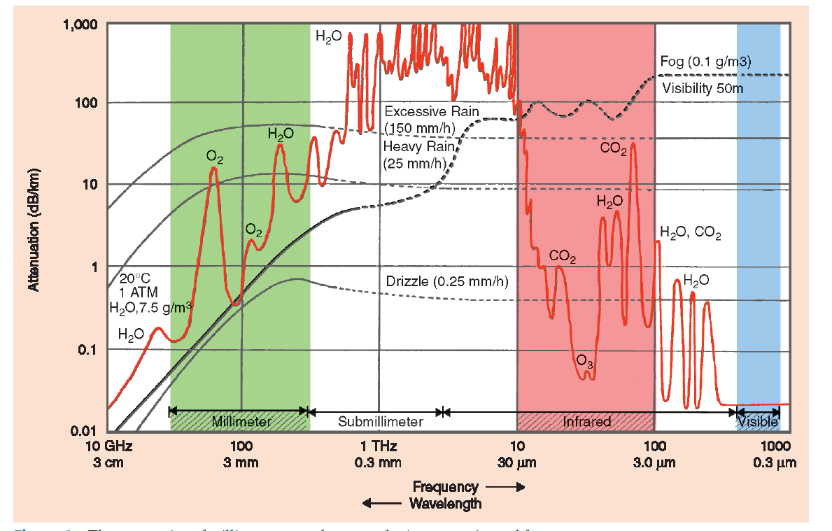
THz attenuation spectrum

Slide 33
Laser source 1.31THz: Device A

Slide 34
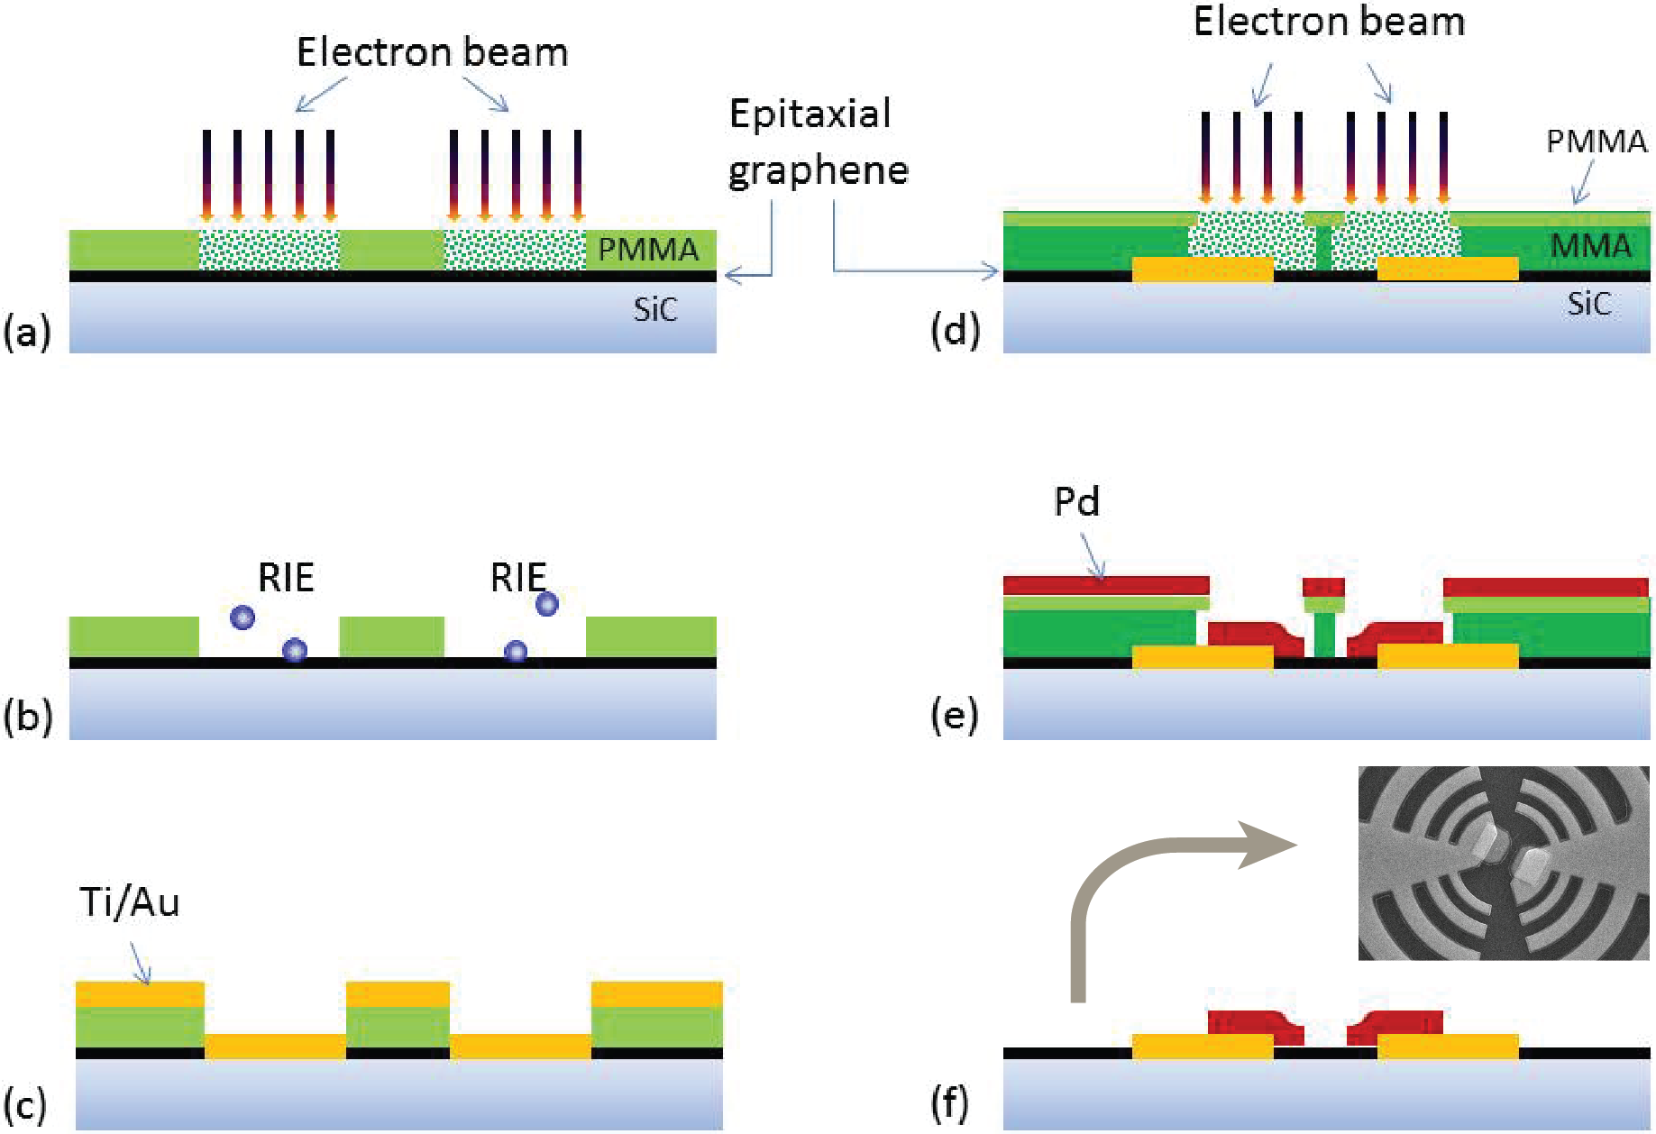
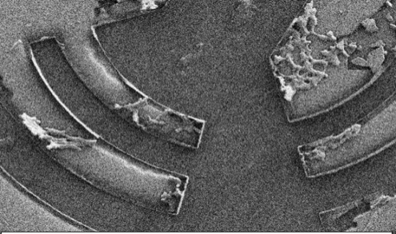
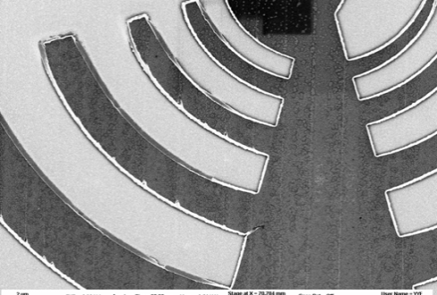
Development of detector arrays
Adhesion problems
for graphene on SiC
Fabrication process for q-dot graphene detectors

Slide 35
Quantum dot for semiconducting CNTs
Quantum dots:
Two main ingredients
T = 4.2 K
L = 800 nm
1)
Source
L< 1μm
Drain
CNT
2)
Electrode material:
Ti, Al for large contact barriers

Slide 36
PAT in superconducting detectors
Photon assisted tunneling:
Widely used in SIS detectors
S
S
Superconductor
Superconductor
P_{ac} = 82 nW
f = 148 GHz
T = 4.2K
Δ
eV
Insulator
P. K. Tien and J. P. Gordon, Phys. Rev. 129, 647 (1963).

Slide 37
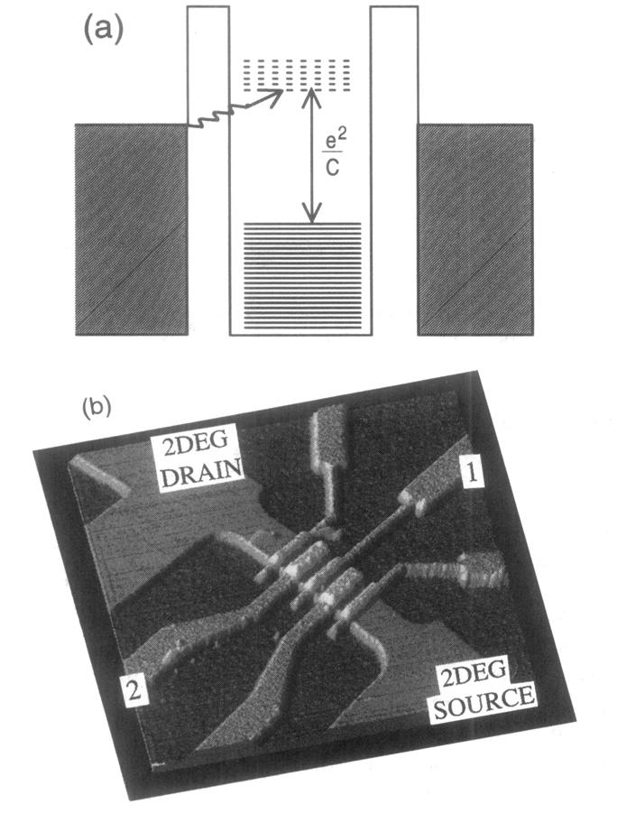
PAT in quantum dots
Photon assisted tunneling:
For quantum dots first observed in 2DEG, Kouwenhoven et al., 1994
9-36GHz, T = 100mK
D.V. Averin, A. N. Korotkov and K. K. Likharev, Phys. Rev. B 43, 6199 (1991).
P. K. Tien and J. P. Gordon, Phys. Rev. 129, 647 (1963).
Notes:
Examples of devices with side gate (left) and top gate (right) electrodes are shown above. Side gates are simpler to fabricate, because they do not require an additional dielectric layer to be deposited on top of the device, but their sharp shape causes focusing of the electric field and electrical breakdown at the gate voltages we need to operate our samples. The fabrication of the top gate requires depositions of a dielectric layer on top of the sample. After many tests (sputtering of Al₂O₃ and SiO₂, PECVD of SiO₂ and ALD of Al₂O₃), we found that the best dielectric layer is obtained with atomic layer deposition of Al₂O₃. Other deposition processes give dielectrics with lower breakdown voltages. In addition, some processes like sputtering consistently destroyed the nanotube samples, even when used with the lowest power and deposition rate.

Slide 38
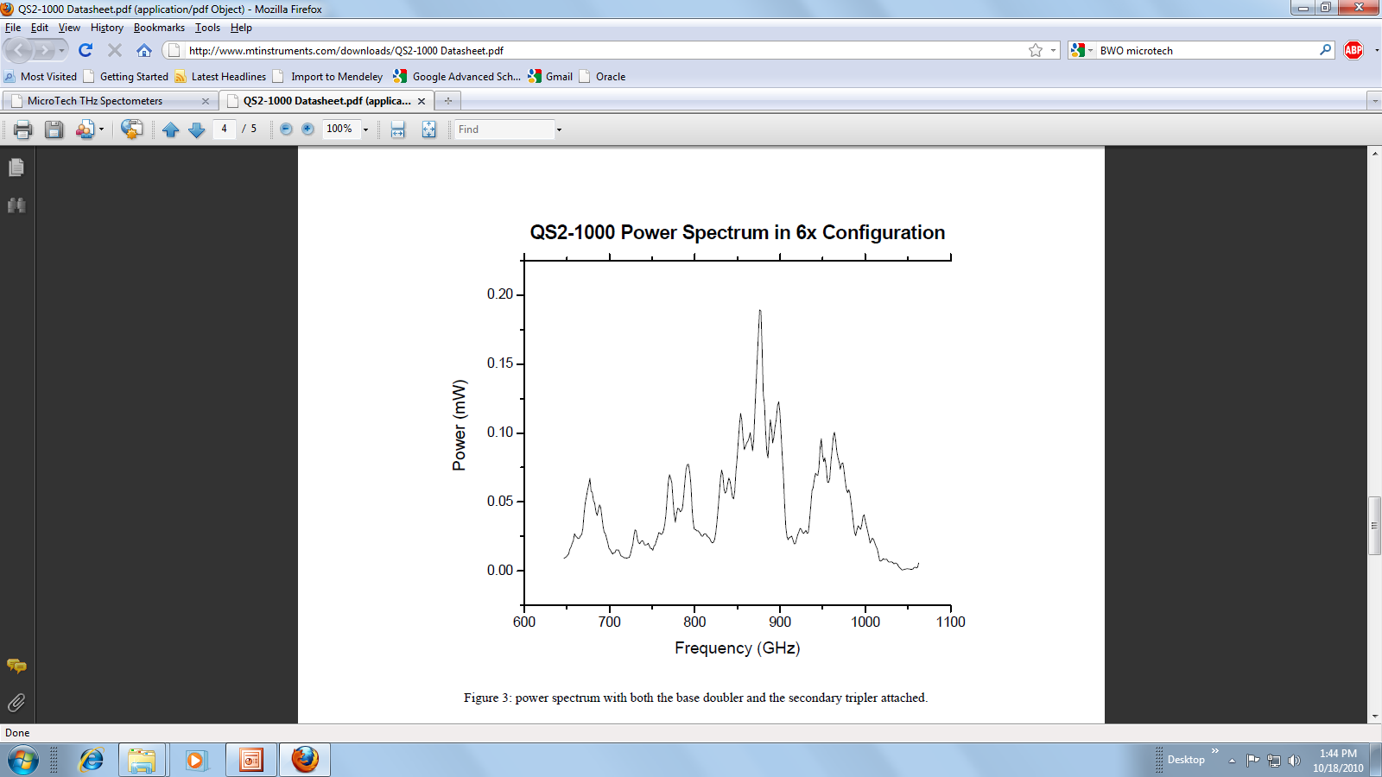
BWO source
Frequency (GHz) | Power (mW)
100-180 | 10-100
200-360 | 1-10
600-1080 | .02-0.1

Slide 39
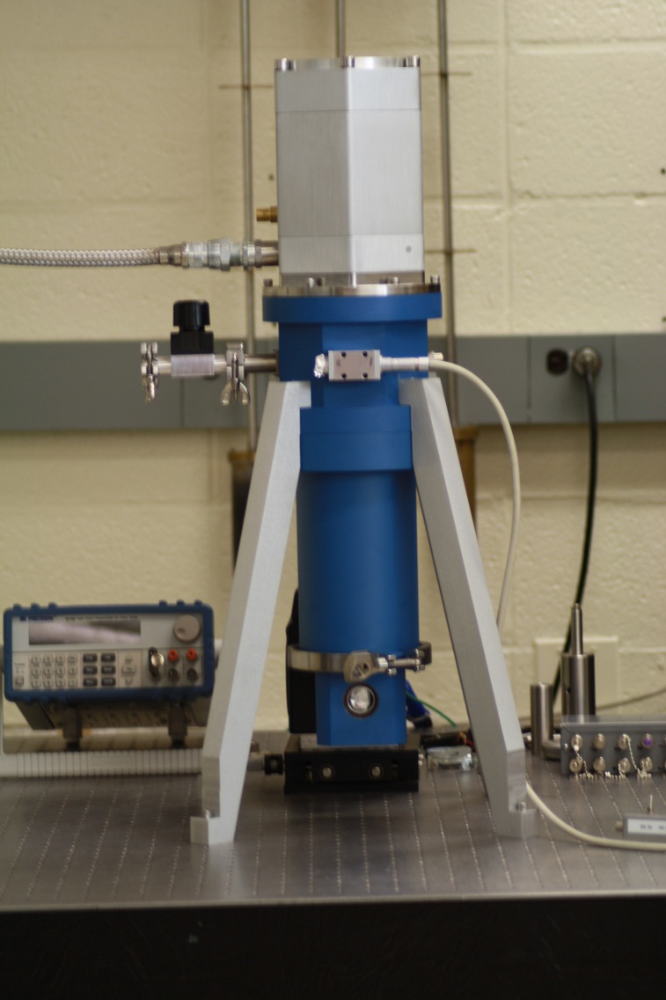
Cryo-free system
Improving noise level of a commercial close cycle cryostat for quantum dot spectrometer measurements.
System “as is”
After improvements

Slide 40

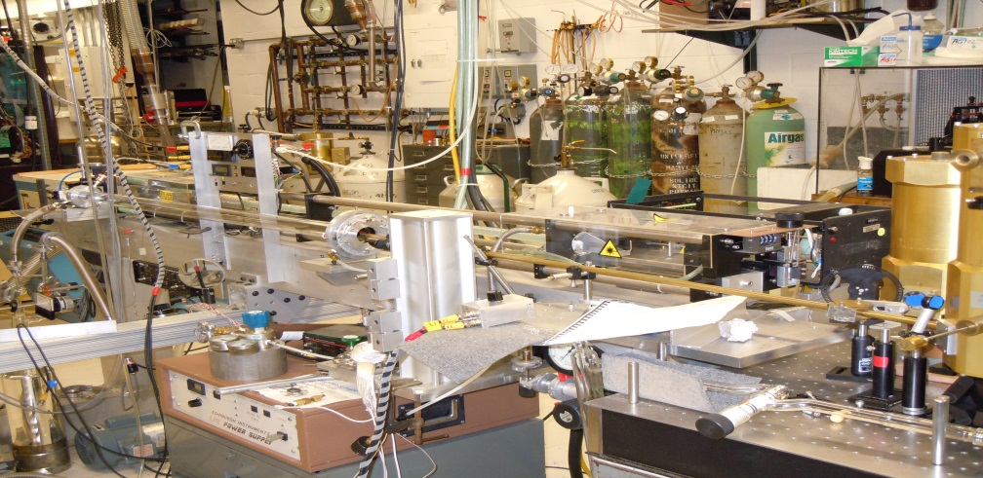

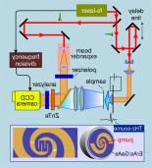
THz laser source @ UMD
Chopper
Control
Gold Mirror
AC coupled
Si-Bolometer
10.6 μm
CO₂ Laser
Pyroelectric
Detector
Chopper
Mylar
BS
CNT-QDOT mounted
Cryogenic Dewar
1.27 THz
THz Laser
Gold Mirror
ZnSe Brewster
window
Mylar
BS
Attenuator
Bias voltage
Terahertz signal
Laser Cavity control
THz
Radiation
CNT-DOT
detector
Winston cone

Slide 41
Let Us Meet Again
We welcome you all to our future conferences of OMICS Group International
Please Visit:
http://materialsscience.conferenceseries.com/
Contact us at
materialsscience.conference@omicsgroup.us
materialsscience@omicsgroup.com

