Slide 1

SCREENING OF BACTERIA FOR BIOPLASTIC PRODUCTION
Presented by
Prof. PADMA SINGH
Department of Microbiology
KANYA GURUKUL CAMPUS
GURUKUL KANGRI UNIVERSITY
HARIDWAR-249407, INDIA

Slide 2
ABSTRACT
About 140 million tons of plastic are consumed every year worldwide, which necessitates the processing of approximately 150 million tons of fossil fuels and directly causes immense amounts of waste that can take thousands of years to naturally deteriorate, if it degrades at all. Bacteria have the ability to produce bioplastics in the form of polyhydroxyalkanoates (PHAs) & they are capable of producing PHA from various carbon sources ranging from inexpensive, complex waste effluents to alkanes, fatty acids, plant oils and as well as simple carbohydrates. The major barrier to wide acceptance of bioplastic is the high cost, particularly carbonaceous raw materials (40%) and polymer recovery (26%). Therefore, the aim of the present study is to focusing on identification of alternative cost effective substrate for the production of PHA. Isolation of bacterial strains for the screening of PHA producing ability carried out by using different oils as carbon source. The samples were collected from edible & lubricating oil contaminated soil from garage & workshop. Isolation of bacterial strain was performed by serial dilution, spread plate & enrichment technique. Screening was carried out by the Nile Blue A (Spiekermann et al., 1999) & Sudan Black B staining (Wani et al., 2015). The total no. of colony forming unit was 134×10⁵ ̶ 3×10⁸ (Edible oil) & 75×10⁵ ̶ 26×10⁸ (Lubricating oil). Out of 21 isolates from edible oil & lubricating oil, 2 bacterial strain (E.O 1 & L.O 1) were fluoresce on plate with Nile blue A indicates the positive result (Fig. 1) and show characteristic granule with Sudan Black B, indicating the presence of PHAs. Bacterial strains were identified as Pseudomonas sp., (edible oil), -rods and Bacillus sp. (Lubricating oil), +rods. Production of PHA through these strains will be carried out to get the sufficient amount of bioplastic.
KEY WORDS: Bioplastic, Edible oil, Lubricating oil,, PHA, Sudan Black, Nile Blue, Optimization, FTIR

Slide 3

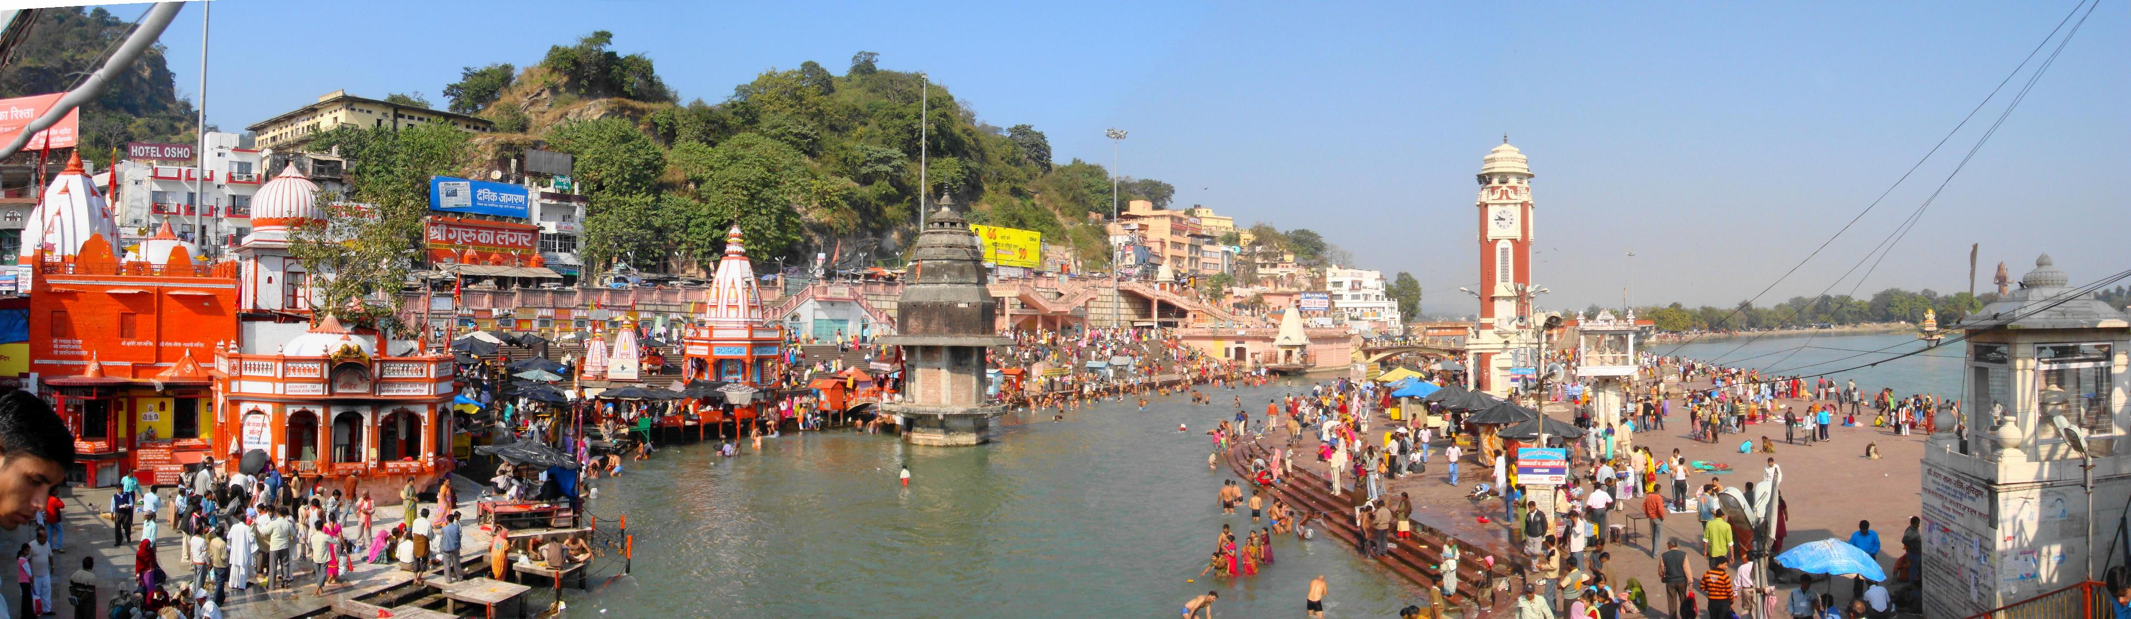

Slide 4
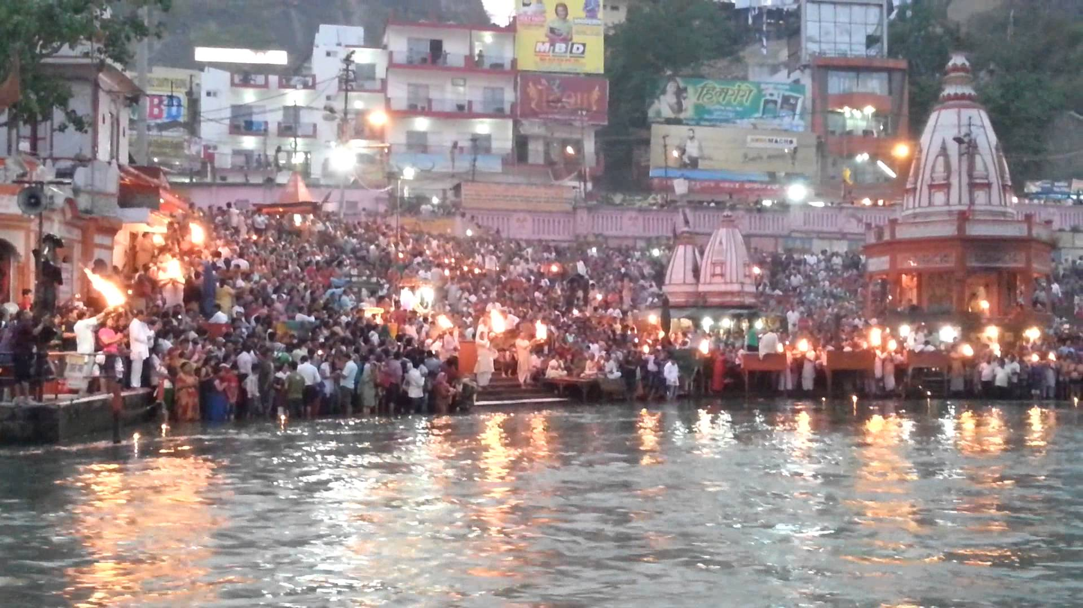

Slide 5

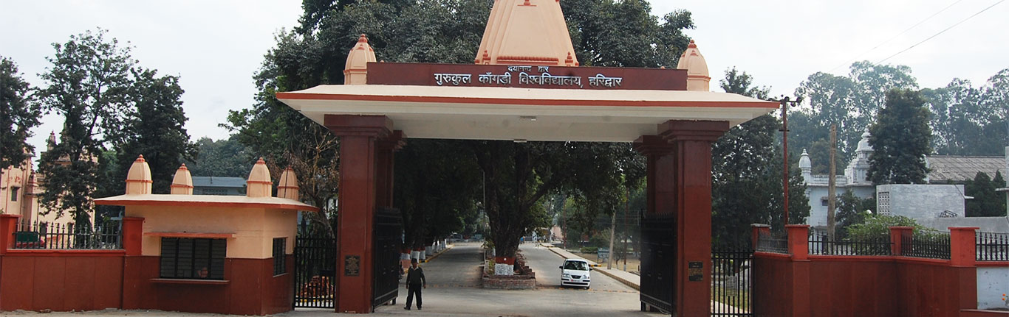

Slide 6
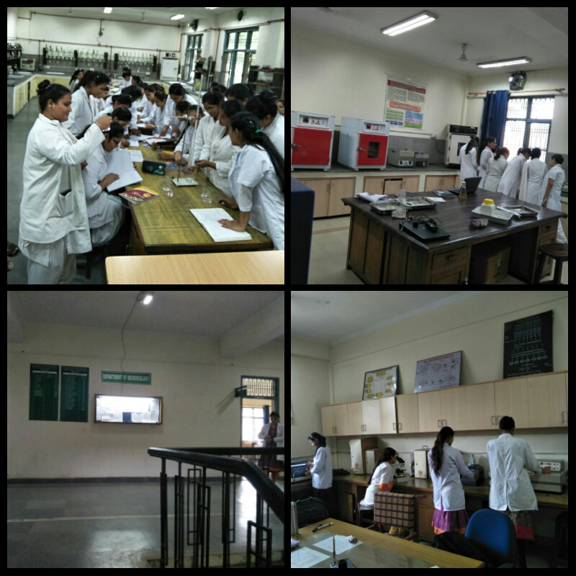

Slide 7

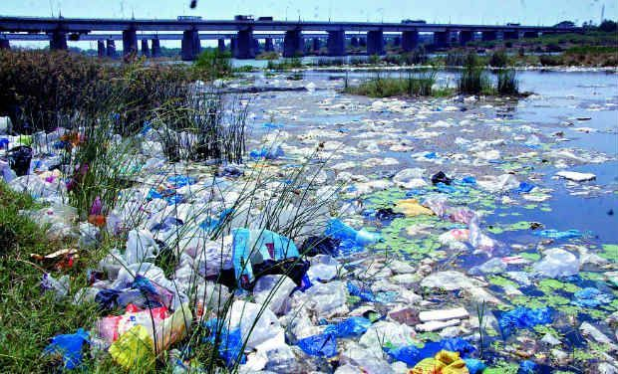
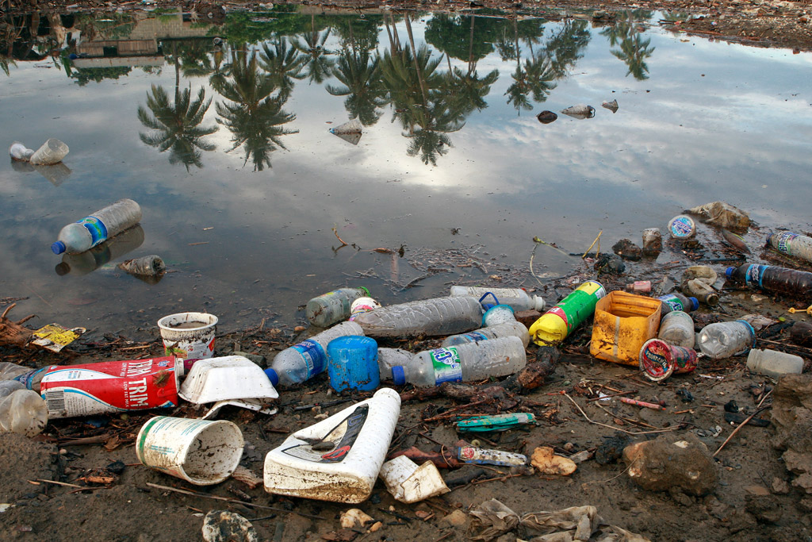
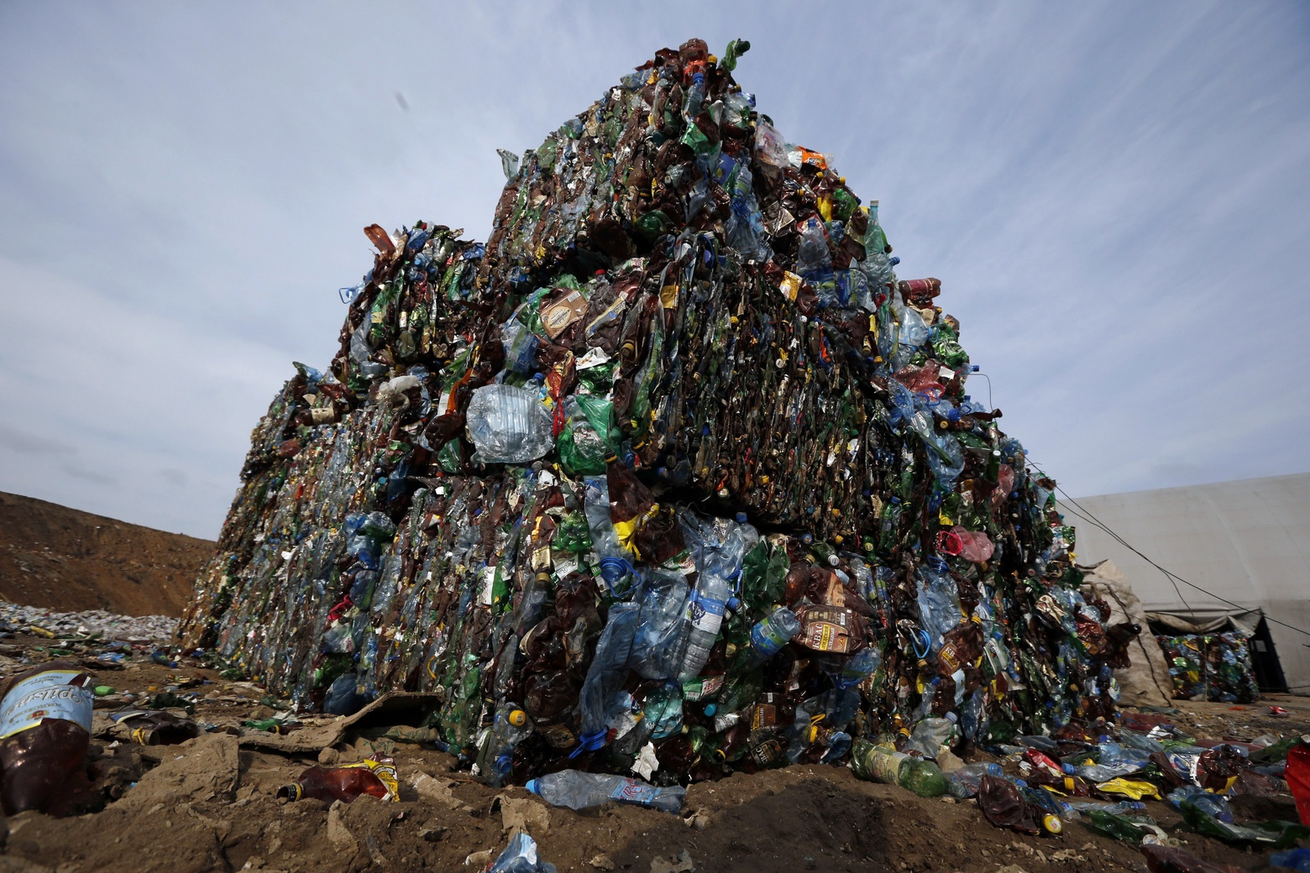

Slide 8
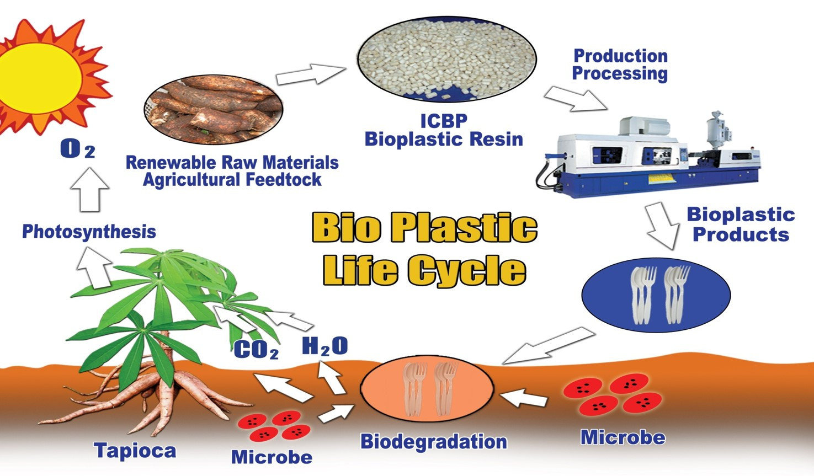
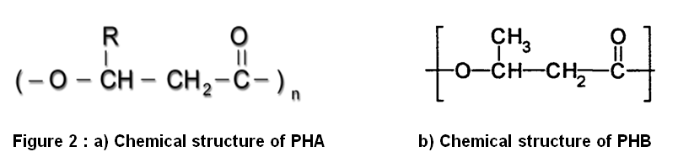

Slide 9
BACKGROUND
Conventional petrochemical plastics are recalcitrant to microbial degradation and accumulate in environment at a rate of 28 million tons per year (Kalaivani and Sukumaran, 2013). In 2011, nearly 280 million tons of petrochemicals-based polymers were produced with expected increased in 4% per annum to 2016.
Their applications are nearly universal: components in automobiles, home appliances, computer equipments, packages and even medical applications are areas, where plastics clearly have become indispensable. However, its properties of durability have caused serious problems since plastic waste accumulates in the environment.
The accumulation of abandoned plastics has caused a global environmental problem. Nature usually cannot handle plastic waste, since the majority of plastics are not degraded by microorganisms. With the imminent fossil fuel crisis, the alarming rate of petroleum prices and environmental impact associated with the products, the search for alternatives is essential in reducing mankind’s dependencies in non-renewable resources (Giin-Yu et al., 2014).
Biodegradable plastics offer the best solution to protect the environment from hazards caused by conventional petroleum based plastics, as they are ‘eco-friendly’ in nature. There are many types of biodegradable plastics with different degrees of biodegradability. PHA was the first main kinds of biomaterial as biodegradable plastic discovered in Bacillus megaterium and characterized by French microbiologist Lemoeigne in 1926.

Slide 10
PHAs have drawn much attention due to their complete biodegradability and the similarity of their material properties to conventional plastics (Luengo et al., 2003).
Polyhydroxyalkanoates (PHAs) is a natural polyesteric biological macromolecules that is synthesized and accumulated by prokaryotes in the form of intracellular granules in response to nutritional limitation or the presence of excess carbon source in the growth environment (Keshavarz and Roy, 2010 and Cheema et al., 2012).
Among the members of PHA family, polyhydroxybutyrate (PHB) is the most common biodegradable polymer and promising alternative to synthetic nondegradable plastics. These polymers are accumulated as inclusion in intracellular membrane up to 90% of the cell dry weight under conditions of nutrient stress and act as energy reserve material.
Among the candidates for biodegradable plastics , It has similar mechanical properties as those of the oil-derived conventional plastics like polypropylene or polyethylene which can be molded, made into films, spun into monofilaments, and used to make heteropolymers with other synthetic polymers and many more applications in agriculture, packaging, and medical field being biodegradable and also immunologically compatible with human tissue (Hazer and Steinbuchel, 2007).

Slide 11
Recently, PHA has been found useful as a new type of biofuel (Choi and Lee, 1997 and Gao et al., 2011). Besides all these properties and applications, wider use of PHAs is prevented mainly due to their high production cost compared with the oil-derived plastics (Yamane et al., 1996). High production cost of PHB production is mainly devoted to the expensive carbon substrates and tedious production procedures (Grothe et al., 1999).
Much attempt has been devoted to reduce the cost of PHA by the isolation of better bacterial strains to produce PHAs from a cheap carbon source such as agriculture waste, edible and lubricating oil waste.
These bacteria can be isolated from various sources such as water and soil environments using a simple method that can monitor the accumulation of PHAs.
The main objective of this study was to isolate and characterize PHA-producing bacteria in oil contaminated soils where by oil may be a better carbon source to produce sufficient amount of polymer as a microbial novel end product PHA which is cost effective and ecofriendly.

Slide 12
AIM & OBJECTIVE
The present study is based on following experiments:
Isolation of bacteria from oil contaminated soil.
Screening of PHA producers.
Morphological and biochemical characterization of PHA producing bacteria.
Optimization of growth conditions for the maximum PHA production such as pH, temperature and incubation period.
FTIR spectrophotometer analysis of extracted sample of PHA.

Slide 13
EXPERIMENTAL
1. Collection of oil contaminated soil sample.
Soil samples were collected from edible oil & lubricating oil contaminated soil from garage & workshop located in the Haridwar (India) region and which was supposed to be rich of oil degrading microorganisms.
The samples were collected and kept in sterilized plastic bags, marked with collection details.
2. Isolation of microorganism from oil contaminated soil.
For the present study a total of two soil sampling were conducted. The isolation of bacterial strain was performed by serial dilution technique, spread plate technique and enrichment technique.
1 gram of soil sample was transferred to sterile nutrient broth (NB) and incubated at 30° for 24 h.
The culture was diluted in 0.9% normal saline with different dilutions (10⁻⁴, 10⁻⁵, 10⁻⁶, 10⁻⁷& 10⁻⁸ ) & spread on sterile nutrient agar (NA).

Slide 14
The plates were incubated at 30 + 2°C for 24 h. Distinct colonies were purified by streaking to obtain single colonies on mineral salt agar (MSA) consist of (g/l); 20 g Sucrose, 1.5 g KH₂PO₄, 3.57 g Na₂HPO₄, 0.2 g MgSO₄ 7H₂O, 1 g (NH₄)SO₄, 1 g and 1 ml trace element solution prepared following the method described by (Grothe et al., 1999).
3. Screening of PHA producing bacteria.
Screening were carried out by the Sudan black B staining (Juan et al., 1998) & Nile blue A staining. Staining of cultures, grown under PHA accumulation conditions, was performed with Nile Blue A using a modified method.
To select PHA-accumulating bacteria, colonies of isolates were stained with Nile blue A on MSB agar media using a modified method (Spiekermann et al., 1999). Briefly, Nile blue A, dissolved in dimethyl sulfoxide (DMSO), was added at a concentration of 0.5 µg/ml to the agar media for viable colony staining. After overnight incubation, plates were observed under UV light. Colonies producing fluorescence were purified and the isolates were further confirmed by Sudan black B staining.
…….ng fluorescence were purified and the isolates were further confirmed by Sudan black B staining.

Slide 15
4. Identification & characterization of PHA synthesizing microorganism.
Characterization and identification of PHA producing bacterial isolates were carried out by morphological as well as biochemical test according to Bergey’s manual of determinative bacteriology (Holt et al., 1994).
The growth characteristics such as structure, shape, colour, cell’s arrangement and Gram staining of the bacterial colonies were observed to characterize the bacterial colonies.
Various biochemical tests were performed in selected PHA-producing bacteria, namely, methyl red and Voges-Proskauer, citrate utilization test, amylase and H₂S production. The fermentative utilization of various carbohydrates (sucrose, dextrose, and lactose) were also carried out for 48 h at 37 + 2°C.
5. Production of PHA by selected isolates
The selected strains were maintained in nutrient broth and incubated in orbital shaking incubator at 200 rpm, 35 + 2°C for 24 h prior to use.
The 5% (v/v) inoculums of the pre-culture was used to inoculate in 250 mL Erlenmeyer flask containing 50 mL sterilized mineral salt medium.

Slide 16
6. Measurement of dry biomass
Dry biomass measurement, the cultures were centrifuged at 10,000 rpm for 15 min, and the pellets were dried in an oven at 55 °C to constant weight (Basavaraj et al., 2013).
7. Extraction and Quantitative Analysis of PHA.
For extraction and quantitative analysis of PHB, 2.5 mL culture broth was inoculated in 50 mL of MSM medium for 72 h of incubation at 37 ° C.
1.5 ml of culture was centrifuged at 8000 rpm for 15 mins. The pellet dissolved in 1.5 mL sodium hypochlorite was incubated at 50°C for 1 h for lyses of cells.
The cell extract obtained was centrifuged at 12000 rpm for 30 min and then washed sequentially with distilled water, acetone, and absolute ethanol.
After washing, the pellet was dissolved in 1.5 mL chloroform and incubated overnight at 50°C and was evaporated at room temperature and kept at 4°C and weighed.
The relative PHB accumulation by the different isolates was compared to help in identification of the best producer.

Slide 17
8. Effect of growth conditions on PHB production by selected isolate
The effect of different pH (6.0, 7.0, 8.0 and 9.0), temperature (25, 30, 35 and 40 °C) and incubation period (24, 48, 72 and 96 h) on PHB production by the selected isolates supplemented with MSM incubated in rotary shaker at 150 rpm. The pH of the medium were adjusted by 1N hydrochloric acid or sodium hydroxide. The result were then compared by measuring the dry biomass and the weight of extracted PHA as described above.
9. FTIR spectrophotometer analysis of PHB
1 mg extracted sample of PHB was mixed with KBr. FTIR analysis of the polymer sample was carried out on FTIR-8400S, (Shimadzu) Fourier transform infrared spectrophotometer in the range 4,000 to 500 cm−1.

Slide 18
RESULT & DISCUSSION
Isolation of bacteria from oil contaminated soil.
After isolation of bacteria from edible oil & lubricating oil contaminated soil, the total no. of colony forming unit was 134×10⁵ ̶ 3×10⁸ (Edible oil) & 75×10⁵ ̶ 26×10⁸ (Lubricating oil) respectively (Table 1).
Table 1. Isolation of bacteria from edible oil and lubricating oil soil sample (Average of triplicates)
SAMPLE | DILUTIONS | CFU±SEM
Edible oil | 10⁻⁵ | 134×10⁵ ± 0.255
 | 10⁻⁶ | 62.6×10⁶ ± 0.22
 | 10⁻⁷ | 10.6×10⁷ ± 0.63
 | 10⁻⁸ | 3×10⁸ ± 0.577
Lubricating oil | 10⁻⁵ | 75×10⁵ ± 0.04
 | 10⁻⁶ | 48.6×10⁶ ± 0.48
 | 10⁻⁷ | 28.6×10⁷ ± 0.85
 | 10⁻⁸ | 26×10⁸ ± 0.403
Cfu= colony forming unit, SEM=standard error mean

Slide 19
Isolation of bacteria from edible oil and lubricating oil soil sample (Average of triplicates)

Slide 20
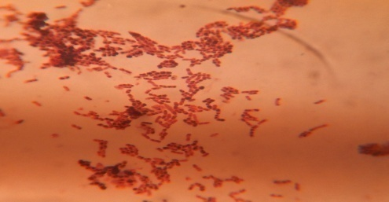
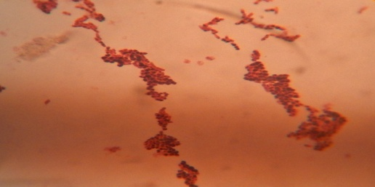
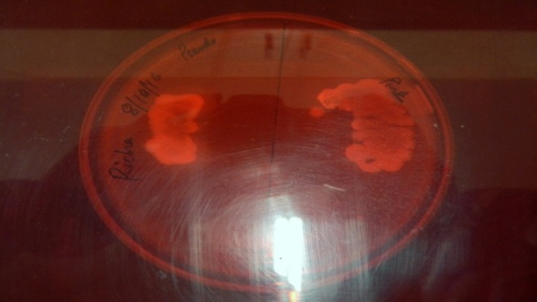
Fig 2. Isolates E.O 1 (Left) & L.O1 (Right) fluorescence under UV light on Nile Blue plate.
Screening of PHA-Producing bacteria
Out of 21 isolates from 2 oil soil sample, 8 strains showed black blue granules when stained with Sudan Black B, a preliminary screening agent for lipophilic compound and a total of 8 isolates showed positive result with Nile blue A staining, a specific dye for the presence of PHA granules. Two isolates EO1 & LO1 showed strong fluorescence for Nile blue and strong blue black granules for Sudan black (Table 2) & (Fig 1 & 2).
Tanamool et al., 2011 used this method to screen the potential PHA producing bacteria from soil and also observed colonies formed on nutrient deficient medium under UV light to screen for the fluorescence which indicated the presence of PHA producers. Lathwal et al 2015 also screened the isolates with Sudan Black B to obtain positive PHB producing bacteria.
Fig 1. Photomicrograph of bacteria E.O 1 (Left) & L.O1(Right) containing PHA inclusions

Slide 21
Table 2: Screening for potential PHA producers*
Strain | Sudan Black stain | Nile Blue stain
E O 1 | +++ ve | +++ ve
E O 2 | - ve | - ve
E O 3 | - ve | - ve
E O 4 | ++ ve | ++ ve
E O 5 | ++ ve | ++ ve
E O 6 | - ve | - ve
E O 7 | + ve | + ve
E O 8 | - ve | - ve
E O 9 | - ve | - ve
E O 10 | - ve | - ve
E O 11 | - ve | - ve
L O 1 | +++ ve | +++ ve
L O 2 | - ve | - ve
L O 3 | - ve | - ve
L O 4 | - ve | - ve
L O 5 | ++ ve | ++ ve
L O 6 | + ve | - ve
L O 7 | - ve | - ve
L O 8 | + ve | + ve
L O 9 | - ve | - ve
L O 10 | - ve | - ve
*Legend : +++ ve = granules fully observed, ++ ve = granules slightly observed, + ve= granules very slightly observed, - ve = no granules observed

Slide 22
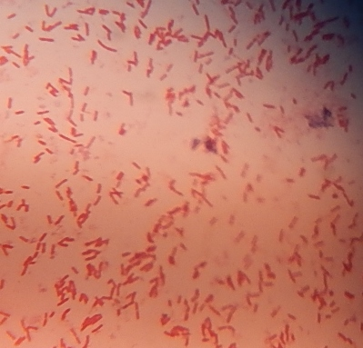
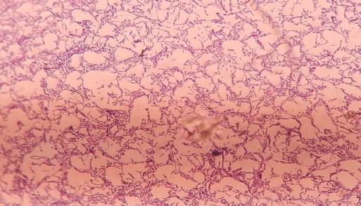
Identification of Polyhydroxyalkanoate (PHA) producing bacteria
Out of 11 isolates from edible oil soil, 9 Gram negative & 2 Gram positive rods whereas from lubricating oil soil 10 bacteria were isolated, out of which 5 Gram positive cocci, 3 Gram positive rods & 2 Gram negative rods were observed. Two best PHA producer E.O1 from edible oil and L.O1 from lubricating oil were identified as Gram negative & Gram positive rods (Fig.3). The selected isolates were identified up to genus level by morphological and biochemical characteristics (Table 3a and 3b) and were appeared as Bacillus sp. and Pseudomonas sp.
Previous studies also reported both the isolates from edible and lubricating oil (Marjadi and Dharaiya, 2011) and Lathwal et al., 2015.
Fig 3. Microphotograph of Gram stain shows E.O 1 is Gram negative rod (left) & L.O 1 is Gram positive rod (right)

Slide 23
Table 3a. Morphological characteristics of selected isolates
Morphological Characters | EO1 | LO1
Colony color | Blue-Green | White
Gram reaction | -ve | +ve
Cell shape | Rod shape | Rod shape
Cell arrangement | Abundant colonies | Isolated colonies
Spore formation | -ve | +ve
Table 3b. Biochemical characteristics of selected isolates
Isolates | Biochemical Properties |  |  |  |  |  |  |  | Probable Genus.
 | Citrate | MR | VP | Amylase | H₂S | Sucrose | Dextrose | Lactose
E.O 1 | +ve | -ve | -ve | -ve | -ve | -ve | -ve | -ve | Pseudomonas
L.O 1 | -ve | -ve | +ve | +ve | -ve | -ve | -ve | -ve | Bacillus

Slide 24
Production of PHB polymer in shake flask
Maximum cell density were reached at 48 h of cultivation of EO1 & LO1in shake flask culture.
The PHB accumulation was started at the log phase and continued up to 48 h of incubation of EO1 & LO1.
The maximum synthesis of PHB was reached at stationary phase of growth and it was slightly decreased after the stationary phase due to the intracellular utilization of the PHB as energy and carbon reserves.
The PHB productivity was increased in nitrogen source limiting condition.
Maximum PHB production in terms of biomass (DCW) of 9.1 & 8.9 g/L, PHB contents 3.8 & 3.5 g/L and % PHB production 41.7% & 45.88% obtained for the isolates EO1 and LO1 respectively (Table 4).
Tanamool et al., 2011 and Getachew & Woldesenbet, 2016 also observed production of PHA .

Slide 25
Table 4. PHB accumulation by selected isolates at pH 7.0, 35 + 2 °C after 48 h and 150 rpm
Name of Isolate | DCW (g/L) | PHB (g/L) | PHB (%)
Edible oil contaminated soil
EO1 | 9.1 ± 0.05 | 3.8 ± 0.12 | 41.7
EO4 | 7.2 ± 0.02 | 2.5 ± 0.05 | 34.72
EO5 | 6.8 ± 0.03 | 2.0 ± 0.01 | 29.4
EO7 | 5.4 ± 0.13 | 1.4 ± 0.31 | 25.92
Lubricating oil contaminated soil
LO1 | 8.9 ± 0.04 | 3.5 ± 0.23 | 45.88
LO5 | 7.8 ± 0.03 | 2.8 ± 0.04 | 35.89
LO8 | 6.9 ± 0.12 | 2.9 ± 0.06 | 33.33
Data represent Two trials in Triplicates + SEM
DCW- Dry Cell Weight, PHB- Polyhydroxybutyrate

Slide 26
PHB accumulation by selected isolates at pH 7.0, 35 + 2 °C after 48 h and 150 rpm

Slide 27
Influence of physical parameters on PHB polymer production
EO1 and LO1 had grown at a wide range of pH (5,6,7 and 8 ) and the maximum polymer
accumulation (51.25% and 48.9% dry cell weight respectively) was observed at pH 7.
Effect of varying incubation temperature (25, 30, 35 and 40°C) were observed and maximum PHB production were obtained at 35 + 2°C as 51% (EO1) and 54.28 % (LO1). At extremes of the temperature, the accumulation of PHB was decreased i.e., (>15 ◦C and <50◦C).
The PHB production by EO1 and LO1were observed by growing from 24, 48, 72 and 96 h of incubation. It was observed that PHB accumulation was maximum at 72 h 52.87% (EO1) and 52.04% (LO1). The production of PHB increased up to 72 h (4.9 and 5.1 g/L respectively) and, thereafter, got reduced (3.1 and 2.5 g/L after 72 h). This reduction in PHB production after 72 h may be due to lack of micronutrients as well as increase in metabolites that might have negative effect on the PHB production (Table 5).
Bhuwal et al., 2014 and Lathwal et al., 2015 reported same findings.

Slide 28
Table 5. Effect of pH, temperature and incubation period on production of Polyhydroxybutyrate (PHB) by selected isolates
EO 1 |  |  |  | LO 1
Parameter | Dry Biomass (g/L) | PHB (g/L) | % PHB (w/w) | Dry Biomass (g/L) | PHB (g/L) | % PHB (w/w)
Temperature (˚C)
25 | 7.1 ± 0.04 | 2.5 ± 0.01 | 35.2 | 8.4 ± 0.02 | 3.2 ± 0.01 | 38.09
30 | 8.2 ± 0.06 | 4.1 ± 0.21 | 50 | 9.1 ± 0.01 | 4.9 ± 0.1 | 53.8
35 | 9.3 ± 0.13 | 4.8 ± 0.01 | 51 | 10.5 ± 0.12 | 5.7 ± 0.20 | 54.28
40 | 6.0 ± 0.15 | 2.9 ± 0.12 | 48.3 | 6.1 ± 0.04 | 2.3 ± 0.03 | 37.7
pH
5 | 4 ± 0.12 | 1.6 ± 0.03 | 40 | 6.2 ± 0.03 | 2.5 ± 0.01 | 40.3
6 | 6.2 ± 0.03 | 3.1 ± 0.12 | 50 | 7.3 ± 0.02 | 3.2 ± 0.12 | 43.8
7 | 8.01 ± 0.05 | 4.1 ± 0.04 | 51.25 | 9.2 ± 0.10 | 4.5 ± 0.04 | 48.9
8 | 7.1 ± 0.2 | 3.6 ± 0.02 | 50.7 | 8.5 ± 0.04 | 3.8 ± 0.03 | 44.7
Incubation period (h)
24 | 5.2 ± 0.12 | 2.3 ± 0.03 | 44.23 | 7.4 ± 0.02 | 31 ± 0.12 | 41.89
48 | 9.1 ± 0.04 | 4.2 ± 0.02 | 46. 15 | 9.5 ± 0.04 | 4.6 ± 0.04 | 48.42
72 | 9.4 ± 0.12 | 4.9 ± 0.10 | 52.87 | 9.8 ± 0.11 | 5.1 ± 0.10 | 52.04
96 | 6.3 ± 0.05 | 3.1 ± 0.04 | 49.2 | 6.2 ± 0.03 | 2.5 ± 0.03 | 40.32
Data represent Two trials in Triplicates + SEM

Slide 29
Effect of pH, temperature and incubation period on production of Polyhydroxybutyrate (PHB) by selected isolates

Slide 30
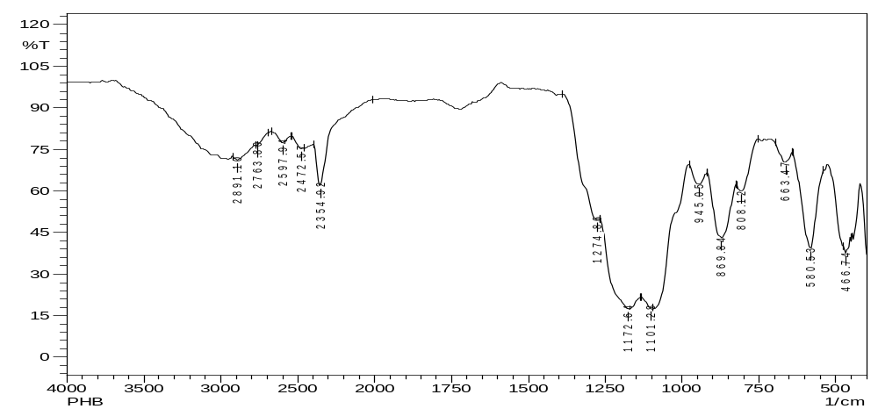
FTIR analysis of PHB
Polymer extracted from (EO 1) Pseudomonas strain was used for recording IR spectra in the range of 4000 to 500 cm⁻¹ (Fig 4).
IR spectra showed two intense absorption band at 2891 and 2763 cm⁻¹ are due to C-H stretching vibrations of methyl and methylene groups.
The absorption bands at 1274 cm⁻¹ which are specific for C-O stretching vibrations.
These prominent absorption bands confirm the structure of poly-β-hydroxybutyrate.
Bhuwal et al., 2014 and Getachew & Woldesenbet 2016 also have been reported the similar results.
Fig 4. FTIR analysis of polyhydroxybutyrate polymer extracted from isolate EO1

Slide 31
CONCLUSION
The major objective of the present study was to isolate effective PHA producers and to optimize their culture conditions so as to obtain the maximum PHA yield. According to present findings the optimum culture conditions for maximum PHA production include supplementation of sucrose as a carbon source along with pH, temp and incubation period. The best screened isolates EO. 1 & LO1 were found to accumulate high level of PHA at the optimized culture condition. FTIR analysis indicated the strong C-H stretching vibrations of methyl and methylene groups and C-O stretching vibrations. These prominent absorption bands identified as PHA marker to confirm the structure of poly-β-hydroxybutyrate. Both isolates EO1 (Edible oil) & LO1 (Lubricating oil) can be regarded as potential strains for the production of PHA.
Future Prospects:
PHA as a replacement to plastic is still limited. The high production cost can be reduced by exploring the cheaper C- sources as the substrate.
As PHA has a very high potential due to their properties of biocompatibility, chemical diversity, manufacture from renewable carbon sources non-toxicity and release of non-polluting products on degradation. With the progress in research and development of new technologies to favour optimized production of PHA and improvements in its mechanical properties we could soon replace synthetic plastics with PHA . A fast emerging alternative of non- degradable plastic to make a greener world.

Slide 32
Acknowledgement
Authors wish to express their sincere gratitude to Gurukul Kangri University, Haridwar (India) for providing research facilities and financial support for carrying out this work.
Authors Contributions: PS as a supervisor designed the research. PS and RP
developed the research experiments and carried out the research work, data research and analysis. Both contributed for the preparation of presentation.

Slide 33
REFERENCES
American Public Health Association (APHA) (1981). Standard Methods for the Examination of Water and Wastewater. 15th ed. APHA; Washington, DC, USA. pp. 85-99.pp. 773-779.pp. 786-828.
Basavaraj, H., Shyama, P.P., and Mohammed, S. (2013). Production of polyhydroxybutyrates from Paenibacillus durus BV-1 isolated from oil mill soil. J Microb Biochem Technol. 5:1948–5948.
Bhuwal, A.K., Singh, G., Aggarwal, N.K., Goyal. V. and Yadav, A. (2014). Poly-β-hydroxybutyrate production and management of cardboard industry effluent by new Bacillus sp. NA10. Bioresources and Bioprocessing. 1(9): 1-11.
Choi, J.I, Lee, S.Y. (1997). Process analysis and economic evaluation for poly(3-hydroxybutyrate) production by fermentation. Bioprocess Eng. 17: 335–342
Cheema, S., Bassas-Galia, M.P., Sarma, M., Lal, B., Arias, S. (2012). Bioresource Technology.103: 322–328.
Gao, X., Chen, J. Wu, Q. and Chen, G. (2011). “Polyhydroxyalkanoates as a source of chemicals, polymers, and biofuels,” Current Opinion in Biotechnology. 22(6): 768–774.
Getachew, A and Woldesenbet, F. (2016). Production of biodegradable plastic by polyhydroxybutyrate (PHB) accumulating bacteria using low cost agricultural waste material. BMC Research Notes. 9: 509.

Slide 34
Giin-Yu, A.T., Chia-Lung, C., Ling, L., Liya, G., Lin, W. (2014). Start a research on biopolymer polyhydroxybutyrate (PHB). Polymers. 6: 706–54.
Grothe, E., Moo-Young, M., Chisti, Y. (1999). Fermentation optimization for the production of poly(beta-hydroxybutyric acid) microbial thermoplastic. Enzyme and Microbial Technology. 25: 132-141.
Hazer, B. and Steinbuchel, A. (2007). “Increased diversification of polyhydroxyalkanoates by modification reactions for industrial and medical applications,” Applied Microbiology and Biotechnology. 74(1):1–12.
Holt, J.G., Kreigh, N.R., Sneath, PHA., Staley, J.T. & Williams, S.T. (1994). Gram positive Cocci. In: Bergey’s Manual of Determinative Microbiology, Hensyl, W.R. (Ed.). 9th Edn., Williams & Wilkins, Baltimore, USA., pp: 527-558.
Juan, M.L., Gonzalez, L.W., & Walker, G.C. (1998). A novel Screening method for isolating exopolysaccharide-deficient mutants, Applied & Environmental Microbiology. 64(11): 4600-4602.
Kalaivani, R., and Sukumaran, V. (2013). Eur. J. Exp. Biol., 3(3): 56–64.
Keshavarz, T. and Roy, I. (2010). Polyhydroxyalkanoates: bioplastics with a green agenda. Current opinion in microbiology. Current Opinion in Microbiology. 13: 321–326.
Lathwal, P., Nehra, K., Singh, M. and Jamdagni, P. (2015). Optimization of culture parameters for maximum polyhydroxybutyrate production by selected bacterial strains isolated from rhizospheric soils. Polish journal of microbiology. 64(3): 227-239.
Law, J.H. and Slepecky, R.A. (1961). Assay of Poly(3-hydroxybutyric acid). Journal of Bacteriologt. 82: 256-261.

Slide 35
Lemoigne, M. (1926). Products of dehydration and polymerization of the acid- oxybutyric, Bulletin society chemistry biology 8.
Luengo, J.M., García, B., Sandoval, A., Naharro, G., Olivera, E.R. (2003). Bioplastics from microorganisms. Curr Opin Microbiol. 6: 251–260.
Marjadi, D. and Dharaiya, N. (2011). Isolation, screening and characterization of polyhydroxyalkanoates producing bacteria utilising edible oil as carbon source. Journal of environmental research and development. 5 (3A): 764-771.
Spiekermann, P., Rehm, B.H., Kalscheuer, R., Baumeister, D. & Steinbuchel, A. (1999). A sensitive viable-colony staining method using Nile red for direct screening of bacteria that accumulate polyhydroxyalkanoic acids & other lipid storage compounds. Arch. Microbial. 171: 73-80.
Tanamool, V., Imai, T., Danvirutai, P., Kaewkannetra, P. (2011). Biosynthesis of poly hydroxylalkanoate (PHA) by Hydrogenophaga sp. isolated from soil environments during batch fermentation. Journal of Life Sciences. 5(12): 1003-1012.
Yamane, T., Chen, X.F., Ueda, S. (1996). Growth associated production of poly(3hydroxyvalerate) from n-pentanol by a methylotrophic bacterium, Paracoccus denitificans. Appl Environ Microbiol. 62: 380–384.

Slide 36

THANK YOU

