Slide 1
AYURVEDIC MANAGEMENT OF DIABETIC RETINOPATHY – CASE REPORT
DR ADITHYA BABU P T P

Slide 2
Ophthalmic affections in diabetes mellitus
Main affections
Retinopathy
Cataract
Glaucoma

Slide 3
Other affections
Changes in refraction- hypermetropia in hypoglycemia and myopia in hyperglycemia
Haemorrhagic iritis and neovascularization of iris(rubeosis iridis)
Lipaemia retinalis
Extra ocular muscle palsy
Optic neuritis

Slide 4
Diabetic retinopathy
Most common cause of legal blindness
Grouped under vascular affections of retina
More common in type I DM
Major cause of retinal blindness in India

Slide 5
Risk factors
Duration of diabetes
Poor metabolic control
Pregnancy
Hypertension
Nephropathy
Other factors like smoking, obesity, hyperlipidaemia

Slide 6
Pathogenesis
Micro angiopathy affecting
  Pre capillary arterioles
  Capillaries
  Post capillary venules
Exhibits features of
  Micro vascular occlusion
  Micro vascular leakage

Slide 7
Micro vascular changes
leakage
occlusion

Slide 8
Stages
Background retinopathy(NPDR/BDR)
Pre-proliferative(PPDR)
Proliferative (PDR)

Slide 9
Management
Main treatment is laser photocoagulation
Number of patients seeking alternative remedies for this ailment, which is not having side effects and more cost effective
Ayurvedic treatment modalities are giving good results in many cases

Slide 10
Management
Aims
To decrease the incidence
To minimize the visual loss
KEYS
Prevention of retinopathy
Early detection
Prompt treatment
Planned and regular follow up

Slide 11
Treatment protocol adopted
Days of treatment | Procedure | Medicines used | Dosage/duration
1st to 14th | Thazhi(keeping medicinal paste over the eyes with the help of a fine cloth) | Manjishta(Rubia cordifolia Linn) powder + milk made into a paste form | 20 minutes/day x14 days
 | Aschyotanam(eye drops) | Nethramritham eye drops | 2drops TID
15th to 21st day | Thalapothichil (covering the scalp area with medicinal paste | Manjishta + milk | 45 minutes/day x 7 days
22nd to 28th | Nasyam (instilling medicated oil to nostrils) | Kumkumadi thaila | 10 drops/nostril/day x 7 days

Slide 12
Internal medicines
Manjishtadi kwatham tab 2 tab BID x 12 weeks
Sapthamrita louham tab 1 at night x 12 weeks
[From the 1st day till the end of follow up period]

Slide 13
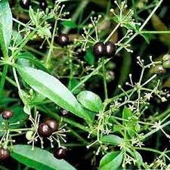
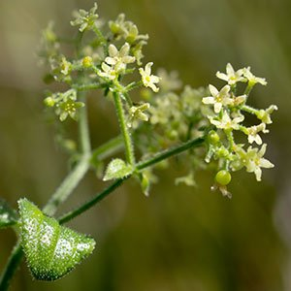
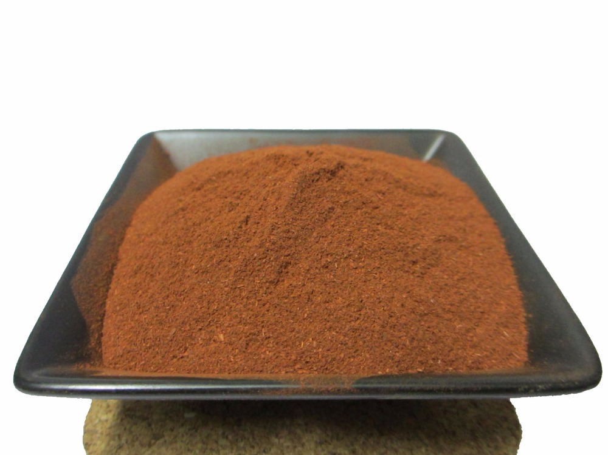
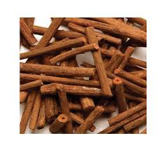
Manjishta (rubia cordifolia Linn.)
-Indian madder/common madder-

Slide 14
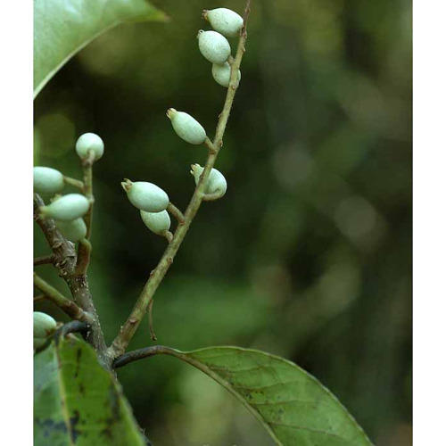
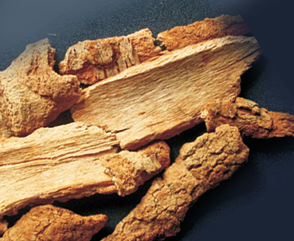
Lodhra – Symplocus racemosa

Slide 15
Case report
Case no.1
Male aged 54 years c/o dimness of vision in both eyes of 5 years duration
Diabetic since 20 years on oral hypoglycemic drugs
o/e his visual acuity was 5/60 in right eye and 6/18 in the left

Slide 16
On direct Ophthalmoscopy
  Micro-aneurisms in mid periphery retina
  Hard exudates in both eyes
  Suggestive NPDR in both eyes

Slide 17
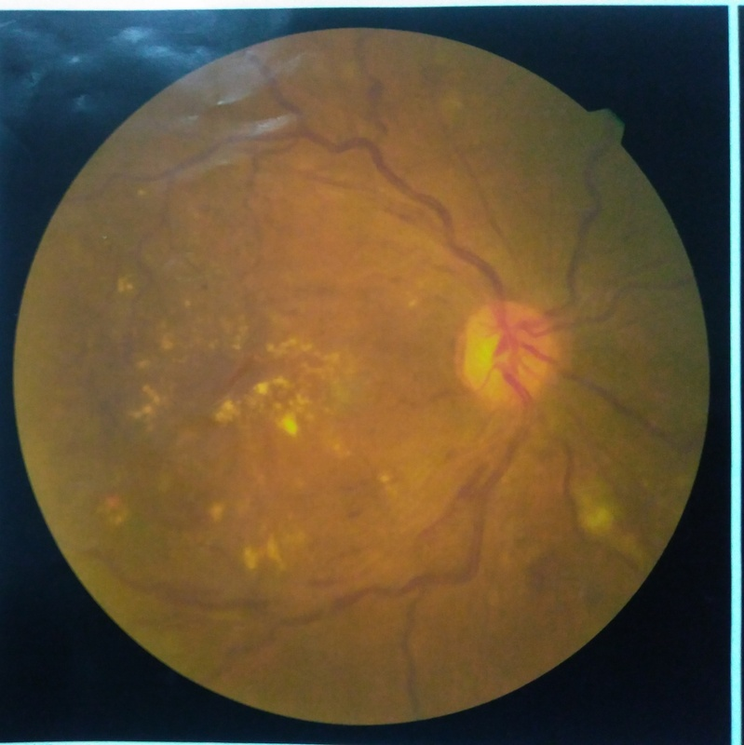
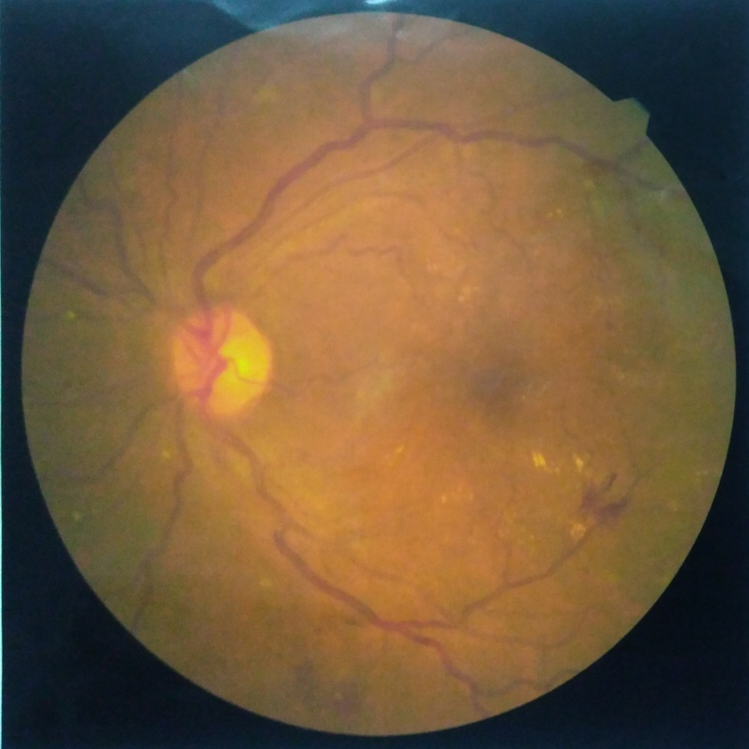

Slide 18
Case no 2
72 year old gentleman c/o dimness of vision for 10 years,
o/e his visual acuity was counting fingers at a distance of 1 meter for both eyes
On direct ophthalmoscopy, his fundus showed evidences of PDR in both eyes

Slide 19
Case no 3
A 60 year old lady consulted in the OPD with c/o dimness of vision in both eyes since 10 years
o/e her visual acuity in right eye was noted as 3/60 and in left eye 6/36
On direct ophthalmoscopy, there was evidence of PDR in both eyes

Slide 20
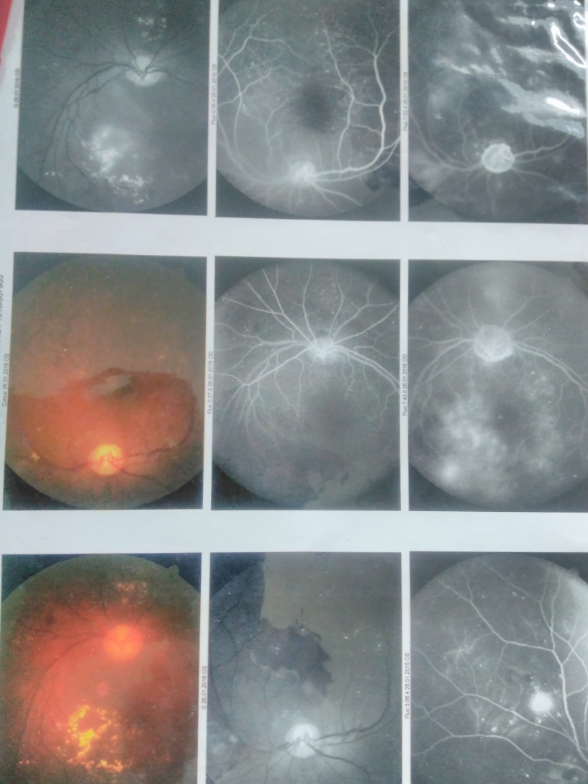
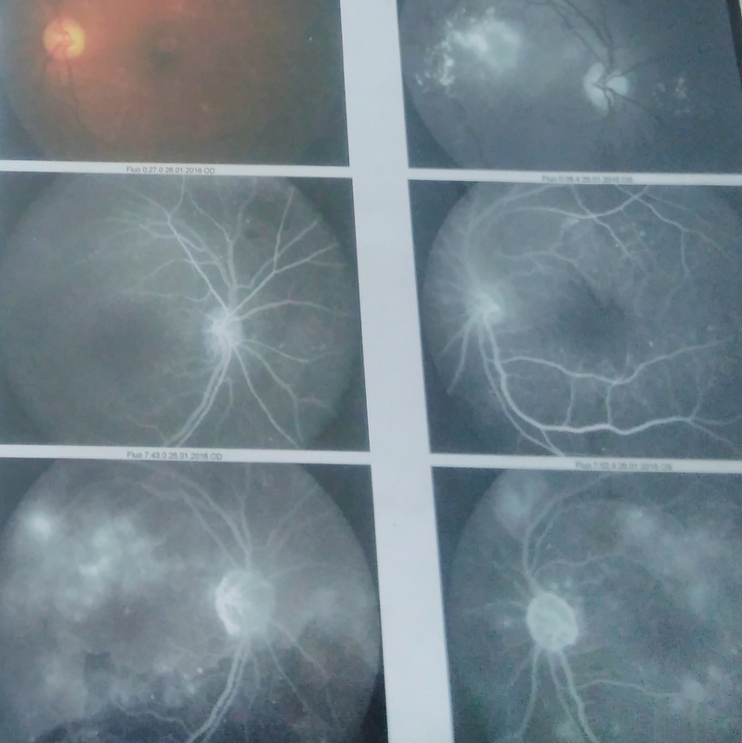

Slide 21
Treatment
Thalapothichil[sirolepanam] with manjishta and lodhra for a period of 7 days
Thalam with kachuradi churnam + manjishtadi tailam for 7 days
Aschyothana with nethramritham eye drops twice daily
Internal medicines
  Pathyakshadhatryadi kwatham 90 ml Bid
  Amrita mehari churnam 5 gms at Bid mixed in buttermilk
  Sapthamritha louham tab 1 at bed time

Slide 22
After 7 days her visual acuity was 6/60 in right eye and 6/36 in the left
The treatment changed
  Thazhi with manjishta and darvi was done for 14 days
  Internal medicines continued
  Visual acuity was again noticed – 6/60 in right and 6/24 in left

Slide 23
Result
In the above three cases, there was marked improvement in the visual acuity
There was mild positive response in the ophthalmoscopic appearance
Improvement in the quality of life was marked
The improvements achieved were maintained in the subsequent follow ups

Slide 24
Visual acuity
 | Right eye before treatment | Right eye after 4 weeks treatment | Left eye before treatment | Left eye after 4 weeks treatment
Case no.1 | 5/60 | 6/24 | 6/18 | 6/12
Case no.2 | 1/60 | 6/60 | 1/60 | 6/36
Case no.3 | 3/60 | 6/60 | 6/36 | 6/24

Slide 25
MEAN VISUAL ACUITY
Before and after treatment

Slide 26
Average improvement in visual acuity

Slide 27
Ophthalmoscopic signs assessed
Micro- aneurisms
Hard exudates
Intra-retinal haemorrhages
Oedema
Cotton wool spots
Venous changes
Arterial changes
Vitreous hemorrhage
Pre-retinal haemorrhage
Neo-vascularization

Slide 28
Scoring of signs
Minimum score 0 no signs
Mild 1
Moderate 2
Severe 3
Max score 3 Min score 0

Slide 29
Ophthalmoscopic signs before and after treatment
signs | Case 1 BT |  | Case 2 BT |  | Case 3 BT |  | Case 1 AT |  | Case 2 AT |  | Case 3 AT
 | R | L | R | L | R | L | R | L | R | L | R | L
1 | 2 | 1 | 2 | 2 | 3 | 2 | 2 | 1 | 2 | 2 | 3 | 2
2 | 3 | 1 | 2 | 3 | 3 | 3 | 2 | 0 | 1 | 2 | 2 | 2
3 | 2 | 1 | 2 | 2 | 2 | 3 | 1 | 0 | 2 | 2 | 2 | 2
4 | 3 | 1 | 2 | 2 | 3 | 3 | 2 | 0 | 1 | 1 | 2 | 2
5 | 0 | 0 | 1 | 1 | 2 | 1 | 0 | 0 | 1 | 1 | 2 | 1
6 | 1 | 1 | 2 | 2 | 2 | 3 | 1 | 1 | 2 | 2 | 2 | 2
7 | 1 | 1 | 2 | 2 | 2 | 2 | 1 | 1 | 2 | 2 | 2 | 2
8 | 0 | 0 | 1 | 1 | 1 | 2 | 0 | 0 | 0 | 0 | 0 | 1
9 | 0 | 0 | 1 | 0 | 1 | 1 | 0 | 0 | 0 | 1 | 1 | 0
10 | 0 | 0 | 1 | 1 | 1 | 1 | 0 | 0 | 1 | 1 | 1 | 1

Slide 30
Mean changes in ophthalmoscopic signs before and after treatment

Slide 31
Overall changes in fundus

Slide 32
Discussion
The diabetic retinopathy is considered as vascular disease
On the basis of Ayurvedic concepts, it may be discussed under the concept of timira – kaacha – linganasa, a group of diseases causing progressive visual loss
The involved dosha is to be assessed as per clinical presentation
In most cases, involvement of all three doshas(viz. vata, pitha and kapha) along with raktha(blood) is evident
Treatment protocol is selected according to the Ayurvedic theorems
The aim was to achieve doshic equilibrium by the use of systemic as well as topical administration of medicines by various means.

Slide 33
Conclusion
Diabetic retinopathy is not mentioned as such in Ayurvedic parlance
Considering the symptomatology, any disease can be approached with Ayurvedic concepts of pathophysiology and management
The unexplored treasures of Ayurveda in such areas has to brought into focus
The possibilities of Ayurvedic treatment modalities in similar cases has to be studied and reported

Slide 34
So that,
Ayurveda can surely help to enhance the eyesight and thereby improve the
quality of life.

Slide 35
References
Jack J Kanski, Clinical Ophthalmology A systematic approach, Bullerworth-Heinanenan, 5th edition
Dr J V Hebbar, Health and lifestyle blog, https:///easyayurveda.com/2013/03/20/manjishta-Rubia cordifolia-benefits - usage - side effects, retrieved on 10th October 2017
Vaghbhata, Ashtangahridaya, Utharasthana, Sarvanga sundara commentary of Arunadatha, Chwkhamba Orientalia, Varanasi, 2007,
Susruta, Susruta Samhita, Utharasthana, commentary by Dalhana, Chowkhamba Krishnadas Acadamy, varanasi, 2007

Slide 36
‘That alone is true which is proved clinically and that which is clinically proved needs no other evidence’
Sir Thomas Lewis
Research in medicine p no.59-1944

Slide 37

THANK YOU

Slide 38
dr. adithya babu p t p
Associate professor
Vaidyaratnam ps varier ayurveda college
Kottakkal, kerala, india, postal code 676501
E mail: adithdr@gmail.com

