Slide 1



About OMICS Group
OMICS Group International is an amalgamation of Open Access publications and worldwide international science conferences and events. Established in the year 2007 with the sole aim of making the information on Sciences and technology ‘Open Access’, OMICS Group publishes 500 online open access scholarly journals in all aspects of Science, Engineering, Management and Technology journals. OMICS Group has been instrumental in taking the knowledge on Science & technology to the doorsteps of ordinary men and women. Research Scholars, Students, Libraries, Educational Institutions, Research centers and the industry are main stakeholders that benefitted greatly from this knowledge dissemination. OMICS International also organizes 500 International conferences annually across the globe, where knowledge transfer takes place through debates, round table discussions, poster presentations, workshops, symposia and exhibitions.

Slide 2
About OMICS International Conferences
About OMICS Group
OMICS International is a pioneer and leading science event organizer, which publishes around 500 open access journals and conducts over 300 Medical, Clinical, Engineering, Life Sciences, Pharma scientific conferences all over the globe annually with the support of more than 1000 scientific associations and 30,000 editorial board members and 3.5 million followers to its credit.
OMICS International has organized 500 conferences, workshops and national symposiums across the major cities including San Francisco, Las Vegas, San Antonio, Omaha, Orlando, Raleigh, Santa Clara, Chicago, Philadelphia, Baltimore, United Kingdom, Valencia, Dubai, Beijing, Hyderabad, Bengaluru and Mumbai.

Slide 3
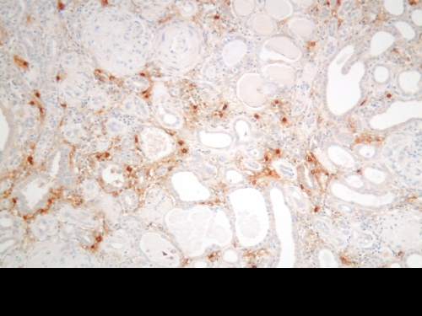
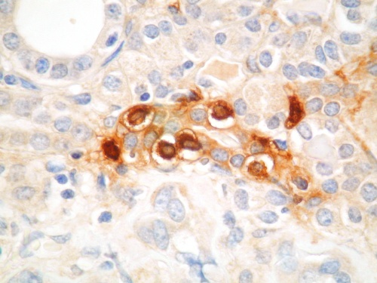
TRYPTASE AS A NOVEL MARKER FOR AML AND CML PATIENTS
Dr Pratap Singh Ghalaut
Sr Prof & Head
Dept of Medicine
PGIMS, Rohtak

Slide 4
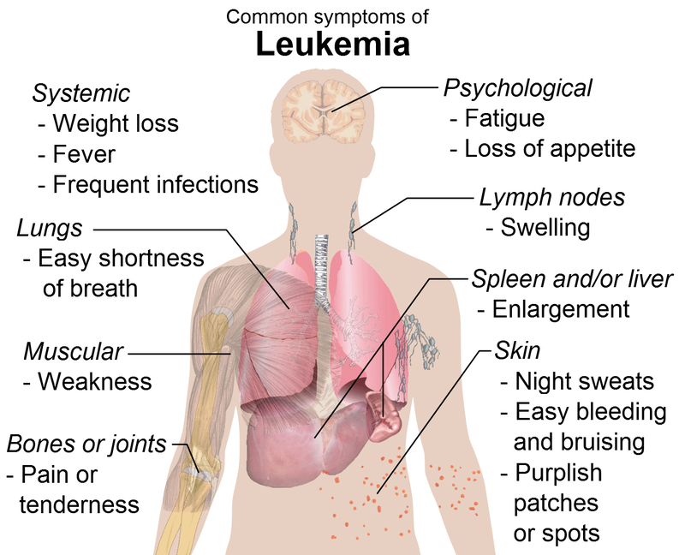
Leukemia
Neoplastic proliferative disorders of bone marrow or blood cells
Types: Myeloid and Lymphoid
Both can be acute or chronic

Slide 5
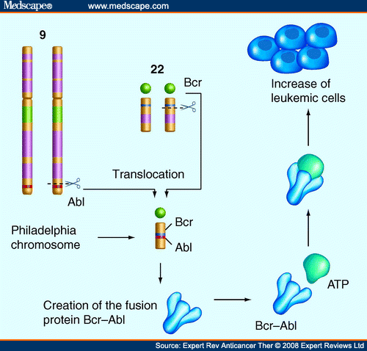
Bcr-abl in leukemia

Slide 6
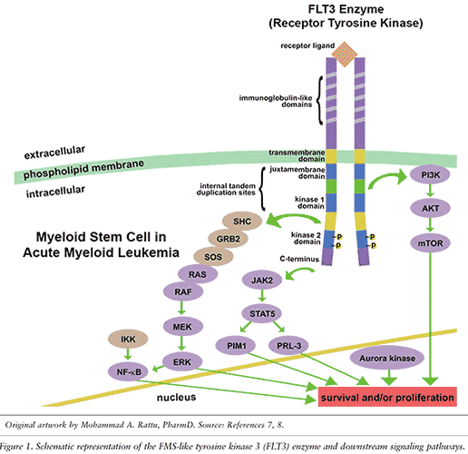
Common pathogenic feature
Mutated
Constitutively activated
Tyrosine kinase

Slide 7

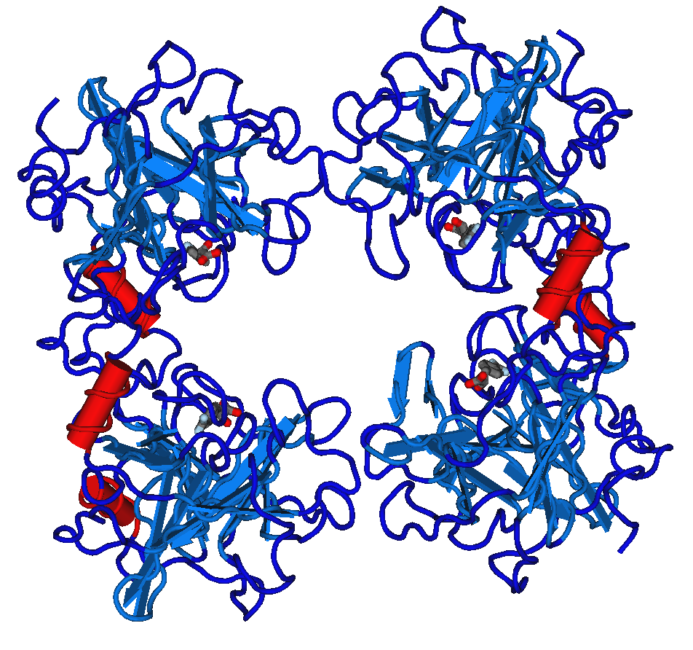
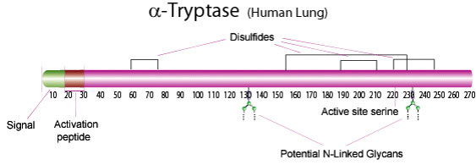
Tryptase
Serine protease expressed in mast cells
Marker of mast cell activation
α β and δ genes and alleles have been identified

Slide 8
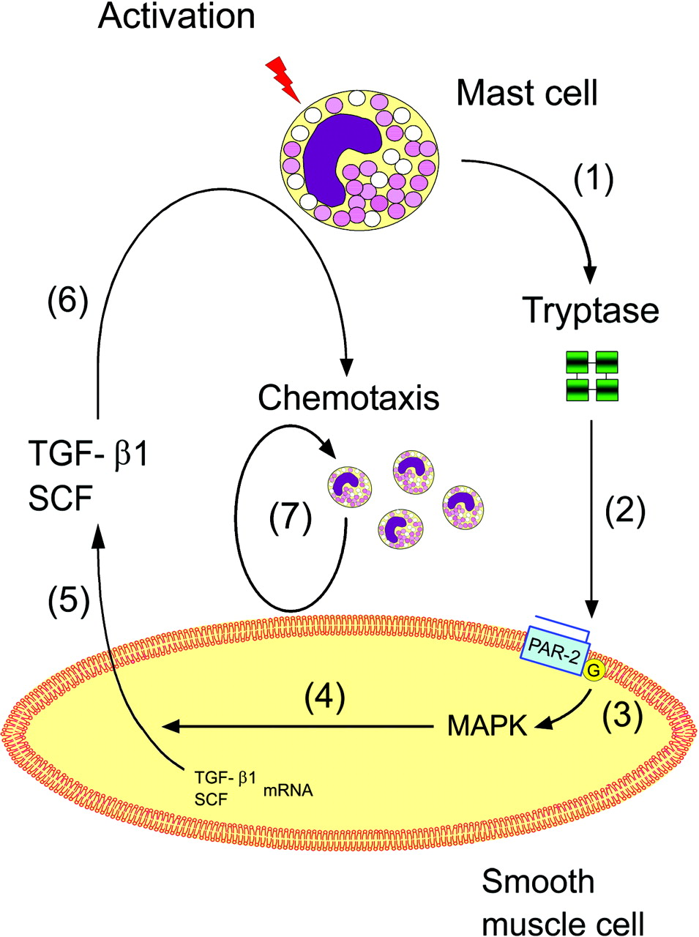
Tryptase AND MAST CELLS

Slide 9
Elevated total Tryptase:
Acute Myelocytic leukemia
Myelodysplastic syndrome
Hypereosinophilic syndrome

Slide 10

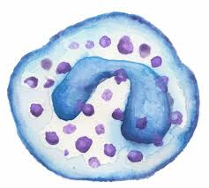
Tryptase is expressed in
Myeloblasts in AML
Basophils in CML
Tryptase estimation in CML & AML : prognostic significance

Slide 11
Aims & Objectives
To evaluate & compare the levels of serum Tryptase in patients of AML& CML before and after treatment
To evaluate & compare the levels of serum Tryptase in patients of AML& CML with controls

Slide 12
Material and Method
20 AML patients
20 CML patients
40 age & sex matched healthy controls
Diagnosis: TLC, DLC, Bone marrow, cytogenetics

Slide 13

CR induction regimes
Cytarabine and Anthracycline
Cytarabine is usually administered as a continuous intravenous infusion for 7 days.
Anthracycline therapy generally consists of daunorubicin intravenously on days 1, 2, and 3 (the 7 and 3 regimen).
After induction chemotherapy, if persistence of leukemia is documented, the patient is usually re-treated with cytarabine and an anthracycline in doses similar to those given initially, but for 5 and 2 days, respectively.

Slide 14
Sample collection
5 ml venous blood was collected:
At the time of diagnosis
After 3 months of treatment
Healthy controls
Serum Tryptase analyzed by kit based on double-antibody sandwich enzyme-linked immunosorbent assay (ELISA) to assay the level of Human Mast Cell Tryptase (MCT) in samples

Slide 15
Results and observations
 | Parameter | AML | CML
1. | Mean age | 58.4±15.73 years | 51.4±13.27 years
2. | Male to female ratio | 1.5: 1 | 1.8: 1
3. | Mean Hb (g/dl) | 8.17g/dl | 10.3g/dl
4. | Total leukocyte count | 16530/mm³ | 152650/mm³
5. | Platelets | 78525/mm³ | 4.2 lakhs/mm³
TABLES no 1. Mean values of cases of AML and CML

Slide 16
Results and observations continued...
s. no | Parameter | AML | CML
1. | Mean value of % peripheral blasts at diagnosis | 5.79±19.65 | 7.95±5.90
2. | Mean value of % peripheral blasts after chemotherapy | 5.9±14.36 | 1.45±4.35
3. | Reduction in % of peripheral blasts significance, p value | < 0.001 | <0.005
4. | Serum tryptase before chemotherapy (cases) | 19.3±9.04ng/dl | 17.22±8.64ng/dl
5. | Serum tryptase (controls) | 5.32±2.84ng/dl | 5.15±2.66ng/dl
6. | Difference between cases and controls, p value | <0.000 | <0.000
7. | Difference between cases before and after chemotherapy, p value | <0.003 | <0.017
TABLE no 2. Percentage of Blasts and Serum Tryptase in AML and CML

Slide 17
Results and observations continued...
 | AML |  | CML
 | Normal tryptase levels (<15ng/dl) | Elevated tryptase levels (>15ng/dl) | Normal tryptase levels (<15ng/dl) | Elevated tryptase levels (>15ng/dl)
Number of cases | 12 | 8 | 13 | 7
Percentage of blasts | 44.16±11.47 | 78.50±9.41 | 3.76±1.23 | 15.71±2.21
TABLE no 3 SERUM TRYPTASE LEVELS AND BLASTS %

Slide 18
It has been observed :
Increased serum Tryptase in patients of AML & CML at the time of diagnosis
Significant decrease after complete remission

Slide 19
All CML cases in present study was Philadelphia chromosome positive.
Imatinib binds at ATP binding site of BCR/ABL resulting in “switching off” the signalling pathway which promote abnormal growth

Slide 20
discussion
Recent studies have shown that a number of myeloid leukemia cell lines also express substantial amounts of tryptases.
In present study out of 20 AML & 20 CML patients 8 & 7 were showing raised (>15ng/dl) levels respectively
Sperr et al done study on AML patients and reported that in these patients serum tryptase level were elevated and reflect the total burden of leukemic cells.
Our data showed that levels of tryptase were elevated at the time of diagnosis in 40 percent patients of AML and 35 percent patients of CML

Slide 21
After chemotherapy 80 percent patients of AML and 90 percent patients of CML achieved complete remission and levels of serum tryptase were significantly reduced after chemotherapy in patients who achieved remission.
Similar significant reduction in percentage of blast cells were observed in patients who achieved remission after chemotherapy.
Significant decrease in serum tryptase levels were seen during induction treatment, and at the time of complete remission in the majority of the patients parameters returned to normal limits, whereas blast cell persistence was associated with a persistently elevated enzyme level

Slide 22
Similar finding were reported in various studies by Puchit, Kiener, Schwartz, Jordan and Sperr in myeloid leukemia. They found that s.tryptase levels were elevated in patients of AML and CML at the time of diagnosis
Sperr et al reported that under physiological condition myeloid cells (except mast) are virtually tyrptase negative

Slide 23

Conclusion
Tryptase may be useful for diagnosis, assessment of severity of disease (leukemic cell burden), monitoring minimal residual disease and prognosis of both AML and CML patients.

Slide 24
THANK YOU

Slide 25
Let Us Meet Again
We welcome you all to our future conferences of
OMICS International
Please Visit:
www.metabolomicsconference.com
www.conferenceseries.com
http://www.conferenceseries.com/clinical-research-conferences.php

