Slide 1
A decade of multi-drug resistant
N. gonorrhoea in Coventry, UK
2007 to 2016.
Dr Sris Allan, MBBS, FRCOG, FRCP
Consultant GU/HIV physician,
Hon Associate Professor,
Coventry, UK

Slide 2
- The world’s first documented case of treatment failure to dual ceftriaxone (MIC 0.25mg/L) and azithromycin (MIC 1.0mg/L) was reported in
England in 2015
- This was an imported isolate from Japan.
- No Treatment failures of gonorrhoea acquired within the UK have been identified.
- Our concern is the emergence of high level resistance to azithromycin (>256mg/L MIC)

Slide 3
WHO
Antibiotic Resistant gonorrhoea on the rise, new drugs are needed.
An estimated 78 million people are infected with N.g.
Widespread resistance to older and cheaper antibiotics

Slide 4
Surveillance
Local
National
Global

Slide 5
Microbiology:
Neisseria gonorrhoea
Neisseria Meningitidis
Gram – Negative diplococci

Slide 6
N. gonorrhoea
Columnar epithelial,
Transitional Epithelium - Mucosal surface
Endocervix
Urethral
Rectum
Pharynx
Conjunctive – adult as well as
Ophthalmia Neonatorum

Slide 7
N. gonorrhoea
No polysaccharide capsule but has multiple serotype
Marked antigenic variation in the gonococcal pili
More than 100 serotypes
3 outer membrane proteins (I, II, III)
Protein II plays a role in attachment

Slide 8
Pathogenesis
Only in humans
Sexually transmitted
Neonatal infection
N. g is very sensitive to dehydration and cool conditions

Slide 9
Pili
Virulence
Mediate attachment
Antiphagocytic

Slide 10
Virulence
Factors in the cell wall
Endotoxin (Lipo oligo saccharide , Los)
Outer membrane proteins
IgA Protease – Hydrolyze secretory IgA

Slide 11
Main host defence
IgA and IgG
Complement
Neutrophils

Slide 12
Laboratory Diagnosis
Gram Staining
NAAT
Culture
Specimen collection

Slide 13
Clinical features
Men – Urethral infections
– urethral discharge >80%
- Dysuria >50%
- Can be asymptomatic ≈10%

Slide 14
Rectal Infection:
- usually asymptomatic
- Discharge ≈ 12%
- Pain/discomfort 7%
Pharyngeal Infection:
- Usually asymptomatic >90%

Slide 15
Women:
- Endocervix, Asymptomatic ≈50%
- Increased vaginal discharge ≈50%
- Lower abdominal pain up to 25%
- Urethral infection, dysuria ≈12%

Slide 16
Complications:
Transluminal spread
- epididymis, prostate ≈ 1%
- endometrium, pelvic organs <10%
Disseminated infection: <1%
- arthritis, tenosynovitis
- skin infections
- Ophthalmia Neonatorum

Slide 17
Treatment:
Prior to 1950:
Penicillin
Low level resistance to Penicillin,
Tetracycline mediated through chromosome.

Slide 18
1976 – Penicillinase – Producing N.g.
- High level resistance
- through Plasmid encoded
1980/90 - Fluoroquinolones resistance
- Ciprofloxacin
2000 - Cephalosporines
2008 - Ceftriaxone 500g IM and
Azithromycin 1g stat

Slide 19
Alternative therapy:
- Cefixime 400mg oral – single dose
- Spectinomycin 2g IM
- Azithromycin 2g Stat
- Ciprofloxacin 500mg oral

Slide 20
Pregnancy & breast feeding
- Ceftriaxone 500mg IM &
Azithromycin 1g

Slide 21
Gonococcal PID:
Ceftriaxone 500mg IM stat & Doxycycline 100mg BD + Metronidazole 400mg BD for 14 days

Slide 22
Gonococcal Conjunctivitis:
Ceftriaxone 500mg IM daily for 3 days, irrigate the eye with saline/water.

Slide 23
Disseminated gonococcal infection:
Ceftriaxone 1g IM or IV for 7 days, may be switched to oral treatment after
48 hours if symptoms improve, ie Cefixime 400mg BD.

Slide 24
Test of Cure:
Two weeks after completion of treatment.
- Asymptomatic patients – NAAT
- Symptomatic patients – culture
≈ 72 hours after treatment

Slide 25
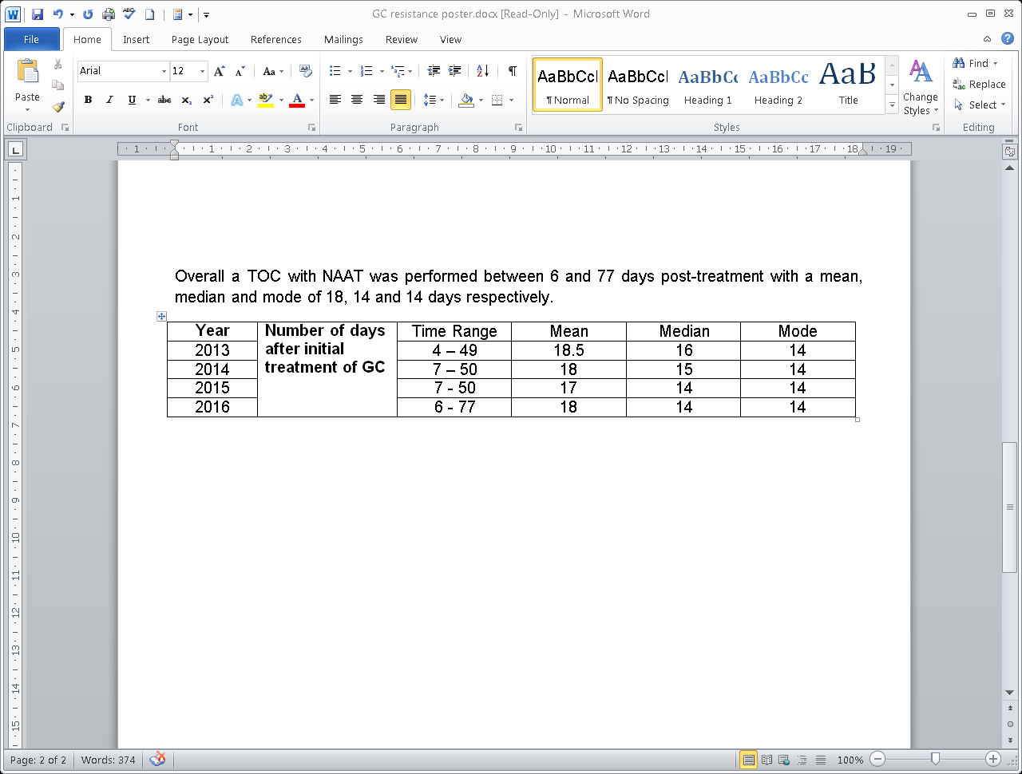

Slide 26
Abstract:
Antibiotic resistance to Neisseria gonorrhoea(N.g) is rapidly developing and changing worldwide.

Slide 27
Methods:
All N.g cases in our clinic between 1st January to 30th June 2007 to 2016 were identified and analysed for antibiotic sensitivity.

Slide 28
Antibiotic Resistance profiles | 2007 | 2009 | 2011 | 2012 | 2013 | 2014 | 2015 | 2016
Total number of cases | 41 | 78 | 75 | 66 | 136 | 126 | 151 | 131
Percentage of GC fully sensitive to antibiotic testing panel | 46% | 67% | 59% | 49% | 79% | 59% | 43% | 55%
Reduced susceptibility to 1 antibiotic group | 27% | 15% | 20% | 38% | 10% | 20% | 23% | 23%
Multi-drug resistant | 27% | 12% | 21% | 11% | 8% | 21% | 26% | 23%
Reduced susceptibility to Cefuroxime | 0% | 0% | 0% | 0% | 0% | 0% | 0% | 1%

Slide 29
 | Fully Sensitive N.G | MDR
Number | 43 | 18
Age (yrs) mean | 24 | 30 | P=0.02
PH Chlamydia | 5% | 27% | P=0.05
PH GC | 18% | 22% | P=0.51 (NS)

Slide 30
Conclusion:
The emergence of cephalosporin resistance is a worrying trend. Continued close monitoring with research to identify new treatment is urgently needed.
Research to predict MDR N. gonorrhoea infection is an urgent priority for the international scientific community.

Slide 31
Prevention:-
Condoms
Prompt treatment
Contact tracing
Symptomatic Male patient:
- All partners within the last 2 weeks
or the last partner if more than 2 weeks
Asymptomatic Male patient – 3 months
Women – 3 months

Slide 32
New Diagnosis of gonorrhoea in England >40,000 in 2015/2016
High risk groups – MSM
- Black Caribbean

Slide 33
Prescribing practice in England 91% of patients received the recommended therapy.
97% in Coventry, UK

Slide 34



Slide 35
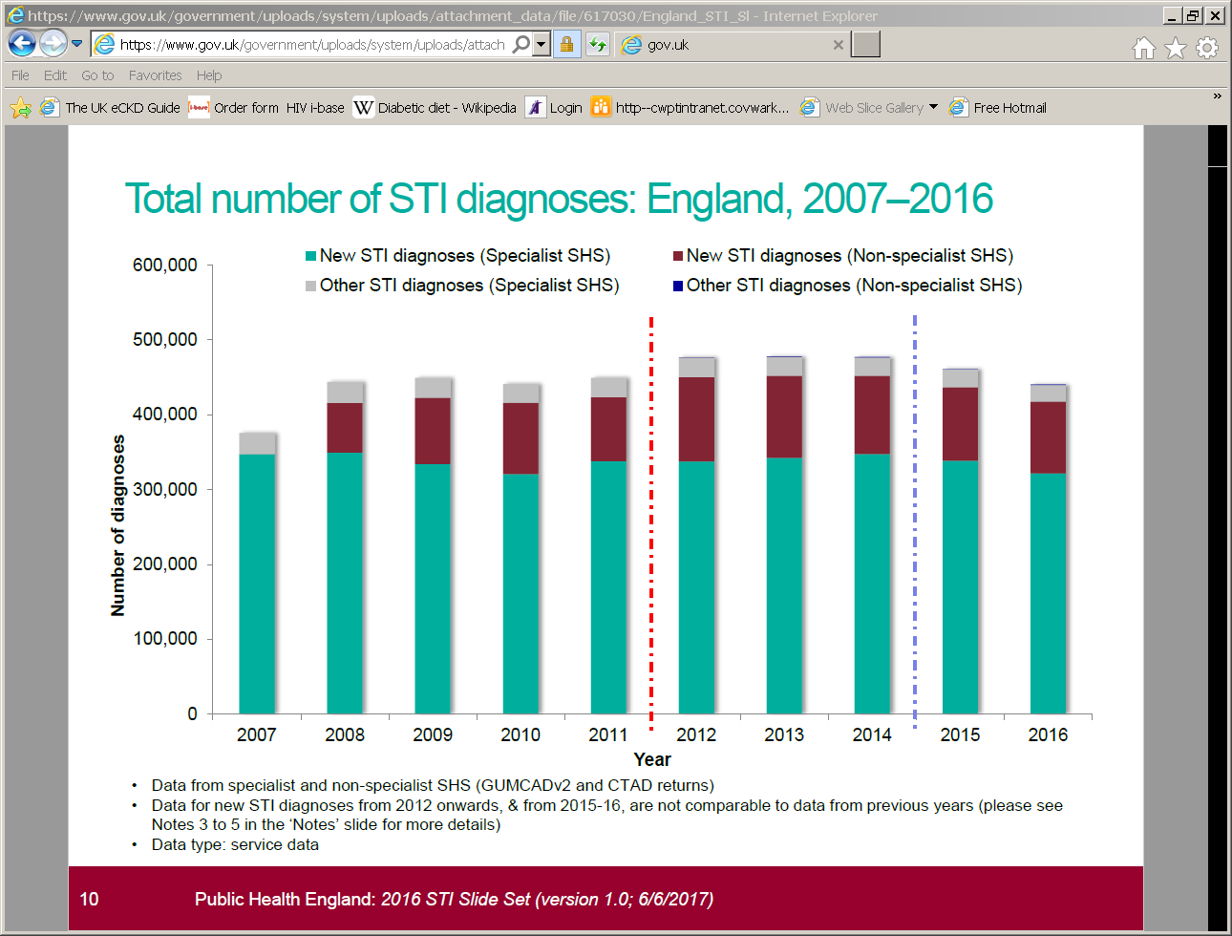

Slide 36
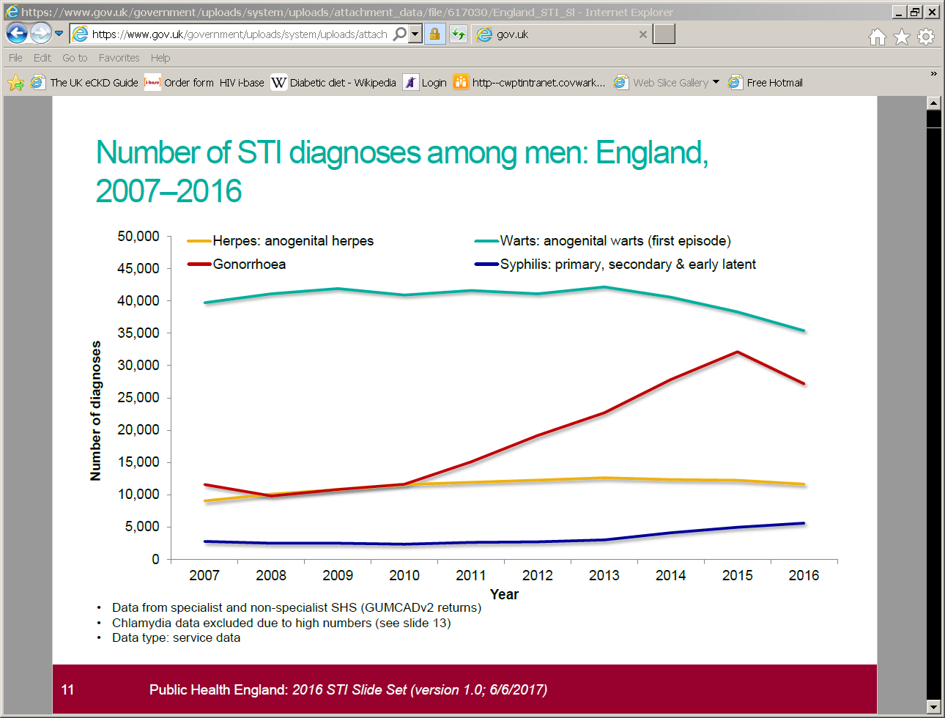

Slide 37
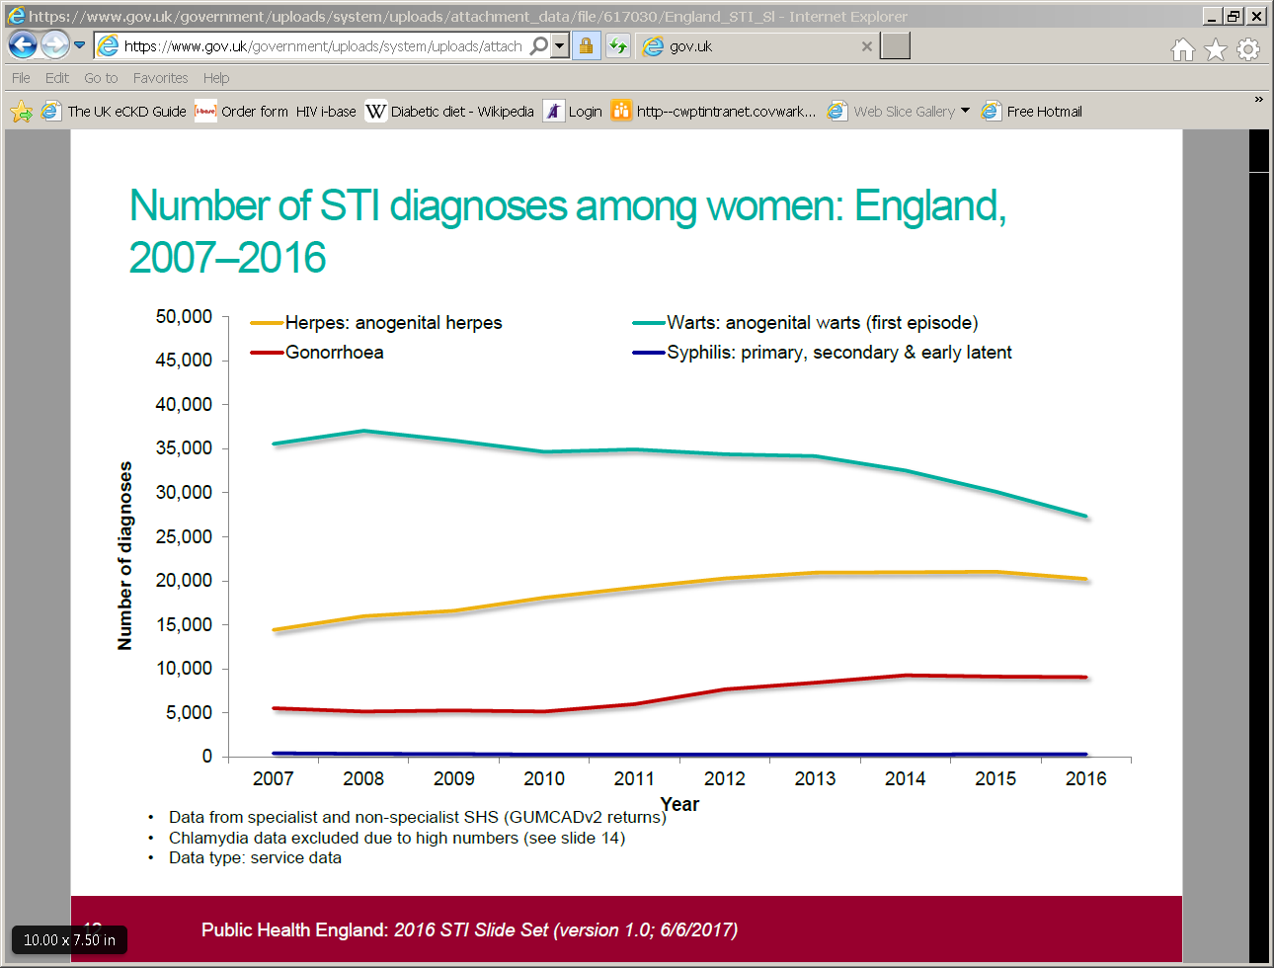

Slide 38
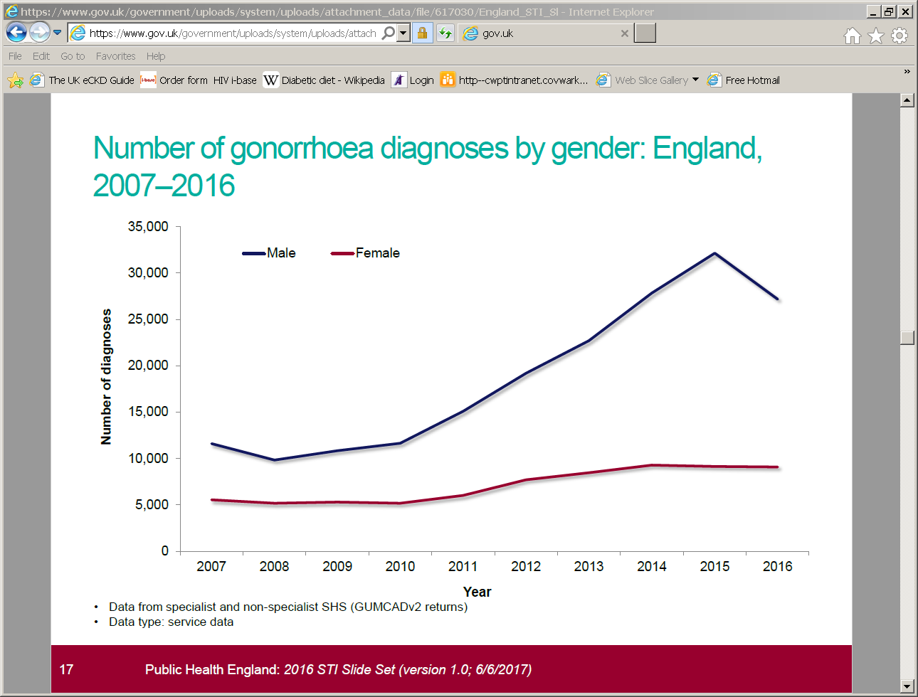

Slide 39
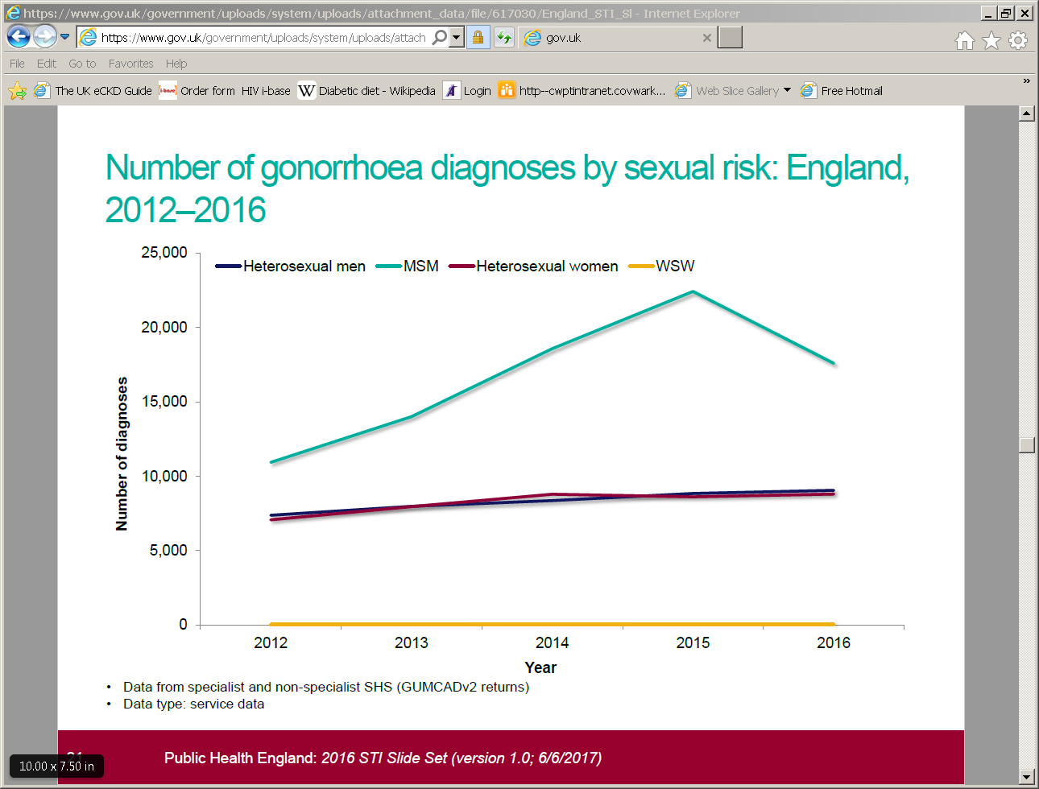

Slide 40
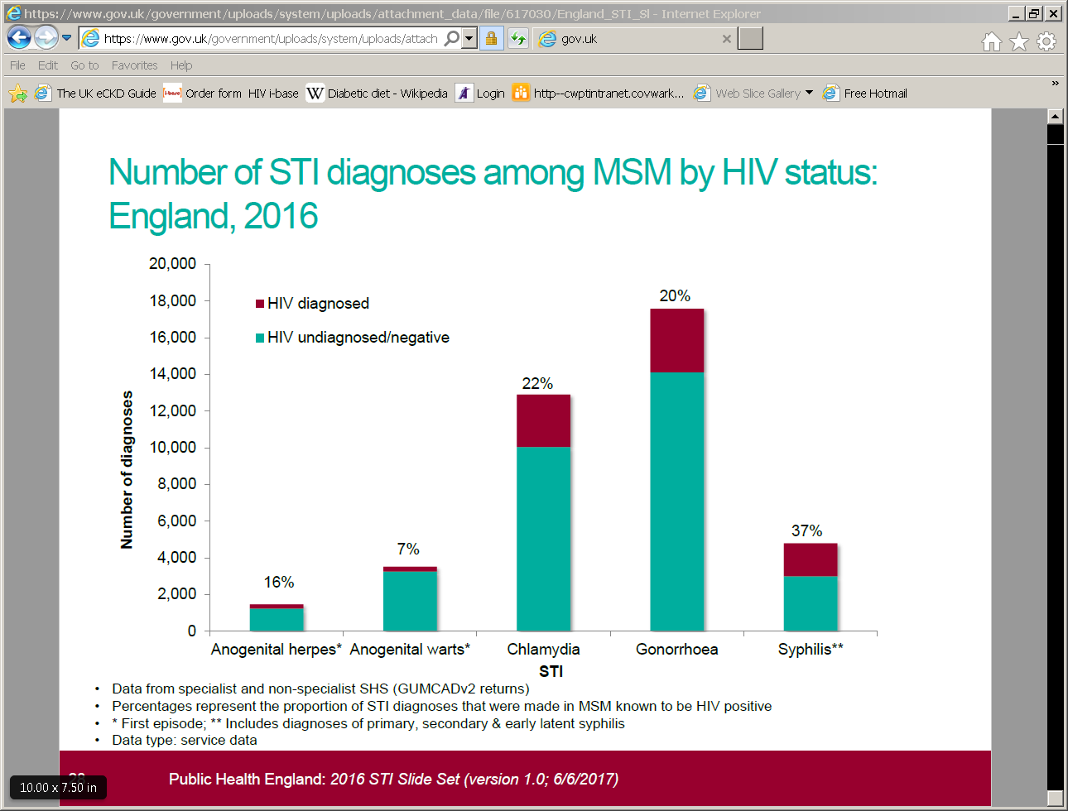

Slide 41
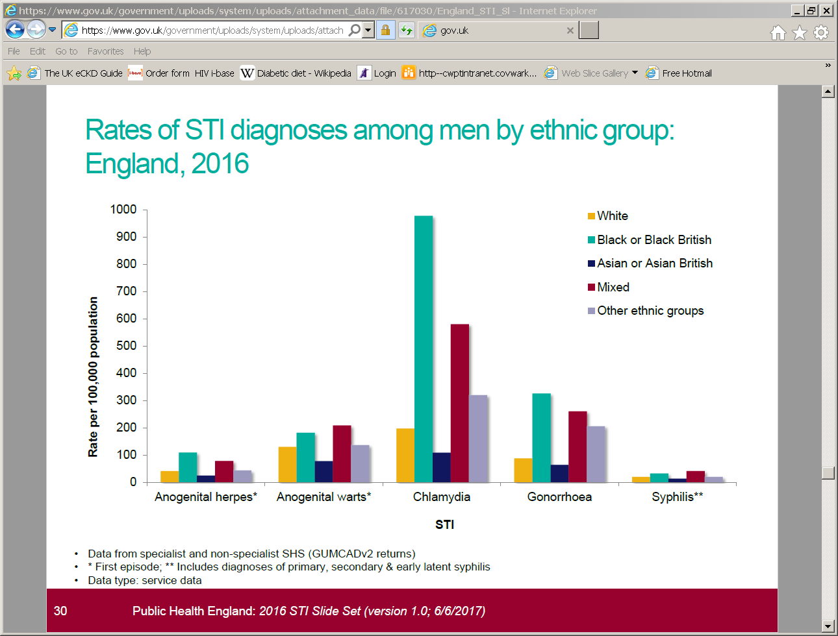
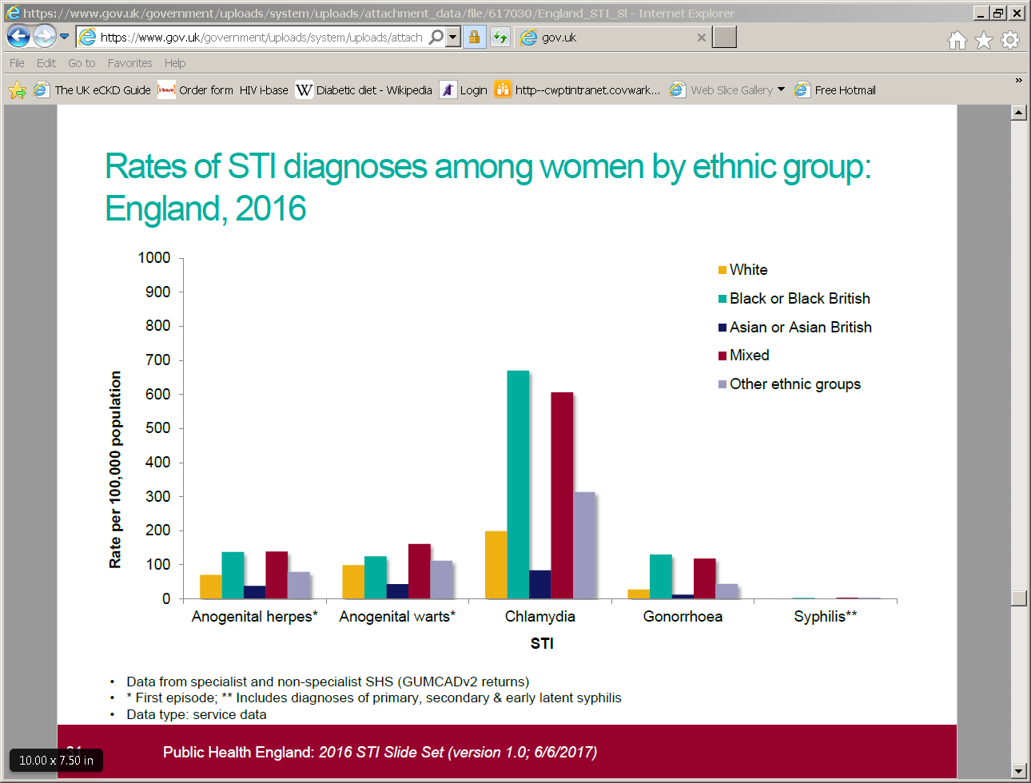

Slide 42
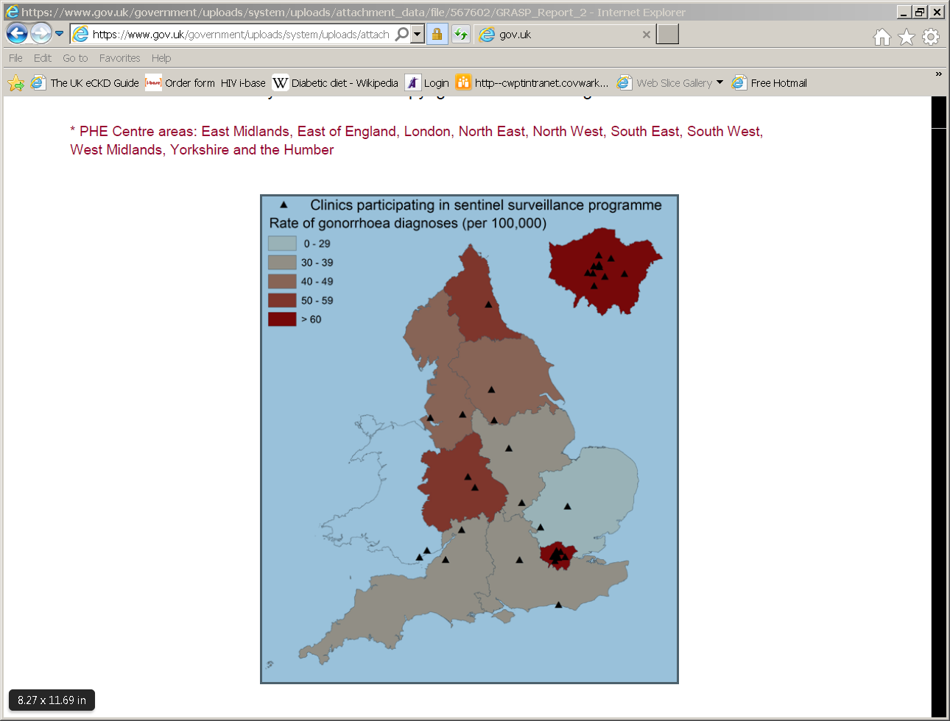

Slide 43
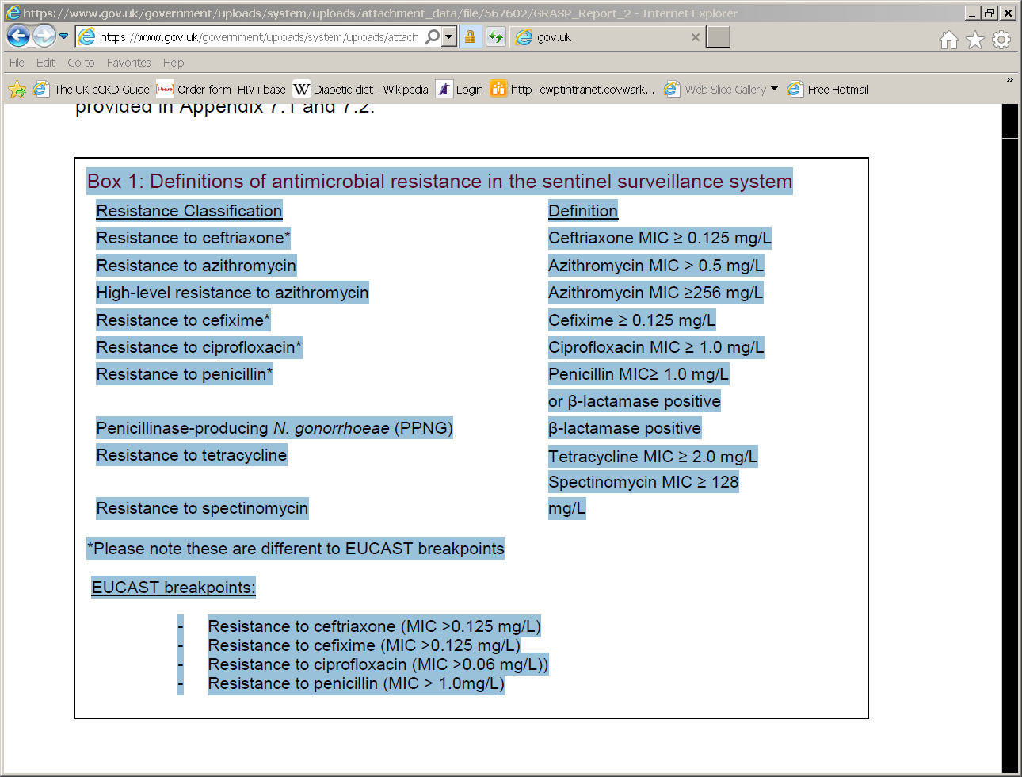

Slide 44
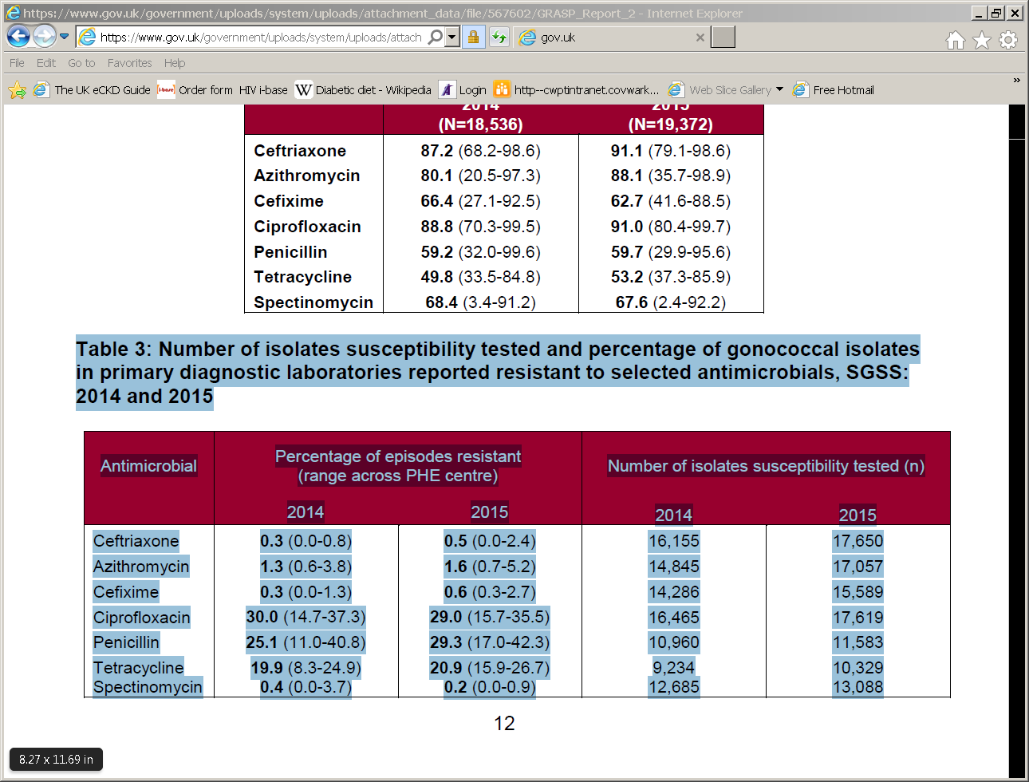

Slide 45
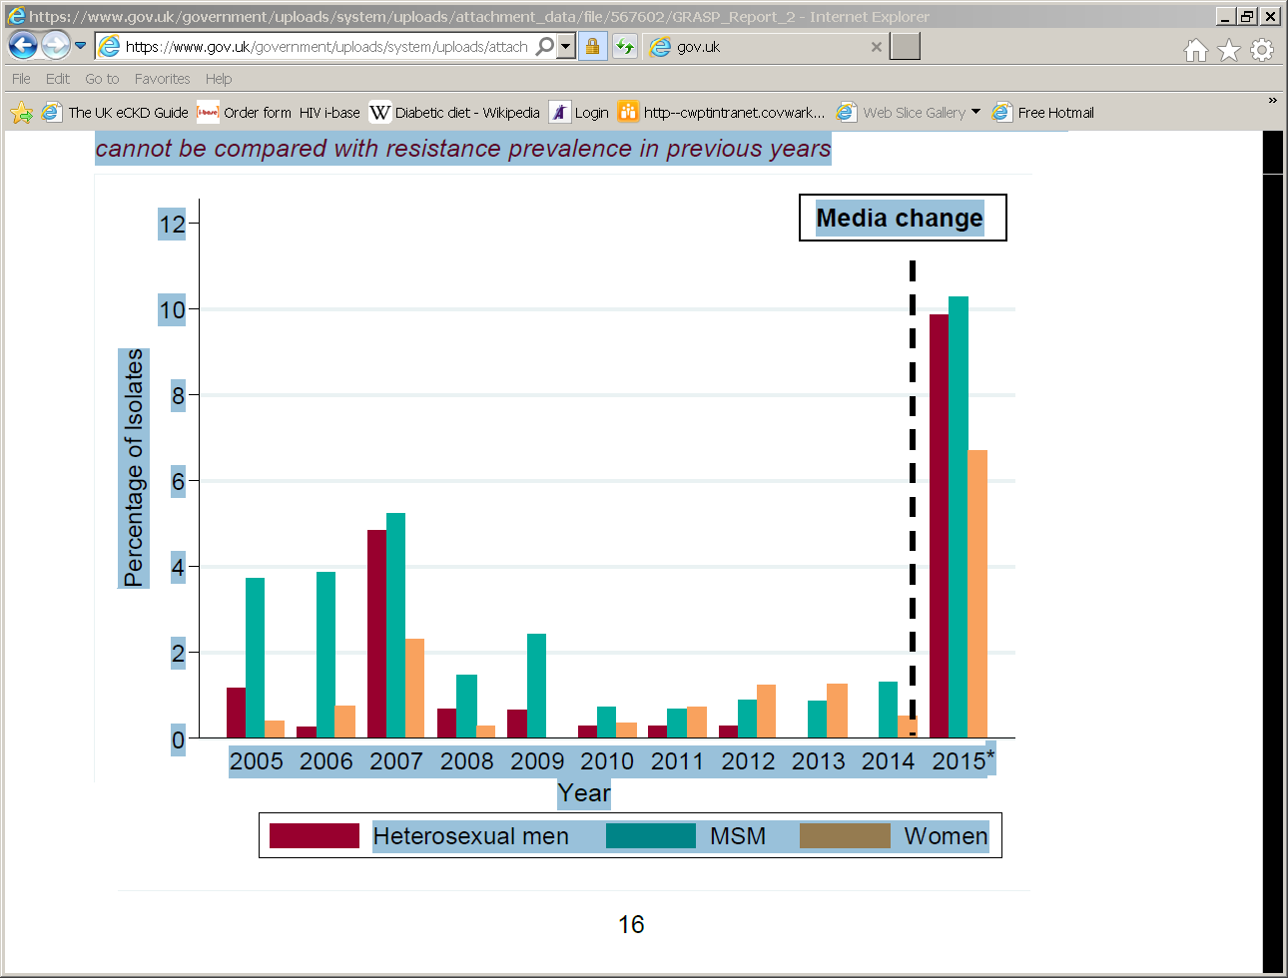

Slide 46
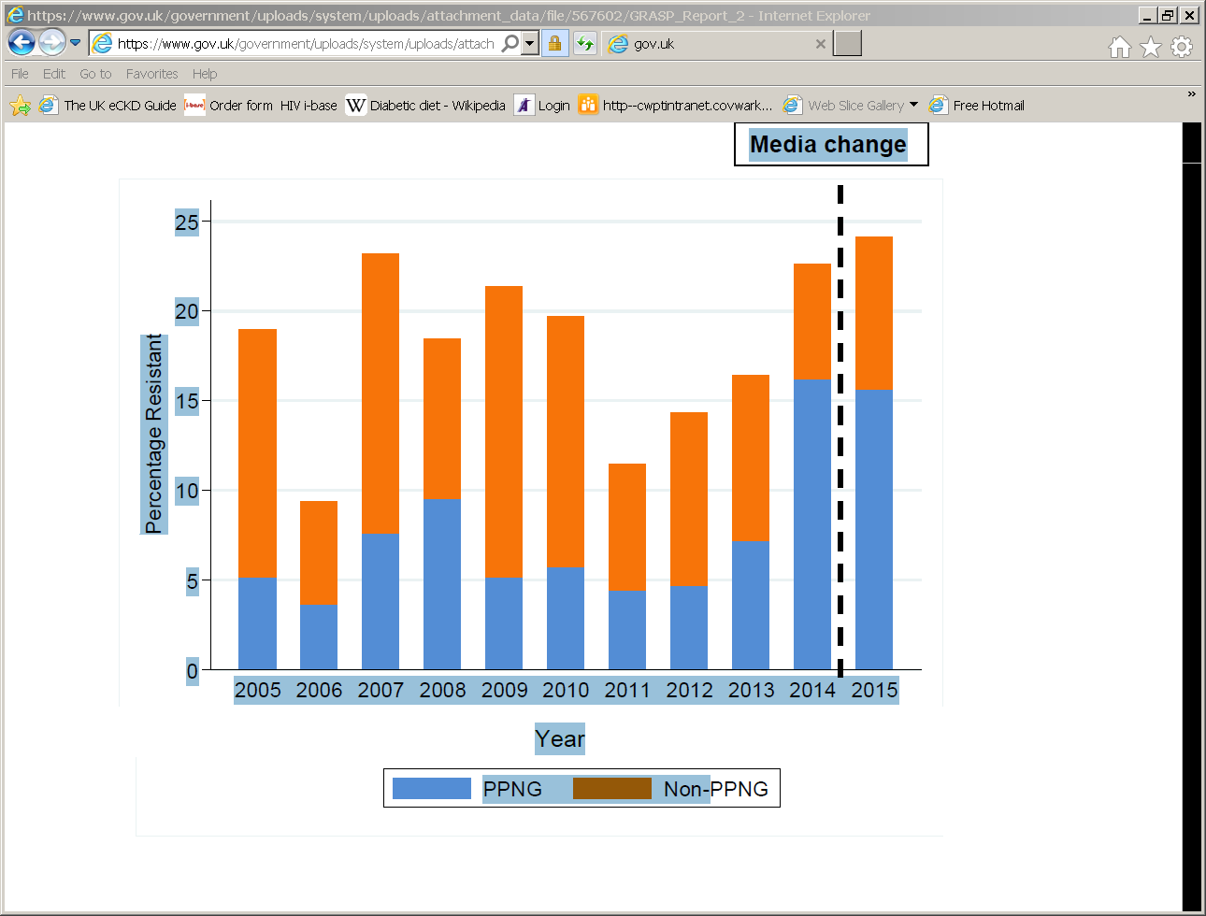

Slide 47
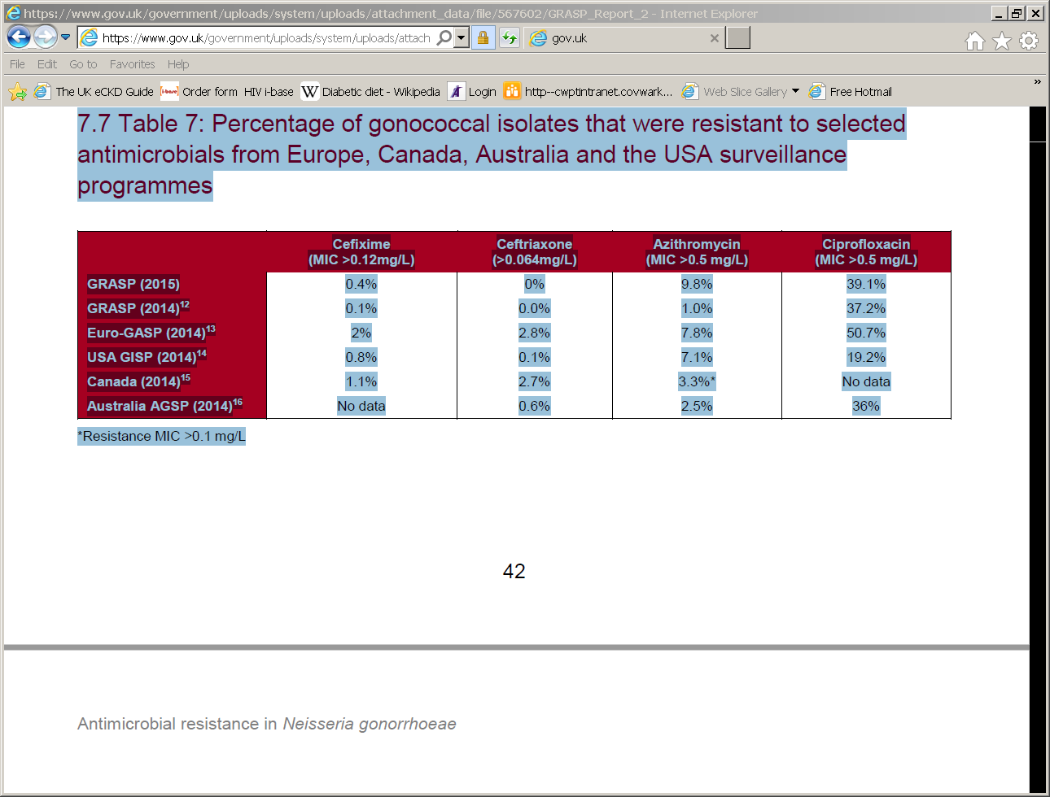

Slide 48
Neisseria gonorrhoea
Continued surveillance in all parts of the world.
Prompt and appropriate treatment.
Partner notification and management.
Prevention.
Research into new antibiotics.

