Slide 1
Speech on
A lean startup strategy to overcome the entrepreneurial challenges in Bio-energy sector: in context of National Mission for a ‘Green India’
by
Dr. P.PACHAURI
Director (Projects & Planning)
Noida institute of Engineering & Technology (NIET)
19, Knowledge Park-II, Greater Noida-201306, UP, India
Email: ppachauri@niet.co.in, profpachauri@gmail.com
(M)+91 9910076602, 9911900314
In
5th World Bioenergy Congress and Expo
June 29-30, 2017 Madrid, Spain

Slide 2
Contents
S.No | Particulars | Slide Number(s)
1 | The National Mission for a Green India (GIM) | 3-9
2 | Why is India a great Business destination | 10-16
3 | Lean startup strategy | 17-26
4 | How to begin | 27-29
5 | Government Schemes | 30-34
6 | Conclusion | 35

Slide 3
The National Mission for a Green India(GIM) ??

Slide 4
The National Mission for a Green India (GIM)
The Mission aims at addressing climate change by enhancing carbon sinks in sustainably managed forests and other ecosystems; adaptation of vulnerable species/ecosystems to the changing climate; and adaptation of forest dependant local communities in the face of climatic variability.
The Mission acknowledges the influences that the forestry sector has on environmental amelioration though climate mitigation, food security, water security, biodiversity conservation and livelihood security of forest dependant communities.

Slide 5
The objectives of the GIM
The objectives of the mission are three-fold:
Double the area to be taken up for afforestation in India in the next 10 years. The mission includes forests and non forest public lands as well as private lands.
Increase the Green House Gases (GHG) removal to 6.35% of India’s annual total GHG emissions by the year 2020.
(it would be an increase of 1.5% in the absence of the Mission).
Enhance the resilience of ecosystems – enhance infiltration, groundwater recharge, stream and spring flows, biodiversity value, provisioning of services (fuel wood, fodder, timber, NTFPs, etc) to help local communities adapt to climatic variability.

Slide 6
Time frame and Cost of GIM
The implementation period of the GIM is 10 years, (from FY 2010-2011 to FY 2019-2020).
Total mission cost is estimated to be Rs 44,000 Crores for achieving following targets:
Governance through secure tenure and capacity enhancement
Strengthening local community institutions
Improving investment climate for planting and forest conservation
Improved monitoring at planning, input, outcome, and impact level
Making the Mission a people’s program

Slide 7
Sub Missions of GIM:
Enhancing climatic resilience in moderately dense forests
Eco - Restoration of open forests
Restoration of scrub/grasslands
Restoration of new mangroves
Restoration of Wetlands
Enhancing tree cover in Urban & Peri-Urban areas (including institutional lands)
Agro forestry and social forestry (increasing biomass & creating carbon sink)
Securing Corridors to help species adapt to climate impacts
Improving fuel use efficiency and promoting alternative energy sources

Slide 8
Entrepreneurial avenues in Green Business
Starting and running the green business
Green Business Idea
Basic Concepts of Green Business
As an entrepreneur, it is very important to know that your green business can help to enhance capacities to cope with climate change risks.
The developing countries like India need them more than business as usual.
A green business can help to increase the Green House Gases (GHG) removal.

Slide 9
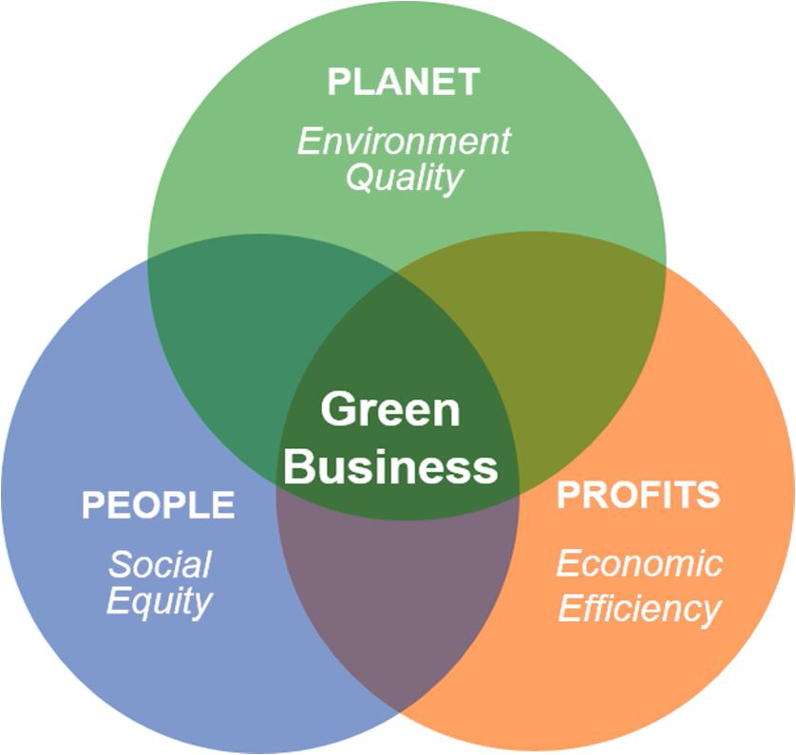
Green Business Pillars
Recycling and Waste Reduction
Reduce, reuse and recycle
Separate waste and dispose in suitable way
Energy and Water conservation
Save water, electricity, and heat
Generate Electricity using Renewable resources
Prevent Pollution
Use low emission equipments
Produce environmentally sustainable products

Slide 10
Why is India a great Business destination ??

Slide 11
Why is India a great Business destination ??
India is at crossroads where it now has to cater to the aspirations of a billion people.
Existing frameworks can prove to be inadequate and there is a great need to leverage a billion minds and become a global power.
Startups and entrepreneurship is the best way forward in becoming a knowledge superpower.
India is seeing a growth phase. People who are passionate to create great things, and companies that aspire to solve bigger problems are able to do much better than those who just look around for funding and money.

Slide 12
Business Opportunities in India
India was ranked as one of the ten largest economies in the world in 2010, and it was expected to continue to grow rapidly over the next two decades.
As per the Government of India reports, the Gross Domestic Product (GDP) of India has risen to $ 2.48 trillion by 2016.
The national and state level policy makers realize that if India has to sustain GDP growth rates the green businesses in particular have the potential to enable this growth.
The economic growth can go hand in hand with environment sustainability and green job creation for inclusive social development.
Per capita energy consumption in India is 1075 kWh (2015-16) and it is rising at the rate if 6% per annum.

Slide 13
The entrepreneurial atmosphere in India
At the 11th edition of E-Summit at IIT-Bombay, Niti Aayog CEO Amitabh Kant briefed that:
India has with a young population below 32 years that account for 72 percent of the population unlike the ageing population in the west.
The challenge for India is to grow at 8-9 percent for three decades or more so as to lift the poor out of the poverty line.
By 2022-23, India should have 100,000 startups at a valuation of Rs 75,000 billion. At the same time India will be confronted with challenges like plastic, sewage, water management, etc.
The other big challenge for the country is urbanisation. Around 600-700 billion people will migrate to urban areas for which the country will have to create regions that are 2.5 times the size of America.
Electrical vehicles, climate change are critical for India and need innovation.

Slide 14
Why Green Business ??
Because,
This presents an opportune time for entrepreneurs to get associated with green business, either by starting one or by greening an existing business.
As a part of a green business, you will have easy access to many direct and indirect benefits such as government schemes, subsidies, grants, start-up capital funding, tax benefits, and bank loans, among others.
The Ministry of Micro, Small and Medium Enterprise (MSME) which supports businesses in India, has several schemes that support entrepreneurs.
In the Indian Union Budget 2015, loans under MSME have now been shifted to priority lending.

Slide 15
Priority Sectors in Green Business
Reserve Bank of India (RBI) in its recently published notification on ‘Priority Sector Lending” has identified the following seven sectors as priority sectors:
Agriculture
Micro, Small and Medium Enterprises
Export Credit
Education
Housing
Social Infrastructure
Renewable Energy

Slide 16
The entrepreneurial challenges in India
Policies of Government–The government’s role has so far been limited to giving out grants and loans, but without an effective, enabling environment, implementation is far off the target.
Business Culture– Entrepreneurship and startups are only a recent phenomenon in the country.
Mentoring– Doing a startup is perilous and often a lonely journey. For a startup, it is very important to have mentors who have been through a similar process of starting or have business experience.
Hiring– In an uncertain economy where one is not sure about demand, for a startup, it is particularly difficult to make correct estimates on the number of employees needed. For a startup, it is particularly difficult to attract and hire talent and skilled workers.
Funding – Capital and access to capital has been a perennial problem for startups.

Slide 17


Slide 18
Lean startup
Fast, Concise and Effective startup..
The most capital-efficient way to run a business. .
Lean Startup principles answer to the question 'How can we learn more quickly what works, and discard what doesn't?
Lean is the never-ending process of eliminating waste: finding every activity that does not create value for the customer and eliminating it.
The two greatest wastes are overproduction (making things the customer doesn’t want) and inventory (making things that aren’t used immediately).

Slide 19
Lean startup Methodology
The core idea is to maximize customer value while minimizing waste. Simply, lean means creating more value for customers with fewer resources.
A lean organization understands customer value and focuses its key processes to continuously increase it. The ultimate goal is to provide perfect value to the customer through a perfect value creation process that has zero waste.
The lean startup methodology was first proposed in 2008 by Eric Ries. Ries shared that his first company, Catalyst Recruiting, failed because he and his colleagues did not understand the wants of their target customers, and because they focused too much time and energy on the initial product launch.

Slide 20
Lean startup Methodology Contd..
The methodology aims to shorten product development cycles by adopting a combination of business-hypothesis-driven experimentation, iterative product releases, and validated learning.
In a lean startup, instead of being organized around traditional functional departments, we use a cross-functional problem team and solution team.
“We must learn what customers really want, not what they say they want or what we think they should want. We must discover whether we are on a path that will lead to growing a sustainable business.”

Slide 21
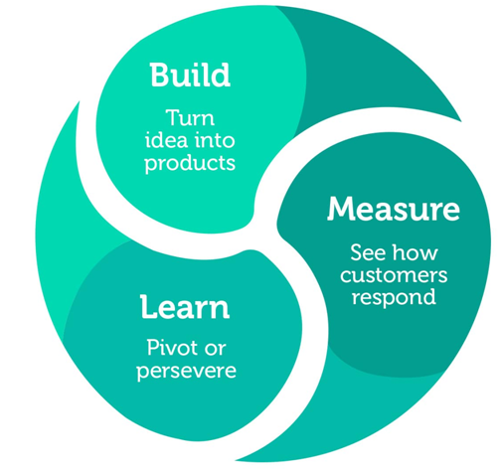
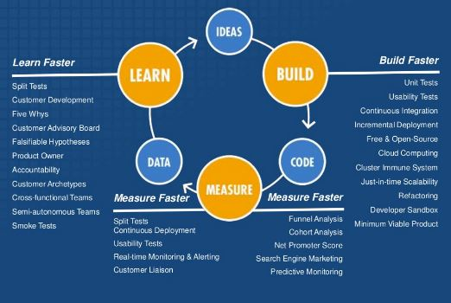
Concept behind Lean startup

Slide 22
Components of Lean Startup Methodology
Lean startup principles have been applied to specific competencies within typical startups and larger organizations:
Lean analytics
Lean brand management
Lean hardware
Lean events
Lean manufacturing
Lean marketing
Lean product management
Lean sales
Lean software development
Lean UX

Slide 23
Minimum Viable Product (MVP)
The first step is figuring out the problem that needs to be solved and then developing a minimum viable product (MVP) to begin the process of learning as quickly as possible.
Minimum viable product is an attempt to get startups to simplify, but it is not itself simple. How do you know which features are essential and which should go? There is no formula, it requires judgment. This leads to two questions:
By what standard is this hypothesis to be chosen?
MVP proposes a clear standard: the hypothesis that seems likely to lead to the maximum amount of validated learning.
How do you train your judgment to get better over time?
Again, the answer is derived from the hard-won wisdom of the scientific method: making specific, concrete predictions and then testing them via experiments that are supposed to match those predictions helps scientists train their intuition towards the truth.

Slide 24
Lean Canvas
A problem well stated is a problem half-solved.”
– Charles Kettering
The Lean Canvas is a version of the Business Model Canvas adapted by Ash Maurya specifically for startups.
Lean Canvas promises an actionable and entrepreneur-focused business plan. It focuses on problems, solutions, key metrics and competitive advantages.
The Lean Canvas focuses on addressing broad customer problems and solutions and delivering them to customer segments through a unique value proposition.
The Lean Canvas is the perfect format for brainstorming possible business models, prioritizing where to start, and tracking ongoing learning.

Slide 25
Unique Value Proposition
As defined by Steve Blank “A single, clear compelling message that states why you are different and worth buying.”
The UVP should clearly present ‘what’s in it for me?’ for early adopters.
This is something I expect will change and be refined over time.
UVP is a clear statement that describes the benefit of your offer, how you solve your customer's needs and what distinguishes you from the competition. Your unique value proposition should appear prominently on your landing page and in every marketing campaign.

Slide 26
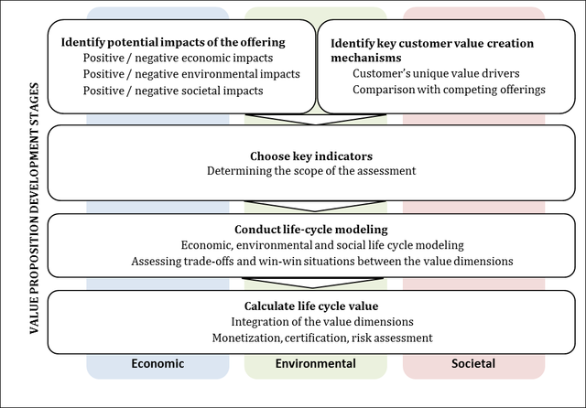
Value Proposition Development Stages

Slide 27
How to begin ??

Slide 28
How to begin..
Test your business idea
Choosing the right business structure
Choose the right start-up name
Create a logo that properly represents your business
Apply for a Start Up Loan
Choose an accountant
Choose office space for your business
Business software when starting out
Red tape checklist: What your small business needs to know
3 key selling techniques that could help your start-up

Slide 29
Registration of Start-up
Option 1: An entity can register itself through Registrar of Firms using the existing processes and subsequently register itself on the Startup India portal and mobile app as a “Startup” to avail the benefits.
Option 2: An entity can register itself through the Startup India portal and mobile app using a seamless process.
Log in to Startup India Portal
Choose your legal entity
Input your incorporation/registration number
Input your incorporation/registration date
Input PAN number (optional)
Input your address with postal code & state
Input authorized representative details
Input director(s)/partner(s) details
Choose and upload supporting documents and self-certification
Incorporation/registration certificate of company/LLP/Partnership
Registration to avail tax and IPR
Certify the official notification terms and conditions

Slide 30
Government Schemes

Slide 31
Atal Innovation Mission (AIM)
The Atal Innovation Mission (AIM) shall have two core functions:
Entrepreneurship promotion through Self-Employment and Talent Utilization (SETU), wherein innovators would be supported and mentored to become successful entrepreneur
Innovation promotion – to provide a platform where innovative ideas are generated through
Establishment of sector specific Incubators
Establishment of 500 Tinkering Labs
Pre-incubation training
Strengthening of incubation
Seed funding
Innovation promotion:
• Institution of Innovation Awards (3 per state/UT) and 3 National level awards
• Providing support to State Innovation Councils
• Launch of Grand Innovation Challenge Awards for finding ultra-low cost solutions

Slide 32
Incubator Setup
To ensure professional management Government plan to create incubators across the country in public private partnership.
35 new incubators in existing institutions.
Funding support of 40% (subject to a maximum of INR 10 crore) shall be provided by Central Government for establishment of new incubators for which 40% funding by the respective State Government and 20% funding by the private sector has been committed.
35 new private sector incubators.
A grant of 50% (subject to a maximum of INR 10 crore) shall be provided by Central Government for incubators established by private sector in existing institutions.
The funding for setting up of the incubators shall be provided by NITI Aayog as part of Atal Innovation Mission.

Slide 33
Research Parks
The Government plans to set up 7 new Research Parks in institutes indicated below with an initial investment of INR 100 crore each.
The Research Parks shall be modeled based on the Research Park setup at IIT Madras.
IIT Guwahati,
IIT Hyderabad,
IIT Kanpur,
IIT Kharagpur,
IISc Bangalore,
IIT Gandhinagar and
IIT Delhi.

Slide 34
Key points of the startup India initiative
Single window clearance, and creation of App
10,000 Crore funds of funds
80% reduction in patent registration fee
90-day exit window
Exempted from capital gain tax
Tax exemption on profits for 3 years
Reduction in red tape
New compliance system (self-check)
IPR (Intellectual Property Rights) protection

Slide 35
Conclusion
We can conclude that:
National Mission for a ‘Green India’ is a big business opportunity for budding entrepreneurs and a lean startup strategy can provide a better solution to overcome the entrepreneurial challenges in Bio-energy sector.
India is offering a Great opportunity as a business destination.
The Government of India is ready to support by all means..
Wishing a great success for
National Mission for a ‘Green India’.

Slide 36


