Slide 1
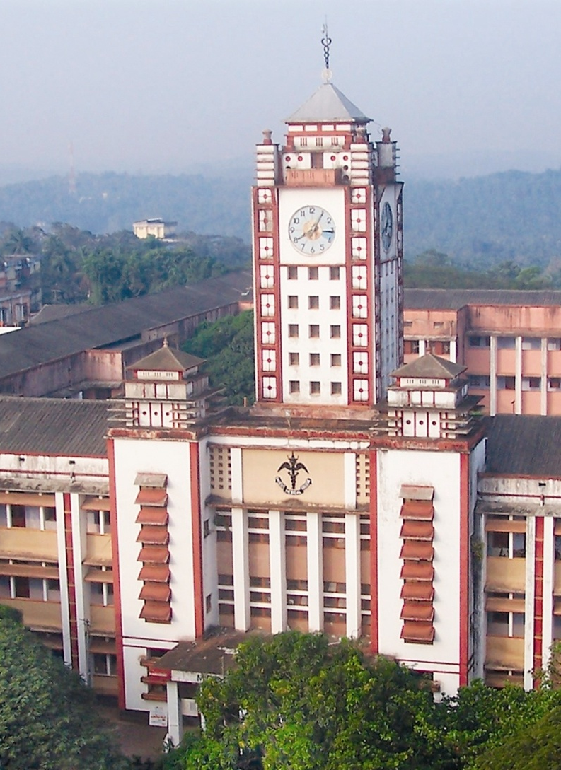
SLE- a Hematological Disorder
&
“KOZHIKODE CRITERIA”
for Early Diagnosis
P.K.Sasidharan
Former Professor and Head ,Department of Medicine& Hematology
Government Medical College, Calicut, India
Former Dean- University of Calicut
Notes:
When SLE is is becoming very common due to several unexplored issues like changed diets and lifestyles, we still depend on ACR criteria for diagnosis, which is satisfied only very late in the course of the diseases = this leads to improper management and poorer outcomes. Based on personal observations over three decades a new criteria for diagnosis was developed and was named as Kozhikode Criteria

Slide 2
OVERVIEW
What is SLE?
How do most patients with SLE present? Two case histories
Pitfalls of ACR criteria to diagnose and the need for an alternative to it
The ‘Kozhikode Criteria’ for Diagnosis
Validation of the new criteria
Prognosis & Principles of Management
Notes:
Most of the time they present as a diagnostic problem, with symptoms pertaining to any part of the body, depending on the frequency of involvement of the dirreent parts of the body. SLE being an autoimmune disorder with antibody to any part of the body, hematological must be the commonest

Slide 3
SLE - prototype of Systemic Autoimmune Disease
King of all autoimmune disease
Hyper-reactivity of humoral immune system
Damage by auto antibodies and immune complexes
Damage to any organ in sequence/simultaneously
Ninety percent are women
Usually of child-bearing age

Slide 4
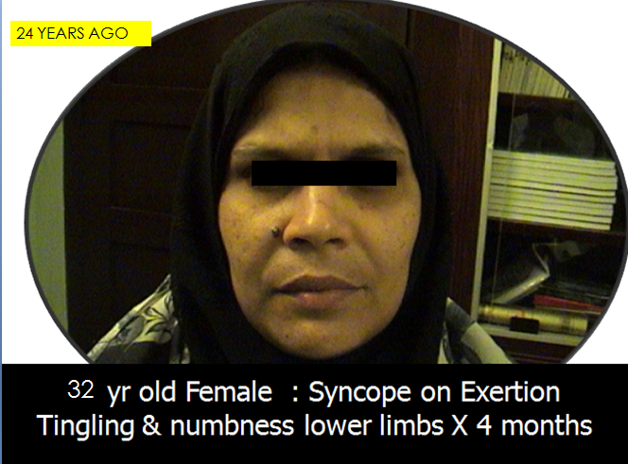

Slide 5
Case history (contd)
Iron Def Anemia- Pallor, Koilonychia, glossitis
B12 deficiency(SACD)
Hb 4.7g/dL; PCV 13%, MCV 104 fl
TC 5500/cmm; P62 L35 E3
ESR 165mm, Platelet 280,000/cmm
Urea/Creat /Bilirubin: N
PBF Dimorphic picture
Low ferritin
Stool Occult Blood negative
Bone Marrow : Megaloblastic

Slide 6
Case history (contd)
Iron+B12 deficiency
B12 injection
Oral Iron
Folic acid
Ranitidine
Blood transfusion
Intra Vascular hemolysis
Cola colored Urine
WHAT NEXT?
No improvement

Slide 7
Case history
DCT (Direct Coomb's Test) was positive
ANA, Anti Ds DNA positive
Iron Deficiency – chronic low grade IV hemolysis
B12 deficiency- anti intrinsic factor antibodies
No joint pains at all- even today after 24 years
Did not satisfy ACR criteria when she was very sick
Presuming SLE---started steroid ---- Azathioprine – recovered
Notes:
Complement mediated AIHA

Slide 8
AUTOIMMUNE DISEASES
A spectrum: Single organ to many organs
  Hashimoto's thyroiditis
  Autoimmune hemolytic anemia
  ITP
  Pernicious anemia
  Antiphospholipid antibodies
  Pemphigus vulgaris
  Vitiligo
  Alopecia aerata
  Sclerosing cholangitis
  Chronic Active Hepatitis
Notes:
Autoimmune diseases form a spectrum, from those specifically affecting a single organ to systemic disorders with involvement of many organs (Table 307-5). Hashimoto's autoimmune thyroiditis is probably the best studied example of an organ-specific autoimmune disease (Chap. 330). In this disorder, there is a specific lesion in the thyroid associated with infiltration of mononuclear cells and damage to follicular cells. Antibody to thyroid constituents can be demonstrated in nearly all cases. Other organ- or tissue-specific autoimmune disorders include pemphigus vulgaris, autoimmune hemolytic anemia, idiopathic thrombocytopenic purpura, Goodpasture's syndrome, myasthenia gravis, and sympathetic ophthalmia. One important feature of some organ-specific autoimmune diseases is the tendency for overlap, such that an individual with one specific syndrome is more likely to develop a second syndrome. For example, there is a high incidence of pernicious anemia in individuals with autoimmune thyroiditis. More striking is the tendency for individuals with an organ-specific autoimmune disease to develop multiple other manifestations of autoimmunity without the development of associated organ pathology. Thus, as many as 50% of individuals with pernicious anemia have non-cross-reacting antibodies to thyroid constituents, whereas patients with myasthenia gravis may develop antinuclear antibodies, antithyroid antibodies, rheumatoid factor, antilymphocyte antibodies, and polyclonal hypergammaglobulinemia. Part of the explanation for this may relate to the genetic elements shared by individuals with these different diseases

Slide 9
DIAGNOSIS OF AN AUTOIMMUNE DISORDER
Evidence of Cellular reactivity to self
Documentation of relevant autoantibody
Lymphocytic infiltrate in the lesion
Beneficial effect from immunosuppressives
Association with other autoimmune disorder
No evidence of infection or other obvious cause
CLINICAL SKILL,
Clinical judgment most important

Slide 10
SLE Diagnostic Criteria
(acr criteria)
Malar rash
Discoid lupus
Photosensitivity
Oral ulcers
Arthritis
Serositis
Renal disorder
Neurologic disorder
Hematologic disorder(Hemolysis, leukopenia, lymphopenia, thrombocytopenia)
Immunolgical disorder (Antids DNA, Anti Sm, APLA)
Antinuclear antibodies
Notes:
Any four of these, simultaneously or sequentially,The point is we have to think of evolving SLE even when a patient presents with a tissue specific or protein specific autoimmune disorder

Slide 11
Diagnosis of SLE
Any four of these
At any time during the course
98% specificity and sensitivity
Early on -confined to one system only
May take several years to fulfill the ACR criteria.

Slide 12
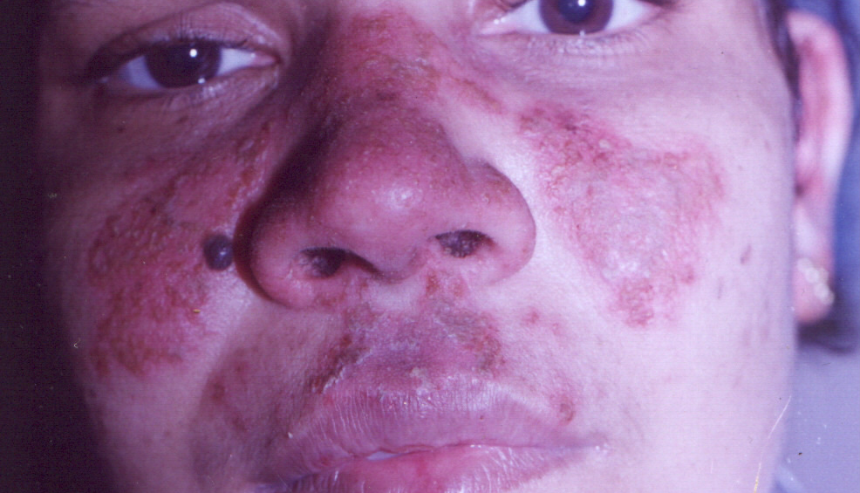
Case history
4 years after diagnosis
ACR CRITERIA WAS SATISFIED ONLY AT THAT POINT
Notes:
This is 5 years after the diagnosis

Slide 13
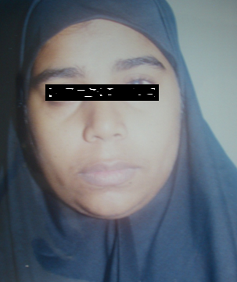
Case history 2 :30 yr- house wife
Chronic ITP in 1993- on steroid
ANA, Anti DsDNA was negative
12 years later (2005):Recurrence of severe thrombocytopenia
ANA & anti Ds DNA +ve
Even in 2015 no arthritis/skin/renal involvement
Notes:
Case records of patients with SLE personally diagnosed by me and followed up for two decades To highlight this point I have the case history of this patient

Slide 14
What lead to the studies on sle?
My observations over 24 years
Starting with these index patients who are still under follow up
Case records of more than 400 such cases
Most cases of SLE present with hematological abnormalities alone, without features of musculoskeletal, skin or other system involvement
Even now after 22 and 24 years of follow up these two index patients do not have joint manifestations

Slide 15
Hematological manifestations in sle-personal experience
Chronic ITP
Autoimmune Ihemolytic Anemia
B12 deficiency/SACD
Iron Deficiency Anemia/Refractory Iron Deficiency
Evan’s Syndrome (ITP+AIHA)
Pancytopenia(MDS/Hypoplasia/Myelofibrosis)
APLA Syndrome –Deep Vein Thrombosis/PTE/PAH
Lympadenopathy ± Hepatosplenomegaly
Kikuchi’s Disease / Rosai Dorfman Disease
Vasculitis with or without thrombocytopenia
Acquired Hemophilia
Macrophage Activation Syndrome(HLH)/TTP
Pure Red cell Aplasia
Blood and blood vessel together has more number of tissues
and proteins and is reaching every part of body

Slide 16
OTHER Manifestations in SLE - personal experience
Vasculitis (HSV/PAN/Takayasu/Retinal)
Alopecia
Discoid lupus
Thyroiditis, Hypothyroidism
Hashimoto’s thyroidits with thyrotoxicosis
Hypothyroidism+ Myasthenia Gravis
Acute Nephritis/IgA Nephropathy/Nephrotic Syndrome
Acute Disseminated Encephalomyelitis(ADEM)
Hepatitis/Cholangitis
Infertility
Arthritis /Arthralgia/MCTD
Pemphigus/Thymoma/Dermatomyositis
Notes:
More haematological than any other parts of the body

Slide 17
Issues unmasked
SLE is often not considered in diagnosis
Most cases do not satisfy ACR criteria
Delay in diagnosis
Wrong to consider it as a Rheumatologic disorder
ACR criteria is weak
Notes:
Name SLE is a misnomer

Slide 18
SLE a great mimicker(masquerader)
All parts of the body affected
Presenting feature most often haematological
Hematological>skin>renal>Endocrine>
>eye>joint>CNS involvement
Joint pains rarely only the presenting symptom
The original study by us proved this
Notes:
SLE father/mother of all autoimmune disorders, It is true that joint pain may be seen as an associated symptom sometime during the course of the disease, but as a presenting manifestataion it is rather uncommon.

Slide 19
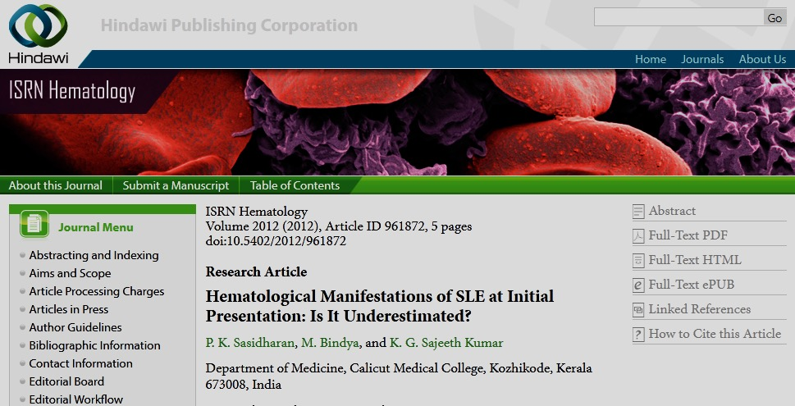

Slide 20
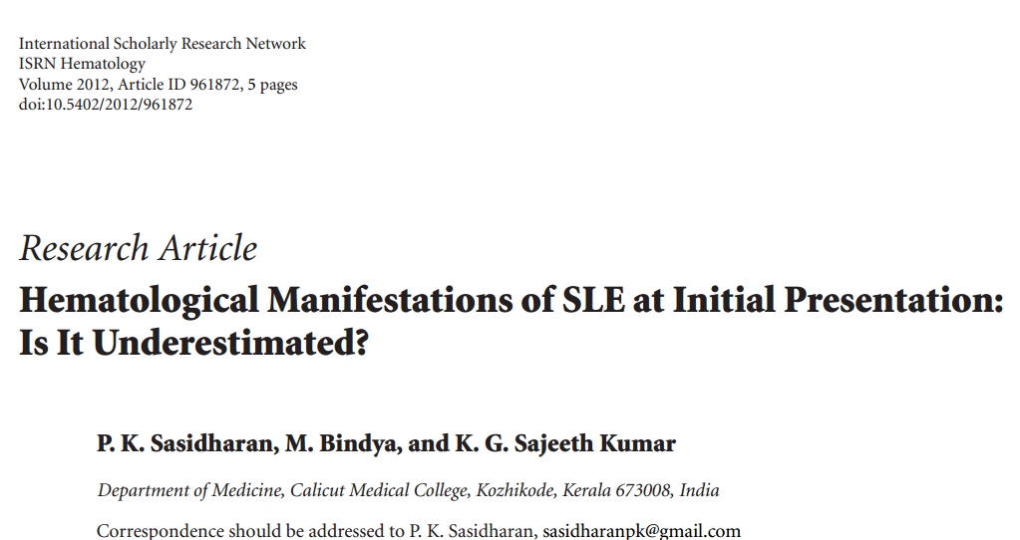

Slide 21
Initial presentation of sle
Notes:
(Arrange in decreasing or increasing order)

Slide 22
Hematological Manifestations

Slide 23
Conclusions of the first study
Commonest manifestation- Hematological
Commonest presenting manifestation- Hematological
A large number of patients did not satisfy the ACR criteria at the time of diagnosis but did so only on follow up
Need for an alternative criteria for early diagnosis

Slide 24
Why a new criteria?
For Early diagnosis
Those in evolution to be picked up
Hematological –not adequately represented
The atypical presentations to be diagnosed
Typical cases only tip of the iceberg
Typical is rare in Medicine
Study of Medicine is study of the atypical

Slide 25
pitfalls of acr Criteria
Only a few typical cases have arthritis/malar rash/photosensitivity
Should we diagnose only when criteria are satisfied?
What about the others?
Who will develop an alternative to ACR criteria?
Should we leave it to the Rheumatologists?
Compartmentalization- killing the profession & the people

Slide 26
“Kozhikode Criteria” for DIAGNOSIS OF sle
Major criteria:
Presence of an autoimmune disorder known to occur with SLE (chronic ITP, Autoimmune hemolytic anemia, skin lesions, APLA syndrome, autoimmune hypothyroidism, autoimmune hepatitis)
No other cause, other than autoimmunity for that clinical problem, by history, physical examination and investigations

Slide 27
Minor criteria
Another coexisting autoimmune disorder/any other evidence of autoimmunity
Positive ANA
Positive Anti Ds DNA
Sustained and definitive response to steroid and or immunosuppressant even after six months of follow up

Slide 28
SLE: Kozhikode Criteria
Presence of one active autoimmune disorder
No other diagnosis
ANA positive
Anti Ds DNA positive
Another coexisting autoimmune disorder
Follow up with good response to treatment
1 & 2 are essential
Plus-- If the patient has two or more minor criteria, they can be diagnosed as SLE.

Slide 29
Validation of “Kozhikode Criteria”
&
Role of lifestyle and diet in SLE
(under publication)
Arathi N
P K Sasidharan
P Geetha
Government medical college
Calicut, kerala, india

Slide 30
Objectives of the study
Is early diagnosis of SLE is possible with the new criteria?
Validation of the Kozhikode criteria
To estimate how many of those who satisfy ACR criteria also satisfy the new criteria- it is necessary for validation
Clinical profile of SLE
Diet and life style as possible etiological factors
Notes:
To study the average time period required to satisfy ACR criteria in patients already diagnosed as SLE with the new criteria

Slide 31
Study design
Prospective study
Case control to compare the influence of diet and life style

Slide 32
Inclusion criteria
Definite autoimmune disorder – most likely SLE
No other diagnosis after extensive evaluation
Exclusion criteria
  Drug induced SLE
  Those who do not give consent

Slide 33
observations
71 patients with autoimmune disorder- clinically SLE- admitted in Medicine, Hematology, Rheumatology, Dermatology over a period from January 2013 to December 2013 were followed up over a period of 6 months

Slide 34
Age distribution
Notes:
Colour contrast not adequate change one of them

Slide 35
Gender (f : m = 9:1)

Slide 36
Socio economic status

Slide 37
Notes:
All those who satisfied the ACR satisfried the KKD, but not vice versa and early daignosis is possible

Slide 38
At first contact with the hospital

Slide 39
6 months follow up
Of the 4 patients who did not satisfy the Kozhikode criteria, 2 of them satisfied the new criteria at the end of 6 months
But they did NOT satisfy the ACR criteria

Slide 40
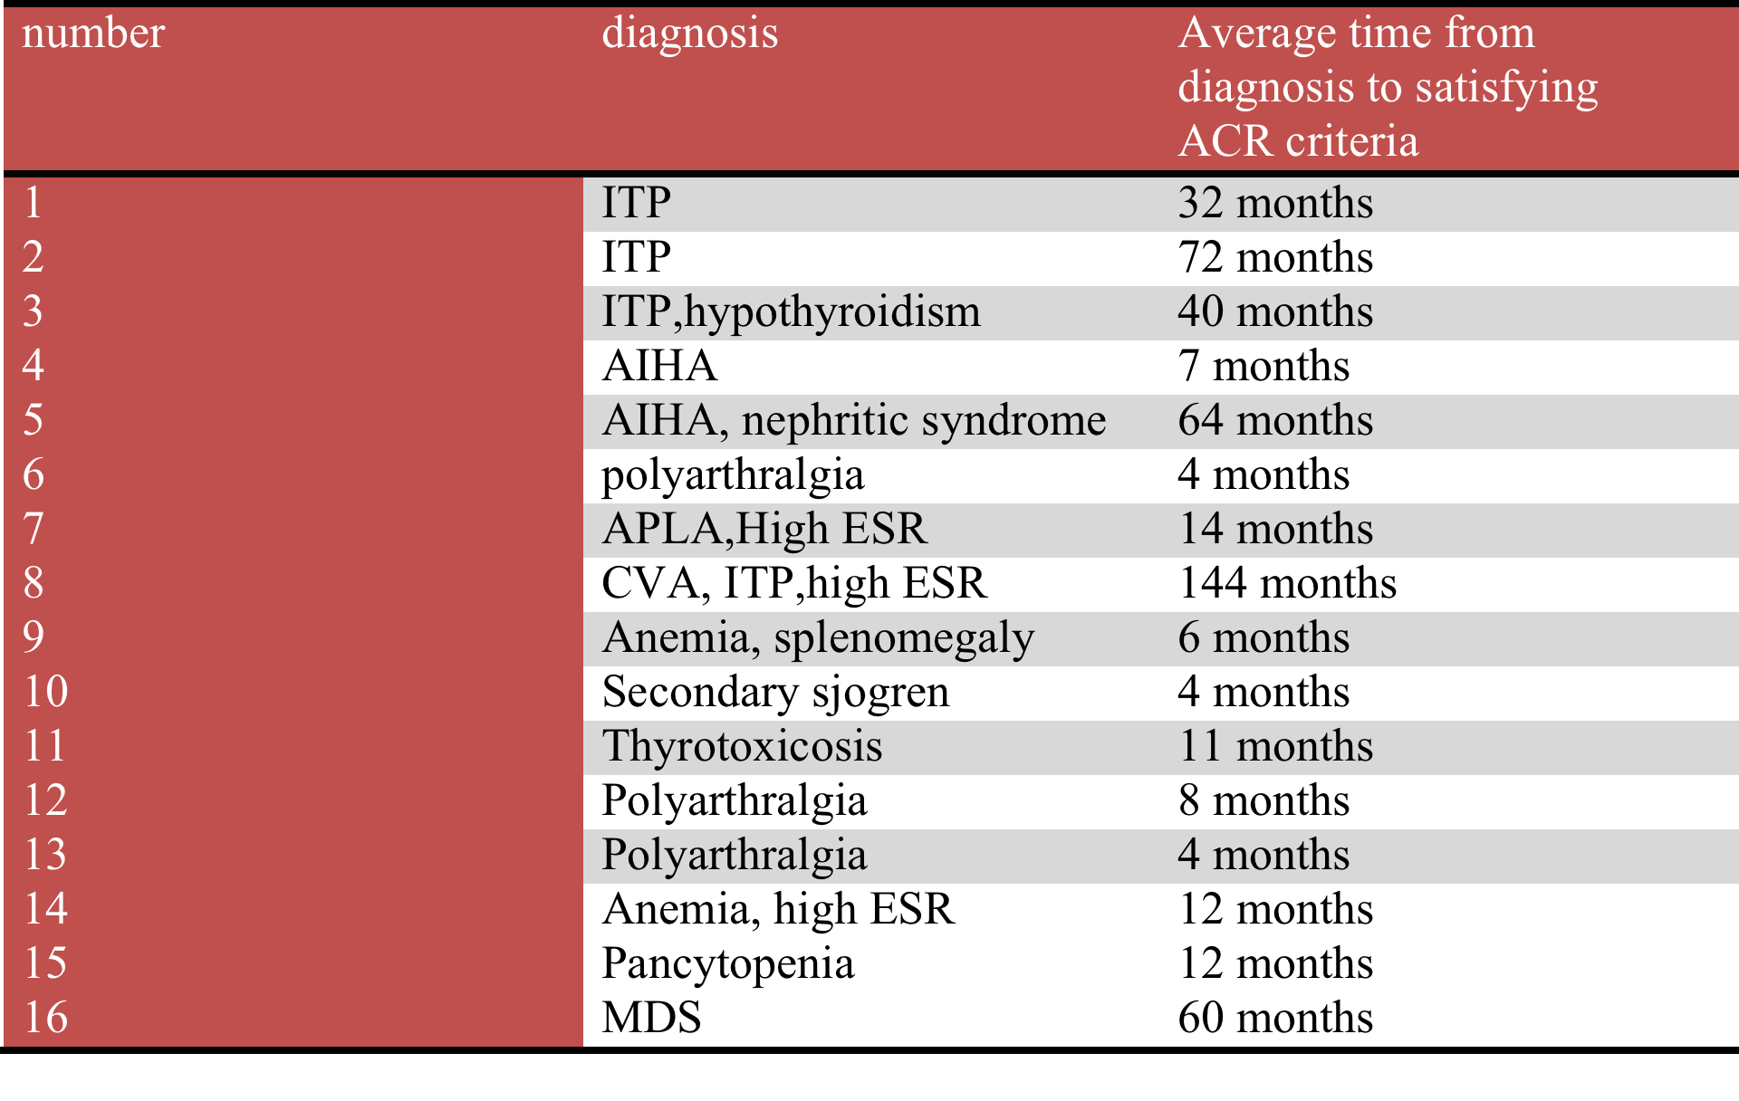
TIME TAKEN TO SATISFY ACR CRITERIA

Slide 41
Overall prevalence of symptoms in those satisfying
KOZHIKODE criteria

Slide 42
NEW CRITERIA -MOST USEFUL WHEN PRESENTS WITH SINGLE ORGAN INVOLVMENT, EVEN WITH MULTIPLE ORGAN INVOLVMENT MANY PATIENTS DO NOT SATISFY ACR
Notes:
MOST USEFUL WHEN THE PATIENT PRESENTS WITH SINGLE ORGAN INVOLVMENT , EVEN WITH MULTIPLE ORGAN INVOLVMENT MANY PATIENTS DO NOT SATISFY ACR

Slide 43
Those satisfying ACR criteria
Notes:
ONLY WITH ADVANCED DISEASE ACR CRITERIA IF AT ALL ARE SATSFIED

Slide 44
Level of physical activity

Slide 45
Dietary assessment

Slide 46
FOOD ITEM | MEAN VALUE |  | P VALUE
 | CASES | CONTROLS
CEREALS | 4.39 | 4.37 | 0.732
PULSES | 1.86 | 3.55 | <0.001
GREEN LEAFY VEG | 1.87 | 3.34 | <0.001
LEGUMES AND TUBERS | 1.97 | 2.27 | 0.011
OTHER VEGETABLES | 1.39 | 2.83 | <0.001
FRUITS | 1.17 | 2.99 | <0.001
MILK AND MILK PRODUCTS | 3.94 | 3.3 | <0.001
EGG | 2.03 | 2.01 | 0.9
MEAT | 1.9 | 1.13 | <0.001
FISH | 2,25 | 1.38 | <0.001
JUNK FOOD | 3.51 | 1.18 | <0.001
CANNED FOOD | 0.018 | 0.07 | 0.044
FRIED FOOD | 3.49 | 1.44 | <0.001
BOTTLED FOOD | 0.04 | 0.04 | 1
ICECREAM | 0.03 | 0.01 | 0.563
Notes:
Patients had low in take of fruits and vegetables and higher intake of junk foods/canned food and fried food as compared to the normal controls

Slide 47
conclusions
Of the 71 patients - 67 had satisfied Kozhikode criteria at the first clinical presentation itself
VERY HIGH SENSITIVITY
Notes:
Of the 67 patients 3 patients had a stormy course and succumbed to the illness and could not be followed up till 6 months. Hence whether or not they could have satisfied the ACR criteria is not predictable

Slide 48
conclusions
Of the 4 patients who did not satisfy the Kozhikode criteria, 2 of them satisfied the new criteria at the end of 6 months
But they did NOT satisfy the ACR criteria
Only 22 patients had satisfied ACR criteria in the beginning and all the 22 were satisfying the new criteria too
This validates the new criteria

Slide 49
conclusions
Diet clearly affects the disease - significant differences in dietary habits among cases and controls
Lack of exercise and sedentary life style also could be an important factor in the disease

Slide 50
Conclusions
“Kozhikode criteria” is simple, easy to use
High sensitivity-helps in early diagnosis
Superior to ACR criteria
Specificity may be evaluated further

Slide 51
Outcome of study
Management made easy- PROGNOSIS BETTER
Because of early diagnosis
Prompt and proper treatment- not half hearted
The prognosis is very good except when they present with multisystem involvement and satisfy ACR criteria
They can live like normal individuals
Management includes lifestyle modifications
Steroid & Immunosuppressant tailor made to suit the patient
Needs personalized care
The index patients are still healthy after 24 and 22 years of follow up
Notes:
Her husband who brought her first to me died due to IHD 15 years back SLE is just like any other disease, the frightening information on the net have to be withdrawn

Slide 52

THANK YOU

Slide 53
Notes:
After 6 months one more satisfied the new criteria but not the ACR criteria

