Slide 1


COMPARATIVE STUDIES ON ANTIULCER ACTIVITY OF TRADITIONAL PLANT SOURCES- A SELECT STUDY
Prof. P. Brindha
Associate Dean & Co-ordinator
Centre for Advanced Research in Indian System of Medicine
School of Chemical & Biotechnology
SASTRA University
Thanjavur, India

Slide 2
Introduction
Peptic ulcer disease (PUD) refers to painful sores or ulcers in the lining of the stomach or first part of the small intestine, called the duodenum.

Slide 3
Peptic
ulcer
Mucus
Bicarbonate
Mucosal blood flow
Prostaglandin
Growth factor
Cell renewal
Gastric acid
Pepsin
NSAIDs
Stress
Alcohol
H. pylori
Free radicals
Aggressive Factor Protective Factor
8/5/2016
Any imbalance between Aggressive and defensive factors leads to peptic ulcer
Types: Gastric and Duodenal ulcer

Slide 4
Adverse effects of existing synthetic drugs
HISTAMINE H₂-RECEPTOR ANTAGONISTS
  Diarrhoea, dizziness, muscle pains, gynaecomastia in men and impotence
PROTON-PUMP INHIBITORS
  Headache, diarrhoea, impotence, gynaecomastia, Weight gain, Muscle and joint pain
BISMUTH CHELATE
  Encephalopathy, blackening of the tongue and faeces
MISOPROSTOL
  Diarrhoea, abdominal cramps, uterine contractions
ANTACID
  Diarrhoea (Mg salts) and constipation (Al salts)
As the incidence of PUD is increasing and the existing synthetic drugs are prone to produce side effects, hence there is a need for the development of safe and effective plant based antiulcer drug

Slide 5
Objective
To develop a Human-friendly antiulcer drug from plant sources

Slide 6
Selection of plant drugs
Based on literature survey and discussions/ interviews with local healers, following plants were selected, identified and authenticated with a view to develop an antiulcer drug from these plant sources
  Caesalpinia sappan L.
  Cyclea peltata Lam.
  Gmelina arborea Roxb.

Slide 7
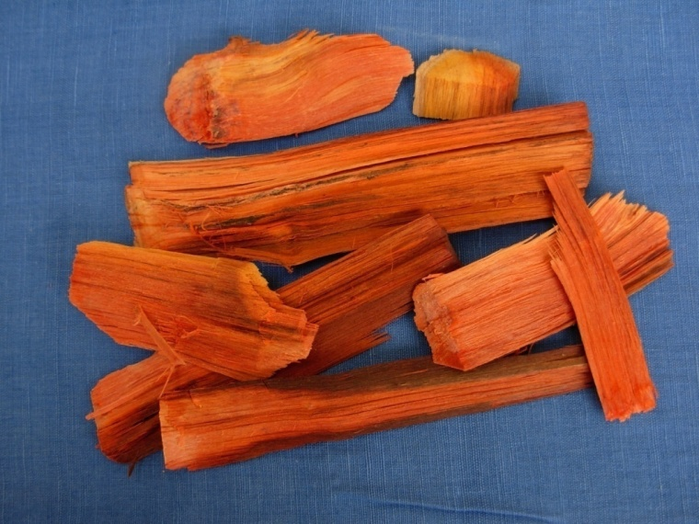
Literature survey
Caesalpinia sappan L.
Traditional uses
  Heart wood: Wound Healing, Anti-ulcer, Antileprotic, Leucorrhoea, Skin Diseases, Anti-diarrhoeal, Anti-convulsant, Anti-diabetic. (Sharma, P. C. et al., 2002)
Existing Scientifically Reported Studies
  Anti-inflammatory (Hikino, H. et al., 1977)
  Antioxidant activity (Badami, S et al., 2003, Jun Hu et al., 2008)
  Anti-microbial activity (Lim, M. Y. et al, 2007, Rajendran Srinivasan et al., 2012)

Slide 8
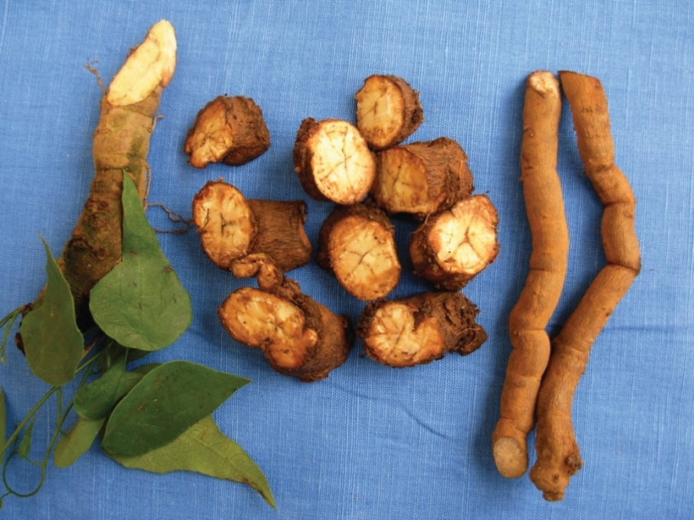
Cyclea peltata (Lam.)
Traditional uses
  Roots: Carminative, Anthelmintic, Antipyretic, Anti-inflammatory, Diuretic, Dyspepsia, Anti-diarrhoeal, Anti-leprotic, Anti-ulcer, Wound healing activity (Kiritikar et al., 1998a)
Existing Scientifically Reported Studies
  Root: Nephrolithiasis (Christina, A. J. M, et al. 2002), antiulcer (Shine et al., 2009)
  Whole plant: Antibacterial (Jyothi Abraham et al., 2012)

Slide 9
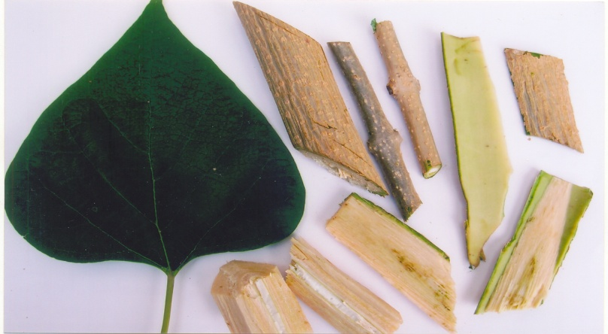
Gmelina arborea Roxb.
Traditional uses
  Root: Stomachic, Laxative, Anthelmintic, Antipyretic, Dyspepsia
  Bark: Stomachic, Antipyretic, Dyspepsia
  Flowers: Antileprotic, Skin disease
  Leaves: Cephalalgia
  Fruits: Diuretic, Aphrodisiac, Anti-anaemic, Anti-ulcer, Constipation, Leucorrhoea (Kiritikar et al., 1998b)
Existing Scientifically Reported Studies
  Leaves: wound healing activity (Shirwaikar et al.,2003), Antiulcer (Giri et al.,2009)

Slide 10
Botanical Profiles of Selected Plants
Botanical name | Caesalpinia sappan L. | Cyclea peltata Lam. | Gmelina arborea Roxb.
Family | Caesalpiniaceae | Menispermaceae | Verbenaceae
Tamil name | Pathimukham | Malaitanki | Kumil
Parts used | Heart wood | Root | Aerial part
Collected at | Kuzhanthupuzha, Kerala | Kuzhanthupuzha, Kerala | Courtallam, TamilNadu

Slide 11
SPECIFIC AIMS
  1. To determine Botanical standards of selected plant drugs
  2. To determine chemical standards of selected plant drugs
  3. To evaluate antioxidant, antiulcer and cytoprotective potentials of selected plants by in vitro methods
  4. To screen selected plant drugs for their toxicity, safety and efficacy profiles against peptic ulcer employing suitable animal models
  5. To conduct in silico docking studies using the phytocompounds detected from selected plants using LC-MS/MS against ulcer targets and to understand the probable mechanism of action

Slide 12
Specific Aim #1
  To determine Botanical standards of selected plant drugs
    Quality standards
    Organoleptic
    Macroscopic
    Microscopic
    Identity, purity and strength
    Extractive values (WHO, 1998)
    Ash values (WHO, 1998)

Slide 13

Organoleptic analysis & Macroscopic features of C. sappan
Nature: Fracture fibrous
Colour: Yellowish or brownish orange
Taste: Salty and sweety
Small pieces of variable sizes

Slide 14
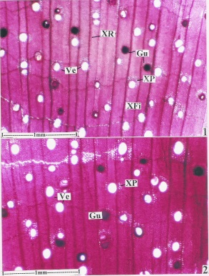
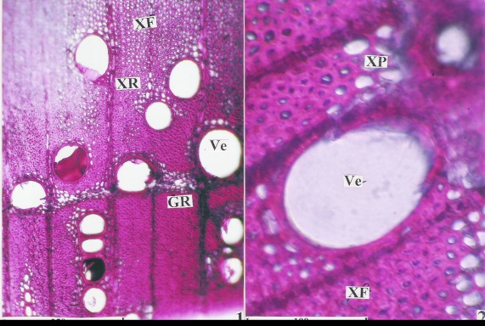
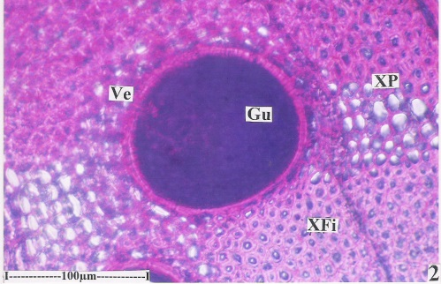
Microscopic features of Caesalpinia sappan Heartwood
T S of wood showing vessel distribution and vessel inclusion. (Gu: gum deposits; Ve: vessels; XFi: xylem fibres; XP: xylem parenchyma; XR: xylem ray)
A vessel with paratracheal parenchyma and gum (GR: growth rings; Ve: vessel; XP: xylem parenchyma; XR: xylem ray; Gu: gum; XFi: xylem fibres;)

Slide 15
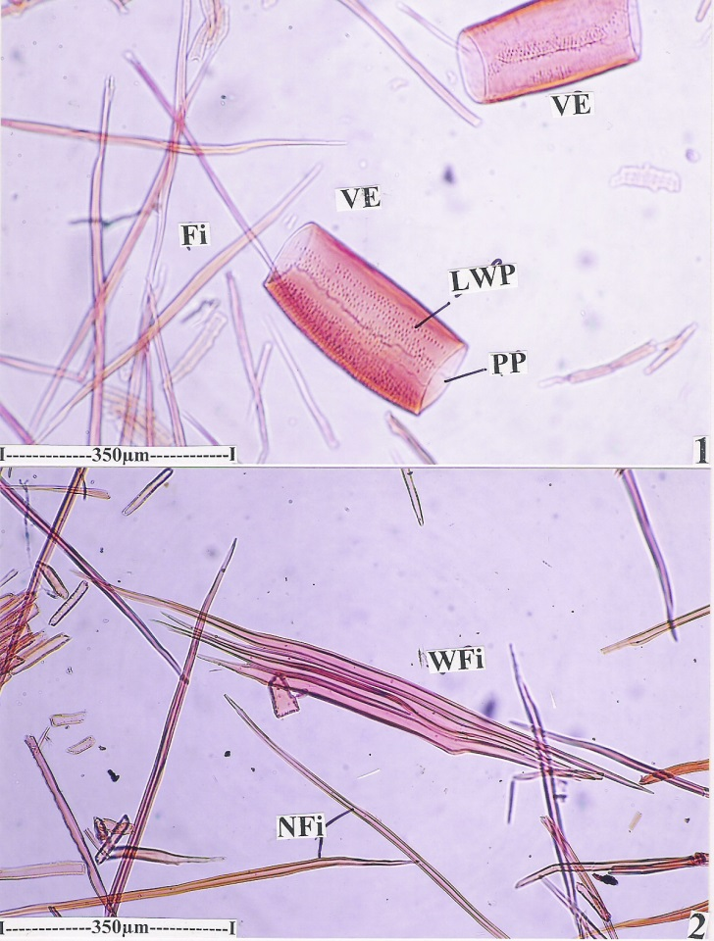
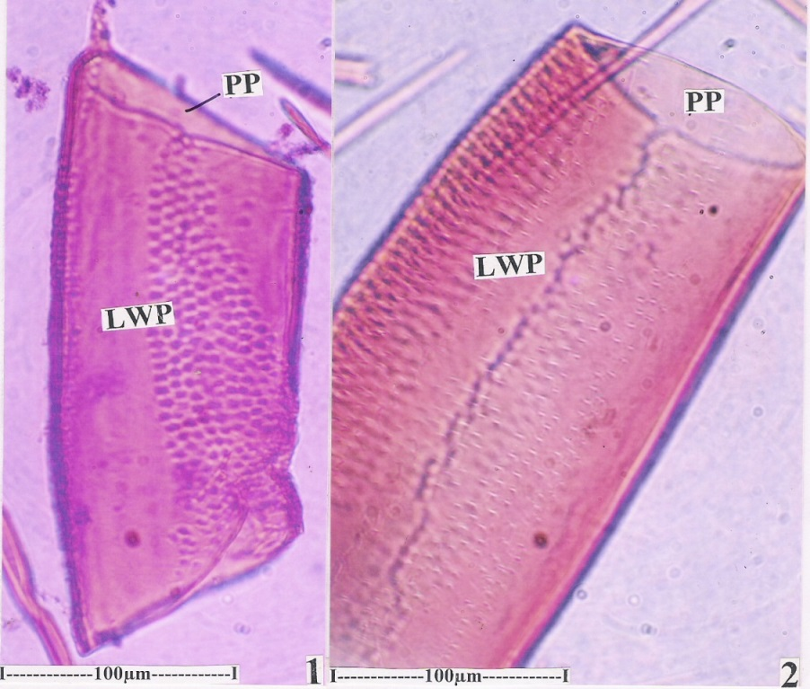
Powder Microscopic features of C. sappan
Wide and narrow fibres (NFi: narrow fibres; WFi: wide fibres)
Two vessel elements enlarged. (LWP: lateral wall pits; PP: perforation plates)

Slide 16

Organoleptic analysis & Macroscopic features of C. peltata
Nature: Powdery
Colour: slight brown
Taste: acrid, pungent and bitter
Rough with shallow irregular fissures.

Slide 17
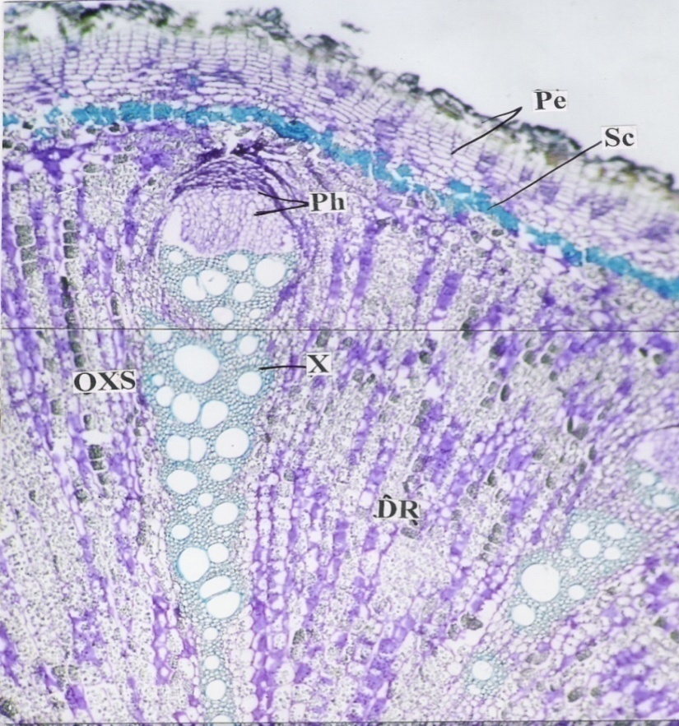
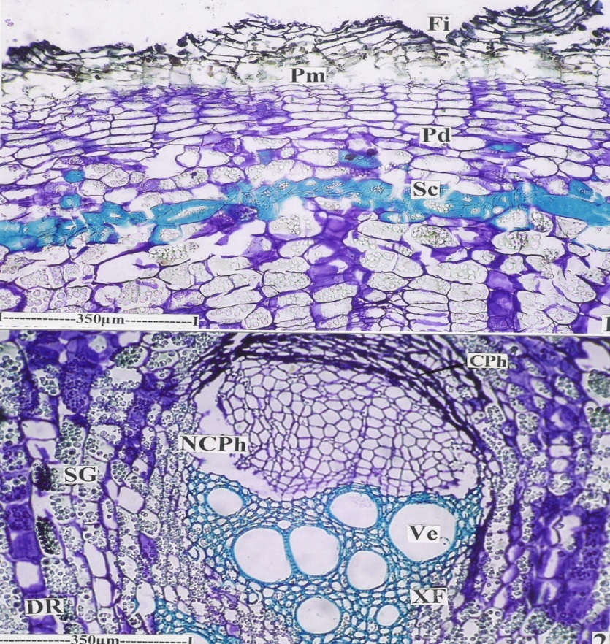
Microscopic features of Cyclea peltata root
T. S of tuberous-A section from centre towards periphery (4X). (DR: dilated ray; IXS: inner xylem segment; OXS: outer xylem segment; Pe: periderm; Ph: phloem; Sc: sclerenchyma)
T. S of root through periderm (10X), T. S of root through outer segment of xylem and phloem cap (10X), (CPh: collapsed phloem; Fi: fissures; NCPh: noncollapsed phloem; Pd: phelloderm; Ve: vessels; XF: xylem fibres)

Slide 18
Microscopic features of Cyclea peltata root
T. S of tuberous-A section from centre towards periphery (4X). (DR: dilated ray; IXS: inner xylem segment; OXS: outer xylem segment; Pe: periderm; Ph: phloem; Sc: sclerenchyma)
T. S of root through periderm (10X), T. S of root through outer segment of xylem and phloem cap (10X), (CPh: collapsed phloem; Fi: fissures; NCPh: noncollapsed phloem; Pd: phelloderm; Ve: vessels; XF: xylem fibres)

Slide 19
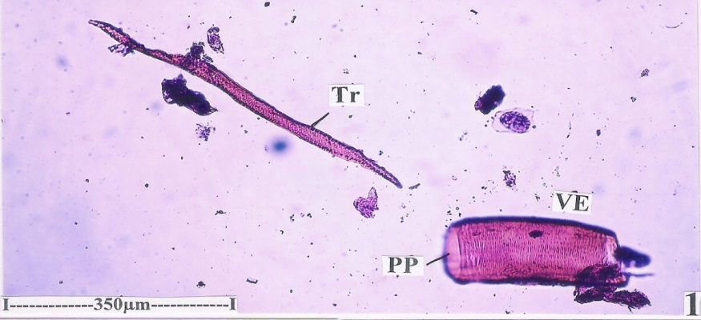
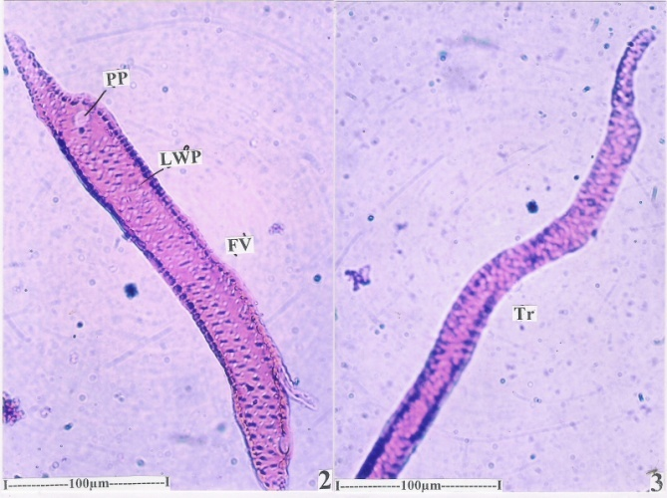
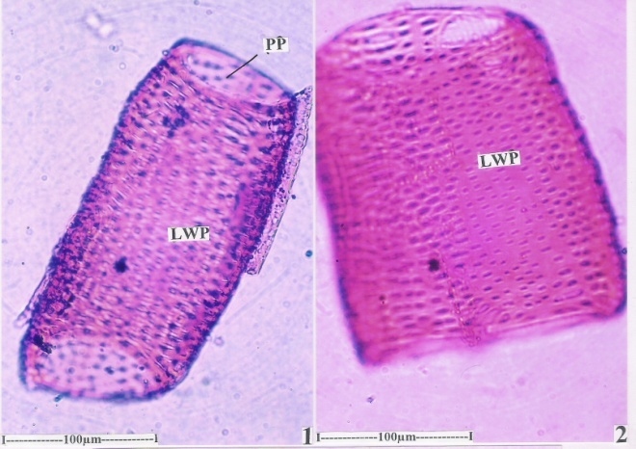
Powder Microscopic features of Cyclea peltata
Fig. 1: A tracheid and a vessel element in the powder, 2: A Fileriform vessel (FV) element 3: Narrow cylindrical vessel element (LWP: lateral wall pits; PP: perforation plate; VE: vessel element)

Slide 20
Organoleptic analysis & Macroscopic features of G. arborea
Nature: Light fibrous
Colour: slight green
Taste: acrid, pungent and bitter
Tomentose, ovate-cordate

Slide 21
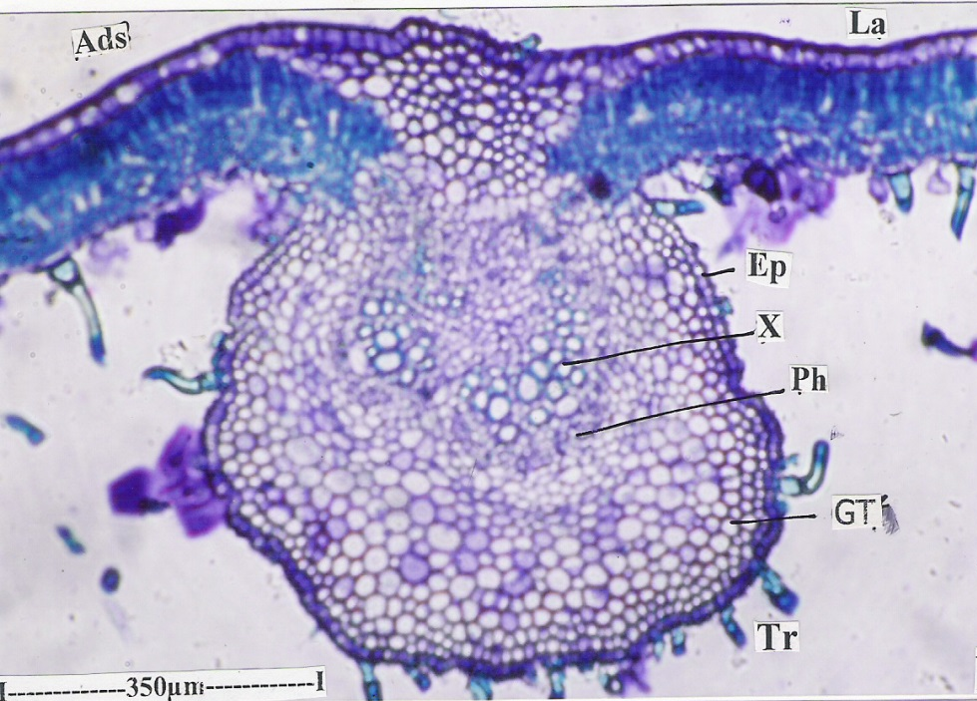
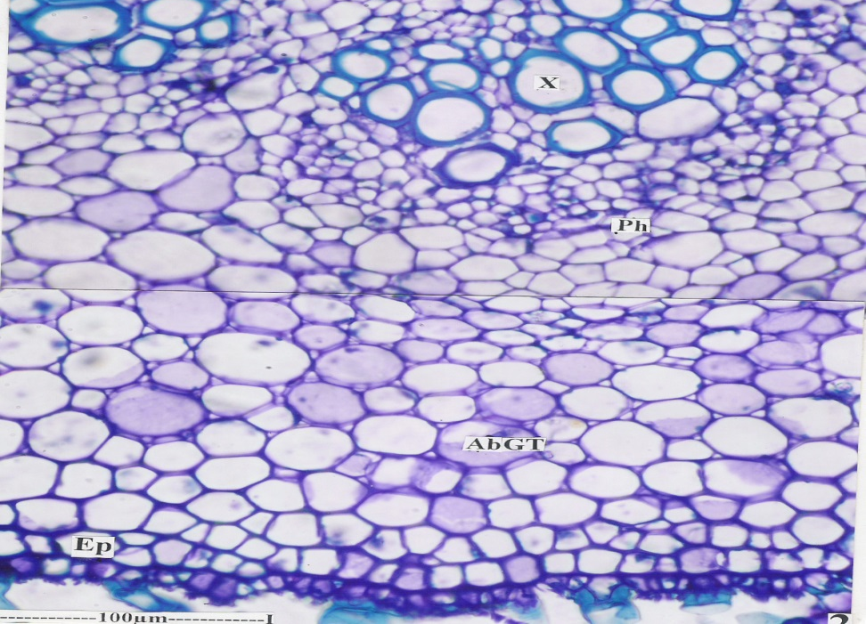
Microscopic features of Gmelina arborea leaf
T. S of leaf through midrib (10X), (AdS: Adaxial side; La: lamina; GT: ground tissue; Ep: epidermis; Ph: phloem; Tr: Trichomes; X: xylem)
T.S of the midrib, a portion enlarged. (40X) (AbGT: Abaxial ground tissue; Ep: epidermis; Ph: phloem; X: xylem)

Slide 22
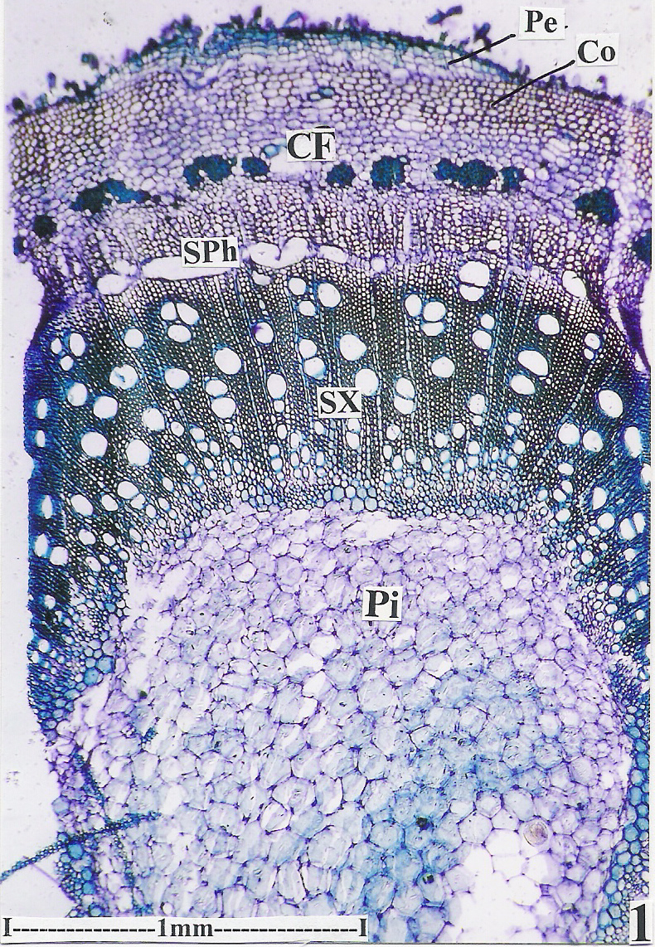
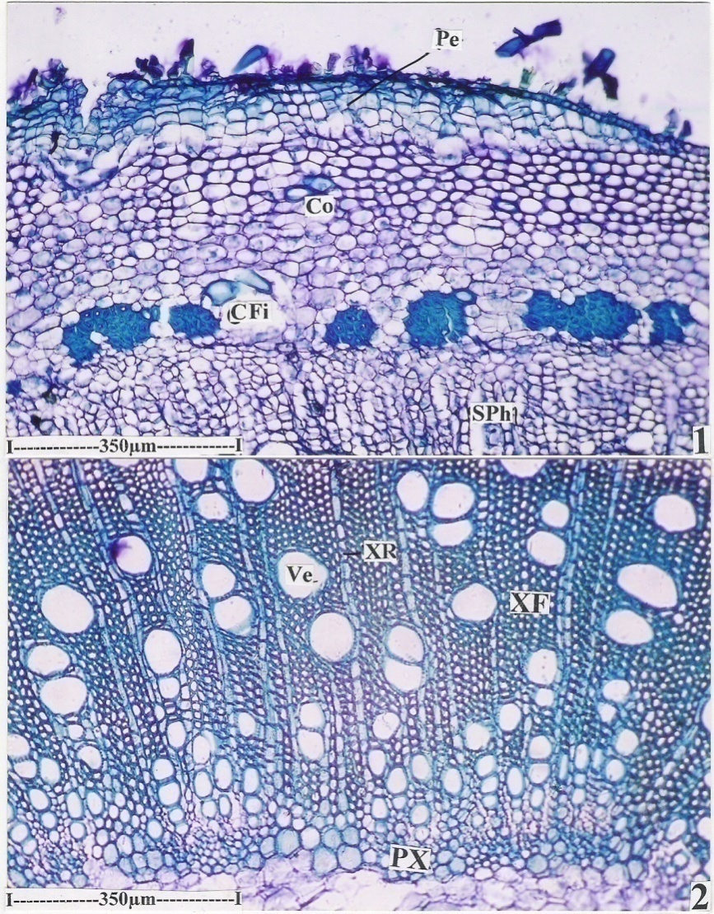
Microscopic features of Gmelina arborea wood
T. S of stem, a sector (4X) (CF: cortical fibres; Co: collenchyma; Pe: periderm; Pi: pith; SPh: secondary phloem; SX: secondary xylem)
Cortex and phloem portions(10X) Secondary xylem enlarged (10X) (Ve: vessel; XF: xylem fibres; XR: xylem ray)

Slide 23
Microscopic features of Gmelina arborea wood
T. S of stem, a sector (4X) (CF: cortical fibres;Co: collenchyma; Pe: periderm; Pi: pith; SPh: secondary phloem; SX: secondary xylem)
Cortex and phloem portions (10X) Secondary xylem enlarged (10X) (Ve: vessel; XF: xylem fibres; XR: xylem ray)

Slide 24
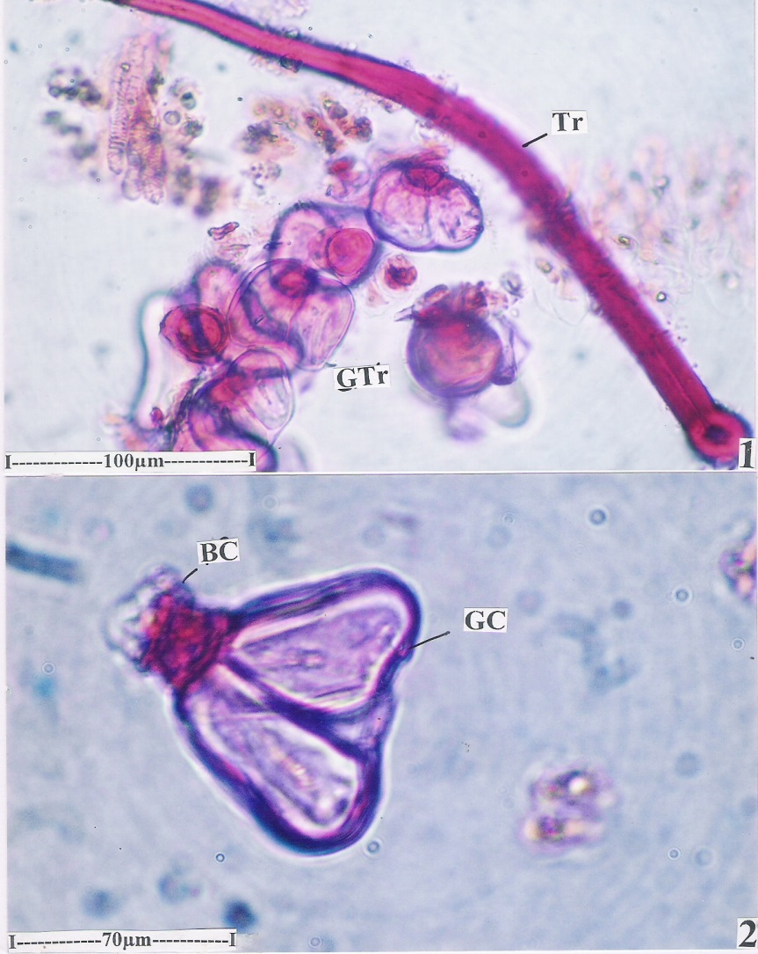
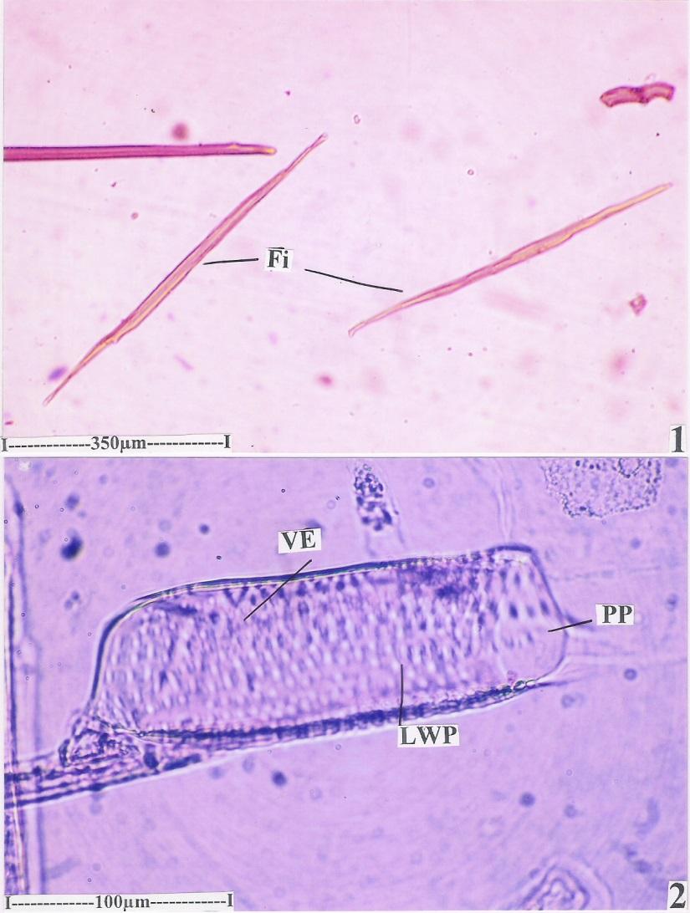
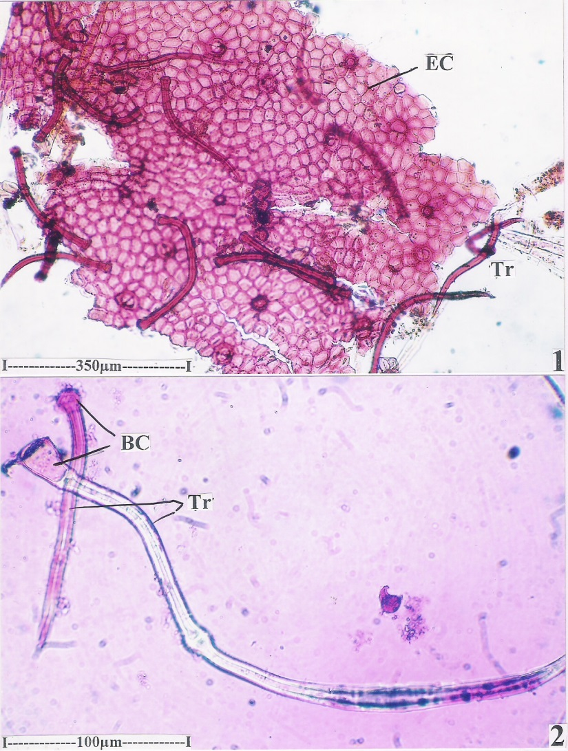
Powder Microscopic features of Gmelina arborea
Fig. 1: Glandular trichomes, Fig. 2: Non-glandular trichome (BC: basal cell; GC: glandular body cells; GTr: glandular trichome; Tr: trichome)
Fig. 1. Macerated fibres, Fig. 2. Vessel element (Fi: Fibres; LWP: lateral wall pits; PP: perforation plate; VE: vessel elements)

Slide 25
Macroscopic standards determined
Name of the standards | Caesalpinia sappan Heart wood | Cyclea peltata Roots | Gmelina arborea Aerial parts
Colour | Yellowish or brownish orange | Light brown | Light green
Taste | Salty and sweety | Acrid pungent and bitter | Acrid pungent and bitter
Nature | fibrous | Rough | Slight fibrous Leaves: tomentose

Slide 26
Microscopic standards determined
Name of the standards | Caesalpinia sappan Heart wood | Cyclea peltata Roots | Gmelina arborea Aerial parts
Growth rings | Distinct | Not applicable | Not applicable
Nature of vessels | Diffuse porous upto 110µm wide and pitted | Wide short and cylindrical, perforation pitted, pits elliptic and bordered | Long and Cyclidrical
Nature of fibres | Libriform, thick walled with narrow lumen | Not applicable | Libriform with narrow lumen
Rays | Homocellular, uni to triseriate | Not applicable | Pholem rays indistinct
Tracheids | Not applicable | Long narrow and cylindrical | Not applicable
Trichomes | Not applicable | Not applicable | Glandular and non-glandular
Periderm | Not applicable | Not applicable | Discontinous
Cortical cells | Not applicable | Not applicable | Inner cortical cells, sclerenchymatous with reduced lumen

Slide 27
EXTRACTIVE VALUES (% w/w)
CHEMICAL STANDARDS DETERMINED
ASH VALUES (% w/w)
Plant | Total ash | Acid insoluble
C. sappan | 0.53 | 0.22
C. peltata | 3.44 | 2.97
G. arborea | 6.35 | 5.08
Plant | Ethanol | Water
C. sappan | 9.89 | 12.46
C. peltata | 2.63 | 10.00
G. arborea | 7.66 | 5.42
Notes:
Has to change

Slide 28
Specific Aims #2
  To determine chemical standards of selected plant drugs
    Preliminary phytochemical screenings of extracts (Harborne, 1998.)
    Quantitative phytochemical analysis
      Total phenolic content (Makkar, 2003)
      Total flavonoid content (Chang et al., 2002)
    LC-MS/MS Analysis

Slide 29
Preliminary Phytochemical Analysis
Phyto-chemical test | Heart wood of Caesalpinia sappan | Roots of Cyclea peltata | Aerial parts of Gmelina arborea
Saponins (Froth test) | + | + | -
Tannins (FeCl₃ Test) | + | + | +
Glycosides (General test) | - | + | -
Cardiac glycosides | + | + | +
Alkaloids (Hager's test) | - | + | -
Volatile oils | - | - | -
Flavonoids (Alkaline reagent test) | + | + | +
Steroids (Libermann-Buchard Test) | + | + | -
Terpenoids (Salkowski test) | + | + | +
Tannins, flavonoids, cardiac glycosides and terpenoids present in all the selected plant extracts

Slide 30
Estimation of Total phenolics and Flavonoids
Hydro-alcoholic Extracts | Total Phenolics (mg of GA/g of extract) | Total Flavonoids (mg of QU/g of extract)
C. sappan | 55.76±0.53 | 27.13±0.88
C. peltata | 2.20±0.35 | 2.00±0.43
G. arborea | 5.52±0.41 | 5.30±0.35
GA-Gallic acid, QU- Quercetin

Slide 31
LC-MS/MS ANALYSIS

Slide 32
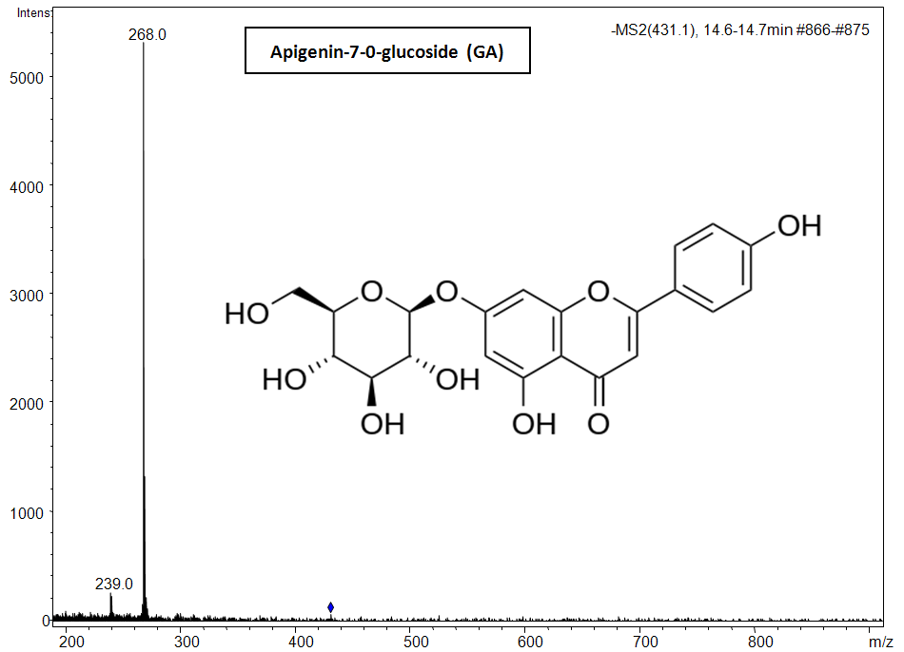
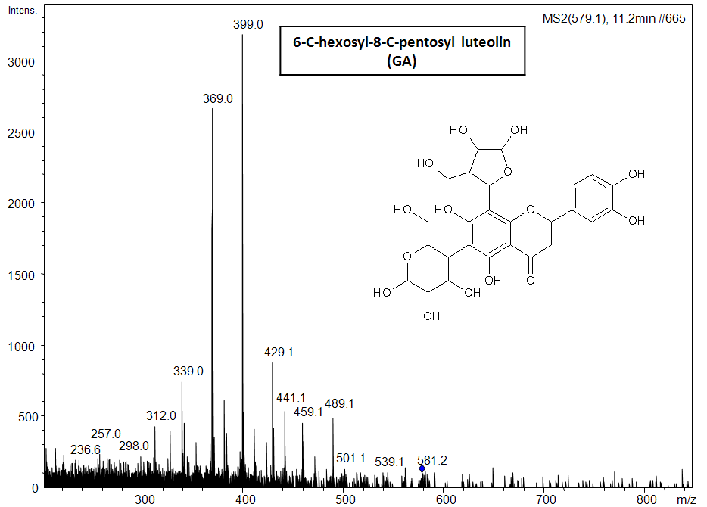
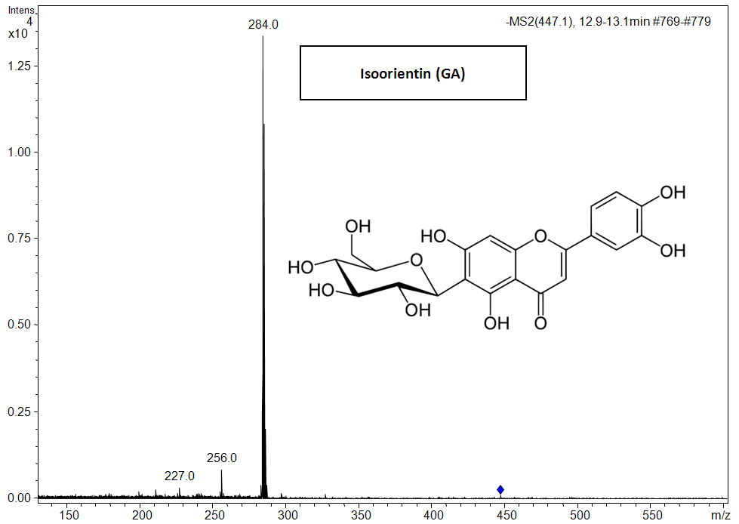
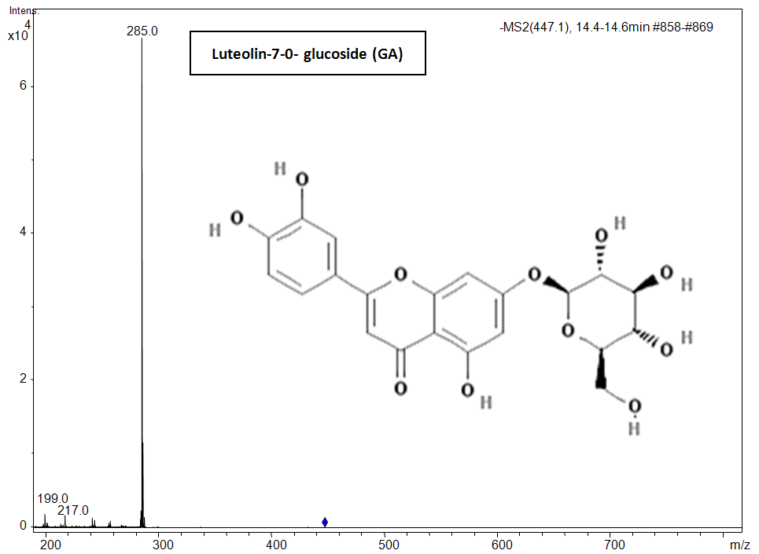
Compounds Identified from G. arborea

Slide 33
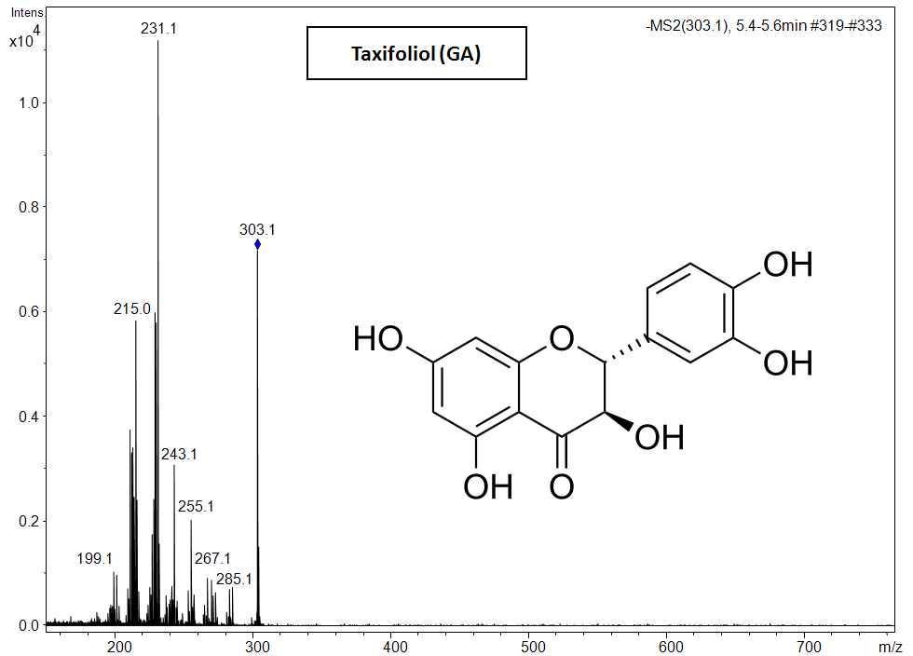

Slide 34
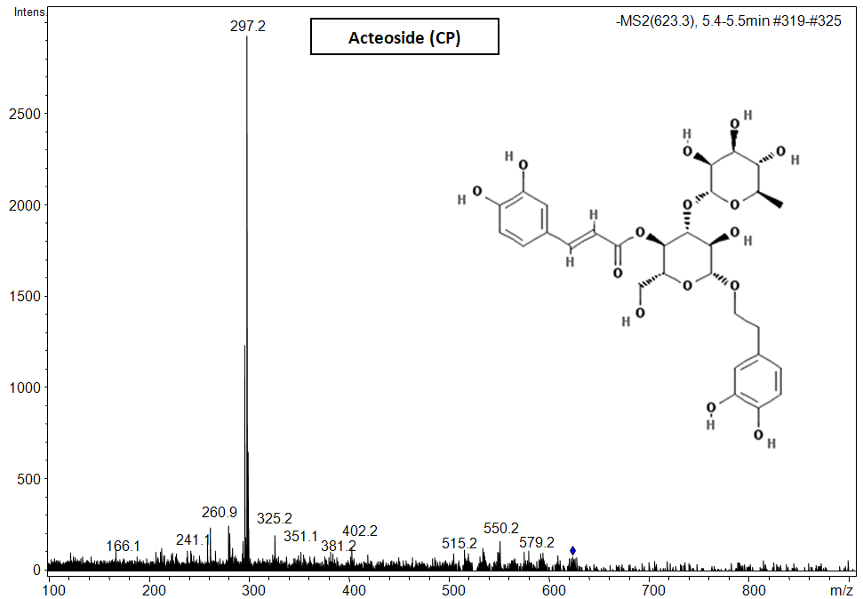
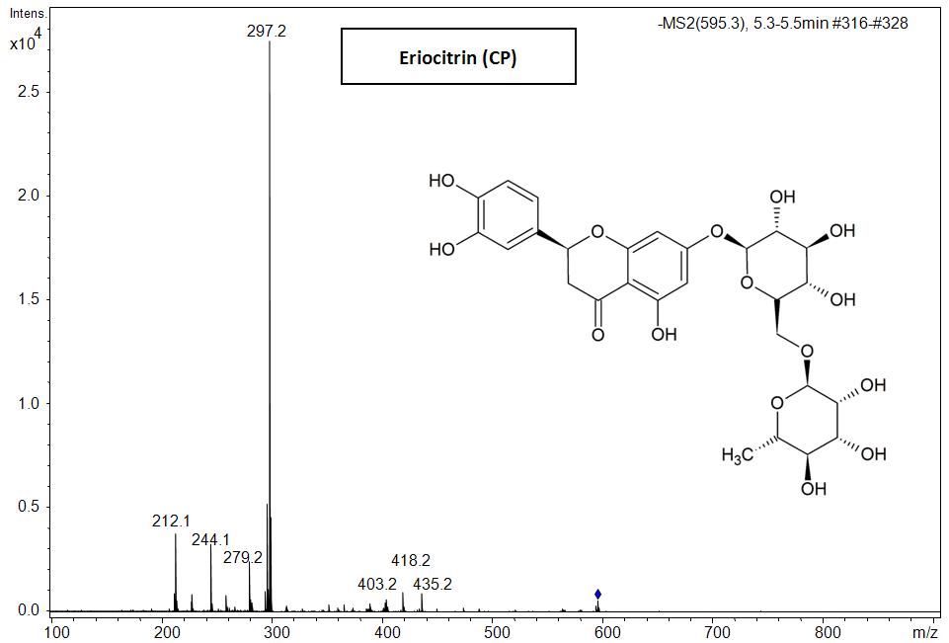
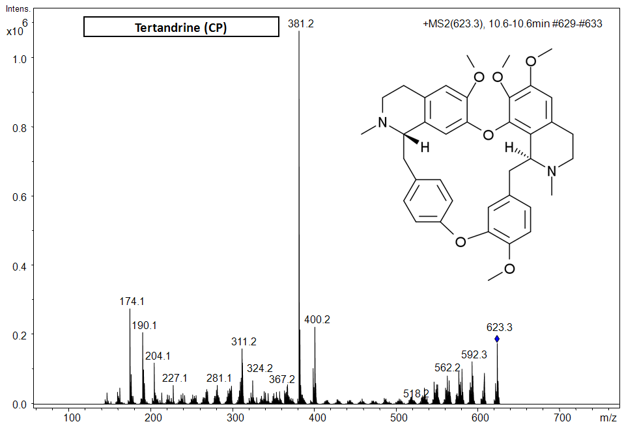
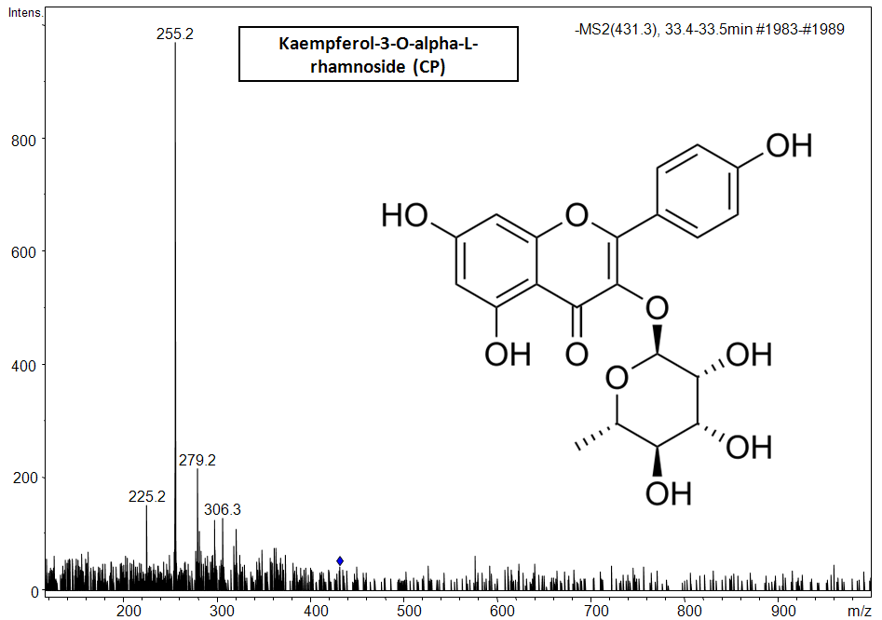
Compounds Identified from C. peltata

Slide 35
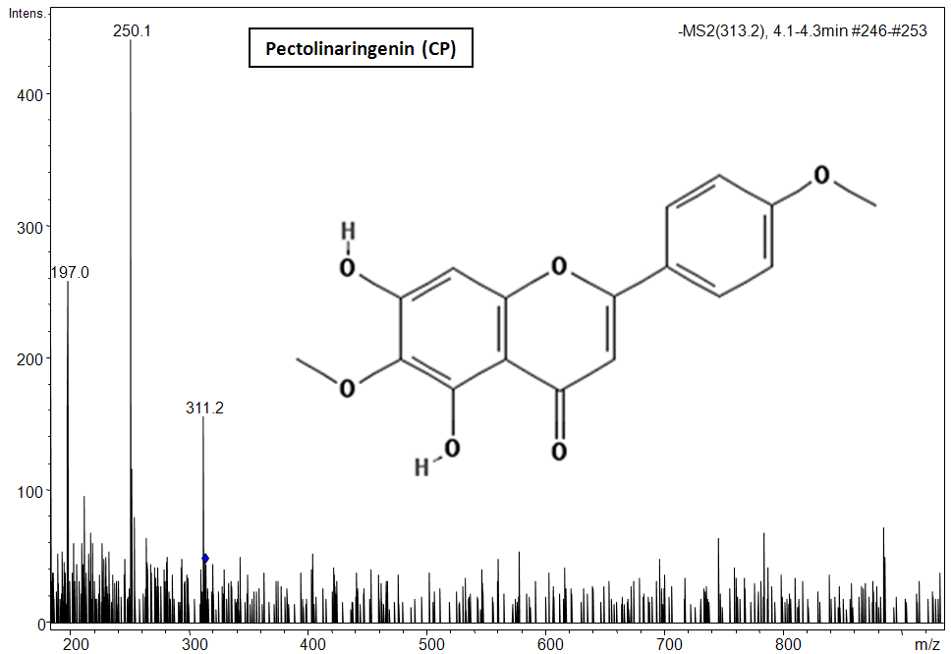

Slide 36
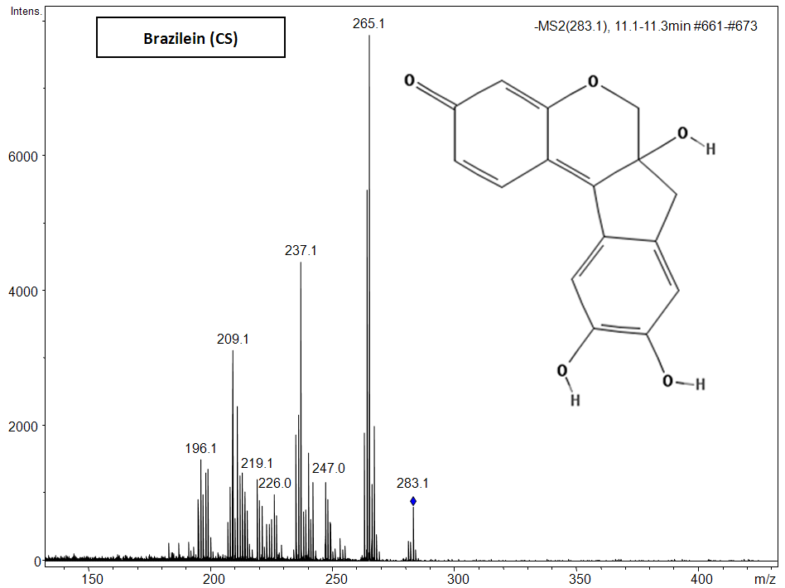
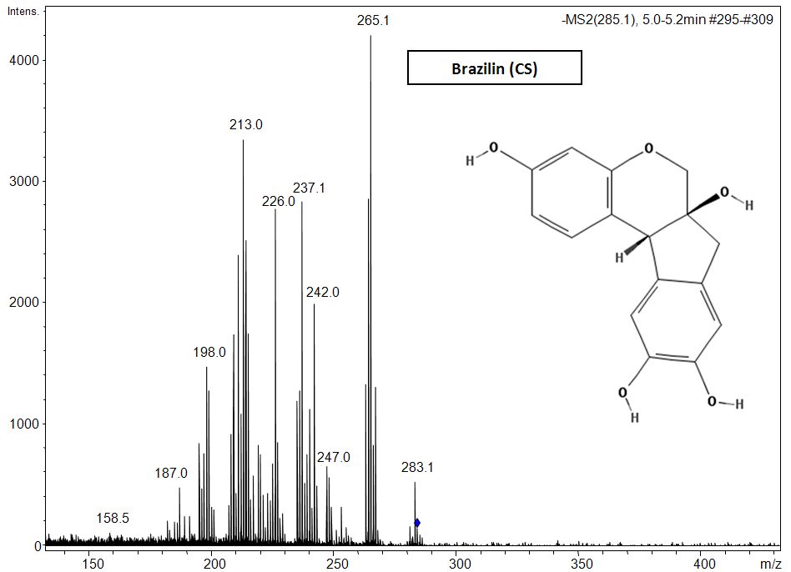
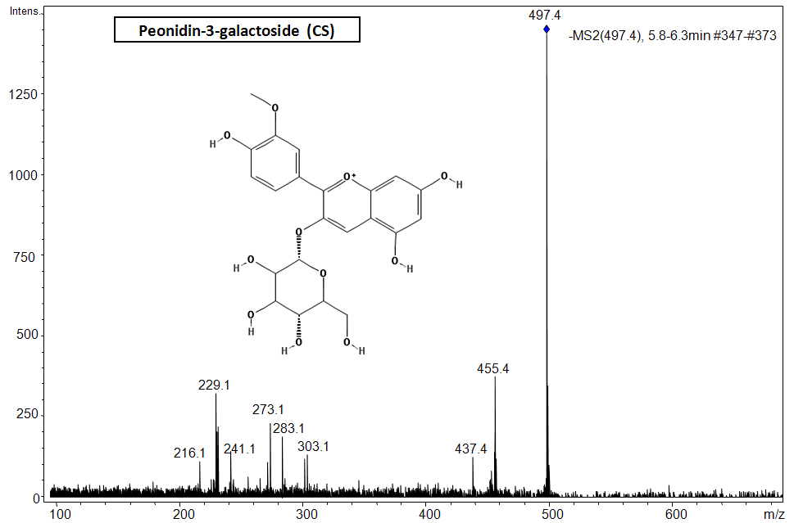
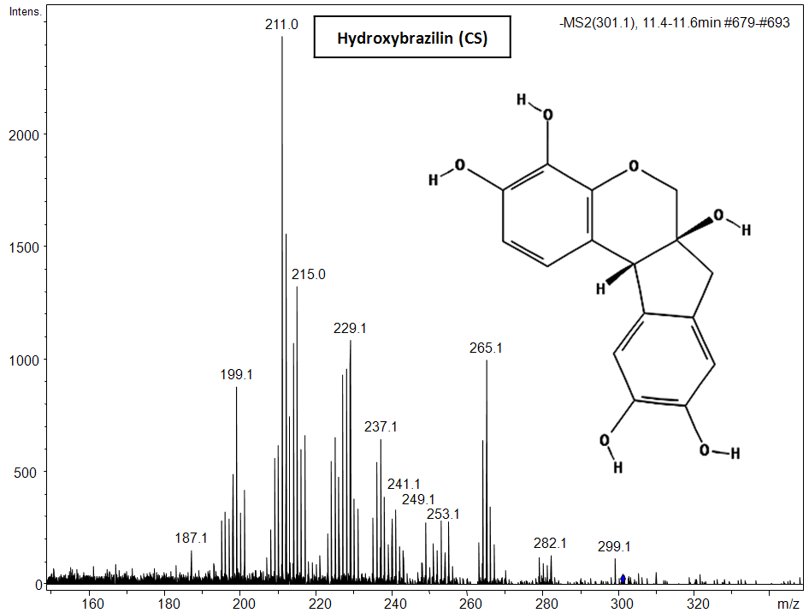
Compounds Identified from C. sappan

Slide 37
Compounds identified in the LCMS/MS analysis of the selected plant extracts
Caesalpinia sappan Heart wood | Cyclea peltata Roots | Gmelina arborea Aerial parts
Brazilin (chromene/ Red pigment) | Tetrandrine (alkaloid) | Apigenin-7-0-glucoside (Flavonoid glycoside)
Brazilein (chromene/ Pigment) | Acteoside (caffeoyl phenylethanoid glycoside) | 6-C-hexosyl-8-C-pentosyl luteolin (Flavonoid glycoside)
Hydroxybrazilin (chromene/ Pigment) | Eriocitrin (flavanone-7-O-glycoside) | Homoorientin (flavone)
Peonidin-3-galactoside (Anthocyanins glucosides) | Kaempferol-3-O-alpha-L-rhamnoside (flavonol glycoside) | Luteolin-7-O-glucoside (flavone glycoside)
- | Pectolinaringenin (flavonoid) | Taxifoliol (flavonoid.)

Slide 38
Specific Aims #3
  To evaluate antioxidant, antiulcer and cytoprotective potentials of selected plants by in vitro methods
    Antioxidant- DPPH Assay (Brand et al., 1995)
    Acid neutralizing capacity (Berchtold et al., 1985)
    Cytoprotective effect using Rat gastric mucosal cells
    H⁺/K⁺ ATPase inhibitory activity

Slide 39
DPPH Assay (IC₅₀ in µg/mL)
Extract | C. sappan | C. peltata | G. arborea
Hydro-alcoholic | 5.43 | 270.06 | 72.01

Slide 40
In vitro acid neutralizing capacity evaluation
Group Description | pH (Mean±SD)
 | 1 minute | 30 minute | 60 minute
Control | 1.17±0.09 | 1.17±0.08 | 1.17±0.11
Caesalpinia sappan | 1.22±0.11 | 1.20±0.03 | 1.19±0.07
Cyclea peltata | 1.19±0.10 | 1.19±0.12 | 1.19±0.10
Gmelina arborea | 1.18±0.05 | 1.17±0.09 | 1.17±0.16
Results are not encouraging

Slide 41
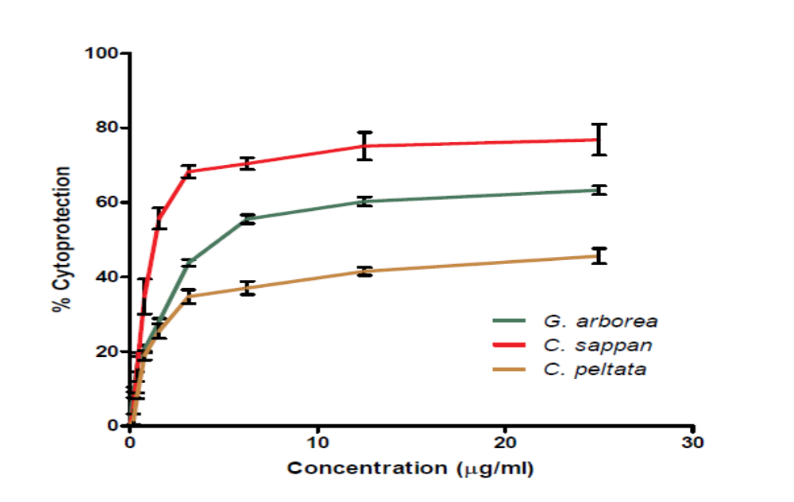
In vitro Cytoprotective Effect of Plant Extracts on Indomethacin-Induced Cytotoxicity using MTT Assay.
Good cytoprotection observed in C. sappan extract

Slide 42
Percentage Inhibition of gastric H⁺,K⁺-ATPase activity by the selected plant extracts
Group Description | Concentration (µg/ml) | Amount of inorganic phosphate released (µg/hr/mg protein) | Percentage Inhibition
Control | - | 194.00±2.12 | -
Caesalpinia sappan | 500 | 70.04±7.51 | 63.91
Cyclea peltata | 500 | 26.67±9.86 | 86.25
Gmelina arborea | 500 | 144.56±7.94 | 25.77
Pantoprazole | 50 | 21.12±5.92 | 89.11
C. peltata extract showed good percentage inhibition of gastric H⁺,K⁺-ATPase

Slide 43
Specific Aims #4
  To screen selected plant drugs for their toxicity and efficacy profiles employing suitable animal models
    Acute oral toxicity
    Antiulcer screening
      Ethanol induced ulcer
      Pylorus ligation induced ulcer
      Cysteamine induced ulcer
      NSAID induced ulcer

Slide 44
Acute oral toxicity studies
(OECD 423)
Animal used- Albino Wistar Rats
Sex – Female
Body weight – 140-160 g
Dose administered – 2000 mg/ Kg, p.o.
Vehicle – 0.5% Tween 80
Direct behavioral observation (first 4 hours)
    Skin and fur
    Eyes
    Salivation, Diarrhoea, Piloerection
    Lethargy, Sleep, Tremor, Convulsion, Coma
Weekly body weight change (14 Days)
Daily food intake
Morbidity and Mortality

Slide 45
Acute oral toxicity studies
Observations
No mortality
No test substance related behavioral changes were observed
Normal feed in take during the entire observation
No significant changes in weekly body weight
Gross pathology - No abnormality detected
Maximum tolerated dose - greater than 2000 mg/kg B. wt.

Slide 46
Antiulcer Screening
In vivo Antiulcer screening
  Ethanol induced ulcer (Suleyman et al., 2002)
  Pylorus ligation induced ulcer (Shay et al.,1945)
  Cysteamine induced ulcer (Szabo, 1978)
  NSAID induced ulcer (Mehmet et al., 2009)

Slide 47
Ethanol induced ulcer-Mechanisms
Ethanol may induce ulcer by,
  Solubilizing and disintegrating mucus layer leading to ulcer formation
  Increasing the accumulation of calcium ions
  Promoting acid secretions and neutrophil infiltration
  Releasing superoxide anions and hydroperoxy free radicals

Slide 48
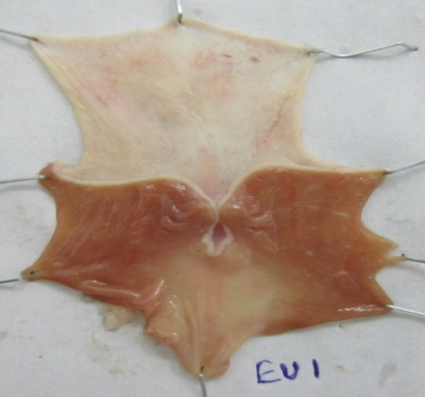
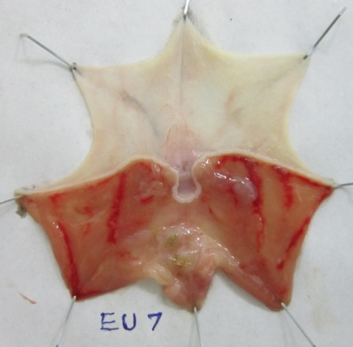
Ethanol induced ulcer-Mechanisms
(Adinortey et al., 2013)
Solubilize Mucus
↑ Accumulation of Ca²⁺
Ethanol
Release superoxide anions & Hydroperoxy free radicals
Promote acid secretion
Neutrophil infiltration

Slide 49
Methodology
Groups | Description | Number of Animals | Treatment
I | Normal control | 6 | 0.5 % Tween 80
II | Ulcer induced control | 6 | Ethanol + 0.5 % Tween 80
III | Standard drug | 6 | Ethanol + Sucralfate (400 mg/kg, p.o)
IV | G. arborea– Low dose | 6 | Ethanol + G. arborea (250 mg/kg, p.o.)
V | G. arborea– High dose | 6 | Ethanol + G. arborea (500 mg/kg, p.o.)
VI | C. sappan – Low dose | 6 | Ethanol + C. sappan (250 mg/kg, p.o.)
VII | C. sappan – High dose | 6 | Ethanol + C. sappan (500 mg/kg, p.o.)
VIII | C. peltata– Low dose | 6 | Ethanol + C. peltata (250 mg/kg, p.o.)
IX | C. peltata– High dose | 6 | Ethanol + C. peltata (500 mg/kg, p.o.)

Slide 50
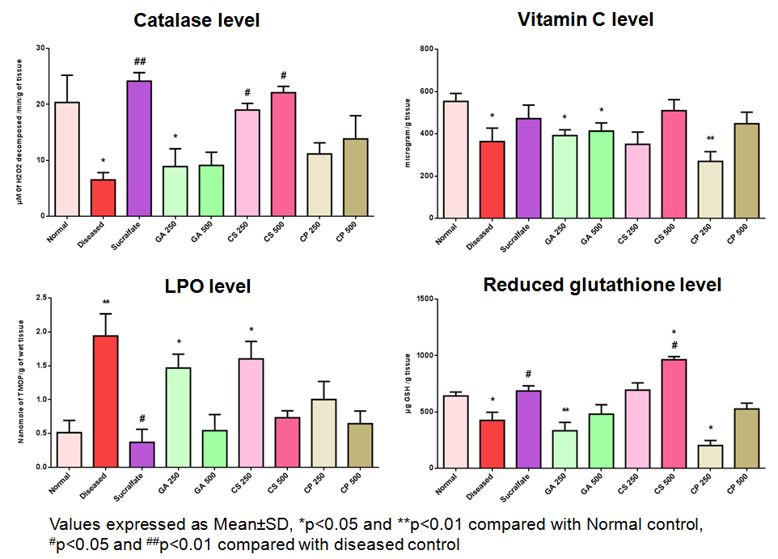

Slide 51
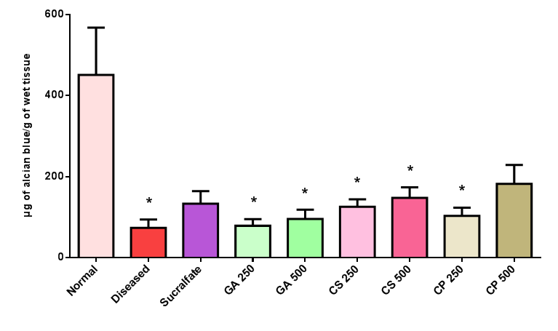
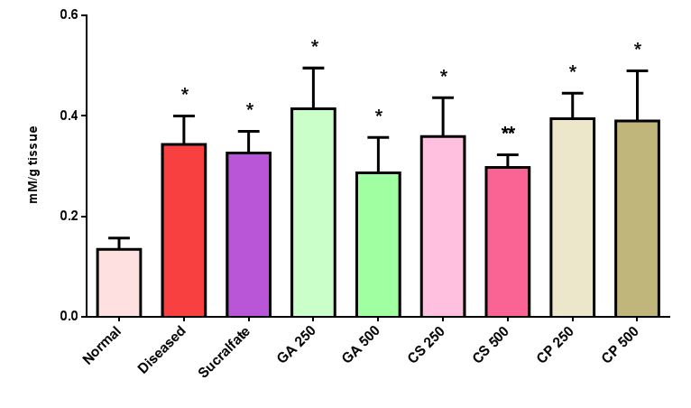
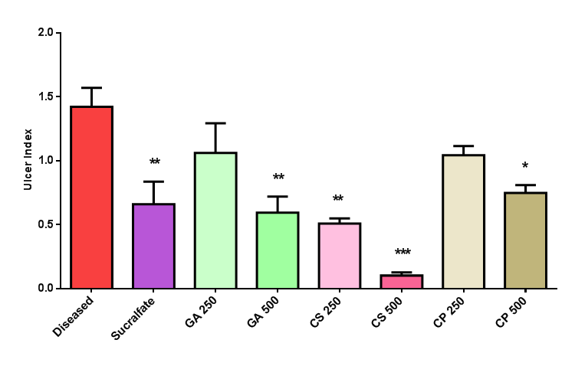
Mucus level
Myeloperoxidase level
Values expressed as Mean±SD, *p<0.05 and **p<0.01 compared with Normal control
Ulcer Index
Values expressed as Mean±SD, *p<0.05, **p<0.01 and ***p<0.001 compared
with diseased control

Slide 52
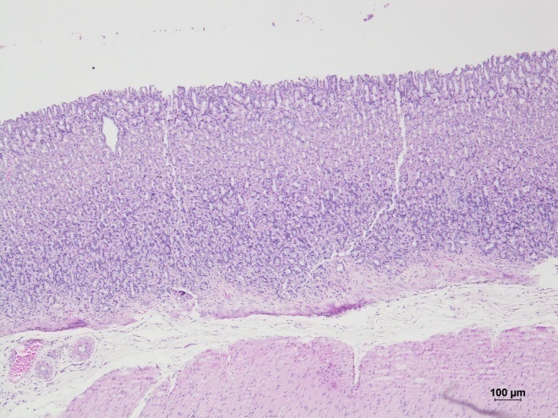
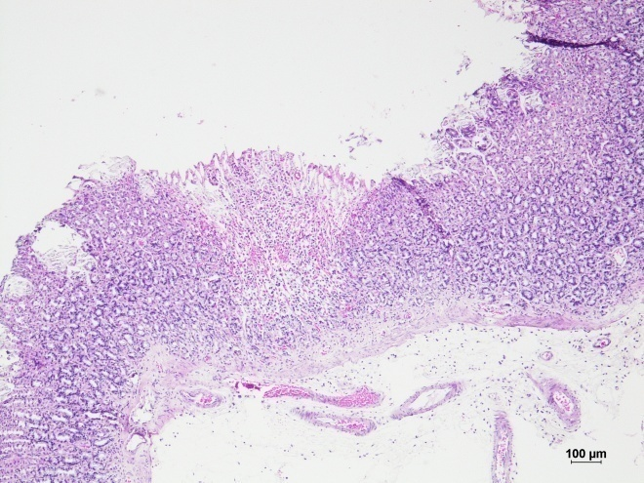
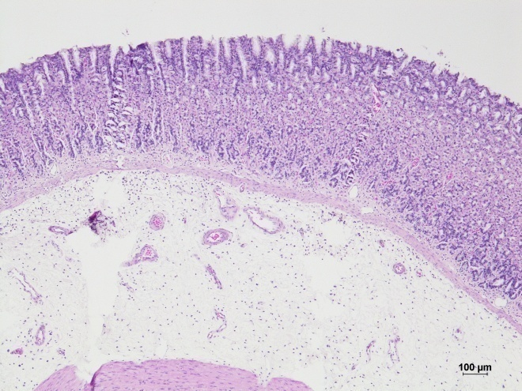
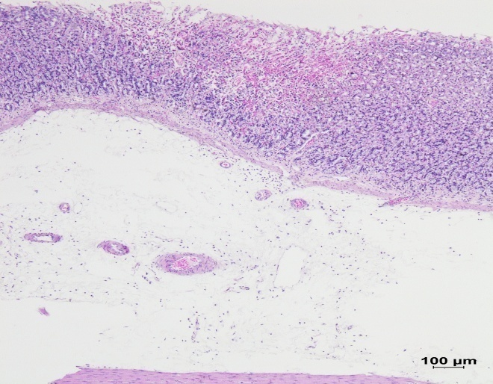
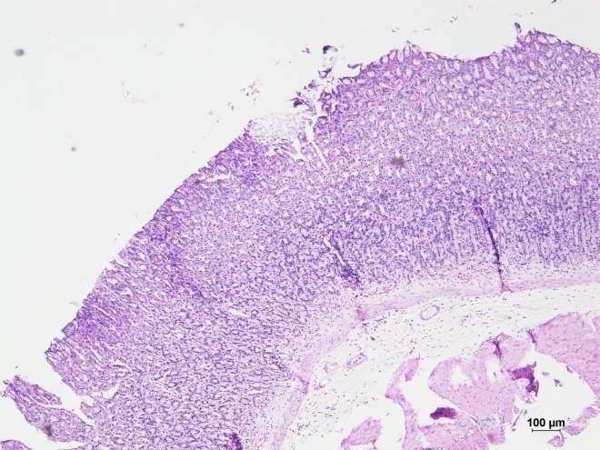
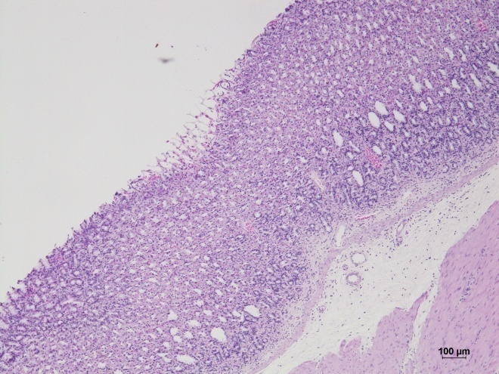
Histology-Ethanol induced ulcer
MU
E
SM
M
Normal Control
Diseased Control
Standard
GA- High Dose
CS- High Dose
CP- High dose
M-Mucosa, SM-Sub-mucosa, M-Muscularis, E-Edema, Presence of ‘V’ shaped ulcer (Red Arrow)

Slide 53
Pylorus ligation induced ulcer-Mechanism
During pylorus ligation, accumulation of gastric juice leads to auto-digestion of gastric mucosa, which in turn breakdown the gastric mucosal barrier, thus leads to gastric ulcer formation in experimental animals

Slide 54
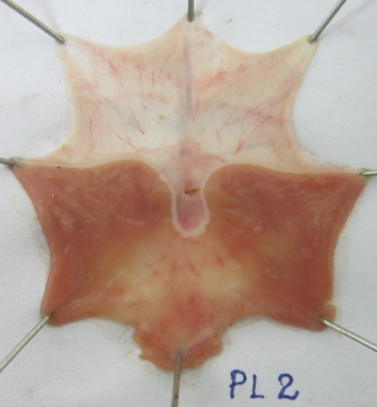
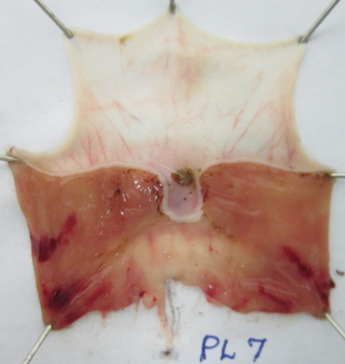
Pylorus ligation induced ulcer-Mechanism
(Adinortey et al., 2013)
Pylorus ligation
Accumulation of gastric juice
Auto-digestion of gastric mucosa
Breakdown of gastric mucosal barrier

Slide 55
Methodology
Group | Description | Number of Animals | Treatment
I | Normal control | 6 | 0.5 % Tween 80
II | Ulcer induced control | 6 | Pylorus Ligation+ 0.5 % Tween 80
III | Standard drug | 6 | Pylorus Ligation + Ranitidine (50 mg/kg, p.o)
IV | G. arborea– Low dose | 6 | Pylorus Ligation + G. arborea (250 mg/kg, p.o.)
V | G. arborea– High dose | 6 | Pylorus Ligation + G. arborea (500 mg/kg, p.o.)
VI | C. sappan – Low dose | 6 | Pylorus Ligation + C. sappan (250 mg/kg, p.o.)
VII | C. sappan – High dose | 6 | Pylorus Ligation + C. sappan (500 mg/kg, p.o.)
VIII | C. peltata– Low dose | 6 | Pylorus Ligation + C. peltata (250 mg/kg, p.o.)
IX | C. peltata– High dose | 6 | Pylorus Ligation+ C. peltata (500 mg/kg, p.o.)

Slide 56
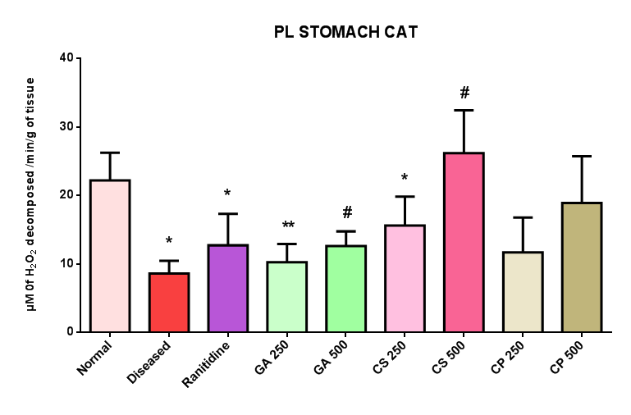



Catalase level
Reduced Glutathione level
LPO level
Mucus level
Values expressed as Mean±SD, *p<0.05 and **p<0.01 compared with normal control, #p<0.05 and ##p<0.01 compared with diseased control

Slide 57




Free Acidity
Myeloperoxidase level
Values expressed as Mean±SD, *p<0.05, **p<0.01 and ***p<0.001 compared with normal control, #p<0.05 and ##p<0.01 compared with diseased control
Gastric juice volume level
pH
Values expressed as Mean±SD, *p<0.05, **p<0.01 and ***p<0.001 compared with diseased control

Slide 58

PL induced ulcer- Ulcer Index
Values expressed as Mean±SD, *p<0.05, **p<0.01 and ***p<0.001 compared with
diseased control

Slide 59






Histology-Pylorus Ligation induced ulcer
MU
SM
M
Normal Control
Diseased Control
Standard
GA- High Dose
CS- High Dose
CP- High dose
MU-Mucosa, SM-Sub-mucosa, M-Muscularis, Presence of Haemorrhage (Red Arrow)

Slide 60
Cysteamine induced ulcer-Mechanism
Administration of Cysteamine may induce ulcer by
  Stimulating gastric acid secretions
  Decreasing mucus and bicarbonates secretions
  Increasing gastrin levels
  Inhibiting gastric emptying and motility
60

Slide 61


Cysteamine induced ulcer-Mechanism
(Adinortey et al., 2013)
Decreases
Mucus & bicarbonate secretions
Stimulate gastric acid secretions
Cysteamine
Inhibit gastric emptying & motility
Increase gastrin level
61

Slide 62
Methodology
Group | Description | Number of Animals | Treatment
I | Normal control | 6 | 0.5 % Tween 80
II | Ulcer induced control | 6 | Cysteamine (400 mg/kg, p.o.)+ 0.5 % Tween 80
III | Standard drug | 6 | Cysteamine (400 mg/kg, p.o.)+ Ranitidine (50 mg/kg)
IV | G. arborea– Low dose | 6 | Cysteamine (400 mg/kg, p.o.)+ G. arborea (250 mg/kg, p.o.)
V | G. arborea– High dose | 6 | Cysteamine (400 mg/kg, p.o.) + G. arborea (500 mg/kg, p.o.)
VI | C. sappan – Low dose | 6 | Cysteamine (400 mg/kg, p.o.)+ C. sappan (250 mg/kg, p.o.)
VII | C. sappan – High dose | 6 | Cysteamine (400 mg/kg, p.o.)+ C. sappan (500 mg/kg, p.o.)
VIII | C. peltata– Low dose | 6 | Cysteamine (400 mg/kg, p.o.)+ C. peltata (250 mg/kg, p.o.)
IX | C. peltata– High dose | 6 | Cysteamine (400 mg/kg, p.o.)+ C. peltata (500 mg/kg, p.o.)

Slide 63




Catalase level
LPO level
Mucus level
Myeloperoxidase level
Values expressed as Mean±SD, *p<0.05 and **p<0.01 compared with normal control, #p<0.05 compared with diseased control

Slide 64






Histology-Cysteamine induced ulcer
MU
C
BG
M
M
Normal Control
Diseased Control
Standard
GA- High Dose
CS- High Dose
CP- High dose
MU-Mucosa, M-Muscularis, BG-Brunner’s gland, C-Crypts, Presence of Haemorrhage (Red Arrow)

Slide 65
NSAID induced ulcer-Mechanism
Administration of Indomethacin may induce gastric ulcer by
  Blocking COX1 and COX2
  Increasing reactive oxygen species
  Decreasing mucus and bicarbonate secretions
  Decreasing mucosal blood flow
  Inhibiting gastric peroxidase, thus increasing mucosal H₂O₂ & OH⁻

Slide 66


NSAID induced ulcer-Mechanism
(Adinortey et al., 2013)
Decreases
Mucus & bicarbonate secretions
Blocks COX₁ &COX₂
Increase ROS
Indomethacin
Inhibit gastric peroxidase-increase mucosal H₂O₂ & OH⁻
Decrease blood mucosal flow
Neutrophil infiltration
66

Slide 67
Methodology
Group | Description | Number of Animals | Treatment
I | Normal control | 6 | 0.5 % Tween 80
II | Ulcer induced control | 6 | Indomethacin (100 mg/kg, p.o) + 0.5 % Tween 80
III | Standard drug | 6 | Indomethacin (100 mg/kg, p.o)+ Ranitidine (50 mg/kg)
IV | G. arborea– Low dose | 6 | Indomethacin (100 mg/kg, p.o) + G. arborea (250 mg/kg, p.o.)
V | G. arborea– High dose | 6 | Indomethacin (100 mg/kg, p.o) + G. arborea (500 mg/kg, p.o.)
VI | C. sappan – Low dose | 6 | Indomethacin (100 mg/kg, p.o) + C. sappan (250 mg/kg, p.o.)
VII | C. sappan – High dose | 6 | Indomethacin (100 mg/kg, p.o) + C. sappan (500 mg/kg, p.o.)
VIII | C. peltata– Low dose | 6 | Indomethacin (100 mg/kg, p.o) + C. peltata (250 mg/kg, p.o.)
IX | C. peltata– High dose | 6 | Indomethacin (100 mg/kg, p.o) + C. peltata (500 mg/kg, p.o.)

Slide 68




Catalase level
Reduced Glutathione level
LPO level
Mucus level
Values expressed as Mean±SD, *p<0.05, **p<0.01 and ***p<0.001 compared with normal
control, #p<0.05 compared with diseased control

Slide 69


Myeloperoxidase level
Ulcer Index
Values expressed as Mean±SD, *p<0.05, **p<0.01 and ***p<0.001 compared with normal control, #p<0.05 compared with diseased control
Values expressed as Mean±SD, *p<0.05 compared with diseased control

Slide 70






Histology-NSAID induced ulcer
MU
SM
M
Normal Control
Diseased Control
Standard
GA- High Dose
CS- High Dose
CP- High dose

Slide 71


The Effect of Plant Extracts on iNOS Expression in NSAID-induced Ulcer Rats
Indomethacin markedly increased iNOS activity in the gastric mucosa
The increase in iNOS activity was reduced after the administration of plant extracts
Gmelina arborea extract showed better activity compared with other plant extracts

Slide 72

C. sappan extract treated rats showed increased Mucosal PGE2 level indicating good cytoprotection supporting invitro studies

Slide 73
Specific Aims #5
  To conduct in silico docking studies using the phyto-constituents detected from selected plants using LC-MS/MS against ulcer targets and to understand the probable mechanism of action

Slide 74
In silico studies
Ulcer targets selected
  H⁺/K⁺-ATPase
  Histamine (H₂)
  Gastrin-receptor
  Cox 1

Slide 75



Slide 76

In silico screening of H⁺/K⁺-ATPase inhibitor
S. No. | Compound ID/Name | G-Score
A | Eriocitrin (CP) | -11.2
B | Isoorientin (GA) | -8.3
C | Apigenin-7-0-glucoside (GA) | -7.9
D | Peonidin-3-galactoside (CS) | -7.5
E | Luteolin-7-0- glucoside (GA) | -7.4
F | Esomeprazole | -4.5
Notes:
Crude Binding affinity value/energy
Binding pose and interaction pattern

Slide 77

In silico screening of Histamine (H₂) antagonist
S. No. | Compound ID/Name | G-Score
A | Acteoside (CP) | -8.1
B | Eriocitrin (CP) | -7.8
C | Pectolinaringenin (CP) | -7.1
D | 6-C-hexosyl-8-C-pentosyl luteolin (GA) | -7.1
E | Famotidine | -5.2

Slide 78

In silico screening of Gastrin-receptor antagonist
S. No. | Compound ID/Name | G-Score
A | Eriocitrin (CP) | -7.8
B | Kaempferol-3-O-alpha-L-rhamnoside (CP) | -7.5
C | Apigenin-7-0-glucoside (GA) | -7.2
D | Acteoside (CP) | -7.1
E | Lorglumide | -3.7

Slide 79

In silico Screening of Cyclooxygenase-1 inhibitor
S. No. | Compound ID/Name | G-Score
A | Brazilein (CS) | -8.8
B | Taxifoliol (GA) | -8.8
C | Hydroxybrazilin (CS) | -8.8
D | Brazilin (CS) | -8.4

Slide 80
Screening methods | Activities | Cyclea peltata | Caesalpinia sappan | Gmelina arborea
In vitro | Antioxidant (IC₅₀) | 270.06 | 5.43 | 72.01
 | Acid neutralization | NO | NO | NO
In vivo | Pylorus ligation induced ulcer model | 87% | 64% | 68%
 | Ethanol induced ulcer model | 47% | 92% | 58%
 | Cysteamine induced ulcer | NS | NS | NS
 | NSAID induced ulcer model | 75% | 86% | 66%
In silico | H₂ receptor | -8.1 | -7.3 | -7.1
 | Gastrin receptor | -7.8 | - | -7.2
 | Proton pump | -11.2 | -7.4 | -8.3
 | Cox 1 | - | -9.3 | -8.8

Slide 81
Conclusions
The Antiulcer action of Cyclea peltata could be through following mechanisms as depicted in in silico, in vitro and in vivo studies
  By inhibiting H+, K+ ATPase, gastrin and histamine receptors and thereby reducing gastric acid secretion – antisecretory action
  By reducing gastric juice secretion and free acidity and increasing gastric pH in pylorus ligation induced gastric ulcer model

Slide 82
Conclusions
The antiulcer efficacy of C. sappan may be attributed to the following mechanisms;
  Maintenance of Antioxidant status
  Inhibition of Myeloperoxidase in cysteamine, pylorus ligation and NSAID induced gastric ulcer models
  Activation of mucosal defence mechanism by increasing PGE₂ levels

Slide 83
Conclusions
The antiulcer efficacy of G. arborea may be attributed to the following mechanisms;
  Maintenance of Antioxidant status
  Reduction in gastric acidity mediated through blocking of gastrin/Histamine receptor
  Significantly increasing PGE₂ levels
  Promoting mucus secretion and thereby protecting the mucosal barrier
  By blocking the up-regulation of iNOS resulting in ulcer healing mechanism

Slide 84
To sum up
The selected plants in combination can be used as an antiulcer drug as they could be useful as follows:
  Caesalpinia sappan can act as cytoprotective agent and can control both gastric and duodenal ulcer
  Cyclea peltata can be a supportive drug as it inhibits gastric juice secretions and can act as an anti-secretory agent
  Gmelina arborea can contribute in promoting mucus secretions and antioxidant status

Slide 85
Acknowledgements
Vice-chancellor, SASTRA University
Dean, Sponsored Research, SASTRA University
Dr. C. David Raj
Dr. S. Panchapakesan & Dr. P. C Prabu, CAF, SASTRA
Central Instrumentation facility, CARISM
Mr. Karthi, SCBT, SASTRA University
Dr. K. P. Arun,
SASTRA for infrastructural support

Slide 86






Slide 87

THANK YOU

