Slide 1
^{7th} Asia Pacific Biotech Congress
International Conference
at Double tree by Hilton
Beijing- China
July 13th to 15th 2015

Slide 2
“AFLP MARKER FOR ESTIMATING RELATEDNESS AND VARIATIONS AMONG NORMAL, TISSUE CULTURED AND AMF TREATED PLANTS OF Andrographis paniculata l.,
ANITHA.P¹ AND TEJAVATHI.D.H²
1 Department of Botany, M e s DEGREE College Bangalore-03
2 DEPARTMENT OF BOTANY, BANGALORE UNIVERSITY BANGALORE-56
Karnataka, INDIA

Slide 3
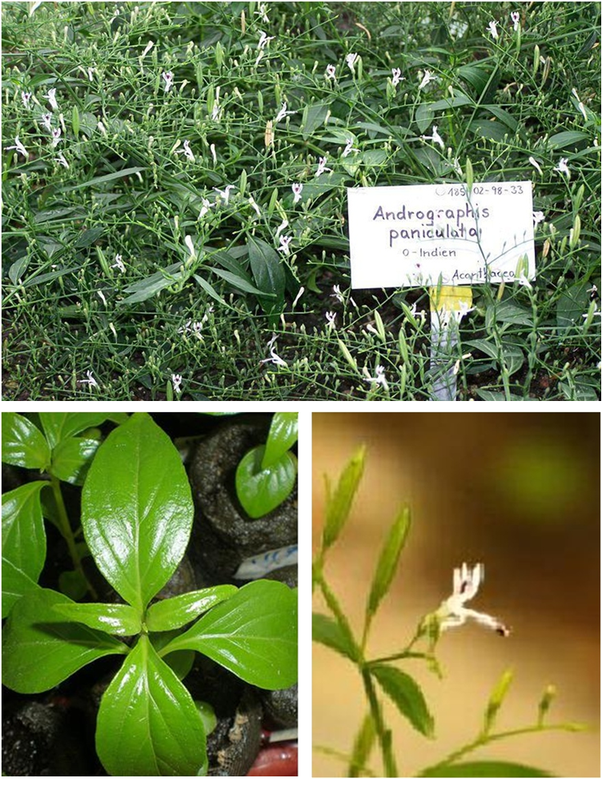
ANDROGRAPHIS PANICULATA

Slide 4
INTRODUCTION
PLANT PROFILE :-
Andrographis paniculata belongs to the family Acanthaceae.
Andrographis paniculata Nees , the “Kalmegh” of Ayurveda is an erect annual herb extremely bitter in taste in each and every part of the plant body. The plant is known in North-Eastern India as “Mahatita”literally “King of bitters”.
Andrographolide
Oxo Andrographolide,
Didehydro Andrographolide,
Deoxy Andrographolide,
Neo Andrographolide.
Apigenin, Andrographin, Panicolin, Monohydroxy trimethyl flavone, α- sitosterol and Paniculides A, B,
The PLANT containS:-

Slide 5
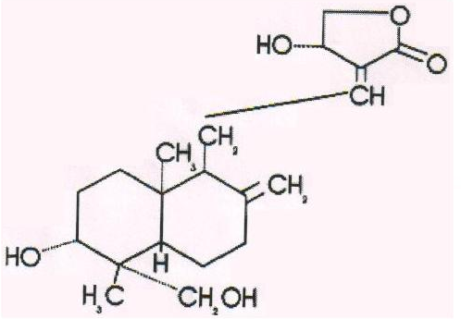
Andrographolide structure

Slide 6
Pharmacological effects of Andrographis paniculata
Sl.no | Biological activity | Benefits
1. | Analgesic | Pain killer.
2. | Anti-inflammatory | Reduces swelling and cuts down exudation from capillaries antiflammatory action probably mediated, in part, by adrenal function.
3. | Anti-viral | Inhibits viral activity.
4. | Anti-typhoid, Anti-ulcer | Fights typhoid and ulcers.
5. | Cancerolytic | Fights, even kills, cancer cells.
6. | Cardio protective | Protects heart muscles.
7. | Expectorant | Promotes mucus discharge from the respiratory system in bronchitis and asthma.
8. | Hepato protective | Protects the liver and gall bladder.
9. | Hypoglycemic | Blood sugar reducer.
10. | Immune Enhancer | White cell phagocytosis, inhibits HIV-I replication and improves CD4+ and T lymphocyte counts

Slide 7
Objectives
Micropropagation
Utilization of AM fungi for better growth and performance
Elite clones
Analysis of Andrographolide
Germ plasm conservation
To evaluate Genetic diversity by using DNA finger printing technique (AFLP Molecular markers)

Slide 8
Materials and Methods
Cotyledon segments were excised from 6 weeks old in vitro seedlings and were surface sterilized.
Surface sterilized explants were inoculated on MS and MMS medium supplemented with various auxins and cytokinins.
The pH of the medium was adjusted to 5-6 before autoclaving.
Cultures were incubated at 25± 2°C with 16 light / 8 hours dark cycle at the light intensity of 25 mol m² s⁻¹ provided by white flourescent tubes.

Slide 9
Establishment of micropropagated in plants in pots association with AM fungi for better growth performance
Arbuscular mycorrhizae (AM) inoculum’s
Glomus mosseae
Glomus fasciculatum
No. of root bits having infection
% of mycorrhizal infection = __________________________________________ x 100
No. of root bits taken for observation
Estimation of Mycorrhizal Spores:
Extramatrical chlamydospores produced by the mycorrhizal fungus were estimated by a wet sieving and decanting method outlined by Gerdman and Nicolson (1963).

Slide 10
Morphological evaluation and comparison of normal and micropropagated plants with and without AM association during pot trial experiments
Morphological / Yield characters: The following morphological / yield characters were studied in both normal, regenerated and AM treated plants periodically at 60, 90 and120 days.
1. Plant height in centimeters.
2.Number of branches: main and lateral.
3.Number of nodes.
4.Inter-nodal length.
5.Number of flowers per plant/ Number of days for flowering/ Days for 50% of flowering.
6.Number of fruits per plant/ Number of seeds per fruit.
7.Biomass in grams, both fresh weight and dry weight.
8.Root and shoot ratio in centimeters.
9.Leaf length in cms/ Leaf width in cms.
10.Surface area of leaf.
11. Stomatal index = E
S.I = ------------ x 100
E+S

Slide 11
Analysis of ANDROGRAPHOLIDE
High Performance Liquid Chromatography (HPLC) Studies for Plants Extracts.
Mobile Phase: Acetonitrate water and phosphate buffer (65:35)
Flow Rate: 1.5 ml/min
Detection: (U.V.VISIBLE) 223 nm.
Extraction of Andrographolide

Slide 12
Materials and methods contd.
To evaluate the genetic diversity of the control normal, regenerated and AM treated plants, using DNA finger printing by using AFLP markers.
Molecular Evaluation and Comparison of Samples of
Andrographis paniculata by using AFLP Finger Printing Technique:
Standardization of DNA extraction and AFLP analysis.
Finger printing and evaluation of genetic diversity among the samples by using AFLP markers.

Slide 13
Plant Materials used for Finger printing and Diversity Analysis
The present study was carried out in six samples of Andrographis paniculata which are as follows:-
Normal
Regenerated
Normal treated with Glomus mosseae
Regenerated treated with Glomus mosseae
Normal treated with Glomus fasciculatum
Regenerated treated with Glomus fasciculatum

Slide 14
Selection of the suitable plant material
Isolation of genomic DNA by modified CTAB method (Vos et al., 1995)
DNA purity assessment
AFLP Analysis: AFLP fragments were generated based on protocol of Vos et al., (1995) with minor modifications.
Digested with Restriction Endonucleases- EcoR I/ Mse I and Pst I/ Mse I
Ligation to adapters using T4 DNA using DNA ligase buffer

Slide 15
Pre-amplification using selective nucleotides: 15 different primer combinations of ECOR-I/Mse-I and Pst-I/Mse-I each having 2-3 selective nucleotides at the 3” end were used for selective amplification.
The amplified DNA fragments were scored using binary matrix.
Clustering analysis was done following (UPGMA) and a dendrogram was constructed by using NTSY SPC-version 2.0.

Slide 16
Sequences of AFLP primers used in this study:-
Sl.no | Primer | Nucleotide sequences
1) | ECOR-I+ACG MseI+CAG | 5׀- GAC TGC GTA CCA ATT C + ACG - 3 ׀ 5׀- GAT GAG TCC TGA GTA A+ CAG - 3 ׀
2) | ECOR-I+ACT MseI+CAT | 5׀- GAC TGC GTA CCA ATT + ACT - 3 ׀ 5׀- GAT GAG TCC TGA GTA + CAT - 3 ׀
3) | ECOR-I+ACG MseI+CTT | 5׀- GAC TGC GTA CCA ATT + ACG - 3 ׀ 5׀- GAT GAG TCC TGA GTA + CTT - 3 ׀
4) | ECOR-I+AAC MseI+CAA | 5׀- GAC TGC GTA CCA ATT + ACT - 3 ׀ 5׀- GAT GAG TCC TGA GTA + CAT - 3 ׀
5) | ECOR-I+ACG MseI+CTG | 5׀- GAC TGC GTA CCA ATT + ACG - 3 ׀ 5׀- GAT GAG TCC TGA GTA + CTG - 3 ׀
6) | ECOR-I+AGG MseI+CTT | 5׀- GAC TGC GTA CCA ATT + AGG - 3 ׀ 5׀- GAT GAG TCC TGA GTA + CTT - 3 ׀
7) | ECOR-I+ACC MseI+CTG | 5׀- GAC TGC GTA CCA ATT + ACC - 3 ׀ 5׀- GAT GAG TCC TGA GTA + CTG - 3 ׀
8) | ECOR-I+TAC MseI+CTA | 5׀- GAC TGC GTA CCA ATT + TAC - 3 ׀ 5׀- GAT GAG TCC TGA GTA + CTA - 3 ׀
9) | ECOR-I+TAC MseI+CAT | 5׀- GAC TGC GTA CCA ATT + TAC - 3 ׀ 5׀- GAT GAG TCC TGA GTA + CAT - 3׀
10) | Pst-I+GC Mse-I+CTA | 5׀- GAC TGC GTA CAT GCA G+ GC - 3 ׀ 5׀- GAC TGC GTA CAT GCA + CTA - 3 ׀
11) | Pst-I+CA Mse-I+CTA | 5׀- GAC TGC GTA CAT GCA + CA - 3 ׀ 5׀- GAC TGC GTA CAT GCA + CTA - 3 ׀
12) | Pst-I+CG Mse-I+CTA | 5׀- GAC TGC GTA CAT GCA + CG - 3 ׀ 5׀- GAC TGC GTA CAT GCA + CTA - 3 ׀
13) | Pst-I+GC Mse-I+CTG | 5׀- GAC TGC GTA CAT GCA + GC - 3 ׀ 5׀- GAC TGC GTA CAT GCA + CTG - 3 ׀
14) | Pst-I+CA Mse-I+CTG | 5׀- GAC TGC GTA CAT GCA + CA - 3 ׀ 5׀- GAC TGC GTA CAT GCA + CTG - 3 ׀
15) | Pst-I+CG Mse-I+CTG | 5׀- GAC TGC GTA CAT GCA + CG - 3 ׀ 5׀- GAC TGC GTA CAT GCA + CTG - 3 ׀

Slide 17
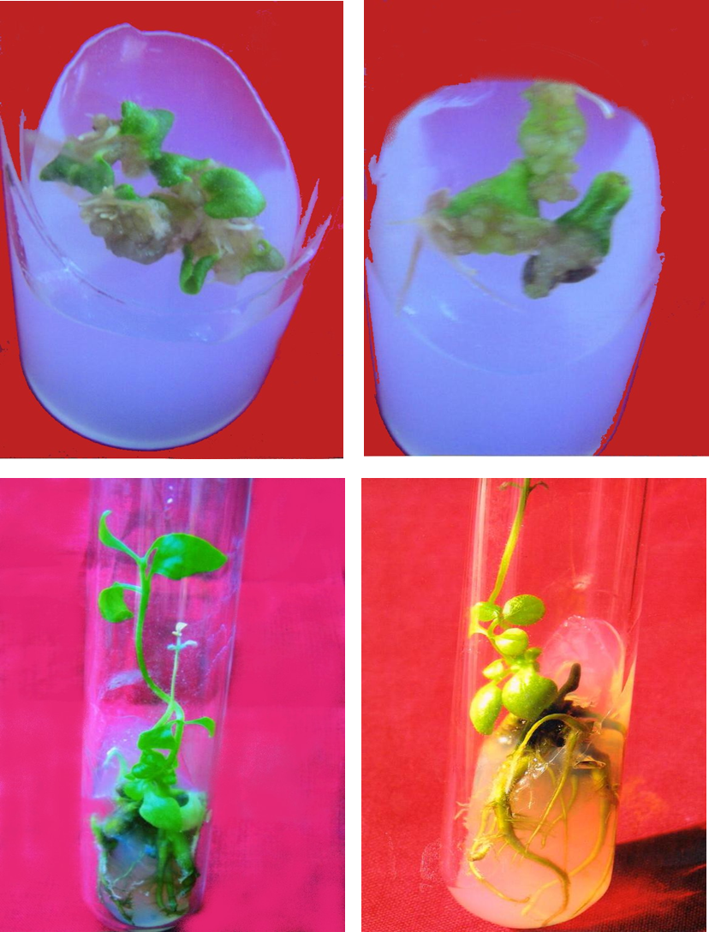
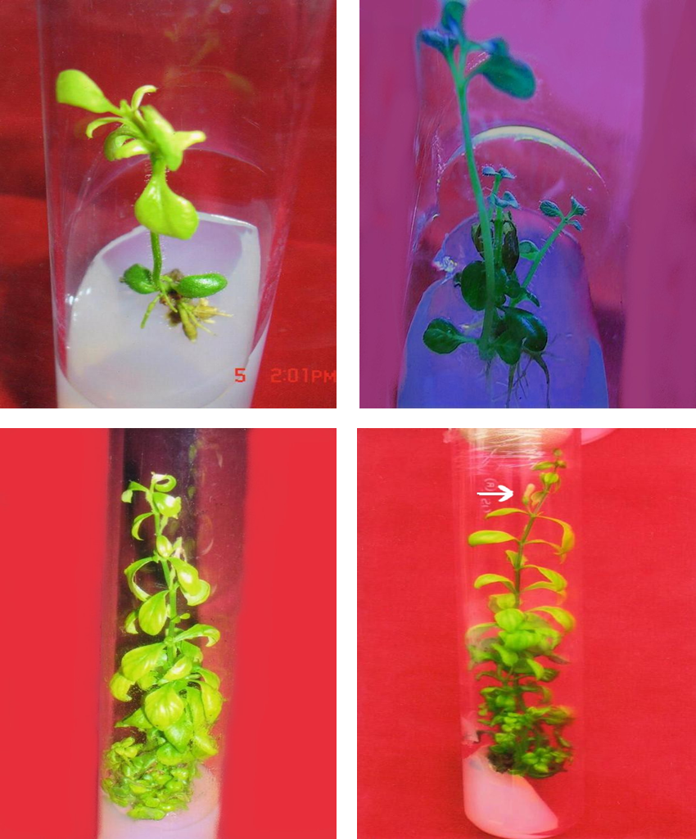
Cotyledon Cultures:-
RESULTS
MS+2,4 D(4.56 µm)
MS+2,4 D(9.05 µm)
MS+IAA(11.42µm)
MS+IBA(9.8 µm)
MS+NAA(5.37 µm)
MS+NAA(5.37 µm)
MS+BAP(8.87µm)
MS+BAP(8.87µm)

Slide 18
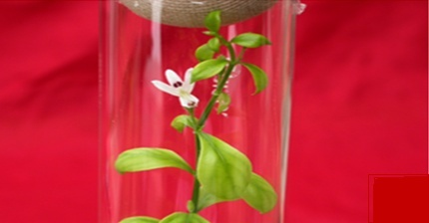
In vitro flowering
MS+BAP(8.87µm)

Slide 19
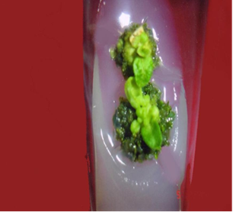
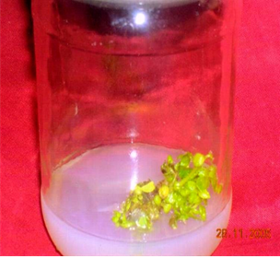
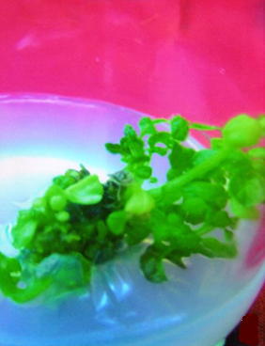
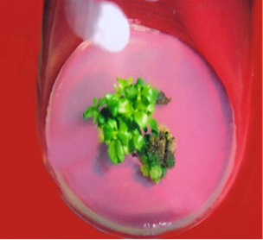
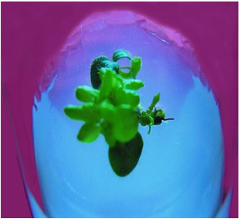
MS+IBA(4.90 µ m)+ BAP(4.44µm)+AS(5.43µ m)
MS+IBA(4.90 µ m)+ BAP(4.44µm)+GA3(1.44µ m)
MS+IBA(9.8 µ m)+ BAP(8.87µm)+AS(10.86µ m)
MS+IBA(4.90 µ m)+ BAP(4.44µm)+GA3(2.88µ m)

Slide 20
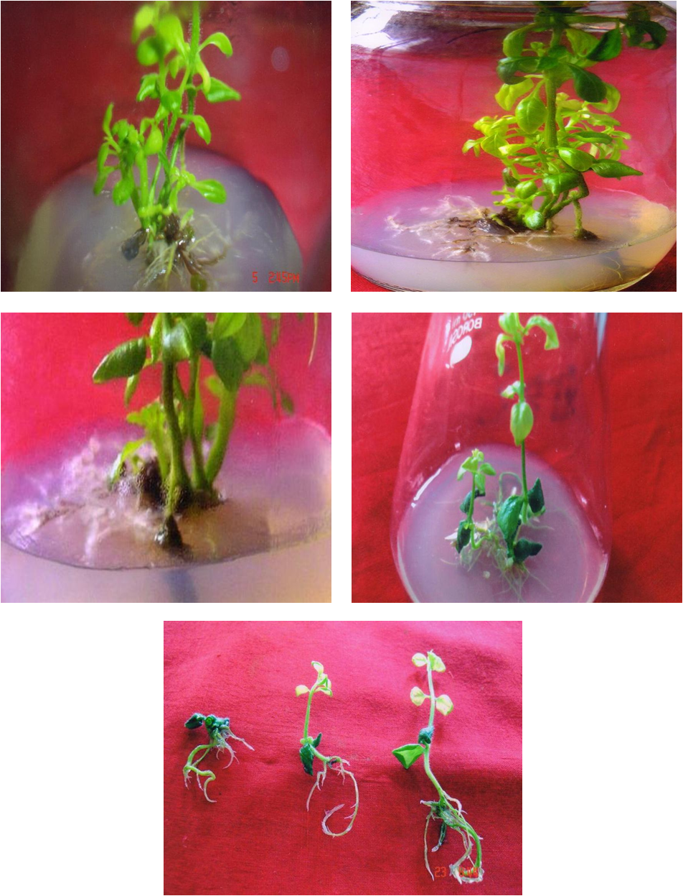
Rooting
MS+IBA(4.90µm)+ BAP(4.44µm)+GA3(2.88µm)
1/2MS+IBA(9.80µm)

Slide 21
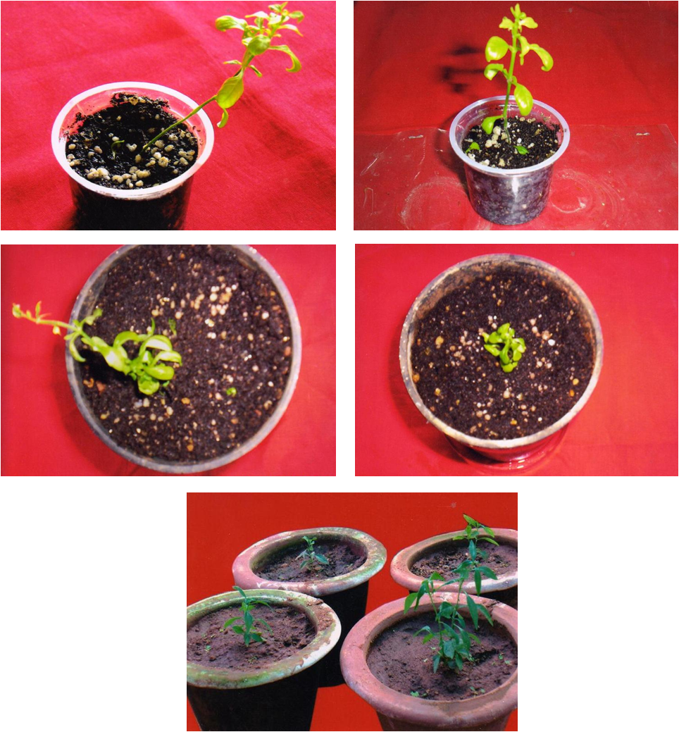
Hardening

Slide 22
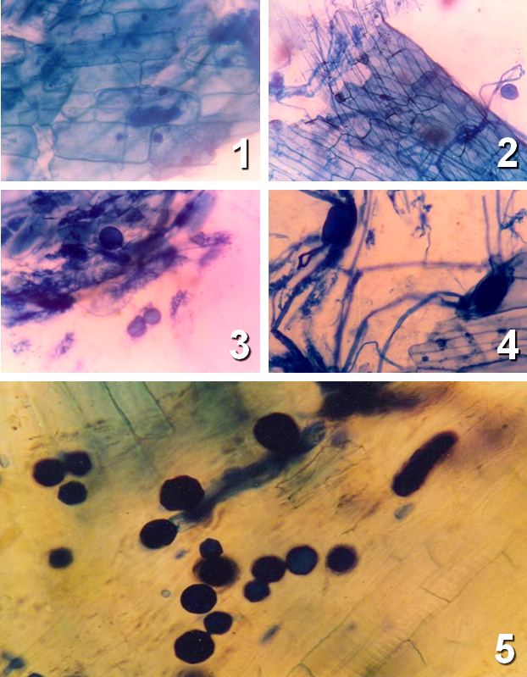
Establishment of micropropagated plants in pots in association with AM fungi for better growth performance.

Slide 23
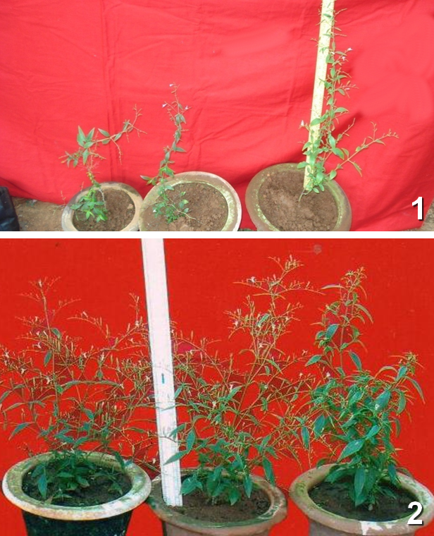
Morphological evaluation and comparison of normal and micropropagated plants with and without AM association during pot trial experiments.

Slide 24
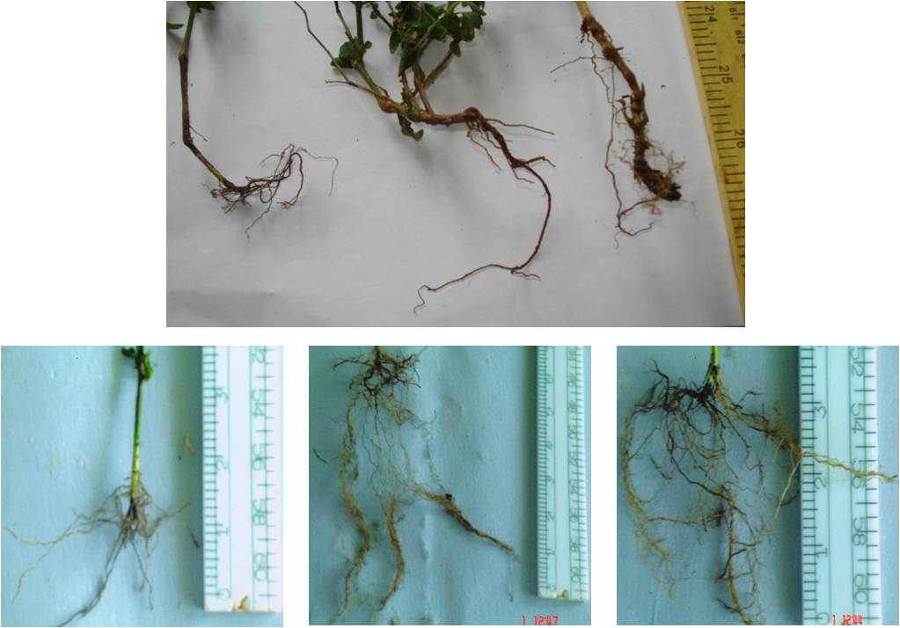

Slide 25
Andrographolide content in Control Normal, Regenerated plants of Andrographis paniculata and after AM treatment Andrographolide content (%)

Slide 26
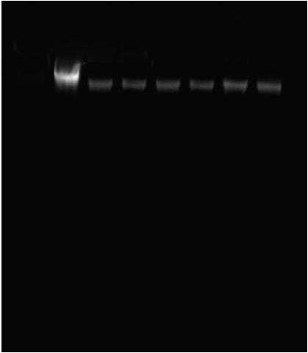
Experiment (8): To evaluate the genetic diversity of the control normal, regenerated and AM treated plants, using DNA finger printing by using AFLP markers

Slide 27
Comparision of genomic DNA yields and absorbance ratios from different samples of Andrographis paniculata leaf tissues after purification.
Sl. No. | Samples | OD 260 / OD 280 | DNA yield µg/ml
1. | Normal | 1.87 | 1340
2. | Regenerated | 2.28 | 1600
3. | Normal treated with Glomus mosseae | 1.54 | 1440
4. | Normal treated with Glomus fasciculatum | 1.62 | 1450
5. | Regenerated treated with Glomus mosseae | 1.78 | 1750
6. | Regenerated treated with Glomus fasciculatum | 1.77 | 1980

Slide 28
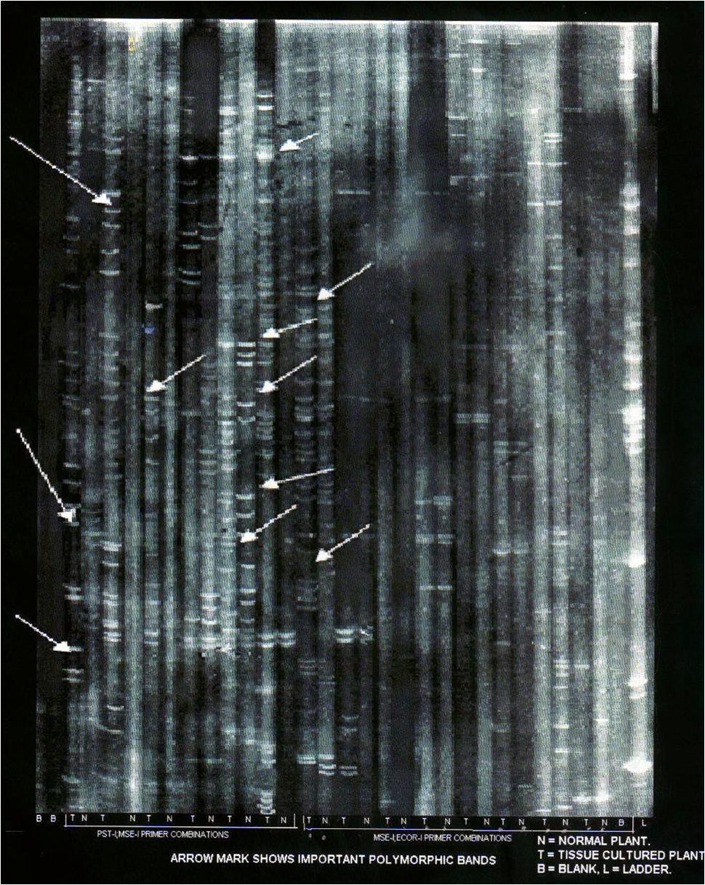
AFLP Profile

Slide 29
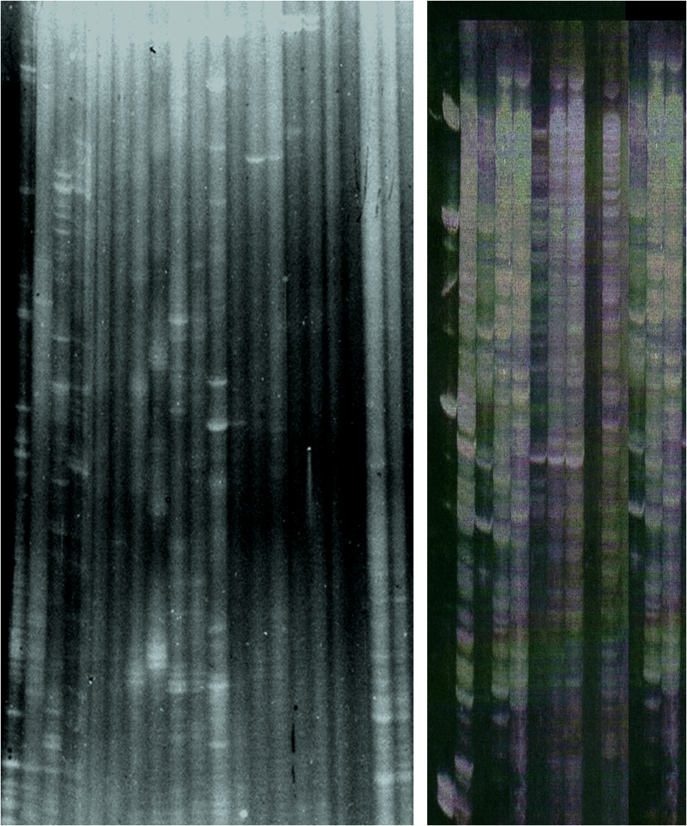
AFLP Profile

Slide 30
Summary of AFLP fragments variation in the six samples of Andrographis paniculata analyzed.
Sl. No. | Primer Pair Pst I / Mse I+3 | Number of AFLP makers Plant Samples |  |  |  |  |  | Number of polymorphic markers
 |  | N | Nm | Nf | R | Rm | Rf | N | Nm | Nf | R | Rm | Rf
1. | P+GC / M+CTA | 11 | 09 | 14 | 35 | 20 | 27 | 06 | 04 | 06 | 31 | 11 | 20
2. | P+CA / M+CTA | 17 | 14 | 21 | 26 | 28 | 30 | 14 | 06 | 21 | 23 | 24 | 26
3. | P+CG / M+CTA | 12 | 08 | 12 | 12 | 10 | 16 | 08 | 06 | 11 | 10 | 04 | 11
4. | P+GC / M+CTG | 13 | 08 | 13 | 21 | 10 | 13 | 12 | 06 | 09 | 20 | 10 | 11
5. | P+CA / M+CTG | 19 | 11 | 14 | 35 | 20 | 28 | 13 | 08 | 10 | 32 | 15 | 21
6. | P+CG / M+CTG | 10 | 09 | 18 | 25 | 20 | 32 | 09 | 06 | 12 | 24 | 10 | 25
 | Total | 82 | 59 | 92 | 154 | 108 | 146 | 62 | 36 | 69 | 140 | 74 | 114
 | Total |  |  |  |  |  | 641 |  |  |  |  |  | 495

Slide 31
Summary of AFLP fragments variation in the six samples of Andrographis paniculata analyzed.
Sl. No. | Primer Pair Pst I / Mse I+3 | % of Polymorphism |  |  |  |  |  | Total No. of AFLP Markers | No. of Polym-orphic markers | % of Polymor-phism
 |  | N | Nm | Nf | R | Rm | Rf
1. | P+GC / M+CTA | 54.5 | 44.4 | 42.8 | 88.5 | 55 | 74 | 116 | 78 | 67.2
2. | P+CA / M+CTA | 82.3 | 42.8 | 100 | 88.4 | 85.7 | 86.6 | 136 | 114 | 83.8
3. | P+CG / M+CTA | 66.6 | 75 | 91.6 | 83.3 | 40 | 68.7 | 70 | 50 | 71.4
4. | P+GC / M+CTG | 92.3 | 75 | 69.2 | 95.2 | 100 | 84.6 | 78 | 68 | 87.1
5. | P+CA / M+CTG | 68.4 | 72.7 | 71.4 | 91.4 | 75 | 75 | 127 | 99 | 77.9
6. | P+CG / M+CTG | 90 | 66.6 | 66.6 | 96 | 50 | 78.1 | 114 | 86 | 75.4
 | Total | 75.6 | 62.7 | 73.6 | 90.4 | 67.6 | 77.8 | 641 | 495 | 77.2
 | Total |  |  |  |  |  |  |  |  | 77.2

Slide 32
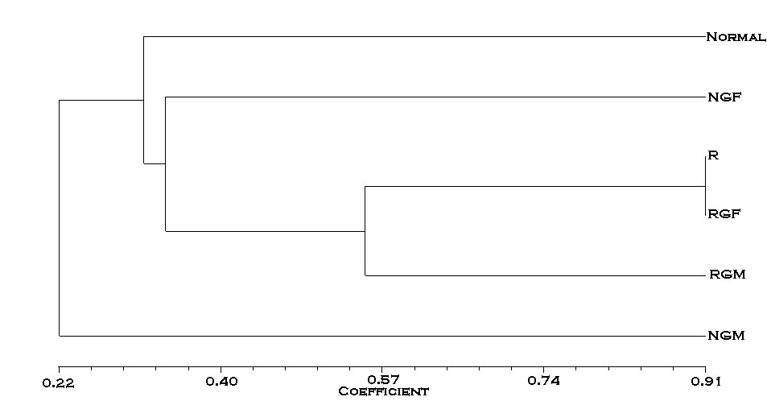
DENDROGRAM Constructed
NTSYSPC-Version 2.0

Slide 33
CONCLUSION
In conclusion Andrographis paniculata otherwise widely distributed faces threat of genetic depletion from over-exploitation due to its wide popularity as a drug to treat a variety of ailments. It is imperative that measures are initiated for the conservation of this species with its varied diversity as otherwise potential variants with highest productivity to be developed as cultivars may disappear once for all. It is well considered opinion that the two way approach viz., selection of an improved variant for development as a cultivar and isolation of a high yielding cultivar from the selected genotype through in vitro mutagenesis should be effectively pursued not only to conserve the existing genetic diversity but also to ensure sustainable utilization of Andrographis paniculata.

Slide 34
ACKNOWLEDGEMENTS
I Express my deep debt of sincere gratitude and thanks to Dr. D.H.Tejavathi, Professor, Department of Botany, Bangalore University for her valuable guidance with constant supervision and immense encouragement throughout the accomplishment of the study.
I also express my gratitude and thanks to Dr. David and the organizing committee for giving me an opportunity to present my research paper at this prestigious conference of 7th Asia Pacific Biotech Congress, Beijing, China.

Slide 35


Dr.P.ANITHA

