Slide 1



Improved Food Preservation and Shelf Life Stability By Ultrasound Processing Technologies: Case Studies
KEY NOT FORUM
Associate Professor Dr. Özlem Tokuşoğlu
CONGRESS CO-CHAIR
July 21, 10:05-10:30,
Hampton Inn Tropicana, Hampton Events Center A, Las Vegas,

Slide 2
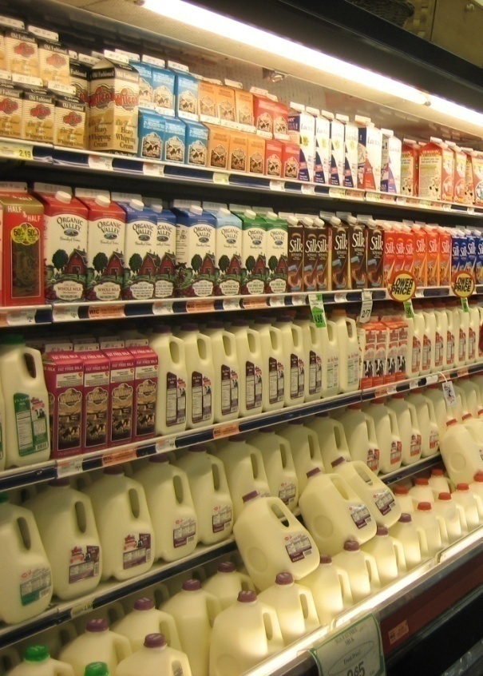


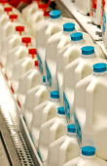
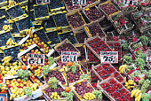
Consumer Demands
With less additives
With high nutritional value
High quality
Less thermal damage
Good sensory properties
Safe products
Thereby, food manufacturing designed for better food safety and quality.

Slide 3
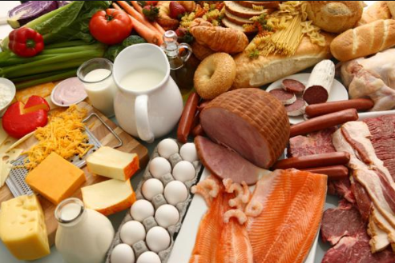
Strategies for
Food Processors
○ Premium food products
○ Long lasting Foods
○ Convenience foods
○ Minimally processed foods
○ Ready-to-cook meals
○ Ready-to-eat foods
○ Low-fat foods
○ Low-carbohydrate foods
○ Specialities in foods
(For Health Treatments
For Kids
For Military
For Pregnants
For Sportmans)
Notes:
--Changed ‘food’ to ‘foods’ in all {for consistency]
--added dashes to ready-to….
--deleted ‘populations’ {to keep consistent format]
-change ‘minimal’ to ‘minimally’ {adverb]

Slide 4

High Hydrostatic Pressure
Pulsed electric fields
Ultrasound
Ultraviolet
Irradiation
Cold Plasma
DensePhase CarbonDioxide
Ozone
Chemicals
NONTHERMAL
Microwave
Radiofrequency
Ohmic Heating
Induction Heating
THERMAL

Slide 5
NONTHERMAL
PROCESSING
Shelf Life Extension
Innovative Fresh Products
UnwantedOR Reduced Constituent
Clean-label Products
Unwanted Enzyme Inactivation
Pathogen Inactivation

Slide 6
Fundamentals:
Ultrasound Theory ; Definitions
Ultrasound is one of the emerging technologies that were developed to minimize processing, maximize quality and ensure the safety of food products.
Ultrasound is applied to impart positive effects in food processing such as improvement in mass transfer, food preservation, assistance of thermal treatments and manipulation of texture and food analysis

Slide 7
Fundamentals:
Ultrasound Theory
Ultrasound is considered as one such nonthermal processing alternative, which can be used in many food processing operations.
It travels through a medium like any sound wave, resulting in a series of compression and rarefaction.
At sufficiently high power, the rarefaction exceeds the attractive forces between molecules in a liquid phase, which subsequently leads to the formation of cavitation bubbles.

Slide 8
Each bubble affects the localized field experienced by neighboring bubbles, which causes the cavitation bubble to become unstable and collapse, thereby releasing energy formany chemical and mechanical effects. The collapse of each cavitation bubble acts as a hotspot,which generates energy to increase the temperature and pressure up to 4000 K and 1000 atm, respectively.

Slide 9
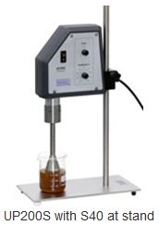
Ultrasound is efficient non-thermal alternative. Ultrasonic cavitation creates
shear forces that break cell
walls mechanically and improve material transfer.

Slide 10
There are a number of mechanisms by which ultrasound can affect mass transfer. The high ultrasonic intensity of the waves can generate the growth and collapse of bubbles inside liquids, a phenomenon known as cavitation.
 Ultrasound that can affect the resistance to mass transfer are the heating of materials due to thermoacoustic effects, the microstirring in fluids, mainly at interfaces, and some structural effects such as the so called “sponge effect” when the samples are squeezed and released like an sponge and the creation of microchannels

Slide 11
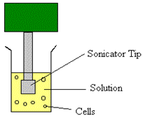
Fundatementals: Ultrasound Processing Principle
○ Energy generated from waves of
20,000 or more vibrations per second
    high frequency or diagnostic (2-10 MHz)
    low frequency or power (20-100 kHz)
Sonicator Tip
○ Lyses and inactivates cells
  Intracelullar cavitation
○ Variables to control:
    Temperature
    Amplitude of the ultrasonic wave
    Time of treatment
    Cycles
Solution
Cells

Slide 12
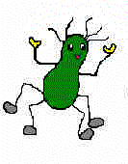
Sonication Modes
○ Sonication (US)
  Ultrasound
○ Thermo-sonication (TS)
  Ultrasound plus heat
○ Mano-thermo-sonication
(MTS)
  Ultrasound plus heat and
  pressure

Slide 13
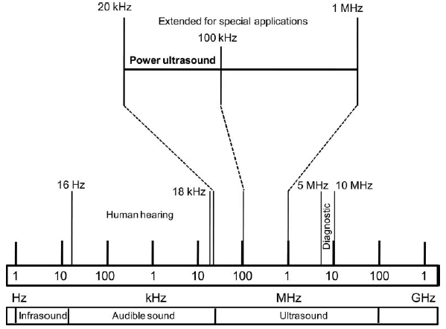
Fundamentals:
Ultrasound Theory

Slide 14
Ultrasound
FOOD
Preservation
Extraction
Transformation
The potential utilizing effects by ultrasound cavitation phenomena are shown in Fig.2.
Cavitation may cause to off-flavors, structural modifications, free radicals, and sometimes metallic taste

Slide 15
Utilizing of Ultrasound in Food Science &Technology
Inactivation of
Microorganisms
and Enzymes
Modifications
Enhancing the Efficiency
of Unit Operations
○
Color Modifi.
Ultrasound-Assisted Extraction
○
Antioxidant Modifi.
○
○
Ultrasound Assisted Drying
○
Bioactive Modifi.
○
Ultrasound Assisted Osmotic
Dehydration
Polysacharide Modifi.
○
○
Ultrasound Assisted Filtration
○
Ultrasound Assisted Freezing
○
Emulsification in Lipid Containing Foods
○
Hommogenization in Lipid Containing Foods
○
Cutting in Lipid Containing Foods

Slide 16
Most Frequently Utilizing of Ultrasound ;
Ultrasonic extraction of phenolic compounds and phenolic pigments (Anthocy., Betacyanin, Betaxanthin) from plant tissues
 Ultrasonic extraction of lipids and proteins from plant seeds, such as soybean
 Cell membrane permeabilization of fruits
 Ultrasonic processing of fruit juices, purees, sauces, dairy
 Ultrasonic processing for improving stability of dispersions
Microbial and enzyme inactivation (preservation) is another application of ultrasound in the food processing

Slide 17
High energy ultrasound can be used in preservation and safety and are applying to food enzymes, in microbial inactivation, in ultrasound assisted extraction whereas low power ultrasound can be used for analysis and quality control of
○ plant food resources including fruit and vegetables, fruit juices, peels, oils and
○ fat-based products including meat products, oil seeds
○ cereals products as bread dough, batters and biscuits, food pastes

Slide 18
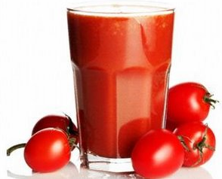
Ultrasound- Plant Food Applications
Fruit Juices
Tomato Juices
Ultrasound
Condition
Ultrasound Processing Effects
20 kHz, 24.4 to 61.0 μm, 2 to 10 min and pulse
durations of 5 s on and 5 s off.
It is reported that power ultrasound is a potential non thermal technique to inactivate microorganisms pertinent to fruit juices. Sonication alone was found an effective process to achieve the desired level of yeast inactivation (YI) in tomato juice, YI was found to follow the Weibull model.
Adekunte et al., (2010).
In tomato juice, the ultrasonic inactivation kinetics of polygalacturonase (PG) and pectin methylesterase (PME) was performed
Combined ultrasound and heat (thermosonication) enhanced the inactivation rates of both
PME and PG. Terefe et al., (2009).
20 kHz, amplitude of 65 μm and temp. Between 50 and 75◦C.

Slide 19
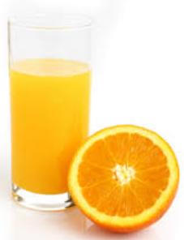
Fruit Juices
Orange Juices
Ultrasound
Condition
Ultrasound Processing Effects
20 kHz, Wave amplitude of 89.25 μm for
8 min
The use of ultrasound extended the shelf-life of orange juice by 4 days. The control juices were rejected by the sensory panel members after 6 days storage at 4◦C (refrigerator) owing to off-flavor, and ultrasonicated juice after 10 days due to off-odor. Also, sonication affected the color and decreased ascorbic acid level.
Ġomez-Ĺopez
et al.,(2010)

Slide 20
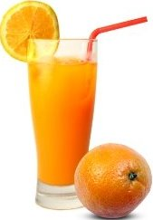
Ultrasound
Condition
Ultrasound Processing Effects
Low temperatures and intermediate amplitude (42.7 μm) resulted in lower non-enzymatic browning and ascorbic acid deterioration, and better quality orange juice
20 kHz,
24.4–61.0 μm,
5–30 °C,
0–10 min
Valdramidis et al. (2010)
In the study of the effect of amplitude level and sonication time on juice quality parameters, there was no significant difference on pH, ◦Brix and titratable acidity. It was found the degradation of color, cloud value and an increase in browning index.
20 kHz, 2-10 min, pulse
durations of 5 s on and 5 s off, amplitude levels 40 to 100%
20
Tiwari et al., (2008 a,b,c)

Slide 21
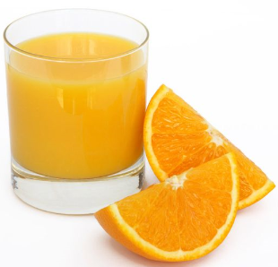
Ultrasound
Condition
Ultrasound Processing Effects
Combination of high intensity ultrasound with mild heat treatment (45◦C), and natural
antimicrobials (vanillin 1,000 ppm and citral 100 ppm) was reported to be the most effective treatment for the control of L.monocytogenes in orange juice
600 W, 20 kHz, 95.2-μm
wave amplitude
Ferrante et al., (2007).
20 kHz, 95 μm-wave
amplitude
Combined treatment involving high-intensity ultrasound and short-wave ultraviolet radiation was more effective in simultaneous rather than in series for the inactivation
of Escherichia coli, Saccharomyces cerevisiae, and a yeast in fruit juice
Char et al., (2010).

Slide 22
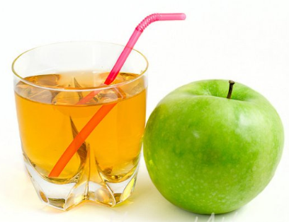
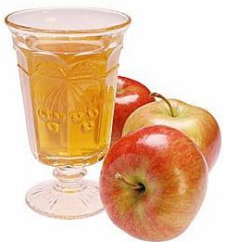
Fruit Juices
Apple Juices
Ultrasound Processing Effects
With ultrasonic treatments, about 60% and 90% of the Alicyclobacillus acidoterrestris cells were inactivated after treating the apple juice with 300-W ultrasound for 30 & 60 min, respectively. The lowest D value at 36.18 min was found when using 600-W. The alterations of sugar level, acidity, haze and juice browning were not affected the juice quality.
23 kHz, 200–700 W, 10–60
min
Yuan et al., (2009
20 kHz, ultrasound
amplitude 0.4 to 37.5 μm
Ultrasound treatment alone can be
effective for inactivation of E. coli
Patil et al., (2009).

Slide 23
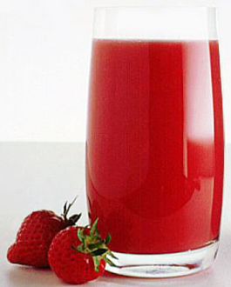
Fruit Juices
Strawberry Juices
Condition
Ultrasound Processing Effects
20 kHz, amplitude level
40–100%, 2–10 min, pulse durations of 5 s on and 5 s off.
The ultrasound amplitude level and sonication time was performed on strawberry juice quality. It was found that sonication reduced the anthocyanin and ascorbic acid contents by 3.2 and 11%, respectively, at the maximum treatment conditions.
(Tiwari et al., 2008d)
Ultrasound treatment (energy density 0.81 W/mL and treatment time 10 min) resulted in 5% and 15% reductions in anthocyanin and ascorbic acid, respectively during storage 4 and 20◦C for 10 days.
20 kHz, energy density 0.33–0.81 W/mL, 0–10min, pulse 5 on 5 off
The improved stability was higher for ascorbic acid and anthocyanins retention
as compared to control sample.
Tiwari et al., (2009d)

Slide 24
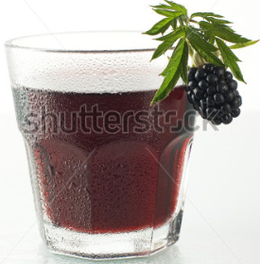
Fruit Juices
Blackberry Juices
Ultrasound
Condition
Ultrasound Processing Effects
20 kHz,
37.5 μm to
61.0 μm, 0–10 min, pulse
durations of
5s on 5s off
Significant alterations in color and anthocyanins with insignificant alterations in pH, titratable acidity, and degree brix were obtained in case of blackberry juice
Tiwari et al., (2009e)

Slide 25
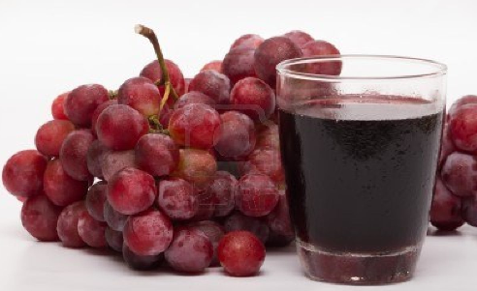
Fruit Juices
Red Grape Juices
Ultrasound
Condition
Ultrasound Processing Effects
Highest degradation of malvanidin-3-O-glucosides (48.2%), cyanidin-3-O-glucosides (97.5%) and delphinidin-3-O-glucosides (80.9%) at 61.0 μm for 10 min were found. It was determined that significant alterations in anthocyanins and color of juice
20 kHz,
37.5 μm to
61.0 μm, 0–10 min, pulse
durations of
5s on 5s off
Tiwari et al., (2010)

Slide 26
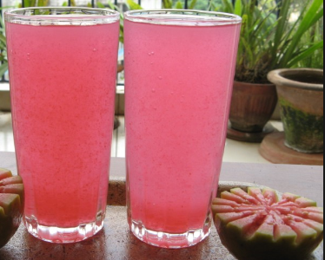
Fruit Juices
Guava Juices
Ultrasound
Condition
Ultrasound Processing Effects
Ascorbic acid content was found to be significantly higher in samples treated with
carbonation and sonication than in the control. juice. Carbonation provided more nuclei for cavitations that permitted the elimination of dissolved oxygen in the juice. Also, further treatment gave rise to a greater cloudiness and PPO activity.
35 kHz, 30 min
Cheng et al., (2007).
26

Slide 27
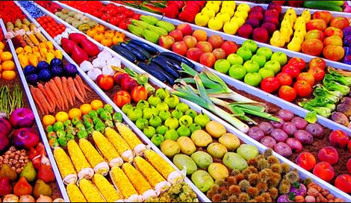
Fruits &Vegetables
Plant foods including fruits and vegetables are highly attenuating materials owing to the scattering of sound from voids and pores, that complicates the interpretation of ultrasound data and thereby unsuitable for evaluating their tissues
(McClements & Gunasekaran, 1997; Povey, 1998; Sarkar & Wolfe, 1983;
Sarkar & Wolfe, 1983)

Slide 28
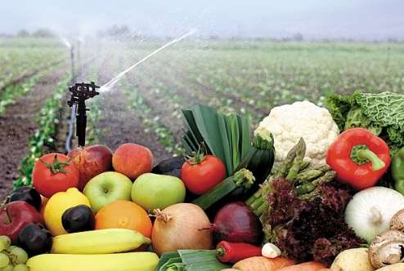
In Quality control of fresh vegetables and fruits By Ultrasound
Preharvest and
postharvest
applications are
important..
(Mizrach, 2008)

Slide 29
Physiological and physiochemical alterations during
growth and maturation,
harvest period,
storage and shelf-life
&
Ultrasound measurements & other physiochemical measurements,
firmness,
mealiness,
dry weight percentage (DW),
oil contents,
total soluble solids (TSS),
acidity
(Mizrach, 2008)

Slide 30
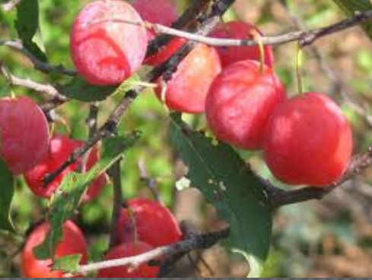
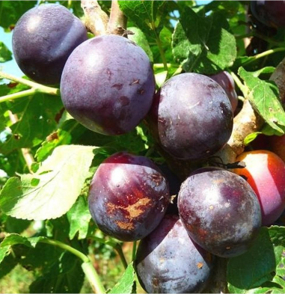
Case Studies on Preharvest Fruits by Ultrasound

Color Changes & Ripeness Correlation
The amplitude of the ultrasound wave transmitted through fruit peels increased when the color changed from green to yellow indicating a good correlation between the ripeness and the acoustic attenuation
The maturity and sugar content of plum fruits
determined by measuring ultrasound attenuation in the fruit tissue correlated well with the firmness of plums and that of tomato in other study
(Mizrach , 2007,2004;
Mizrach , et.al.,1991)

Slide 31
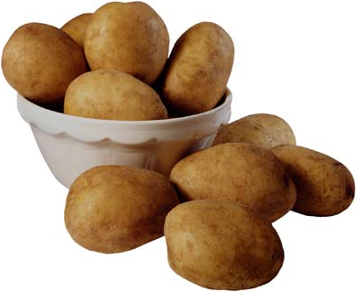
With using the ultrasound attenuation parameter, the detecting of defective potatoes was performed.
(Cheng & Haugh, 1994).

Slide 32
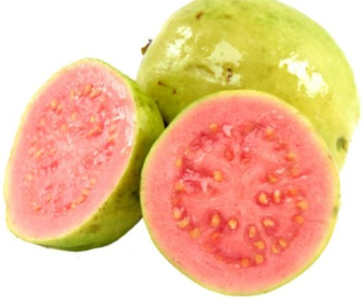
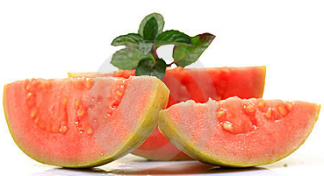
Case Studies on Postharvest Fruits by Ultrasound
Application of ultrasound to osmotic dehydration of guava slices via indirect sonication using an ultrasonic bath system and direct sonication using an ultrasonic probe system.
Pre-treatments were designed in three osmotic solution concentrations of 0, 35, and 70 °Brix at indirect ultrasonic bath power from 0 to 2.5 kW for immersion times ranging for 20–60 min and direct ultrasonic probe amplitudes from 0 to 35% for immersion times of 6–20 min.

Slide 33
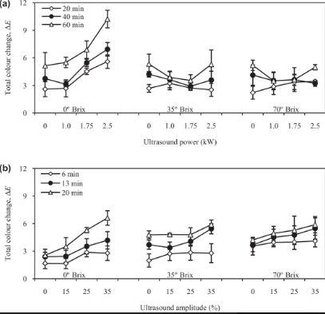

Ultrasound power (kW)
Ultrasound amplitude (%)

Slide 34
Ultrasound input as power and amplitude, osmotic solution concentrations, and immersion time increased the water loss, solid gain, and total colour change of guava slices significantly with p < 0.0005.
Applying ultrasound pre-osmotic treatment in 70 °Brix prior to hot-air drying reduced the drying time by 33%, increased the effective diffusivity by 35%, and decreased the total colour change by 38%. A remarkable decrease of hardness to 4.2 N obtained was also comparable to the fresh guava at 4.8 N.

Slide 35
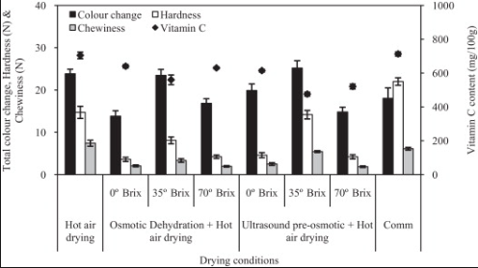
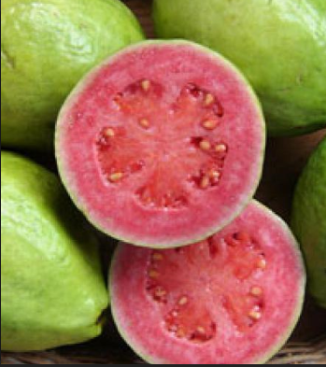
Total colour change, vitamin C content, hardness, and chewiness of dried guava after hot-air drying, osmotic dehydration prior to hot-air drying, and ultrasound pre-osmotic treatment prior to hot-air drying with the commercially dried guava
(Kek et.al.,2013)

Slide 36
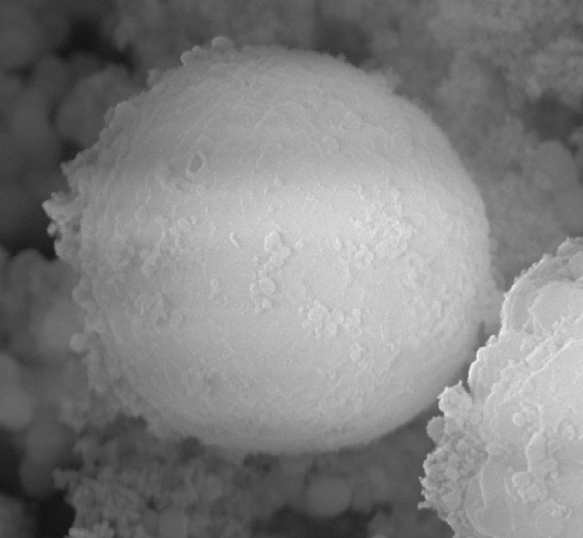
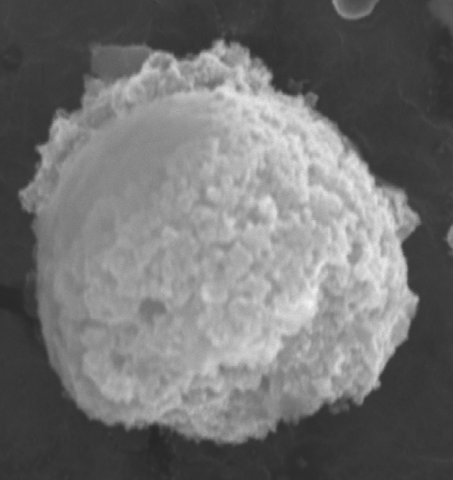
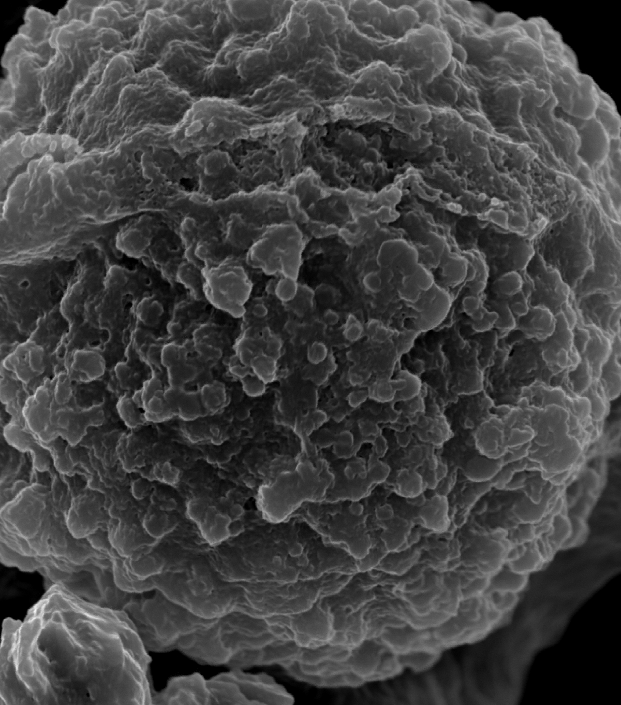
Disruption of fat globules of milk by thermo-sonication
Thermal treatment
Ultrasound
After 10 min
Ultrasound
After 30 min
By US, better homogenization, color, appearance and consistency

Slide 37
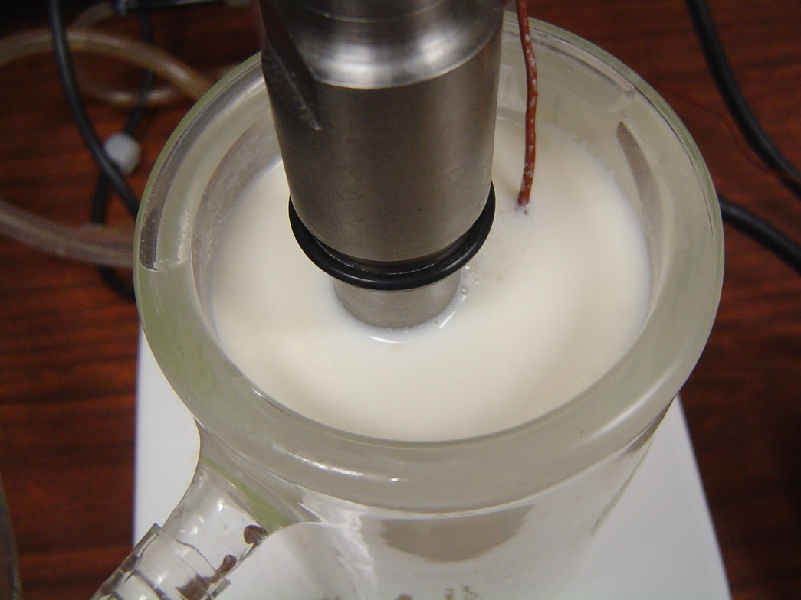
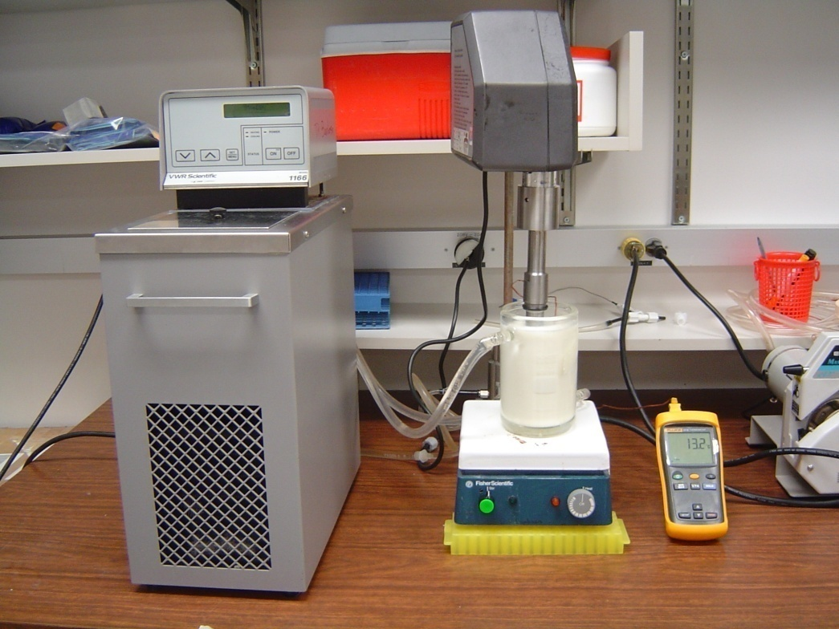
Ultrasound treatment of milk at WSU
Ultrasonic processor Hielscher® UP400S
(400 W, 24 kHz) with a 22 mm probe

Slide 38
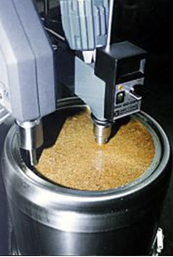
Ultrasound –Assisted Extraction
Ultrasound is probably the most simple and most versatile method for the disruption of cells and for the production of extracts. It is efficient, safe and reliable.
Due to ultrasonic cavitation creates
shear forces that breaking cell walls mechanically and improving the material transfer; this effect is being used in the extraction of liquid compounds from solid
cells (solid-liquid extraction).
Ultrasound (Hielscher,USA)

Slide 39
Ultrasound is faster and more complete than maceration or stirring. The particle size reduction by the ultrasonic cavitation increases the surface area in contact between the solid and the liquid phase, significantly.
The mechanical activity of the ultrasound enhances the diffusion of the solvent into the tissue. As ultrasound breaks the cell wall mechanically by the cavitation shear forces, it facilitates the transfer from the cell into the solvent.

Slide 40
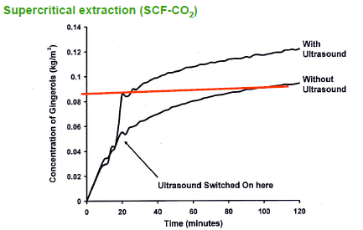
Extraction Yield Improvements By Ultrasound
Source: Balachandran et al. (2006)

Slide 41
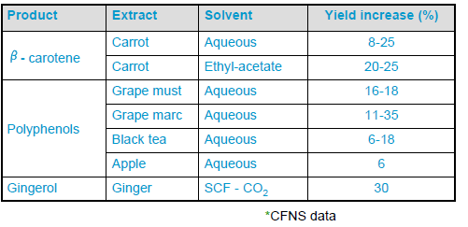
Extraction Yield Improvements By Ultrasound

Slide 42
Ultrasound- Oily Food Applications
Target extract : Phenolics of nuts and pastes
Solvent: ethanol-distilled water (30/70, v/v)
Process: Laboratory 24 kHz, 20-75 W s ml⁻¹
Processing conditions: Ambient
Exposing duration: 10 min
Target extract : Lipids of nuts and pastes
Solvent: chlorophorm /methanol (2/1, v/v)
Process: Laboratory 24 kHz, 20-75 W s ml⁻¹
Processing conditions: Ambient
Exposing duration: 10 min
Target: Microbiological quality of nuts & pastes
Solvent: Pepton water (0.1%)
Process: Laboratory 24 kHz, 20-75 W s ml⁻¹
Processing conditions: Ambient
Exposing duration: 10 min
Tokuşoğlu et.al.,2011

Slide 43
The Alterations of Total Lipid Value After Processing
NUTS Total Lipid g/100 g | KONTROL | Ultrasound Treated
Almond | 42.3 ± 1.9 | 38.63 ± 2.1
Pistachio | 54.3 ± 0.8 | 46.12 ± 1.8
Peanut | 48.9 ± 1.2 | 43.66 ± 1.3
Hazelnut | 62.6± 2.03 | 57.25± 2.83
Total lipid content decreased after
ultrasound treatment (p<0.05)
With ultrasound, the destruction of the cell walls facilitates the pressing and thereby reduces the residual oil or fat in the pressing cake.
Tokuşoğlu et.al.,2011

Slide 44
Total Phenolics of Studied Nuts
NUTS | CONT . Total Phenolics g/100g D.W | UP Effect g/100g D.W
Almond | 176.58 ± 13.83 | 192.43 ± 6.75
Pistachio | 378.72 ± 9.77 | 397.23 ± 11.04
Peanut | 334.51 ± 6.06 | 361.30 ± 5.46
Hazelnut | 278.43 ± 10.1 | 298.55 ± 7.22
After Ultrasound Processing
(Avg. 12% increasing in total phenolics )
The use of Ultrasound Ass.extraction enhanced mass transfer rates, increases cell permeability, and increased the extraction capacity of phenolic constituents, and higher levels of bioactive compounds are preserved with ultrasound assisted extraction.

Slide 45

Minor Bioactive (Lutein Xanthophylls) of Studied Nuts
NUTS | Lutein Xanthopyyllsg/100g D.W | UP Effect
Almond | ND | ND
Pistachio | 4.12 ± 0.48 | 7.3 ± 2.02
Peanut | ND | ND
Hazelnut | ND | ND
Lutein Xanthophyll
PISTACHIO LUTEIN

73% Increasing

Slide 46
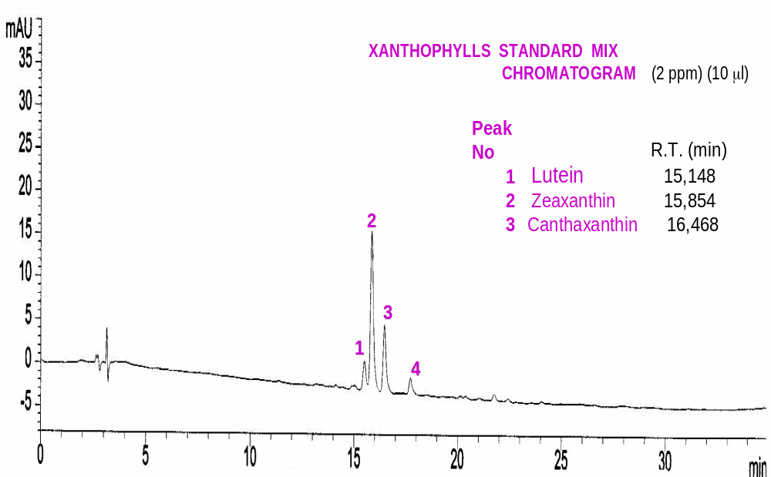

Slide 47
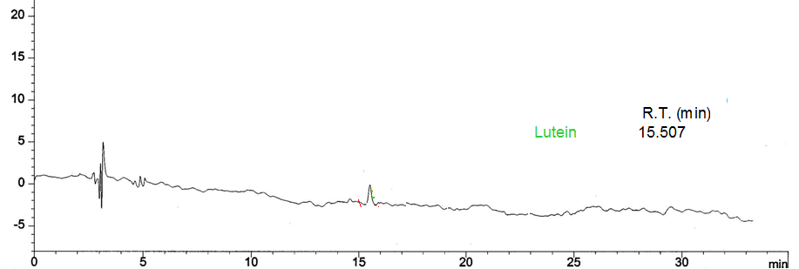
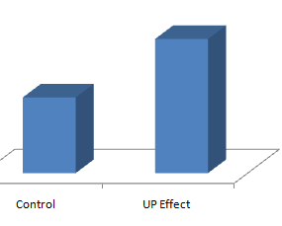
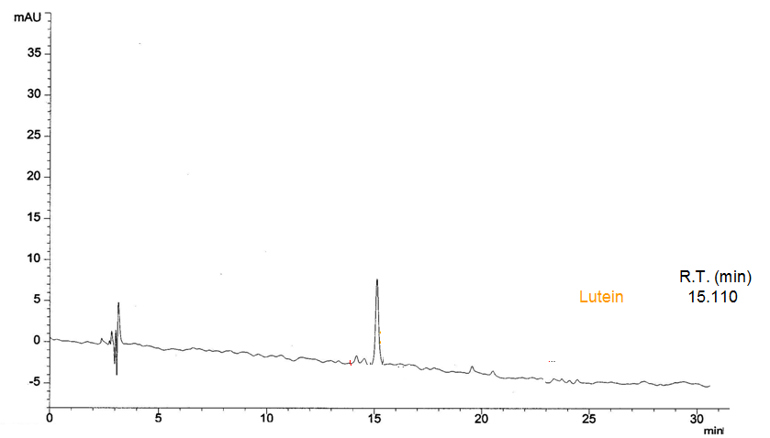
Cont.Pistachio Oil
Lutein
LUTEIN
LUTEIN
After Ultrasound Assisted
Extraction
Lutein
Control
UP Effect

Slide 48
Conclusion
○ Potential inactivation of pathogens and unwanted enzymes
○ Enhanced yield or extraction rate, maintaning and enhancing bioactive levels
○ Enhancement of extraction processes where solvents cannot be used (juice concentrate processing).
○ Enhance extraction of heat sensitive constituents
○ Potential opportunity for aqueous extraction or use of alternative (GRAS) solvents
○ Commercially viable and scaleable.

Slide 49

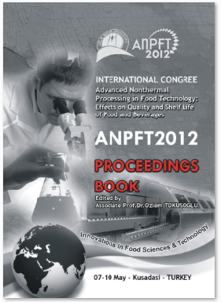

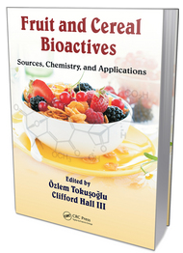
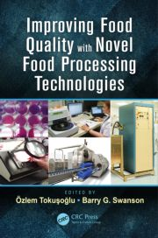
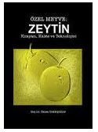
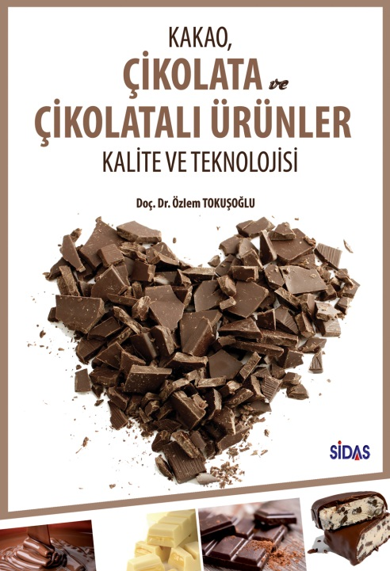

Tokuşoğlu Books

Slide 50



In Fortcoming
YUMURTA VE
YUMURTA
ÜRÜNLERİ
Kalite ve
Teknolojisi

Slide 51
See You Next Conference in London
It will be announced soon….

