Slide 1
THE ROLE OF DEVELOPMENT CULTURE IN TOTAL QUALITY MANAGEMENT IN PUBLIC VS. PRIVATE HOSPITALS: THE MEDIATING EFFECT OF EMPLOYEE EMPOWERMENT
İzlem Gözükara*, Nurdan Çolakoğlu
Assistant Professor, Department of Business Administration, Istanbul Arel University
Özlem Akçay Kasapoğlu
Associate Professor, Faculty of Business Administration,
Department of Prodcution Management, Istanbul University

Slide 2

What is Quality?

Slide 3
It is simple but enough for my needs
I have been using it since three years but I havent gone to maintenance yet
It works properly between the spesifications written in the catalogue
It is twice durable than the other brand
It is so accurate that it can weight the 10 % of 1 gram
It is a little bit expensive but it maintenance costs are less.

Slide 4
Quality
Comes from Latin =qualis

Slide 5

Quality
  Fitness for purpose
(Dr. J.M. Juran)

Slide 6

Quality
  Meeting goals
(P.B.Crosby)

Slide 7

Quality
  Meeting requirements

Slide 8

Quality
Customer Satisfaction

Slide 9
Definitions of Quality
ASC: Product characteristics & features that affect customer satisfaction
User-Based: What consumer says it is
Manufacturing-Based: Degree to which a product conforms to design specification
Product-Based: Level of measurable product characteristic
Notes:
Once you have introduced these definitions of quality, ask students to provide example of products that use them.

Slide 10

History of Quality…
Hammurabi^{[1]} (ca. 1810 BCE – 1750 BCE), was the sixth king of Babylon. Hammurabi is known for the laws called Hammurabi's Code, one of the first written codes of law in history
Says that :
“if a construction worker builds a house and if the house collapses and if a person dies then the worker’s head will be cut off” (m.ö. 2150)

Slide 11
History of Quality…
Total Quality management
Total Quality Control
Statistical Quality Control
Control person
Foreman
Worker
İLERİ
1900 1918 1937 1960 1980

Slide 12
Evolution of Quality Management
Inspection
Salvage, sorting, grading, blending, corrective actions, identify sources of non-conformance
Develop quality manual, process performance data, self-inspection, product testing, basic quality planning, use of basic statistics, paperwork control.
Quality Control
Quality Assurance
Quality systems development, advanced quality planning, comprehensive quality manuals, use of quality costs, involvement of non-production operations, failure mode and effects analysis, SPC.
TQM
Policy deployment, involve supplier & customers, involve all operations, process management, performance measurement, teamwork, employee involvement.

Slide 13
What is TQM?
Concern for employee involvement and development
Management by Fact
Constant drive for continuous improvement and learning.
Organisation response ability
Passion to deliver customer value / excellence
Result Focus
Actions not just words (implementation)
Partnership perspective (internal / external)
Process Management

Slide 14
BASIC PRINCIPLES OF TQM
Approach Management Led
Scope Company Wide
Scale Everyone is responsible for Quality
Philosophy Prevention not Detection
Standard Right First Time
Control Cost of Quality
Theme On going Improvement

Slide 15
Abstract
Total quality management practices have gained importance in the healthcare field with the adoption of a customer-oriented approach due to increasing global competition.
Such practices require several factors in order to achieve success. Among others, employee empowerment is known as a critical success factor in the implementation of a total quality management practice since such practice requires changes in attitudes and actions.
Total quality management is an organization-wide strategy, which is closely associated with an appropriate culture to adapt to both internal and external changes.
In this context, development culture that focuses especially on innovation and adaptation is likely to increase the success of a total quality management program.
In light of this background, the present paper aims to explore the role of development culture in total quality management and to reveal the mediating effect of employee empowerment on the development culture and total quality management relationship.
For this purpose, the study sample included 510 participants who were working at public and private hospitals within Istanbul, Turkey.

Slide 16
Abstract
The study data were collected using Total Quality Management Scale, Development Culture Scale and Employee Empowerment Scale.
Frequency distributions were used to analyze the study data, while factor analyses were performed using SPSS 17.0 software program and structural equation model was analyzed using 16.0 software program.
The study results indicated that development culture has a positive effect on total quality management both in public and private hospitals and employee empowerment partially mediates this relationship in both types of hospitals.
Additionally, our study also revealed that the positive effect of a development culture on employee empowerment was stronger in public hospitals compared to private hospitals.
Besides, employee empowerment was found to have a greater impact on total quality management in public hospitals compared to private hospitals.
Keywords: Development culture, Total Quality Management, TQM, employee empowerment, healthcare organizations, public and private hospitals

Slide 17
Introduction
In the prevailing century, management has been shaped by globalization, leading to a severe competition among business enterprises.
A greater competitive advantage has evolved into a primary organizational goal for both public and private enterprises.
In achieving such advantage, innovative behaviors of employees play a critical role, which can be developed only if organizations create a culture that supports innovation and creativity.
Organizations also try to achieve a competitive edge by aiming at targets such as increased quality, employee and customer satisfaction, effectiveness, performance assessment and strategic planning, all of which can be achieved by implementing a Total Quality Management (TQM) program.

Slide 18
TQM-Total Quality Management
TQM is a set of management principles aimed at enhanced performance and effectiveness to accomplish a prime quality status, and it has been in use over the past twenty years (Konecny and Thun, 2011).
In general, the main concepts underlying TQM are continuous improvement and better organizational performance (Agus, 2005).
On the other hand, the current understanding is that TQM is not just a simple practice of certain methods, but a complicated cultural transformation from a conventional management toward a quality-oriented approach (Lukasova et al., 2004, cited in Jancikova and Brychta, 2009).
Accordingly, the culture of an organization, which is described as the whole values that determine employees’ code of conduct and shape their perceptions of work processes (Schein, 1984), should be entirely changed for a successful TQM practice toward continuous improvement (Deming, 1986).

Slide 19
TQM efforts may result in failure
Even though TQM has been proven to be successful in various organizations, there is a high probability that TQM efforts may result in failure or not provide the expected outcomes
Such failure has been reported to result from ignoring cultural characteristics of the organization .
In this sense, Deal and Kennedy (1999) suggest that an organizational transformation in beliefs, attitudes and culture is required for a successful TQM practice.
Another key concept of TQM is employee empowerment as TQM is a concept focusing on a culture that includes all organizational members in the process and contributes to improve job performance (Lawler, 1992).
Employee empowerment has also been demonstrated to relate with the quality culture of an organization (Howard and Foster, 1999). Therefore, it can be argued that employee empowerment is essential to get the most benefit from a TQM practice. In light of this background, we aim to discover the effect of development culture on TQM and the mediating effect of employee empowerment on the development culture-TQM relationship.

Slide 20
Literature Review-Total Quality Management (TQM)
TQM is likely to be one of the greatest contributions of the last decades to the management field. This management concept has received wide acceptance and remarkable interest due to the transformations and developments across the globe. TQM concerns with process improvement on a continuous basis for the purpose of increased effectiveness and profitability by ensuring higher customer value and satisfying customer needs (Wang et al., 2012).
TQM delivers an efficient change of organizational processes by changing the organizational culture, applying participatory management based on organizational goals, providing training, achieving continuous improvement with a focus on overall organizational goals, enhancing communication that would help improvement, determining and satisfying customers (both internal and external) and encouraging employees in all fields related to quality (Franz and Foster, 1992; Ittner and Larcker, 1995).
Among several definitions of TQM, the present study discusses this concept as 'the efforts to meet and preferably exceed the needs and expectations of customers with the lowest cost through continuous improvement of labor, to which all those involved have a commitment, focusing on the processes of the organization' (Isaksson, 2006).
It is known that superior organizations place importance on their employees and support an encouraging culture with mutual benefits from accomplishing both organizational and individual goals (EFQM, 2010). Accordingly, a successful TQM implementation necessitates organizations to invest in developing the skills of their employees through training programs and inducing empowerment and teamwork toward creativity and participation in such activities (Oakland, 2011).

Slide 21
Literature Review- Development Culture
It has been long acknowledged that the culture of an organization has impact on organizational strategies (Hofstede, 1991). One of the unique characteristics differentiating successful organizations from others is their culture (Keller and Richey, 2006). Culture is an important factor to ensure success in the business environment as it has influence on productivity, adopting new systems, and future changes to the organization (van den Bosch et al., 1999).
The Competing Values Framework (CVF) is a way of organizational culture analysis, which is also discussed in terms of organizational changes (Denison and Spreitzer, 1991). In recent years, quality management studies (e.g., Detert et al., 2000; Wu et al., 2011; Zu et al., 2010) have also started to employ this framework. CVF consists of four cultural subtypes; group culture, development culture, hierarchical culture and rational culture (Cameron and Quinn, 2006; Denison and Spreitzer, 1991). Only development culture is addressed for the purposes of this paper.
The basic characteristics of development culture include growth, expansion to new markets and resource acquisition. Development culture also focuses on flexibility and creativity. This type of culture is oriented at development, stimulation, innovation and continuous adaptation to the external environment. Organizations with a development culture make constant efforts to expand to new markets and try to realize innovations according to customer needs. Such culture enables organizations to react to issues related to changing preferences of customers with creative solutions.
In order to be effectively respond to changes of the marketplace, an organization has to possess a flexible and adaptive culture (Elashmawi, 2000). When a TQM practice succeeds, it affects the culture of the organization. The culture of the organization, in turn, affects the implementation and operation of TQM (Lukasova et al., 2004, cited in Jancikova and Brychta, 2009). Accordingly, culture and TQM are related with each other (e.g., Sousa-Poza et al., 2001). Therefore, an organization with an intent to adopt TQM has to create a suitable culture which can produce effective responses to the changes both related to the external environment and internal processes.

Slide 22
Literature Review- Employee Empowerment
Employee empowerment and involvement are considered as closely related constructs (Goetsch and Davis, 2010). However, there are significant differences in between. Involved employees are not granted the ownership of the job. Empowered employees, in turn, have such ownership with responsibility for the services and products produced as a result of their jobs. Empowerment enables employees to utilize their resources when encountered a quality problem, which increases quality and enhances effectiveness. Besides, empowerment has a critical part in cultural change that allows the low level where issues are most recognizable to access the process of decision making (Hradesky, 1995).
Consequently, empowerment is an essential and significant concept for any organization in terms of achievement, effectiveness and development (Hunjra et al., 2011). Employee empowerment is a practice of motivation that focuses on better performance through enhanced participation and engagement in decision-making processes (Hanaysha, 2016). Aiming at trust-building, motivation and participation, empowerment eliminates the boundaries between top management and employees (Meyerson and Dewettinck, 2012). Accordingly, empowerment refers to grant employees the authority to make decisions, and it involves responsibility allocation from managers to other employees (Saif and Saleh, 2013). Huxtable (1994) describes empowerment as giving an employee the authority to solve the problems experienced during their daily tasks. Spreitzer (1995), on the other hand, defines empowerment as a cognitive adjustment to the employee's own role of job, which is characterized by an employee's perception of meaning, competence, autonomy and impact.
Employee empowerment is also one of the critical elements of TQM since changing attitudes and actions constitute the basis of a successful TQM implementation. Empowerment has a considerable impact on enhancing quality of service (Ueno, 2010). Furthermore, empowerment is related with the culture of organizations (Shakibaei et al., 2012) and it is likely to be effective in organizations with a change-oriented culture (Jung et al., 2003). Based on this literature, we formulate the following hypotheses:

Slide 23
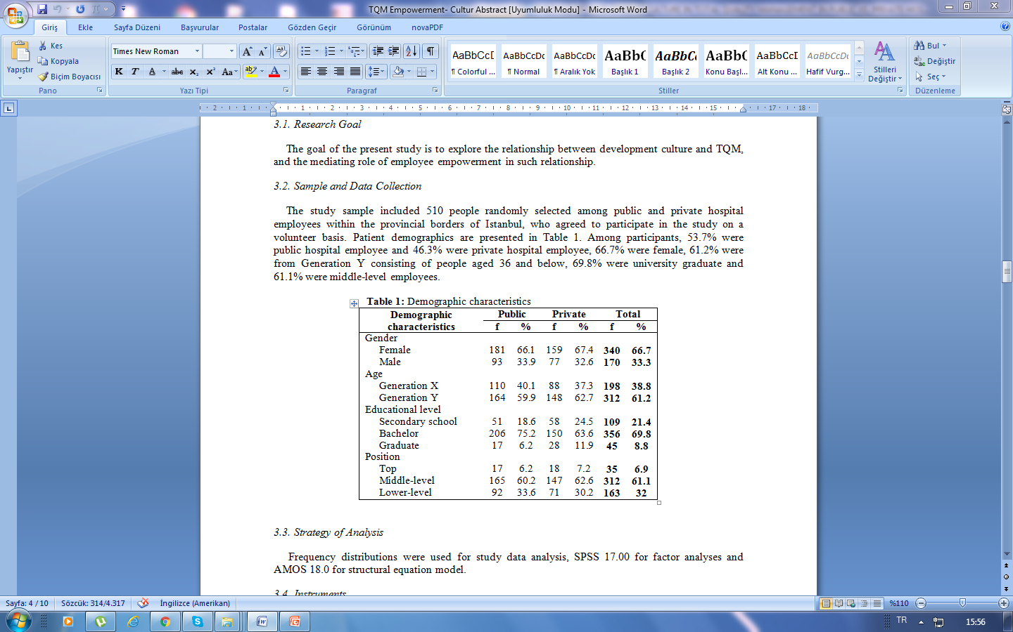
Methodology
Research Goal
The goal of the present study is to explore the relationship between development culture and TQM, and the mediating role of employee empowerment in such relationship.
Sample and Data Collection
The study sample included 510 people randomly selected among public and private hospital employees within the provincial borders of Istanbul, who agreed to participate in the study on a volunteer basis. Patient demographics are presented in Table 1. Among participants, 53.7% were public hospital employee and 46.3% were private hospital employee, 66.7% were female, 61.2% were from Generation Y consisting of people aged 36 and below, 69.8% were university graduate and 61.1% were middle-level employees.

Slide 24
Hypotheses:
H_{1a}: Development culture has a positive impact on TQM in public hospitals.
H_{1b}: Development culture has a positive impact on TQM in private hospitals.
H_{2a}: Development culture has a positive impact on employee empowerment in public hospitals.
H_{2b}: Development culture has a positive impact on employee empowerment in private hospitals.
H_{3a}: Employee empowerment has a positive impact on TQM in public hospitals.
H_{3b}: Employee empowerment has a positive impact on TQM in public hospitals.
H_{4a}: Employee empowerment mediates the development culture-TQM relationship in public hospitals.
H_{4b}: Employee empowerment mediates the development culture-TQM relationship in private hospitals.

Slide 25
Strategy of Analysis
Frequency distributions were used for study data analysis, SPSS 17.00 for factor analyses and AMOS 18.0 for structural equation model.
Instruments
The instrument for Total Quality Management was a scale adapted from prior research by Coyle-Shapiro (2002) and Zeitz et al. (1997). This 5-point Likert scale includes 16 items covering 4 dimensions; top management support (e.g., Top managers in this organization allocate resources to improve quality”), employee involvement (e.g., “People are encouraged to verbalize how things could improve supervisory reinforcement”), continuous improvement (e.g., “Continuous quality improvement is an important goal of this organization”) and customer focus (e.g., “This company encourages people to listen to customer when they need to make decisions”). The reliability coefficient of the scale varied from 0.73 to 0.84.

Slide 26
Instruments
The instrument for development culture was a scale introduced by Tseng and Lee (2009). This 5-point Likert scale includes 8 items (e.g., “Our company adopts the creative idea to make the decision”). The reliability coefficient of the scale was 0.73.
The instrument for employee empowerment was a scale introduced by Ugboro and Obeng (2000). This 5-point Likert scale includes 9 items covering three measures; authority delegation of decision making with 4 items (e.g., Employees only have authority to reject or accept the quality of their own work”), participation with 4 items (e.g., “Employees were actively involved in the definition of our quality mission and objectives”) and employee access to information of job requirements with 1 item (“Information about job requirement is made available to employees”). The reliability coefficient of the scale was 0.77.

Slide 27
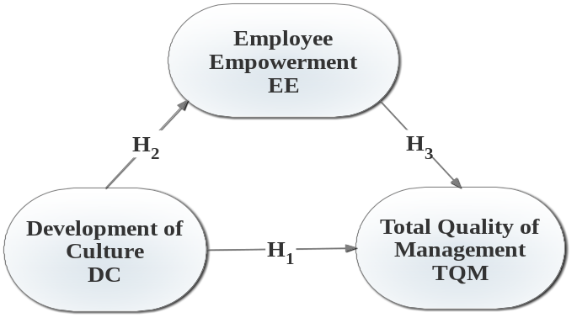
Analysis
The research model (Figure 1) was analyzed based on the data from 510 participants (274 public hospital and 236 private hospital employees) and approached for public and private hospitals together to conduct multiple group comparison

Slide 28
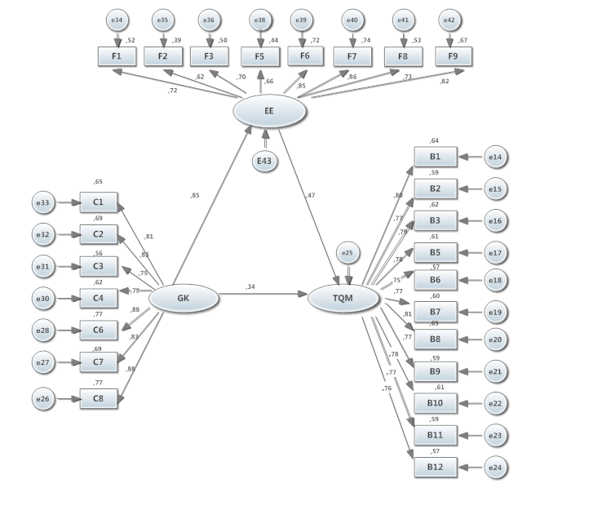
PUBLIC HOSPITALS

Slide 29
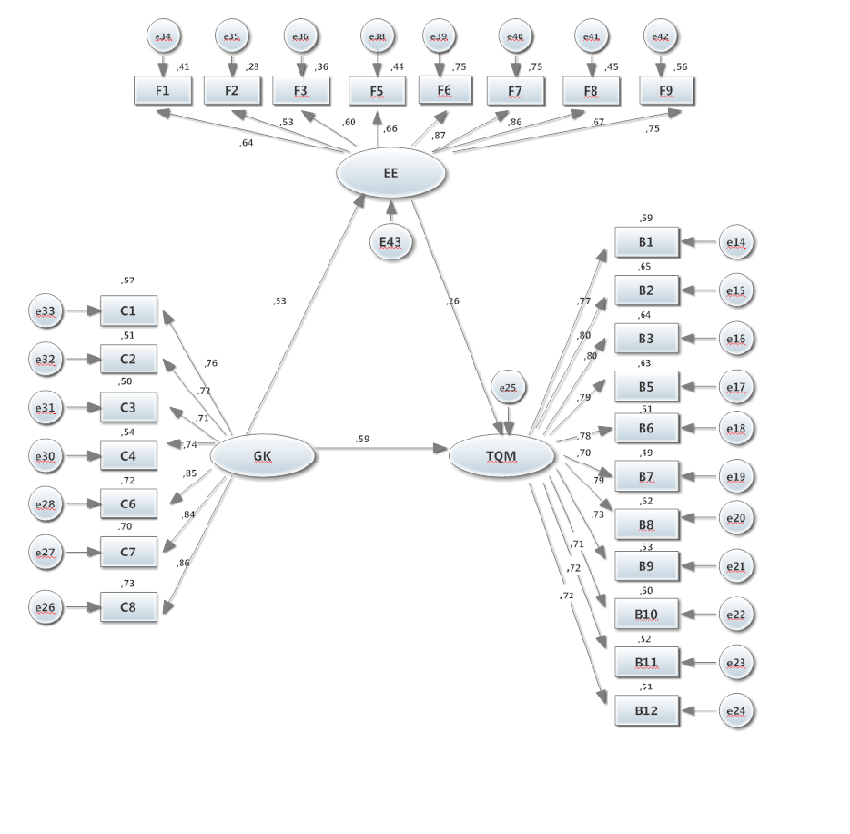
Figure 2: Research Model for Public vs. Private Hospitals

Slide 30
Factor Analysis Results
The adequacy of the data on development culture for factor analysis was determined using the KMO, and the KMO value was 0.90 and Bartlett’s Test of Sphericity (Chi-Square: 3133.847 df: 21 p=0.00) was significant. The results revealed adequate data for factor analysis.
The KMO value for the TQM scale was 0.94. Bartlett’s Test of Sphericity (Chi-Square: 4374.193 df: 55 p=0.00) was significant.
The KMO value for the employee empowerment scale was 0.88. Bartlett’s Test of Sphericity (Chi-Square: 2442.857 df: 28 df=6 p=0.00) was significant.
The items from each scale gathered under one each factor and Table 3 shows the results of factor analysis of the scales.

Slide 31
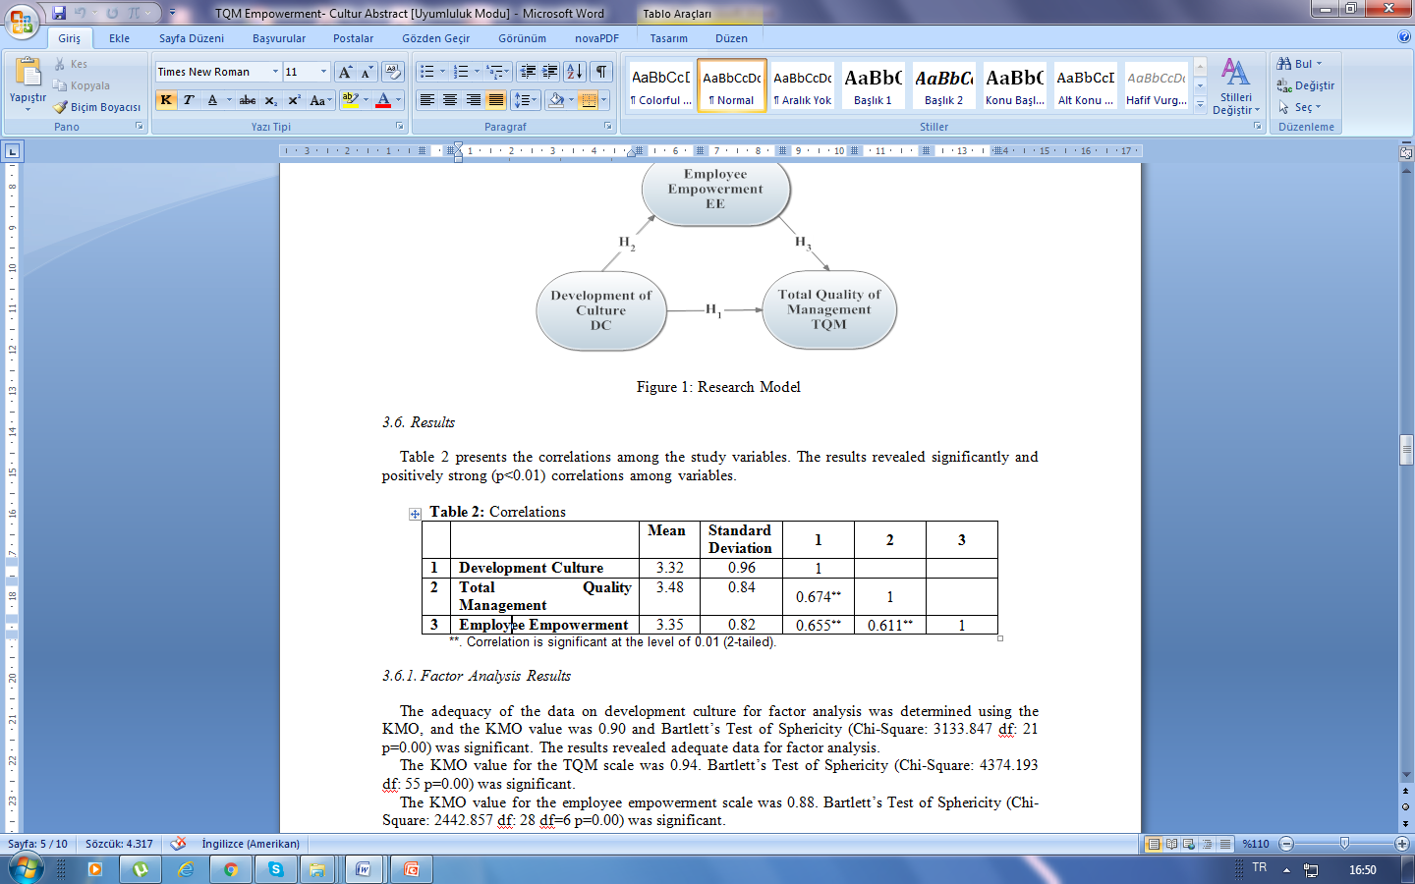
Results
Table 2 presents the correlations among the study variables. The results revealed significantly and positively strong (p<0.01) correlations among variables.

Slide 32
Research Model Results
The structural equation model created was analyzed using AMOS 16.0 and Figure 2 presents the difference between public and private hospitals. According to the model created based on public hospital employees; development culture had a positive effect (0.34) on TQM, while it had a strongly positive effect (0.85) on employee empowerment.
TQM was also positively affected (0.47) by employee empowerment. Employee empowerment was found to partially mediate the development culture-TQM relationship. When considered private hospitals; development culture had a positive effect (0.59) on TQM and had a positive effect (0.53) on employee empowerment.
TQM was also positively affected (0.26) by employee empowerment. As such in public hospitals, employee empowerment was found to have a partially mediating effect on the development culture-TQM relationship in private hospitals.
Thus, all hypotheses were affirmed. The model-related results of goodness of fit indices revealed that the data and the model were compatible (χ2/df=1.997; RMSEA=0.044; GFI=0.877; AGFI=0.824; CFI=0.956).

Slide 33
Conclusion
The present research was conducted to discover the effect of development culture on total quality management as well as the mediating role of employee empowerment in public vs. private hospitals.
Our findings revealed a significantly positive relationship between development culture and TQM, and a partially mediating effect of employee empowerment on this relationship in both public and private hospitals.
The results of our research demonstrated remarkable differences between public and private hospitals.
The presence of a development culture has a considerably positive effect on employee empowerment in public hospitals, while such effect is weaker in private hospitals.

Slide 34
Conclusion
Besides, employee empowerment was found to have a greater impact on TQM in public hospitals compared to private hospitals.
This suggests that private hospitals empower their employees but it leads to a weaker effect on TQM, which we believe it results from a managerial perspective.
As well, the direct effect of development culture on TQM is greater in private hospitals compared to public hospitals.
It may be possible that public hospitals do not strongly emphasize a culture of development by promoting innovation and creativity or the private hospitals place more importance on development culture.
We believe that our research would contribute to the TQM literature in healthcare organizations, especially about the factors influencing the implementation of a TQM program.
Therefore, both public and private healthcare organizations may benefit the findings of the present study to create an organization culture supporting innovation, flexibility and growth as well as granting their employees authority to make decisions.

Slide 35
Thank you for listenning

