Slide 1
Talking about general relativity
Important concepts of Einstein’s general theory of relativity
Øyvind Grøn
Berlin July 21, 2016

Slide 2
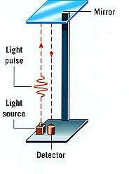
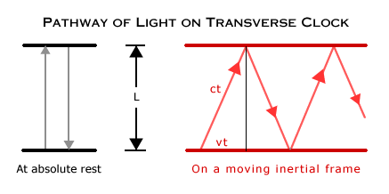
A consequence of the special theory of relativity is that
the rate of a clock is less the faster it moves.
photon clock in a train observed from the train observed from the station

Slide 3
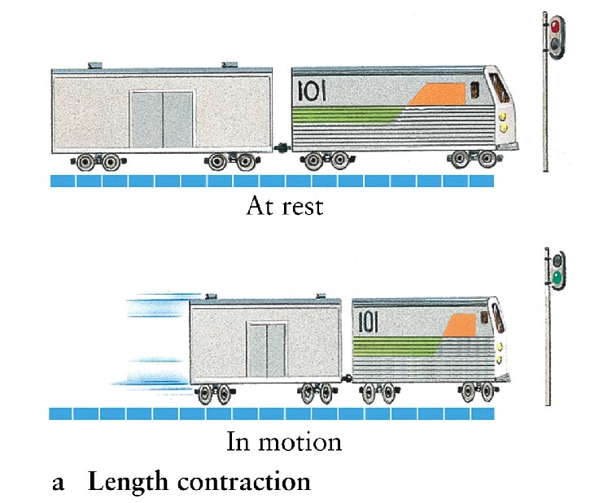
Length (or Lorentz) contraction
Measured by simultaneity the difference between the front position of a body
and its rear position is less the faster the body moves.

Slide 4
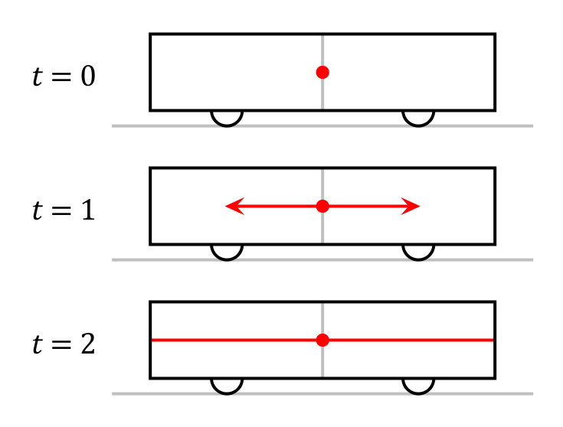
Einstein synchronization of clocks:
A train passes a station. As observed by a person in the train it is at rest.
She synchronizes two clocks – one to the left and one to the right in the wagon –
by emitting a light signal towards the clocks from a position at the center of the wagon.
The clocks are synchronized to show the same time when they are hit by the signals.
The signals hit the clocks simultaneously as observed from the train.

Slide 5
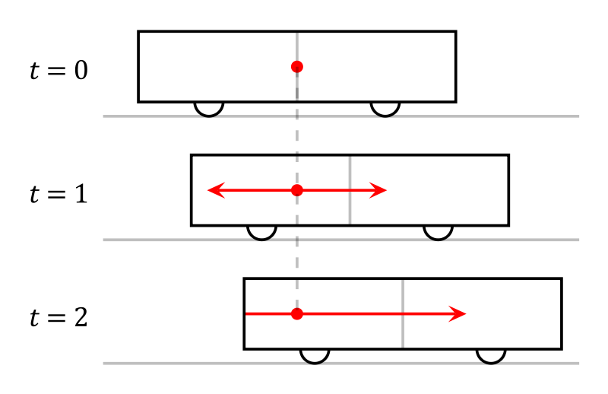
Relativity of simultaneity:
As observed from the station the train moves to the right,
and the light signals hit the rear wall of the wagon before the front wall.
Thus, these events that are simultaneous as observed from the train,
are not simultaneous as observed from the station.

Slide 6
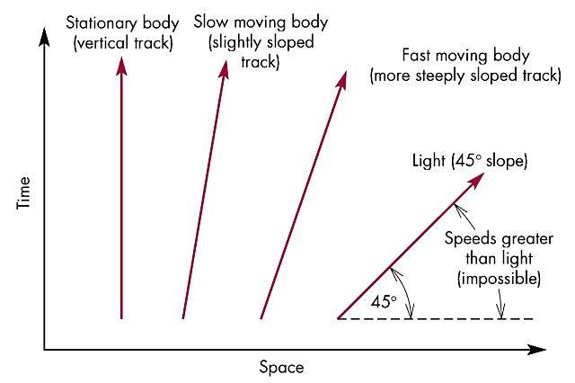
Spacetime diagram also called Minkowski diagram

Slide 7
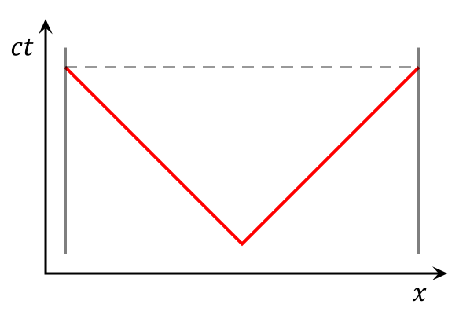
Minkowski diagram of the synchronization process
with reference to the train frame.
The red lines are the world lines of the light signals.
The gray lines are the world lines of the clocks.
Since the clocks are at rest in 3-space
they move only in the time direction.
The horizontal dashed line represents simultaneity in the train frame.

Slide 8
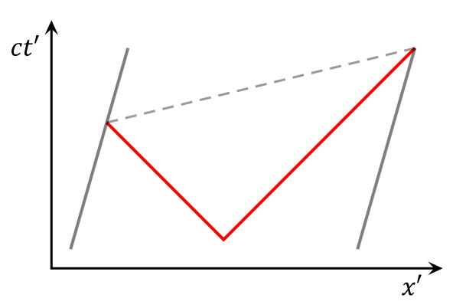
Minkowski diagram of the synchronization process
with reference to the station frame.
Again the red lines are the world lines of the light signals,
and the gray lines are the world lines of the clocks.
As before, the horizontal dashed line represents
simultaneity in the train frame.
It is not horizontal, showing that events that are simultaneous in the train frame are not simultaneous in the station frame.

Slide 9


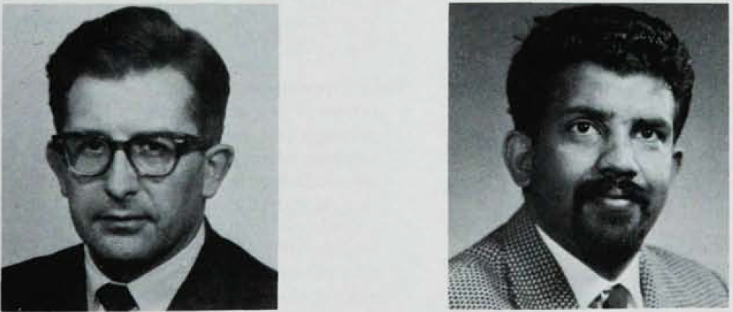
Tachyons
Are superluminal signals permitted by the theory of relativity?

Slide 10
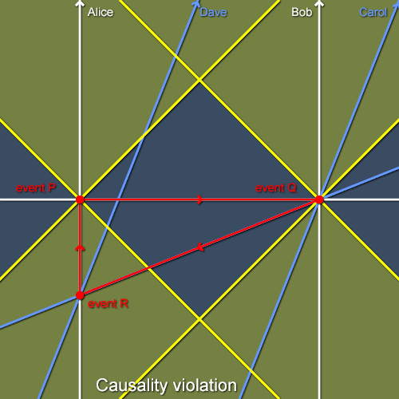
The tachyon telephone paradox
We have a tachyon telephone transferring signals instantaneously.
Event P is emission of a message from Berlin, and event Q that the message arrives at Paris.
It is immediately transferred to a tachyon telephone line on a train moving from Berlin to Paris. The line Q-R represents simultaneity on the train.
Hence the signal arrives back in Berlin before it was emitted.

Slide 11
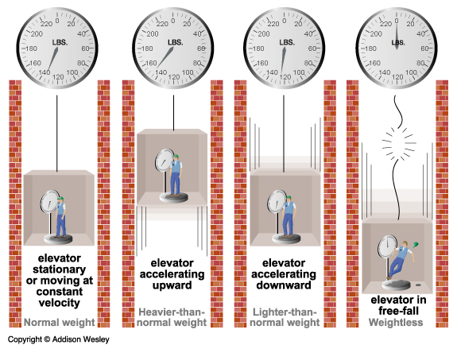
Vekt

Slide 12
"On the Influence of Gravitation on the Propagation of Light"
Albert Einstein (1911)
"Über den Einfluss der Schwercraft auf die Ausbreitung des Lichtes", Annalen der Physik [35], 1911

Slide 13
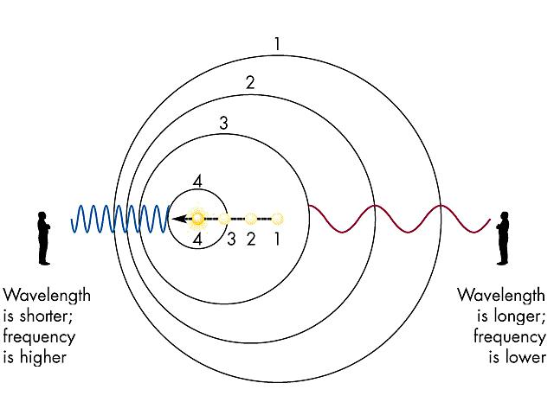
The Doppler effect

Slide 14
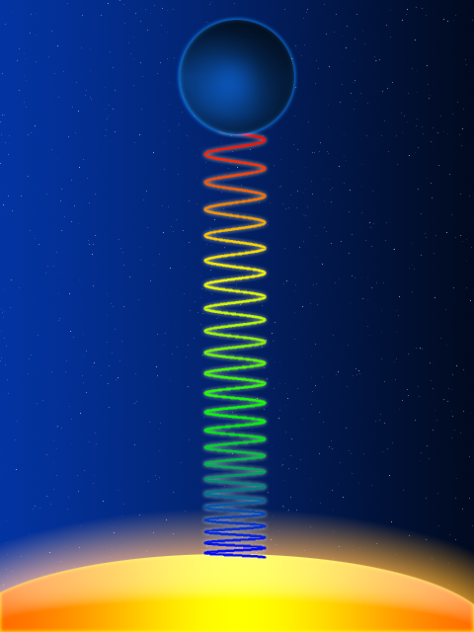
gravitational frequency shift
Light moving downwards
gets a blueshift,
and light moving upwards
gets a red shift.

Slide 15
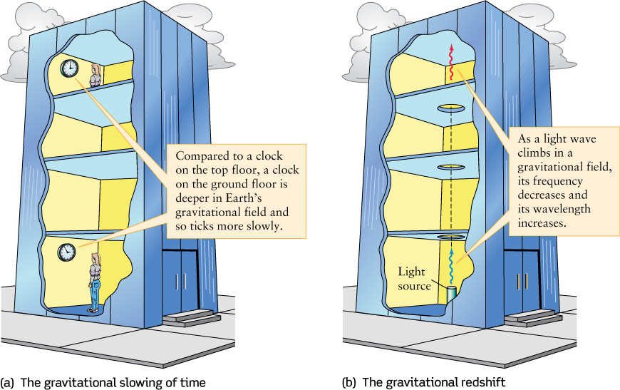

Slide 16
Relativistic time effects in the GPS-system
In order to obtain correct positions with an accuracy of a few meters
by means of the GPS-system
one has to take account of both
the kinematical and gravitational time effects.

Slide 17
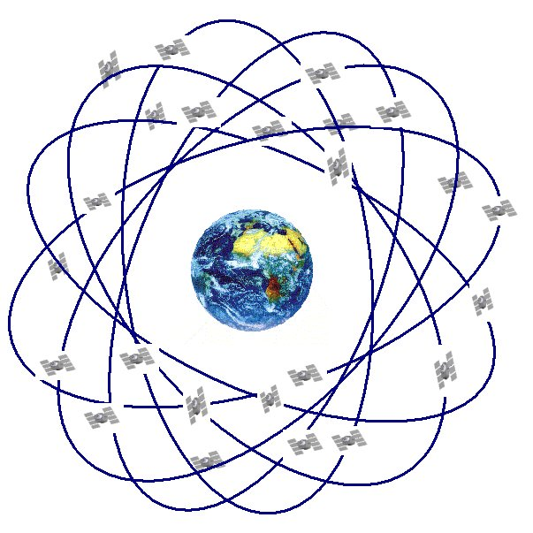
24 satellittes move along approximately circular paths
20 000 km above the surface of the Earth.

Slide 18
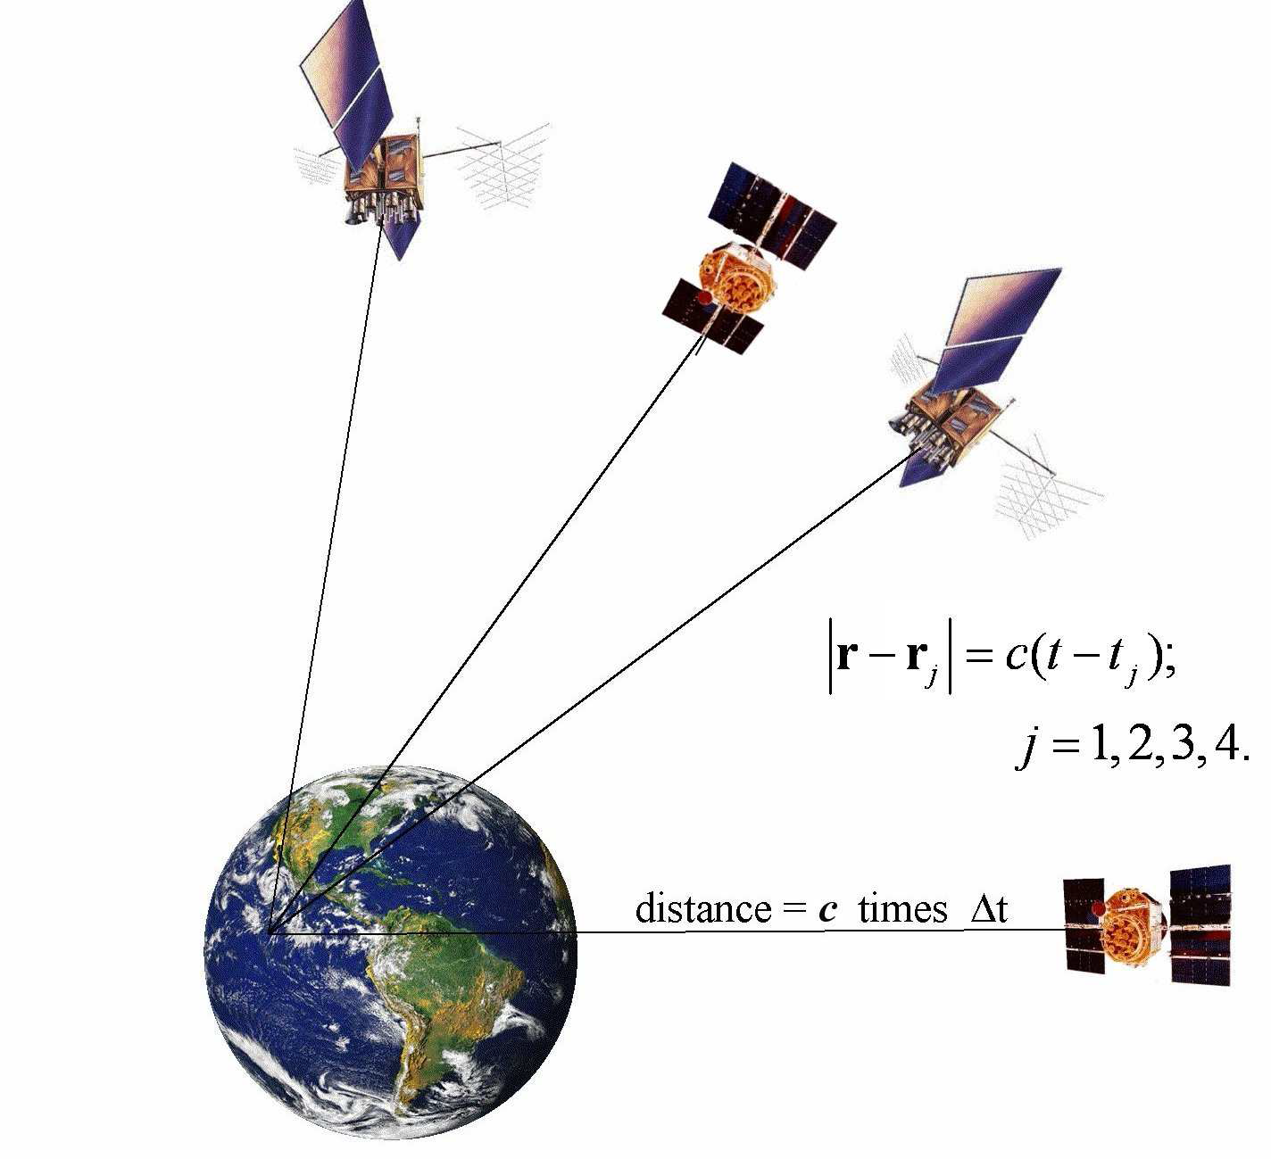
From
Relativistic Effects in the Global Positioning System
Neil Ashby July 18, 2006

Slide 19


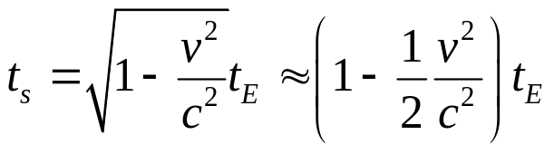


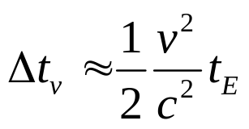


Kinematical time dilation
If an observer on Earth measures a time interval between two events on a satellite,
then the time interval measured between the same events on a satellite clock is
where is the velocity of the satellite with respect to the surface of the.
Hence to 2. order in this velocity dependent time dilation
makes the satellite clock slow down with
during the time . With v = 4•10³ m/s, c = 3•10⁸ m/s and = 24 h = 86400 s we get

Slide 20
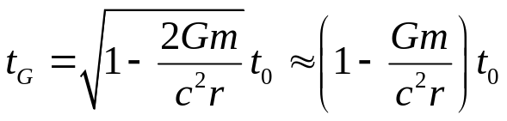



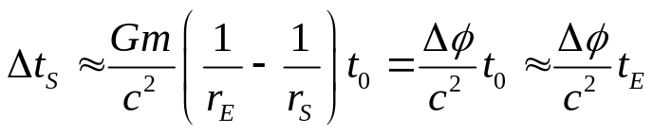

Gravitational time distortion
The gravitational time dilation in a spherically symmetrical gravitational field is given by
where is a time interval as measured on a clock
at a distance r from the center of a spherical body with mass m,
and G is Newton’s constant of gravity.
The difference in time as measured by by a satellite clock
at a distance from the center of the Earth
and a clock on the surface of the Earth at is
where is the difference of gravitational potential at the two clocks.
This expression says that
the gravitational time dilation is proportional to the difference of gravitational potential
at the positions of the two clocks.

Slide 21
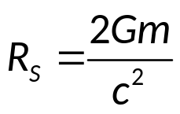

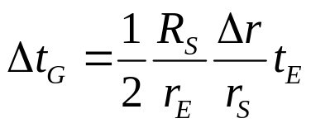


The Schwarzschild radius of a mass m is
Inserting the values of Newton’s constant of gravity,
the velocity of light and the mass of the Earth gives
In terms of the Schwarzschild radius
the expression of the gravitational time dilation takes the form
where is the height difference of the clocks.
During 24 h the gravitational time distortion makes the satellite clock 20 000 km above the Earth come ahead of the clock on the surface of the Earth by
Hence for the GPS satellite clocks the gravitational increase of the rate of time is
more than 6 times greater that the velocity dependent time dilation.

Slide 22
What does the time difference mean for the position determination?
Taken together the relativistic effects imply that during a day
the satellite clock proceeds by 38 microseconds more
than a clock at rest on the surface of the Earth.
This introduces an accumulating error in the position determination on the surface of the Earth.
The satellites have a velocity equal to around 4 km/s.
One may wonder whether the accumulated error per day is equal to
the displacement of a satellite during 38 microseconds, 15 cm,
or equal to the distance travelled by light during 38 microseconds, i.e. 11,4 km.

Slide 23



Neil Ashby writes:
“This (the relativistic distortion of the rate of the satellite clock)
is actually a huge effect.
If not accounted for, in one day it could build up to a timing error
that would translate into a navigational error of 13.7 km.”
So it is the distance moved by light, not the satellite, during 38 microseconds that accounts.
The reason is the following.
The position of a point on the Earth is determined
by means of a distance measurement,
where the distance is equal to
Here is the point of time that the signal is received on the Earth
as measured on an Earth clock,
and is the point of time that the signal is emitted from the satellite
as measured on a satellite-clock.
Hence the position error induced by an error in
is equal to the velocity of light times
the error of the satellite clock relative to the earth clock.

Slide 24
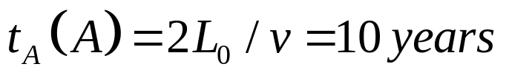
The twin paradox
It is often claimed that special relativity is sufficient for solving the twin paradox.
I will here argue that this is not correct,
and that you cannot even formulate the twin paradox within the special theory of relativity.
I will first consider the usual version of the twin paradox in the Minkowski spacetime:
Imagine that twin A remains at rest on the Earth,
and twin B travels with velocity v = 0,8c to the nearest star Alpha Proxima
4 light years from the Earth and back. According to A this will take
which means that A is 10 years older at the reunion.

Slide 25
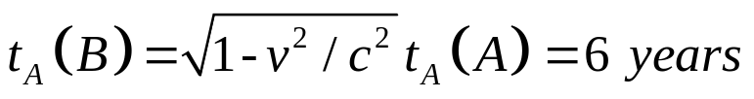
A would predict that the twin B is
older at the reunion.
But according to the principle of relativity
B could consider himself as at rest and A as moving.
According to the special theory of relativity
B would then predict that
he is 10 years older and A is 6 years older at the reunion.
The contradiction between these predictions is the twin paradox.

Slide 26
The principle of relativity
is essential for the formulation of the twin paradox.
There would be no paradox if not both A and B
could consider them self at as rest.
In the special theory of relativity
only non-accelerated motion is relative.
This special principle of relativity is, however,
not enough to formulate the twin paradox.
In order that the twins shall be able to
travel away from each other and reunite again,
at least one of them must accelerate during the departure.
So the general principle of relativity,
including accelerated and rotating motion, is needed.

Slide 27


B observes twin A and the Earth and Alpha Proxima move with a velocity v = 0,8c
a Lorentz contracted distance
According to B the time taken by A’s travel to Alpha Proxima and back is
i.e. B predicts that he ages by 6 years during A’s travel.
This is in agreement with A’s prediction.
But due to the kinematical time dilation B would predict that A ages by
which is in conflict with A’s prediction that he should age by ten years.

Slide 28

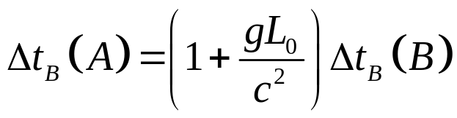
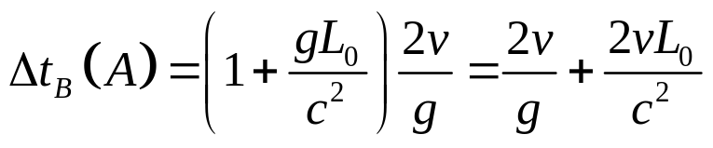
Let us take a closer view upon what happens with A, according to B,
when B turns at Alpha Proxima.
When B accelerates towards his brother he experiences a field of gravity away from A,
who is higher up in this gravitational field than he is.
Hence as measured by B twin A at the Earth ages faster than B during the time,
when B accelerates.
If B has constant proper acceleration it follows from the general theory of relativity
that the relation between A’s ageing and B’s is
which gives

Slide 29
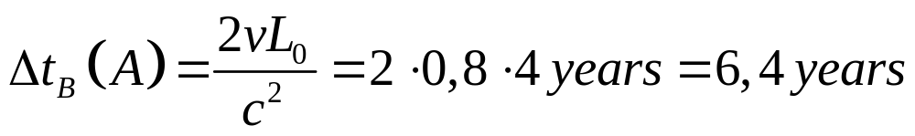
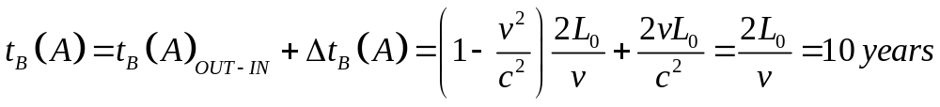
When the Earthbound twin A calculated
his own and B’s ageing during B’s travel,
he neglected the time taken by A
at Alpha Proxima to reverse his velocity.
This means that his calculation is correct
only in the limit of an infinitely large acceleration.
The expression for the ageing of A as calculated by B
during the time B experiences a gravitational field, then reduces to
Hence, the total ageing of A as correctly predicted by B is
in agreement with A’s own prediction.

Slide 30
The concept acceleration in the theory of relativity
There are two quantities called “acceleration”:
three-acceleration and four-acceleration.
Three-acceleration is defined as the derivative of the coordinate velocity with respect to coordinate time.
It is a relative acceleration which can be transformed away.
In spacetime three-acceleration is not a vector.
Four-acceleration is defined as the derivative of the four-velocity with respect to proper time.
It is an absolute acceleration which cannot be transformed away.
It is a vector in spacetime.
Four-acceleration represents deviation from free fall.
Particles falling freely have vanishing four-acceleration.
A non-vanishing four-acceleration is due to non-gravitational forces.

Slide 31
Acceleration of gravity
One sometimes hear that gravity is due to spacetime curvature.
This is not always true.
It depends upon what you are talking about.
The acceleration of gravity represents a local experience:
That a free particle falls – or that the weight is not showing zero.
This is not due to spacetime curvature.
Acceleration of gravity is something you experience
in a room which is not freely falling,
whether spacetime is flat or curved – that does not matter.
On the other hand:
Tidal forces are due to spacetime curvature.
In a global gravitational field,
say the gravitational field of the Earth,
there are tidal forces, and spacetime is curved.

Slide 32

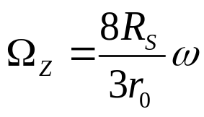
Inertial dragging inside a rotating shell of matter
  The weak field result
Inertial dragging inside a rotating shell of matter was described already in 1918 by Hans Thirring. He calculated the angular velocity of a an object with zero angular momentum
inside a shell with Schwarzschild radius and radius r₀
rotating slowly with angular velocity 
in the weak field approximation,
and found the inertial dragging angular velocity

Slide 33
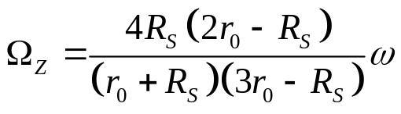


Perfect inertial dragging
In 1966 D. R. Brill and J. M. Cohen presented a calculation
of the inertial dragging angular velocity inside a rotating shell
valid for arbitrarily strong gravitational fields,
but still restricted to slow rotation, giving
If the shell has a radius equal to its own Schwarzschild radius, ,
The expression above gives .
Then there is perfect inertial dragging.
This means that for example the swinging plane of a Fouceault pendulum
rotates together with the shell.
Then the motion of a free object inside the shell is determined by the shell.
This is in agreement with Mach’s principle.

Slide 34


A cosmic consequence of assuming that rotational motion is relative
The distance that light and the effect of gravity have moved since the Big Bang
is called the lookback distance, ,
where is the age of the universe.
We shall now assume that rotational motion is relative.
This means that an observer for example at the North pole of the earth
with a Foucault pendulum and a telescope,
may consider the Earth as at rest and the
stars on the sky as rotating.
The observer sees that the swinging plane of the pendulum rotates together with the stars.
If rotational motion is relative, he must be able to explain this as a gravitational effect.
Then there must be perfect gravitational dragging in our universe.
Since we have assumed the validity of the principle of relativity for rotational motion,
we then have to assume that there is perfect inertial dragging in our universe.
We shall deduce two interesting consequences of this assumption.

Slide 35
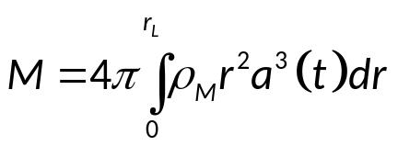




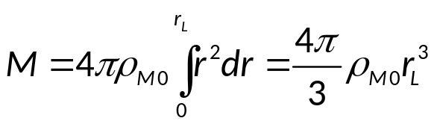
We shall interpret Brill & Cohen’s result to mean that
in order to have perfect inertial dragging in our universe,
the Schwarzshild radius of the mass inside the look back distance
integrated along the past light cone of an observer,
must be equal to the look back distance.
The mass of the dust inside the look back distance integrated along the past light cone of the observer is given by
where is the lookback radius of the Hubble horizon at the emission time, and
is the scale factor. The density of the dust at an arbitrary point of time is
where is the present density of the matter. Hence

Slide 36
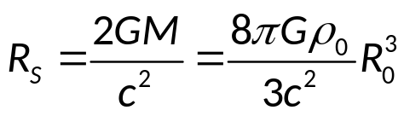


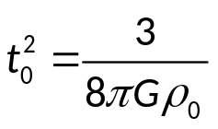
The Schwarzschild radius of this mass is
where is the present density of all mass and energy contained in the universe.
Requiring that the Schwarzshild radius of the mass inside the look back distance
is equal to the look back distance, , gives for the age of the universe

Slide 37
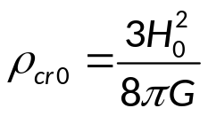

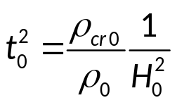
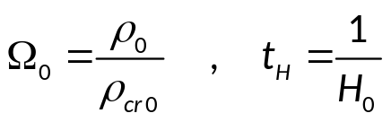
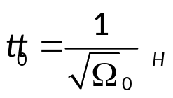
The present value of the critical density,
corresponding to a universe with Euclidean spatial geometry, is
where is the present value of the Hubble parameter. Hence
The present value of the density parameter and the Hubble age of the universe are defined by
The assumption that rotational motion is relative thus leads to the relationship

Slide 38


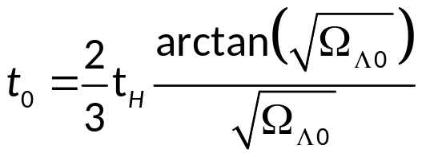
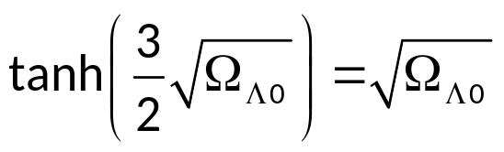
A large amount of different observations indicate that
the density of the universe is very close to the critical density, .
The equation above then shows that for a flat universe
the assumption that rotational motion is relative, leads to the simple relationship
i.e. that the age of the universe is equal to its Hubble age.
The standard model of the universe is a flat universe with
dust and Lorentz Invariant Vacuum Energy, LIVE.
This type of dark energy has a constant density
which may be represented by the cosmological constant, Λ .
The present density parameter of the LIVE is Ω_{Λ0}.
The age of such a universe is given in terms of the Hubble age as
The last two equations lead to

Slide 39

The last two equations lead to
The positive, real solution of this equation gives the following present value of
the density parameter of dark energy,
This is the prediction of the general theory of relativity
together with the assumption that rotational motion is relative in our universe
and that the universe is flat and contains dust and LIVE.
It says that 73,7 % of the contents of the universe consists of dark energy.

Slide 40
Gravitation:
Einstein’s theory contra Newton’s theory
Newton
Einstein
The acceleration of gravity is due to the gravitational force produced by a body.
Tidal forces are due to masses.
Tidal forces cause change of shape
The acceleration of gravity is the acceleration of a free body in a room which is not freely falling.
Geodesic deviation is due to spacetime curvature.
Gravitational waves are emitted by asymmetrical bodies changing shape or orientation.
Gravitational waves cause change of shape.

Slide 41
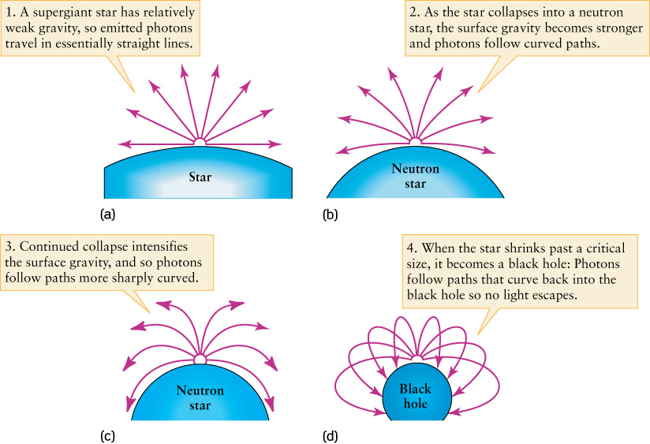

Slide 42
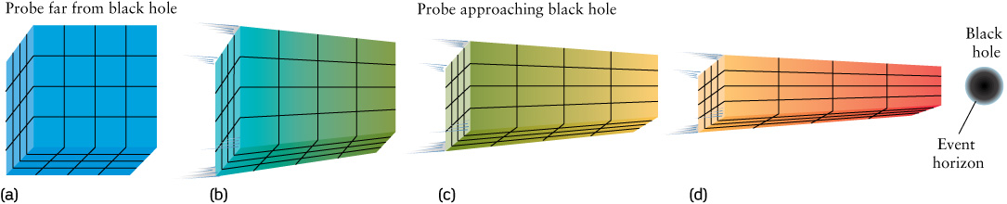

Slide 43
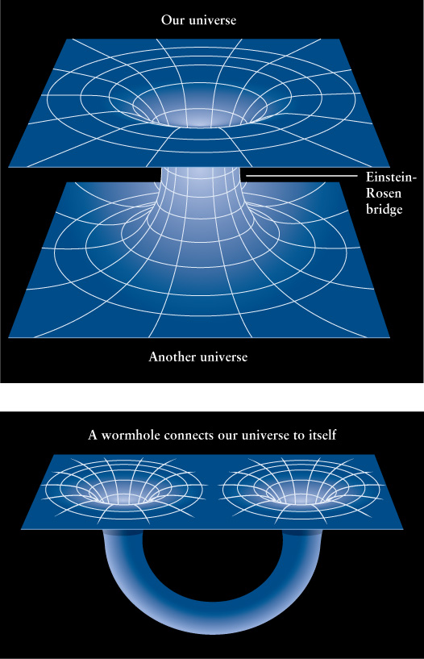

Slide 44
