Slide 1
Strategy for the Global Development of Biosimilars: Putting It All Together
Oxana Iliach PhD
Senior Director, QuintilesIMS, Biosimilars Center of Excellence
August 11, 2017
Asian Biosimilars 2017
Radisson Blu Hotel
August 11, 2017 (Day 2)
Keynote Presentation at 10:05 AM

Slide 2
Disclaimer
The views and opinions expressed in the following PowerPoint slides are those of the individual presenter(s) and should not be attributed to QuintilesIMS, its directors, officers, employees, volunteers, members, chapters, councils, Special Interest Area Communities or affiliates, or any organization with which the presenter is employed or affiliated.
These PowerPoint slides are the intellectual property of the individual presenter and are protected under the copyright laws of the United States of America and other countries. Used by permission. All rights reserved. QuintilesIMS, QuintilesIMS logo are registered trademarks or trademarks of QuintilesIMS. All other trademarks are the property of their respective owners.

Slide 3
Agenda
Developing a biosimilar product for global market
Selection of the reference product
Evaluation of the market and competition
Developing of a highly similar product
Meeting regulatory requirements

Slide 4

Defining Global Biosimilar Development
Does your company have a unique strategy for developing a global biosimilar product?
Strategy: A plan of action designed to achieve a long-term or overall aim
  The art of planning and directing overall military operations and movements in a war or battle
  Global: Relating to the whole world, worldwide
  Relating to or encompassing the whole of something, or of a group of things
Biosimilars: A biotherapeutic product which is similar in terms of quality, safety and efficacy to an already licensed reference biotherapeutic product

Slide 5
Planning Biosimilar Development
11 Key Questions to Answer
Which is the best route for biosimilar development: manufacturing, in licensing etc?
How to expedite clinical program for biosimilar?
Which geographic markets to enter?
What are the pricing regulations for biosimilar and reference product?
How to reduce risk in the development: financing through revenue versus investments?
How to develop a strategy for patent litigation?
What is the Reference Product targeted for biosimilar development?
What is the legal landscape of Reference Product: exclusivity, patents etc?
How many competitors will the biosimilar product have?
How to ensure high similarity of the product?
How to meet regulatory requirements in different jurisdictions?
Global Biosimilar Product

Slide 6
Patents for 19 biologics will expire before 2019
1st wave of biosimilars development and global approvals
Therapy Areas²
Endocrinology
Genetic Lysosomal Storage Disease
Hematology
Immunology
Immunology/Rheumatology
Oncology
Respiratory
Virology
RITUXIMAB (EU)
(Fabry’s Disease)
¹IMS MIDAS 2016 - QuintilesIMS Biosimilar Watchlist
²Therapy areas targeted for clinical trials are predicted based on QuintilesIMS experience in biosimilar clinical development

Slide 7
Patents for another 18 biologics will expire between 2020 and 2026
Therapy Areas²
Hematology
Immunology
Neurology
2nd wave of biosimilars development and global approvals
Immunology/Rheumatology
Oncology
Ophthalmology
Organ Transplantation
¹IMS MIDAS 2016 - QuintilesIMS Biosimilar Watchlist
²Therapy areas targeted for clinical trials are predicted based on QuintilesIMS experience in biosimilar clinical development

Slide 8
Biosimilars Development for Biologics with Patent Expiry 2013-2019
Biosimilar development continues for the first wave of biologics
Analysis developed by QuintilesIMS using public sources of information, including company websites, , current as of July 2017
* No biosimilar under development

Slide 9
Biosimilars Development for Biologics with Patent Expiry 2020- 2026
Biosimilar development ongoing for the second wave of biologics
Analysis developed by QuintilesIMS using public sources of information, including company websites, current as of July 2017
* No biosimilar under development

Slide 10
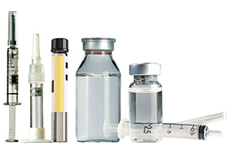
Selection of the Reference Product
A Comprehensive evaluation of Reference Product is key to successful biosimilar development
Review Reference Product Information:
Labeling, formulation and dosage strength(s)
Purity, Potency and Stability
Evaluate Reference Product Application:
Use in clinical setting, route of administration, dosage form, container closure and delivery systems.
Clinical pharmacology and pharmacokinetics; efficacy, safety, special population consideration
Conduct Reference Product Evaluation:
Extensive analytical testing using state of the art techniques
Understand Reference Product mechanism of action, plan for in-vitro and/or in-vivo studies

Slide 11
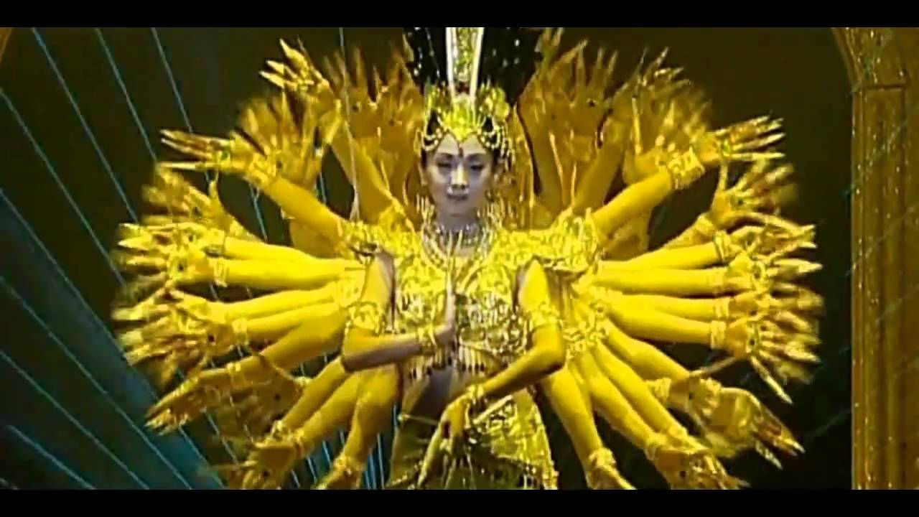
Biosimilar Development Program
“Global” does not mean overly complicated
Source of Reference Product or
how many arms to include in:
Similarity Evaluation?
Non-Clinical Study?
Clinical Study?
Timely and regular discussion of biosimilar program with Health Authorities is a key to a successful biosimilar development
FDA: Biosimilar Biological Product Development Meeting: BPD Type 1, 2, 3 and 4
EMA: Tailored scientific advice for development of biosimilars
Health Canada: Scientific Advice Meeting Pilot (2015 – 2018)
Discussion with Health Authorities of other jurisdictions

Slide 12
Biosimilar Development Approach
Step-wise approach is critical in development of highly similar product
HIGH
Phase III
Phase I PK/PD
Non-Clinical Study
Functional Characterization
Physicochemical Characterization
LOW
Probable clinical relevance of found differences
Sensitivity to product differences
LOW
HIGH

Slide 13
Biosimilar Development Strategy
Marketing and Regulatory Strategy
Product Selection
Regulatory Strategy
Marketing Strategy
Regulatory Meetings with Health Authorities
Chemistry Manufacturing and Control
Reference product acquisition, Target Product Profile and Critical Quality Attributes determination
Cell Line, Master Cell Bank and Working Cell Bank Development and Characterisation
Methods Development, Qualification, Validation
Non-Clinical Clinical
Non-Clinical study (as applicable)
Phase I study
Phase III study
Risk Management Plan
Pharmacovigilance
Planning for Real World Late Phase
Similarity Study
Process development, scale up, manufacture of biosimilar for various studies
Development of commercial container closure
Shipping Validation
Preparation for inspection
Planning is essential for successful biosimilar development
Global Biosimilar Dossier

Slide 14
Regulatory Requirements for Biosimilar Dossier
Preparation of a dossier in the Common Technical Document (eCTD) format facilitate review and approval
Regulatory CTD* Modules
Originator
Biosimilar
Similarity Study
Full Process and Product Development PLUS Extensive Similarity Study
Module 3 – Quality
Quality Information
Quality Information
Module 4 – Non-Clinical
Non-Clinical Study
Reduction of Non-Clinical Program: in vitro and in vivo studies
Non-Clinical Study
Module 5 – Clinical
Phase I and Phase III Clinical Program with Extrapolation in Iindications Interchangeability Study?
Clinical Study
Clinical Study

Slide 15
Biosimilar Regulations in Different Jurisdictions
Local regulatory expertise is essential for success of a submission to regulatory authority
EU, USA, Canada, Japan
BRIC: Brazil, Russia, India, China
APAC, Africa, Middle East, Latin America
Complex Regulatory Landscape
EMA, Health Canada lead the way with the development of regulatory guidances, following by FDA and PMDA
WHO issued biosimilar guidance to help harmonize biosimilar requirements
Australia, Brazil, Russia, India and China are updating their regulatory requirements
Rest of the World: Africa, Latin America, Middle East, Asia – Pacific (APAC), are opening up for approval of biosimilars

Slide 16
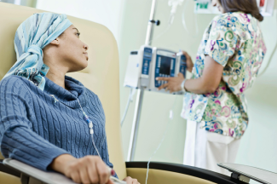
Application of Biosimilars…
The purpose of biosimilar is to meet patients need for affordable treatment
Stand alone biosimilar with extrapolation of indication
Biosimilars for rare diseases: from Rituximab for treatment of follicular lymphoma to Imiglucerase for Gaucher's disease
Biosimilars in oncology: combination with PD-L1 inhibitors
Are biosimilar patentable?

Slide 17
Putting It All Together
Successful strategy for the global development of biosimilar requires cooperation and partnership
Product Development + Non-Clinical and Clinical Programs
Regulatory Strategy
Marketing Strategy
Each biosimilar product development presents unique challenges
Biosimilar development should start with collecting and evaluating of information and data on reference product
Development of global strategy is essential for biosimilar: adding on markets at the latest stages of development will increase time and cost of the development
Development of highly similar product is the critical for success of biosimilar program

Slide 18
Questions?

