Slide 1
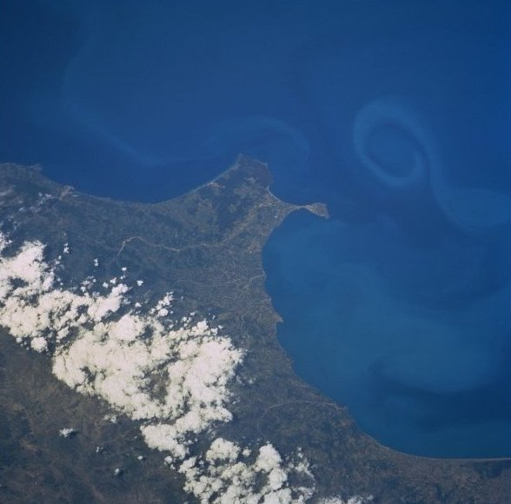



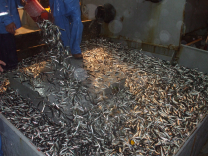
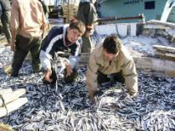
SUSTAINABLE FISHERIES OF THE EUROPEAN ANCHOVY
(Engraulis encrasicolus ) IN THE BLACK SEA, TURKEY
Osman SAMSUN, Ferhat BUYUKDEVECI, Çetin SUMER, Sabri BILGIN
Sinop University, Faculty of Fisheries and Aquatic Science,
Sinop, TURKEY osamsun@yahoo.com

Slide 2
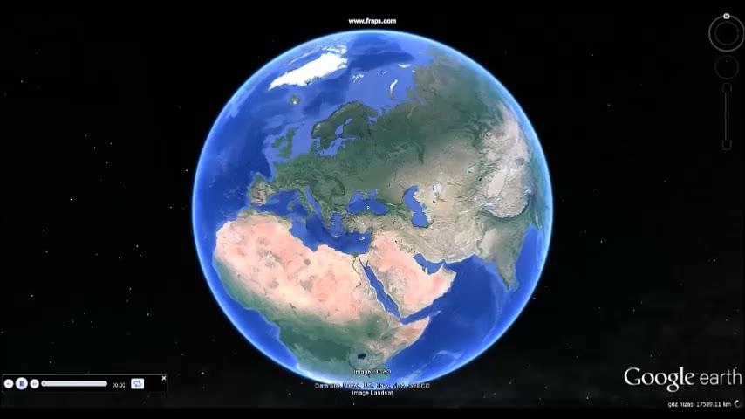
WHERE IS THE FACULTY OF AQUACULTURE AND FISHERIES?

Slide 3

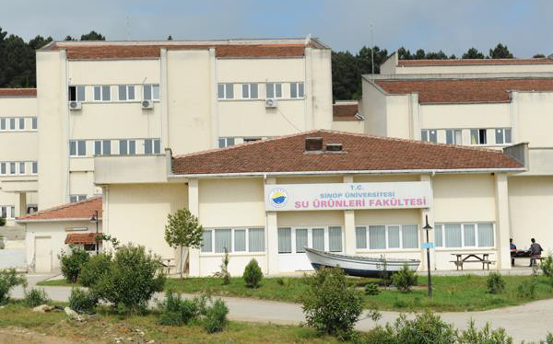
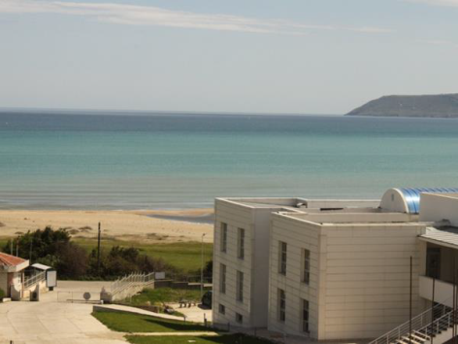
SINOP UNIVERSITY
FACULTY OF AQUACULTURE AND FISHERIES

Slide 4
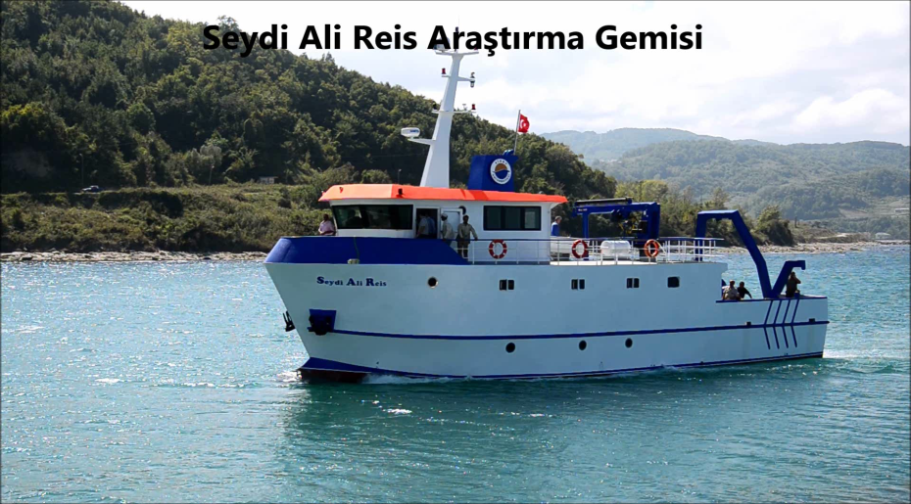
WHAT ARE THE FACULTY APPLICATION POSSIBILITIES?
We have research vessel, 21 m, and it was the first local production in Turkey.
Seydi Ali Reis Research Vessel

Slide 5


Slide 6
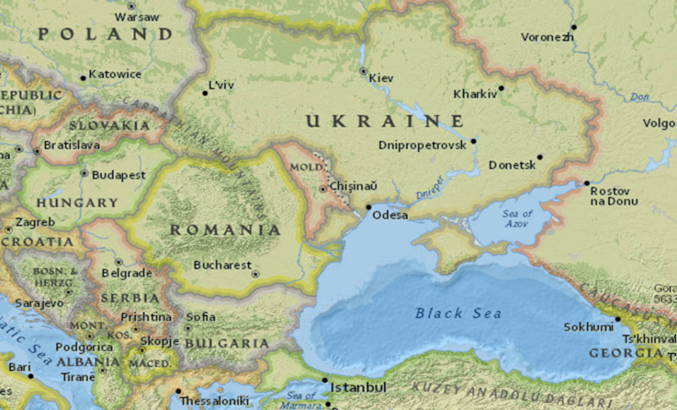
Drainage in the Black Sea Area

Slide 7
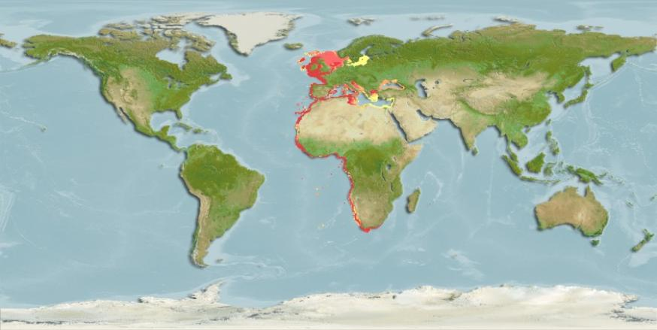
European Anchovy (Engraulis encrasicolus) distribution areas

Slide 8
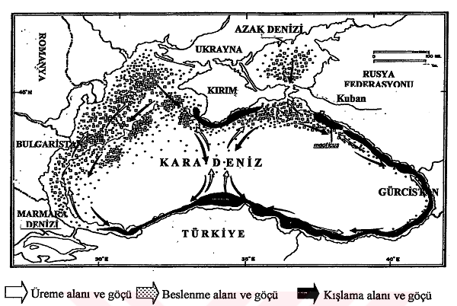
General migration
Ivanov and Beverton, 1985

Slide 9
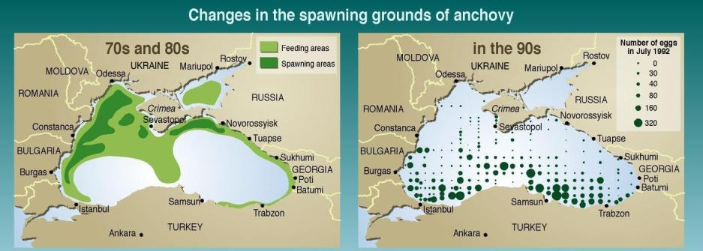

Slide 10
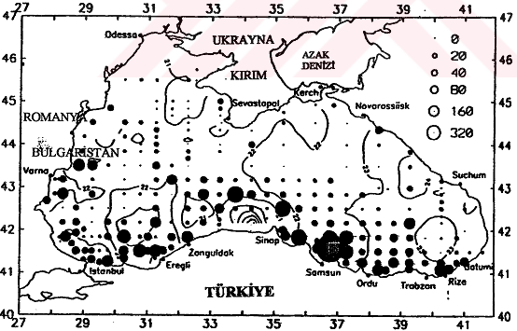
Changes of spawning area
Nierman, 1994

Slide 11

The Black Sea currents create a migration of pelagic fishes for biological nutrition, spawning and wintering cover. Hence, in particular, such as anchovies, an important fishing of pelagic fish is discussed in this article on the issues that need to be done. In this sense, common policies are required in Black Sea.

Slide 12
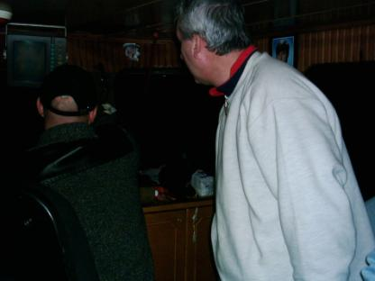
Anchovies production has significantly decreased in recent years due to many factors.
In Black Sea region there have been many surveys. In the context of international projects, long-term monitoring conducted a lot of research is currently being conducted by researchers from different countries in this research. Several of these studies are shown below.

Slide 13
Map of the Black Sea basin - Pollution in the Black Sea Area - Main crude and dirty product routes in the Black Sea - Species richness in countries of the Black Sea region - Black Sea pipelines Socio-economic indicators for the countries of the Black Sea basin - Evolution of the phytoplankton composition in the Black Sea - Black Sea water indicators - Oil transport in the Black Sea - Long term variations in the biomass percentage of copepods in Sevastopol Bay - Turbot distribution in the Black Sea - Water Discharges measured by Biological Oxygen Demand - Fish catch in the Black Sea over the last 30 years, Turkey and USSR.
Total fertilizer consumption in the countries bordering the Black Sea in the 1990`s - Changes in the spawning grounds of anchovy - Phytoplankton pigments concentration in the Black Sea - Long- term changes in the CHl-a levels in the Black Sea - Reduction of the Zernov`s Phyllophora fields in the Bay of Odessa - Endangered species in the Black Sea region,

Slide 14
Populatıon growth projections in the Black Sea region until 2030 - Nutrients in the Varna Bay and the Romanian Black Sea costal area - Fish catch in the Black Sea over the last 30 years - Fisheries under threat in the Black Sea - Salinity of the Black Sea - Relationship between the decrease in Turkish anchovy catch and the growth of Mnemiopsis, 1968-1990 - Comparison of long-term variability of different characteristics of the Black Sea ecosystem - Fish catch in the Black Sea over the last 30 years, Bulgaria and Romania - Expansion of hypoxia and anoxia zones in the northwest of the Black Sea - Fish catch in the Black Sea over the last 30 years - Fish landings and fishing fleet in the Black Sea, 1975-1995 (Report on the Black Sea drainage basin, for the UNEP Global Impact on Waters Assessment -GIWA Black Sea team and the GIWA secretariat, 10 Mar 2006 - by Philippe Rekacewicz, UNEP/GRID-Arendal-
http://www.grida.no/graphicslib/collection/giwa-black-sea-raphics?p=1).

Slide 15
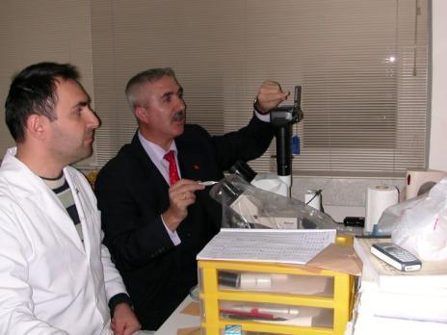
By many researchers in Turkey on the Black Sea, anchovy fisheries biology and population dynamics of several years of research done on various parameters laid down over the years, and the stock of anchovy is known (mean L and W, % age frequancy, % sex ratio, length-weight a-b, Von Bertalanfy parameters, S,Z,F,M and E).
[Ozdamar et al., 1991; Karacam and Duzgunes, 1988; Duzgunes and Karacam, 1989; Unsal, 1989; Okur, 1989; Genc and Basar, 1991; Genc and Basar, 1992a; Genc and Basar, 1992b; Mutlu, 1994; Ozdamar et al., 1995; Mutlu, 2000; Kayalı, 1998; Mutlu, 2000; Samsun et al., 2006; Sahin et al., 2006; Bilgin, 2006; Saglam and Saglam, 2013.}

Slide 16
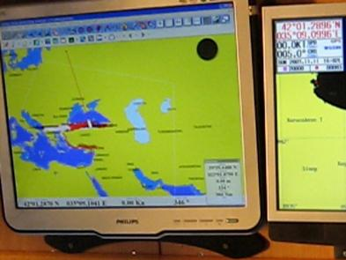
In the Black Sea, anchovy fishery biology of the basic parameters and the data on the prosecution of continuous research has been made by many authors, in recent years ( Aka, Z. Torcu H and Turan C, A, 2004., Özdemir, S and Duyar H, A, 2013., Bat L, and et al , 2013, Kalaycı and et al, 2007).
What kind of changes in the general conditions of changing climate, still to be followed by the researchers within the framework of the Black Sea. (Kideys A.E, 1994, Kideys A, E and et al , 1999 Gordina, A.D and et al, 1997, Oguz T and Gilbertb D, 2007, Bat L. and et al, 2007, Samsun O and et al, 2004., Şahin C and et al, 2009).

Slide 17
Other riparian countries of the Black Sea in the various studies were conducted on fish such as anchovy and horse mackerel (Yankova M and et al, 2010, Alison J. and et al, 2009) are known. Horse mackerel studies are avaible in black sea region but not as much as anchovies. (Kasapoglu N and Düzgüneş, E, 2013, Yankova, M, 2013, Bostancı, D, 2009).
All this work is done by individual researchers observed a variety of very different dates. In general, small pelagic fish such as anchovy and horse mackerel of the Black Sea countries never conducted a lot of researches. Legislation and for the management of fisheries research in our country, a small numbers (Sesli FA and et al, 2009, Can, MF and Smith, A, 2012) are available.

Slide 18
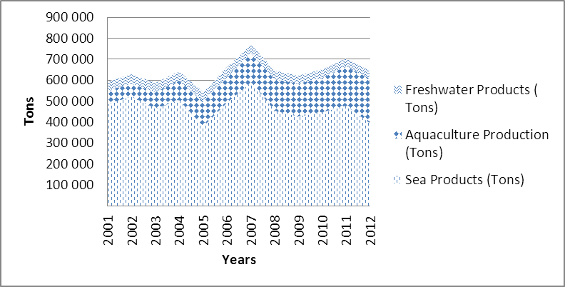
Although in recent years, particularly in the Black Sea anchovies have made up of different topics and much research is still ongoing, but the data below shows that significant decrease have occurred in the amounts of the annual hunting.
Fishery products in Turkey according to years (TÜİK, 2012).

Slide 19
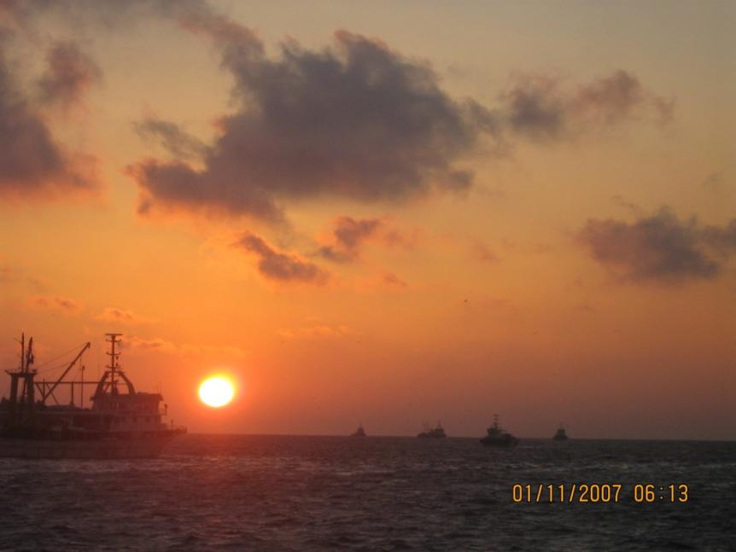

Slide 21
There is not enough prohibition of size of hunting for anchovy in Georgia, where huge amounts of small-sized hunting of anchovies. Georgia, which was founded hunting anchovy for fish meal and processed food factories.
The purpose of this article, the Black Sea, which is the most important fish species in this imported and also exported to the EU countries, the measures necessary for the operation of profitable stocks in the Black Sea coastal countries and international level, as well as to facilitate open discussion and knowledge of the subject concerned, the necessary measures to be retrieved.

Slide 22
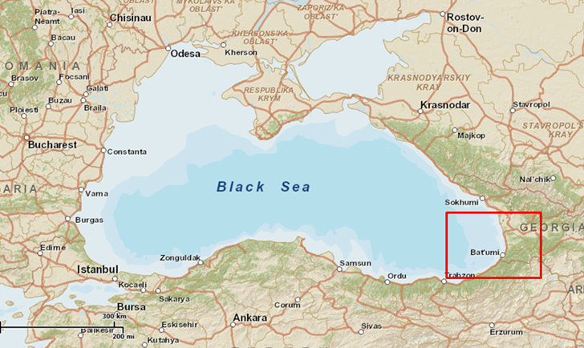
In the Black Sea countries and problem of anchovy hunting area in (Batum) Georgia.

Slide 23
In this study, the amount of aquaculture in Turkey in recent years, how hunting equipment and technologies are affected by many parameters that affect the current situation has been analyzed. Anchovies in Turkey, in recent years, on the research carried out in previous years were compared with the results of the new research.
On the subject the old and new practices of Turkey Statistical Institute and the General Directorate of Fisheries and Aquaculture data are used. With all the neighboring countries of the Black Sea region, is still used as a common asset protection and control measures are evaluated by Turkey. Exclusive economic zones (km²), properties of protection and control organizations, coastal lengths (km), total fish production (t), the amount of fish caught in the Black Sea (t) and number of fishing vessels are compared for the countries of Black Sea region.

Slide 24
Anchovy, the most important pelagic species caught in the Black Sea and Turkey as a dominant; at least half of the annual aquaculture production is around 600,000 tons. At the same time a larger fish and mammals in the food chain is also an important source of nutrition.
In recent years, especially the 2011-2012 hunting season is one of the important fishing centers on the Black Sea province of Sinop anchovy fishing only 12 days, and then quickly drain is very thought-provoking and need to focus on the shores of Georgian issue. This topic has been on anchovy in the old and new in comparison with the results of the research were injured, anchovy fishery management carefully maintained.

Slide 25
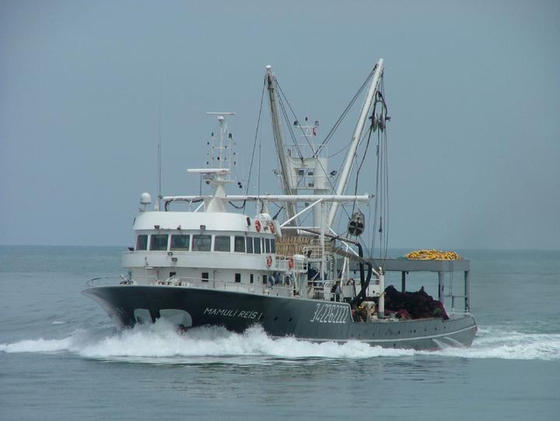
Purse seine in the Black Sea.

Slide 27
Turkey has the highest economic zone value within the 6 Black Sea region counties, Table 1.
The Black Sea countries economic zones (Anonym, 2013 a ), http://www.seaaroundus.org/eez/
Turkey has the greatest share in the context of the amount of fisheries production, coastal lengths, catch size and fishing powers within the Black Sea countries.

Slide 28
The amount of fisheries production, coastal lengths, catch size and fishing powers of the Black Sea countries (Duzgunes, E., Erdogan, N. 2008).
Data | Bulgaria | Georgia | Romania | Russia | Turkey | Ukraine
Coastal length (km) | 354 | 310 | 225 | 800* | 1329 | 2782*
Total fish production (t) | 11000 | 3000 | 13000 | 3051000^ | 644000 | 229000
The amount of fish caught in the Black Sea (t) | 2843 | 2837 | 1824 | 24922 | 342455 | 63161
The Black Sea Anchovy (Engraulis encrasicolus ponticus) minimum of catch size (cm) | unknown | 7 | unknown | unknown | 9 | unknown
Number of Fishing vessels | 1261 | 360 | 436 | 2912 | 7308 | 2300
* Including Azov Sea.
^ Including high seas fisheries

Slide 29
The total coast guard elements of the Black Sea countries (T.C. SGK 2013)
Data | Bulgaria | Georgia | Romania | Russia | Turkey | Ukraine
Ship | 25 | 22 | 35 | 250 | 184 | 44
Aircraft | - | - | - | Number is unknown | 3 | -
Helicopter | - | - | - | Number is unknown | 14 | -

Slide 30

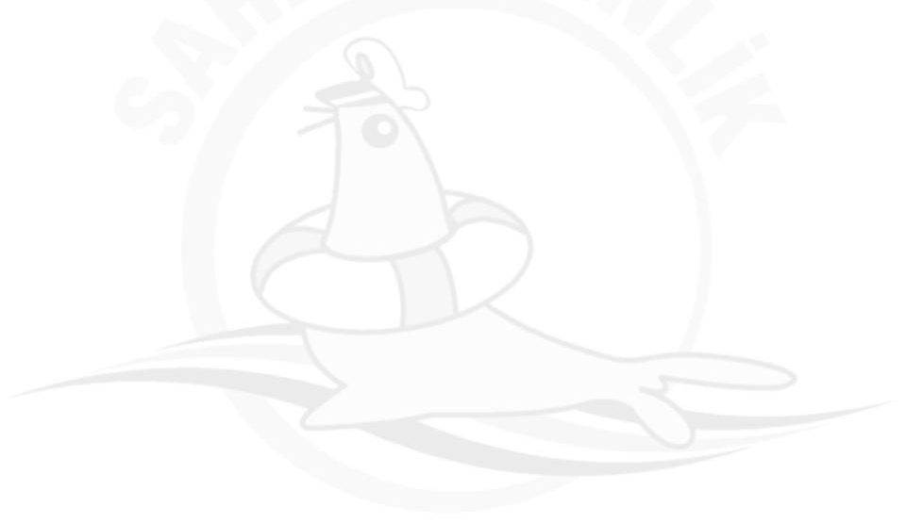





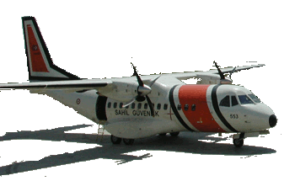

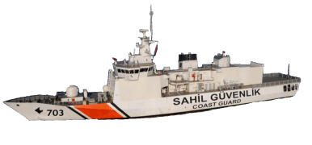


Turkish Coast Guard Assets
2013
Diving
Safety,
Security
12 and SAR
Boats
48 Coastal
Control
Crafts
12 Mobile Radar
14 Coast Guard
Helicopter
25 Coastal Safety
and Security Boats
3 Coast Guard
Aircraft
97 Coast Guard
Boats
2 Coast Guard
Ships
Notes:
30
2033 YILINDA ULAŞILMASI HEDEFLENEN KUVVET YAPISI;
* 16 SAHİL GÜVENLİK GEMİSİ,
* 108 SAHİL GÜVENLİK BOTU,
* 112 LASTİK BOT,
* 3 SAHİL GÜVENLİK UÇAĞI,
* 20 HELİKOPTER,
* 12 MOBİL RADAR VE
* 12 İNSANSIZ HAVA ARACI ŞEKLİNDEDİR.

Slide 31
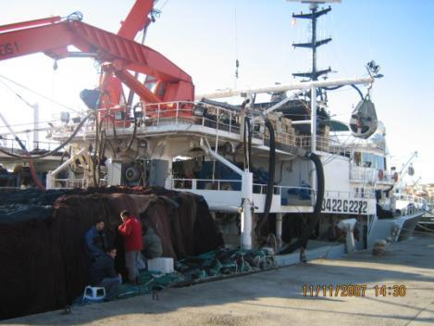
Turkey, especially anchovy, horse mackerel, bonito used for catching fish such as purse seiners fishing capacity has reached quite large. Length of these boats, motor power, and very sophisticated fish finding equipment, etc., is more advanced than all the other countries in the Black Sea.

Slide 32
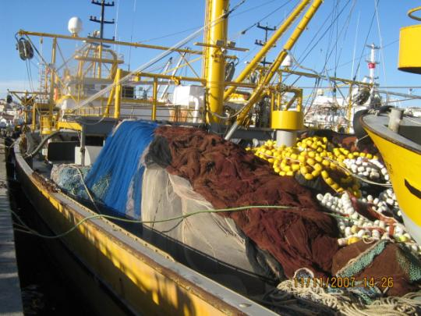
The amount of anchovy fishing for Turkey, an important place in the fisheries sector. Including fish flour and oil mills, particularly, provides a small retail fishermen living by selling fish, as much as 20 to 60 meters long the owners of many elements of the purse seiners fishing anchovy, fishing sector and the amount of time adversely affected by the reduction.

Slide 33
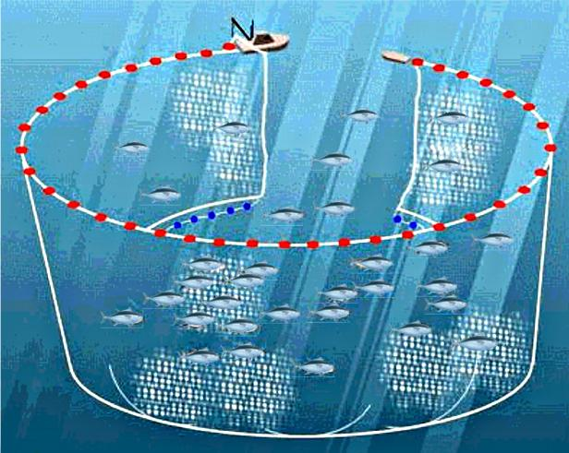

Slide 34
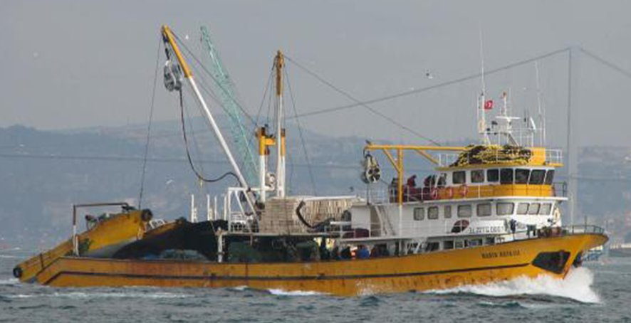
Gırgır Teknesi

Slide 35
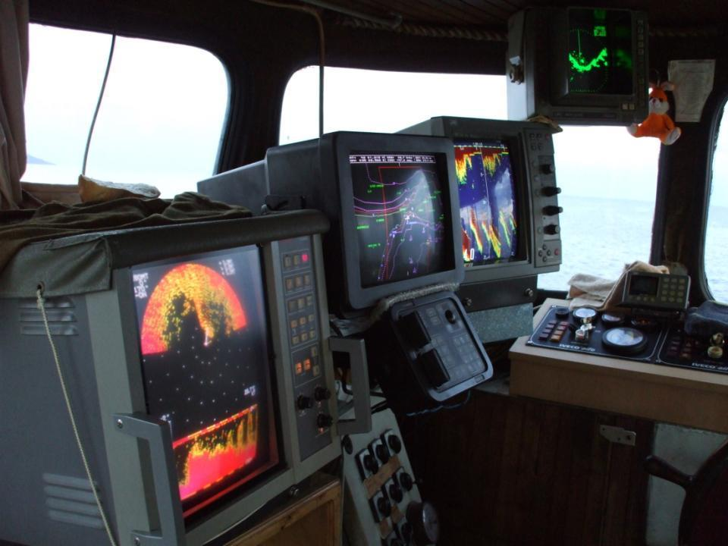

Slide 36
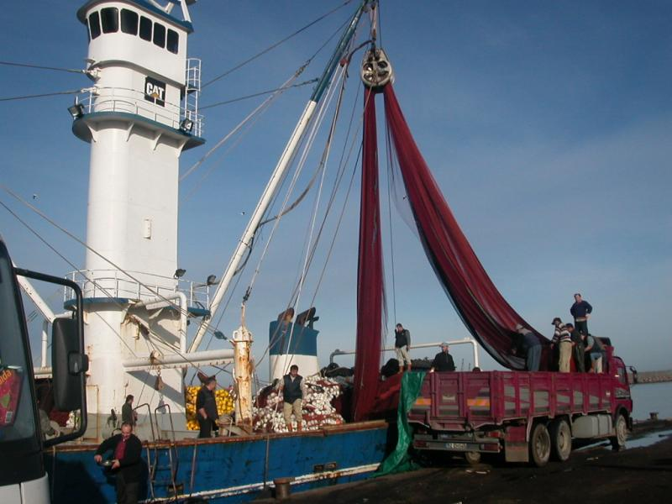
Modern Power Block ve Kullanılışı

Slide 37
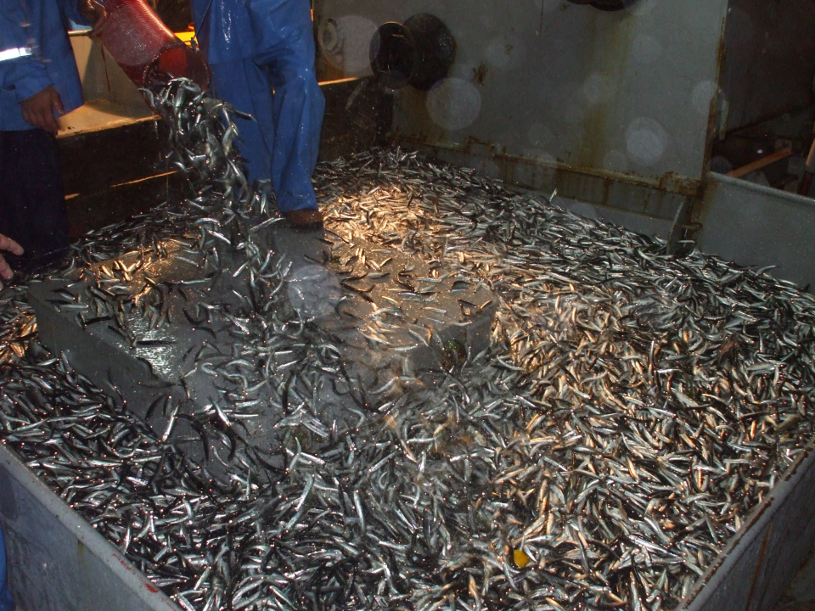
Balığın Güverteye Dökülmesi

Slide 38
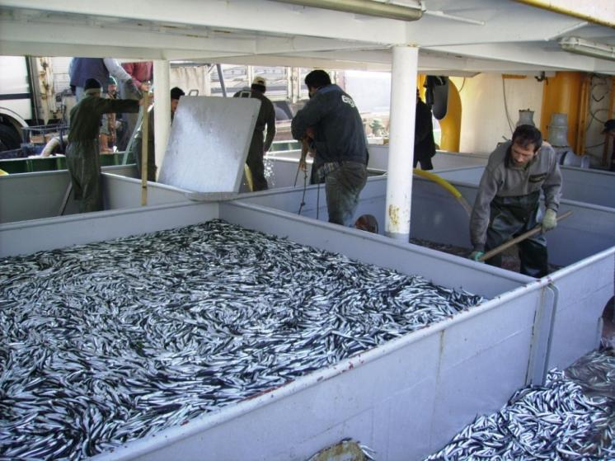
Anchovy is going to fish oil fabric.

Slide 39
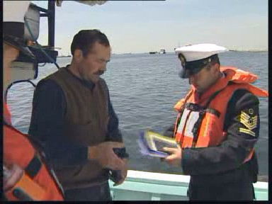
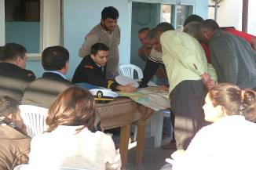
Especially in Turkey, the Coast Guard is renewed every year and with increasing knowledge of the hardware and the control of fishery products as fishing is a very important. During these audits, the fishermen are also subject to various training programs in certain periods.
Hunting pressure in recent years, clearly demonstrating the Black Sea comparative annual exploitation rate were analyzed (excessive hunting pressure seems to be still on anchovies.

Slide 40
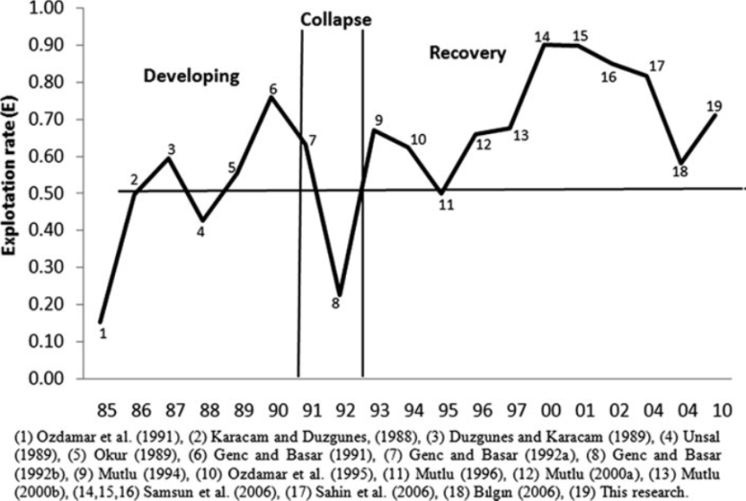
Exploitation rate of anchovy in the Black Sea recent year (N. Erdogan Saglam and C. Saglam, 2013)

Slide 41
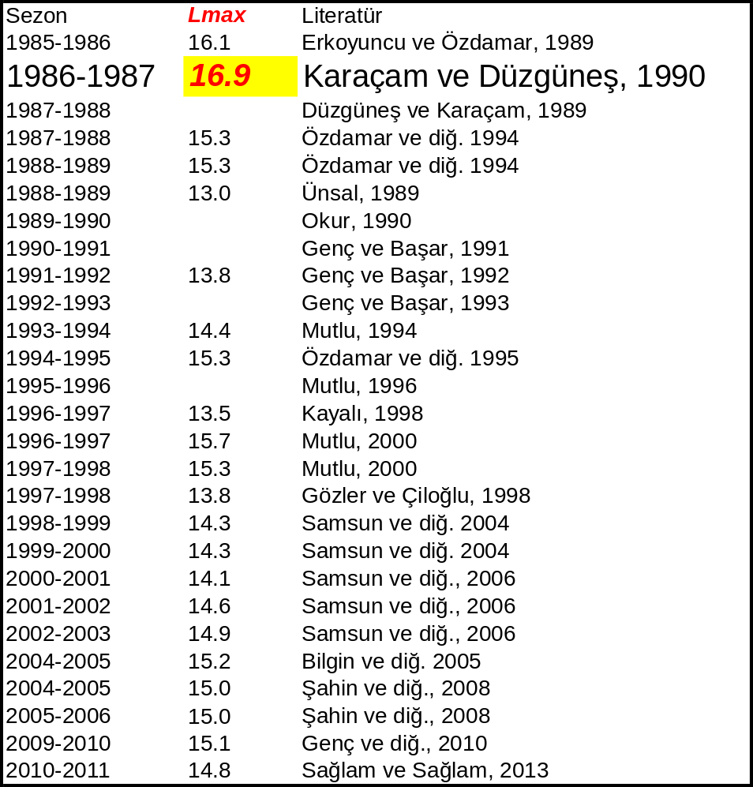
Fast growth and short living species
Growth up to 3 ages
Measured Maximum length 16. 9 cm

Slide 42
Ctenophore effects

Slide 43
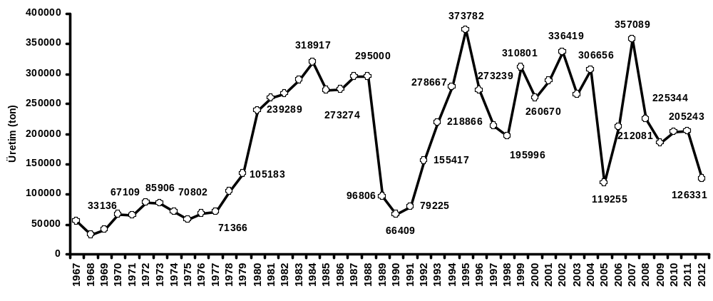


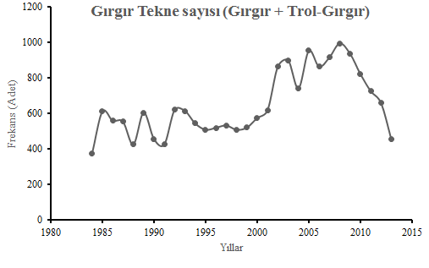
43

Slide 44
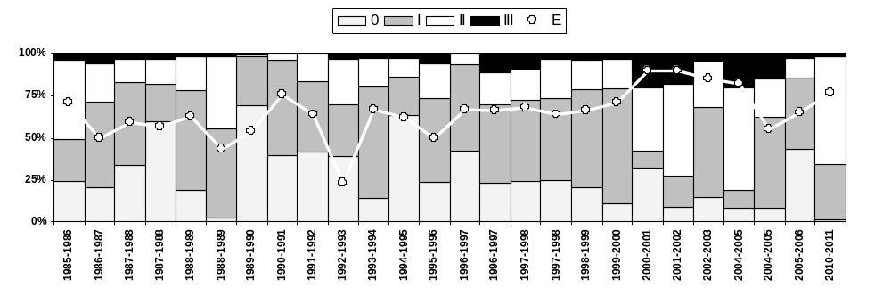
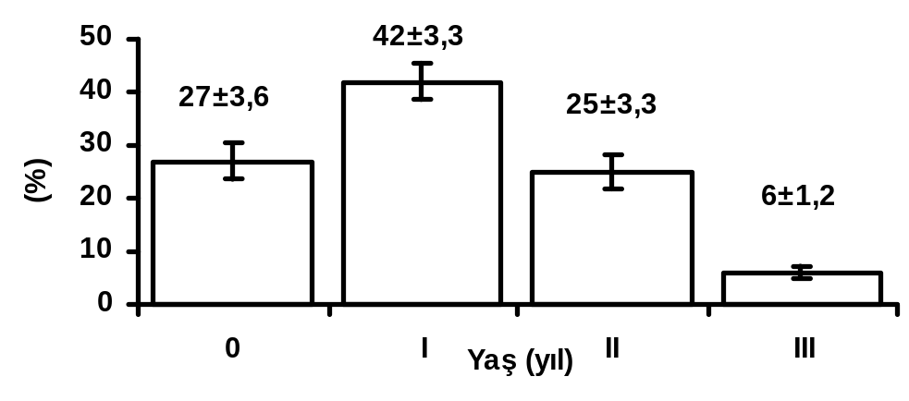
Age composition
From 1985 to 2011

Slide 45
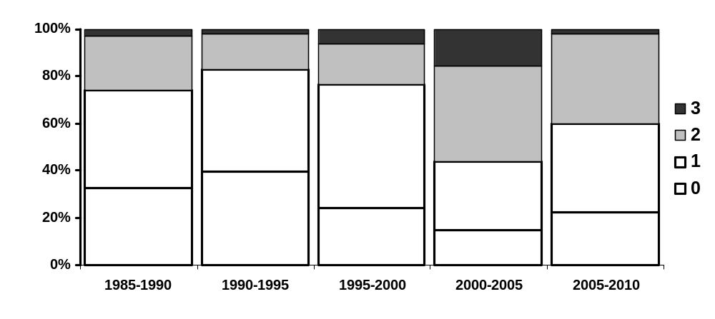
Age composition
Season | Age (Year)
 | 0 | 1 | 2 | 3
1985–1990 | 33±23,9 | 41±15,4 | 23±16,3 | 3±1,7
1990–1995 | 40±17,4 | 44±17,9 | 15±8,7 | 2±1,3
1995–2000 | 24±9,4 | 53±8,1 | 17±5,3 | 6±3,3
2000–2005 | 15±10,2 | 29±22,5 | 41±16,5 | 15±6,8
2005–2010 | 22±29,8 | 38±6,8 | 38±36,9 | 2±0,3

Slide 46
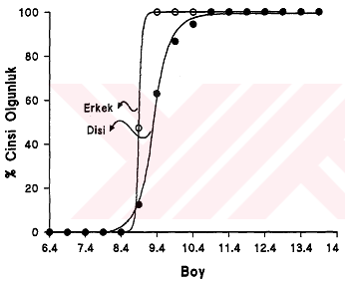
Maturity
Size at age (1985 - 2011)
 | 0 | I | II | III
Lort.±SH (Min. – Mak.) | 8,3±0,09 (7,15 – 8,98 ) | 10,3±0,09 (8,8 – 11,1) | 12,1±0,09 (11,2 – 13,1) | 13,3±0,09 (12,5 – 14,1)
Number of working | ( n = 24) | ( n = 24) | ( n = 24) | ( n = 23)
(8,9±1,66 cm)
(9,3±0,017 cm)
Maturity size of anchovy in the Black Sea (Kayalı, 1998)

Slide 47
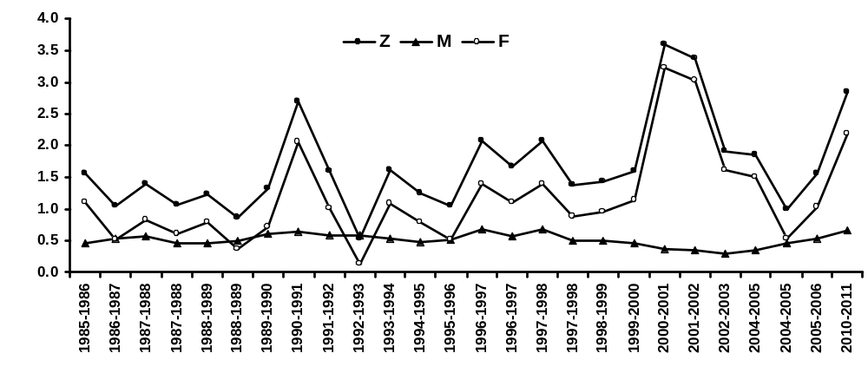
Mortality ratio from 1985 to 2011

Slide 48
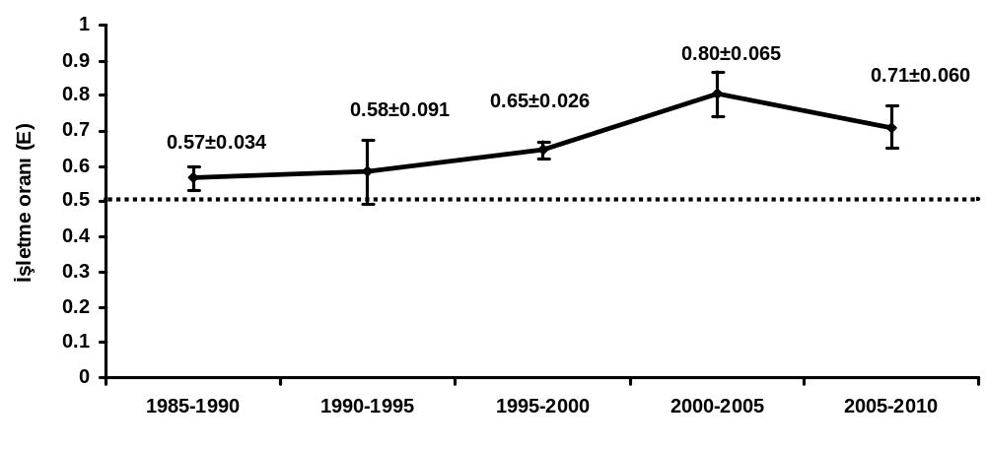
Exploration ratio from 1985 to 2010
E _{mean (1985 - 2010)} : 0.65±0,029

Slide 49
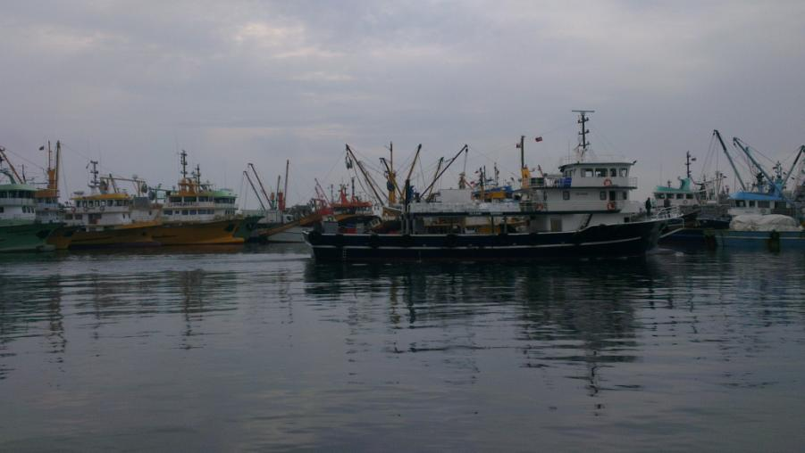

Slide 50
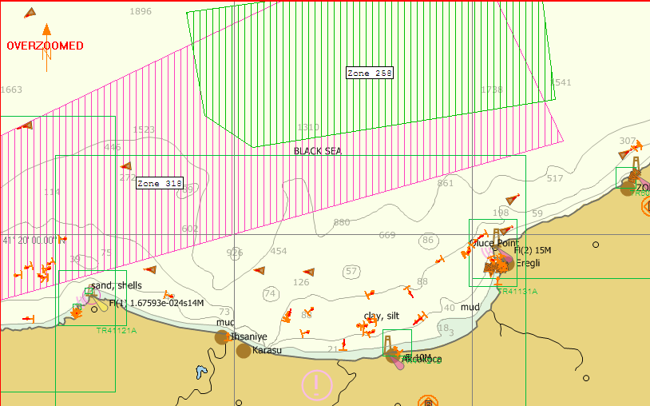
IMMIGRATION OF ANCHOVY ON THE WEST BLACK SEA 2014-2015 FISHING SEASON
EK-A
12 Ekim 2014

Slide 51
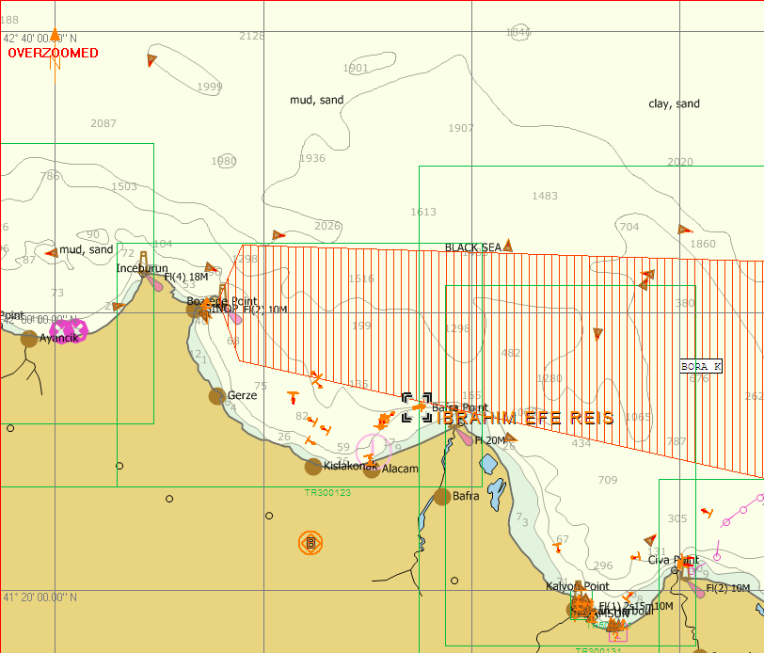
IMMIGRATION OF ANCHOVY ON THE MIDDLE BLACK SEA 2014-2015 FISHING SEASON
EK-A
12 Ekim 2014

Slide 52
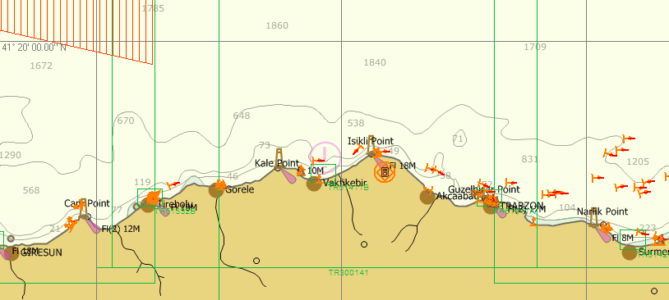
IMMIGRATION OF ANCHOVY ON THE EAST BLACK SEA 2014-2015 FISHING SEASON
EK-A
12 Ekim 2014

Slide 53
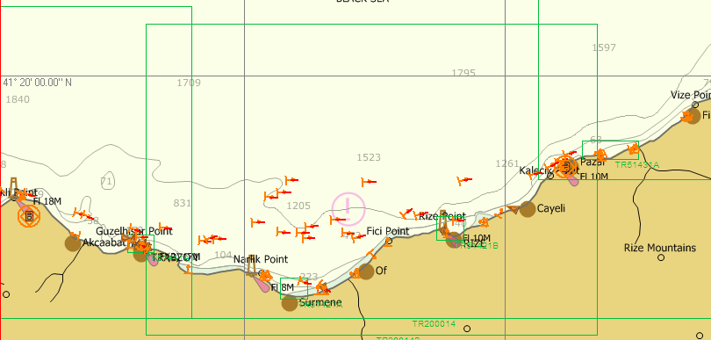
IMMIGRATION OF ANCHOVY ON THE EAST BLACK SEA 2014-2015 FISHING SEASON
12 Ekim 2014

Slide 54
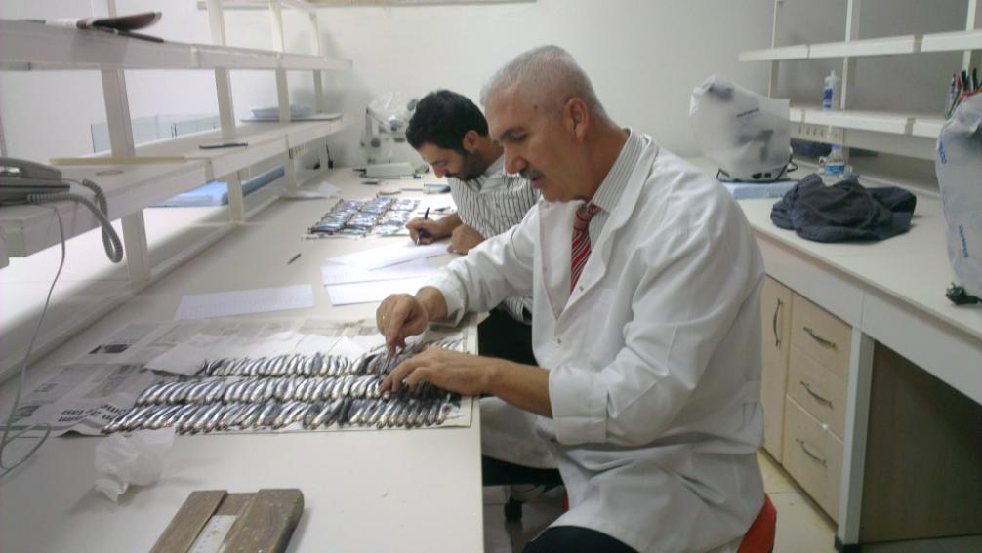

Slide 55
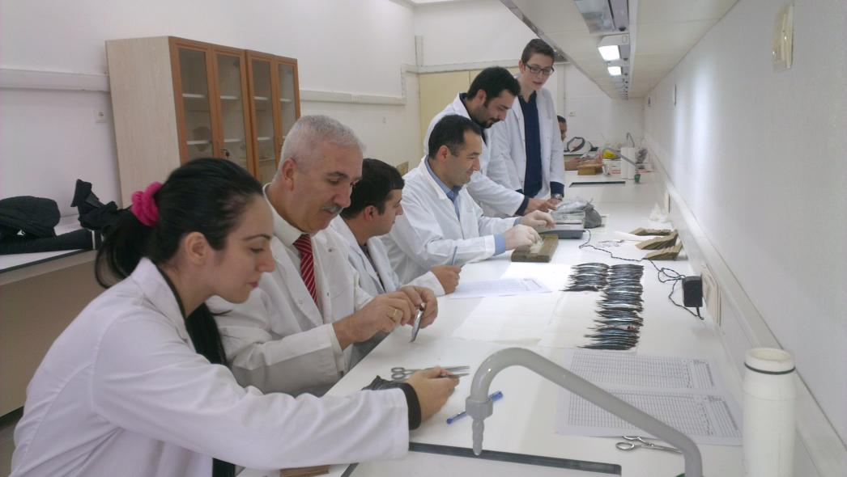

Slide 56
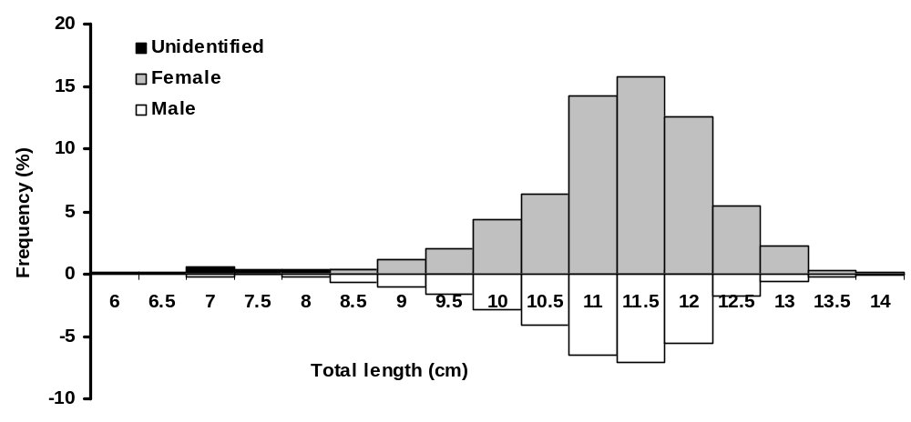
2014 – 2015 fishing season
Length composition
Length (cm) | Unidentified | Female | Male | All
6.0 | 0.1 | 0.0 | 0.0 | 0.1
6.5 | 0.2 | 0.0 | 0.0 | 0.2
7.0 | 0.5 | 0.0 | 0.2 | 0.7
7.5 | 0.3 | 0.1 | 0.0 | 0.4
8.0 | 0.3 | 0.2 | 0.2 | 0.6
8.5 | 0.3 | 0.3 | 0.6 | 1.3
9.0 | 0.0 | 1.1 | 1.0 | 2.2
9.5 | 0.1 | 2.1 | 1.7 | 3.8
10.0 | 0.0 | 4.3 | 2.9 | 7.2
10.5 | 0.0 | 6.3 | 4.1 | 10.4
11.0 | 0.1 | 14.2 | 6.5 | 20.8
11.5 | 0.2 | 15.8 | 7.1 | 23.1
12.0 | 0.2 | 12.6 | 5.5 | 18.3
12.5 | 0.0 | 5.4 | 1.8 | 7.2
13.0 | 0.0 | 2.2 | 0.6 | 2.9
13.5 | 0.0 | 0.3 | 0.2 | 0.5
14.0 | 0.0 | 0.1 | 0.2 | 0.2
All | 2.6 | 65.1 | 32.4 | 100.0

Slide 57








Frequency (%)
Total length (cm)
Total length (cm)
2014 – 2015 fishing season

Slide 58



2014 – 2015 fishing season
Length - Weight Relationships
W = 0.011TL^{2.7368}, r² = 0.8454, SdlogL = 0.0362, SdlogW = 0.107798029, N = 1709,
Pauly’ t test = 9.291496, P < 0.05, negative allometric growth (Female).
W = 0.0065TL^{2.9483}, r² = 0.8917, SdlogL = 0.0442, SdlogW = 0.137917881, N = 851,
Pauly’ t test = 1.466093, P > 0.05, isometric growth (Male).
W = 0.0079TL^{2.8682}, r² = 0.8983, SdlogL = 0.0458,
SdlogW = 0.138522039, N = 2627,
Pauly’ t test = 6.997254, P < 0.05,
negative allometric growth (All)

Slide 59

Seasonal growth of Anchovy during
2014 – 2015 fishing season in the Black Sea
 | Hoenig Seasonal |  | Non-Seasonal
L∞ (cm) | 13.272 |  | 13.187
K (year-1) | 1.200 |  | 1.054
t₀ (year) | -0.590 |  | -0.760
t_{s} | -0.469
WP | 0.031 (Jan.)
C | 0.570
Rn | 0.601 |  | 0.531
φ' | 2.235 |  | 2.263

Slide 60


2014 – 2015 fishing season

Slide 61
Fishing regulation is based on the following criteria *
• Minimum mesh size (there is no regulation for anchovy),
• Minimum fish size (9 cm TL for anchovy),
• Closed season and area [seasonal prohibition protects spawning stocks as it bans the use of bottom and mid-water trawls and purse seines between May and September. Zone restriction refers to the law against fishing within three miles from the coastline]
• Species under full conservation (dolphin, seal, salmon, sea turtle, sponge, corals and sturgeons),
• Completely banned fishing methods and fishing gears,
• Gear restriction for identified species,
• Gear or fishing method restrictions,
• Some restrictions concerning pollutants.
*Düzgüneş, E and Erdoğan, N. Fisheries Management in the Black Sea Countries. Turkish Journal of Fisheries and Aquatic Sciences 8: 181-192 (2008)

Slide 62


Slide 63


Last two years Anchovy in Georgia, hunting and fishing is known to migrate to the coast. However, there is no legal protection measure on anchovies, where heavily anchovy reach breeding size hunted for fish flour and oil mills. This situation is a cause for concern for the future of anchovy stocks.

Slide 64
Circulation in the form of the Black Sea, breeding, feeding, migration and hunting all the Black Sea countries, can be common interest to protect the anchovy stocks. Turkey, which has not formed enough to other formal organizations such as the Black Sea countries, the establishment of a common organization, protection and control activities in a transparent manner, will be useful to a dialogue and solidarity.
Under the leadership of the Black Sea Commission and the Black Sea Economic Cooperation community, with the support of scientific research institutions, anchovy stocks and the effective implementation of control measures for the protection and required. Otherwise, large pelagic species in the food chain in the stocks of anchovy fed on the basis of similar problems can occur.

Slide 65

Vessel Monitoring System
Notes:
THE TURKISH COAST GUARD COMMAND CONTINUES TO FIGHT AGAINST ILLEGAL ACTIVITIES WITH ALL EFFORTS ON 24/7 BASIS.

Slide 66
Turkish fishermen fishing activities in Georgia, largely in line with the decisions taken by public officials for their advantage when processing actually hunting Turkish fishermen in the waters of that country in which the economic benefit from fully benefiting from questionable.
Because the amount of Georgia by the Turkish anchovy fishermen in the hunt with a certain limitation of certain fishing quotas introduced restrictions.

Slide 67
The main ones were:
By the Government of Georgia reserves of marine living/ created for the purpose of conserving biodiversity 'special marine protected areas hunting is prohibited. Coordinates at detected other than those prohibited.
(2) Within a distance of 300 m from the shore are prohibited.
(3) 7 cm (full size), a small anchovy fishing is prohibited.
(4) Turkish anchovy fishermen hunted only 1/3 of the fresh sent to Turkey. The rest of the prey of the factory in Georgia, as fresh as can be processed or consumed in the domestic market. As a result of the compulsory one-sided agreements, under the leadership of Turkish entrepreneurs today, a total of 8 to 4 each in Poti and Abazya anchovy fish meal and oil processing plants were in operation (Zengin, M., Genç, Y., Ak, O. 2012).

Slide 68
Turkey adopted several international and domestic protection and control regulations for anchovy and other stocks. These regulations are given as, (Anonym, 2013 b);
Sanctions are imposed on those acting against the regulations set for fisheries. These sanctions include; fines, seizure of catch, temporary withdrawal of fishing license and nullification of the fishing license

Slide 69


• For the fishing season 2012-2016, Notification No. 3/1 Regulating Commercial Fisheries and Notification No. 3/2 on Recreational Fishing published in the official gazette and came into force on the 1st of September 2012.
• For purse seine fisheries; min. fishing net depth has been increased from 18 meters to 24 meters.

Slide 70


• Fisheries Geographical Information System covering all spatial adjustments regarding fishing zones / fisheries has been established. Satellite - based Vessel Monitoring System (VMS) has continued to be utilized for monitoring of Bluefin-tuna Fishing Vessels.

Slide 71

Through the Automatic Identification System (AIS) of Ministry of Transportation Maritime and Communication, all vessels above 15 meters LoA could be monitored successfully. Technical works started to establish an integrated monitoring system (involving both VMS and AIS) pertaining to MoFAL Development of a suitable monitoring SW is in progress.
In 2013, construction and equipment of an additional Fisheries Port Office will be completed. As of today, total number of Fishing Port Offices has reached to forty two (42).
•

Slide 72

Meetings of the Fisheries Dialogue Working Group are conducting. 2nd Meeting of the WG took place in Ankara on 10th of May, 2012 and 3rd Meeting of the WG took place in Brussels on 15th of April, 2013. The process intends to strengthen the cooperation in the field of fisheries and to perpetuate the dialogue between Turkey and the EU.

Slide 73
Under the scope of ICCAT Joint Inspection Scheme, Turkish Naval Forces Command and Turkish Coastguard Command have assigned 75 inspection boats/ships and 398 inspector staff to conduct ICCAT inspections during the 2013 fishing campaign.
Turkey has signed the FAO Agreement on 9 November 2010 with endorsement of the Board of Ministers.
As an initial step, a number of landing ports has been designated for port inspections to be conducted under the terms of Agreement and ICCAT Recommendation. Recommendations adopted by ICCAT Commission are transposed into domestic legislation. Rec.12-03 and Rec.09-11 on Eastern Atlantic Bluefin tuna fishery are modified, In 2012, 11 BFT Catching Vessel are issued special fishing licenses and In 2013, 9 BFT Catching Vessel are issued special fishing licenses, due to capacity reduction scheme Rec.11-03 on MED-SWO transposed into legislation

Slide 74


As Turkey, other Black Sea countries shall adopt international regulations in order to protect and control anchovy stocks and all countries of Black Sea Region must apply same regulations together.

Slide 75


Thank you for listening

