Slide 1
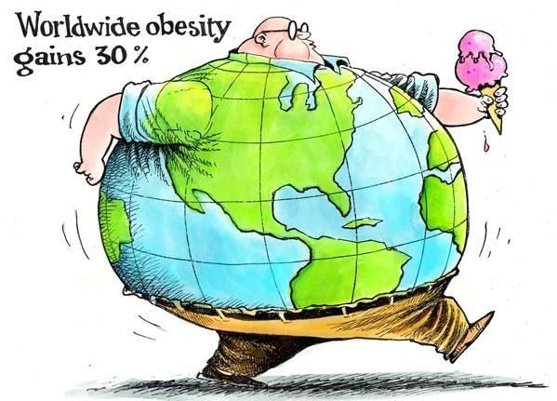
Review on
Obesity Prevention and Management
Osman El-Labban

Slide 2
Obesity…
Major public health affecting all age groups, both genders &
both urban & rural areas
Most prevalent nutritional problems...putting increased burden on the health care system
Prevalence is escalating & affecting almost one-third (2.1 billion) of world population with a prediction of increase to half of the population by 2030
Has adverse effects on patients’ health, psychology, and
socioeconomic status
Obese individuals less productive in work and raise the governmental health care expenditure

Slide 3

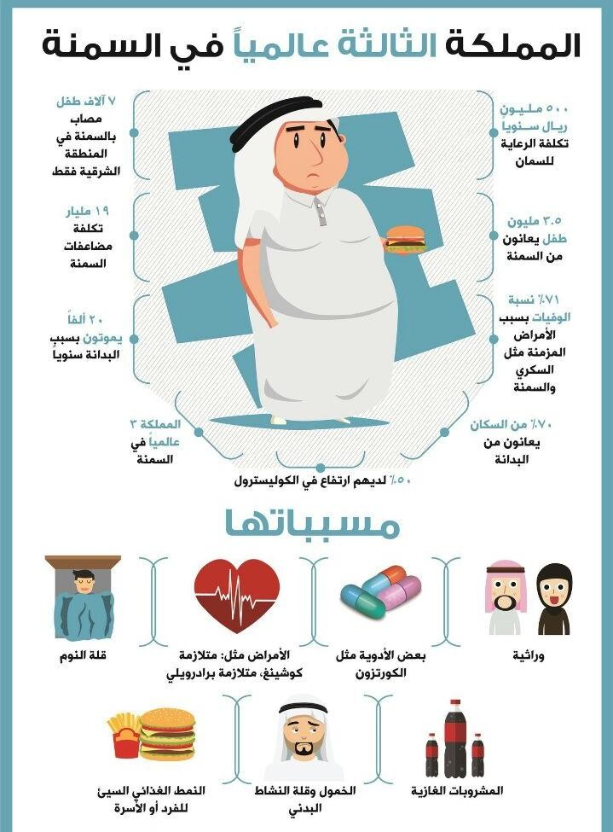
Etiology…
Availability& consumption of larger portions & higher calories of junk foods & sweetened drinks.
Abnormal individuals’ eating
behaviors
Inactivity with sedentary lifestyles
Retention of weight after multiple
pregnancies,
Some endocrine diseases, stress & depression, use of obesogenic drugs
Some genetic syndromes

Slide 4
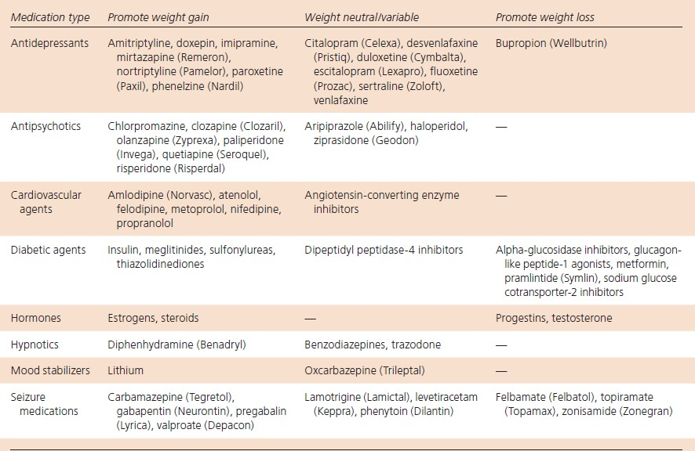
Medications which contribute to weight gain or loss

Slide 5
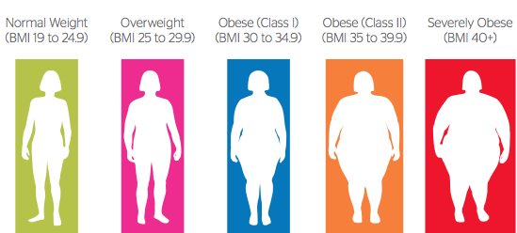
Normal..Over..Obesity I …II….Severe

Slide 6

Adults aged more than 18 years who have a body mass index (BMI) greater than 25 kg/m2
Children & adolescents aged between 2 and 18 years who have BMI greater than the 85th percentile
Overweight: if BMI for age percentile above or equal 85th %
– less than 95th %
Obesity: if BMI for age percentile above or equal 95th%
Infants under 2 years of age who demonstrate rapid weight gain as assessed using growth charts

Slide 7
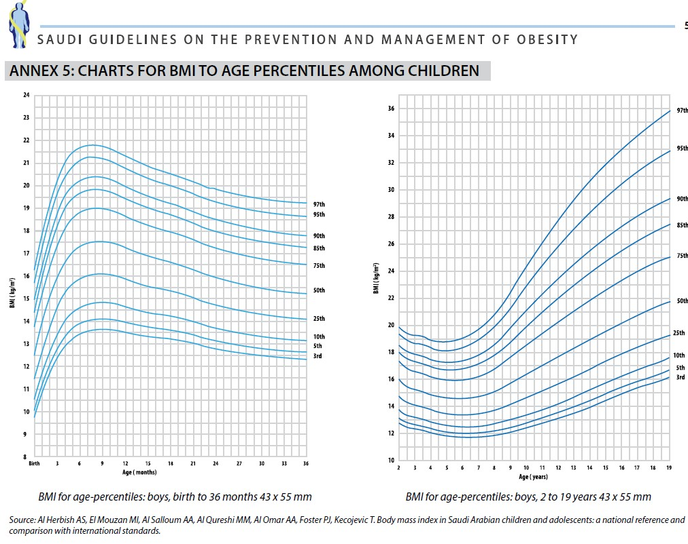

Slide 8
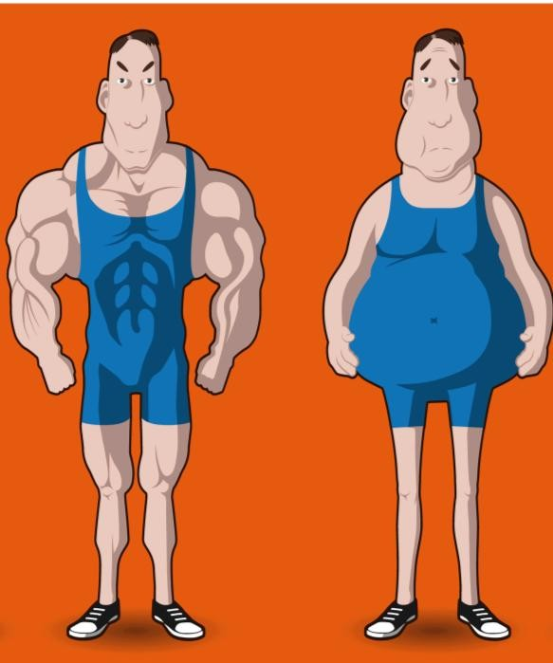
Interpreting BMIs in adults
Individuals with same BMI may have different ratios of body fat to lean mass
Women have more body fat than men at
equivalent BMIs
People lose lean tissue with age so an older person will have more body fat than a younger one at the same BMI
South Asian,Chinese and Japanese population groups may have more body fat at lower weights and be at greater risk of ill-health than people from other population groups. Hence, lower BMI threshold (e.g. > 23 kg/m2) may be considered
Athletes have a lower proportion of body fat &
more muscles (higher BMI threshold considered)

Slide 9

Assess abdominal fat & risk of co-morbidities
Measure waist circumference (WC):
Males with WC ≥102 cm and females with WC ≥88 cm are at high-risk)
For South Asian, Chinese and Japanese adults, thresholds of ≥ 90 cm for men and ≥ 80 cm

Slide 10

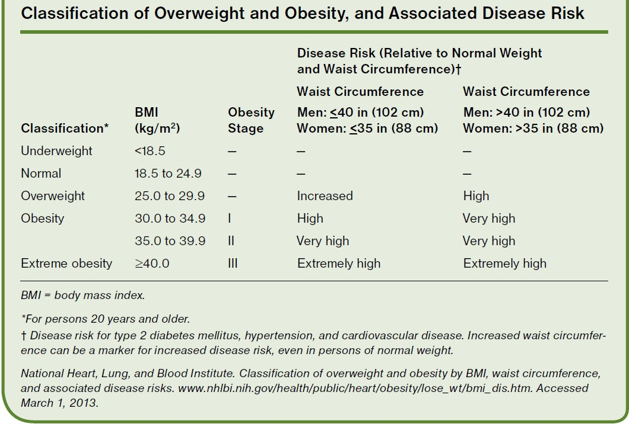

Slide 11

Family Physician’s Role
Physicians should screen all patients for
obesity with measurement of body mass index (BMI) or
waist circumference.
USPSTF recommends that all persons 18 years and older AAFP recommends screening for obesity followed by intensive counseling and behavioral interventions, with at least one session per month for at least three months
Diet and behavioral interventions should be initiated in patients who are obese
Assist in setting weight loss goals, improving nutrition, increasing physical activity, addressing barriers to change, and developing strategies to maintain long-term lifestyle changes.

Slide 12

SCREENING FOR OVERWEIGHT AND
OBESITY
Hypertension.
Diabetes.
Dyslipidemia.
Smokers who cessation.
Patient on insulin, lithium, anti-diabetes drugs, sodium valproate, steroids, oral contraceptives, hormone replacement therapy, tricyclic antidepressant, and beta blockers.
Family history of obesity.

Slide 13

Primary Prevention of Obesity
A. Guideline for healthy eating
Exclusive Breastfeeding below 6months
Follow specific dietary requirement
Provide 3 meals &2 between-meal snacks
Encourage eating breakfast meal
Follow the 5-2-1-0 message
B. Guideline for physical activity
Encourage children/young adults to perform at least 60 minutes of moderate to vigorous exercise daily
Encourage adults to do at least 30 min of moderate intensity physical activity on 5 or more days p week

Slide 14
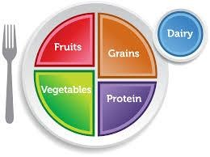
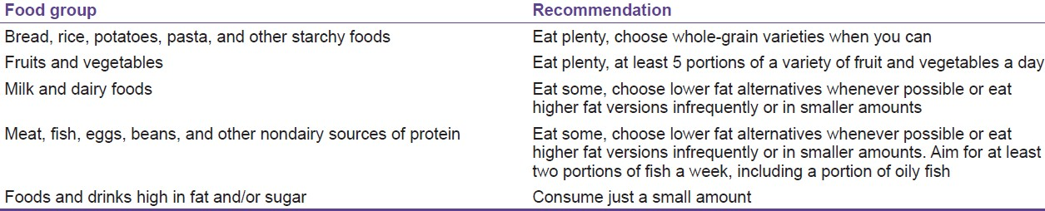
The eat-well plate guidelines
SIGN Guidelines

Slide 15

5 - 2 - 1- 0 Message
5 = Encourage intake of daily 5 rations of fruits &
vegetables
2 = Encourage eating with the child in a sociable atmosphere without distractions, separate eating from other activities and keep recreational screen time to <2 hour,
1 = Include at least 1 hour or more of active play every day
0 = Skip sugar- sweetened beverages and drink more water
every day.
Advise patients using medications associated with weight gain, on weight management
(ICSI, strong recommendation, high quality evidence)

Slide 16
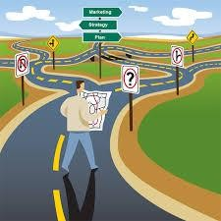
Office Approach Roadmap
Diagnosis & classify Obesity adults (measure BMI )
& compare BMI to age percentile in children)
Assess for co-morbidities & underlying Causes
Conduct clinical & laboratory investigation, if needed
Assess patient readiness to change
Setting weight loss goals in children & adults
Lifestyle Modification Program: Diet, physical Activity & psychological (behavior Interventions)
Weight Maintenance & prevention of weight gain
When to Consider pharmacotherapy
When to consider bariatric Surgery

Slide 17

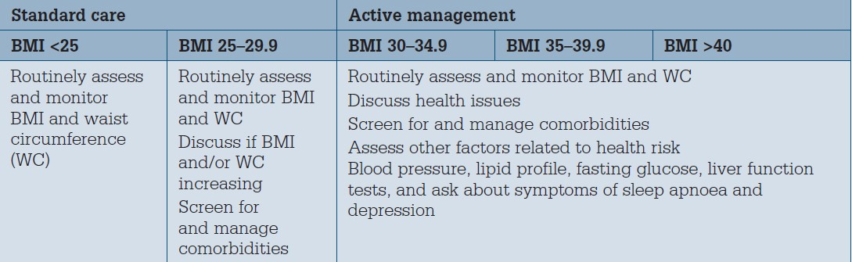
Weight management

Slide 18
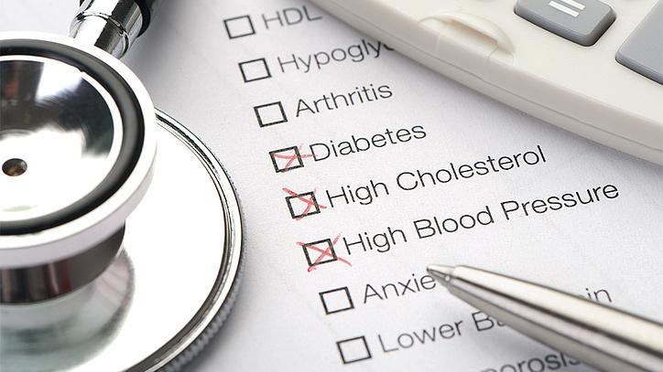
Co-morbidities
Type 2 diabetes,
Hypertension,
Hyperlipidemia,
Obstructive sleep apnea,
Nonalcoholic fatty liver disease,
Debilitating arthritis, or
Impaired quality of life

Slide 19
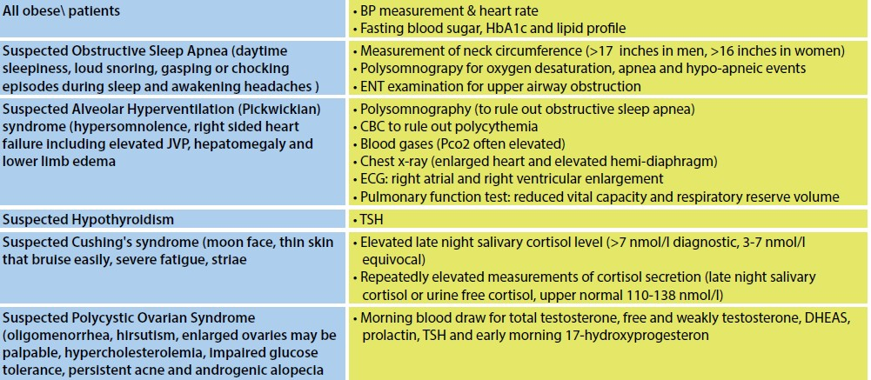
Diagnostic Evaluation

Slide 20

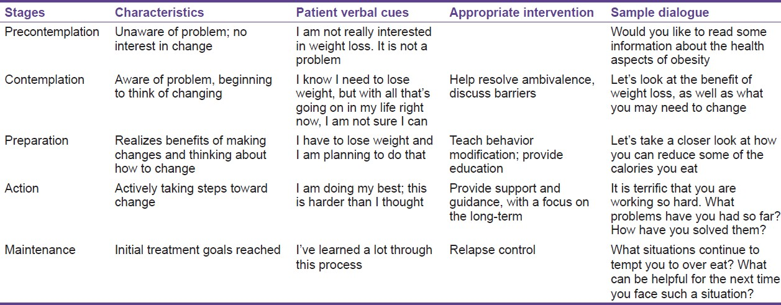
Assess Readiness to
Change

Slide 21

Goals of Weight Loss of obese Patients
Prepubertal :Weight maintenance rather than weight loss.
Postpubertal: weight loss rather than weight maintenance
For adults with BMI 25-35 Kg/m2 the target is to lose 5- 10% of body weight (0.5-1 Kg/week)
For adults with BMI above 35 Kg/m2 and obesity-related comorbidities, the target is to lose above 15-20% of body weight
Modest weight loss of 5–10% of starting weight can result in significant health benefits, with substantial weight loss offering even greater improvements in obesity related
comorbidities

Slide 22
Weight management in adults
Dietary interventions in adults for weight loss: should be
calculated to produce a 600 kcal/day energy deficit
Physical activity in adults: equal 1,800-2,500 kcal/week corresponding to 225-300 min/week of moderate intensity physical activity (achieved through 5 sessions of 45-60 min/week or lesser amounts of vigorous physical activity)
Pharmacological treatment in adults: Patients with BMI
≥27 kg/m2 (with comorbidities) or BMI ≥30 kg/m2
Bariatric Surgery in Adults: BMI ≥35 kg/m2 & presence of one or more severe comorbidities, BMI ≥ 40 kg/m2 and Adults, with a BMI >30 kg/m2 with poorly controlled type 2 diabetes and high risk of CVDs.

Slide 23

Diet & Motivation
A deficit of at least 500 kcal per day can be achieved with intake of 1,200 to 1,500 kcal for women and 1,500 to 1,800 kcal for men.
Multiple studies have shown that motivational interviewing can modestly enhance the effects of a weight-loss program
[–1.5 kg]; and it can be readily used by primary care physicians

Slide 24

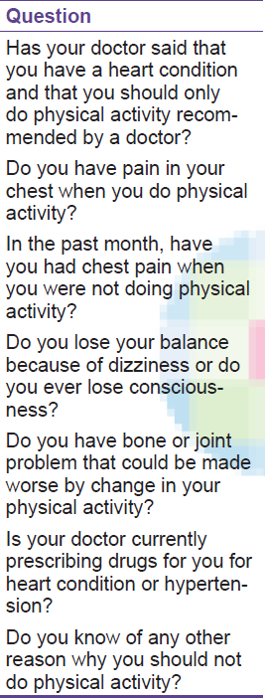
The physical activity readiness questionnaire (PAR-Q)
Check any contraindications to exercise using physical activity readiness questionnaire (PAR-Q)
*If patient answered yes to one or more questions, doctor should ensure that patient can do physical activity without harm or risk and to choose the appropriate type of physical activity for the patient.
*If patient answered “no” to all questions, he
can practice physical activity

Slide 25

Physical activity in adults
Check any contraindications to exercise using physical activity
readiness questionnaire (PAR-Q)
Volume of physical activity equal to approximately 1,800-2,500 kcal/week.
Corresponds to approximately 225-300 min/week of moderate
intensity physical activity
Achieved through 5 sessions of 45-60 min/week in one or multiple small sessions
Moderate intensity: heart rate is in the range55-70% of age- predicted maximum (220 minus age)
Vigorous intensity: heart rate is 70-90% of age-predicted
maximum

Slide 26
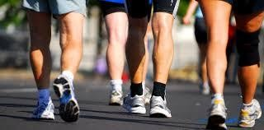
Walking & Other exercises
Weight-bearing physical activity
Walking one km (0.62 miles) on flat ground burns approximately 60 kcal for a 70 kg person and 90 kcal for a 100 kg person
Those with joint problems gradually increase non-weight- bearing moderate intensity physical activities (e.g., cycling, swimming, water aerobics

Slide 27
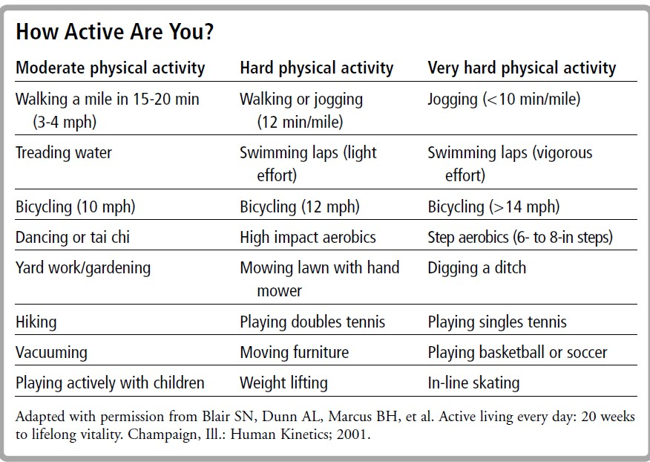

Slide 28

secondary/ Tertiary Care
Eating disorders
Poor body image
Depression and anxiety,
Presence of co-morbidities (e.g., sleep apnea, orthopedic problems, risk factors for CVD or type 2 diabetes, and psychological distress)
Suspected underlying medical or endocrine cause
Concerns about height and development
Referral to pharmacologic or bariatric surgery may be considered in post pubertal adolescents, with severe obesity (a BMI >40 kg/m2 (or >35 kg/m2 with obesity-related complications) who failed to respond to lifestyle interventions

Slide 29
Pharmacologic treatment / Bariatric Surgery
Pharmacologic treatment as an adjunct to lifestyle
BMI >30 kg/m2 or
BMI >28 kg/m2 with co-morbidities or
Adults who are not attaining, or unable to maintain clinically important weight loss with dietary and exercise therapy
Bariatric surgery is a consideration :
BMI > 40 kg/m2.
BMI > 35 kg/m2 and co-morbidities not adequately improved
with the lifestyle intervention.
BMI > 30 kg/m2 with poorly controlled type 2 diabetes and high risk of cardiovascular diseases.
(Canadian, evidence grade B, level 2, SIGN evidence grade A)

Slide 30

Pharmacologic treatment
Patients who have not achieved weight loss goals with diet and lifestyle changes, and after an extensive discussion of the risks and benefits
Despite their indication for long-term therapy, the optimal duration of treatment is unclear; the available evidence was limited to one to two years.
Multiple sympathomimetic agents, including phentermine, are approved for short term treatment (less than 12 weeks)
Review effect of medications prescribed for concomitant conditions may have on a patient’s weight

Slide 31
Indications for Pharmacotherapy
BMI >30
General cut off BMI for FDA Approval for Weight Loss Medications
BMI >27 with
complication
Type 2 Diabetes
Hypertension
Dyslipidemia
Obstructive Sleep Apnea
Nonalcoholic Fatty Liver Disease
Degenerative Joint Disease

Slide 32


FDA Approved Duration
Treat For Twelve Weeks at full dose.
For Medications that are titrated,
this means 12 Weeks
after Titration to Final Dose has been Achieved.
If you Don’t Lose 5% of Body Weight after 12 Weeks— Stop the Medication (4% for Liraglutide, Saxenda at 16 Weeks)

Slide 33

Weight loss pharmacotherapy Studies
In the 15 studies of orlistat (Alli, Xenical), the percentage of patients achieving clinically meaningful (at lea 5%) weight loss ranged from 35% to 73%.
With lorcaserin (3 studies), 37% to 47% of patients achieved clinically meaningful weight loss.
With phentermine 15 mg-topiramate 92 mg, 67% to 70% of patients had weight loss of at least 5% in each of two studies.
st

Slide 34
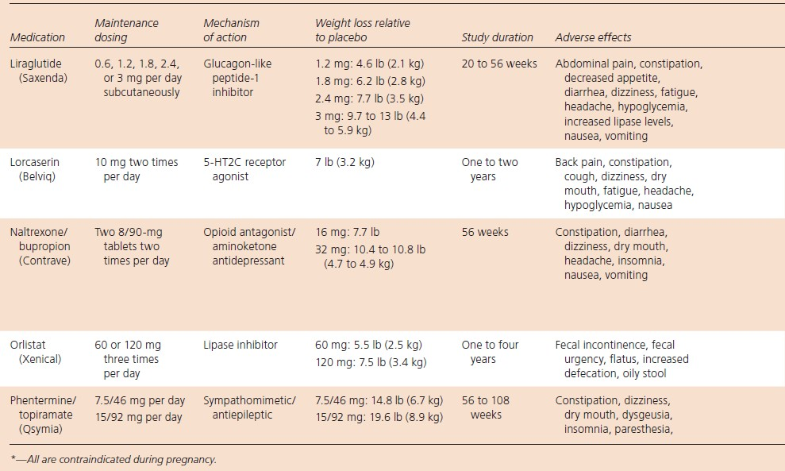
Pharmacologic treatment

Slide 35
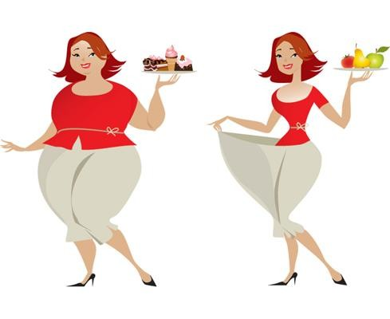
Selection Criteria for Bariatric Surgery
Able to adhere to postoperative
care
BMI ≥ 40 kg per m2 without coexisting medical conditions
BMI ≥ 35 kg per m2 and one or more severe obesity-related comorbidities
BMI 30 to 34.9 kg per m2 with diabetes mellitus or metabolic syndrome (evidence is limited)

Slide 36
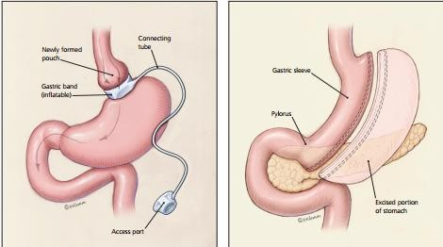
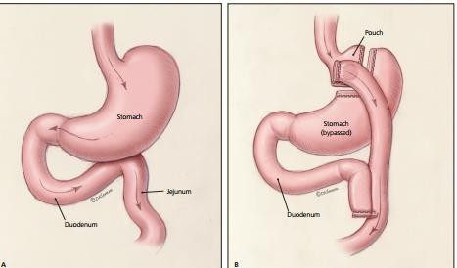
Types of Bariatric surgeries
Adjustable gastric banding involves inserting an inflatable ring, which can be adjusted via a subcutaneous access port.
Laparoscopic sleeve gastrectomy involves removing most of the body of the stomach, creating a narrow gastric structure
Normal Stomach, duodenum, and jejunum before bariatric surgery 4- Stomach, duodenum, and jejunum after Roux-en-Y gastric bypass
American Family Physician www.aafp.org/afp Volume 93, Number 1 , January 1, 2016

Slide 37
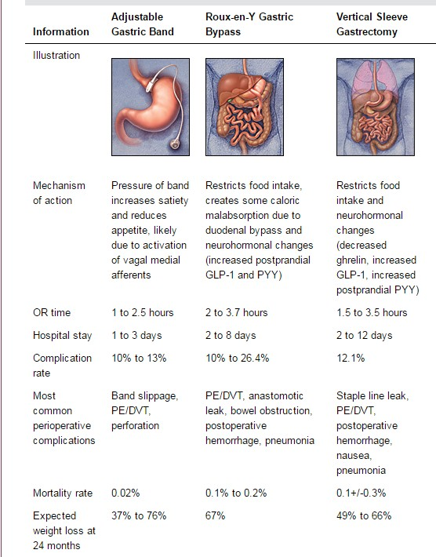

Slide 38
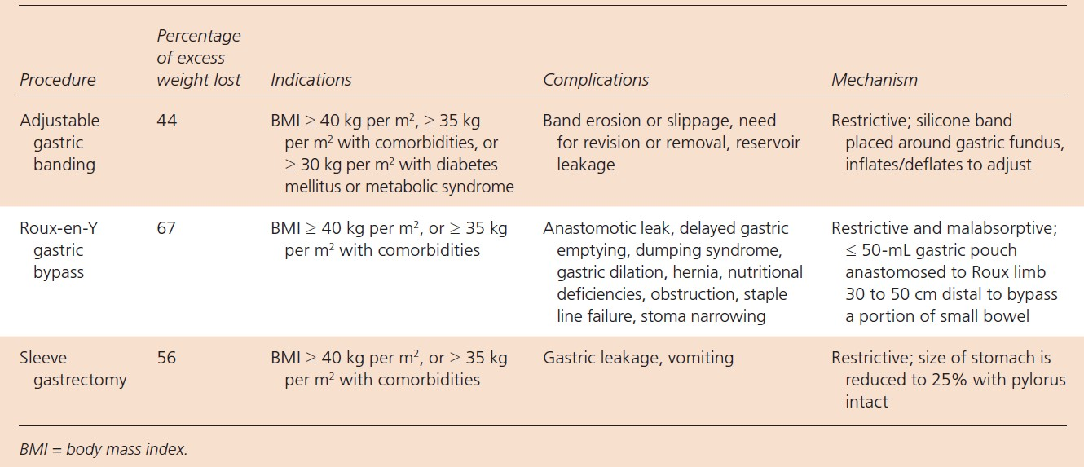
Common Bariatric Surgeries

Slide 39

Pathophysiology
Restrictive, malabsorptive or a combination
Improvements in blood glucose levels, dyslipidemia & co- morbidities occur earlier than can be fully explained by the actual weight loss.
Levels of glucagon-like peptide-1 and peptideYY, which are secreted by intestinal L cells, increase after Roux-en-Y gastric bypass and laparoscopic sleeve gastrectomy procedures

Slide 40

Dramatic improvement
of type 2 diabetes
Levels of glucagon-like peptide-1 and peptideYY, increase after Roux-en-Y gastric bypass & sleeve gastrectomy procedures.
Glucagon-like peptide-1 enhances insulin secretion
PeptideYY increases satiety and delays gastric emptying through receptors in the central and peripheral nervous systems.
Ghrelin, secreted primarily by the gastric fundus and proximal small intestine, acts via the hypothalamus to stimulate appetite and suppress energy expenditure and fat catabolism.

Slide 41

Follow-up After Bariatric Surgery
Adjust postoperative medications
Avoid nonsteroidal anti-inflammatory drugs
Avoid pregnancy for 12 to 18 months
Bone density measurement with dual energy x- ray absorptiometry at 2 years Laboratory studies (e.g., complete blood count, complete metabolic profile, folic acid, iron studies, intact parathyroid hormone level, lipid profile, vitamin B12, 24- hour urinary calcium excretion, 25- hydroxyvitamin D)
Monitor adherence to dietary, behavioral, and physical activity recommendations

Slide 42
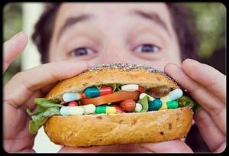
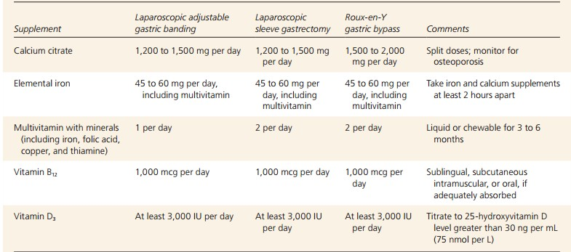
Supplementation After Bariatric Surgery

Slide 43
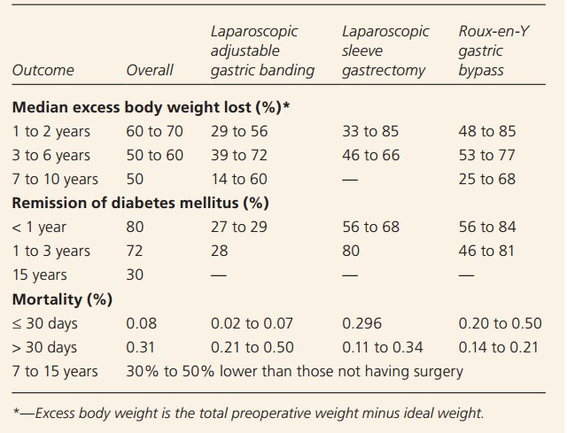
Comparison of Outcomes for Bariatric
Surgical Procedures
January 1, 2016 ◆ Volume 93, Number 1 www.aafp.org/afp American Family Physician

