Slide 1
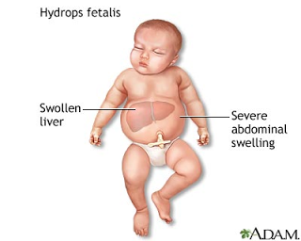

ABO AND RHESUS D BLOOD GROUP AND HAEMOLYTIC DISEASE of THE NEWBORN IN SOKOTO SPECIALIST HOSPITAL, NIGERIA
Prof. Erhabor Osaro
Faculty of Medical Laboratory Science, Department of Haematology and Blood Transfusion

Slide 2
Outline
Introduction
Statement of the problem
Justification
Aim and Objectives
Study Design
Materials and Methods
Statistical Analysis
Results
Discussion
Conclusion
Recommendation
References

Slide 3
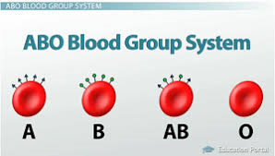
Introduction
The ABO blood group system is the most clinically significant system.
The Rh blood group system is the 2nd most clinically significant blood group (D, C, c, E and e).
Of these, D antigen is very important in transfusion and most common cause of HDFN
HDFN is associated with the transplacental passage of maternal ABs into foetal circulation resulting in immune haemolysis of foetal/neonatal red cells.
The implicated antibodies could be naturally occurring (anti-A, anti-B) or immune antibodies
Immune Abs often develop following a sensitizing event like transfusion or pregnancy.
The haemolytic process result in anaemia & hyperbilirubinemia (foetal/neonatal morbidity and mortality).
Before the discovery of the Rh IG, HDFN due to anti-D was a significant cause of perinatal mortality.
Administration of Rh IG to Rh(D) negative women during pregnancy & after delivery has reduced the incidence of Rh D HDFN (Liumbruno et al., 2010).
ABO incompatibility is now the single largest cause of HDFN in the western world (Roberts, 2008).
Detection & follow up of HDFN is necessary to reduce negative impact on newborn (Cheesbrough, 2006).

Slide 4
Introduction
HDFN affects an estimated 3 -80 in 100,000 patients annually (Joe et al., 2000).
Before the establishment of anti-D prophylaxis, 1% of all pregnant women developed Rh alloimmunization.
Since the advent of routine prophylaxis, incidence of Rh D sensitization has declined from to 10.2 cases per 10,000 total births (Joy et al., 1988).
Alloimmunization due to Kell antigen accounts for 10% of severely affected foetuses.
Currently, anti-D is still the most common ABs followed by anti-K, anti-c and anti-E.
Of the foetuses who require intrauterine transfusions, 85%, 10%, and 3.5% were due to anti-D, anti-K, and anti-c, respectively (Marwaha et al., 2009).
ABO incompatibility frequently occurs during the first pregnancy and is present in approximately 12% of pregnancies
Evidence of foetal sensitization due to ABO incompatibility occurs in 3% of live births.

Slide 5
Statement of the Problem
The spectrum of HDFN has changed in the last decade (immunoprophylaxis).
HDFN due to ABO & other Allo Abs has now emerged as major causes.
HDFN due to ABO and Rh D incompatibility is a huge challenge in Nigeria (silently caused a lot of mortality and morbidity in the newborn).
The prevalence of Rh D negativity in Nigeria is lower compared to the West.
Despite this fact, a significant number of women develop anti- D & HDFN.
In the West, Rh neg women having a TOP are offered prophylactic Ig.
Alloantibody testing during pregnancy is not practiced in Nigeria
There is no universal access to prophylactic immunoglobulin D (RAADP).
Following potentially sensitizing event during pregnancy, only pregnant woman who have the affordability gets it .
Those who cannot afford it risk the development of anti-D and HDFN.

Slide 6
Causes of HDFN
Antibodies are produced when the body is exposed to an antigen foreign to the make-up of the body.
If a mother is exposed to a foreign antigen they produce IgG (cross the placenta)
The IgG will target the antigen, if present in the foetus and may affect it in utero and persist after delivery.
3 most common models in which a woman becomes sensitized (produces IgG antibodies) are:
FMH which occurs due to abortion, childbirth, ruptures in the placenta during pregnancy, or medical procedures carried out during pregnancy that breach the uterine wall.
The woman may have received a therapeutic incompatible blood transfusion.
Sensitization model in women of blood type O. A and B Ags are widespread in the environment (lead to the production of IgG anti-A and anti-B antibodies).
Women of blood type O are more prone to making IgG anti-A and anti-B antibodies than A &B
About 15% of pregnancies involve a type O mother and a type A or type B child
About 3% of these pregnancies (ABO incompatibility between mum and baby) result in HDFN.

Slide 7
Justification
The knowledge of ABO & Rh D blood groups has proved helpful in the determination of HDFN.
Many literature have been published worldwide on the investigation of HDFN.
However, there is paucity of data on HDFN in Sokoto in particular and Nigeria in general.
This research will potentially provide information required for the evidence- based mgt. and improve the QOL of new-borns with HDFN.

Slide 8
Aim and Objectives
Aim
The aim of this study is to determine the ABO and Rhesus D blood group and HDFN among newborn in Specialist Hospital Sokoto.
Specific Objectives
To determine the ABO and Rh D blood group among mothers and neonates delivered in Sokoto Specialist Hospital.
To determine the prevalence of ABO and Rh D HDFN in Specialist Hospital Sokoto.
To determine the prevalence of complement & IgG antibody-related HDFN among newborn in Specialist Hospital Sokoto.

Slide 9
MATERIALS AND METHODS
THE STUDY AREA
This study was carried out at Specialist Hospital Sokoto, Nigeria.
The Hospital is situated in Sokoto North Local Government Area within Sokoto city.
Sokoto State is located in the extreme Northwest of Nigeria with annual average temperature of 28.30 ⁰C (82.9 0 F).
Sokoto is a very hot area. Maximum temperatures can get to 40⁰C (104OF).
The population of Sokoto was 3.6 million (NPC/NG, 2006).

Slide 10
Inclusion and Exclusion Criteria
INCLUSION CRITERIA
Inclusion criteria include; Mothers and babies delivered in Sokoto Specialist Hospital and willingness of mothers to provide informed consent to participate in the study.
EXCLUSION CRITERIA
Mothers and babies not delivered in Sokoto Specialist Hospital & mothers who refused to offer informed consent to participate were excluded from the study.
INFORMED CONSENT
Written informed consent were obtained from the mothers after counselling.
ETHICAL CONSIDERATION
Ethical approval for this study was obtained from the Research and Ethical Committee of Specialist Hospital Sokoto.

Slide 11
Study Design and Statistical Analysis
Study Design
The present study was a descriptive case study of ABO and Rh D blood group and HDFN among New-born in SSH.
Statistical Data Analyses
Socio-demographic data was collected using a questionnaire and entered into the Excel speed sheet and analyzed statistically using SPSS Version 20 (SPSS Inc., Chicago, IL).
Statistical significant level was put at p≤ 0.005.

Slide 12
Sample Collection
Two milliliters (2ml) of cord blood from the new-born was collected in to K3EDTA anticoagulated tube
2ml of whole blood of the mother was also collected.
These samples were tested in the service laboratory in the FMLS of Usmanu Danfodiyo University Sokoto.

Slide 13
Analytical Methods
ABO, Rhesus D Blood Grouping and Direct Antihuman Globulin Test was determined using the column agglutination technique using the Ortho Diagnostic ABO and Rh D grouping cards (Ortho Diagnostic, U.S.A).
The Principle is based on the differential passage of free red blood cells and trapping of the agglutinated red blood cells, based on the sieving effect of glass beads, dextran or acrylamide gel.
Ags & Abs react they show agglutination in the column.
On centrifugation, the agglutinated cells will be trapped on top of the glass beads and the unagglutinated cells will form a pellet at the bottom of the tube.

Slide 14
RESULTS
Analyses carried out on 79 samples both from the Mothers and Babies
Blood Group O was the most prevalent among the Mothers 44(55.7%), followed by group A 22 (27.8%), B 12 (15.2%) and AB 1(1.3%).
For the babies the same pattern was observed with group O 36 (45.6%), A 21(26.6), B 20 (26.3%) and AB 2 (2.5%).
Among the neonates, Rh D positive has the highest frequency of 57(72.2%) and Rh D negative with a frequency of 22 (27.8%).
Rhesus D group distribution among the mothers indicated that 74 were Rhesus D pos (93.7%) and only 5 were grouped as Rh D neg (6.3%).
HDFN status, indicated that 4 neonates were positive (5.1%) & 75 were negative (94.9%).
ABO incompatibility was responsible for HDFN in 2(50%) while Rh D incompatibility was 2 (50%).
HDFN based on the antibody responsible indicated that anti-complement Abs (Anti-C3d) in 2 (2.5%) while IgG- mediated HDFN was seen in 2 (2.5%).

Slide 15
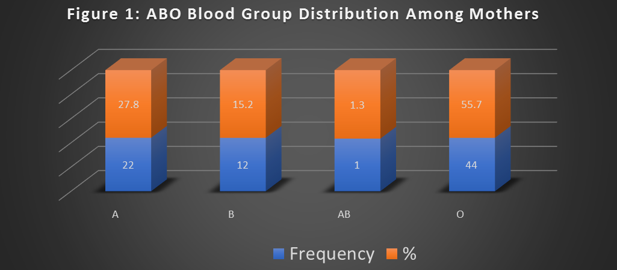

Slide 16
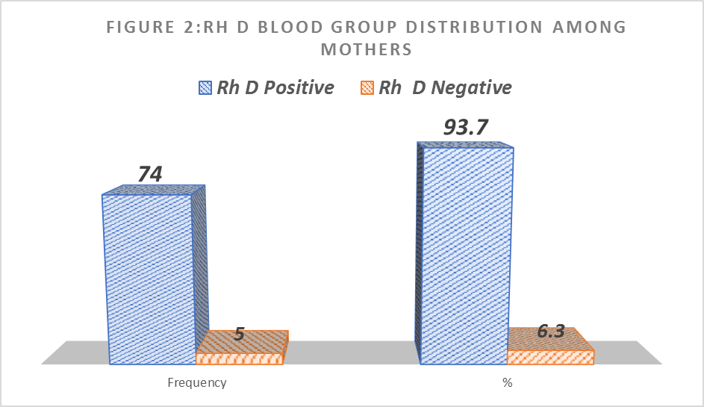

Slide 17
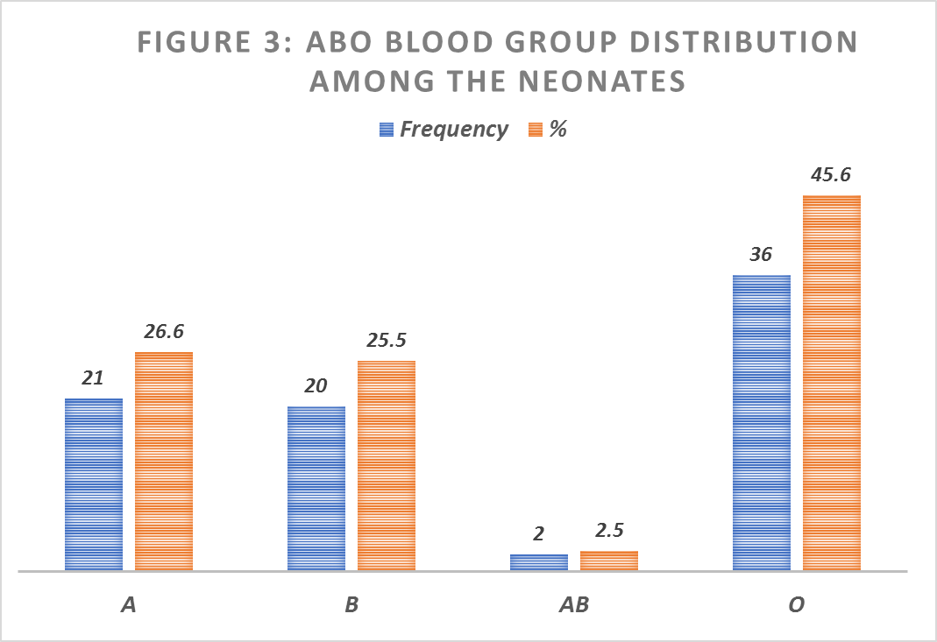

Slide 18
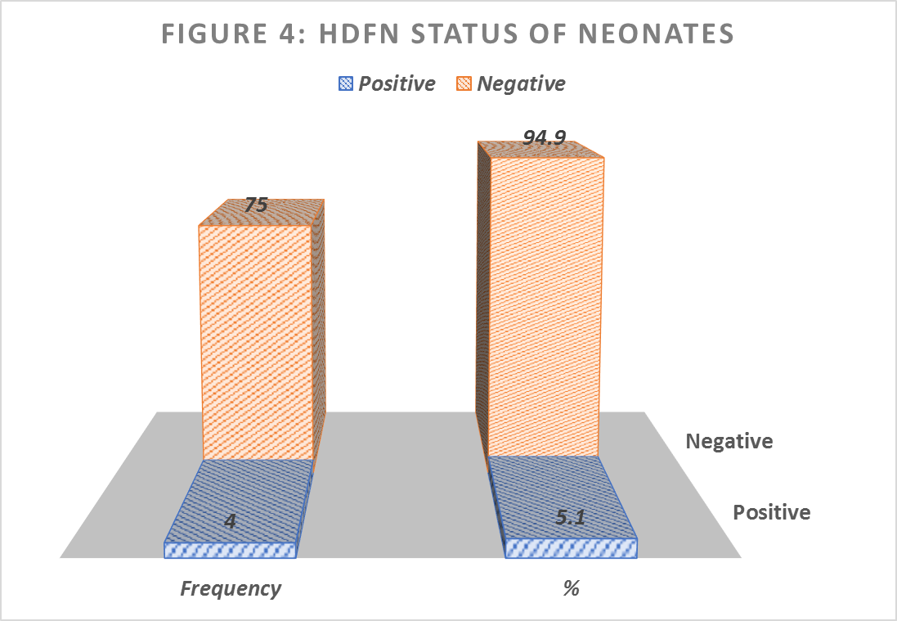

Slide 19
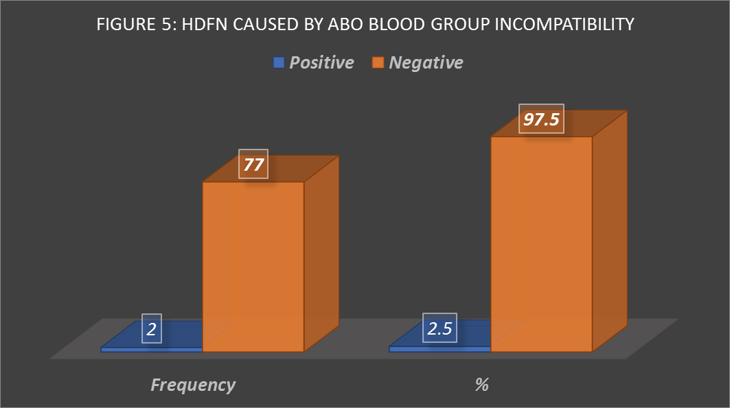

Slide 20
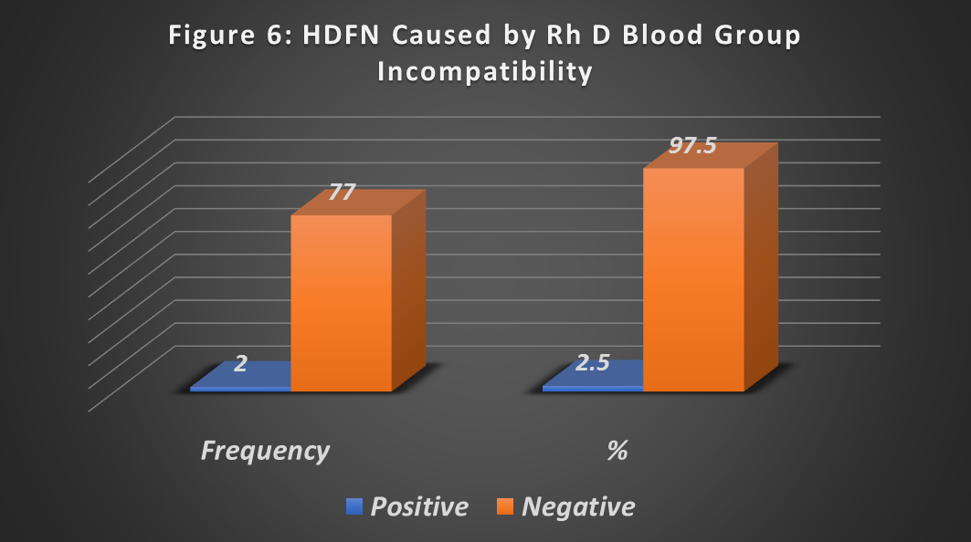

Slide 21
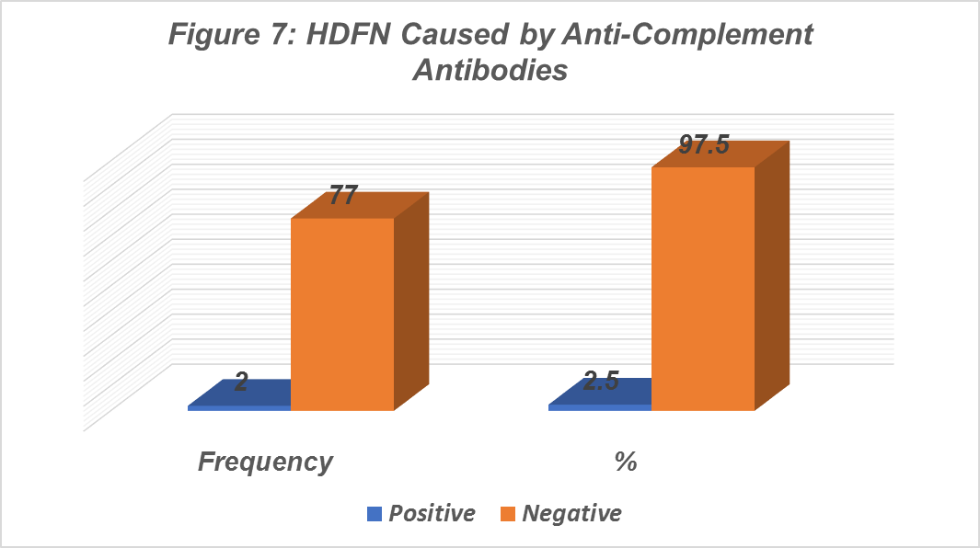

Slide 22
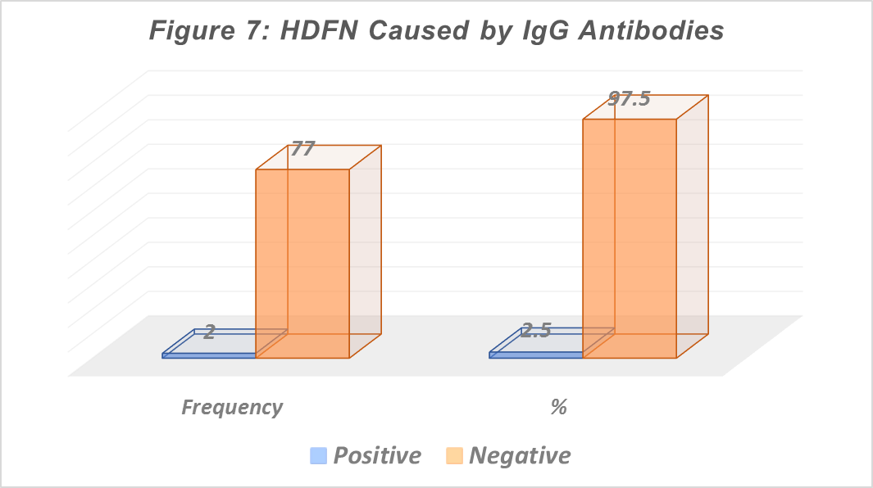

Slide 23
Discussion
ABO Blood group distribution among mum and neonates followed the pattern O>A>B>AB. This finding is consistent with previous reports in other parts of Nigeria and among American Blacks which showed that group O was the commonest ABO blood group (Erhabor et al., 2010; Jeremiah, 2006; Omotade et al., 1999; Worlledge et al., 1974 and Las et al., 2008).
However, some exception to this rule was observed among the Gwarri tribe of Abuja and the Rubuka tribe of Plateau State of Nigeria in which group B was the predominant group over O (intra- family marriages is common among these tribes).
Our finding is at variance with a study in Pakistan which indicated that group B was the predominant blood group (Khattak et al., 2008).

Slide 24
Discussion
We observed prevalence of Rh D negativity of 6.3% among the mothers and 27.8% among the neonates.
Our finding among the mothers is consistent with previous reports obtained among non-Caucasians which indicated Rh D negativity of less than 10% (Erhabor and Colleagues,2013; Egesie and Colleagues, 2009; Ukaejiofor and Colleagues, 1996; Jeremiah, 2006; Adeyomo and Soboye, 2006; Bakare et al., 2006; Pannap et al., 2011; Pramanik and Colleagues, 2000; Mwangi, 1999; Bashwari et al., 2001; Loua et al., 2007 and Sarhan and Colleagues, 2009.

Slide 25
Discussion
The direct antiglobulin test (DAT) is the cornerstone of the diagnosis of HDFN. In this current study, we observed HDFN status associated with a positive DAT among 4 neonates tested (5.1%).
Our finding is consistent with a previous report among 2,695 neonates which indicated a pos DAT in 2.59% (Valsami et al., 2015).
Our finding is also consistent with a previous report among 1,944 neonates in China and showed that 3.4% HDFN (Wan, 1991).
The clinical records of all newborn babies over a 6-month period in a previous report indicated a pos DAT in 5.5% of cases (Dinesh, 2005).

Slide 26
Discussion
2.5% cases of the HDFN were due to ABO incompatibility between mum and baby.
Our finding is also consistent with a previous reports that HDFN due to ABO incompatibility is common (Cariani et al., 1990; Usanga and Akwiwu, 1990 and Cwik, 1988).
Our finding is also consistent with previous report (Feng et al., 1990) in Hong Kong which indicated that two combinations (O-A and O-B mother-infant pairs) were commonly responsible for ABO-HDN.
Similarly, among 1608 baby-maternal pairs who were typed for ABO, Rh, DAT in Singapore, 251 were ABO incompatible & incidence of HDFN due to ABO incompatibility was 3.7% of all group O mothers (Han et al., 1988).
Similarly, a previous report on 1537 ABO-incompatible births indicated that DAT was more commonly positive among BO incompatible (21.5% in BO vs. 14.8% in AO, P=0.001) and Black (18.8% in Blacks vs. 10.8% in non-Blacks, p=0.003). infants (Özgönenel et al., 2015).

Slide 27
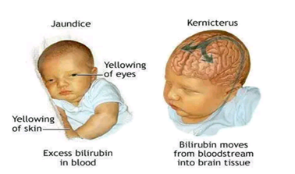
Discussion
We observed that 2.5% cases of the HDFN were due to Rh D blood group incompatibility between mum and baby.
Incidence of Rh disease in a population is a fxn of the prevalence of Rh negativity (Houston et al., 2015; Okwundu and Afolabi, 2013 and Erhabor and Adias, 2010).
Many non-Caucasian people have a very low proportion of Rh negativity, so the incidence of Rh disease is suppose to be very low in these populations.
In Caucasian populations about 1 in 10 of all pregnancies involve Rh neg woman with a Rh pos baby.
Rh Ig has decreased the prevalence of anti- D associated HDFN (Moise, 2008).
Anti-D HDFN is responsible for the most severe cases (foetal anaemia, risk for foetal death and severe hyperbilirubinaemia with a risk for kernicterus (de Haas et al., 2015).

Slide 28
Discussion
We observed among the 4 cases of HDFN that 2 cases (2.5%) of due to complement coating on the foetal red cells while 2 (2.5%) were due to IgG antibody coating.
DAT that is reactive only with anti-C3d (-C3b) may indicate cold agglutinin syndrome.
Reactions with polyspecific and/or anti-IgG AHG only may indicate a HDFN.

Slide 29
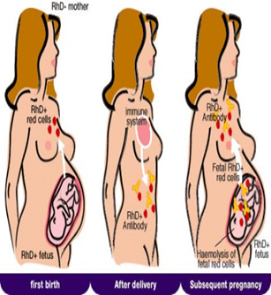
Conclusion
Findings from this study indicates that HDFN due to ABO and Rhesus D incompatibility between mothers and their babies is prevalent in Sokoto, North Western Nigeria.

Slide 30
Recommendations
Universal antenatal screening in all pregnant women need to be initiated aimed at detecting maternal alloimmunization early in pregnancy to facilitate the identification of high-risk cases & allow for a timely start of antenatal and postnatal treatment (de Haas et al., 2015).
A close follow up throughout pregnancy is required to detect irregular Abs.
There is need to improve the human and material endowment of hospitals in the area to enable an evidenced based management of children affected by HDFN.

Slide 31

Acknowledgement
I am grateful to my co-investigators:
Saleh Ribah Ati
Mr. Abdulrahman Y
Dr. Bello Umar Tambuwal
Isaac Zama

Slide 32


Slide 33
References
Alfred von Decastello and Adriano Sturti, (1902); AB blood group pattern. Australian and New Zealand Society of Blood Transfusion Limited, (3rd edition, 2007). Guidelines for blood grouping and antibody screening in the antenatal and perinatal setting
Altunyurts, S., Okyay, E., Saatil, B., Cambahishov, T. and Demir, N. (2012). Neonatal outcome of fetuses receiving intrauterine transfusion for severe hydrops complicated by Rhesus haemolytic disease. International Journal of Obstetrics and Gynaecology; 117:153-156.
Basu, S., Kaur, R., Kaur, G. and Jain, S. (2011). Severe hemolytic disease of the newborn due to non-Rh D antibody. Indian Journal of Paediatrics; 78(3):366-367.
Bethesda, D.L. (2005). Haemolytic disease of the Newborn; National Centre for Biotechnology Information (US).
Bowman, J.M. (1999). Haemolytic disease (Erythroblastosis Fetalis). In Creasy, R.K. and Resnik, R. Maternal-fetal Medicine 4th edition Philadelphia; W.B., Saunders: 736-767.

Slide 34
References
Chavez, G.F, Mulinare. J. and Edmonds L.D (1991). Epidemiology of Rh hemolytic disease of the newborn in United States. Journal of American Medical Association; 265:3270-3274.
Creasy, R.K. and Resnik, R. (2014). Maternal-Fetal Medicine; Principles and Practice. 6th edition. Saunders Publishers:479-495.
Delaney, M. and Mathews, D.C. (2015). Haemolytic disease of the foetus and newborn managing the Mother, Fetus and newborn; Haematology. American Society of Haematology Education Program;(1); 146-151.
Eder, A.F. (2006). Update on haemolytic disease of the foetus and newborn new information on long-standing controversies. Immunohaematology; 26(4):188-195.
Erhabor, O. and Adias, T. (2012). Blood Transfusion Services in Sub- Saharan Africa. Challenges and Constraints: 38 - 39.
Faranoff, A.A. and Martins, R.J. (2010). Neonatal-Pernatal Medicine; Disease of the fetus and infant; 9th edition. Elsevier:1314-1315
Faranoff, A.A. and Martins, R.J. (2010). Neonatal-Perinatal Medicine; disease of the fetus and infants, 9th edition. Elsevier: 1478-1480.

