Slide 1
Importance and Applications of
Infinite Dimensional
Non-Orthogonal Quantum State
International Conference on Quantum Physics and Nuclear Engineering
March 14-16, 2016 London, UK
Osamu Hirota
Quantum ICT Research Institute
Tamagawa University, Tokyo
March 15, 2016

Slide 2
Main Topics in Talk
1. Basis of Quantum Optics
Quantum Optical Field
Quantum Entanglement of Q-mode
2. Quantum Information Science :QIS
Basis of QIS
Main Theorems in QIS
3. Applications of QIS
Quantum Methodology/Radar
(Quantum Radar Camera)
2. Quantum Enigma Cipher

Slide 3
Basis of Quantum Optics
Quantum Optical Field
Quantum Entanglement of Q-mode

Slide 4

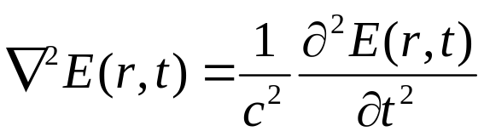

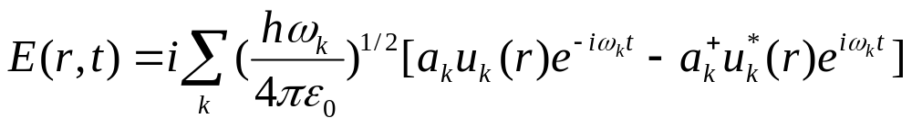
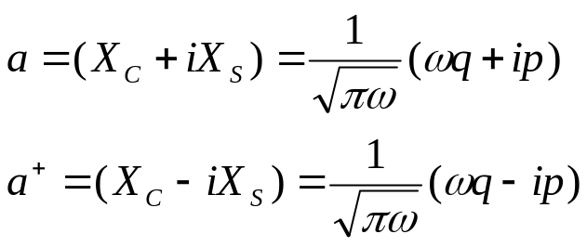
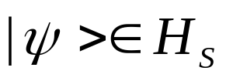

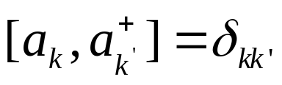
Quantum Optical Field
Glauber unified classical and quantum theory for Optical Field
Quantum mode ( -mode)
Mode function
1.Observable in mode
2. Quantum state in mode=>
Infinite dimensional Hilbert Space

Slide 5
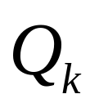

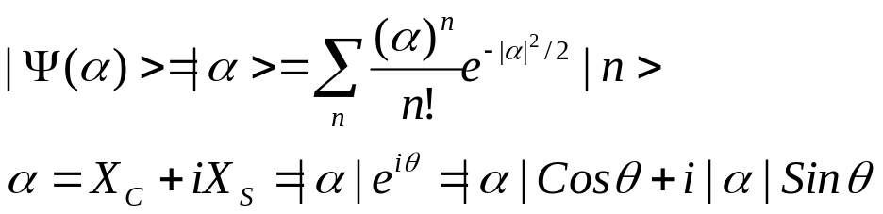

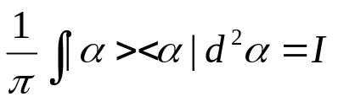
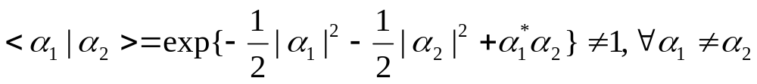
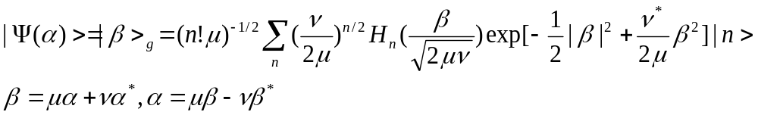
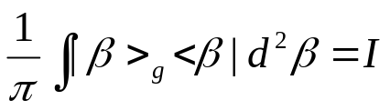
2. Basic quantum state of -mode =Non orthogonal state
2.1 Coherent state
(R.Glauber, PRB-1,1963)
Over completeness
Non-orthogonality
2.2 Two-photon coherent state (Squeezed state)
(H.Yuen, PRA-13,1976)
Over completeness

Slide 6
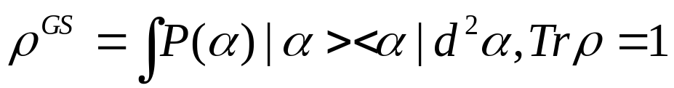
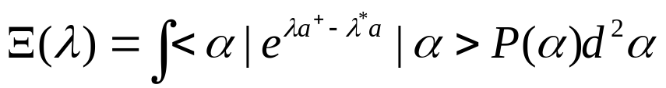
3. Glauber-Sudarshan representation
(R.Glauber, PR-130,1963)
(E.Sudarshan, PRL-10,1963)
First Order Mutual coherence function
Higher Order Mutual coherence function
New Applications

Slide 7
Basis of Quantum Optics
Quantum Optical Field
Quantum Entanglement of Q-mode

Slide 8
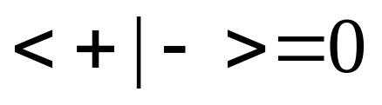
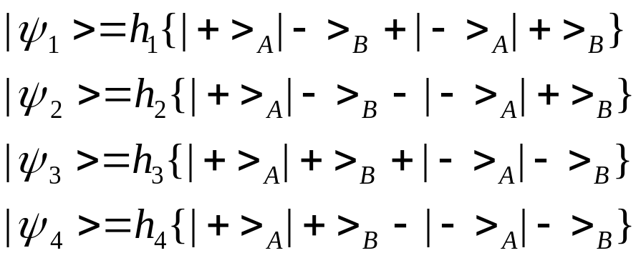
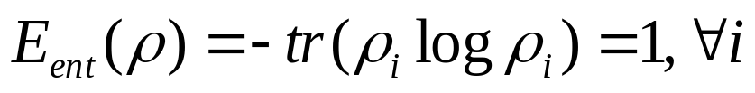
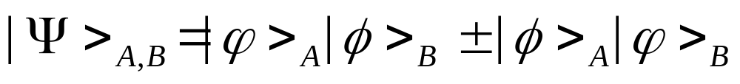
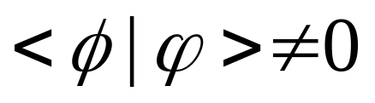
Bell States vs Quasi Bell States (1)
Bell state
Complete Entanglement
Entangled state for non-orthogonal state
In general, it does not have Complete Entanglement

Slide 9
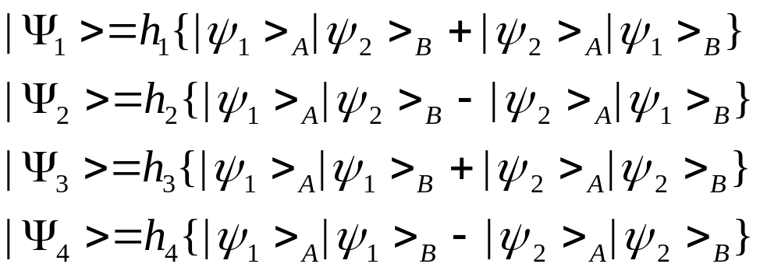
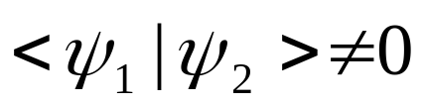
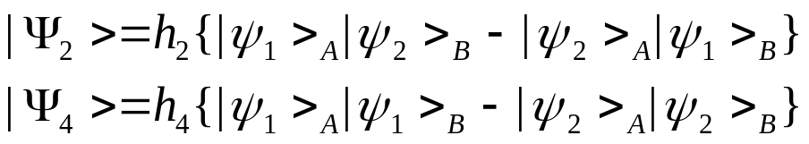
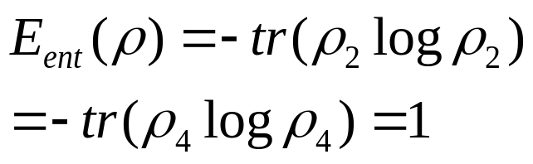
Bell States vs Quasi Bell States (2)
Quasi Bell state based on non-orthogonal state
O.Hirota, Proc. of QCMC, 2000
H-state
Complete Entanglement

Slide 10
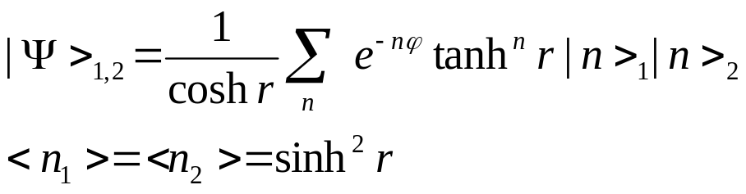
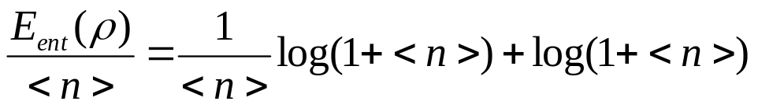


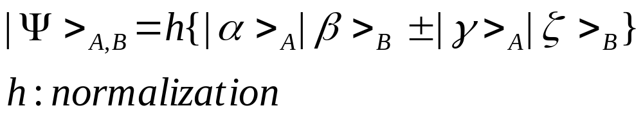
Entanglement of -mode
1. Two mode squeezed state
2. General entangled coherent state
(R.Mecozzi,P.Tombesi, J.Opt.Soc.Am.,1987)
(B.Sanders, PRA-45,1992)
These do not have Complete Entanglement

Slide 11
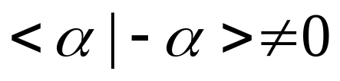
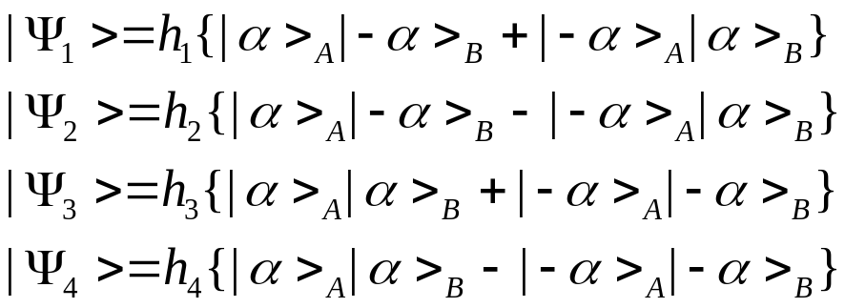
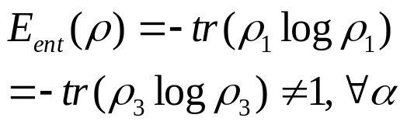
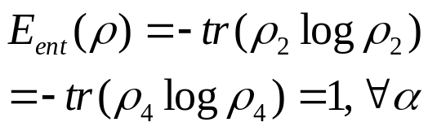
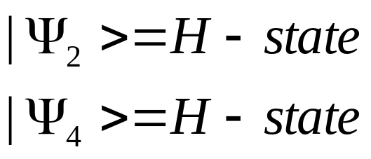
3. Concrete example of H-State in mode
Quasi Bell Entangled Coherent State
O.Hirota, Proc. of QCMC, 2000
Complete Entanglement
More detailed properties of H-state have been given by
S.van Enk, O.Hirota, PRA , vol- 64, 2001

Slide 12
Quantum Information Science
Our Philosophy
All technological functions can be realized by
Classical Physics.
Some functions can be enhanced by
Quantum Physics
QIS supports the realization for
the enhancement

Slide 13
Basis of Quantum Information Science
Microscopic
phenomena
Macroscopic
phenomena
Q-bit
Q-mode
Orthogonal state
Non-Orthogonal state
Strong quantum effect
Weak quantum effect

Slide 14
Main Theorems in
Quantum Information Science
Theorems on non-orthogonal states in QIS
Indistinguishability of non-orthogonal state
by quantum measurement
(C.W.Helstrom 1967, A.S.Holevo 1973, H.P.Yuen 1978, O.Hirota 1982)
2. Channel capacity of Gaussian channel
(A.S.Holevo-M.Sohma-O.Hirota, PRA-59, 1998)
3. No-cloning of non-orthogonal state by Unitary operation
(W.Wootters,-W.Zurek, Nature-229,1982)
4. Quantum data compressing in non-orthogonal states
(B.Schumacher, PRA-51,1995)

Slide 15
Applications of Q-mode
1. Quantum Methodology/Radar
2. Quantum Enigma Cipher

Slide 16
1. Quantum Methodology/Radar
-Applications of Correlation-
Target detection
Quantum Illumination
(entanglement)
noisy case
Quantum Reading
(entanglement)
without noise
Target imaging
Quantum Ghost Imaging
(entanglement, discord)
Quantum Radar Camera

Slide 17

Quantum Illumination
(S.Lloyd, Science-321,2008)
(S-H.Tan et al, PRL-101,2008)
Two mode squeezed light
target
Ａ
signal
External
noise
reference
reflection
Decision
for existence
of target
Entanglement receiver

Slide 18
Quantum Reading (Quantum DVD)
S.Pirandola, (PRL-106,2011) defined the model.
H -state
target
signal
Phase shift
reference
reflection
(Helstrom receiver)
H-State provides
Error Free quantum reading:
There is no effect of Uncertainty
Principle in quantum measurement.
Decision
for phase shift
(O.Hirota, Bulletin of Quantum ICR Research Institute, 2011
and quant-ph arXiv:1108.4163,2011)

Slide 19
Quantum Radar Camera
for Auto Motive
To synthesis moving object under turbulence
Theoretical Back Ground
Quantum (Ghost) Imaging
(A.Belinskii, and D.Klyshko, Sov.Phys.JETP-78,1994)
Full-quantum phenomena
Semi-quantum phenomena
Classical phenomena
(T.Pittman,et al, PRA-52,1995)
(A.Gatti, et al, PRL-90,2003)
(J.H.Shapiro, PRA-78,2008)
Unified theory
(B.Erkmen, J.H.Shapiro, PRA-77,2008)
(N.Hardy, J.H.Shapiro, PRA-84,2011)

Slide 20
Design Theory under Turbulence
Unified Theory for Ghost Imaging through Turbulence
Phenomenological theory
Reformulation by
“Space-Time Quantum Wiener Receiver Theory”
for Quantum Gaussian Space

Slide 21


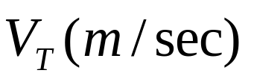



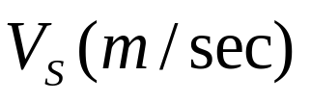
Model of Moving Object under Turbulence
Turbulence
Quasi –Lambert Reflection
Space-Time Wiener
Receiver
Auto motive

Slide 22

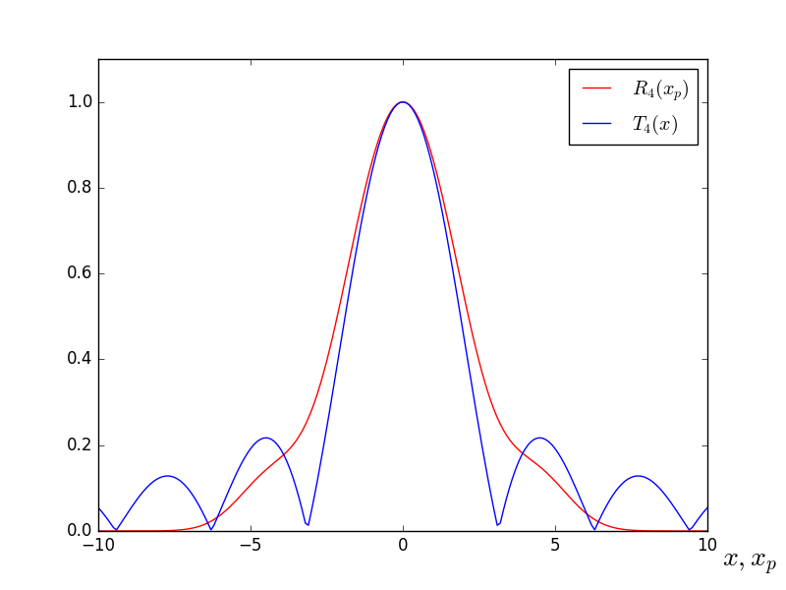
Simulation of Generalized Wiener receiver
Degradation parameter
Length =100 m
Acceptable
in applications
Refractive index
Synthesized flame
Real object flame
The result is not so bad

Slide 23



We can expect to realize Pedestrian
detection
fog
fog
Stereo Camera
Reflected wave
Radar Camera
Source
Image Synthesizer
Monitor
Monitor

Slide 24
2. Quantum Enigma Cipher
Application of Indistinguishability of non-orthogonal state
by quantum measurement
Yuen’s protocol (Y-00 or αη )
Alice and Bob share a priori information such as secret key
Bob can receive coherent state signals without error
with shared a priori information such as secret key
Eve cannot avoid error in her receiving
without shared a priori information such as secret key
Quantum Enigma Cipher (Generalization of Y-00)
With Randomization that enhances the quantum effect
(O.Hirota, K.Kurosawa, Quantum Inf. Processing, vol-6,2007)

Slide 25
Implementation of system
Bob
Alice
Symmetric key cipher
(Old Enigma cipher)
Shared secret key
Shared secret key
Key expansion by
Mathematical function
Key expansion by
Mathematical function
Transmission line
Synchronization to
detection of
non-orthogonal states
as data signals
Randomization of
non-orthogonal states
as data signals
Eve
Secret key and data are
hidden by quantum noise
from un-matched detection
of non-orthogonal states
Complete Error
Error free data

Slide 26
Security of Quantum Enigma Cipher
Sets of Coherent state which convey the data (Plaintext)
are scrambled by Mathematical cipher.
If Eve can receive the correct ciphertext of the mathematical cipher
consisting of coherent state signals, then the security of the system is
equivalent to Mathematical cipher.
But ciphertext of mathematical cipher is hidden by quantum noise
Based on the miss-matched receiver of Eve without initial key.
Thus, the systems exceed the Shannon limit of cryptography.
That is, QEC is stronger than One Time Pad.
Initial key problem: QKD is meaningless, because QKD also requires
initial secret key before it starts.

Slide 27
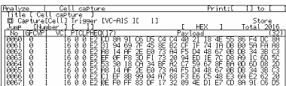
Why do we need Quantum Enigma Cipher
Tokyo
Washington DC
Data rate is 1 Gbit/sec ～100 Gbit/sec
Optical fiber
Protocol
analyzer
Attacker’s Server
Tapping Technology by USA
Storage the whole data
S. V. Kartalopoulos,, John Wiley & Sons.
Decrypted by
Computer or
Mathematical analysis

Slide 28
Protect against Attack
Quantum Enigma Cipher
Washington DC
Tokyo
1 Gbit/sec ～100 Gbit/sec
Optical fiber
Protocol
analyzer
Attacker’s Server
Secret key and data are
hidden by quantum noise
from miss-matched detection
of non-orthogonal states

Slide 29
Thank you for your attention

