Slide 1


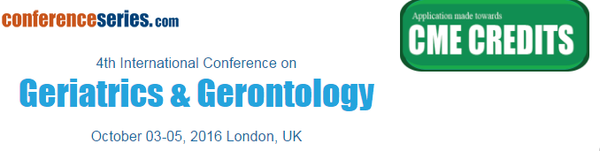
A Pilot Study of the Effect of Chronic Kidney Disease on Steady-State Disposition of Warfarin and Warfarin Alcohols
Osama Alshogran, MS, PhD
Assistant Professor of Clinical Pharmacy
Faculty of Pharmacy
Jordan University of Science and Technology

Slide 2
Outline
Introduction: CKD, PK, elderly
Previous data: preclinical work
Hypothesis & aims
Major conclusions
Acknowledgments
Notes:
I will be starting with brief intro

Slide 3

Chronic Kidney Disease (CKD) Epidemiology
Affects ~26 million Americans
Prevalence:
  13% in all US population
Incidence:
  ESRD: 400 cases/million in the US
Mortality:
  15-20% of ESRD patients die annually
Cost:
  $57.5 billion: annual Medicare costs for CKD - 28% of Medicare spending
http://www.usrds.org/atlas.aspx
Levey, A. S. and Coresh, J. Lancet, 379: 165-80 (2012).
Weiner, D. E. Clin Pharmacol Ther, 86: 566-9 (2009).
Notes:
26 million including ESRD
600,000 have ESRD
87,000 die of ESRD
Demonstrate the burden and significance of CKD, and how important is to improve the treatment strategies and approaches for CKD patients to minimize the adverse effects and cost (achieve optimum outcomes with lower cost).
Individuals 65 years old and older now comprise the most rapidly growing segment of the ESRD population in wealthier countries
40% of adults >60 years have ckd in the US

Slide 4
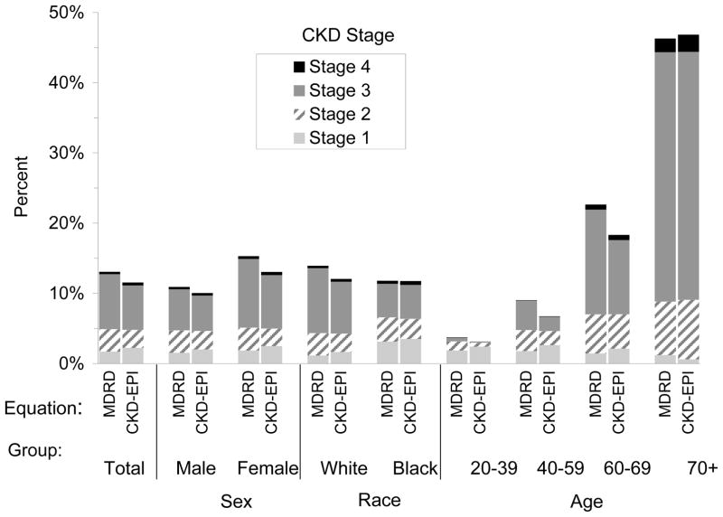
CKD in Elderly
In participants 70 years old and older in the 1999–2004 National Health and Nutrition Evaluation Survey (NHANES), the prevalence of CKD is 46.8% compared to 6.71% in those between 40–59 years of age
Coresh J. Am. J. Kidney Dis. 41, 1-12, 2003
Leavy AS., et al. Am J Kidney Dis. 2009;53(3 Suppl 3):S4-16.
Notes:
in 2006–07 patients 65-years-old or older comprised half of the incident adult US dialysis population
hypertension and diabetes predisposing to a high burden of CKD in this population.
% of US people more than 65 is 12% by 2000, 20% by 2030. In the UK, the elderly account for only one fifth of the population, yet they receive nearly 60 % of the prescribed drugs
Men have more CKD than women and African-Americans are also much more likely to have CKD than whites.
a mean decrease in creatinine clearance as 0.75 ml/min/year, which could be estimated as 10 ml/min/decade in those over the age of 40 years

Slide 5
PK in Elderly
Absorption: decrease in small-bowel surface area, slowed gastric emptying, and an increase in gastric pH
Distribution: body fat generally increases and total body water decreases. Serum albumin decreases and α1-acid glycoprotein increases
Metabolism: Elimination through cytochrome P-450 enzyme system decreases with age
Excretion: with aging there is a decrease in renal elimination
Notes:
Decrease in liver and kidney vol and blood flow
no concomitant increase in plasma creatinine because of age-related loss of muscle mass.
reduction in liver blood flow with ageing will mainly affect the clearance of drugs with a high extraction ratio.
Phase 1 can reduce the met by 30%

Slide 6
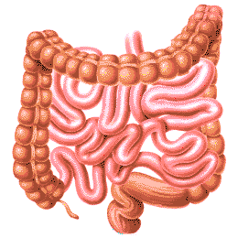

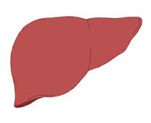
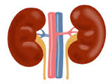
Kidney Disease Affects Drug Disposition
Absorption
Distribution
Kidney Disease
Metabolism
Excretion
Velenosi, T. J. and Urquhart, B. L. Expert Opin Drug Metab Toxicol, 10: 1131-43 (2014).
Notes:
One way to improve outcome is to optimize drug therapy in CKD pts
CKD is considered an important determinant of drug PK

Slide 7
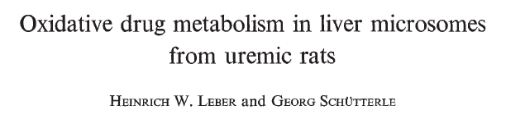
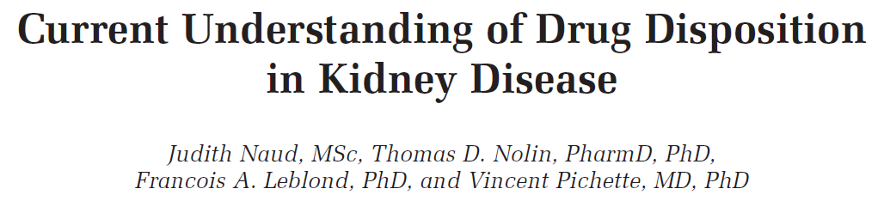
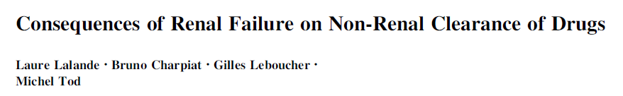
Kidney Disease Affects Non-Renal Clearance
Notes:
Aminopyrine p-Nitroanisole Acetanilide

Slide 8
Non-Renal Drug Clearance Major Pathways
Phase I
Oxidation (CYP450)
Phase II
Glucuronidation
Reduction
Hydrolysis
Acetylation
Sulfation
Phase III
  Uptake Transporters
  Efflux Transporters
Döring B and Petzinger E. Drug Metab Rev. 2014 Aug;46(3):261-82
Rowland A et al. Int J Biochem Cell Biol 45:1121-1132, 2013.
Notes:
Reduction has emerged as a critical pathway of metabolism

Slide 9
Phase I Reductases
Quinone Reductases
Reductase Enzymes
Short-chain Dehydrogenase Reductase (SDR)
Carbonyl Reducing Enzymes
Aldo-Keto Reductase (AKR)
Barski OA, et al. Drug Metab Rev. 2008. 40:553-624.
Malatkova, P. and Wsol, V. Drug Metab Rev, 46: 96-123 (2014).

Slide 10
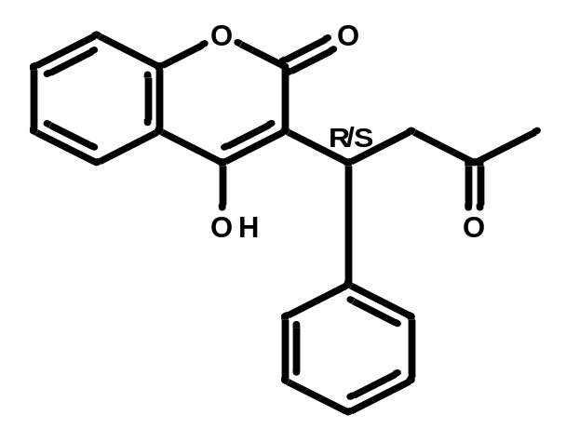
Warfarin is a Highly Metabolized Drug
CYPs
Warfarin
OH-WAR
Phase II conj.
Reductases
30%
50%
WAR-Alcohols
Urine
Urine
15-20%
Urine
Jones DR et al. Drug Metab Rev, 2010. 42(1): p. 55-61.
Lewis RJ et al. J Clin Invest. 1974 Jun;53(6):1607-17.
Banfield C et al. Br J Clin Pharmacol. 1983 Dec;16(6):669-75.
Notes:
Warfarin is a good example of highly metabolized drugs

Slide 11
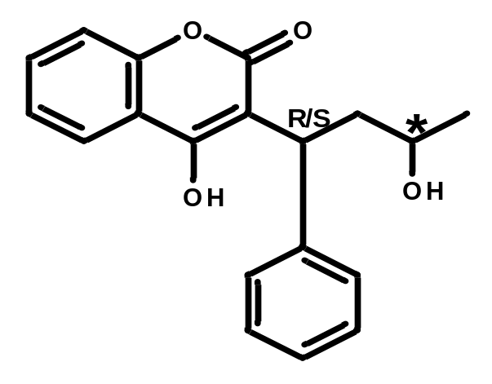
Warfarin Reduction
Warfarin
Warfarin Alcohols
Reductases
RS, SR
Alcohol 1
RR, SS
Alcohol 2
Chan KK et al. J Med Chem. 1972 Dec;15(12):1265-70.
Alshogran OY et al. J Chromatogr B. 2014 Jan 1;944:63-8.
Notes:
Indicates that the reduction is stereoselective for substrate preference and product formation.
Human 4x rats
Kidney is 3-6 more active than liver
Human = rat in kidney, the above is in the human kidney
S-warfarin reduction was unpredictable at concentration <0.52 mM.
About 5-times more alcohol1 is produced after administration of R compared to S-warfarin

Slide 12
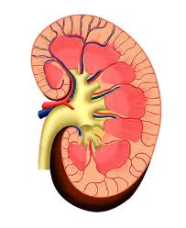
Warfarin Use in Kidney Disease is Challenging
Bleeding:
  2-5 fold increased risk of bleeding
Stroke:
  Warfarin use double the risk of stroke (HR: 1.93)
  89% increase in hospitalization from stroke
Mortality:
  27% increased risk of mortality
Dosing:
  Moderate: 10% lower maintenance dose
  Severe: 20% lower maintenance dose
Limdi, N.A., et al. J Am Soc Nephrol. 2009; 20(4): 912-921
Chan, K.E., et al. J Am Soc Nephrol. 2009; 20(4): 872-81
Limdi, N.A., et al. Am J Kidney Dis. 2010; 56(5): 823-31
Chan, K.E., et al. J Am Soc Nephrol, 2009. 20(10): 2223-33
Notes:
More than 50 million American on warfarin
25% ESRD

Slide 13
Hypothesis & Aims
Warfarin
Warfarin Alcohols
Reductases
CKD
Major Objective: To assess steady-state warfarin pharmacokinetics in kidney disease patients
Notes:
Briefly discuss

Slide 14
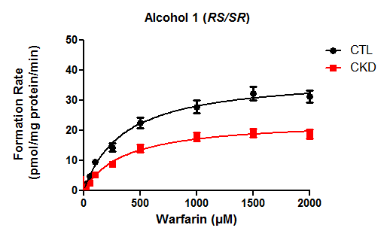
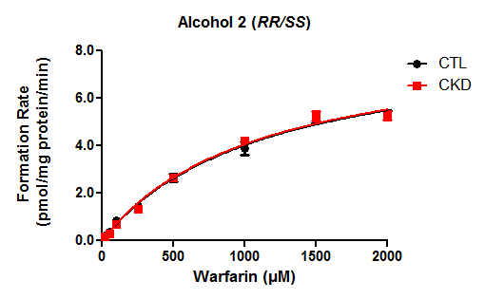
Warfarin Reduction is Selectively Decreased in Cytosol
39%
Alshogran OY. Drug Metab Dispos. 2015 Jan;43(1):100-6.
Notes:
44% 51% 42.40% 32.50%

Slide 15
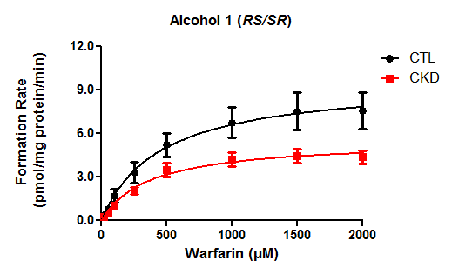
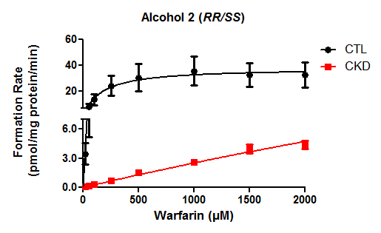
Warfarin Reduction is Decreased in Microsomes
87%
43%
Alshogran OY. Drug Metab Dispos. 2015 Jan;43(1):100-6.
Notes:
18.60% 56%
cytosol enzymes are selective for formation of alcohol1. it seems no preference in microsomes.
Agrees with in vivo findings that RS is the most abundant.

Slide 16
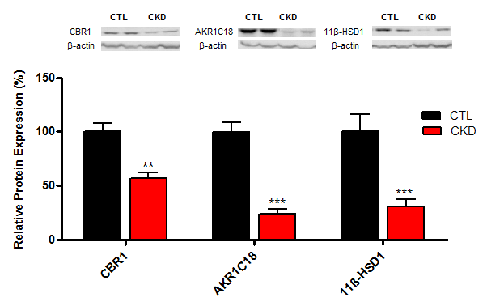
Decreased Protein Expression of Rat Hepatic Reductases in CKD
Alshogran OY. Drug Metab Dispos. 2015 Jan;43(1):100-6.

Slide 17
Patients Demographics & Clinical Data
Characteristic |  | Control (n=11) |  | ESRD (n=10) |  | P
Age (yr; mean ± SD) |  | 70.9 ± 9.7 |  | 74.8 ± 5.3 |  | NS
BMI (kg/m²; mean ± SD) |  | 22.7 ± 4.8 |  | 25.8 ± 7.3 |  | NS
Missing (n) |  | 1 |  | 0
Gender [n (%)] |  |  |  |  |  | NS
Male |  | 7 (63.6) |  | 7 (70%)
Female |  | 3 (27.3) |  | 3 (30%)
Missing |  | 1 (9.1) |  | 0 (0)
Race [n (%)] |  |  |  |  |  | NS
Caucasian |  | 11 (100) |  | 8 (80)
African |  | 0 (0) |  | 2 (20)
No. of Comorbid Conditions [n (%)] |  |  |  |  |  | 0.016
0 or 1 |  | 5 (45.5) |  | 0 (0)
2 - 4 |  | 6 (54.5) |  | 7 (70)
≥5 |  | 0 (0) |  | 3 (30)
Comorbid conditions were hypertension (10 patients), congestive heart failure (8), diabetes (6), chronic obstructive pulmonary disease (5), and coronary artery disease (4)
Notes:
Cause of death:
CTL: cardiac arrest, MI, stroke
ESRD: cardiac arrest, RF
HTN: 6 ESRD 4 CTL
CHF: 6 ESRD 2 CTL
Obesity: 5 ESRD 3 CTL
Ages: control: 49-80, ESRD: 67

Slide 18
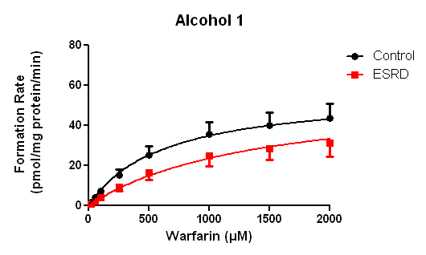
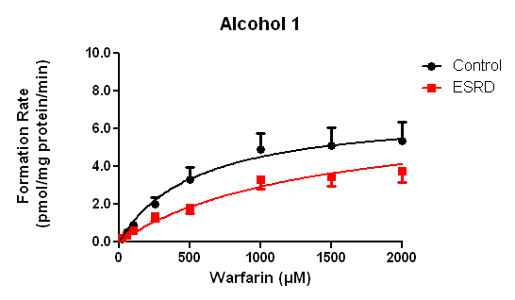
Activity in Human Cytosol & Microsomes
22%
27%
Alshogran OY. Drug Metab Lett. 2015;9(2):111-8
Notes:
44% 51% 42.40% 32.50%

Slide 19
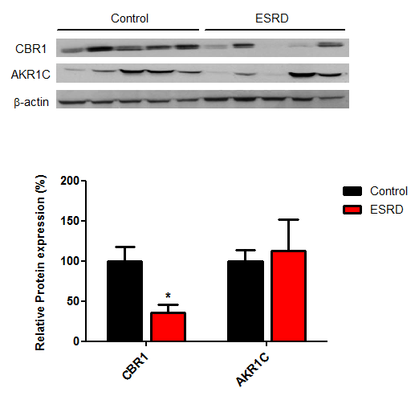
Protein Expression of Human Hepatic Reductases
Alshogran OY. Drug Metab Dispos. 2015 Jan;43(1):100-6.

Slide 20
Aim: To assess steady-state warfarin pharmacokinetics in kidney disease patients: a pilot study
Patient population (n=25)
Normal/mild CKD
(n=6)
eGFR> 60
mL/min/1.73m²
Moderate CKD
(n=4)
eGFR 30-60 mL/min/1.73m²
Severe CKD
(n=5)
eGFR 15-30 mL/min/1.73m²
ESRD
(n=5)
eGFR <15 mL/min/1.73m²
ESRD/HD
(n=5)
eGFR <15 mL/min/1.73m²
Levey AS. et al. Ann Intern Med. 2009;150:604-612.
Notes:
National Kidney Foundation (NKF) Kidney Disease Outcome Quality Initiative (KDOQI)
Kidney disease improving global outcome (KDIGO)
Chronic Kidney Disease Epidemiology Collaboration (CKD-EPI): more accurate at higher levels of GFR

Slide 21
Patients Demographics & Clinical Characteristics
 | All patients (n=25) | Normal/Mild (n=6) | Moderate (n=4) | Severe (n=5) | ESRD (n=5) | ESRD/HD (n=5) | P
eGFR (mL/min/1.73m²) | 31.4 ± 26.6 | 72 ± 6.8 | 42.8 ± 5.2 | 19 ± 3.4 | 12.6 ± 2.8 | 4.6 ± 2.0 | <0.001
Age (year) | 73.4 ± 11 | 65 ± 10.9 | 70.5 ± 12.6 | 79.4 ± 4.7 | 80.4 ± 9.9 | 72.6 ± 10.6 | 0.105
BMI (kg/m²) | 29.8 ± 4.9 | 29 ± 2.4 | 30.0 ± 3.4 | 30.5 ± 4.3 | 29.5 ± 5.3 | 30.4 ± 8.8 | 0.989
Gender (% male) | 52 | 50 | 50 | 60 | 80 | 20 | 0.439
Race (% white) | 96 | 100 | 100 | 100 | 100 | 80 | 0.384
Serum albumin (g/dL) | 3.9 ± 0.35 | 4.2 ± 0.32 | 4.1 ± 0.25 | 3.9 ± 0.22 | 4.0 ± 0.29 | 3.7 ± 0.48 | 0.171
Warfarin dose (mg/week) | 28.6 ± 14.3 | 39.5 ± 15.4 | 25.6 ± 8.3 | 28.6 ± 14 | 20.3 ± 8.7 | 28.4 ± 19 | 0.270
Blood sampling | 15.9 ± 3.3 | 16.2 ± 3.1 | 16.1 ± 1.0 | 15.4 ± 3.1 | 16.4 ± 5.3 | 15.2 ± 3.6 | 0.978
time (h)
Notes:
age: 52-87 years
Dose: 7-57.5 mg/w
Dose: 1-8 mg/d

Slide 22
Patients Demographics & Clinical Characteristics
 | All patients (n=25) | Normal/Mild (n=6) | Moderate (n=4) | Severe (n=5) | ESRD (n=5) | ESRD/HD (n=5) | P
CYP2C9 genotypes
wild type (n, %) | 16 (64) | 5 (31) | 2 (12.5) | 4 (25) | 3 (19) | 2 (12.5) | 0.532
at least one mutant allele (n, %) | 9 (36) | 1 (11.1) | 2 (24.4) | 1 (11.1) | 2 (24.4) | 3 (33.3)
VKORC1 genotypes
extensive activity (n, %) | 12 (48) | 4 (33.3) | 1 (8.3) | 2 (16.7) | 3 (25) | 2 (16.7) | 0.779
intermediate/poor activity (n, %) | 8 (32) | 1 (12.5) | 1 (12.5) | 2 (25) | 2 (25) | 2 (25)
high activity (n, %) | 5 (20) | 1 (20) | 2 (40) | 1 (20) | 0 (0) | 1 (20)
Notes:
age: 52-87 years
Dose: 7-57.5 mg/w
Dose: 1-8 mg/d

Slide 23
Clinical Study Approach
Study protocol was approved by the Research and Ethics Committee of Maisonneuve-Rosemont Hospital.
All subjects provided written informed consents.
Single blood sample was collected from patients who are under long-term warfarin therapy.
Analytes were measured using LC-MS/MS.
    Total/ free warfarin and alcohols
    Total/ free warfarin enantiomers (R & S)
Steady-state PK analyses:
CL_{total} = D/(C_{ss}×τ)
CL_{u} = CL_{total}/f_{u}
f_{u}= C_{f}/C_{t}
Alcohols exposure
S/R warfarin ratio
Jensen BP. et al. Br J Clin Pharmacol 2012. 74:797-805

Slide 24
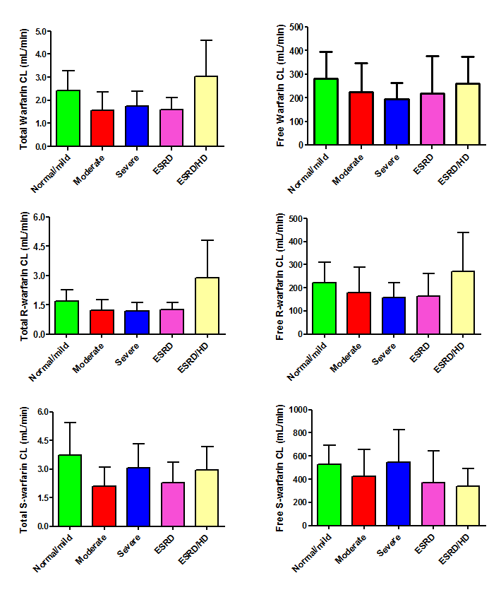
    Warfarin Clearance & Kidney Disease
No differences were found in warfarin clearance among CKD patients

Slide 25
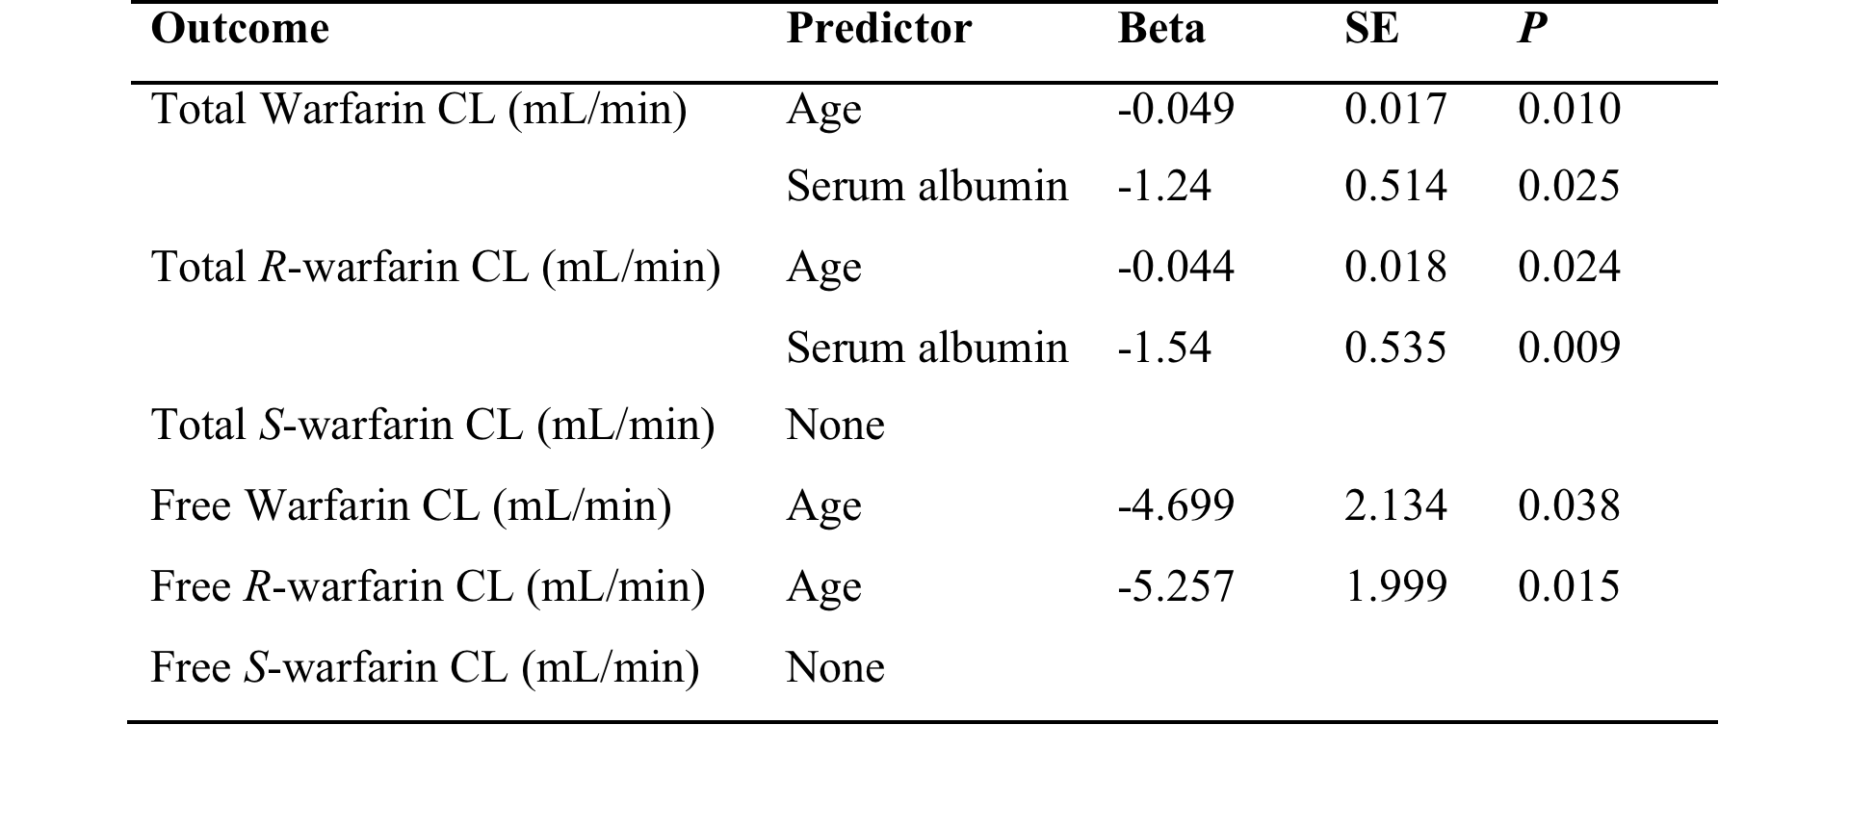
    Predictors of Warfarin Clearance

Slide 26
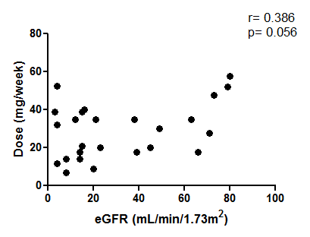
    GFR Correlation with Warfarin Dose
Notes:
There is a minor relationship between dose and eGFR

Slide 27
    Age Correlation with Warfarin Dose
Regression: age was the only significant modifier of average weekly warfarin dose
Notes:
As age increases by one year, the average weekly warfarin dose decreases by 0.74 mg

Slide 28
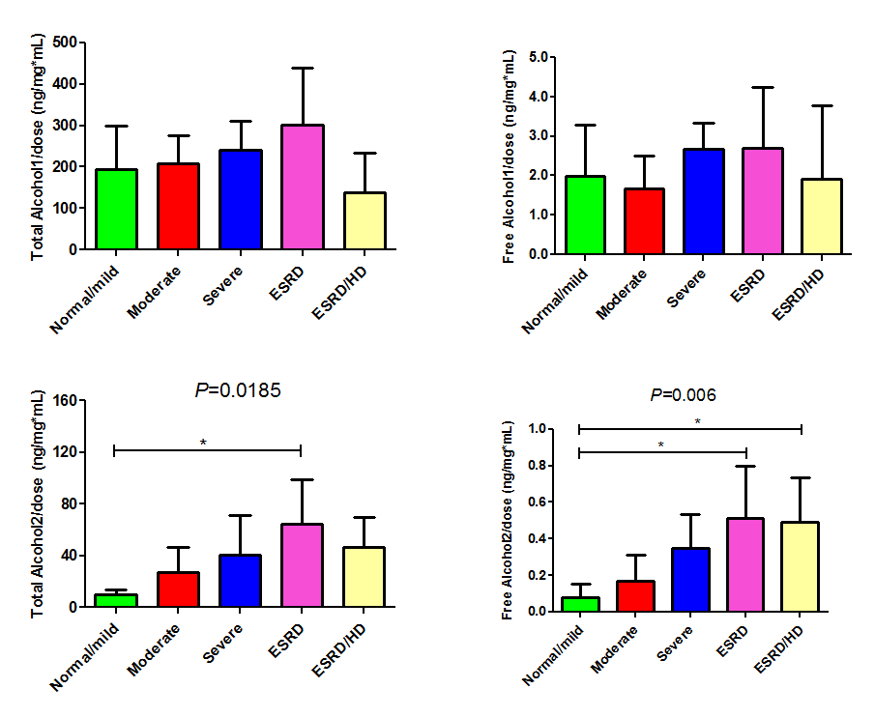
    Warfarin Alcohols Concentration & Kidney Disease
Increased alcohol 2 dose-normalized concentrations in ESRD
* p<0.05
Notes:
6.5-fold higher

Slide 29
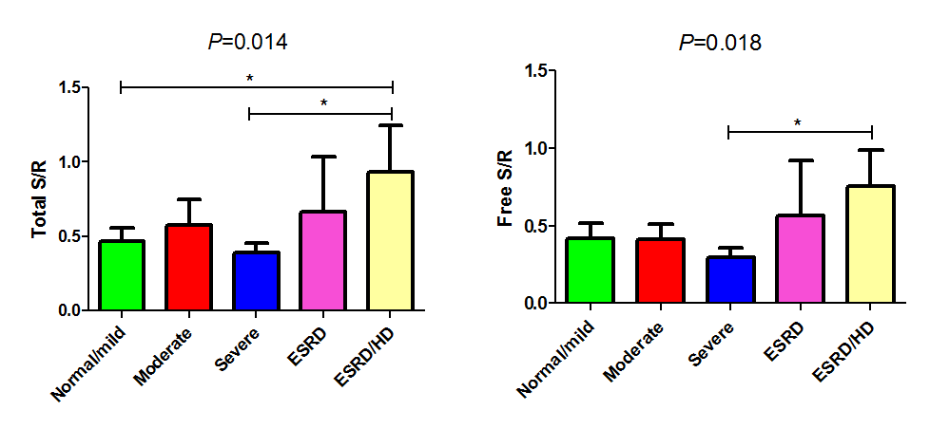
    S/R Warfarin Ratio & Kidney Disease
Increased S/R ratio in ESRD
* p<0.05
Notes:
Serum albumin and CYP2C9 genotypes were significant predictors for total S/R ratio
CYP2C9 variation was the only significant predictor of free S/R ratio

Slide 30
Conclusions
As age increases, a significant decline in warfarin dose and clearance is observed.
6-fold increase in the exposure of warfarin alcohol 2 in ESRD (HD) compared to control/mild CKD patients.
2.5-fold increase in warfarin S/R ratio in ESRD/HD versus control/mild or severe CKD patients.
Notes:
Using F-test with alpha level of 0.05, our study had only 62% power to detect differences ranging from 27-35% in total warfarin clearance between patients with different degrees of kidney disease (the calculated effect size was 0.64).

Slide 31
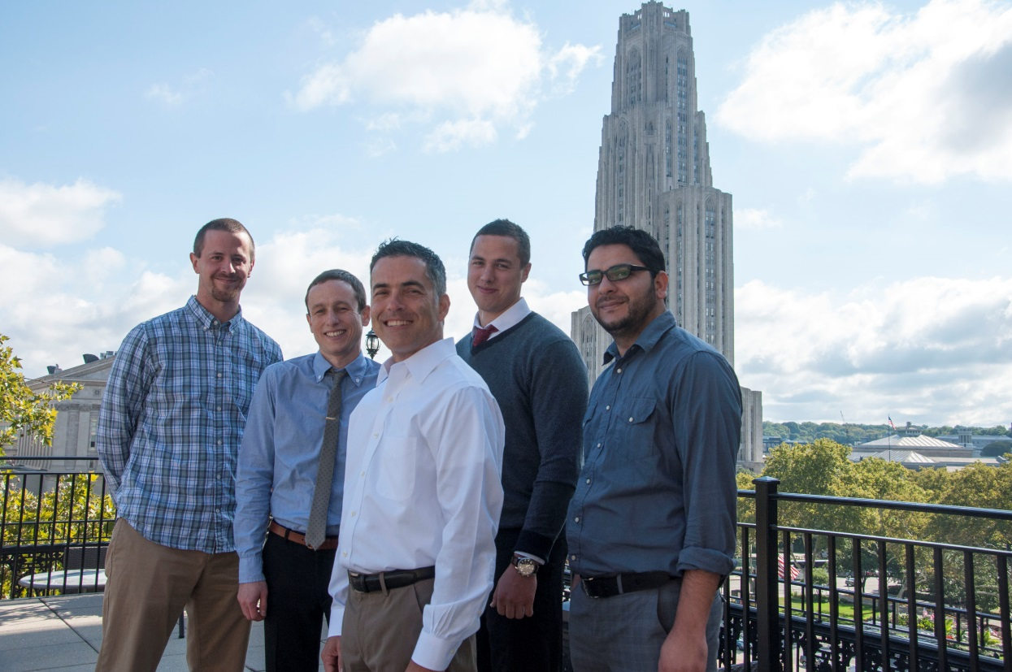
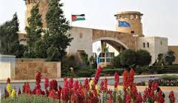
Acknowledgments
University of Pittsburgh
Thomas Nolin, PharmD, PhD
University of Montreal
Vincent Pichette, MD, PhD
Francois Leblond, PhD
Jordan University of Science & Technology (JUST)

Slide 32
Phase I Reductases
Quinone Reductases
NADPH Quinone Oxidoreductase (NQO)_Cytosol
Reductase Enzymes
Short-chain Dehydrogenase Reductase (SDR)
Carbonyl Reductase (CBRs)_Cytosol
Carbonyl Reducing Enzymes
11β-Hydroxysteroid Dehydrogenase (11β-HSD)_Microsomes
Aldo-Keto Reductase (AKR)
Aldehyde Reductase (AKR1A) and Aldose Reductase (AKR1B)_Cytosol
3α-Hydroxysteroid Dehydrogenase (AKR1C)_Cytosol
Barski OA, et al. Drug Metab Rev. 2008. 40:553-624.
Malatkova, P. and Wsol, V. Drug Metab Rev, 46: 96-123 (2014).

Slide 33
Reductases & Drug Substrates
Carbonyl Reducing Enzymes
Quinone Reductases
Short-chain Dehydrogenase Reductase (SDR)
Aldo-Keto Reductase (AKR)
Befunolol
Dolasetron
Oracin
Naltrexone
Ketoprofen
Ketotifen
Loxoprofen
Tibolone
Ketoprofen
Nabumetone
Naloxone
Naltrexone
Benfluron
Daunorubicin
Doxorubicin
Daunorubicin
Doxorubicin
Oracin
Bupropion
Eperisone
Prednisone
Acetoheximide
Daunorubicin
Doxorubicin
Metyrapone
Mitomycin C
Substrates
CBR1
CBR3
11β-HSD1
AKR1A1
AKR1C1
AKR1C2
AKR1C4
NQO1
Isoforms
Cellular
Fraction
Cytosol
Microsomes
Cytosol
Quercetin, Menadione, Ethacrynic acid, Rutin
Indomethacin
18β- glycyrrhetinic
acid
Barbital
Flufenamic acid, Indomethacin, Phenolphthalein
Dicoumarol
Inhibitors
Matsunaga T, et al. Drug metabolism and pharmacokinetics. 2006. 21:1-18.
Malatkova P and Wsol V. Drug Metab Rev. 2013
Notes:
Toxins: aflatoxin B1 or the nitrosamine NNK, polycyclic aromatic hydrocarbons
Reductases characterized by broad and overlapping substrate specificities
Endogenous: endogenous steroid hormone, prostaglandins, bile acid and arachidonic acid metabolism,

Slide 34
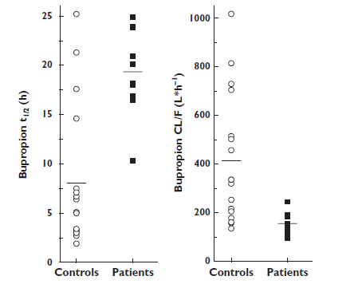
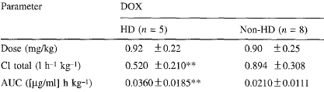
Does CKD Affect Drug Reduction?
Turpeinen, M et al. Br J Clin Pharmacol, 64: 165-73 (2007)
Yoshida, H. et al. Cancer Chemother Pharmacol, 33: 450-4 (1994).
Notes:
Bupropion: CTL (17): 119 CKD (10): 30 no HD (85% bound)
Doxorubicin: HD (5), non-HD normal (8) 75% bound

Slide 35
Reductase Drug Substrates by Class
Drug |  | Class |  | Drug |  | Class
L-691,121* |  | Antiarrhythmic |  | Haloperidol* |  | Antipsychotic
Ketotifen* |  | Antiasthmatic |  | Timiperone* |  | Antipsychotic
Benfluron* |  | Anticancer |  | Boceprevir* |  | Antiviral
Daunorubicin |  | Anticancer |  | S-1360 |  | Antiviral
Dimefluron |  | Anticancer |  | Levobunolol |  | β-Blocker
Doxorubicin |  | Anticancer |  | Metyrapone |  | Diagnostic
Epirubicin |  | Anticancer |  | Ethacrynic Acid |  | Diuretic
Idarubicin* |  | Anticancer |  | Pentoxifylline |  | Hemorheological
Iododoxorubicin |  | Anticancer |  | Oxisuran |  | Immunosuppressive
Mitomycin C |  | Anticancer |  | Eperisone |  | Muscle relaxant
Oracin* |  | Anticancer |  | HY-770 |  | Muscle relaxant
Wortmannin* |  | Anticancer |  | Tolperisone |  | Muscle relaxant
 |  |  |  | CS-670 |  | NSAID
Nafimidone |  | Anticonvulsant |  | Flobufen* |  | NSAID
Bupropion |  | Antideprassant |  | Ketoprofen |  | NSAID
E/Z-10-oxonortriptyline |  | Antideprassant |  | Loxoprofen |  | NSAID
Acetohexamide* |  | Antidiabetic |  | Nabumetone* |  | NSAID
Dolasetron* |  | Antiemetic |  | Methylnaltrexone |  | Opiate antagonist
Oxcarbazepine* |  | Antiepileptic |  | Naloxone |  | Opiate antagonist
Fenofibrate |  | Antihyperlipidemia |  | Naltrexone* |  | Opiate antagonist
Triadimefon |  | Antifungal |  | Glucocorticoids |  | Steroid
Befunolol* |  | Antihypertensive |  | Norethynodrel* |  | Steroid
Ketanserin* |  | Antihypertensive |  | Tibolone* |  | Steroid
TA-510 |  | Anti-inflammatoy |  | Naftazone |  | Vasoprotectant
Bromperidol* |  | Antipsychotic |  | Menadione |  | Vitamin (K3)
Warfarin Anticoagulant

Slide 36
Pharmacological Activity/ in-vivo
Alcohols possess anticoagulant activity
- Decrease activity level of clotting factors (Vit K dependent)
- Alcohol 1 = Alcohol 2 in the activity
- RS: sustained decrease in coagulation activity
- The activity is lower than that of warfarin
Lewis RJ et al. Ann N Y Acad Sci. 1971 Jul 6;179:205-12.
Chan KK et al. J Med Chem. 1972 Dec;15(12):1265-70.

Slide 37
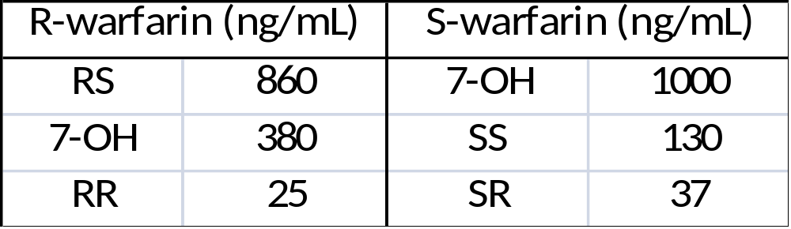
Kinetics
Excreted unchanged in urine: 15-20% of warfarin dose
At dose of 0.75mg/kg: peak:
The clearance rate of RS alcohol is comparable to that of warfarin; nevertheless the clearance rate of the other alcohols (RR, SR, and SS) is 2.5-3 folds faster.
Half-life: RS: 34 hrs
SR, SS, RR: 13 hrs
Banfield C et al. Br J Clin Pharmacol. 1983 Dec;16(6):669-75.
Lewis RJ et al. J Clin Invest. 1974 Jun;53(6):1607-17.
Lewis RJ et al. Ann N Y Acad Sci. 1971 Jul 6;179:205-12.
Chan KK et al. J Med Chem. 1972 Dec;15(12):1265-70.
Notes:
VdL 7-10 L.
About 5-times more alcohol1 is produced after administration of R compared to S-warfarin

Slide 38

Activity in-vitro
Activity was tested based on the inhibition of rat microsomal VKOR enzyme
Gebauer M. Bioorg Med Chem. 2007 Mar 15;15(6):2414-20.

Slide 39
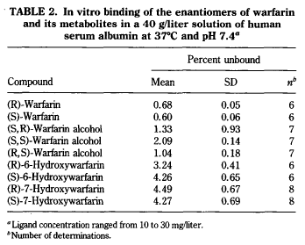
Protein binding
Warfarin: 99%
Alcohols: 98%
OH-Met: 96%
Chan E et al. Chirality. 5610-615 (1993)

Slide 40
Reductases By Drug Substrates

Slide 41
Multiple Regression Analysis
Outcome | Predictor | Beta | SE | P
Total Warfarin CL (mL/min) | Age | -0.049 | 0.017 | 0.01
 | Serum albumin | -0.124 | 0.051 | 0.025
 | Constant | 10.613 | 2.351 | <0.001
Total R-warfarin CL (mL/min) | Age | -0.044 | 0.018 | 0.024
 | Serum albumin | -0.154 | 0.054 | 0.009
 | Constant | 10.981 | 2.449 | <0.001
Total S-warfarin CL (mL/min) | eGFR | 0.025 | 0.012 | 0.045
 | Constant | 8.953 | 3.341 | <0.001
Free Warfarin CL (mL/min) | Age | -5.548 | 2.116 | 0.016
 | Constant | 468.80 | 168.68 | 0.011
Free R-warfarin CL (mL/min) | Age | -5.257 | 1.999 | 0.015
 | Constant | 589.47 | 149.63 | 0.001
Free S-warfarin CL (mL/min) | None

Slide 42
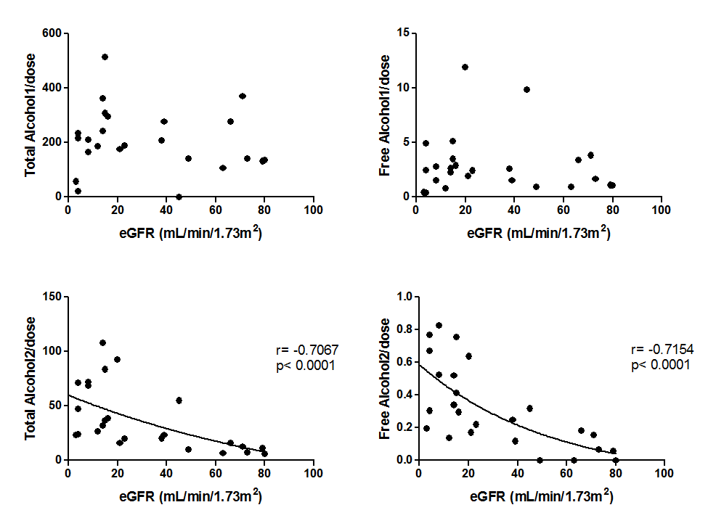
Alcohols vs GFR

Slide 43
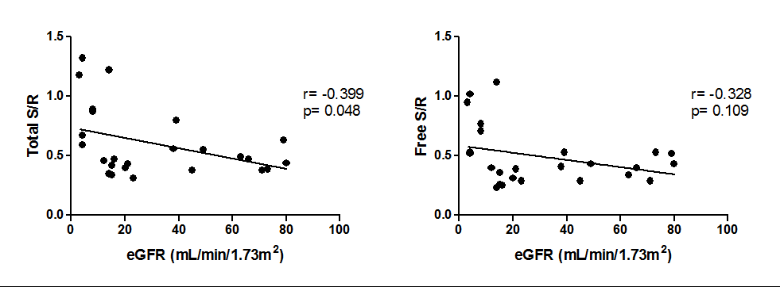
S/R vs. GFR

Slide 44
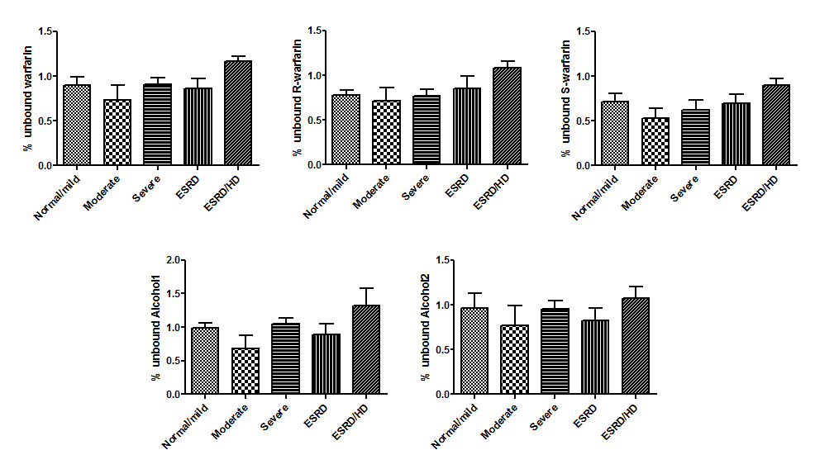
Protein binding

