Slide 1
The nature of prebiotics and the impact of prebiotics/probiotics on gut health
Osama O. Ibrahim, PH.D.
Consultant Biotechnology
Gurnee IL. 60031-USA
bioinnovation04@yahoo.com

Slide 2
Agenda
Probiotics and its benefits.
Probiotics microorganisms
Prebiotics and its benefits.
Chemical structure of some prebiotics.
Inulin, oligofructos, FOS and GOS.
The definition of synbiotics .
Microencapsulation.
Probiotic market.

Slide 3
Probiotics
Probiotics are viable bacteria which colonize in the large intestine and provide health benefits to the host.
Probiotics also colonize in the upper part of the intestine and prevent the adhering of pathogens to the intestinal tract (competitive exclusion).
Probiotics also help in food digestion and improve immune response.

Slide 4
Probiotoc Microorganisms
There are numerous probiotic microorganisms:
Fermented foods: Lactobacillus rhamnosus, Lactobacillus reuteri, Lactobacillus casei, Lactobacillus acidophilus and bifidobacteria.
Investigated: Escherichia coli Nissle 1917, Enterococcus faecium SF68, and the probiotic yeast Saccharomyces boulardii.

Slide 5
Benefits
Maintaining healthy digestion and friendly bacteria level.
Assisting with digestive disturbance (e.g. bloating, flatulence, diarrhea, constipation, poor digestion).
Maintaining a healthy-immune system and energy level.
Supporting the gut during and after antibiotics treatment.
Maintaining healthy liver function.
Supporting clear healthy skin.

Slide 6
Prebiotics
Prebiotics is a general term to chemicals that induce the growth and the activity of commensal microorganisms that contribute to the well-being of the host.
Its function is in the gastrointestinal tract, where prebiotics can support probiotics growth and alter the distribution of organisms in the gut microbiome.
Prebiotics can also function in other areas of the body as well.

Slide 7
Type of prebiotics
Prebiotics are classified as soluble fiber.
It is the type of fibers that our gut flora can actually consume and ferment.
These type of soluble fibers are:
Inulin and oligofructose.
Fructo-oligosaccharides (FOS).
Galacto-oligosaccharides (GOS).
Other oligosaccharides.
Polysaccharides
Oligosaccharides

Slide 8
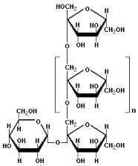
Polysaccarides
(Inulins and Oligofructose)
Inulins belong to a class of dietary fibers known as fructans.
Inulins are a group of soluble fibers naturally produced by many types of plants, industrially extracted from chicory.
Oligofructose belongs to a subgroup of inulin. It's found in various vegetables and plants, including onions, bananas, garlic, chicory and wheat
Innulin
Fructose polymer B2-1
DP 60
Oligo fructose Fructose polymer B2-1
DP 10

Slide 9
Oligosaccharides
Oligosaccharides are important group of polymeric carbohydrates that are found in all living organisms.
Oligosaccharides composed of 2 to10 mono-saccharide residues.
These mono-saccharide's linked together by glycoside bonds.
The discovery of enzymes helps in the production of oligo-saccharides with high yield and coast effective.

Slide 10
Oligosaccharides Substrates
Enzymatic process
Oligosaccharides Substrate
Fructo-oligosaccharide Sucrose
Galacto-oligosaccharide Lactose.
Malto-oligosaccharide Starch.
Iso-malto-oligosaccharide Starch.
Xylo-oligosaccharide Xylan.
Soy-oligosaccharide Soy.
-

Slide 11
Oligosaccharides properties
Low sweetness intensity (1/3 of sucrose).
Highly soluble than sucrose.
Zero calorie (calorie free).
Heat stable (doesn't degrade by heating process)
Resistance to hydrolysis by digestive enzymes.
Hydrolyze in high acid environment.
Non-cariogenic (inhibit the growth of Streptococcus mutans).

Slide 12
Oligosaccharides general benefits
Prebiotic (enhance befidus bacteria in colon).
Increase digestion of lactose metabolism.
Increase mineral absorption.
Increase HDL/LDL ratio.
Decrease serum lipids and blood cholesterol.
Decrease blood pressure.
Decrease glycemic response.
Decrease fecal PH, toxic, and carcinogenic metabolites.

Slide 13
Oligosaccharides
Legal status
Oligosaccharides cannot be labeled as sugars or carbohydrates.
They are food ingredients not food additives.
Can be applied without restrictions.

Slide 14
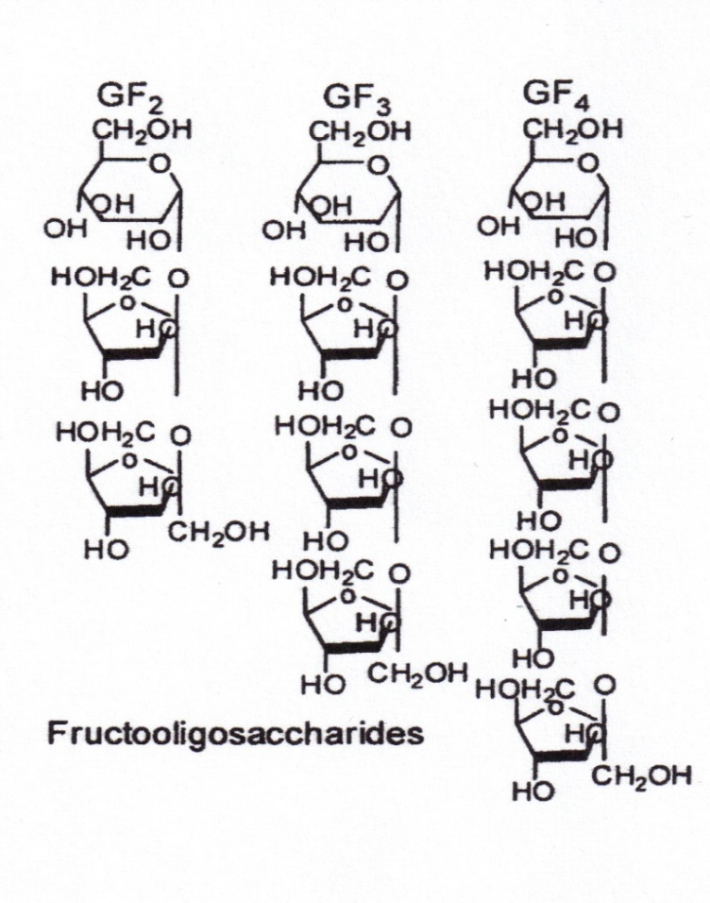
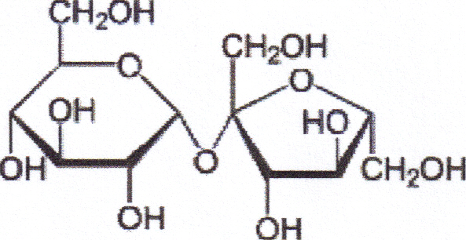
Fructo-oligosaccharides
(FOS)
GF
Sucrose
O-α-D-glucopyranosyl-(1-2)β-D-fructofuranoside
Substrate
products

Slide 15
Fructo-oligosaccharide
(FOS)
Naturally occurring (fruits and vegetable).
Built from sucrose (D-glucose and D-fructose).
G- (F)_{n}-F
Enzymatic reaction:
- GF +GF GF₂ (1-Kestose)
- GF +GF₂ GF₃ (Nestose)
- GF + GF₃ GF₄ (fructosyl-nestose)
By-product:
- Free glucose (process enzyme inhibitor)

Slide 16
Fracto-oligosaccharides products of enzymes
Enzymes:
- Fructosyltransferase (EC 2.4.1.9).
- B-fructofuranosidase (EC.3.2.1.26).
Microbial source:
- Aureobacidium pullulans.
- Aspergillus niger.
- Fusarium Sp.
- Arthrobacter sp.
- Lactobacillus vulgalicus

Slide 17
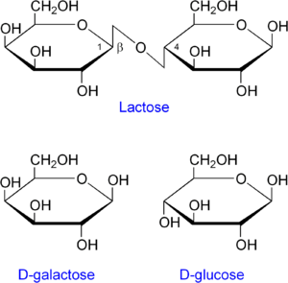
Galacto-Oligosaccharides
(Substrate)

Slide 18
Galcto-oligosaccharides
(GalOS)
Naturally occurring in milk products.
It is one of the major oligosaccharide in Japan.
It is built from lactose(D-glucose and D-galactose).
G-(Gal)_{n}-Gal
G-Gal di-saccharide 33 %
G-(Gal)₂ tri-saccharide 39 %
G-(Gal)₃ tetra-saccharide 18 %
G-(Gal)₄ penta-saccharide 7 %
% of mixture

Slide 19
Galacto-oligosaccharides
(GalOS)
Enzyme
Lactose + Lactose GalOS + G
Process by-product:
- Glucose (enzyme inhibitor in the process).
- Galactose (galactocymia in the blood)
G-Gal, G-(Ga)_{2,} G-(Gal)_{3,} G(Gal)₄

Slide 20
GalOS Production Enzyme
Enzyme name:
- B-galactosidase (EC 3.2.1.22).
(Also known by the name lactase)
- B-galactosyl transferase (EC 2.4.1.134)
Microbial source:
- Aspergillus niger.
- Aspergillus oryzae.
- Kluyveromycin lactis.
- Kluyveromycin Fragili.
- Bacillus circulans.
- Streptococcus thermophilus.

Slide 21
Synbiotics
the United Nations Food & Agriculture Organization (FAO) recommends that the term "synbiotic" be used only if the net health benefit is synergistic
Synbiotic concept was first introduced as “mixtures of probiotics and prebiotics that are beneficially to the host.

Slide 22
Protecting Probiotic
Bacteria
Probiotic bacteria play an important role in promoting and maintaining human health.
In order, to produce health benefits probiotic strains should be in a viable form during: (1) its shelf life until consumption and (2) maintain its high viability throughout the gastrointestinal tract.
Experimental data indicated free probiotic cells have a poor survival rate.
Maintaining probiotics in a viable form (living cells) is the must approach.
Develop a physical barrier for probiotics to be protected from adverse environmental conditions.

Slide 23
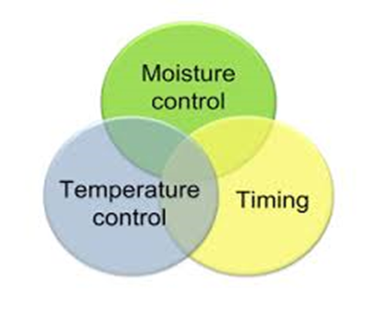
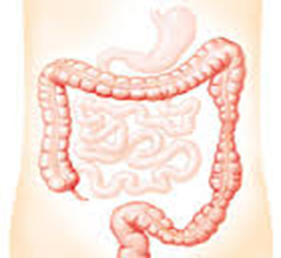
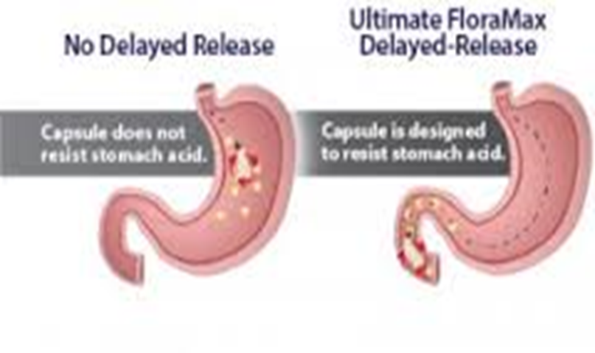
Protecting Probiotic
Bacteria

Slide 24
Microencapsulation
The microencapsulation techniques enhanced viability of Probiotics in food products as well as in the gastrointestinal tract.
microencapsulation is a process to entrap active agents (probiotic/prebiotic) within a carrier material and convert them into a powder form for convenient use.
microencapsulation prevent these microorganisms from multiplying in food that would otherwise change their sensory characteristics
In addition, microencapsulation can promote controlled release and optimize delivery to the site of action.

Slide 25
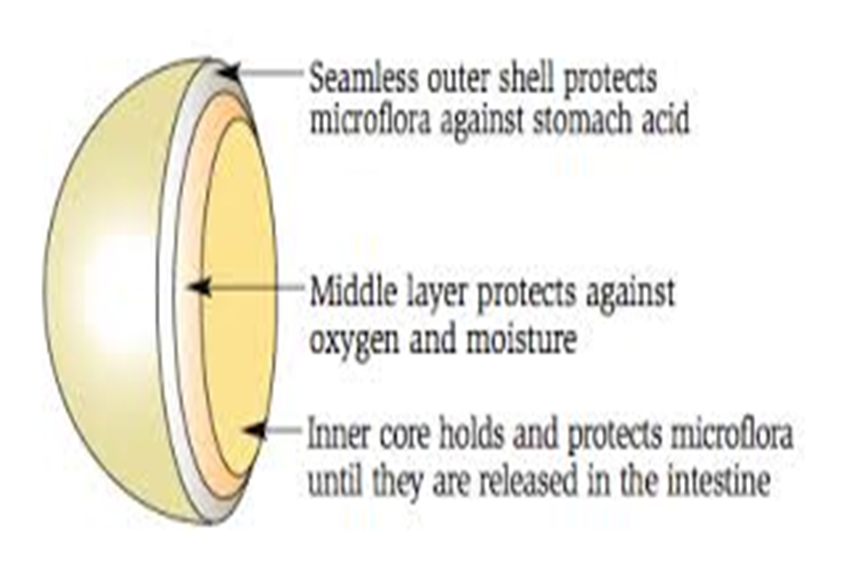
Micoencapsulation
A technology to Protect Probiotic Bacteria

Slide 26
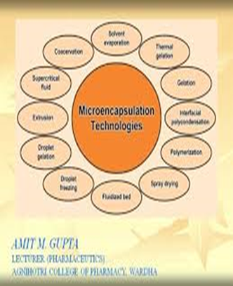
Materials used for Microencapsulation
Various types of encapsulating materials are used for the process.
Namely, alginate, chitosan, carrageenan, gums (locust bean, gellan gum, xanthan gum, etc.), gelatin, whey protein, and starch.
The selection of any material depends on (1) its capsule forming capability, (2) its strength, (3) its enhancing viability of probiotics, (4) its cheapness, (5) its availability, and (6) biocompatibility.

Slide 27
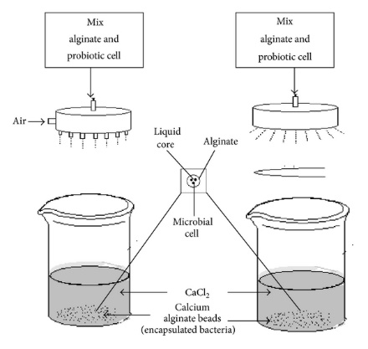
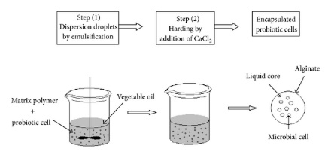
Microencapsulation
Techniques
The techniques are divided into two parts:
Encapsulation process.
Drying process (freeze drying , spray drying , fluidized bed drying ).
Encapsulation Process
Extrusion Technique
Emulsion Technique

Slide 28
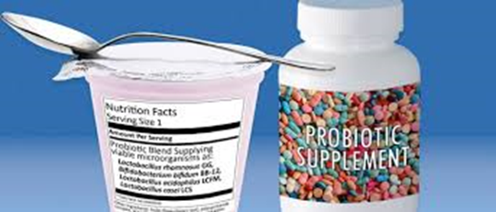
Probiotics market
Food & beverages dominated the application market and accounted for over 80% of the total probiotics market.
Asia Pacific emerged as the most dominant regional market, accounting for over 50% of the total market share. This owing to the fact that the concept started in Japan.
The global market for probiotics is expected to reach $ 52.34 billion by 2020.
Asia Pacific is also expected to be the fastest growing market.

Slide 29

Probiotics market
In the United States, probiotics are available as dietary supplements (capsules, tablets, and powders) and in dairy foods (such as yogurts with live active cultures).
Probiotics for human consumption accounted for over 90% of the total market,
probiotics have made significant growth in the animal feed industry and are expected to grow.

Slide 30
Conclusion
Growing consumer awareness regarding gut health has pushed the demand for supplements and dietary products.
This awareness has tremendous reflect on probiotics consumption.
Probiotics expected to play a critical role in market development over the next years.
Labeling and regulations, especially in the U.S. and European Union, are also expected to have significant impact on market growth.

Slide 31
Thank You for your attention

