Slide 1
Eliminating
Andean Region
Health Disparities via Human Papilloma Virus Vaccination Administration Programs Implementation
2nd International Congress on
Contemporary Issues in Women Cancers & Gynecologic Oncology
Aug 29-30, 2017 London, UK
Oroma Nwanodi, MD, DHSc.

Slide 2


Presenter Disclosures
The following personal financial relationships with commercial interests relevant to this presentation existed during the past 12 months:
Merck and GlaxoSmithKline, nonspecific, ownership interest, less than $5,000 common stock outside a mutual fund.
This presentation is based on coursework previously submitted to the College of Graduate Health Studies in partial fulfillment of the Doctor of Health Sciences Degree, A. T. Still University, and publicly presented at the American Public Health Association 2014 World Expo on November 18, 2014, in New Orleans, Louisiana.

Slide 3
Learning Objectives
Describe the need for increased human papilloma virus (HPV) vaccination in the Andean region.
List three barriers to increasing HPV vaccination rates.
Identify global resources for improving HPV vaccination rates.
Formulate an HPV vaccination program from available organizational resources.

Slide 4
Overview: Cervical Cancer
Globally, human papilloma virus (HPV) is responsible for over 500,000 incident cases of cervical cancer (CC).
  7.8 million female years of life lost (YLL), limits women’s socioeconomic contribution (Forman et al., 2012).
  86,000 (17%) of CC cases occur in the Latin American Countries (LAC) of the Caribbean, Central and South America (Brown et al., 2010; Perez et al., 2008).
  CC is the most frequent female cancer in Bolivia, the 2nd most frequent female cancer in Colombia, Ecuador, and Peru, and the 3rd most frequent female cancer in Chile (Murillo et al., 2016).
  597,886 female YLL in South America due to CC (Bruni et al., 2017)

Slide 5
Overview: Cervical Cancer
Globally, about 274,000 women die from CC annually.
Globally, CC is the 4th cause of female deaths.
  241,120 (88%) of CC deaths occur in low- and middle-income countries (LMIC) (Forman et al., 2012; Ladner et al., 2012; Levinson et al., 2013; Murillo et al., 2016; Soohoo et al., 2013).
Cervical cancer is attributed with at least 33,000 (12%) deaths in LAC (Andrus et al., 2008; Bartolini et al., 2010).
LAC and LMIC comprise the Andean region.
Bolivia, Chile, Colombia, Ecuador, and Peru are part of the Latin American Andean region of South America.

Slide 6
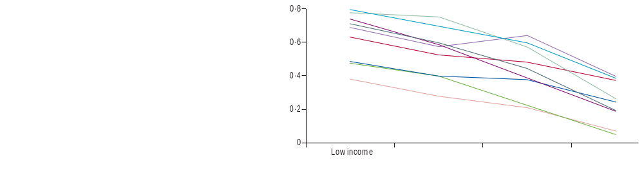

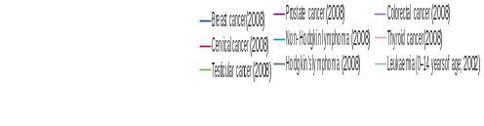
Overview: Cervical Cancer
In 2002 Colombia had 5,500 incident CC cases and 2,045 deaths (Aponte-González et al., 2013).
In Peru CC has an estimated annual mortality rate of 24.6 per 100,000 or 2,098 deaths annually (Brown et al., 2010; Lee et al., 2010; Penny et al., 2011; Bartolini et al., 2012).
CC is the leading female cancer mortality cause in Bolivia, Colombia, Ecuador, and Peru (Aponte-González et al., 2013; Brown et al., 2010; Penny et al., 2011).
  Higher CC case-fatality is associated with lower national income (Farmer et al., 2010).
Mortality:Incidence Ratio
Cancer Mortality to Incidence Ratio by Country Income (Farmer et al., 2010).
Low income Low-middle income High-middle income High income

Slide 7
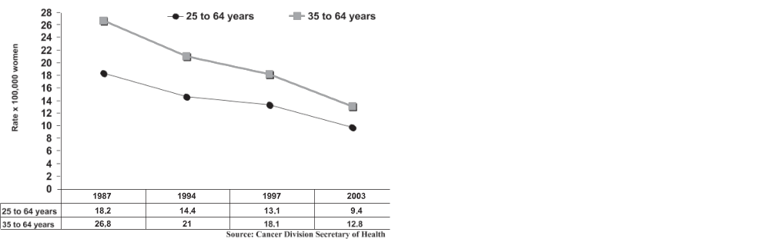
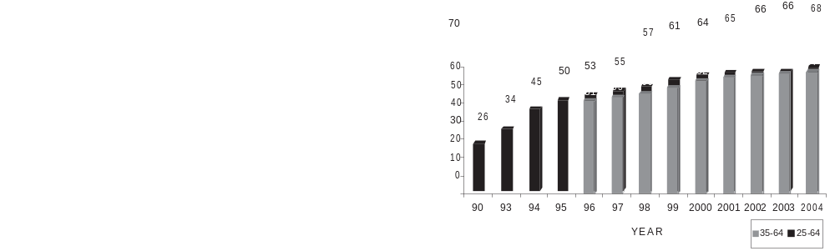
Overview: Cervical Cancer
From 1987 and 2003, Chile had a 48% reduction in CC mortality due to improved CC screening (Gomez et al., 2014; Suarez & Prieto et al., 2006).
  The reduced CC mortality rate of 8.4 per 100,000 women or 677 deaths, the 2nd leading female cancer mortality cause, resulting in 129 YLL per 100,000 women in 2003 (Suarez & Prieto, 2006).
  From 2003 to 2007 the Chilean CC mortality rate dropped to 7.3 per 100,000, reducing CC to the 6th cause of female cancer mortality (Murillo et al., 2016).
As Chilean CC screening rose, CC mortality fell (Suarez & Prieto et al., 2006).

Slide 8
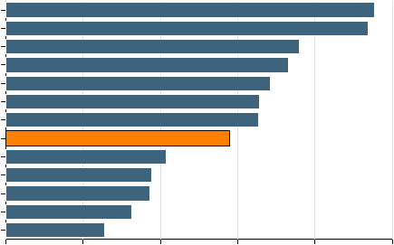
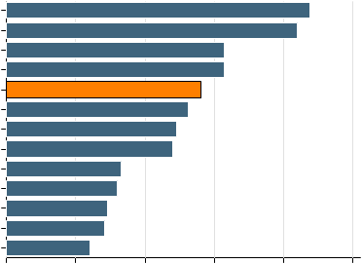
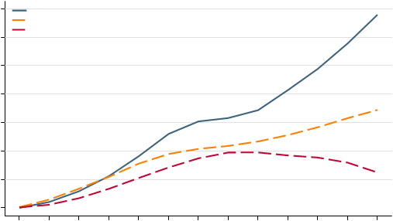
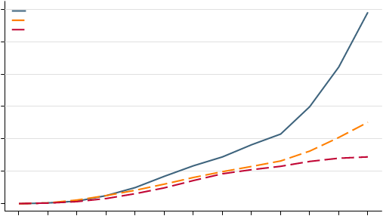
Overview: Cervical Cancer
Age-Standardized CC Incidence per 100,000 women in South America (Bruni et al., 2017).
Age-Standardized CC Mortality per 100,000 women in South America (Bruni et al., 2017).
Bolivia
Guyana
Suriname
Paraguay
Venezuela
Peru
Ecuador
Argentina
Uruguay
Colombia
Brazil
Chile
47.7
46.9
38
French Guiana 36.6
34.2
32.8
32.7
29
20.8
18.9
18.7
16.3
12.8
Guyana
Bolivia
Suriname
Paraguay
Ecuador
Venezuela
Peru
Argentina
Colombia
Brazil
Uruguay
Chile
21.9
21
15.7
15.7
14
13.1, French Guiana
12.3
12
8.3
8
7.3
7.1
6
0 10 20 30 40 50
0 5 10 15 20
Age-specific CC rates
140
120
100
80
60
40
20
0
Ecuador
South
America
World
120
100
80
60
40
20
0
15-19
45-49
≥75
15-19
45-49
≥75
Age group (years)

Slide 9
Overview: HPV Vaccines
The heat-labile bivalent (2vHPV), quadrivalent (4vHPV) and nonavalent (9vHPV) vaccinations provide prophylactic primary prevention against the 70-82% of CC due to high risk (HR) HPV-16 and -18 (Bartolini et al., 2010; Goldie et al., 2012; Penny et al., 2011; Riethmuller et al., 2015).
Long-term efficacy of 4vHPV was confirmed with 6.26 years follow-up in Colombia (Luna et al., 2013).
An additional 9-15% prevention of CC from HR HPV-31, -33, -35, -45, -52, and -58 is provided by 9vHPV (Riethmuller et al., 2015).
Vaccination-based primary prevention of CC is the leading method for LAC and LMIC to forestall impending unaffordable long term health care associated costs (Farmer et al., 2010).

Slide 10
Overview:
Other HPV-Attributable Diseases
HPV is etiological in anal, oropharyngeal, penile, vaginal, and vulvar cancers (Alemany et al., 2014; Soohoo et al., 2013).
HPV types 6 and 11 contribute to 4.3 cases of incompletely curable recurrent respiratory papillomatosis (RRP) per 100,000 children (Sanchez et al., 2013).
  4vHPV administered post incidence of RRP may reduce frequency of subsequent bouts of RRP.
External genital warts (EGW) may have a prevalence of 1%, with a total lifetime risk of 10% (Piñeros et al., 2013).
  HPV types 6 and 11 cause 90% of EGW (Soohoo et al., 2013).
  4vHPV and 9vHPV protect against EGW and RPP (Riethmuller et al., 2015; Sanchez et al., 2013).
  Treatment of recurrent EGW has significant human and financial costs in Central and South America (Perez et al., 2008).

Slide 11
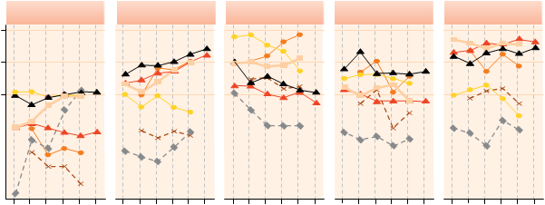
Overview:
Other HPV-Attributable Diseases
Age-standardized world incidence per 100,000
0.5 1 2
OROPHARYNX ANUS PENIS VAGINA VULVA
Male + Female Male + Female
1980 1990 2000 1980 1990 2000 1980 1990 2000 1980 1990 2000 1980 1990 2000
Period
India, Mumbai
Colombia, Cali
USA, SEER Registries, White
Denmark
Philippines, Manila
Japan, Miyagi
USA, SEER Registries, Black
HPV-Attributable Cancers, other than CC, and 2008 incidence.
From Foreman et al., 2012

Slide 12
Overview:
HPV Vaccination Implementation
In 2006, the Ministers of Health of LAC agreed to introduce HPV vaccination (Andrus et al., 2008).
The Chilean Working Group on HPV needed cost-effectiveness studies of HPV in Chile (Marquez-Calderon et al., 2009).
  Chile started a 2-dose school-based HPV vaccination program for 9-year old and older girls in 2014 (Murillo et al., 2016).
Colombia began a 3-dose school-based HPV vaccination program for 9-year old and older girls in 2012 (Bruni et al., 2016, Murillo et al., 2016).
Ecuador is to start a 2-dose HPV vaccination program for 9-year old and older girls (Bruni et al., 2017).
Bolivia lacks an HPV vaccination program (Murillo et al., 2016).

Slide 13
Overview: Vaccine Approvals
Peru approved 4vHPV and added hepatitis B virus vaccination (HepBV) to the Peruvian National Vaccine Schedule in 2008 (Brown et al., 2010).
  HepBV is the only other vaccine for primary prevention of cancer
  HepBV implementation in low-income countries can take 20 years (Bartolini et al., 2012).
  It may be unrealistic to expect HPV vaccination program implementation completion in less than 20 years from HPV vaccination marketing (2006).
  In 2011 Peru began a 3-dose school-based HPV vaccination program for 10-year old girls (Murillo et al., 2016).

Slide 14
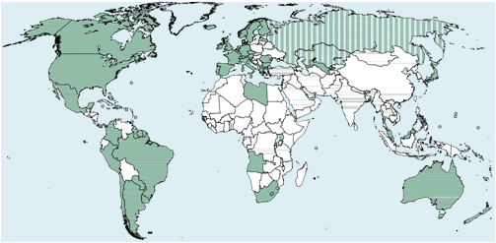
Overview:
HPV Vaccination Implementation
Nations with publicly funded HPV Vaccination Programs, from Bruni et al., 2016
Bolivia ?, Chile 2014, Colombia 2012, Ecuador planned, Peru 2011

Slide 15
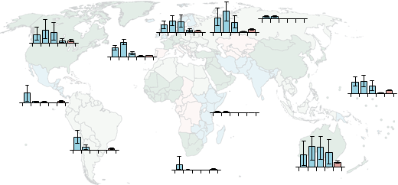
Overview:
HPV Vaccination Implementation
Eastern Europe
Western Europe
Northern Europe
North America
Southern Europe
Southeastern
Asia
Central America
Eastern Africa
South America
Southern Africa
Australia and New Zealand
Estimated full-course coverage of human papillomavirus vaccine by 2014, by age group and geographical region, from Bruni et al., 2016.
Bolivia ?, Chile 2014, Colombia 2011, Ecuador planned, Peru 2011

Slide 16
Overview: Vaccine Approvals
Despite proven efficacy, calculated cost-effectiveness, and a measure of political will, 11 years later the Andean region lacks universal HPV vaccination programs.
Attitudes towards HPV, vaccine supply costs, and vaccination implementation needs contribute to low vaccination rates.
Acceptable vaccination cost may be linked to both personal and national income, referred to in terms of gross domestic product (GDP).
Vaccination acceptability only leads to immunization if affordable vaccine is available.
Low HPV vaccination rates mean that the incidence of anal, cervical, oropharyngeal, penile, vaginal, and vulvar cancers, EGW, and RRP will not decline as rapidly as possible.

Slide 17
Overview: HPV
Vaccination Implementation
Given that LAC and LMIC may only have sufficient resources for either a CC screen and treat program or an HPV vaccination program, means of reducing HPV vaccination program cost will be identified.
It will be shown that there are resources available to provide HPV vaccination in the Andean region.
Two Peruvian concurrent screen and treat and HPV vaccination trials will be presented.
HPV vaccination introduction approach may predetermine successful attainment of adequate vaccination rates.

Slide 18
Methods
The PubMed database was searched in September 2015 and July 2017.
Searches used Bolivia, Chile, Colombia South America, Ecuador, or Peru, followed by the terms “HPV vaccine” or “HPV vaccination.”
Parameters were human subjects.
74 articles, of which 45 articles were excluded.
  Duplication (3 articles),
  Extraneous (4 articles),
  HPV genotyping (10 articles),
  Pathogenesis (3 articles),
  Phase 3 trials (1 articles)
  Redundant (3 articles),
  Sociocultural (5 articles),
  Spanish language (16 articles).
Other included articles:
  7 articles from prior searches, 1 update on HPV in Ecuador,
  1 articles on 9vHPV were added.
Total 37 included articles.

Slide 19
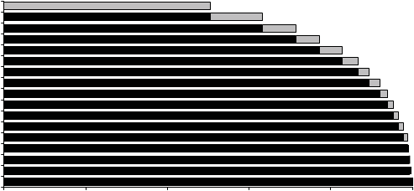
Andean Region HPV Vaccination Programs’ Cost-effectiveness
50.5
63.2
71.4
77.3
82.7
86.6
89.3
91.9
93.8
95.3
96.6
97.8
98.8
99.1
99.4
99.7
  Cost per vaccinated person, and vaccine efficacy for reduction of CC and EGW incidence are major determinants of HPV vaccine cost-effectiveness (Murillo et al., 2009).
  2vHPV or 4vHPV administered pre-coitarche may reduce CC by 65% in Central and South America (Murillo et al., 2009).
  The Pan American Health Organization (PAHO) has led HPV cost-effectiveness analysis workshops for all LAC (Andrus et al., 2008).
100
80
60
40
20
0
HPV-16
HPV-18
HPV-45
HPV-58
HPV-31
HPV-33
HPV-56
HPV-59
HPV-51
HPV-35
HPV-66
HPV-68
HPV-52
HPV-39
HPV-53
HPV-82
HPV-44
Cumulative % of CC cases attributable to specific single or multiple HPV types (Murillo et al., 2009)

Slide 20
Andean Region HPV Vaccination Programs’ Cost-effectiveness
  One of 5 blinded, placebo-controlled 3-dose international clinical trials of 4vHPV included 725 female Colombians and 393 female Peruvians aged 9-24-years-old who received 4vHPV (Perez et al., 2008).
    Placebo adjuvant aluminum vaccine was received by 637 female Colombians and 374 female Peruvians.
    At 7 months post vaccination series, the per protocol efficacy population (PPE) achieved 92.8% efficacy against cervical intraepithelial neoplasia grade 1 (CIN1) or worse, 95.3% efficacy against cervical intraepithelial neoplasia grade 2 (CIN2) or worse, 92.5% efficacy against CIN3, and 100% efficacy against EGW.
    Forty-three Colombians out of 6,004 total participants received HPV-16 monovalent vaccine.
    Pain, swelling, and erythema were the three most common adverse events (Andrus et al., 2008; Perez et al., 2008).

Slide 21
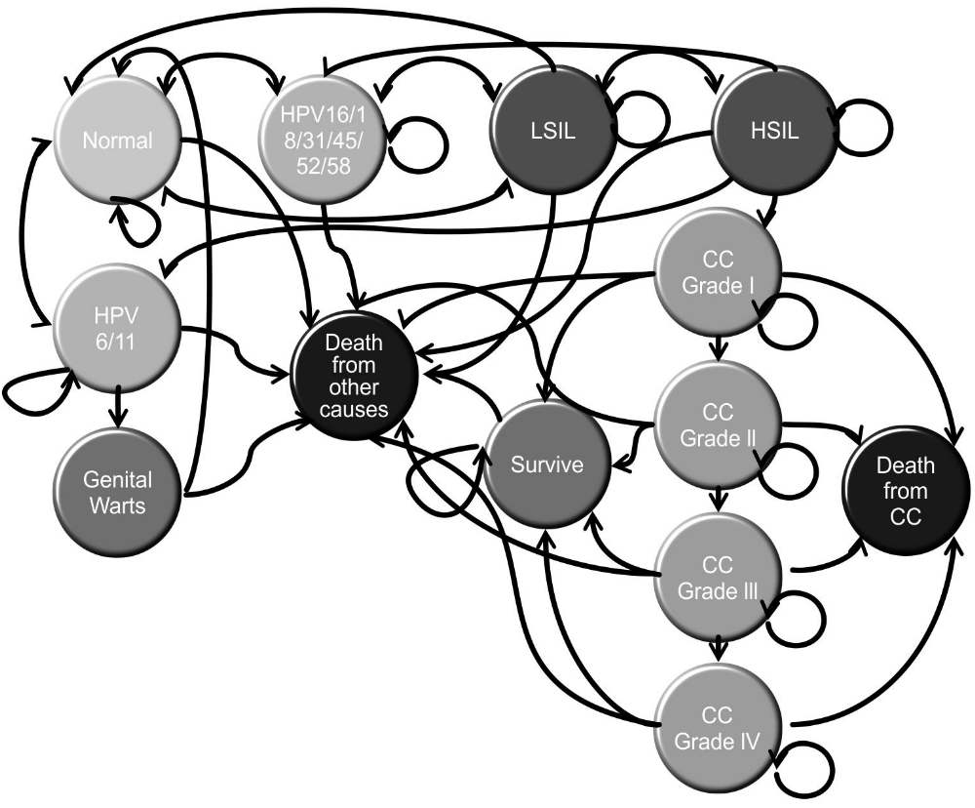
Andean Region HPV Vaccination Programs’ Cost-effectiveness
  While 2vHPV and 4vHPV have similar efficacy for HPV-16 and -18 etiologic CC and CIN1-3, 2vHPV has twice the effectiveness of 4vHPV against other HPV-type etiologic CC and CIN1-3 (Gomez et al., 2014).
  As HPV-18 occurs in only 2.8% of female Ecuadorian HPV-positive specimens, and HPV-6, -11, 16 and -18 occur .52-.67 times less often in Colombia than in the United States, 2vHPV with double the non-HPV-16 and -18 effectiveness, may be more cost-effective in Colombia and Ecuador than 4vHPV (Mejía et al., 2016; Velicer et al., 2009).
Markov CC Model
(Aponte-González et al., 2013 )

Slide 22
World Health Organization Vaccination Program Requirements
  World Health Organization (WHO) vaccination program requirements demand cost-effective.
    Cost-effectiveness is achieved if program year of life saved (YLS) or incremental cost-effectiveness ratio (ICER) per quality-adjusted-life-year is less than a nation’s gross domestic product (GDP).
The Peruvian cost would be $500-1,300 per year of life saved (YLS) at a $30.33-72.48 cost for one course of vaccine per girl, which is less than the 2005 Peruvian per capita GDP of $2,852 (in 2009 USD) (Goldie et al., 2012).
  HPV vaccination with current screening in Peru has a discounted incremental cost-effectiveness ratio (ICER) of $4,576 (in 2006 US$) per QALY (Colantonio et al., 2009).

Slide 23
World Health Organization Vaccination Program Requirements
  WHO’s goal is affordable, cost-effective vaccination programs befitting the public good (Banura et al., 2012).
  Vaccines should prevent diseases affecting public health.
  Vaccinations should be administered prior to exposure to the agent the vaccine is to protect against.
      HPV vaccination should occur before coitarche (Banura et al., 2012; Zimet et al., 2013).
Vaccination programmes should be logistically possible.
Vaccination programs can be financed.

Slide 24
Mathematical
Cost-effectiveness Models
  The Chilean National Health System Universal Access with Explicit Guarantees Plan (AUGE) ensures treatment of cervical cancer (Colantonio et al., 2009).
  Using a $210 overall cost of HPV vaccination (or $70 per dose in 2006 U.S.$), which is less than the Chilean per capita GDP of $8,865, the undiscounted cost of HPV vaccination for one birth cohort of 12-years-old Chilean females would be $21 million.
    When applied to Peru, this model gives an undiscounted HPV vaccination cost for one birth cohort of $45 million (Colantonio et al., 2009).
  In Chile, the projected incremental cost-utility ratio (ICUR)/incremental cost-effectiveness ratio (ICER) per quality-adjusted life years (QALY) for 2vHPV:4vHPV is 1:4.7 (116:541) and for life-years saved (LYS) 1:4.9 (147:726) (Gomez et al., 2014).
    In Chile, 2vHPV is economically expedient for addition to the existing CC screening program.
  In Colombia, where 37-61% of women age 18-25 years have annual CC screening, 4vHPV is cost-effective at US$ 49 or less per dose, whereas 2vHPV must cost $2 less (Aponte-González et al., 2013).
  Modeling with 9vHPV may yield a different outcome given expanded HPV type coverage.

Slide 25
Mathematical
Cost-effectiveness Models
  Pre-coitarche 2vHPV vaccination of 82% of Peruvian females would reduce the lifetime risk of cervical cancer by more than 50%, preventing 5,500 cases of cervical cancer, saving over 80,000 life years for one birth cohort (Goldie et al., 2012).
  At US$ 5 - 20 per dose, annual HPV vaccination would cost $5 million-$16 million, or from less than $300-$1,300 per year of life saved (YLS), which is less than the 2005 Peruvian per capita GDP of $2,852 in 2009 US$.

Slide 26
School-based HPV
Vaccination Programs
  Two Bolivian non-governmental organizations (NGOs) successfully applied for donated 4vHPV from the Gardasil Access Program (GAP) from 2009 to 2011 (Ladner et al., 2012).
    All other support for GAP approved programs comes from the applying nation.
  The 2009 Bolivian program covered 57 schools, targeting 3,480 9- to 13-years-old females, but achieved 107.4% program coverage by prolonging the vaccination period by two weeks to include unintended school sites, vaccinating 3,739 females at a 96.1% three-dose vaccination rate.
  The 2010 Bolivian program was both clinic- and school-based, with 258 sites, targeting 30,900 9- to 13-years-old females, achieving 89.3% program coverage, by vaccinating 27,597 females with a 96.2% three-dose vaccination rate.
  For successful school-based vaccination programs GAP recommends advanced coordination and logistical support, and planned completion of vaccination within the academic year limiting loss to follow-up.
  Mixed clinic- and school-based vaccination programs are better able to vaccinate persons absent from school on vaccination days, but require greater coordination and logistic support, and more cold chain capacity than do solely school-based vaccination programs.

Slide 27
School-based HPV
Vaccination Programs
  Peru undertook a pilot study of HPV vaccination of fifth grade females 9-years or older with the Program for Appropriate Technology in Health (PATH) in 2007.
  PATH, working within World Health Organization (WHO) guidelines, selected school based outreach for the Expanded Program on Immunization (EPI) delivery of HPV vaccination in Peru.
  This was a donated 4vHPV school-based vaccination program targeting 8,092 females attending 527 schools and 105 health centers in the Piura region of northwestern Peru in 2008 (LaMontagne et al., 2011; Penny et al., 2011).
  Peru simultaneously promoted HepBV for 2 to 11-years-old children, and upgraded the cold chain (Penny et al., 2011).

Slide 28
School-based HPV
Vaccination Programs
  Cascade training of vaccination program staff included effective communication (Penny et al., 2011).
    Regional planning meetings were held (Penny et al., 2011).
    Radio stations, television, and the print media concurrently advertised each of the three doses of the 4vHPV vaccination (Bartolini et al., 2012).
  Program success depended on health system capacity comprising personnel, physical structures, cold chain, immunization supplies, training, and reporting, without negatively affecting existing vaccination programs (Penny et al., 2011).
  In part due to single dose vial HPV packaging, cold chain capacity was to be increased by up to 103% in Ayacucho, 117% in Piura, and 167% Ucayali (Bartolini et al., 2010).
    82.6% of eligible females were vaccinated (95% CI 79.3-85.6), with 95% of vaccinations being school-based (Bartolini et al., 2012; LaMontagne et al., 2011; Penny et al., 2011).
  Support of educators accounted for 100% vaccination rates in some schools (PATH et al., 2010).
    In schools with uninvolved educators vaccination rates could be as low as 50%.
    As the consenting process for HPV was different than for HepBV some parents questioned the program’s legitimacy.

Slide 29
School-based HPV
Vaccination Programs
  School-based outreach can cost more than twice health-center based or integrated outreach (Levin et al., 2013).
    The lowest delivery cost per dose of HPV vaccine was $1.44 for Ugandan integrated outreach, contrasted with $3.88 for Peruvian school based outreach.
    Integrated outreach costs are dependent upon existing program capacity especially for storage and transportation, and simultaneous introduction of other new vaccines.
  PATH estimates that HPV vaccine introduction costs 5-13% of a national immunization budget, which may be greater than currently provisioned for EPI vaccines.
  Other program limitations are difficulties tracking receipt of all vaccination doses per person, training cost and time, logistics and expense of vaccination at isolated schools or in homes when doses were missed at school (Penny et al., 2011).
  Following the success of this school-based program, in April 2011 HPV was included in the Peruvian national vaccination schedule (LaMontagne et al., 2011; Penny et al., 2011).

Slide 30
Global Resources for
Improving HPV Vaccination Rates
Immunization is a global health focus area of the Program for Appropriate Technology in Health (PATH).
PATH, working within WHO guidelines, investigated school based outreach, health center based outreach, and integrated outreach into Expanded Program on Immunization (EPI) for delivery of HPV vaccination in Peru, Uganda, and Viet Nam (Levin, et al., 2013).
  School-based outreach, achieved 82.6%, 88.9%, and 87.8% vaccination rates respectively for Peru, Uganda, and Viet Nam (Levin, et al., 2013).
  School-based outreach can cost more than twice health-center based or integrated outreach (Table 2 and Figure 3).
  The lowest delivery cost per dose of HPV vaccine was $1.44 for Ugandan integrated outreach, contrasted with $3.88 for Peruvian school based outreach (Levin et al., 2013).
  Due to geographical logistics school based outreach in Uganda was proportionately more expensive than in Peru or Viet Nam.
  Integrated outreach costs are dependent upon existing program capacity especially for storage and transportation, and simultaneous introduction of other new vaccines (Levin, et al., 2013).

Slide 31
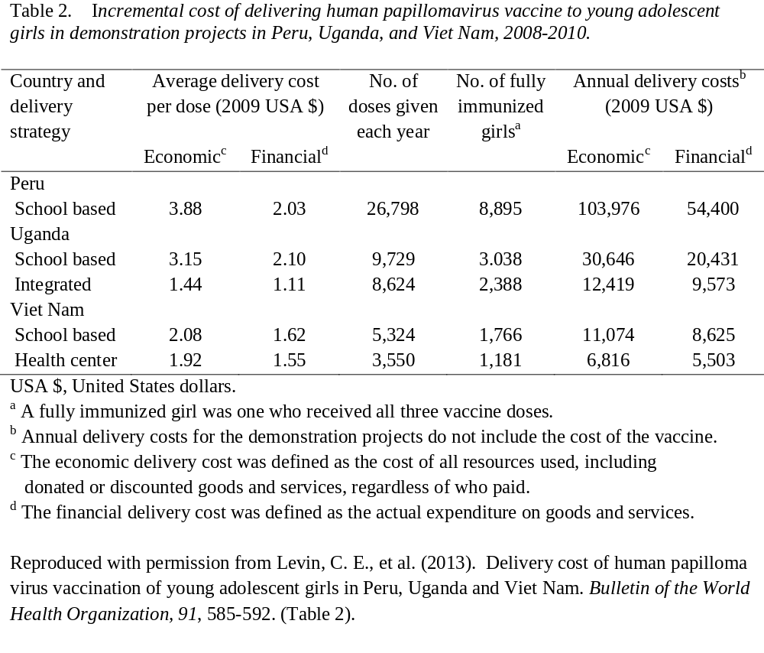
Global Resources for
Improving HPV Vaccination Rates

Slide 32
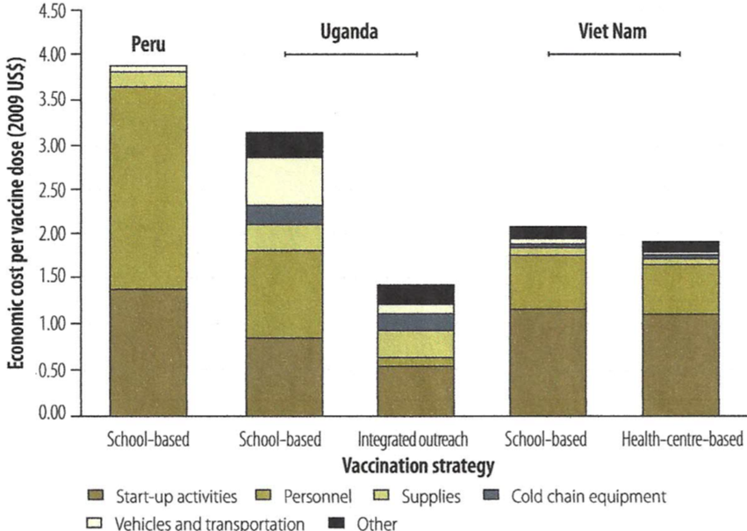
Global Resources for
Improving HPV Vaccination Rates
Profile of the economic cost of human papillomavirus vaccination strategies for young adolescent girls, Peru, Uganda and Viet Nam, 2008-2010. Reproduced with permission from Levin et al. (2013).

Slide 33
Health Center-based HPV
Vaccination Programs
  The Peru CC prevention study (PERCAPS) intended for mothers and daughters, comprised of self-sampling for HPV, and treatment of HPV with cryotherapy for 30- to 45-years-old mothers accompanied by 10- to 14-years-old daughters who received three doses of 4vHPV in Manchay (a shanty town outside Lima) and in the Iquitos region of Peru (Table 2) (Levinson et al., 2013).
    In the Manchay trial PERCAPS achieved a 90.6% three dose 4vHPV vaccination rate.
    The 2nd 4vHPV dose arrived onsite one month late by which time some study subjects were lost to follow-up.
    At completion 96.4% of PERCAPS subjects were willing to participate in another study.
    School-based vaccination was suggested to reduce logistical loss to follow-up from cold chain and other supply issues including delayed vaccine delivery.
  In the Iquitos region rural and urban trial of clinic-based 4vHPV (and school-based 2vHPV) vaccination, a 64.7% three dose vaccination rate was achieved (Abuelo et al., 2014).
    The lower completion rate was attributed to flooding of roads and bridges, impaired travel, delayed vaccine delivery, and loss of 64 subjects to follow-up .

Slide 34
Tools to Improve HPV
Vaccination Program Implementation
  In Chile, Colombia, and Peru public health insurance can be a mechanism for HPV vaccination. Bolivia’s and Ecuador’s public health systems could consider HPV vaccination as part of system modernizations. Increased public awareness of HPV-associated diseases and the prevention thereof by HPV vaccination through health promotion advocacy programs can improve public reception of HPV vaccination programs (Bartolini et al., 2010).
  2vHPV vaccination of 82% of one birth cohort of Peruvian females would reduce the lifetime risk of cervical cancer by more than 50%, preventing 5,500 cases of cervical cancer, saving about 2,625 lives (Goldie et al., 2012).
  In 2011 the Peruvian Ministry of Health planned to purchase 2vHPV for the national vaccination program targeting sequential birth cohorts of 10-years-old females at one-quarter the market price via the PAHO Revolving Fund (Vicari, 2011).

Slide 35
Means for Improving
HPV Vaccination Rates
  Immunization encounter reduction by simultaneous administration of HPV vaccine with either influenza vaccine or with tetanus, diphtheria, acellular pertussis vaccine (Tdap) and meningococcal vaccine (MCV4) eases the logistics of HPV vaccination program implementation while potentially increasing first and second dose HPV vaccine administration rates (Schilling et al., 2015).
    Co-administration of 9vHPV vaccine, Tdap, and MCV4 achieves equivalent immunogenicity as separate vaccination schedules, with a statistically significant increase in injection site swelling, p = .007.

Slide 36
Means for Improving
HPV Vaccination Rates
  None of the Andean region countries are currently eligible for support from the Global Alliance for Vaccines and Immunizations (GAVI), which works with the United Nations Children’s Fund (UNICEF), the WHO, the World Bank, and other organizations to assist in vaccination delivery in developing countries.
  The 4vHPV vaccine is prequalified by the WHO and available to GAVI at $5 per dose (LaMontagne et al., 2011).
    This price is less than both the $34 per dose cost negotiated by Mexico, and the $120 per dose price in the USA (Andrus et al., 2009).
    At $5 per dose, equating to $25 per vaccinated person, HPV vaccination cost is equivalent to other vaccination series and is also less than per capita GDP for all LAC, making further cost-effectiveness redundant (Andrus et al., 2009).
  HPV vaccination is further subsidized by GAVI in the most economically disadvantaged nations (Lowy & Schiller, 2012).
  Bolivia, a low-income country, was previously the only Andean nation qualified for GAVI new vaccine program introduction (Andrus et al., 2008).
  Chile is a middle-income country and would not normally qualify for GAVI, which supports the perceived need for Chilean cost-effectiveness studies prior to HPV vaccination program implementation (Colantonio et al., 2009; Marquez-Calderon et al., 2009).

Slide 37
Means for Improving
HPV Vaccination Rates
  HPV vaccine is also available for $10-15 per dose via the PAHO Revolving Fund of the WHO established in 1977 for LMIC LAC (Andrus et al., 2009; Levin et al., 2013).
    PAHO Revolving Fund $40 million working capital allows LMIC LAC to reimburse PAHO within 60 days of receipt of vaccine (Andrus et al., 2009).
  Of note, PAHO adopted a Regional Strategy and Plan of Action for Cervical Cancer Prevention and Control, within the ProVac Initiative in 2008.
    ProVac allows for rapid start HPV vaccination programs (Bartolini et al., 2010).
  Since 2004 ProVac has worked to improve LAC public health infrastructure, assure availability of appropriate data and analysis thereof for policy formation, promote new vaccination implementation programs, and foster partnerships for attainment of health care goals (Andrus et al., 2008).
  Peru has ordered 600,000 doses of HPV vaccine from PAHO (Goldie et al., 2012).
  The Peruvian immunization budget was increased by 500% from 2006 to 2010 for the 2011 launch of HPV vaccination (Levin et al., 2013).

Slide 38
Considerations
  Comparative study of national vaccination programs or mathematical models thereof would be facilitated if identical types of data were published. For instance, some authors use discounted and undiscounted costs, total quality-adjusted life years, QALYs gained, and incremental cost-effectiveness ratio (ICER) per QALY gained, whereas other authors use cost per YLS or YLL (Colantonio et al., 2009; Goldie et al., 2012).

Slide 39
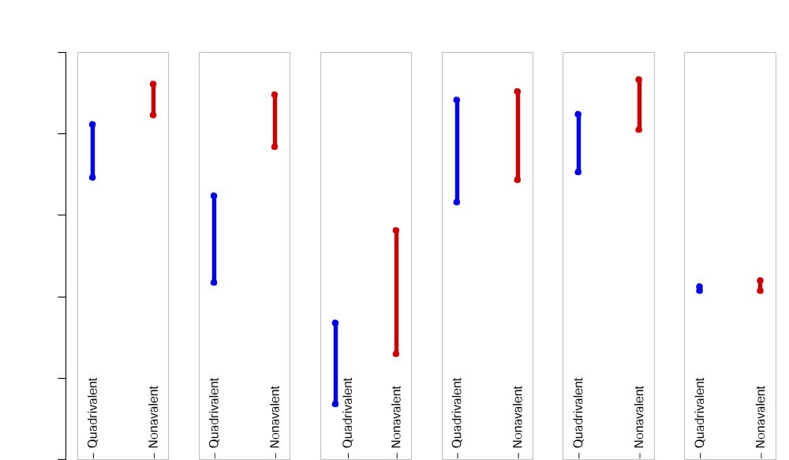
Considerations
  Given differing efficacy against non-HPV 16/18 genotypes, in Colombia and Ecuador, and other nations with comparatively low HPV 18 prevalence, 2vHPV with greater immunogenicity than 4vHPV, and 9vHPV with broader immunogenicity than 4vHPV, may be more cost-effective than 4vHPV (Gomez et al., 2014).
100
80
60
40
20
0
Potential Effect of 4vHPV and 9vHPV vaccines %
Invasive CC High-grade Low-grade EGW Anal Cancer Oropharyngeal
(From Riethmuller et al., 2015) Cancer

Slide 40
Considerations
  Given documented pregnancies at 10-years-old, it is recommended that national guidelines permit initiation of HPV vaccination at 9-years-old, which is consistent with manufacturers’ guidelines (Abuelo et al., 2014).
  Many LAC and LMIC are in regions with drastic seasonal climate and other geophysical variables (earthquake, tornado, monsoon).
    To preclude interruption of vaccination programs by uncontrollable climate and geophysical variables, vaccination programs should be held in the most stable season.
    In Peru the goal should be to start annual vaccination drives simultaneously with the onset of the dry season.
    If all 2 or 3 doses cannot be accommodated within one dry season, plan to give the 2nd and/or 3rd dose in the following year when the first dose is administered to the next birth cohort.
  Multi-dose vials should reduce cold chain infrastructure needs.

Slide 41
Considerations
  HPV background prevalence reduction could be approached in a similar manner to elimination of rubella (Andrus et al., 2008):
  First, attain high vaccination rates for male and female birth cohorts at 9-years-old, primarily via school based vaccination programs.
  Second, vaccinate those 10- to 26-years-old who were not vaccinated as part of a birth cohort.
  Third, improve secondary prevention screen and treat programs for cervical cancer that will also serve as vaccination program effectiveness surveillance.

Slide 42
Considerations
  Increasing HPV awareness via media campaigns and health care worker promotion emphasizing CC primary prevention, increasing the volume of trained community health workers (CHWs) and health leaders (HLs), coupled with increased cold chain capacity to preclude delays in vaccine delivery at administration sites form part of a health systems strengthening diagonal approach (Farmer et al., 2010; LaMontagne et al., 2011).
    Requires collaboration with national Ministries of Health who may also participate in the PAHO Directing Council of Ministers of Health (Andrus et al., 2008).
  Consistent nationwide use of school-based or integrated clinic- and school-based programs requires collaboration with national Ministries of Education (Andrus et al., 2008).
    Funding for the nationwide vaccination programs may be more available if Ministers of Finance are also involved.
  Consistent consenting processes for all adolescent vaccines will promote the legitimacy of vaccination programs in the community (LaMontagne et al., 2011).
    Consenting may begin in the prior academic year so that signed consents are available at the start of the vaccination academic year.

Slide 43
Conclusion
  Varied HPV vaccination cost-effectiveness study methodology precludes direct study comparison.
  Increasing acceptance of more affordable 2-dose instead of costlier 3-dose HPV vaccination schedules reduces the direct applicability of much of the existing HPV vaccination cost-effectiveness studies.
  Irrespective of whether a 2- or 3-dose HPV vaccination program is chosen, the framework for vaccination program implementation remains constant: Program maintenance costs should be reduced.
  Vaccination program models and supportive international agencies are in place to assist national vaccination program implementation.
  Political will driving the necessary policy enactment and cooperation between Ministries of Education, Health, and Finance, are crucial for successful implementation and maintenance of Andean nation HPV vaccination programs.

Slide 44
CME Questions
1) Which of the following statements about school-based vaccination is false?
A. Reduces demand for cold chain capacity.
B. Loss to follow-up occurs after an academic year.
C. Educators’ support is ineffectual.*
D. Using the same consenting process as for other vaccines increases parental
acceptance of HPV vaccination.
E. Delivery cost for school-based vaccination is higher than for integrated delivery.
2) Funding support for human papilloma virus (HPV) vaccination programs include:
A. The Pan American health Organization (PAHO) Revolving Fund.
B. The Global Alliance for Vaccines and Immunizations (GAVI).
C. Reduced delivery costs administring human papilloma virus (HPV) vaccination with
pre-existing vaccination programs such as diphtheria, tetanus and pertussis (DTaP);
measles, mumps, and rubella (MMR); and varicella vaccination programs.
D. The Program for Appropriate Technology in Health (PATH).
E. All of the above.*
The World health Organization (WHO) criteria for establishment of vaccination programs do not include which of the following?
A. The vaccine should prevent a disease important to public health.
B. The vaccination program should be logistically possible.
C. Financing mechanisms should be in-place to support the vaccination program.
D. The vaccination program does not need to be cost effective.*
E. Vaccination should be given before exposure to the agent the vaccine protects
against.

Slide 45

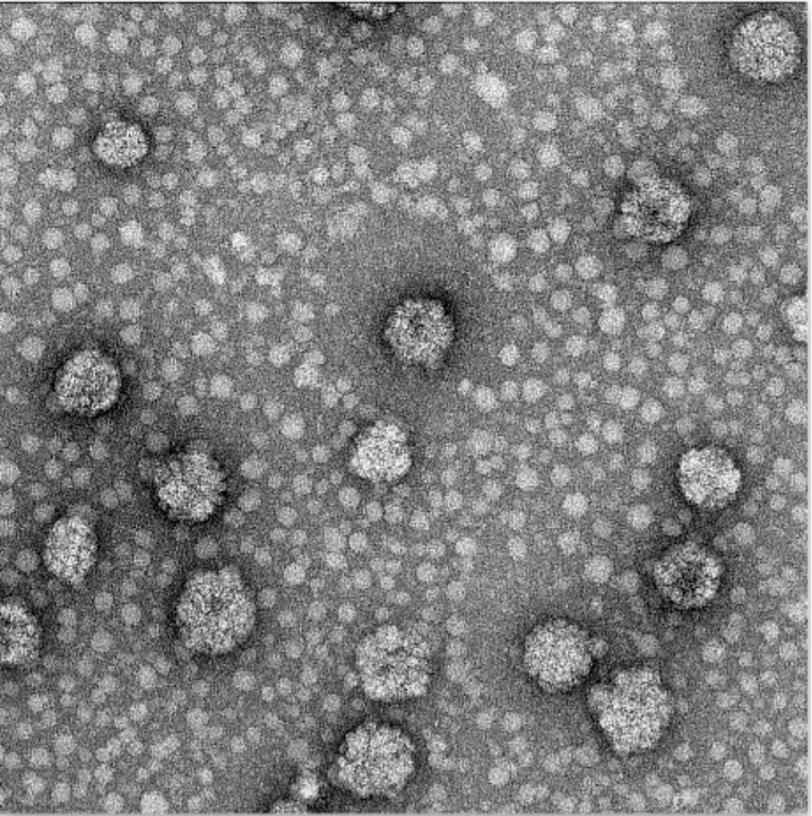
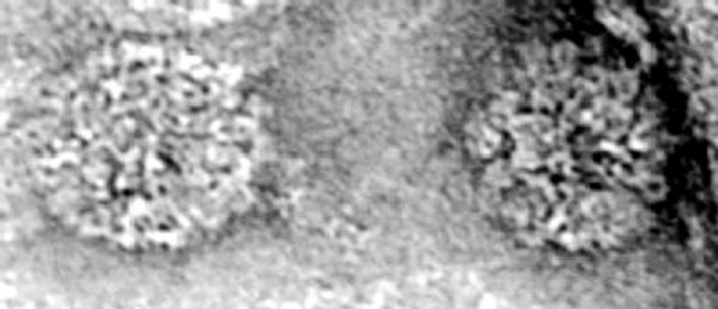
Email for Dr. Nwanodi:
onwanodi@atsu.edu
Virus-like particles composed of HPV-16 L1 protein and plant made HPV 16 VLPs. From Viroblogy. Virology-related and hopefully educational posts. Post tagged ‘HPV’. Retrieved from https://rybicki.wordpress.com/tag/hpv/

Slide 46
References (A to G)
Abuelo CE, Levinson KL, Salmeron J, Sologuren CV, Fernandez MJV, et al. (2014) The Peru Cervical Cancer Screening Study (PERCAPS): the design and implementation of a mother/daughter screen, treat, and vaccinate program in the Peruvian jungle. J Community Health 39(3): 409-415.
Alemany L, Saunier M, Tinoco L, Quirós B, Alvarado-Cabrero I, et al. (2014) Large contribution of human papillomavirus in vaginal neoplastic lesions: A worldwide study in 597 samples. European Journal of Cancer 50: 2846-2854.
Andrus JK, de Quadros C, Matus CR, Luciani S, Hotez P (2009) New vaccines for developing countries: Will it be feast or famine? American Journal of Law & Medicine 35(2-3): 311-322.
Andrus JK, Lewis MJ, Goldie SJ, García PJ, Winkler JL, et al (2008) Human papillomavirus vaccine policy and delivery in Latin America and the Caribbean. Vaccine 26 Suppl 11: L80-L87.
Aponte-González J, Fajardo-Bernal L, Diaz J, Eslava-Schmalbach J, Gamboa O, et al. (2013) Cost-effectiveness analysis of the bivalent and quadrivalent human papillomavirus vaccines from a societal perspective in Colombia. PLOS ONE 8(11): e80639
Banura, C., Mirembe, F. M., Katahoire, A. R., Namujju, P. B., & Mbidde, E. K. (2012). Universal routine HPV Vaccination for young girls in Uganda: a review of opportunities and potential obstacles. Infectious Agents and Cancer, 7, 24. http://dx.doi.org/10.1186/1750-9378-7-24
Bartolini RM, Drake JK, Creed-Kanashiro HM, Diaz-Otoya MM, Mosqueira-Lovón NR, et al (2010) Formative research to shape HPV vaccine introduction strategies in Peru. Salud Publica Mex 52(3): 226-233.
Bartolini RM, Winkler JL, Penny ME, LaMontagne DS (2012) Parental acceptance of HPV vaccine in Peru: a decision framework. PLoS One 7(10): e48017.
Brown B, Carcamo C, Blas MM, Valderrama M, Halsey N (2010) Peruvian FSWs: understanding HPV and barriers to vaccination. Vaccine 28(49): 7743-7747.
Bruni L, Barrionuevo-Rosas L, Albero G, Serrano B, Mena M, et al. (2017a) Human Papillomavirus and
Related Diseases in Ecuador. Summary Report 30 June 2017. ICO Information Centre on HPV and Cancer (HPV Information Centre).
Bruni L, Diaz, M, Barrionuevo-Rosas L, Herrera R, Bray F, et al. (2016) Global estimates of human papillomavirus vaccination coverage by region and income level: a pooled analysis. Lancet Global Health 4:e453-e463.
Colantonio L, Gomez JA, Demarteau N, Standaert B, Pichón-Rivière A, et al. (2009) Cost-effectiveness analysis of a cervical cancer vaccine in five Latin American countries. Vaccine 27(40): 5519-5529.
Farmer P, Knaul FM, Shulman LN, Alleyne G, Armstrong L, et al (2010) Expansion of cancer care and control in countries of low and middle income: a call to action. Lancet 376(9747): 1186-1193.
Forman D, de Martel C, Lacey CJ, Soerjomataram I, Lortet-Tieulent J, et al (2012) Global burden of human papillomavirus and related diseases. Vaccine 30 Suppl 5: F12-F23.
Goldie SJ, Diaz M, Constenla D, Alvis N, Andrus JK, et al. (2008) Mathematical models of cervical cancer prevention in Latin America and the Caribbean. Vaccine 26S, L59-L72.

Slide 47
References (G to Mejía)
Goldie SJ, Levin C, Mosqueira-Lovón NR, Ortendahl J, Kim J, et al. (2012) Health and economic impact of human papillomavirus 16 and 18 vaccination of preadolescent girls and cervical cancer screening of adult women in Peru. Rev Panam Salud Publica 32(6): 426-434.
Gomez JA, Lepetic A, Demarteau N (2014) Health economic analysis of human papillomavirus vaccines in women of Chile: perspective of the health care payer using a Markov model. BMC Public Health 14: 1222.
LaMontagne DS, Barge S, Le NT, Mugisha E, Penny ME, et al. (2011) Human papillomavirus vaccine delivery strategies that achieved high coverage in low- and middle-income countries. Bull World Health Organ 89(11): 821-830B.
Ladner J, Besson MH, Hampshire R, Tapert L, Chirenje M, et al (2012) Assessment of eight HPV vaccination programs implemented in lowest income countries. BMC Public Health 12: 370.
Lee FH, Paz-Soldan VA, Carcamo C, García PJ, et al. (2010) Knowledge and attitudes of adult Peruvian women vis-a-vis Human Papillomavirus (HPV), cervical cancer, and the HPV vaccine. J Low Genit Tract Dis 14(2): 113-117
Levin CE, Van Minh H, Odaga J, Rout SS, Ngoc DN, et al. (2013) Delivery cost of human papilloma virus vaccination of young adolescent girls in Peru, Uganda and Vietnam. Bull World Health Organ 91(8): 585-592.
Levinson KL, Abuelo C, Chyung E, Salmeron J, Belinson SE, et al (2013) The Peru cervical cancer prevention study (PERCAPS): community-based participatory research in Manchay, Peru. Int J Gynecol Cancer 23(1): 141-147.
Lowy DR, Schiller JT (2012) Reducing HPV-associated cancer globally. Cancer
Prevention Research 5(1), 18-23.
Luna J, Plata M, Gonzalez M, Correa A, Maldonado I, et al. (2013) Long-term follow-up observation of the safety, immunogenicity, and effectiveness of gardasil in adult women. PLOS ONE 8(12): e83431.
Marquez-Calderon S, Lopez-Valcarcel BG, Segura A (2009) Medical societies' recommendations for immunization with human papillomavirus vaccine and disclosure of conflicts of interests. Preventive Medicine 48: 449-453.
Mejía L, Muñoz D, Trueba G, Tinoco L, Zapata S (2016) Prevalence of human papillomavirus types in cervical cancerous and precancerous lesions of Ecuadorian women. J Med Virol 88(1): 144-152.

Slide 48
References (Mu to V)
Murillo R, Herrero R, Sierra MS, Forman D (2016) Cervical cancer in Central and South America: Burden of disease and status of disease control. Cancer Epidemiology S121-S130.
Murillo R, Molano M, Martinez G, Mejia JC, Gamboa O (2009) HPV prevalence in Colombian women with cervical cancer: implications for vaccination in a developing country. Infect Dis Obstet Gynecol 2009: 653598.
PATH, I.D.I.N.I., and Ministerio de Salud (MINSA) de Peru, Estrategia la Sanitaria nacional de Inmunizaciones (ESNI) HPV Vaccination in Latin America (2010) Lessons learned from a pilot program in Peru, Seattle, WA: Program for Appropriate Technology in Health.
Penny M, Bartolini R, Mosqueira NR, La Montagne DS, Mendoza MA, et al (2011) Strategies to vaccinate against cancer of the cervix: feasibility of a school-based HPV vaccination program in Peru. Vaccine 29(31): 5022-5030.
Perez G, Lazcano-Ponce E, Hernandez-Avila M, García PJ, Muñoz N, et al (2008) Safety, immunogenicity, and efficacy of quadrivalent human papillomavirus (types 6, 11, 16, 18) L1 virus-like-particle vaccine in Latin American women. Int J Cancer, 122(6): 1311-1318.
Piñeros M, Hernández-Suárez G, Orjuela L, Vargas JC, Pérez G (2013) HPV knowledge and impact of genital warts on self esteem and sexual life in Colombian patients. BMC Public Health 13: 272.
Riethmuller D, Jacquard A-C, St. Guily JL, Aubin F, Carcopino X, et al. (2015) Potential impact of a nonavalent HPV vaccine on the occurrence of HPV-related diseases in France. BMC Public Health 15:453.
Sanchez GI, Jaramillo R, Cuello G, Quintero K, Baena A, et al. (2013) Human papillomavirus genotype detection in recurrent respiratory papillomatosis (RRP) in Colombia. Head Neck 35(2): 229-234.
Schilling A, Parra MM, Gutierrez M, Restrepo J, Ucros S, et al. (2015) Coadministration of a 9-valent human papillomavirus vaccine with meningococcal and Tdap vaccines. Pediatrics 136(3): e563-e572.
Soohoo M, Blas M, Byraiah G, Carcamo C, Brown B (2013) Cervical HPV Infection in Female Sex Workers: A Global Perspective. Open AIDS J 7: 58-66.
Suarez E, Prieto M (2006) Cervical cancer: The Chilean perspective. Int J Gynaecol Obstet 95(Suppl 1): S235-S238.
Velicer C, Zhu X, Vuocolo S, Liaw K-L, Saah A (2009) Prevalence and incidence of HPV genital infection in women. Sexually Transmitted Diseases 36(11): 696-703.
Vicari A (2011) Peru introduces nationwide HPV vaccination; Argentina announces HPV vaccine introduction. Global Immunization News 1.
Zimet, G. D., Rosberger, Z., Fisher, W. A., Perez, S., & Stupiansky, N. W. (2013). Beliefs, behaviors and HPV vaccine: Correcting the myths and the misinformation. Preventive Medicine, 57, 414-418. http://dx.doi.org/10.1016/j.ypmed.2013.05.013

