Slide 1


The Relationship Between Plantar Flexor Spasticity and Swing Phase of Gait Cycle in Children with Hemiplegic Cerebral Palsy
¹Orhan ÖZTÜRK, ¹Zübeyir SARI, ²Yasemin KALA, ²Hüseyin BOL,
¹Onur AYDOĞDU, ¹Mine Gülden POLAT
¹Marmara University, Health Science Faculty, Physiotherapy and Rehabilitation Department,
²Turkey Spastic Children Foundation
İstanbul 34862, Turkey

Slide 2
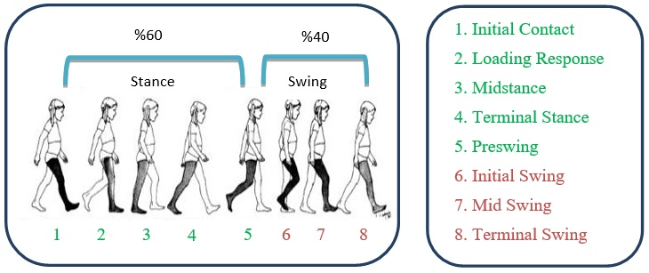
Background
Gait cycle consists of two main periods which are stance phase and swing phase.

Slide 3
Background
Spasticity and Gait Cycle
  Prolonged swing period leads contralateral limb to carry more weight than normal. And that causes to occur secondary problems in children with hemiplegic Cerebral Palsy (CP) in later periods.

Slide 4
Purpose
To determine the relationship between plantar flexor spasticity and duration of swing phase of gait cycle in children with hemiplegic CP.

Slide 5
Participants
Inclusion Criterion
  Diagnosed as hemiplegic CP
  Children between 5-10 years old
  Able to walk independently (GMFCS level 1 or 2).
  Turkey Spastic Children Foundation’s official committee’s approval for gait analysis
Exclusion Criterions
  Being injected Botulinum Toxin A at least 4 months earlier than examination.
  Being operated at least 6 months earlier than examination.
20 children (mean age: 7.3±1.89 y, 10 girls, 10 boys) who match with the classification criterias for hemiplegic pathologic gait Type 1 and Type 2 made by Winters an al.* recruited to study.
*J Bone Joint Surg Am. 1987; 69: 437-41

Slide 6
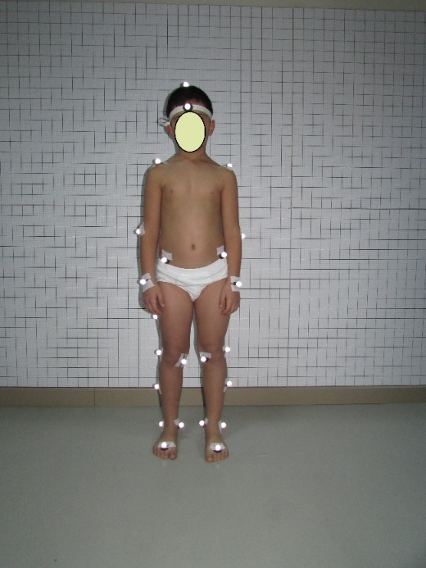
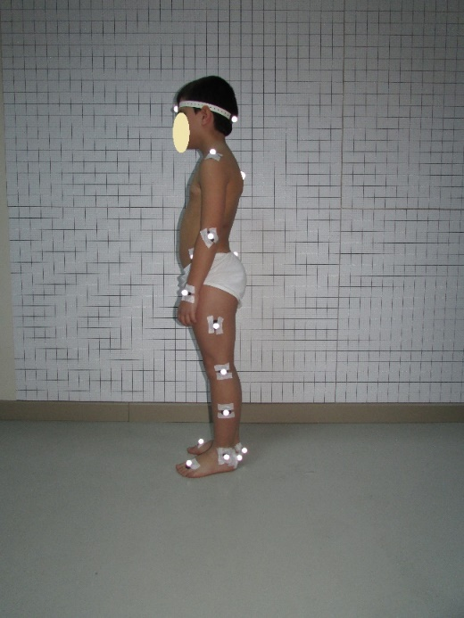
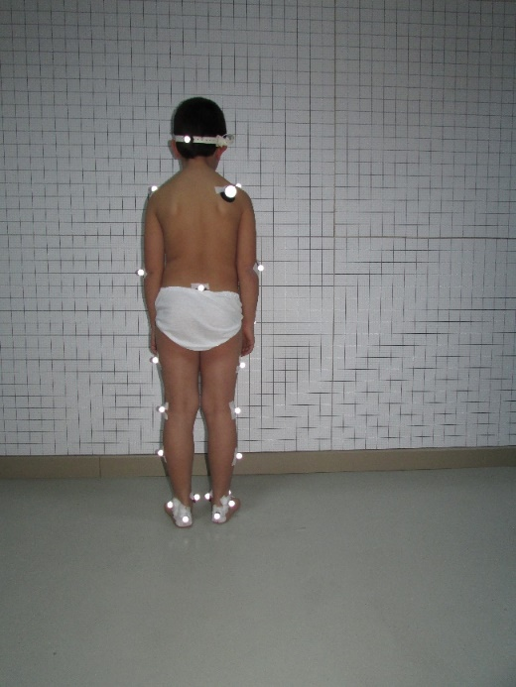
Method
Initially, twenty nine reflective markers were affixed to the children’s skin with double-sided tape by the same physiotherapist.
Anatomical landmarks on the pelvis, upper and lower extremities were selected by using the Helen Hayes Marker Set

Slide 7
Method
The Osprey Digital Real Time System was used for three dimensional (3-D) gait analysis. This system consists of eight Osprey camera which were capable to image 245 frames/s.
Kinematic and kinetic data were analysed in the sagittal plane and normalized over the gait cycle using the Orthotrack Software.

Slide 8
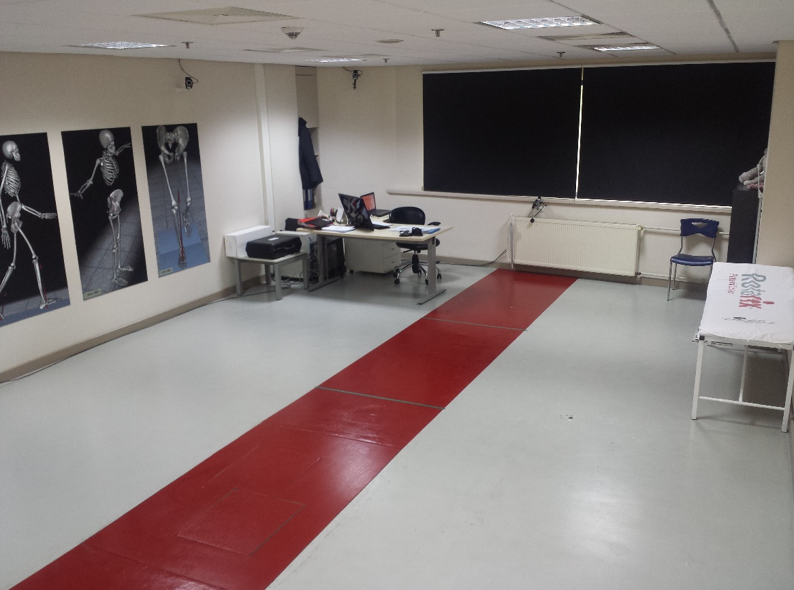
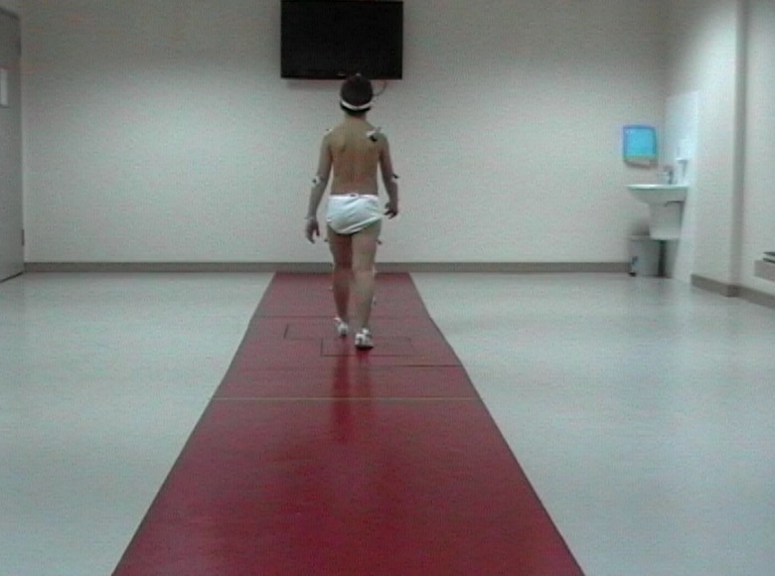
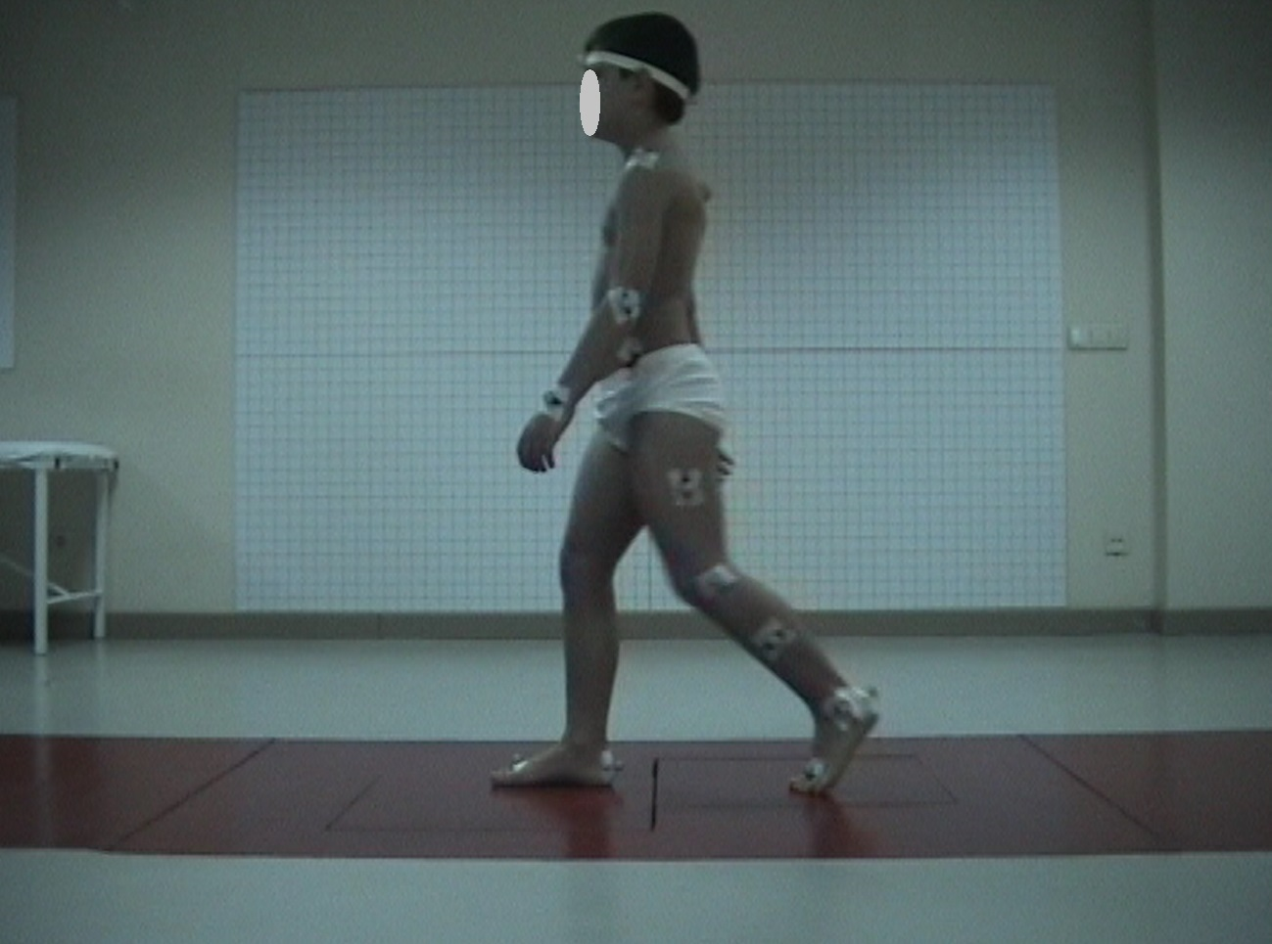
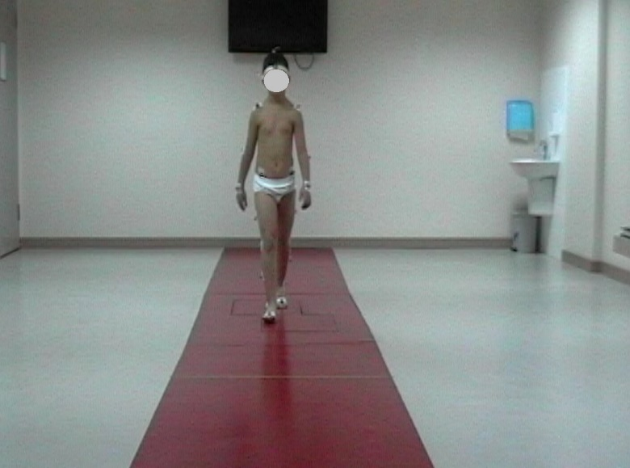
Turkey Spastic Children Foundation
Gait Analysis Lab

Slide 9
Method
After twenty nine markers were placed and 3-D gait analysis were performed, plantar flexor spasticity was evaluated with Modified Ashworth Scale by the same physiotherapist.

Slide 10
Statistical Analysis
The correlation between plantar flexor spasticity and swing phase duration was analysed with Spearman Correlation Test.
As statistical analysis programme, we used Statistical Package for Social Sciences” (SPSS) Version 11.5 (SPSS inc, Chicago, IL, ABD).

Slide 11
Result
Duration of the affected limb swing phase in gait cycle was, in average, 57.19±7,37% in children with hemiplegic CP recruited to the study.
According to analysis, there was a positive statistically significant correlation between plantar flexor spasticity and swing phase duration of affected limb (p:0,011) (rho=0,554).

Slide 12
Discussion
As hypothesized, asymmetrical limb loading due to plantar flexor spasticity caused alteration of proportion of gait cycle phases. The body weight was mainly supported by unaffected lower limb in hemiplegic CP and thus, it took longer time to transfer the body weight from unaffected side to affected side. This is consistent with the data published by Bensoussan et al. (2006) and Stackhouse et al (2007).

Slide 13
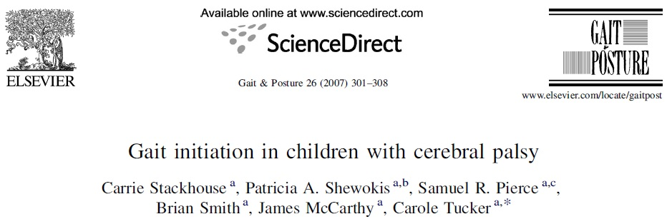
It was reported that there was a reduced lateral shifting of the COP due to plantar flexor spasticity in children with hemiplegic CP. This lateral shift reduction was related to load the less affected limb more than the more affected limb.

Slide 14
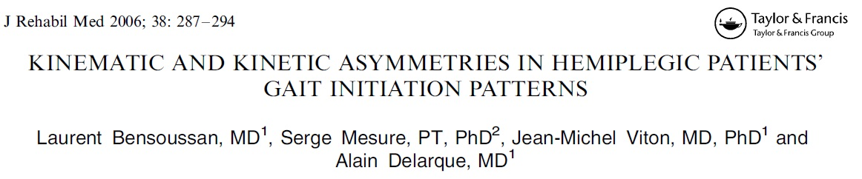
It was suggested that the lack of equilibrium in the hemiplegic limb also required more time to transfer the body weight onto the affected side.
In other words, this expression was releated with prolonged swing phase.

Slide 15
Conclusion
This asymmetrical limb loading should be took into account while planning rehabilitation programme and also the exercise should be done to gain symmetrical limb loading. Thus, we can remedy the duration gait phases.
Also long term follow-up will give an opportunity to determine secondary problems of this situation in the future.

Slide 16
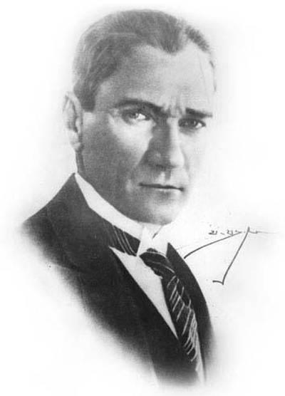
History is not the duty of politicians.
fzt.orhanozturk@gmail.com

