Slide 1
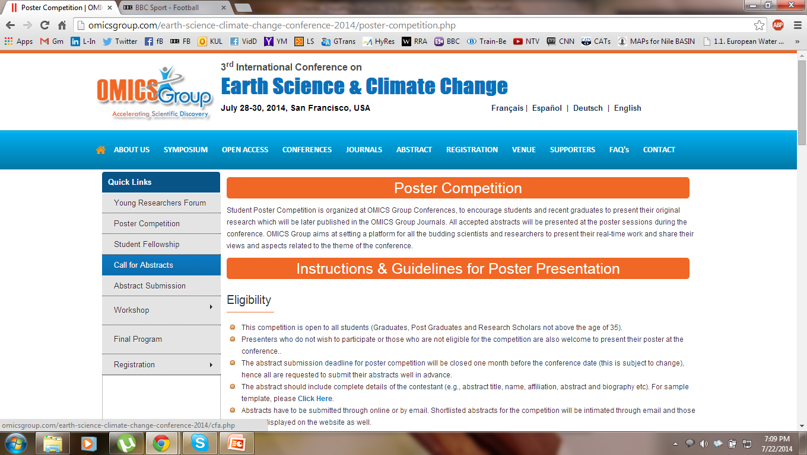
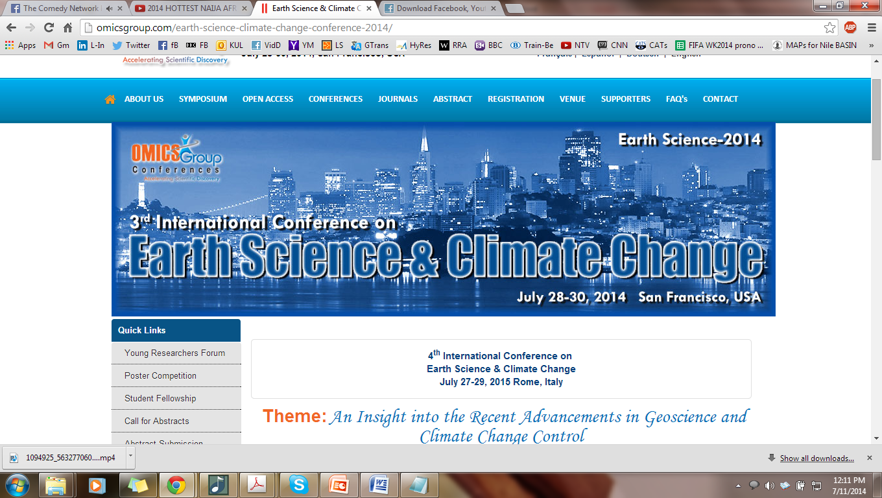
Uncertainties in Impact Assessment of Climate Change on Rainfall Extremes in the Lake Victoria Basin
C. Onyutha, P. Nyeko-Ogiramoi & P. Willems
July 28th, 2014

Slide 2
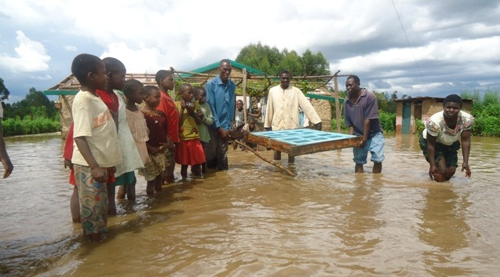
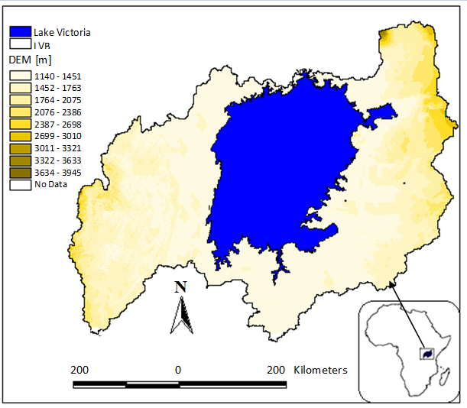
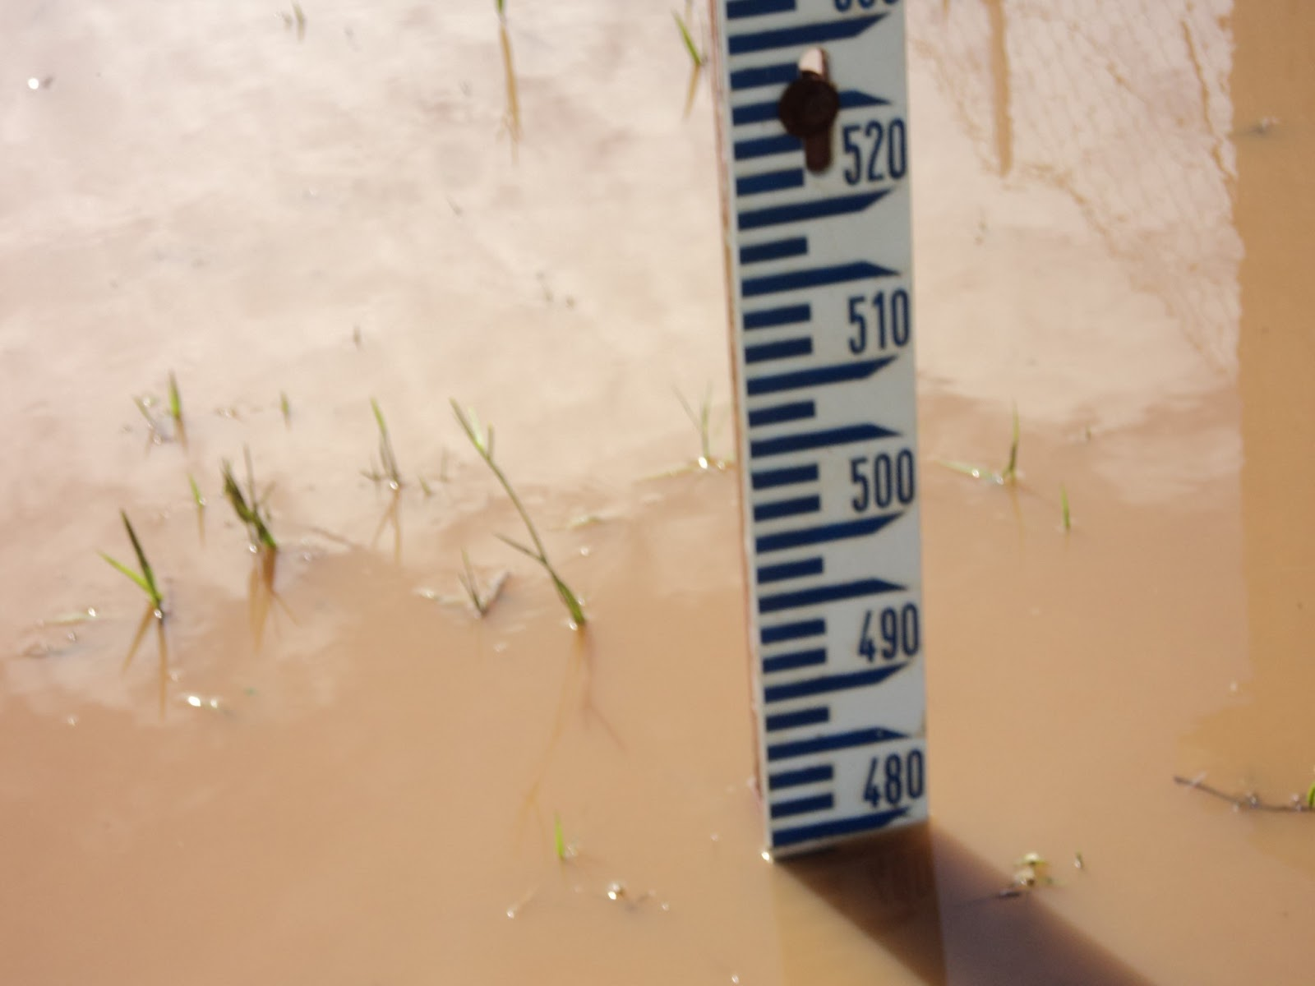
Why Lake Victoria Basin?
World
LVB has 2nd largest fresh water lake
R. Nile
Key source
Extreme rainfalls
episodes of floods
+ loss of lives
+ damage to prop.
Population
- so high
- increased poverty
Need for proper mgt of water resource
3rd International Conference on Earth Science and Climate Change

Slide 3

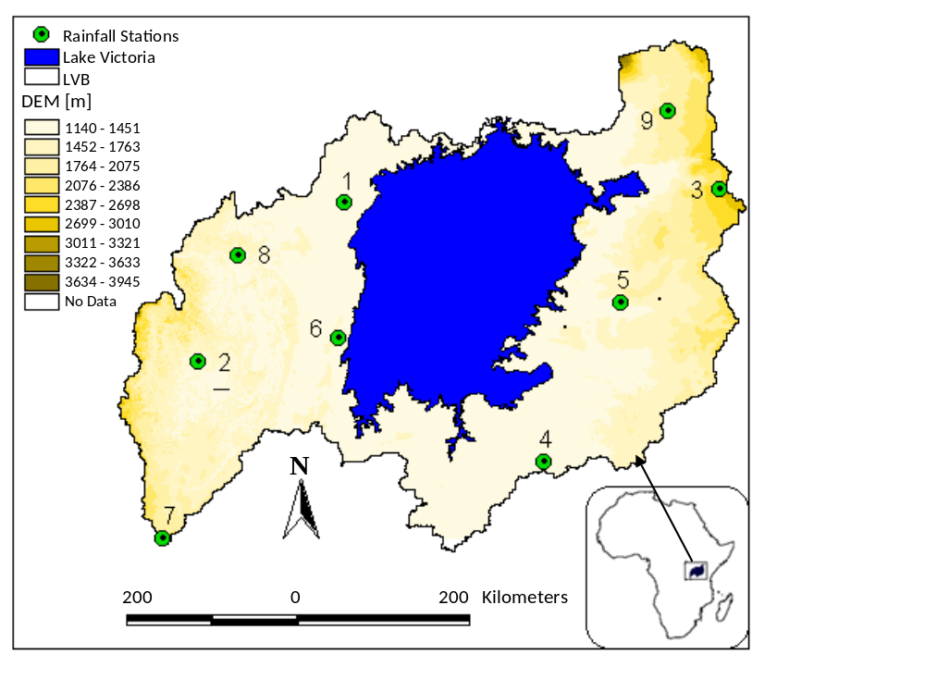
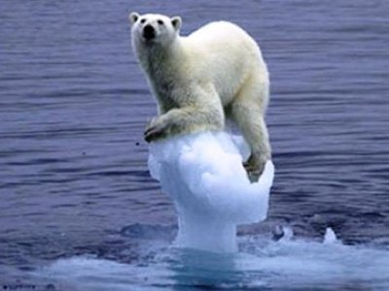
Data
Rainfall
1961-2000
GCMs
14 – CMIP3
7 – CMIP5
Control/Hist. sim
20 – CMIP3
17 – CMIP5
Fut. Projections
53 – CMIP3
35 – CMIP5
Horizon
2049-2065 [2050s]
2081-2100 [2090s]
Scenarios
B1-550ppm of CO₂
A1B-720ppm of CO₂
A2-850ppm of CO₂
Scenarios
B1, A1B, A2 – CMIP3
rcp4.5, 6.0, 8.5 – CMIP5
3rd International Conference on Earth Science and Climate Change

Slide 4


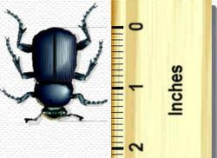
Sources of uncertainty
Those due to:
Sampling extremes
Inter-GCM differences
Difference between statistical downscaling methods
3rd International Conference on Earth Science and Climate Change

Slide 5
Uncertainty – sampling of extremes
Data limitation: sampling extremes
Risk based applications: - detailed representation - rainfall
Planning, Design & Operation: accurate descriptive study - extremes &
recurrence rates - long-term series
Extreme value analysis: Data scarce area - short-term series –extrapolation
Predictive uncertainty: - large - important to quantify for decision making
3rd International Conference on Earth Science and Climate Change

Slide 6


Quantifying uncertainty
How ?
Extract independent extremes – AMS/PDS
Station 4
POTs
EVD fitting
Resampling
POTs
3rd International Conference on Earth Science and Climate Change

Slide 7
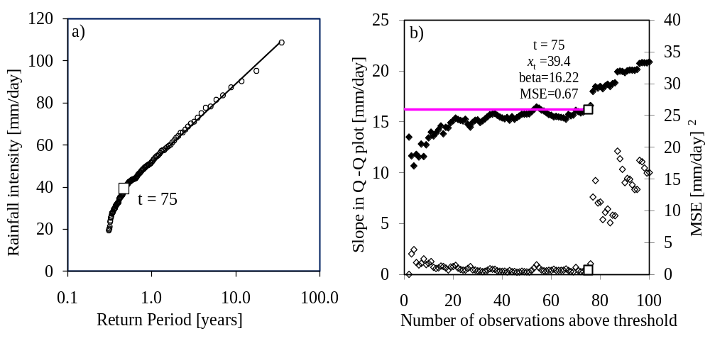
Quantifying uncertainty
How ?
Parameter estimation – GPD(loc, scale, shape) - fit distribution - Q-Q plot
Method – Weighted Linear Regression*
POTs
EVD fitting
Resampling
Station 5
EVD fitting
*Onyutha, C. & Willems, P. (2014). Uncertainty in calibrating generalised Pareto distribution to rainfall extremes in Lake Victoria basin. Hydrol. Res. Doi:10.2166/nh.2014.052
3rd International Conference on Earth Science and Climate Change

Slide 8
Quantifying uncertainty
How ?
Uncertainty on extremes– resampling - Jackknife – at 5% lev. Sig
Delete i^{th} event from POTs of size w
Determine Ɵ(β,γ,x_{t}) of EVD using (w -1) POTs
Steps (a) and (b) repeated w times
Rank w sets of Ɵ(β,γ,x_{t}) in descending order
Upper and lower limits are determined from [0.025× w]^{th} and [0.975× w]^{th} Ɵ(β,γ,x_{t})
95% CI determined using (e) above
POTs
EVD fitting
Resampling
Resampling
3rd International Conference on Earth Science and Climate Change

Slide 9
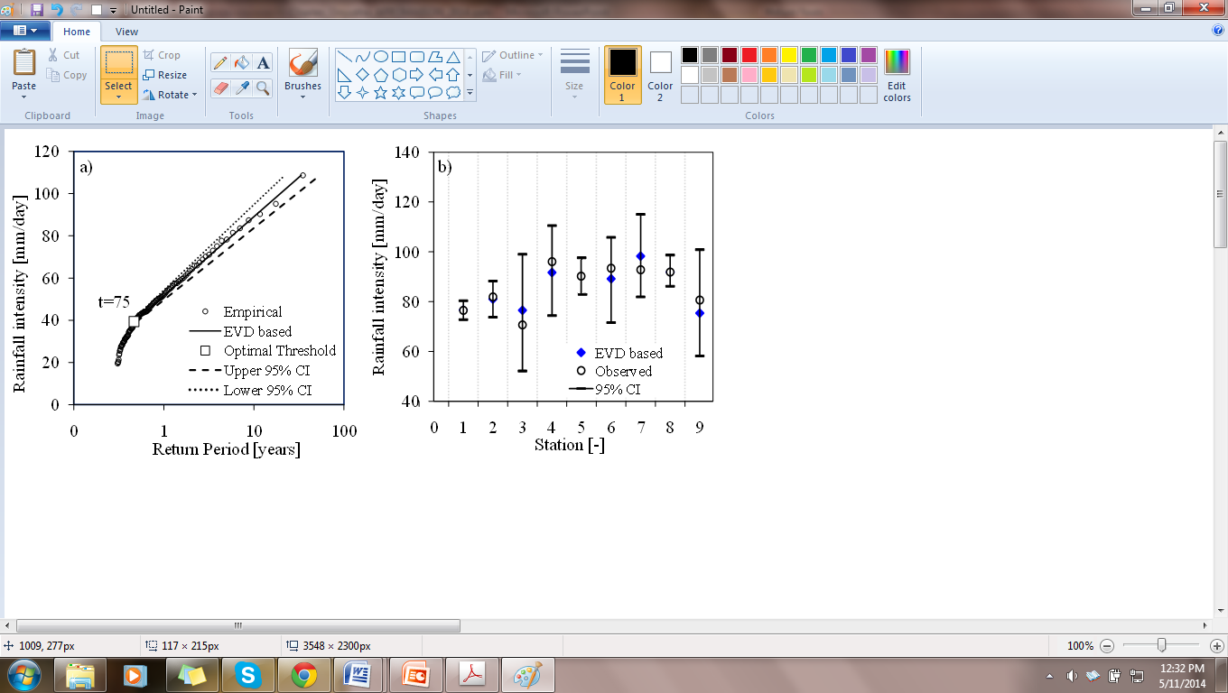
Quantifying uncertainty
How ?
Uncertainty on extremes– resampling - Jackknife – at 5% lev. Sig
Station 5
POTs
EVD fitting
Resampling
Resampling
3rd International Conference on Earth Science and Climate Change

Slide 10
Quantifying uncertainty
How ?
Uncertainty on extremes– resampling - Jackknife – at 5% lev. Sig
Station 5
POTs
EVD fitting
Resampling
Upper lim
Lower lim
Resampling
3rd International Conference on Earth Science and Climate Change

Slide 11
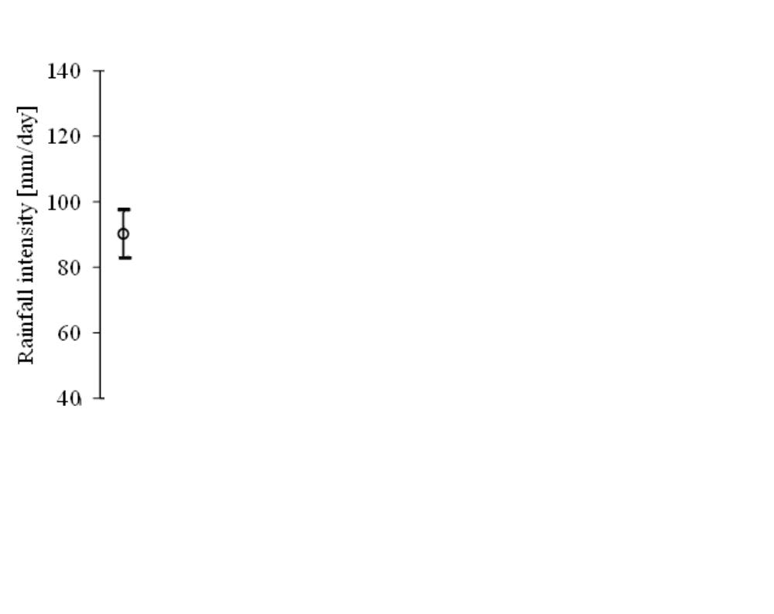
Quantifying uncertainty
How ?
Uncertainty on extremes– resampling - Jackknife – at 5% lev. Sig
Station 5
POTs
EVD fitting
Resampling
Upper lim
Lower lim
Resampling
3rd International Conference on Earth Science and Climate Change

Slide 12
Quantifying uncertainty
How ?
Uncertainty on extremes– resampling - Jackknife – at 5% lev. Sig
Station 5
10-year quantiles
POTs
EVD fitting
Resampling
Upper lim
Lower lim
Resampling
10 years < 40 data record length(1961-2000)– what if, say 100 years is used?
3rd International Conference on Earth Science and Climate Change

Slide 13

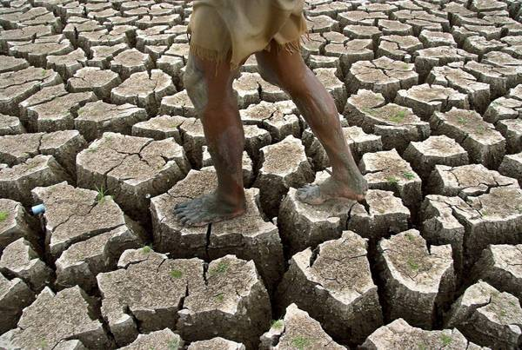
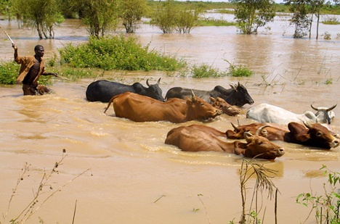
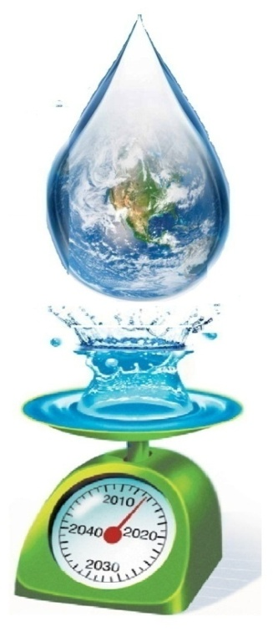
Climate change
&
Extremes
3rd International Conference on Earth Science and Climate Change

Slide 14
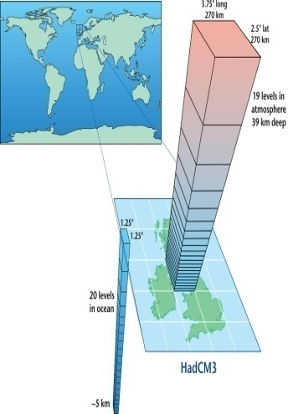
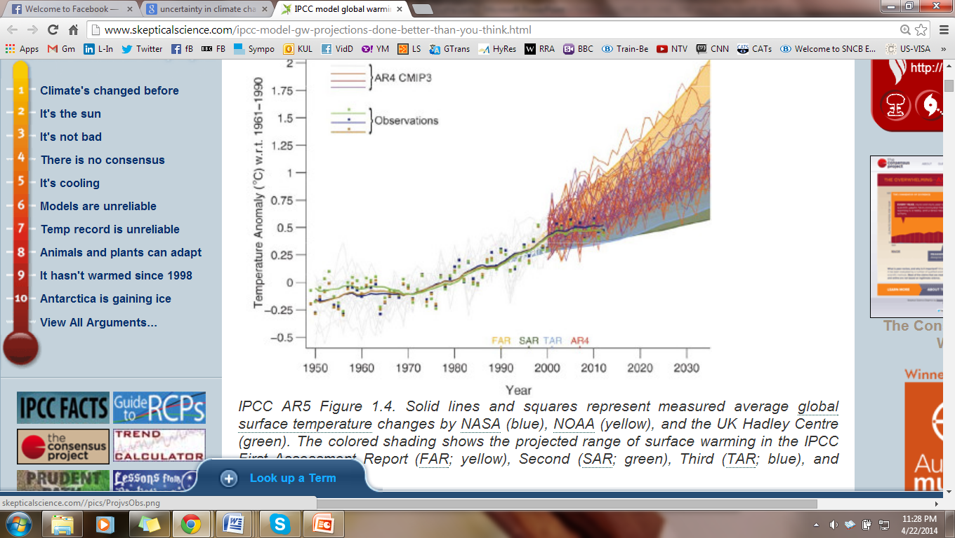
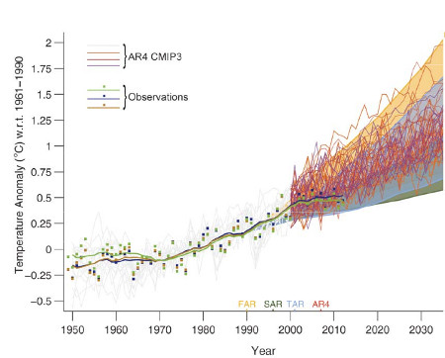
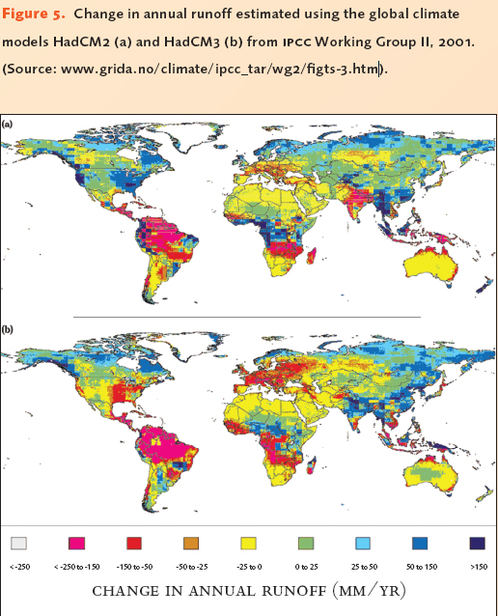

Inter-Global climate model differences
Climate change: Managers confronted - impact on hydro-clim. Extremes
Impact analysis : - not uncertainty-free - large differences exist
IPCC model global warming projections
Source: IPCC (2013) report
3rd International Conference on Earth Science and Climate Change

Slide 15
Inter-GCM differences
Inter-compare GCMs: metrics - Bias, SEE, β-related
Empirical POTs
A higher value of β means higher variations in extreme rainfall intensity
3rd International Conference on Earth Science and Climate Change

Slide 16

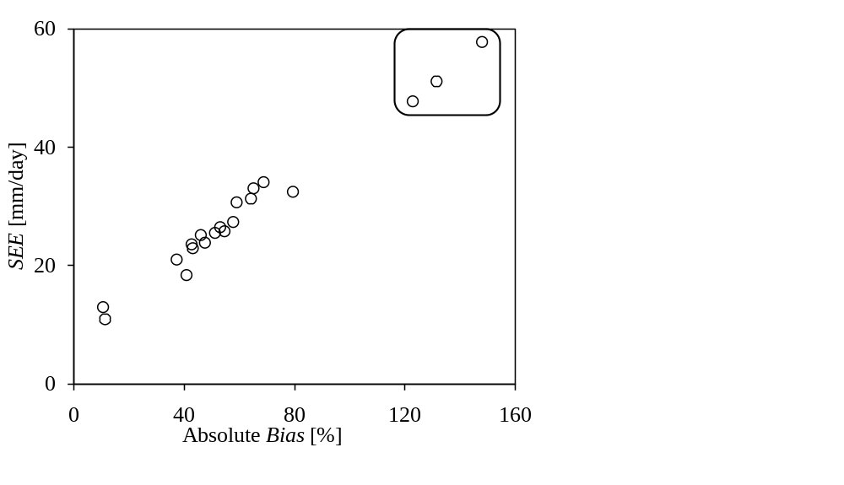
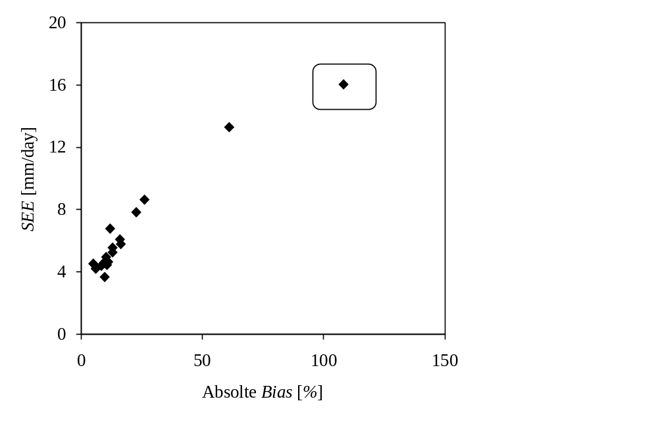

Inter-GCM differences
Bias versus SEE: - quantifying differences btn control runs & empirical series
Station 5
Station 5
CMIP3
CMIP5
3rd International Conference on Earth Science and Climate Change

Slide 17


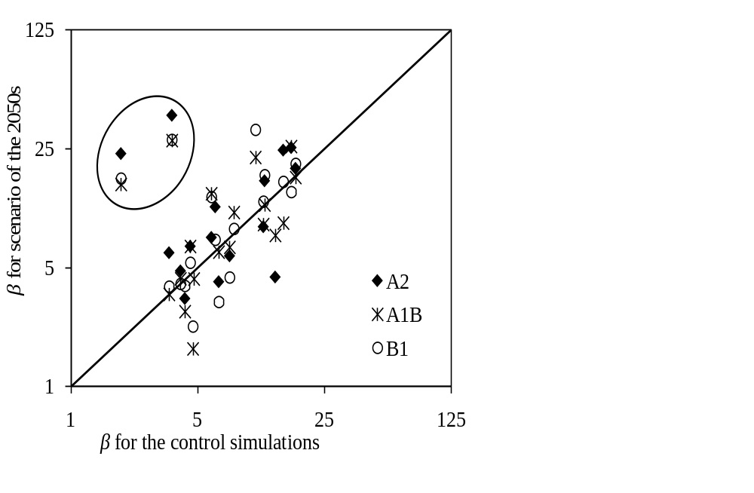
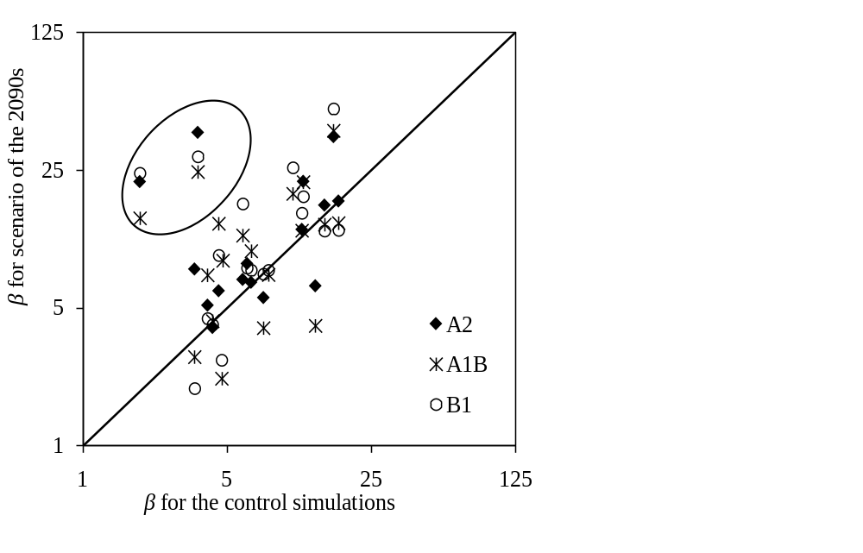
Inter-Global climate model differences
Control versus scenario: β – EVD scale parameter
Station 5 – CMIP3
3rd International Conference on Earth Science and Climate Change

Slide 18

Inter-Global climate model differences
Combining empirical, control and scenario:
Station 5 – CMIP3
3rd International Conference on Earth Science and Climate Change

Slide 19
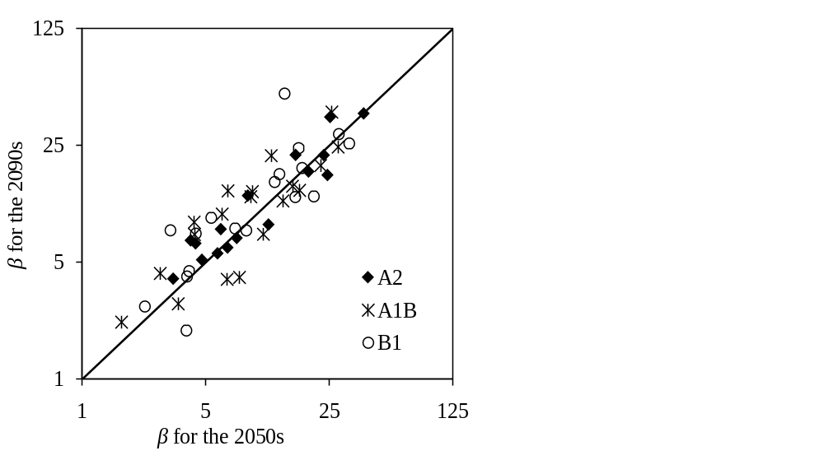
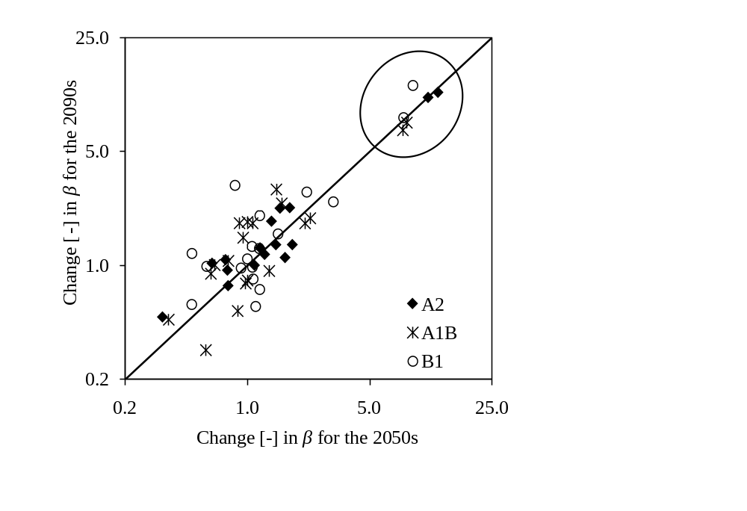
Inter-GCM differences
Control versus scenario: change in β
Station 5 – CMIP3
3rd International Conference on Earth Science and Climate Change

Slide 20



Inconsistency of the GCMs
What should I do?
Seive-out the GCMs:
  Poor performance for:
  CMIP5 by GFDL-ESM-2G_R1 at station 9
  CMIP3
      by at station(s)
      CSIRO-MK3.0,R1 4 and 6
      GISS-AOM,R1 5 and 9
      GFDL-CM2.0,R1 5
Decision: Downscale – consistent GCMs
3rd International Conference on Earth Science and Climate Change

Slide 21
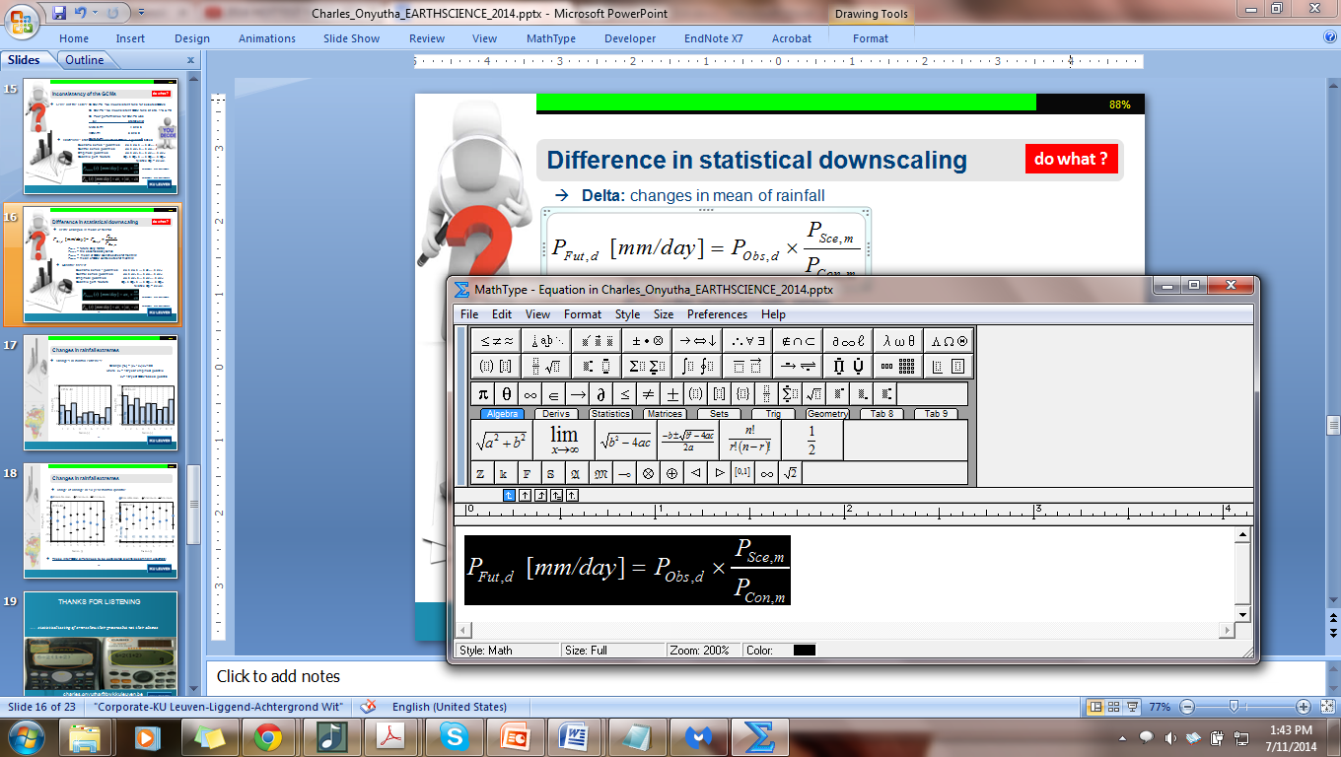
Difference in statistical downscaling
what methods?
Delta: changes in mean of rainfall
P_{Fut,d} = future daily rainfall
P_{Obs,d} = the observed daily series
P_{Sce,m} = mean of GCM scenario series for month m
P_{Con,m} = mean of GCM control series for month m
3rd International Conference on Earth Science and Climate Change

Slide 22
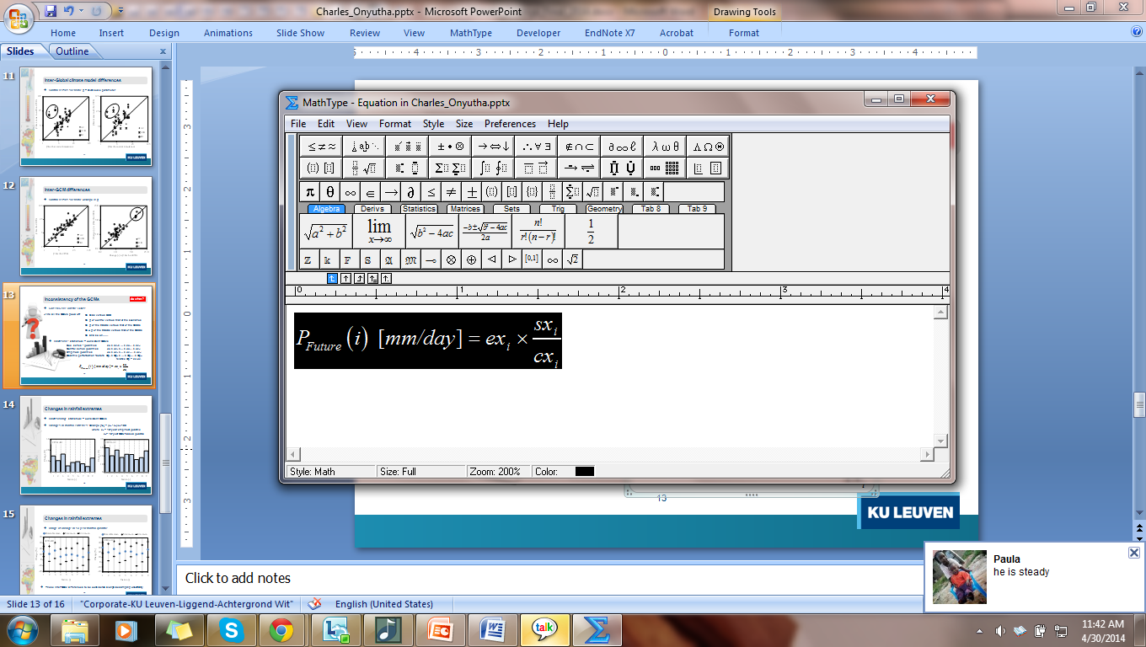
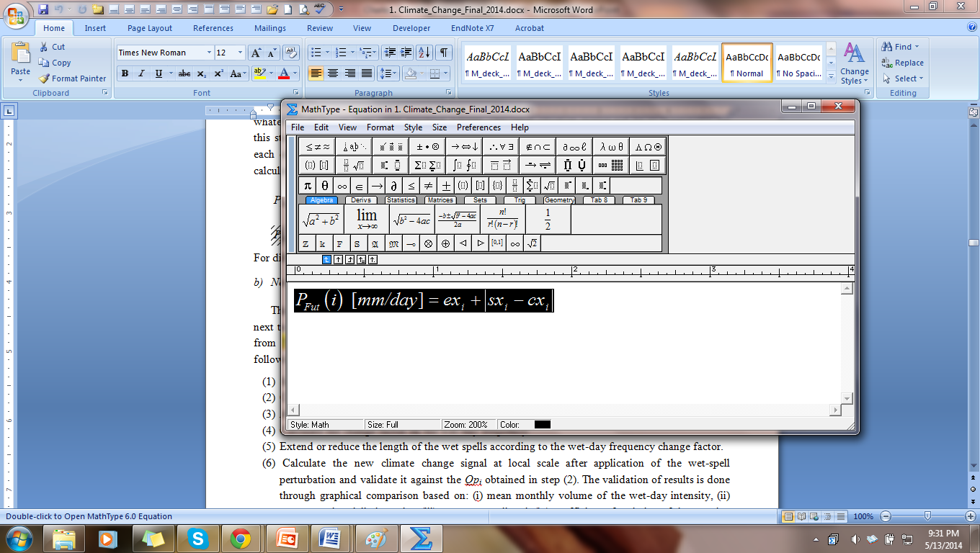
Difference in statistical downscaling
what methods?
Delta: changes in mean of rainfall
P_{Fut,d} = future daily rainfall
P_{Obs,d} = the observed daily series
P_{Sce,m} = mean of GCM scenario series for month m
P_{Con,m} = mean of GCM control series for month m
Quantile based:
Thresh. >1 mm/day…RelQp
(simQP)
Threshold<1 mm/day…AbsQp
Scenario series - quantiles sx₁ ≥ sx₂ ≥ … ≥ sx_{i}…..≥ sx_{B};
Control series quantiles cx₁ ≥ cx₂ ≥ … ≥ cx_{i}…..≥ cx_{B}; Empirical quantiles ex₁ ≥ ex₂ ≥ … ≥ ex_{i}…..≥ ex_{B}; Quantile pert. factors Qp₁ ≥ Qp₂ ≥ … ≥ Qp_{i}…..≥ Qp_{B},
relative Qp_{i} = sx_{i}/cx_{i}
3rd International Conference on Earth Science and Climate Change

Slide 23
Difference in statistical downscaling
what methods?
Delta: changes in mean of rainfall
P_{Fut,d} = future daily rainfall
P_{Obs,d} = the observed daily series
P_{Sce,m} = mean of GCM scenario series for month m
P_{Con,m} = mean of GCM control series for month m
Quantile based:
Thresh. >1 mm/day…RelQp
(simQP)
Threshold<1 mm/day…AbsQp
Scenario series - quantiles sx₁ ≥ sx₂ ≥ … ≥ sx_{i}…..≥ sx_{B};
Control series quantiles cx₁ ≥ cx₂ ≥ … ≥ cx_{i}…..≥ cx_{B}; Empirical quantiles ex₁ ≥ ex₂ ≥ … ≥ ex_{i}…..≥ ex_{B}; Quantile pert. factors Qp₁ ≥ Qp₂ ≥ … ≥ Qp_{i}…..≥ Qp_{B},
relative Qp_{i} = sx_{i}/cx_{i}
Wet spell-based: similar to simQP but addition/removal of wet spell
3rd International Conference on Earth Science and Climate Change

Slide 24
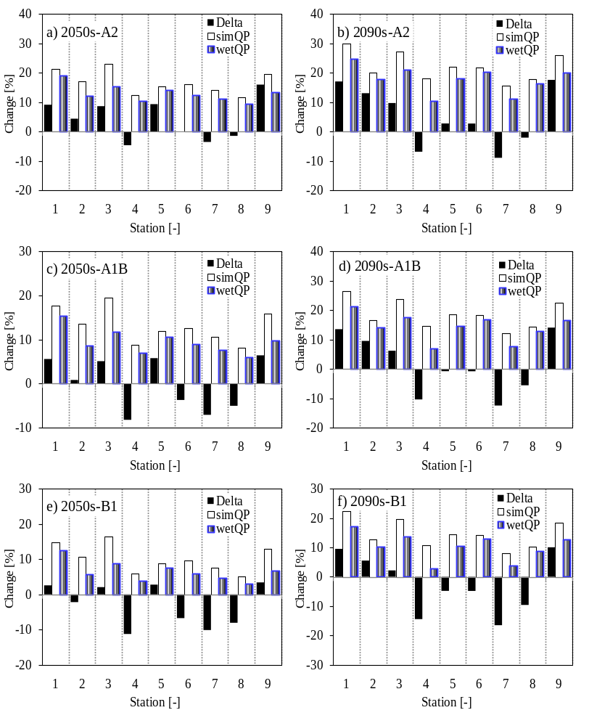
Changes in rainfall extremes
Changes in rainfall extremes: Change [%] = (x_{e} - x_{g})/x_{g}*100
where x_{e} = 10-year empirical quantile
x_{g} = 10-year GCM-based quantile
76 mm/day
81
70
96
90
93
92
91
80
3rd International Conference on Earth Science and Climate Change

Slide 25
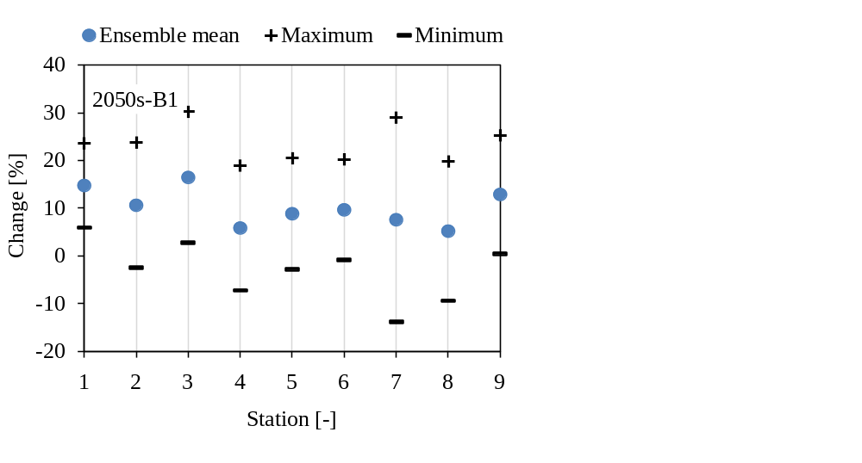
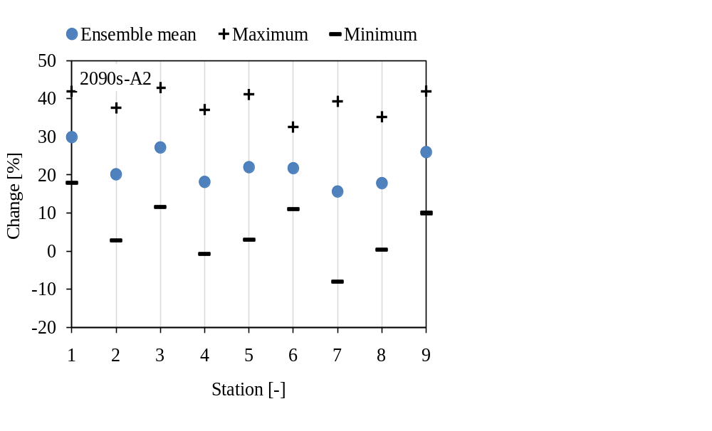
100%
Changes in rainfall extremes
Range of change in 10-year rainfall quantile – simQP using CMIP3
76 mm/day
81
70
96
90
93
92
91
80
25
3rd International Conference on Earth Science and Climate Change

Slide 26
100%
Combining diff. sources of uncertainties
Station 7:
Sampling uncertainty:
upper limit: 118 mm/day
Estimated : 92 mm/day
Lower limit: 84 mm/day
Inter-GCM differences – projection of changes[%]:
CMIP3 -2090s – A2
 | Mean | Min | Max
Delta | -9 | -24 | 2
simQP | 16 | -6 | 40
wetQP | 12 | 1 | 37
CMIP5 -2090s – rcp8.5
 | Mean | Min | Max
Delta | -4 | -16 | 3
simQP | 12 | -4 | 29
wetQP | 10 | -3 | 22
26
3rd International Conference on Earth Science and Climate Change

Slide 27
100%
Conclusions
Need to quantify uncertainty in sampling of extremes– data limitation
Inter-GCM differences be used to select those to be downscaled
Choice of a downscaling method – objective driven
3rd International Conference on Earth Science and Climate Change

Slide 28
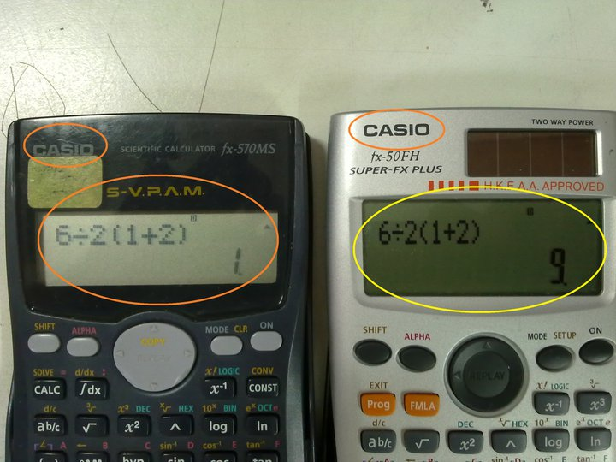
THANKS FOR LISTENING
….. statistical testing of errors show their presence but not their absence
charles.onyutha@bwk.kuleuven.be

Slide 29
GCMs-CMIP3 & 5
Model identity | IPCC model identity | Available control and scenario runs
AOM | GISS-AOM | Run1: Ctrl, A1B and B1
BCM2.0 | BCCR-BCM2.0 | Run1: Ctrl, A1B, B1 and A2
CGCM3.1(T47) | CGCM3.1(T47) | Run1, Run2, Run3: Ctrl, A1B, B1 and A2
CGCM3.1(T63) | CGCM3.1(T63) | Run1: Ctrl, A1B and B1
CM2.0 | GFDL-CM2.0 | Run1: Ctrl, A1B, B1 and A2
CM2.1 | GFDL-CM2.1 | Run1: Ctrl, A1B, B1 and A2
CM3.0 | INM-CM3.0 | Run1: Ctrl, A1B, B1 and A2
ECHAM4 | MPI- ECHAM4-OM | Run1: Ctrl, A1B and A2
ECHAM5 | ECHAM5/MPI-OM | Run1: Ctrl, B1 and A2, Run4: Ctrl,
ECHO-G | ECHO-G | Run1: Ctrl, B1 and A2; Run2, Run3: Ctrl, A1B, B1 and A2
MIROC3.2(hires) | MIROC3.2(hires) | Run1: Ctrl, A1B, B1 and A2
MIROC3.2(medres) | MIROC3.2(medres) | Run1: Ctrl, B1; Run2: Ctrl, A1B, B1 and A2
MK3.0 | CSIRO-MK3.0 | Run1: Ctrl, A1B, B1 and A2
MK3.5 | CSIRO-MK3.5a | Run1: Ctrl, A1B, B1 and A2
BNU | BNU-ESM | Run1: His, rcp4.5 and rcp8.5
MK 3.6 | CSIRO-MK3.6 | Run1-10: His, rcp4.5 and rcp6.0, Run10: rcp8.5
FG2 | FGOALS-G2 | Run1: His, rcp4.5 and rcp8.5
GFCM | GFDL-CM | Run1: His, rcp4.5, rcp6.0 and rcp8.5, run3: His, rcp4.5
GESM | GFDL-ESM-2G | Run1: His, rcp4.5 and rcp6.0
MLR | MP-ESM-LR | Run1: His, rcp4.5 and rcp8.5
MMR | MP-ESM-MR | Run1: His, rcp4.5 and rcp8.5

Slide 30
3rd International Conference on Earth Science and Climate Change
Independence criteria
based on threshold values for (Willems 2009)¹ :
the time between two successive independent rainfall intensity peaks,
the ratio of the min. rainfall intensity btn the two peaks over the peak value,
the peak height
¹Willlems, P. (2009). A time series tool to support the multi-criteria performance evaluation of rainfall-runoff models. Environ.
Model. Softw. 24, 311–321.

Slide 31
3rd International Conference on Earth Science and Climate Change
Combining e.g. sampling unc. & inter-GCM diff.
Station 1:
Statistical uncertainty:
upper limit: 80 mm/day
Estimated : 76 mm/day
Lower limit: 72 mm/day
Inter-GCM differences – Changes[%] in the 2090s-A2 –CMIP3:
Maximum: 42%
Mean : 30%
Minimum: 19%
If choices for a design value of 78 mm/day and allowance of 40% (due to climate change) are made,
Final value => 78*(100+40%)/100 = 109.2 mm/day

Slide 32
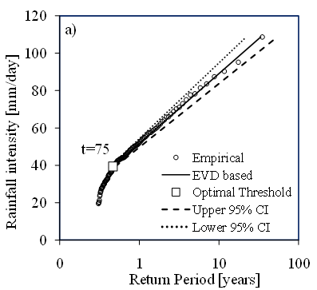
3rd International Conference on Earth Science and Climate Change
Quantifying uncertainty
Uncertainty on extremes– resampling - Jackknife – at 5% lev. Sig
Station 5
Procedure
i^{th} event is deleted from POTs of size w
Ɵ(β,γ,x_{t}) of EVD determined using (w-1) POTs
Steps (a) and (b) repeated w times
w sets of Ɵ(β,γ,x_{t}) ranked in descending order
Upper and lower limits of the Ɵ(β,γ,x_{t}) are determined from [0.025×w]^{th} and [0.975×w]^{th}
95% CI determined using (e) above
POTs
EVD fitting
Resampling
Resampling

