Slide 1


Slide 2
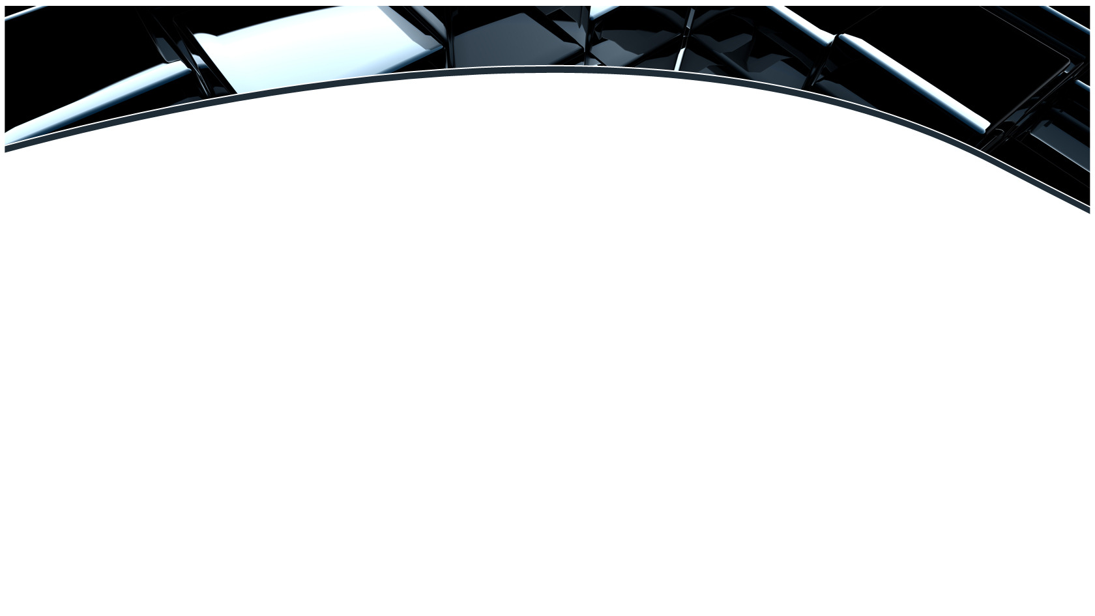

Outline
Introduction
Objectives
Experimental Program
Results and Discussion
Conclusions
References
Steel Structure-2015, November 18, 2015
2

Slide 3
INTRODUCTION
Fiber reinforced polymers (FRP) are extensively used in several engineering fields due to their superior properties.
In Structural Engineering applications,
FRP composites
have
been
used
for
retrofitting and strengthening of existing structures.
A common technique of strengthening steel structures involves bonding FRP
composites to targeted steel elements.
Bonding technique is always associated with undesirable brittle failure of the
adhesive at the steel-FRP interface [1,2].
Steel Structure-2015, November 18, 2015
3

Slide 4
INTRODUCTION
Recent studies were conducted at UAEU on anchored FRP-steel connections and beams [3,4].
Highlights of the outcomes of these studies:
Anchoring technique provides good alternative to overcome the unfavorable brittle failure of
bonded FRP composites.
The proposed anchoring technique revealed ductile behavior of the FRP-steel connections.
Yield and ultimate load capacities improved by 10%, and 30%, respectively.
Limitation of the studies:
Very narrow range of fastening parameters was examined.
Steel Structure-2015, November 18, 2015
4

Slide 5
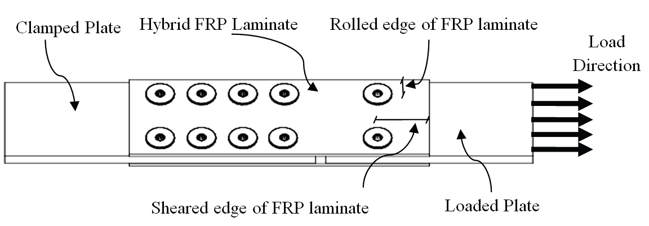
OBJECTIVES
To investigate the response of composite-steel lap connections along associated interfacial behavior considering the following variables:
with
the
Magnitude of clamping torque
Value of hole diameter
Steel Structure-2015, November 18, 2015
5

Slide 6
EXPERIMENTAL PROGRAM: Materials
STEEL PLATES:
A242 Steel (Fy = 300 MPa and Fu = 460 MPa)
10 mm thick
100 mm width
200 mm long at loaded side, and 300 mm long at clamped side.
Steel Structure-2015, November 18, 2015
6

Slide 7
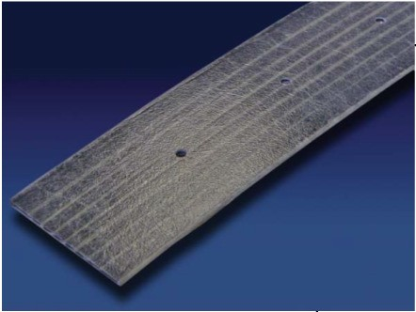
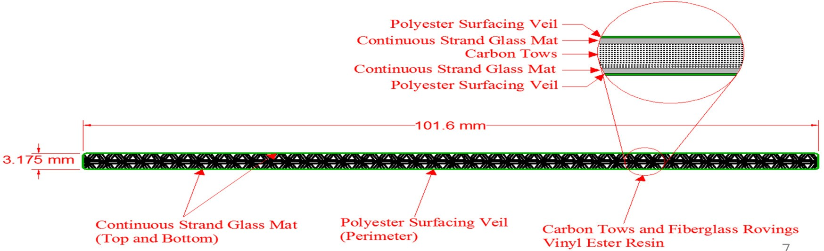
EXPERIMENTAL PROGRAM: Materials
Composite FRP Laminates:
Supplied by STRONGWELL® manufacturer in rolls of length 30 m, width
101.6 mm and thickness 3.175 mm [5].
7

Slide 8
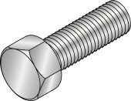
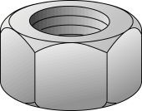
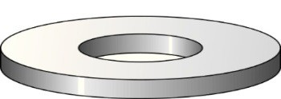
EXPERIMENTAL PROGRAM: Materials
STEEL BOLTS:
• Material: Hexagonal galvanized zinc coated steel bolts (Hilti).
• Bolt designation: M6x40
STEEL NUTS: 5 mm thick hexagon zinc coated nut (Hilti).
STEEL WASHERS: 2 mm thick flat washers, 8.4/28 mm inner/outer
diameters.
Steel Structure-2015, November 18, 2015
8

Slide 9
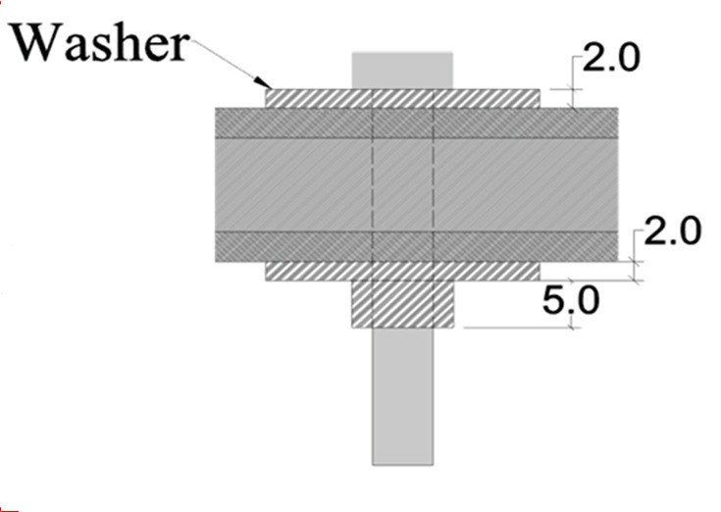
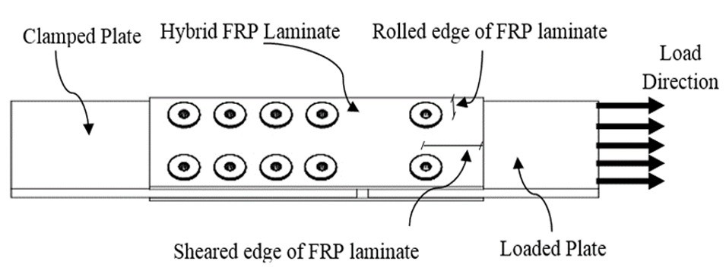
EXPERIMENTAL PROGRAM:
Specimens’ Details:
Connection
Design
Rolled Edge = 20 mm
Sheared Edge = 50 mm
Number of washers-per-bolt = 2
Steel Structure-2015, November 18, 2015
9

Slide 10
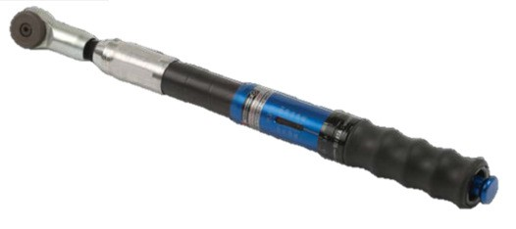
EXPERIMENTAL PROGRAM: Test Configurations
“Clamping Torque”
Four different configurations are used to examine the effect of clamping torque on the behavior of FRP-steel lap connections.
Designation
Torque (N.m)
Torque/Snug-tight
T1
T2
T3
T4
11.0
1.0
13.2
1.2
16.5
1.5
20.0
1.8
Sensitivity of the breaking-type torque wrench: 0.1 N.m.
Typical hole-diameter: 8 mm
Number of replicates: 3
Steel Structure-2015, November 18, 2015
10

Slide 11
EXPERIMENTAL PROGRAM: Test Configurations
“Hole Diameter”
Three different values of hole-diameter are used to investigate the effect of clearance on
the behavior of FRP-steel lap connections.
Designation Hole Diameter (mm) Clearance (mm)
D6
D8
D10
6.0 0.0
8.0 2.0
10.0 4.0
Applied clamping torque: 11 N.m.
Number of replicates: 3
Steel Structure-2015, November 18, 2015
11

Slide 12
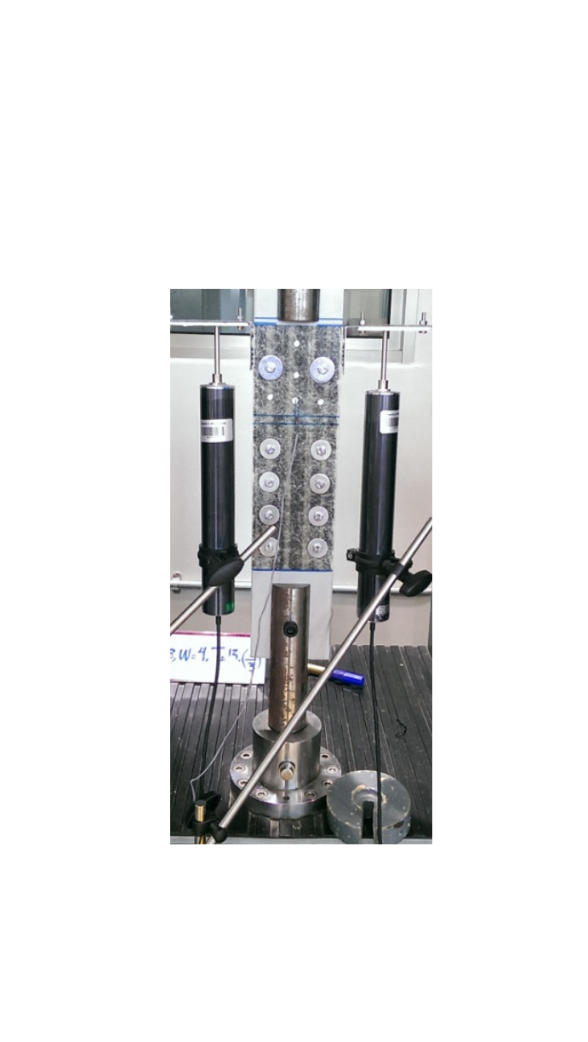
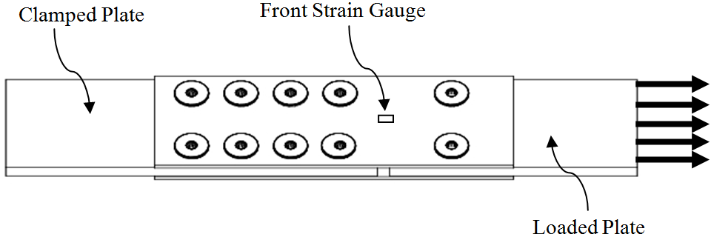
Setup
ment of
12
EXPERIMENTAL
PROGRAM:
Test
MTS Universal Testing Machine:
Machine capacity : 100kN
Cross-head speed: 1mm/min
Strain Gauges:
3 mm longitudinal strain gauges.
LVDTs:
100 mm LVDTs are used to measure the longitudinal displace
the specimen during loading.
Steel Structure-2015, November 18, 2015

Slide 13
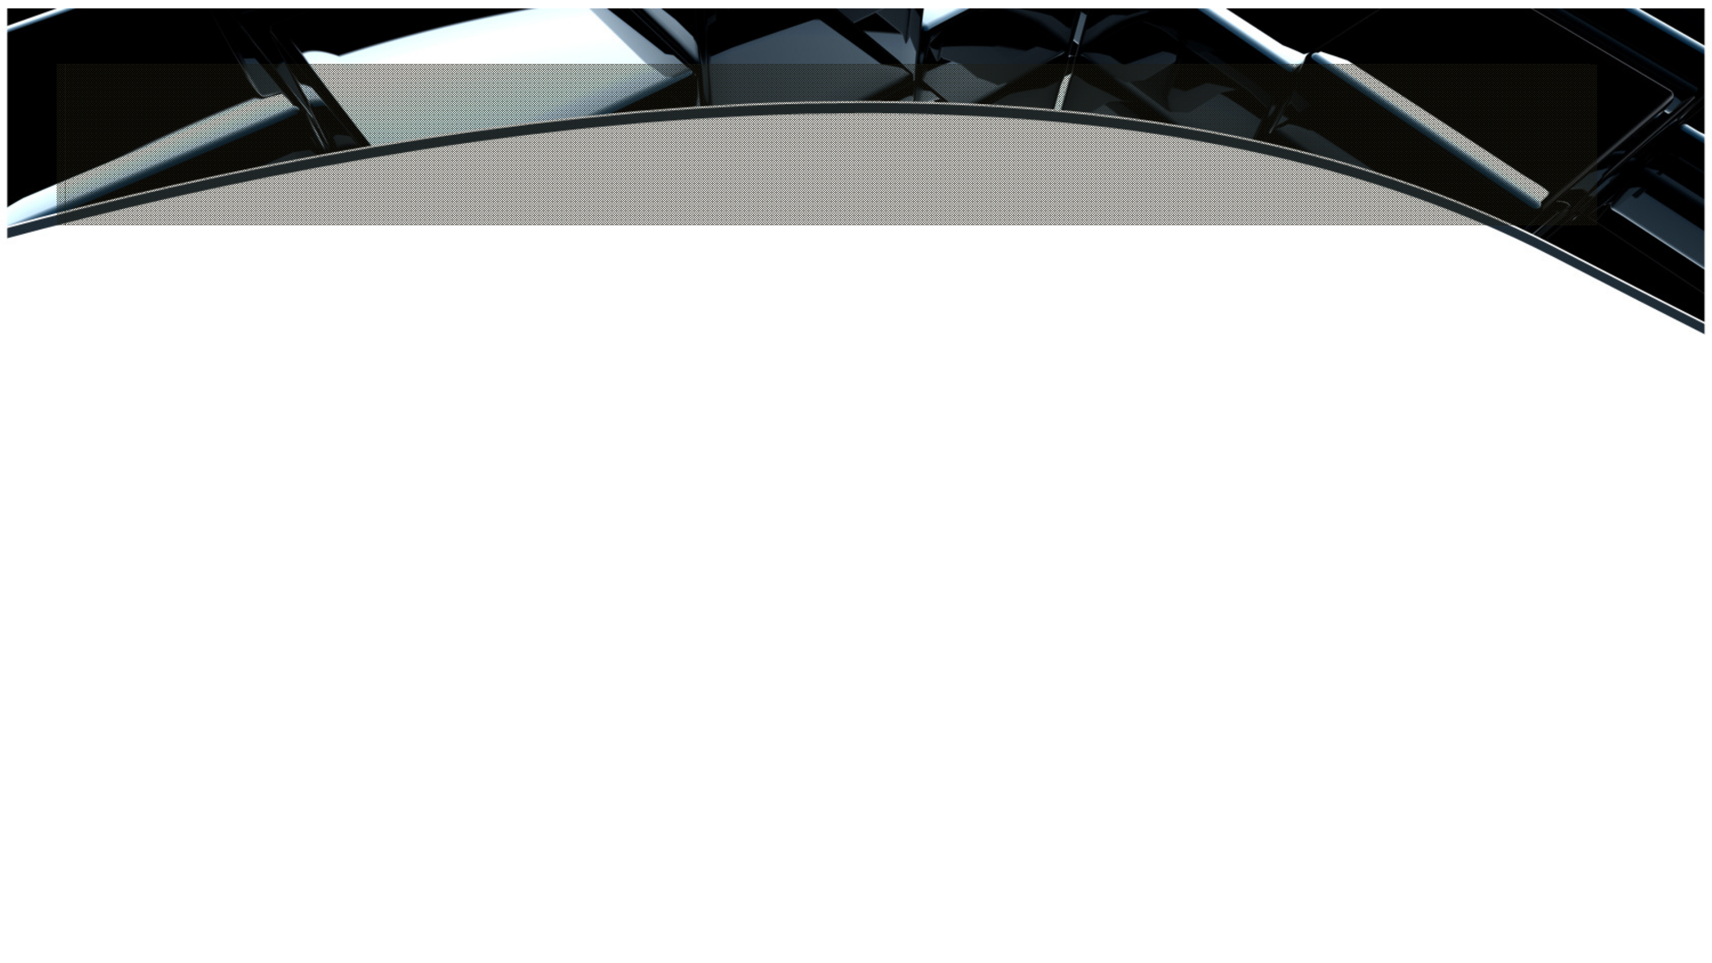
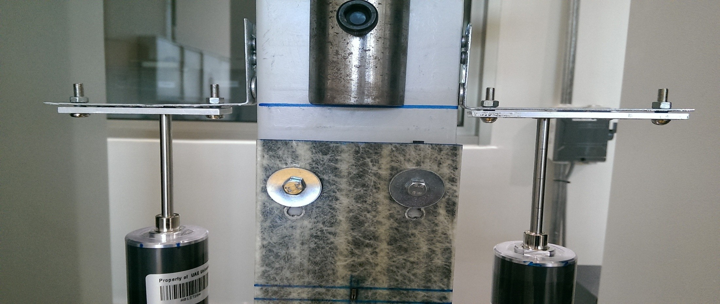
Typical
behavior
of
connections
under
T1
13

Slide 14
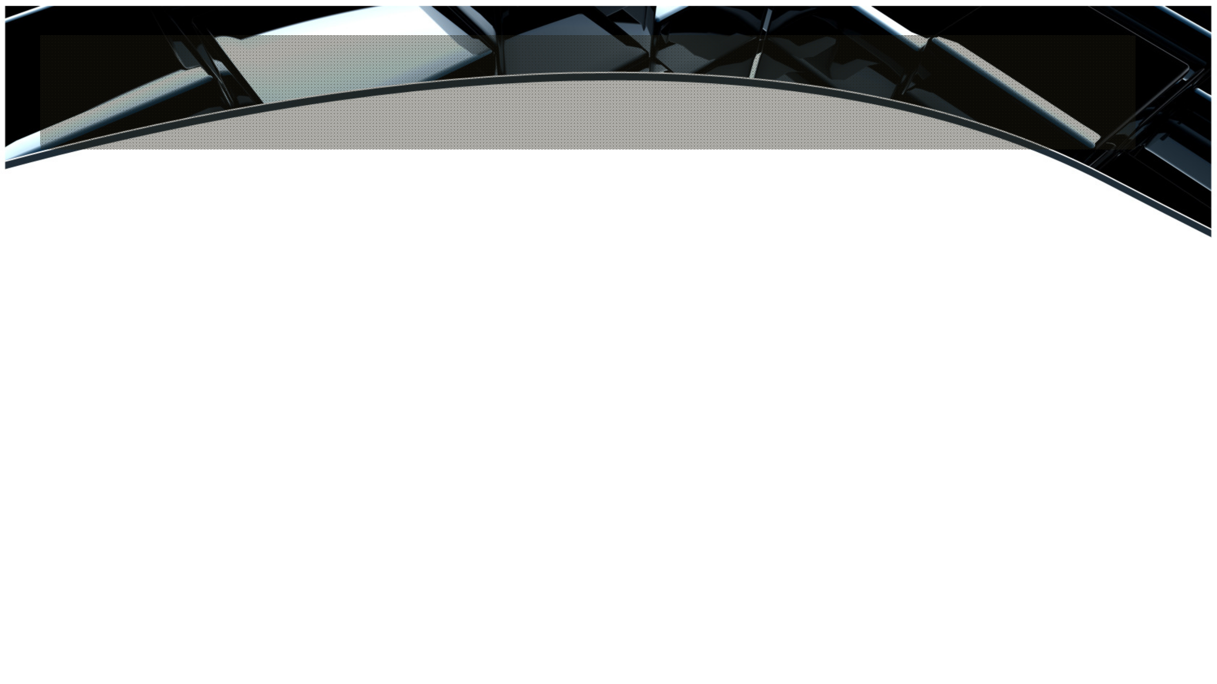
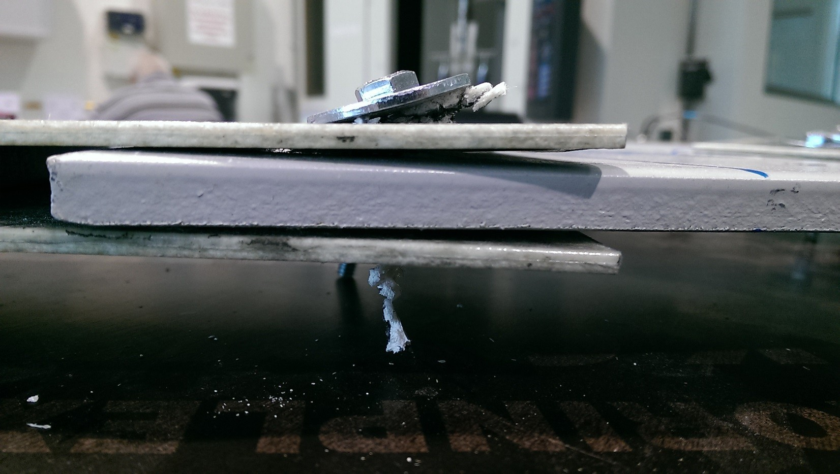
Typical
behavior
of
“D6”
connections
14

Slide 15

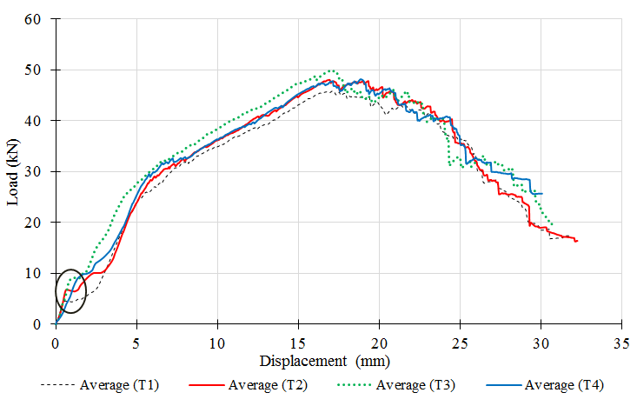
RESULTS AND
DISCUSSION:
Clamping Torque
Failure modes.
Relative slippage. Peak loads.
Steel Structure-2015, November 18, 2015
15

Slide 16
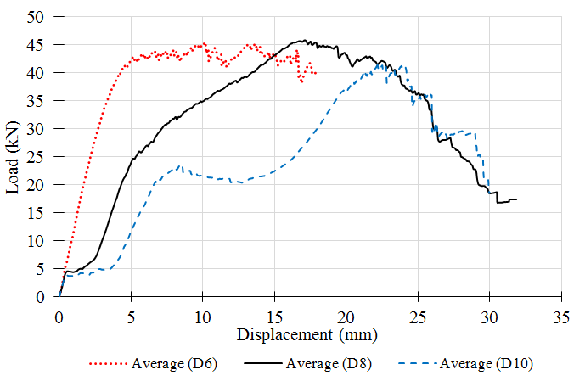
RESULTS
AND
DISCUSSION:
Hole Diameter
Failure modes.
Peak loads.
Steel Structure-2015, November 18, 2015
16

Slide 17
CONCLUSION
An experimental study is conducted to examine the behavior of composite FRP- steel anchored connections subjected to axial tensile loading with variable values of clamping torque, and bolt hole.
Experimental findings highlight the insignificant effect of torque on both failure mechanisms, and peak loads of this special type of connections.
Bolt hole was proven to affect the failure modes of the connection without
influencing its load carrying capacity.
The study recommends to snug-tight the bolts after placing them in standard hole-
diameter for optimum behavior of similar composite connections.
Steel Structure-2015, November 18, 2015
17

Slide 18
REFERENCES
1.
Xia,
S.
H.,
and
Teng,
J.
G.
"Behaviour of FRP-to-steel
bonded
joints."Proceedings of the international symposium on bond behaviour of FRP
in structures (BBFS 2005). 2005, pp. 411-418.
Fawzia, S., Zhao, X. L., Al-Mahaidi, R., and Rizkalla, S. "Preliminary bond- slip model for CFRP sheets bonded to steel plates." Proceedings of the Third International Conference on FRP Composites in Civil Engineering (CICE
2006), pp. 737-740.
Sweedan, A.M.I, El-Sawy, K.M., and Alhadid, M. "Interfacial behavior of mechanically anchored FRP laminates for strengthening steel beams." Journal of Constructional Steel Research, 80 (2013): 332-345.
2.
3.
Steel Structure-2015, November 18, 2015
18

Slide 19
REFERENCES
4.
Sweedan, A.M.I., Rojob, H.N., and El-Sawy, K.M. and (2014) "Mechanically-
Fastened Hybrid Composites for Flexural Strengthening
Journal of Thin Walled Structures, Vol. 85, pp. 250-261.
of Steel Beams",
5.
Strongwell
Manufacturing Plants
(2008)
“SAFSTRIP:
Fiber
reinforced
strengthening strip”, Product Datasheet.
Steel Structure-2015, November 18, 2015
19

Slide 20


20

