Slide 1
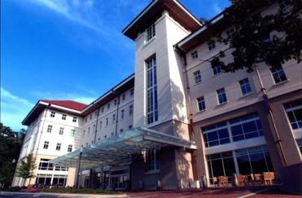

MECHANISMS OF GENISTEIN IN PROSTATE CANCER PREVENTION AND TREATMENT
Omer Kucuk, MD
Professor of Hematology, Medical Oncology and Urology
Winship Cancer Institute of Emory University
Atlanta, Georgia, USA
okucuk@emory.edu
International Conference on Prostate Cancer
Orlando, Florida, USA
June 22-24, 2015

Slide 2
Acknowledgements
Emory University
    Carlos Moreno, PhD
    Morgan McLemore, MD
    Daqing Wu, PhD
Wayne State Uni.
    Fazlul Sarkar, PhD
    Gilda Hillman, PhD
    Edson Pontes, MD
University of Oslo
    B. Lazarevic, MD, PhD
    Steiner Karlsen, MD
    F. Saatcioglu, PhD
Ankara University
    Nurdan Tacyildiz, MD
Firat University
    Kazim Sahin, PhD
    FUNDING
    NIH
    DOD
    GCC
    Carpenter Fund

Slide 3
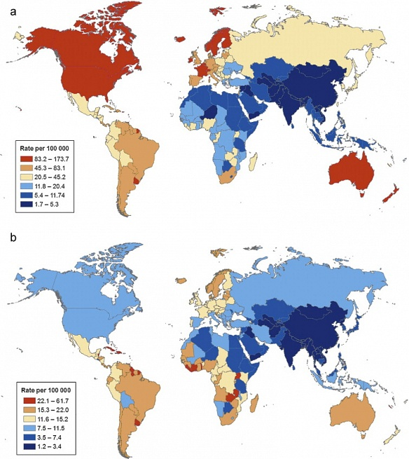
(a) Prostate cancer incidence (b) Prostate cancer mortality

Slide 4
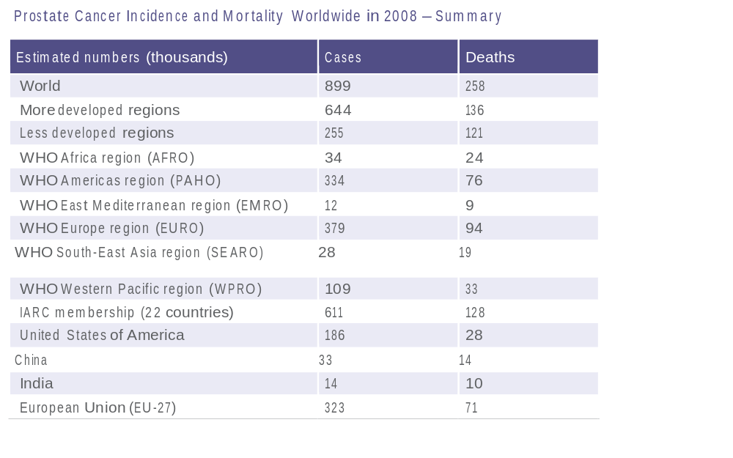

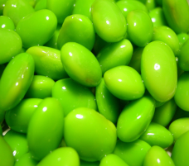
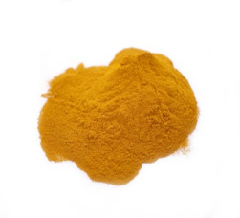
Prostate cancer incidence and mortality worldwide

Slide 5
Soy isoflavones and cancer
Epidemiologic studies show an inverse association between dietary soy intake and cancer risk (breast, prostate, lung, and others)
Genistein and daidzein are the most abundant isoflavones in soy
Genistein has activity against a variety of cancer cells in culture, animal model and clinical studies

Slide 6
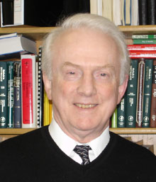
Stephen Barnes, PhD University of Alabama at Birmingham
Professor of Pharmacology and Toxicology
Professor of Biochemistry and Molecular Genetics
Professor of Environmental Health Sciences
Professor of Genetics
Professor of Vision Sciences
Director, UAB Center for Nutrient-Gene Interaction
Associate Director, Purdue-UAB Botanicals Centers for Age-Related Disease
Director, Targeted Metabolomics and Proteomics Laboratory (TMPL)
Senior Scientist, UAB Comprehensive Cancer Center
“Genistein Guru”

Slide 7
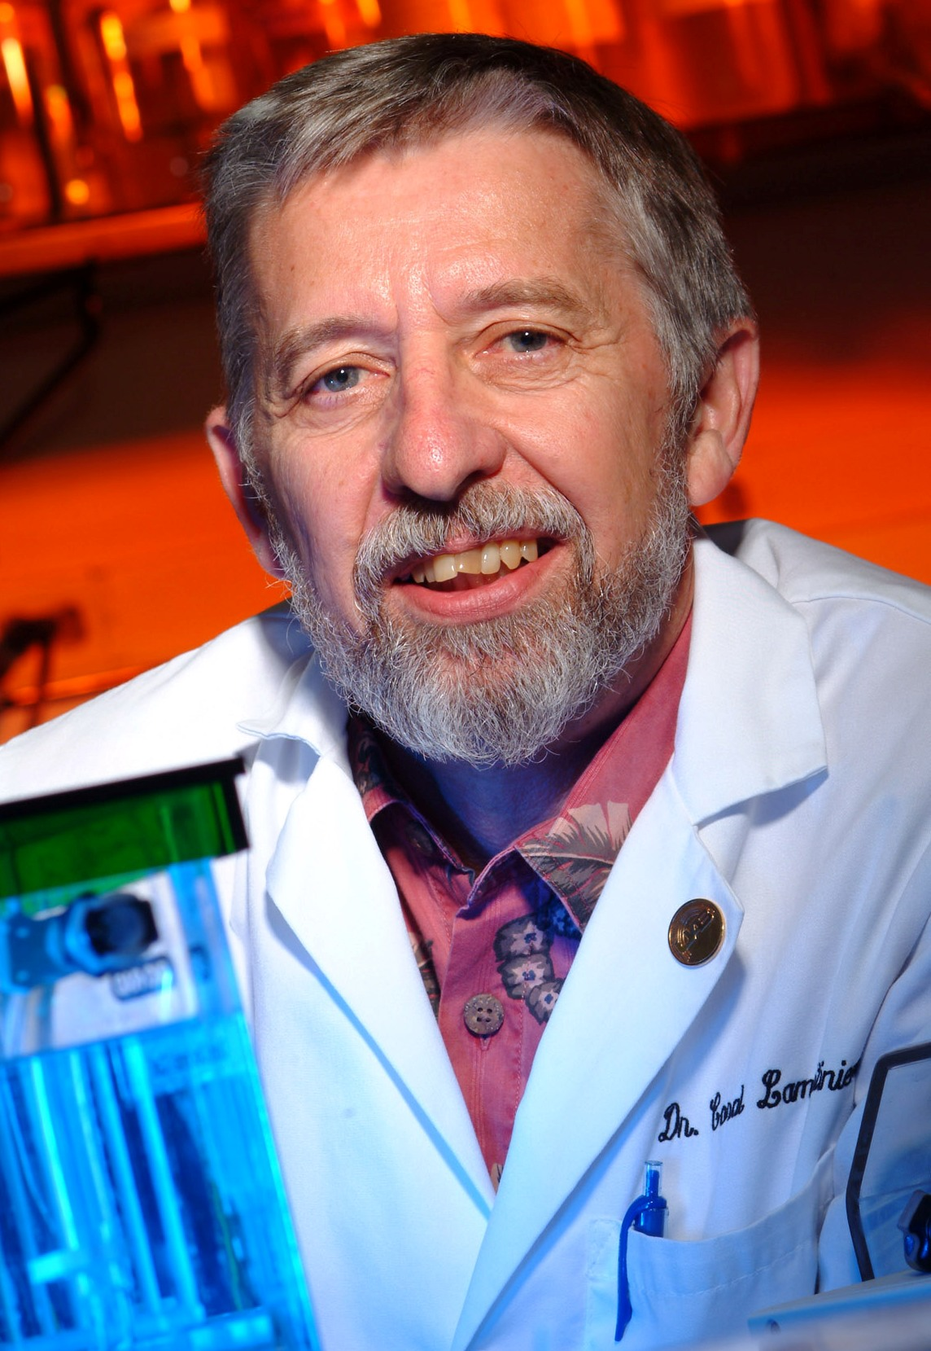
Coral A. Lamartiniere, Ph.D.
Director of Pharmacology and
Toxicology Program
Director of Graduate Training
Program in Toxicology
Director of Integrative Biomedical
Sciences
Professor of Pharmacology
and Toxicology
Senior Scientist in the UAB Comprehensive Cancer Center
“Genistein Guru”

Slide 8
J Carcinog. 2007; 6: 3.
Genistein chemoprevention of prostate cancer in TRAMP mice
Jun Wang, Isam-Eldin Eltoum and Coral A Lamartiniere
Epidemiological studies suggest an inverse association between soy intake and prostate cancer risk. Genistein, the predominant phytoestrogen in soy food, has been proposed as a potential chemopreventive agent due to its anti-estrogen and tyrosine kinase inhibitory effects. To determine the most effective period for genistein chemoprevention, the Transgenic adenocarcinoma mouse prostate (TRAMP) model was used. The treatments were 250 mg genistein/kg AIN-76A diet 1) prepubertally only, 2) in adulthood only or 3) through out life. Controls received AIN-76A diet. By 28 weeks of age, 100% TRAMP mice fed control diet developed prostatic intraepithelial neoplasia (PIN) or adenocarcinomas with 6%, 16%, 44% and 34% developing high grade PIN, well differentiated, moderately differentiated and poorly differentiated prostatic adenocarcinomas, respectively. Prepubertal only (1–35 days postpartum) and adult only genistein treatments (12 – 28 weeks) resulted in 6% and 29% decreases in poorly-differentiated cancerous lesions compared with controls, respectively. The most significant effect was seen in the TRAMP mice exposed to genistein throughout life (1–28 weeks) with a 50% decrease in poorly-differentiated cancerous lesions. In a separate experiment in castrated TRAMP mice, dietary genistein suppressed the development of advanced prostate cancer by 35% compared with controls. Of the tumors that developed in castrated TRAMP mice, 100% were poorly-differentiated in contrast to the 37% of noncastrated TRAMP mice that developed poorly-differentiated tumors. ICI 182,780 (ICI), genistein and estrogen down-regulated androgen receptor (AR), estrogen receptor alpha (ER-α) and progesterone receptor (PR) in the prostates of C57BL/6 mice, and act independently of ER. Our data obtained in intact and castrated transgenic mice suggest that genistein may be a promising chemopreventive agent against androgen-dependent and independent prostate cancers.

Slide 9
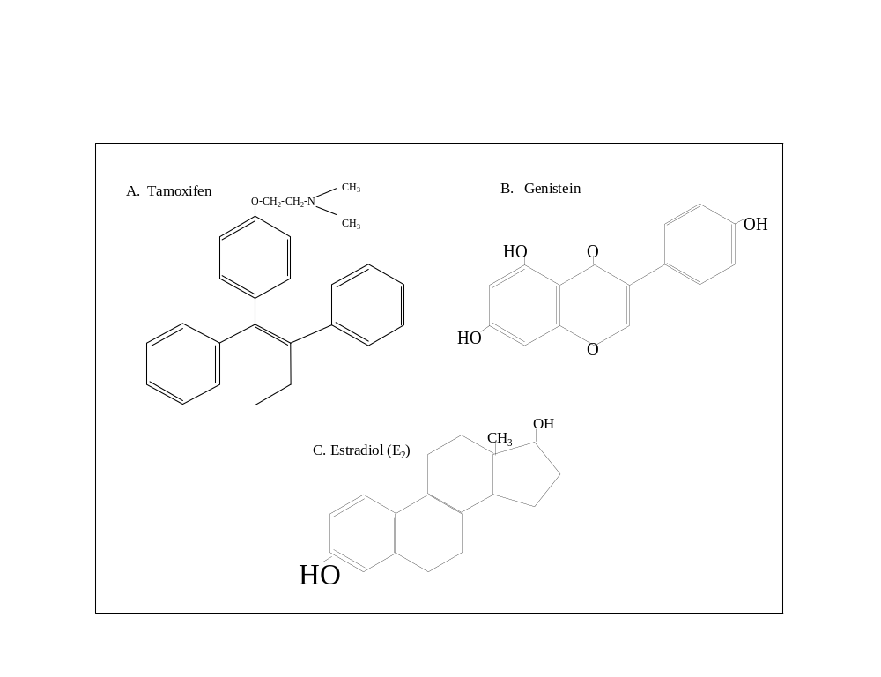
Soy Isoflavones

Slide 10
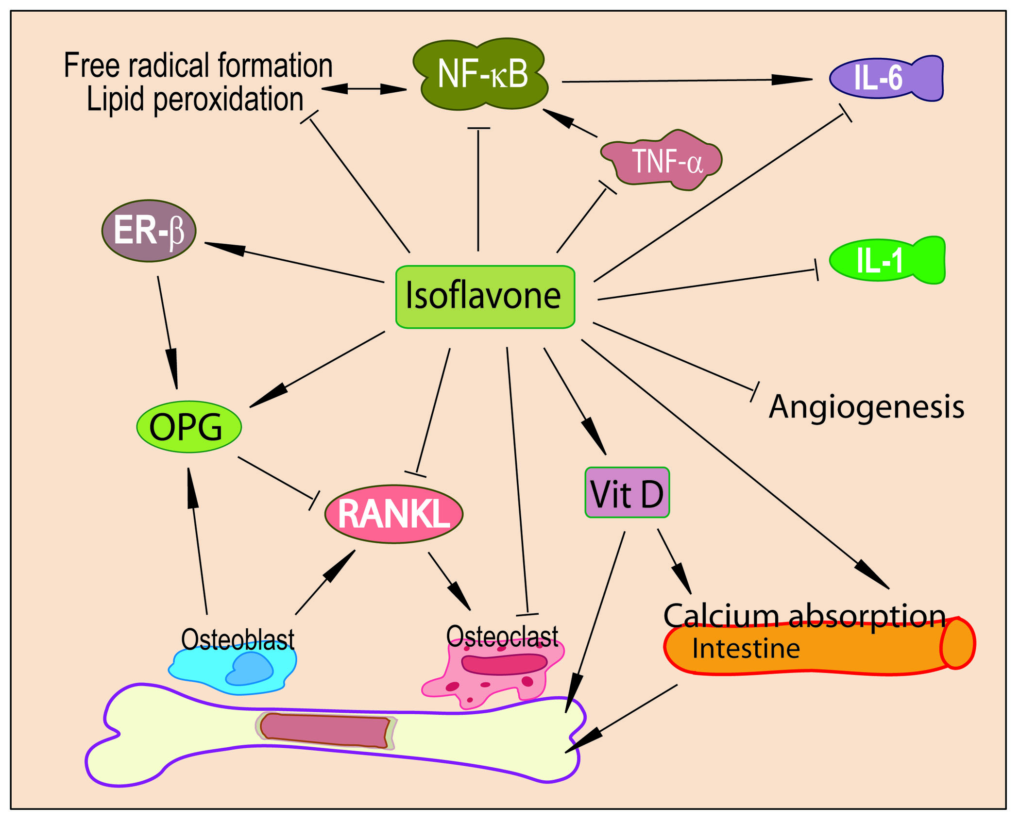
Genistein Has Pleiotropic Effects
Atmaca A, Kleerekoper M, Bayraktar M, Kucuk O. Menopause 15:748-57, 2008

Slide 11
Genistein and Cancer
Inhibits growth and induces apoptosis in Ca cells
Growth inhibition mediated by G2/M cell cycle arrest and up-regulation of p21WAF1
Down-regulates cyclin B1, CDKs, Bcl-2/Bcl-xL
Up-regulates Bax expression and induces translocation of Bax to Mitochondria

Slide 12
Genistein
Down-regulates MMP-2, MMP-9, uPA, c-IAP and VEGF
Inactivates Akt and NF-κB (by inhibiting IKK)
  blocks nuclear translocation of p50 and p65
  inhibits phosphorylation of IκBα
  decreases MEKK1 kinase activity

Slide 13
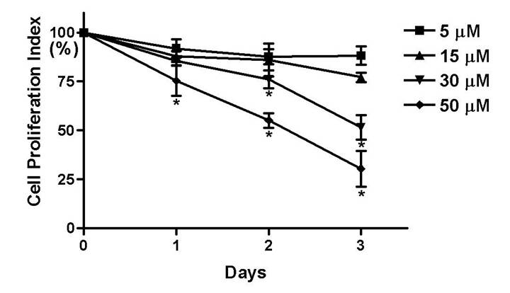
Genistein and PC3 Proliferation

Slide 14
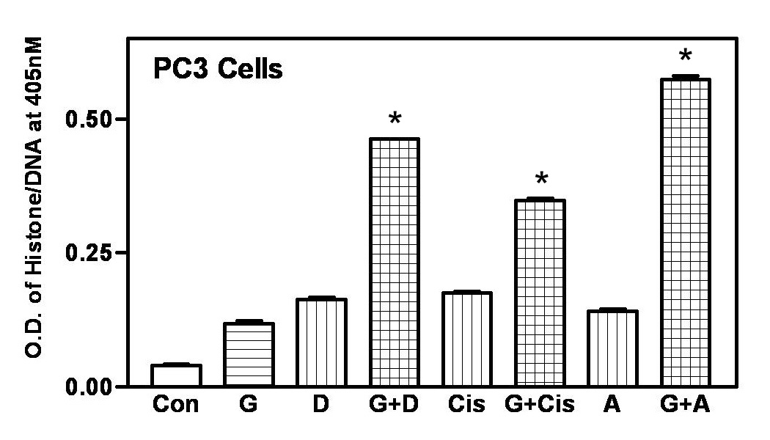
Apoptosis assay for PC3 cells treated with genistein,
docetaxel, cisplatin, adriamycin, or combination
Con: Control; G: genistein; D: docetaxel; Cis: cisplatin; A: adriamycin
G+D: genistein followed by docetaxel; G+Cis: genistein followed by cisplatin.
G+A: genistein followed by adriamycin. *: p < 0.01

Slide 15
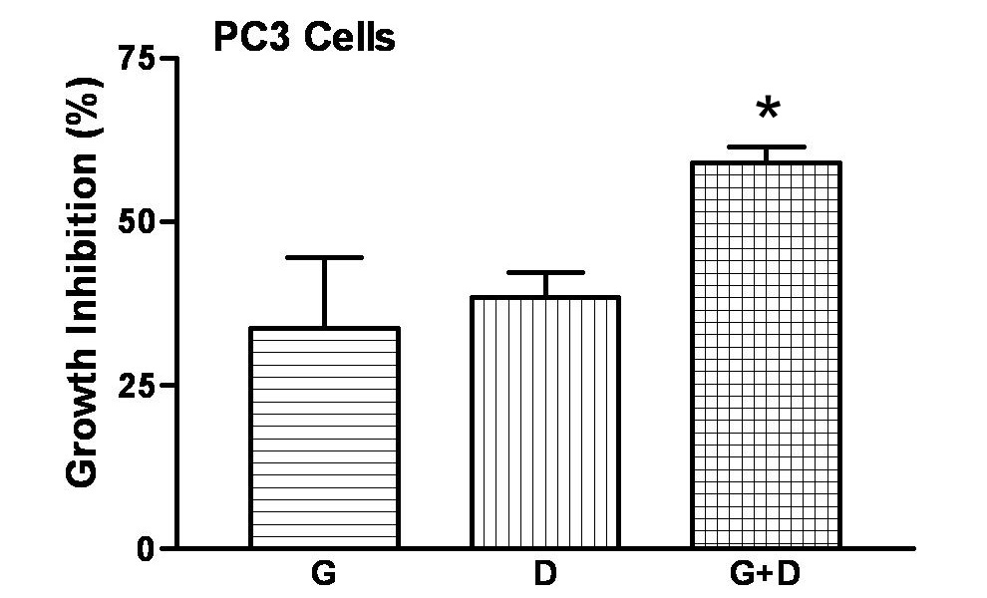
Growth inhibition in PC3 cells treated with genistein,
docetaxel, or combination measured by MTT
G: treated with 50 μM genistein for 48h; D: treated with 1nM docetaxel for 48h;
G+D: treated with 30 μM genistein for 24h followed by 0.5 nM docetaxel for 24h.
*: p < 0.05

Slide 16
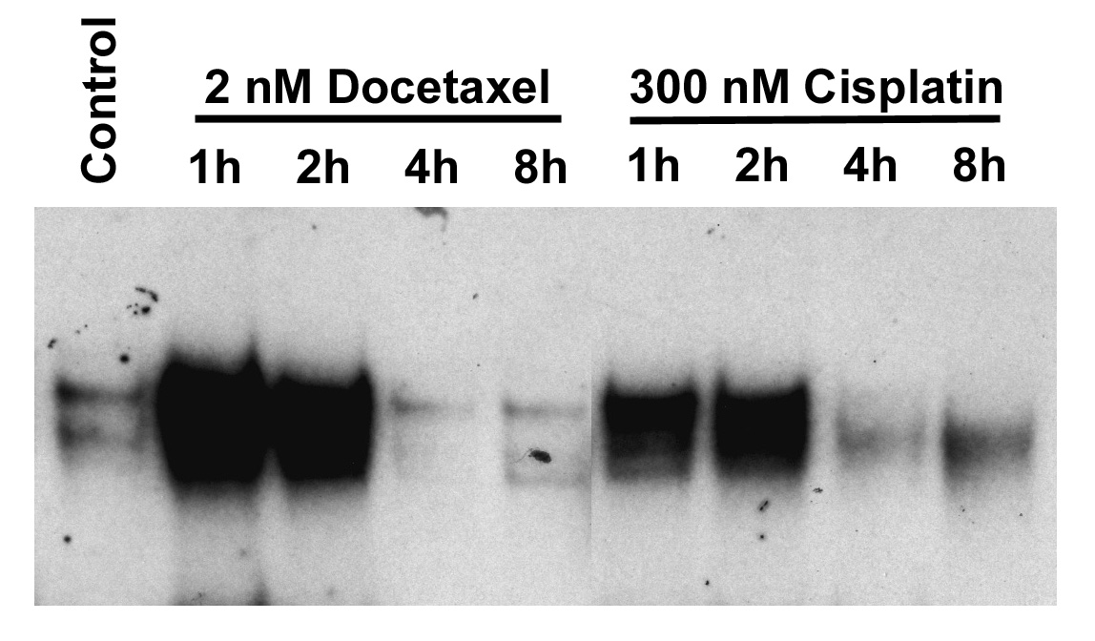
EMSA for NF-kB activity in PC3 cells treated with
docetaxel or cisplatin

Slide 17
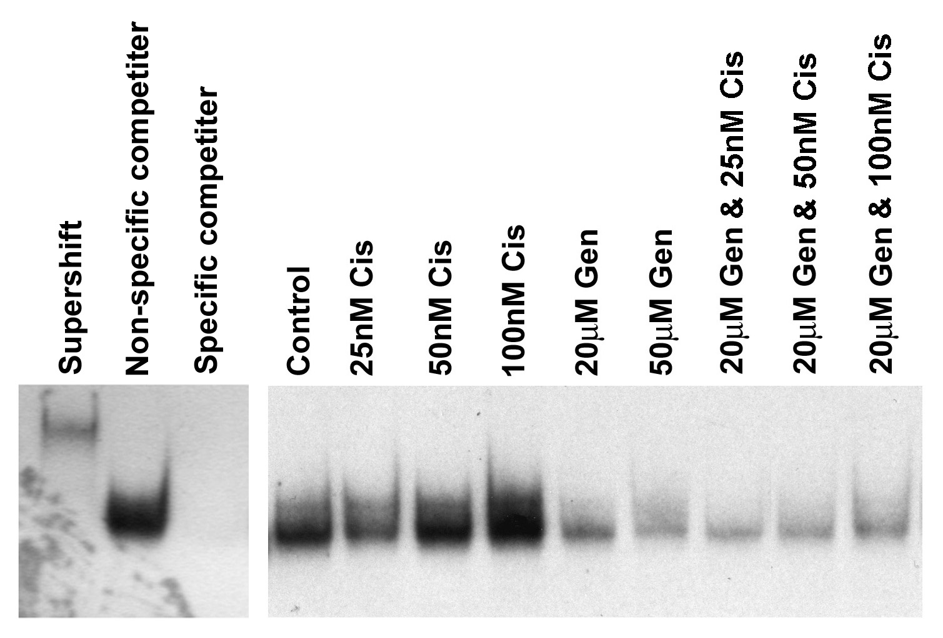
EMSA for NF-kB activity in BxPC-3 cells treated with
genistein, cisplatin, or combination
Cis: cisplatin; Gen: genistein.

Slide 18
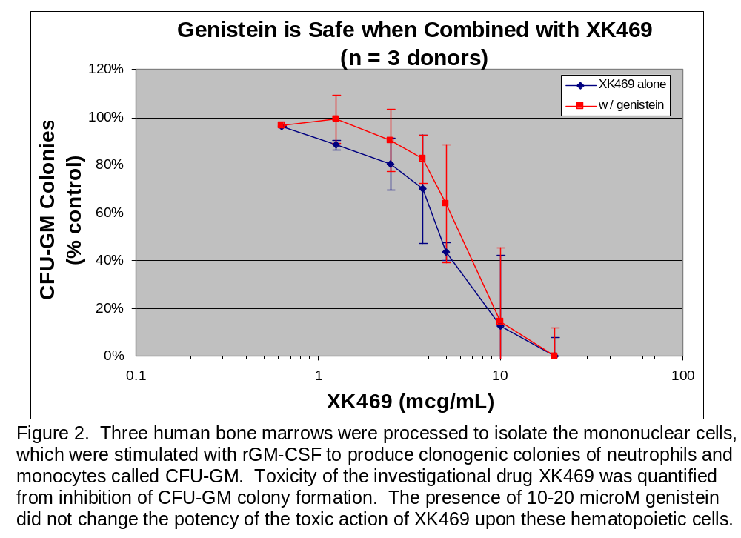

Slide 19
Growth Factor, Cytokine
Genistein
NIK
IKK
Akt
P
p50
p65
NFκB
P
Active
NFκB
IκB
p50
p65
Degradation
Ubiquitin-Proteasome
Nuclear Translocation
p50
p65
cIAP-1, XIAP, MMP-9, uPA, VEGF, etc.
κB site
Transcription

Slide 20
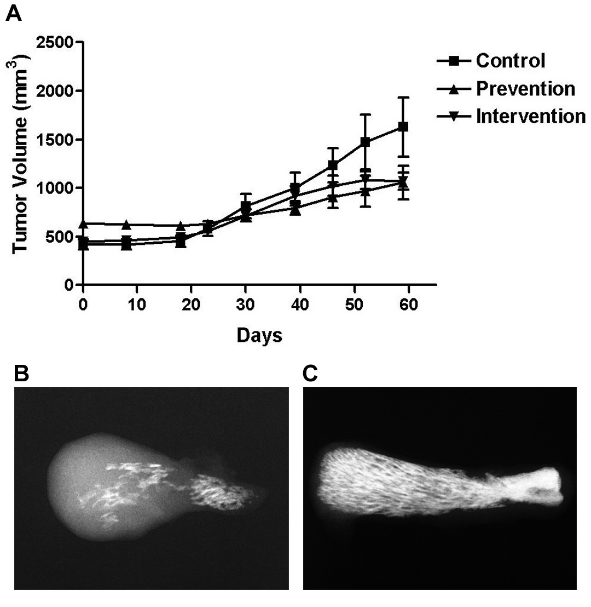
Dietary Genistein and Experimental PC3 Bone Metastasis (Neoplasia 6:354-63, 2004)
p≤0.0001
p=0.0003
control
prevention

Slide 21
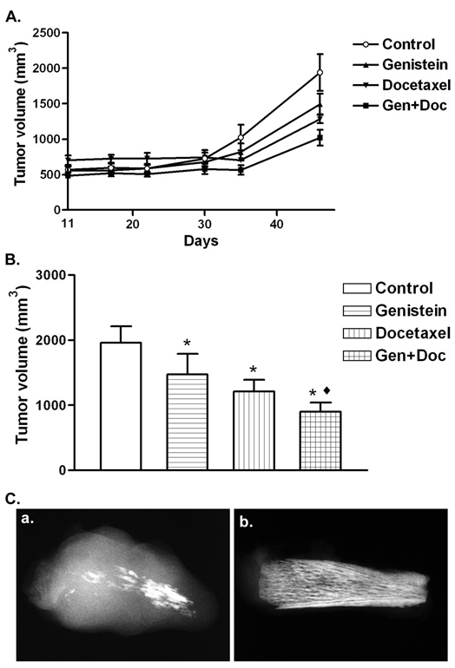
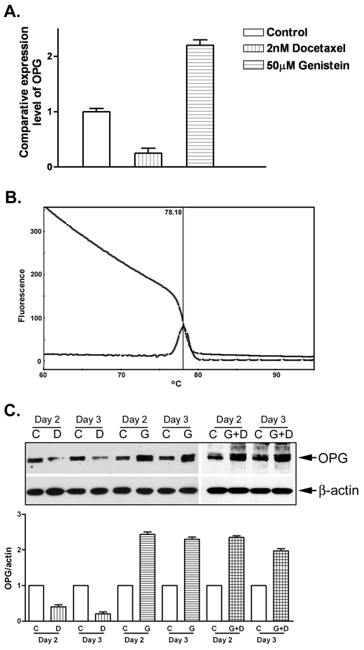
Fig-8: Genistein enhanced PC-3 bone tumor growth inhibition induced by docetaxel. A: Inhibitory effects of genistein and/or docetaxel on the growth of bone tumors formed by PC-3 cells in SCID-human mice. B: Comparison of the tumor volumes in each group on the day when all mice were sacrificed. (*: p<0.01, Genistein vs Control, Docetaxel vs Control, Genistein+Docetaxel vs Control; ♦: p=0.01, Genistein+Docetaxel vs Docetaxel). C: Ex vivo bone tumor X-ray showed more osteolysis and tumor growth in control group (a) than in genistein treatment group (b).
Fig-9: OPG expression was up-regulated by genistein and down-regulated by docetaxel. A: Real-time RT-PCR analysis of OPG mRNA expression in genistein or docetaxel treated PC-3 cells. B: Real-time RT-PCR melting curve showing the PCR product of OPG is pure (only one peak). C: Western Blot analysis of OPG protein expression in genistein and/or docetaxel treated PC-3 cells (C: Control; G: 50 μM Genistein treatment; D: 2 nM Docetaxel treatment; G+D: 30 μM Genistein and 1 nM docetaxel combination treatment).
Li Y et al. Cancer Res. 2006

Slide 22
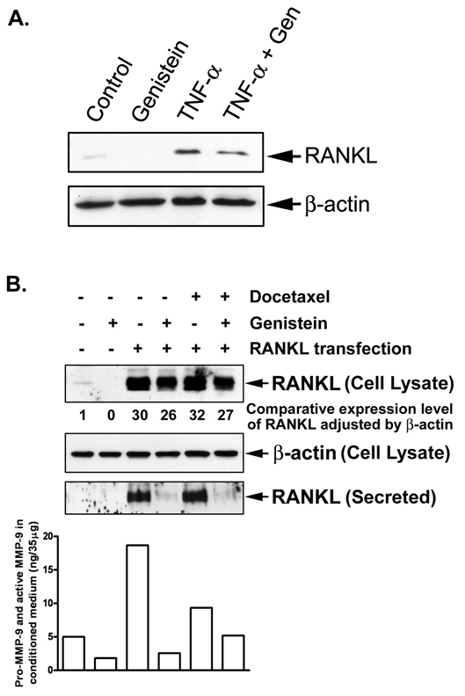
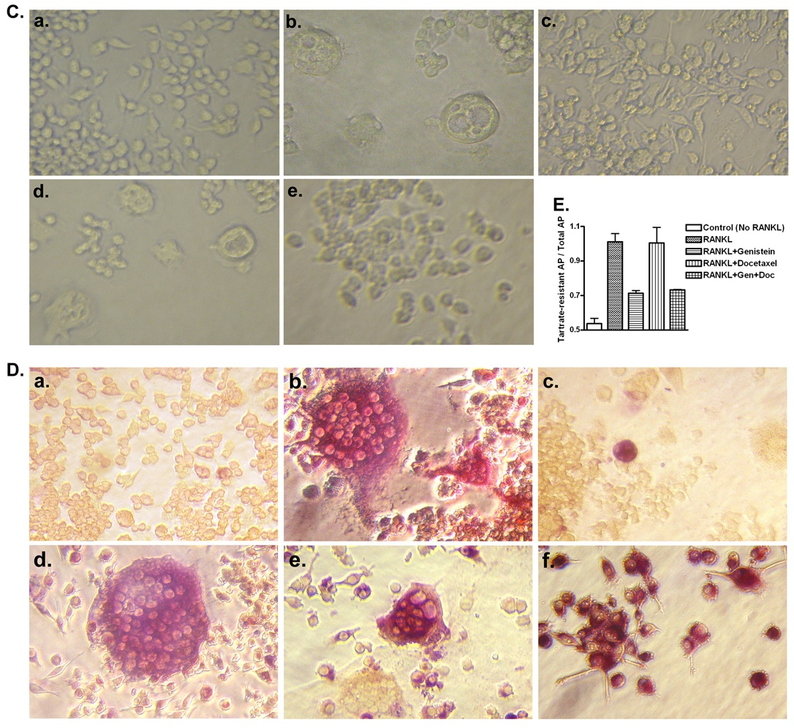
Genistein down-regulated expression and secretion of RANKL and inhibited osteoclast differentiation. A: Western Blot analysis showed that 50 μM genistein inhibited the expression of RANKL and abrogated TNF-α (100 ng/ml) induced expression of RANKL in PC-3 cells. B: Western Blot analysis showed that genistein significantly inhibited the secretion of RANKL in RANKL transfected PC-3 cells.
MMP-9 activity assay showed that genistein significantly inhibited activity of MMP-9 secreted by RANKL-transfected PC-3 cells. C: Genistein inhibited RANKL-induced RAW264.7 cell differentiation to osteoclasts. The multinucleated osteoclasts were observed. (a. control, no RANKL added; b. treated with 100 ng/ml RANKL; c. treated with 100 ng/ml RANKL and 10 μM genistein; d. treated with 100 ng/ml RANKL and 0.5 nM docetaxel; e. treated with 100 ng/ml RANKL, 10 μM genistein, and 0.5 nM docetaxel; x200). D: Genistein inhibited RANKL-induced RAW264.7 cell differentiation to osteoclasts (TRAP staining; x200). In figures a to e, tartrate was added during staining. Multi-nuclei and purplish to dark red granules were observed only in osteoclasts. (a. control, no RANKL added; b. treated with 100 ng/ml RANKL; c. treated with 100 ng/ml RANKL and 10 μM genistein; d. treated with 100 ng/ml RANKL and 0.5 nM docetaxel; e: treated with 100 ng/ml RANKL, 10 μM genistein, and 0.5 nM docetaxel). In figure f, no tartrate was added during TRAP staining. The purplish granules indicated total acid phosphatase (tartrate-resistant and tartrate-sensitive acid phosphatase). RAW264.7 cells contain tartrate-sensitive acid phosphatase. E: Graph showed the ratio of tartrate-sensitive acid phosphatase versus total acid phosphatase. The value indicated the comparative amount of osteoclasts in each sample.

Slide 23
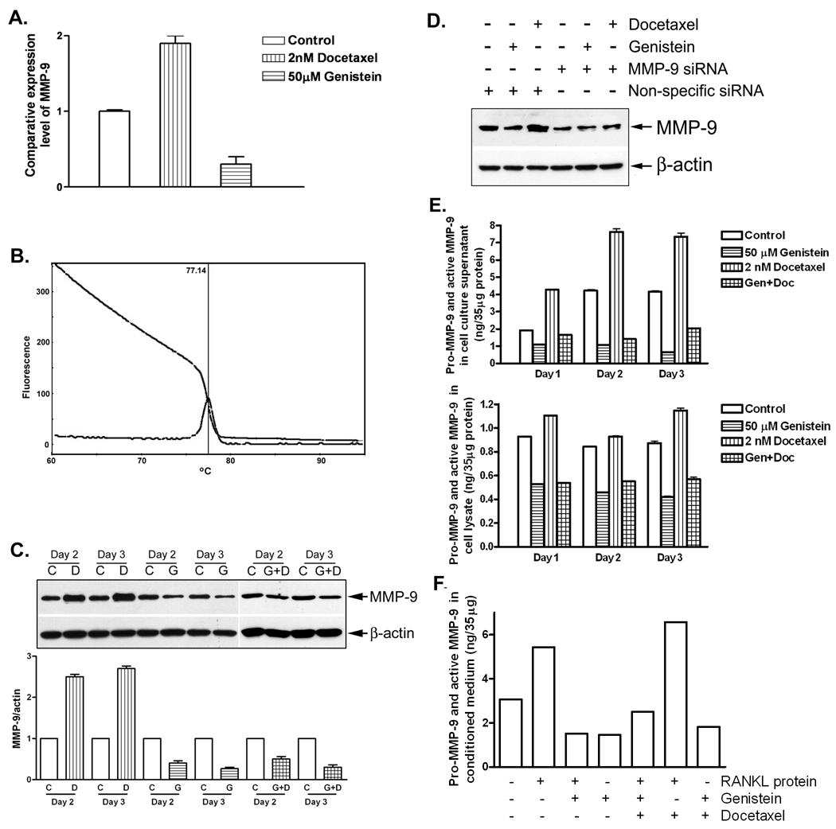
Fig-14: MMP-9 expression was up-regulated by docetaxel and down-regulated by genistein. A: Real-time RT-PCR analysis of MMP-9 mRNA expression in genistein or docetaxel treated PC-3 cells. B: Real-time RT-PCR melting curve showing the PCR product of MMP-9 is pure (only one peak). C: Western Blot analysis of MMP-9 protein expression in genistein and/or docetaxel treated PC-3 cells (C: Control; G: 50 μM Genistein treatment; D: 2 nM Docetaxel treatment; G+D: 30 μM Genistein and 1 nM docetaxel combination treatment). D: Western Blot analysis of MMP-9 protein expression in genistein or docetaxel treated PC-3 cells with or without MMP-9 siRNA transfection. E: MMP-9 activity assay showed that MMP-9 was up-regulated by docetaxel and down-regulated by genistein in PC-3 cell lysate and conditioned medium. F: MMP-9 activity assay showed that MMP-9 was up-regulated by docetaxel and down-regulated by genistein in conditioned medium of PC-3 cell and RANKL induced RAW264.7 cell co-culture.
Li Y et al. Cancer Res. 2006

Slide 24
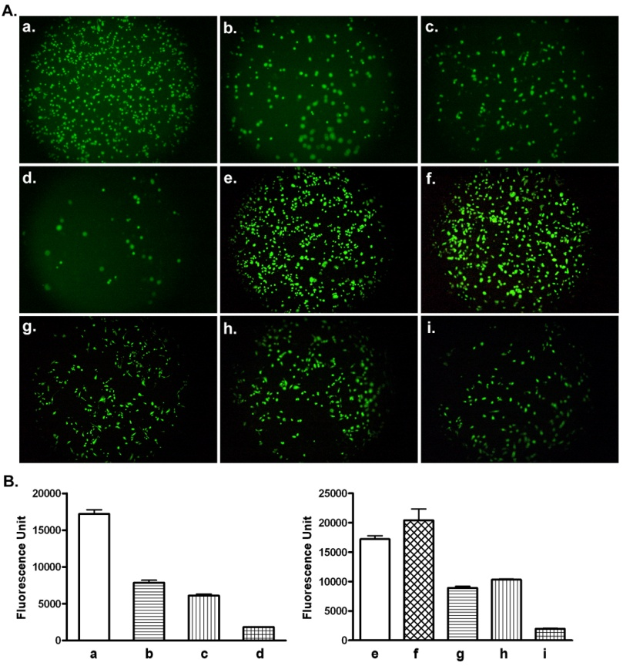
Fig-11: Genistein potentiated docetaxel-induced inhibition of PC-3 cell invasion. A: Invasion assay showed that combination treatment of genistein and docetaxel significantly inhibited the invasion of PC-3 cells through matrigel matrix membrane in PC-3 growth (a to d) or differentiated osteoclast growth (e to i) environment. (a. control; b. treated with 50 μM genistein; c. treated with 2 nM docetaxel; d. treated with 50 μM genistein and 1 nM docetaxel; e. control, no RANKL added; f. treated with 100 ng/ml RANKL; g. treated with 100 ng/ml RANKL and 50 μM genistein; h. treated with 100 ng/ml RANKL and 2 nM docetaxel; i: treated with 100 ng/ml RANKL, 50 μM genistein, and 1 nM docetaxel; x200). B: The graphs showed the value of fluorescence from the invaded PC-3 cells. The value indicated the comparative amount of invaded PC-3 cells.
Li Y et al. Cancer Res. 2006

Slide 25
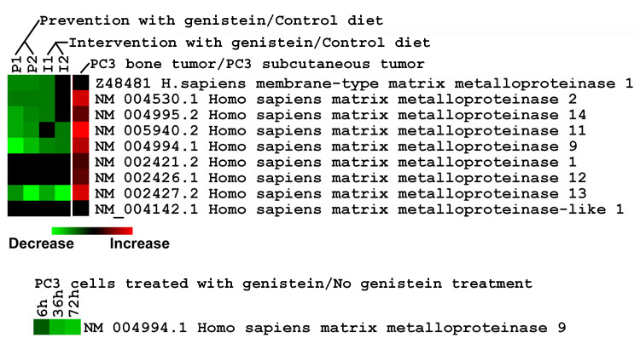
Effect of Dietary Genistein on MMP Gene Expression in Experimental Metastasis
Affymetrix Human Genome U95 or U133A Array

Slide 26
Cluster Analysis According to Biological Function
Numbers of altered genes in different categories in PC3 bone tumors after genistein treatment
Category | Up | Down
apoptosis | 12 | 1
cell cycle arrest, negative regulation of cell proliferation and transcription | 13 | 0
signal transduction, chemotaxis | 10 | 7
regulation of transcription and protein biosynthesis | 11 | 10
oncogenesis | 8 | 4
Based on Cluster, Onto-Express, and GenMAPP Software

Slide 27
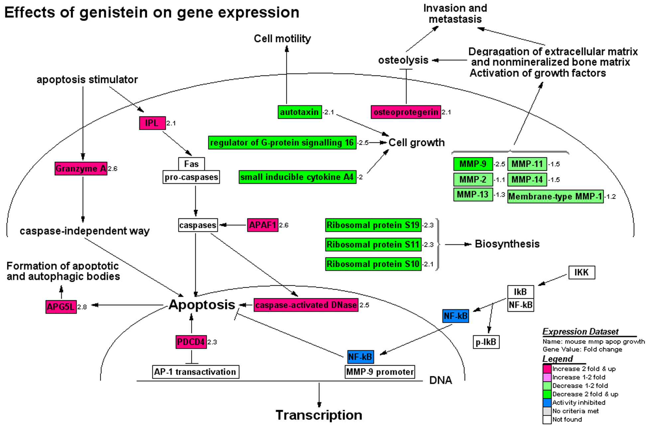
Effects of genistein on gene expression*
*Based on in vitro and in vivo gene profiling with and without genistein

Slide 28
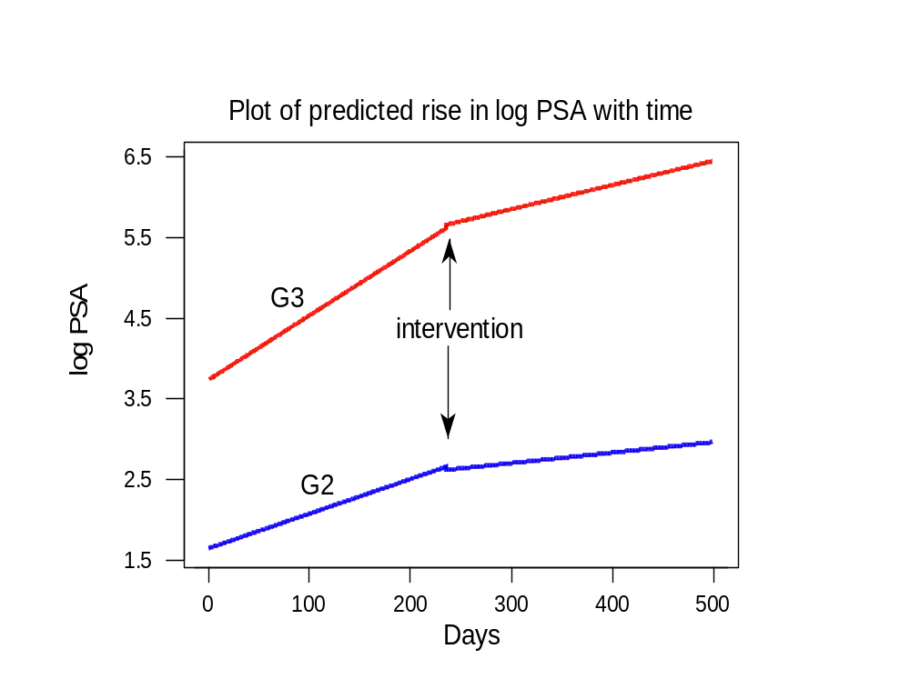

Slide 29
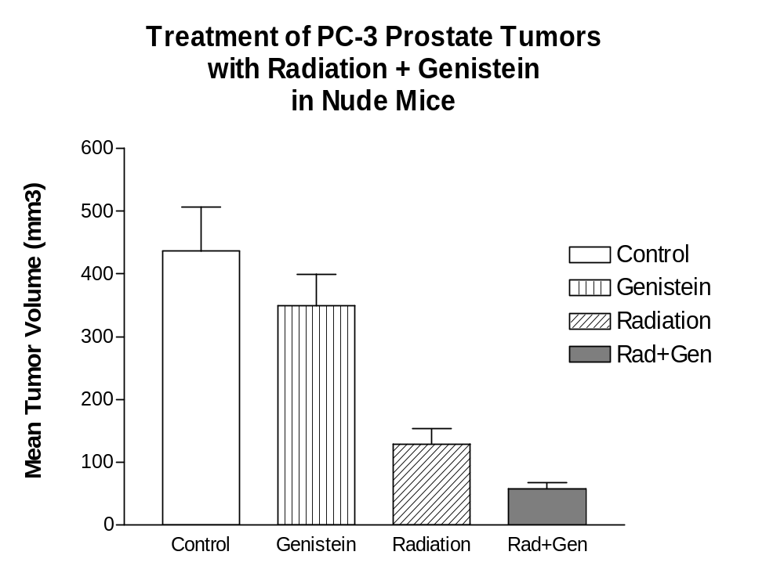

Slide 30
Genistein-Radiation Pilot Study
42 patients with prostate cancer
Randomized, placebo-controlled, phase 2 study
20 patients received soy isoflavones 200 mg/day for 3 months, starting with the first day of radiation, and 22 received placebo
QOL questionnaires given at 3 and 6 months

Slide 31
Study Patients
Group 1 (Soy) |  | Group 2 (Placebo)
Median Age = 60 y |  | Median Age = 65 y
8 T1c, 3 T2a, 2 T2b |  | 10 T1c, 2 T2a, 1 T2b
Median Pre PSA | 3.7 | Median Pre PSA | 4.9
Median 4-6 month PSA | 0.9 | Median 4-6 month PSA | 2
PSA decrease | 75.7% | PSA decrease | 59.2%

Slide 32
Genitourinary (GU) Toxicity
Soy | 3M n=13 | 6M n=13 | Placebo | 3M n=13 | 6M n=14
GU toxicity |  |  | GU toxicity
Leakage/Dripping of Urine | 15.4% (2) | 7.7% (1) | Leakage/Dripping of Urine | 23.1% (3) | 28.6% (4)
Big/Medium Problem with Frequency | 38.5% (5) | 0% | Big/Medium Problem with Frequency | 38.5% (5) | 7.1% (1)
Big/Medium Problem with Urgency | 30.8% (4) | 0% | Big/Medium Problem with Urgency | 0% | 0%
Function same as before RT or Better | 92.3% (12) | 92.3% (12) | Function same as before RT or Better | 92.3% (12) | 85.7% (12)

Slide 33
Erectile Function
Soy | 3 M n=13 | 6 M n=13 | Placebo | 3 M n=13 | 6 M n=14
Erectile Function |  |  | Erectile Function
Ability to Have Full Erections | 69.2% (9) | 77% (10) | Ability to Have Full Erections | 61.5% (8) | 57.1% (8)
Reduction in Ability to Have Erections | 15.4% (2) | 15.4% (2) | Reduction in Ability to Have Erections | 46.2% (6) | 57.1% (8)
Function Same as Before RT or Better | 84.6% (11) | 84.6% (11) | Function Same as Before RT or Better | 61.5% (8) | 57.1% (8)

Slide 34
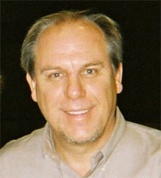


Trygve O. Tollefsbol, PhD
Professor
UAB Department of Biology
Epigenetics and Gene Regulation in Cancer and Aging

Slide 35
Impact on DNA methylation in cancer prevention and therapy by bioactive dietary components
Yuanyuan Li and Trygve O. Tollefsbol
Curr Med Chem. 2010; 17(20): 2141–2151.
It is well established that aberrant gene regulation by epigenetic mechanisms can develop as a result of pathological processes such as cancer. Methylation of CpG islands is an important component of the epigenetic code and a number of genes become abnormally methylated during tumorigenesis. Some bioactive food components have been shown to have cancer inhibition activities by reducing DNA hypermethylation of key cancer-causing genes through their DNA methyltransferase (DNMT) inhibition properties. The dietary polyphenols, (−)-epigallocatechin-3-gallate (EGCG) from green tea, genistein from soybean and possibly isothiocyanates from plant foods, are some examples of these bioactive food…

Slide 36
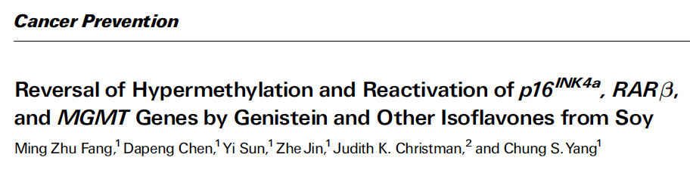
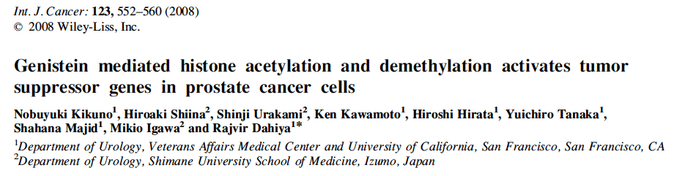
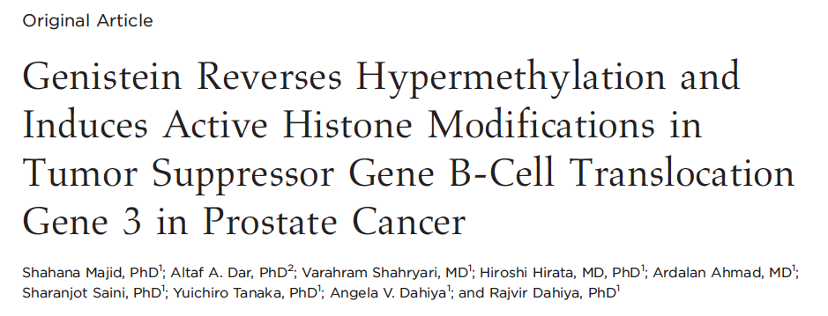
Effects of Genistein on CpG Methylation and Histone Acetylation Have Been Reported From Several Groups

Slide 37
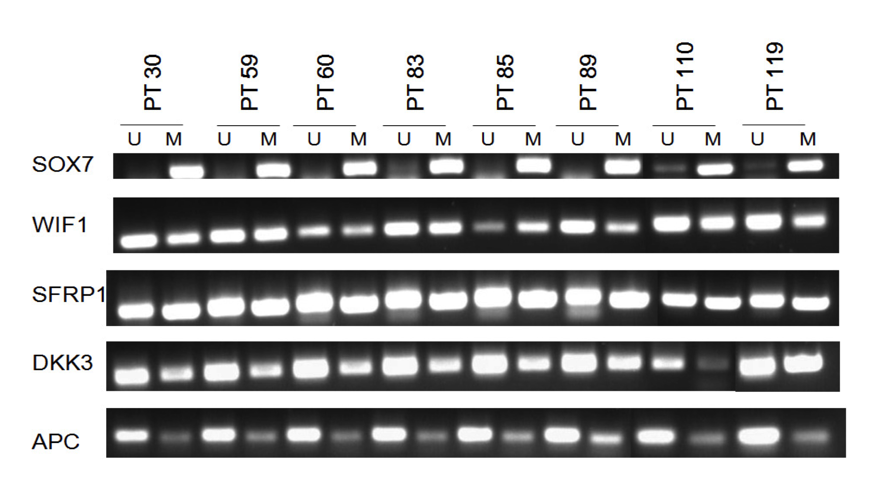
Wnt Pathway Inhibitory Genes are hypermethylated in prostate cancer patients
Phillip et al, BMC Cancer, 2012, 12(1):145.

Slide 38
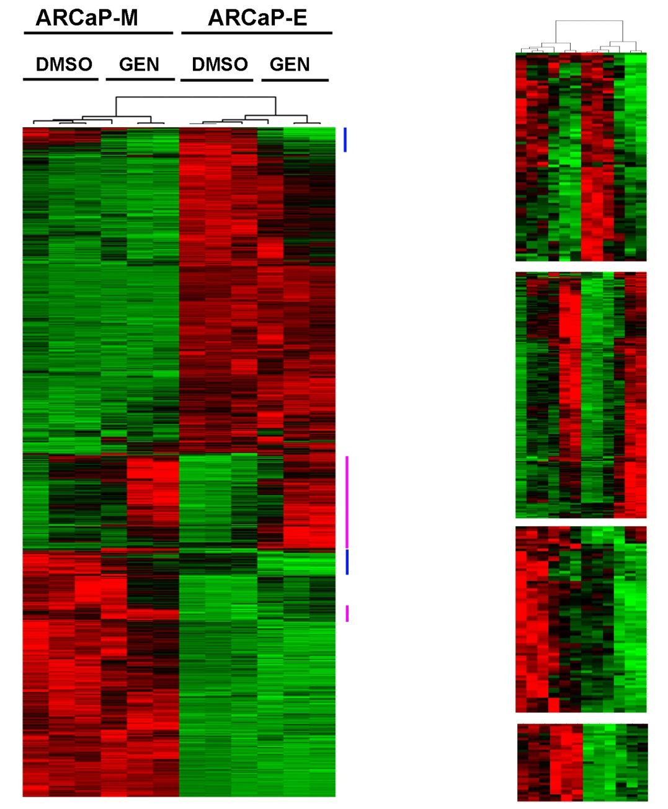
Whole Genome Expression Profiling
Of Prostate Cancer Cells Treated with Genistein
Down
Up
Down
Up
Phillip et al, BMC Cancer, 2012, 12(1):145.

Slide 39
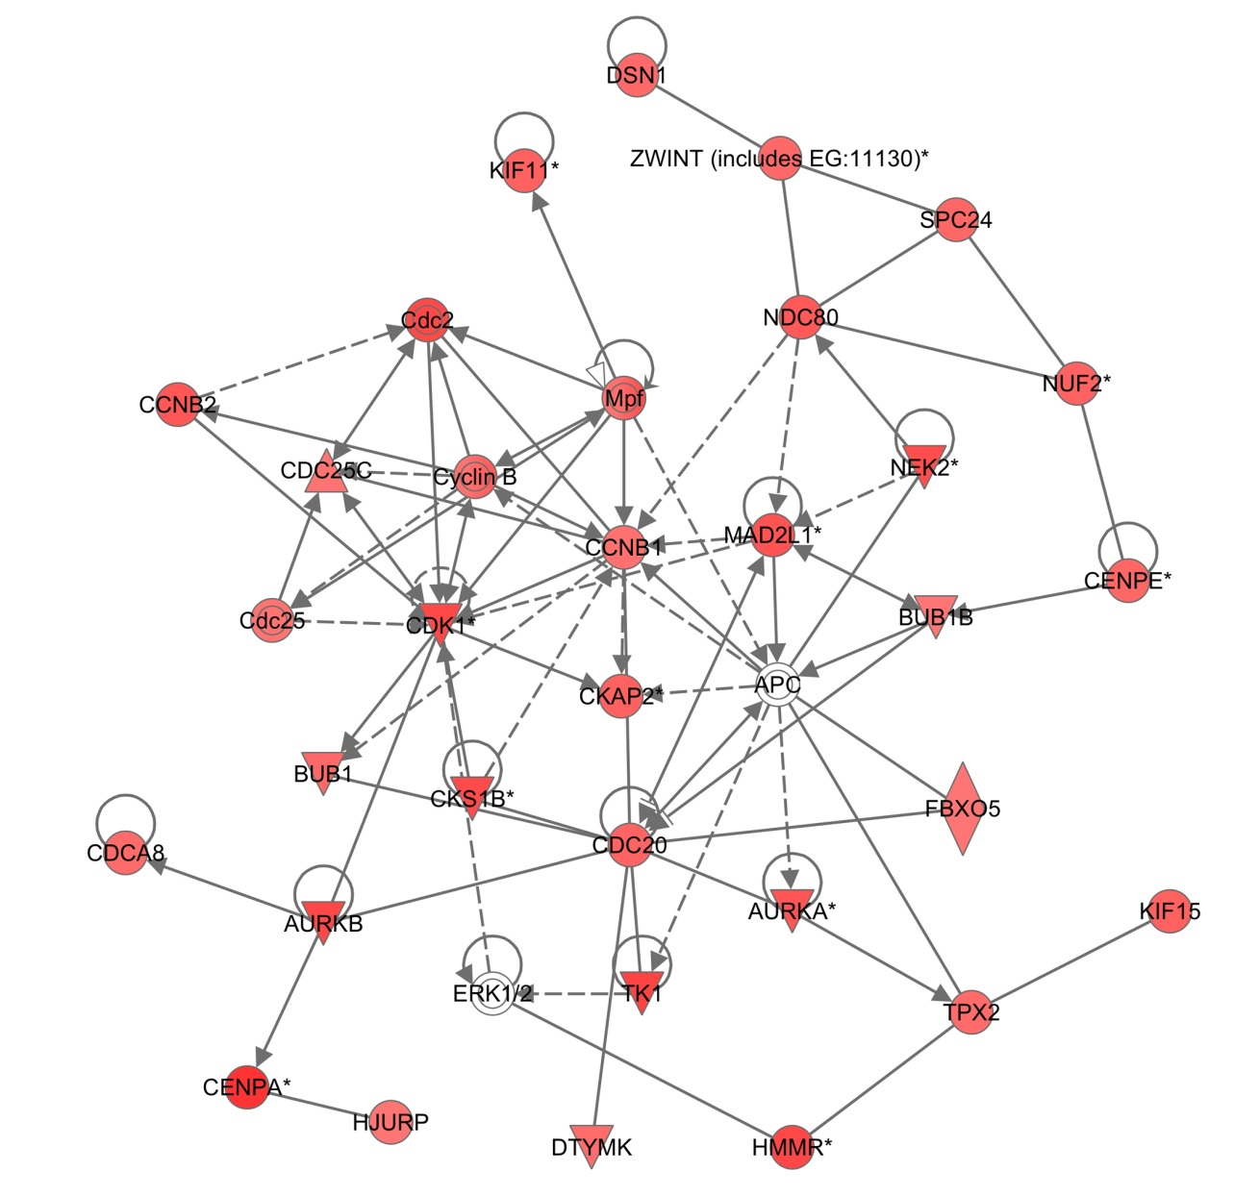
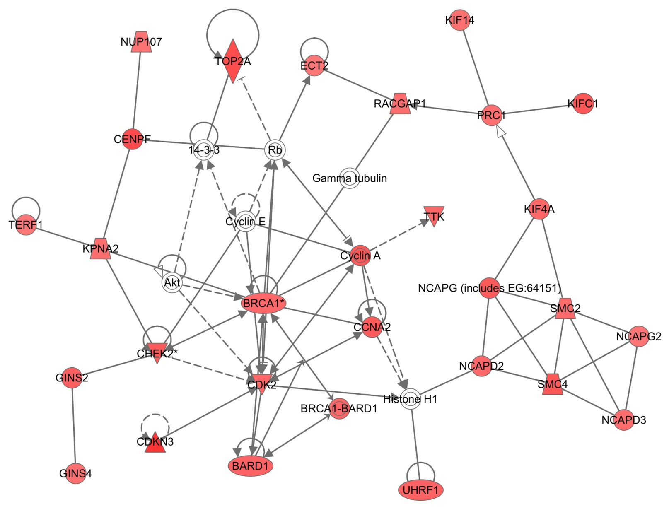
Genistein Upregulates Genes Involved in Cell Cycle Responses to DNA Damage

Slide 40
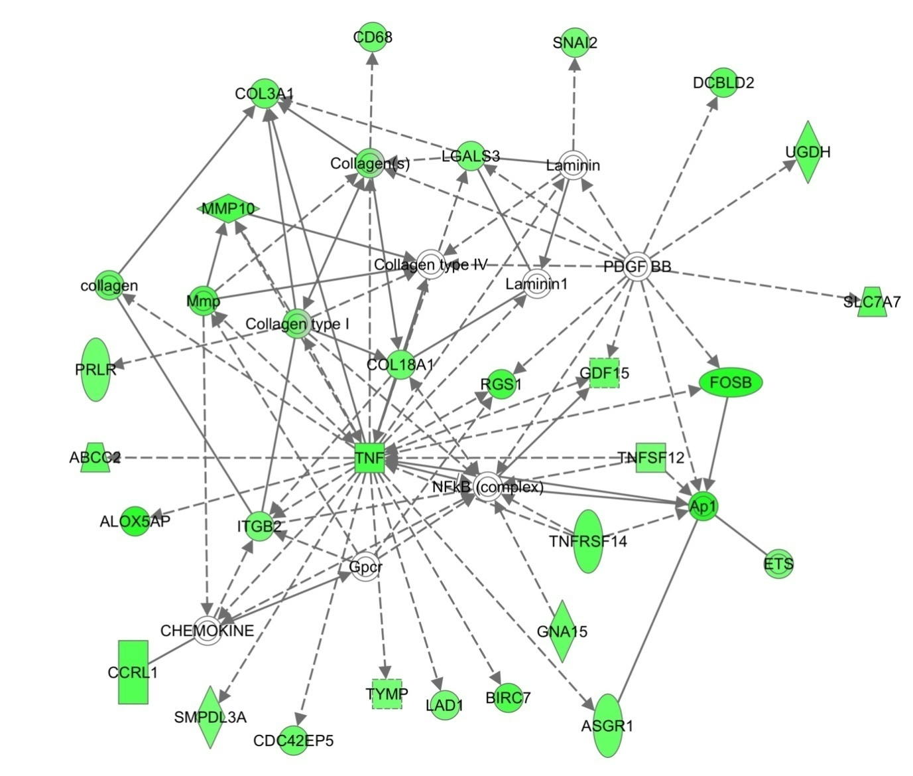
Genistein Downregulates Genes Involved in the TNF-NFKB Pathway
Slug
Livin

Slide 41
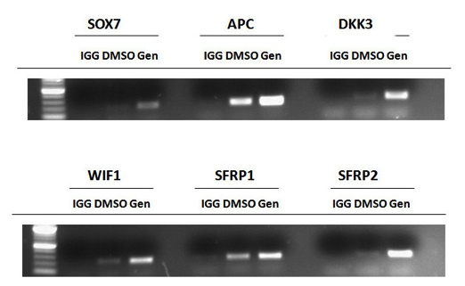
Genistein induces Acetylation of Histone H3K9
Anti-Ac-H3K9 Chromatin Immunoprecipitation
Phillip et al, BMC Cancer, 2012, 12(1):145.

Slide 42
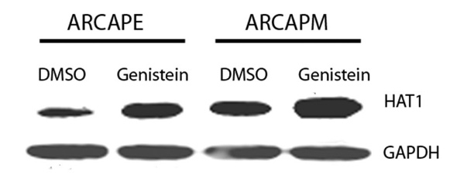
Genistein induces expression of HAT1
Histone Acetyl Transferase 1 (HAT1)
Phillip et al, BMC Cancer, 2012, 12(1):145.

Slide 43
Genistein synergizes with HDACi Vorinostat
to inhibit proliferation
Genistein 6 days 20 uM
5-aza 6 days 1 uM
Vorinostat 2 days 1 uM
Phillip et al, BMC Cancer, 2012, 12(1):145.

Slide 44
Genistein synergizes with HDACi Vorinostat
to induce apoptosis
Phillip et al, BMC Cancer, 2012, 12(1):145.
Notes:
1µM vorinostat 48hrs

Slide 45
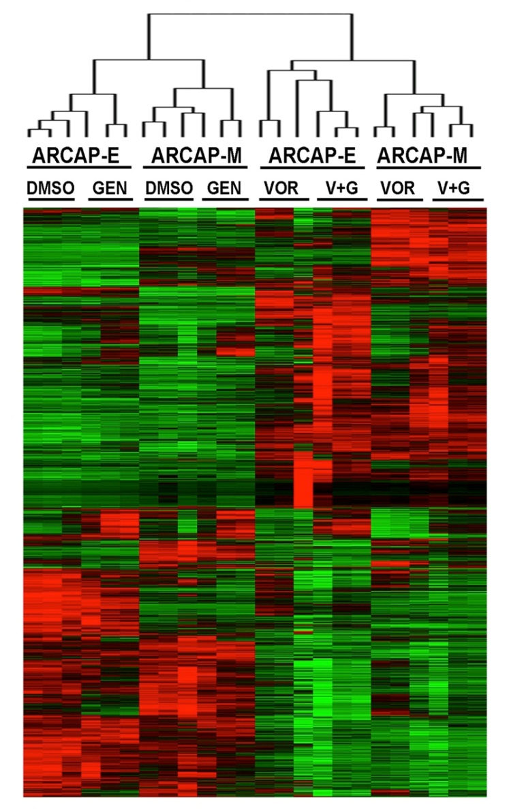
Whole Genome Expression Profiling
Of Prostate Cancer Cells Treated with Genistein,
Vorinostat, or Genistein plus Vorinostat
Phillip et al, BMC Cancer, 2012, 12(1):145.

Slide 46
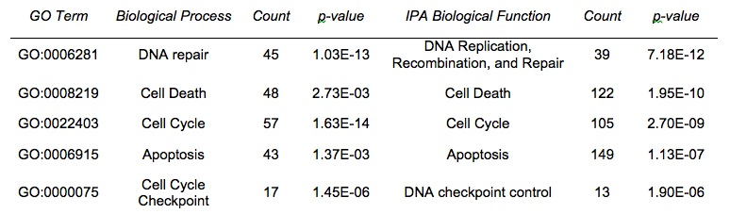
Genistein/Vorinostat Upregulates Genes Involved in Cell Cycle Responses to DNA Damage
Phillip et al, BMC Cancer, 2012, 12(1):145.

Slide 47
AMPK and PPAR agonists are exercise mimetics
Ronald M. Evans et al: Cell 134:405-415, 2008
Natural compounds may mimic or potentiate the effects of exercise and may prevent the development of metabolic syndrome:
  Natural compounds, such as genistein, have endurance-enhancing activities, but their exact mechanisms remain unclear
Studied endurance capacities of mice in a treadmill running test.
PPAR agonist and exercise training synergistically increased myofibers and running endurance in adult mice.
In sedentary mice, 4 weeks of treatment with an AMPK agonist induced metabolic genes and enhanced running endurance by 44%.

Slide 48
Genistein improves cardiovascular risk factors
Atteritano M et al. Effects of genistein on predictors of cardiovascular risk in osteopenic, postmenopausal women: a two-year randomized, double-blind, placebo-controlled study. J Clin Endocrinol Metab. 92:3068-75, 2007.
54 mg genistein + Ca + vitamin D,
was associated with favorable effects on
glycemic control and
cardiovascular risk markers

Slide 49
Genistein, insulin sensitivity and memory
Alonso A et al. Age 2010.
In aged ovariectomized female rats
GENISTEIN
increased insulin sensitivity
improved spatial memory

Slide 50

Helen Kim, Ph.D.
Associate Professor of Pharmacology and Toxicology
Senior scientist, UAB Comprehensive Cancer Center
Senior scientist: UAB Center for Aging

Slide 51
Soy isoflavones, but not Premarin, attenuated AD-relevant protein phosphorylation in primate brain.
Epitopes
assessed:
Arbitrary
units
PHF-1
Tau-1
CT
Soy iso
CEE
(from H Kim et al., 2001, BioFactors)

Slide 52
Relationship between neuroprotective actions by soy versus estrogen
Hyperphosphorylated tau
tau
hyperphosphorylation
Soy?
stable microtubule
(viable neuron)
depolymerized microtubules;
(dysfunctional neuron)
Estrogens ?
(Kim, 2001)

Slide 53
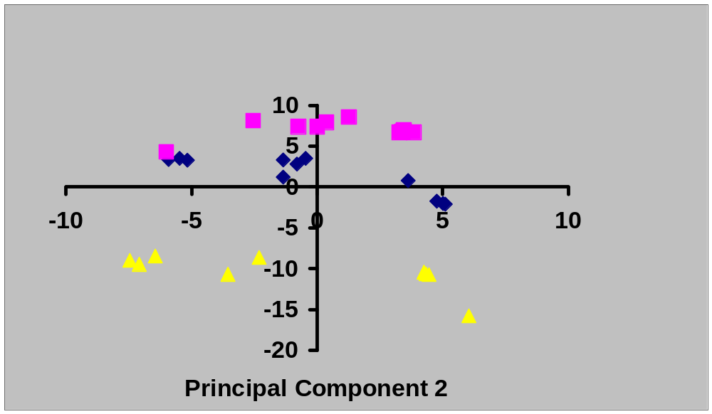
Principal Component Analysis indicates that soy+, soy- and casein-based diets, had non-overlapping global effects on brain proteins
casein
soy-
soy+

Slide 54
Isoflavones and cognitive function in older women: the Soy and Postmenopausal Health In Aging (SOPHIA) Study
  6-month, double-blind, randomized, placebo-controlled clinical trial
  Study subjects were in good health, postmenopausal and not using estrogen replacement therapy
  Randomized to active treatment (n = 27) two pills per day, each containing 55 mg of soy-extracted isoflavones (110 mg per day) or placebo (n = 26).
  Cognitive function tests administered at baseline and follow-up included: Trails A and B, category fluency, and logical memory and recall (a paragraph recall test assessing immediate and delayed verbal memory).
  Kritz-Silverstein D; Von Muhlen D; Barrett-Connor E; Bressel M. Menopause. 10:196-202, 2003.

Slide 55
Isoflavones and cognitive function in older women: Soy & Postmenopausal Health In Aging (SOPHIA) Study.
At baseline, all women were cognitively intact; there were no significant differences by treatment assignment in age, education, depressed mood, or cognitive function (all P values > 0.10).
The women in the treatment group did consistently better, both as compared with their own baseline scores and as compared with the placebo group responses at 6 months.
Comparisons of percentage change in cognitive function between baseline and follow-up showed greater improvement in category fluency for women on active treatment as compared with the case of those on placebo (P = 0.02) and showed greater improvement on the other tests of verbal memory and Trails B.

Slide 56
Soy isoflavones ameliorate the adverse effects of chemotherapy in children
Tacyildiz N, Ozyoruk D, Yavuz G, Unal E, Dincaslan H, Dogu F, Sahin K, Kucuk O. Nutr Cancer. 2010;62(7):1001-5.
9 cycles of chemotherapy were administered without genistein, and 57 cycles with genistein (8 mg/day).
Patients had less myelosuppression, mucositis, and infection when they received their chemotherapy with genistein.
During supplementation, serum genistein levels were 2-6 times higher compared to presupplementation levels.
Patients who received abdominal radiation reported less pain and diarrhea when they took the genistein supplement.

Slide 57
Summary
Genistein
  Antioxidant (prevents DNA damage)
  Anti-inflammatory (IL-1, IL-6 inhibition)
  DNA demethylation
  Histone acetylation
  NFkB, RANKL, VEGF, MMP, EMT inhibition
  Enhances chemo/RT
  Reduces toxicities of chemo/RT
  Potentiates immune function (anti-viral, anti-bacterial)

Slide 58
Genistein in survivorship research
    Opportunities for prevention of short term and long term adverse effects of radiation and chemotherapy:
        Second primary tumors
        Cognitive decline
        Cardiac toxicity
        Myelosuppression
        Pulmonary toxicity
        Neurotoxicity (CNS and peripheral neuropathy)
        Nephrotoxicity
        Hepatotoxicity
    Improved efficacy of chemo/RT and targeted therapy
    Genistein is a safe, orally bioavailable compound which has been well tolerated in clinical trials

Slide 59

THE SOCIETY FOR INTEGRATIVE ONCOLOGY (SIO) IS A NON-PROFIT, MULTI-DISCIPLINARY ORGANIZATION DEDICATED TO ADVANCING EVIDENCE-BASED, COMPREHENSIVE, INTEGRATIVE HEALTHCARE TO IMPROVE THE LIVES OF PEOPLE AFFECTED BY CANCER.
SIO members share the common goals of excellent comprehensive patient care, enhancement of anti-cancer therapy, supportive care and prevention of cancer.
Members are part of a unique multidisciplinary community of oncologists, nurses, psychologists, social workers, nutritionists, complementary therapy practitioners, naturopathic doctors, herbalists, acupuncturists, massage therapists, other health care practitioners, and patient advocates.

Slide 60
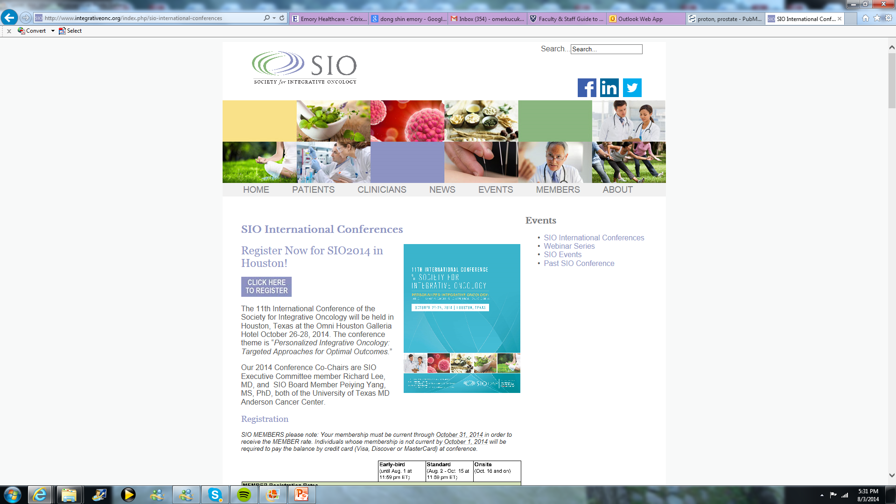
SIO 2015
12th International
Conference
of the Society for
Integrative
Oncology
14-16 November,
2015.
Joseph B. Martin
Conference Center
at Harvard Medical School.

Slide 61
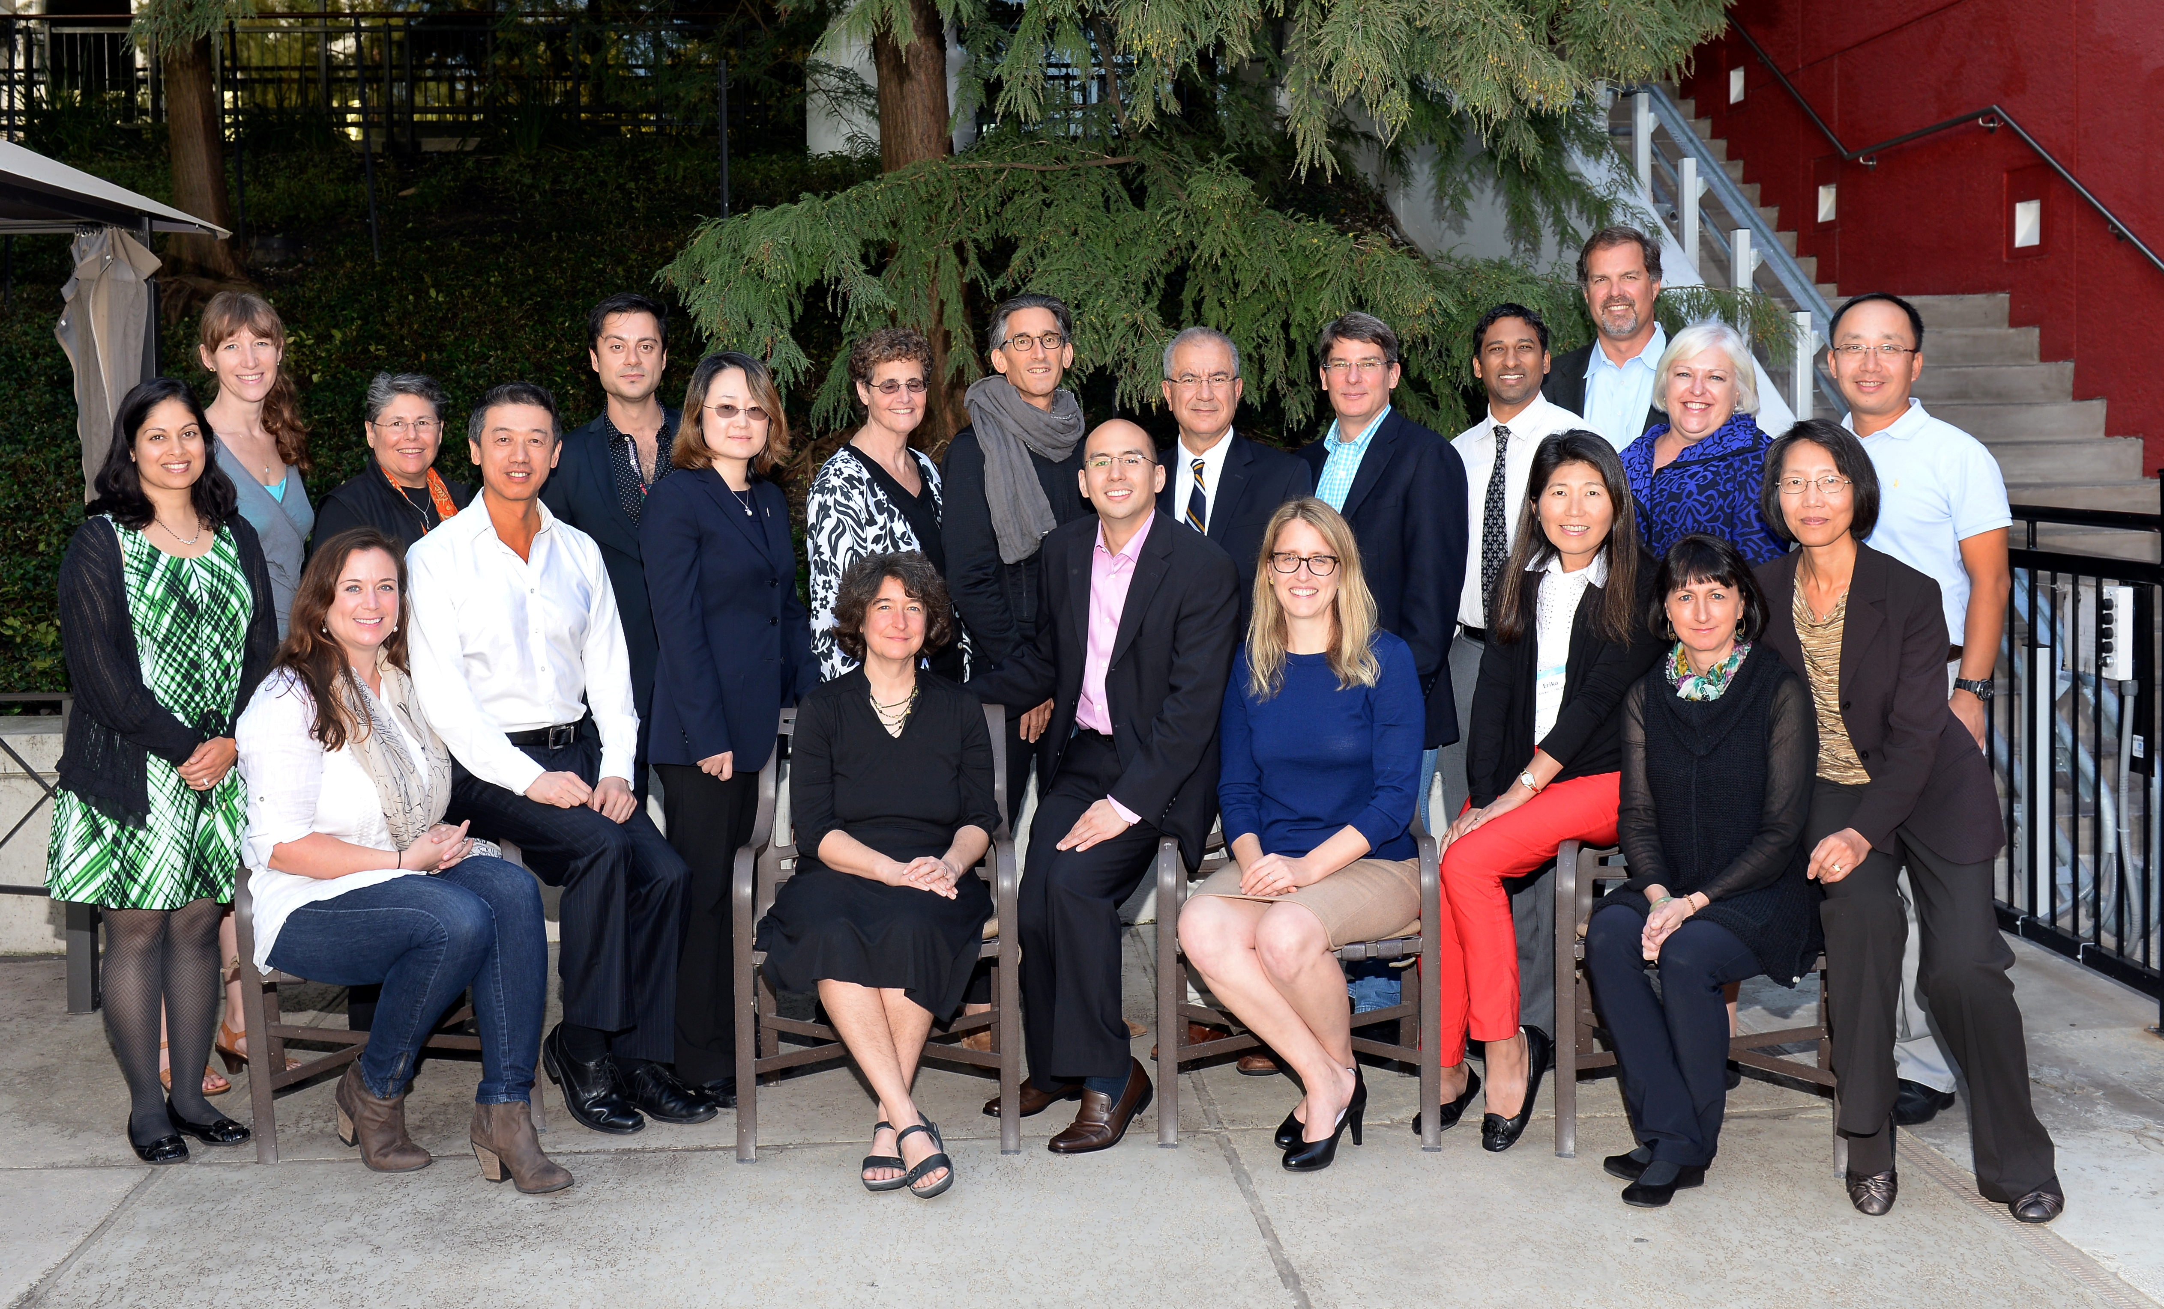
SIO BOARD OF TRUSTEES

Slide 62
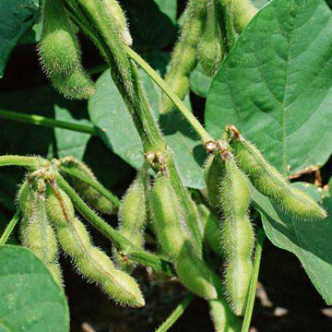
Let food be your medicine.
Hippocrates
okucuk@emory.edu

