Slide 1
CASE PRESENTATION Conference - Dubai 2016
DR. OMER BASHIR ABDELBASIT
Consultant Neonatologist
Security Forces Hospital
Riyadh - KSA

Slide 2
A Case of a Reversible Cardiomyopathy & Left Ventricle
NONCOMPACTION

Slide 3
History
Pregnancy: Uneventful
  Antenatal U/S No fetal abnormality
  Antenatal serolgy for infectious disease
        Non significant
  HVS for GBS Negative

Slide 4
History
Delivery
  Elective Caesarean section at term because of previous C/S
  Apgar Score 9 &10 at 1 & 5 min respectively
  Female infant birth weight 2230 grams
  Baby Vigorous > normal newborn nursery
  Oxygen saturation at 15 min > 95%

Slide 5
History
Family History
  First degree consanguinity
  One male sibling expired at age of 2 days 7 years ago labelled as severe HIE, ? septic shock, ? metabolic disorder
  Five other siblings all normal

Slide 6
Hospital Course
Age One Hour: Developed
  Signs of respiratory distress
  Marked cyanosis
  SaO₂ 70 – 80%
  Clinically no dysmorphism
  CVS clinically normal
  Admitted to NICU

Slide 7
Initial Management
Started on CPAP 6 – 7 mm Hg , FiO₂ 0.3 – 0.4
  SaO₂: 80%
Blood Gas: pH 7.12, pCO₂ 45, HCO3 14, base deficit -13
With increased oxygen requirement mechanical ventilation started with PC mode
PPHN: HFOV + NO
Persistent hypotension: Dopamine + Dobutamine titrated to
  20 micrograms/kg/min
Still hypotensive: Epinephrine > Hydrocortisone
Antibiotics commenced

Slide 8
Summary
Term female infant with RD and cyanosis
Persistent hypoxemia
Severe metabolic acidosis
Persistent hypotension
Differential Diagnosis
Cyanotic congenital heart disease
Septic shock with pulmonary hypertension
  Metabolic disorder

Slide 9
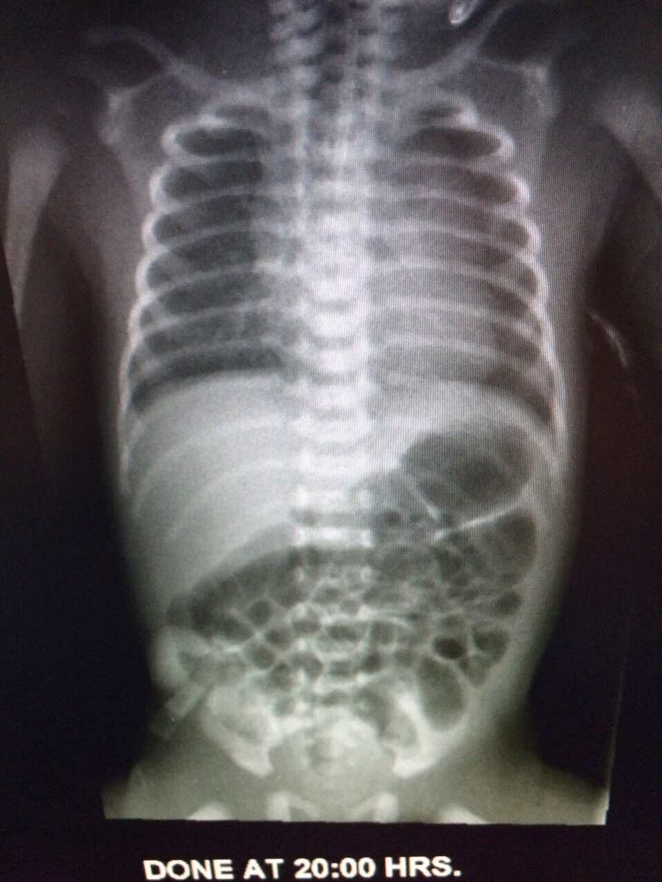
Investigations
CXR

Slide 10
Investigations
CBC + Diff
CRP
Blood culture
Lactate
Ammonia

Slide 11
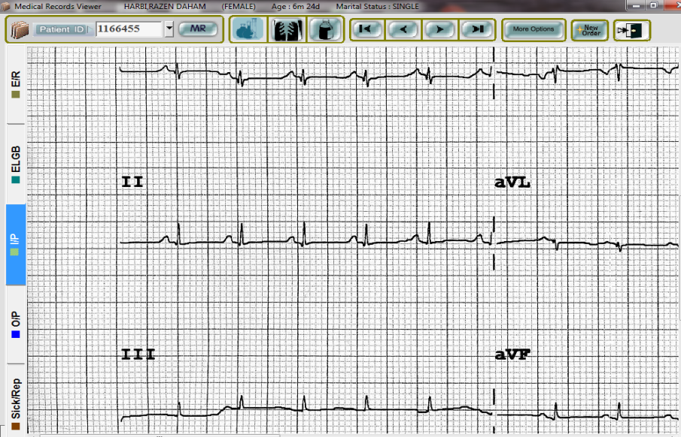
Investigations

Slide 12
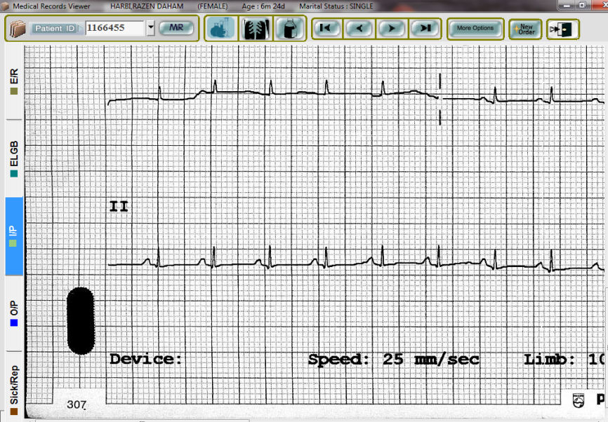
Investigations

Slide 13
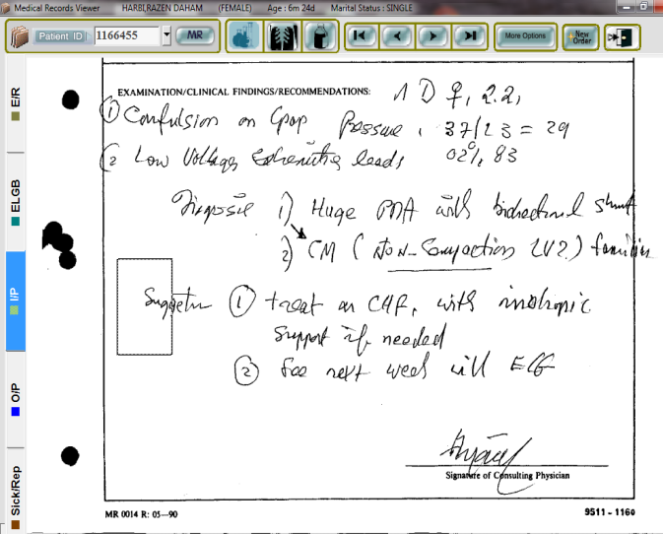
Investigations: ECHO

Slide 14
Hospital Course at 24 Hours
HFOV + NO > SaO₂ > 95%
Blood Gas: pH 7.4, pCO₂ 37, HCO₃ 25
Repeat CBC and CRP no significant change
Blood culture: no growth
BUN 2 mmol/l Creatinine 100 micromol/l
Na 126 mmol/l, K 4.6 mmol/l, Cl 93 mmol/l
Glucose 2.1 mmol/l
Protein 60 gm/l Albumen 35 gm/l

Slide 15
Further Management
Due to findings of:
  Persistent hypotension
  Hypoglycemia
  Hyponatremia
Baby started on physiological dose of hydrocortisone emp
Response:
  Hypotension resolved. BP normalized
  Serum sodium normalized after 48 hours
  ECG became normal
  Hypoglycemia resolved
  Oxygenation improved – weaned from NO and ventilation

Slide 16
Further Management
More Investigations:
  CK : 153U/l - not significant
  LFT: normal
  Tandem MS: not remarkable
  Plasma amino acid screen: no significant abnormality
  Urine for organic acids: not remarkable
Endocrine work up:
  17 –Hyroxyprogesterone < 40 ng/l (RR > 630 in newborn)
  ACTH 303 pg/ml (NR 7.2 – 63.7)
  TSH 0.3 mIU/l FT4 5.61 pmol/l(NR 12 – 22)
  FT3 3.6 pmol/l (NR 3 – 6.8)
  GH 7.37 ng/ml (NR 0.01 – 0.97)

Slide 17
Diagnosis
Cardiomyopathy with noncompaction of the left ventricle
Secondary Hypothyroidism
Adrenal Insufficiency ? Primary

Slide 18
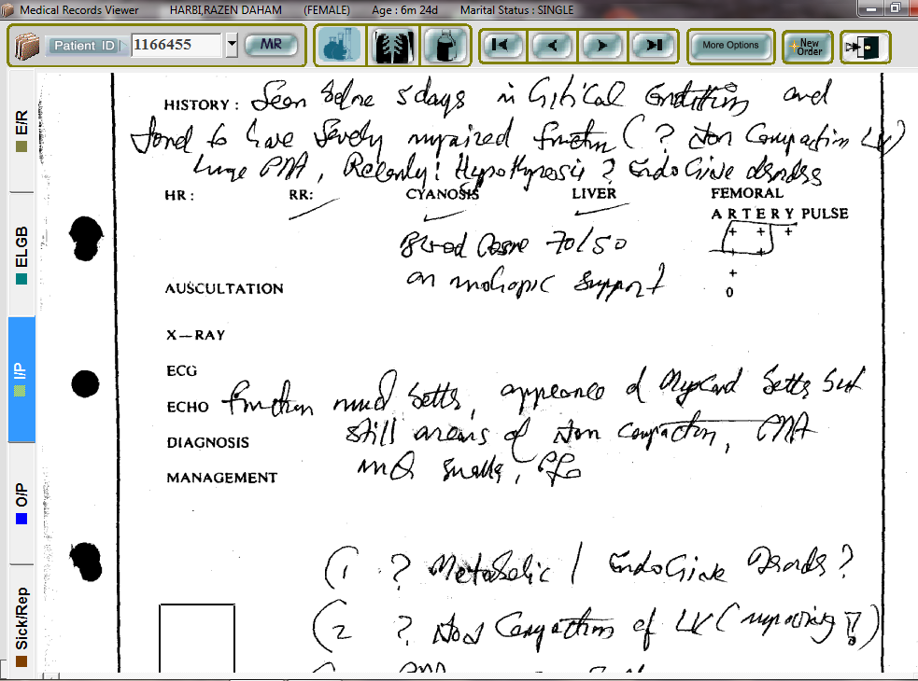
Outcome- ECHO follow up

Slide 19
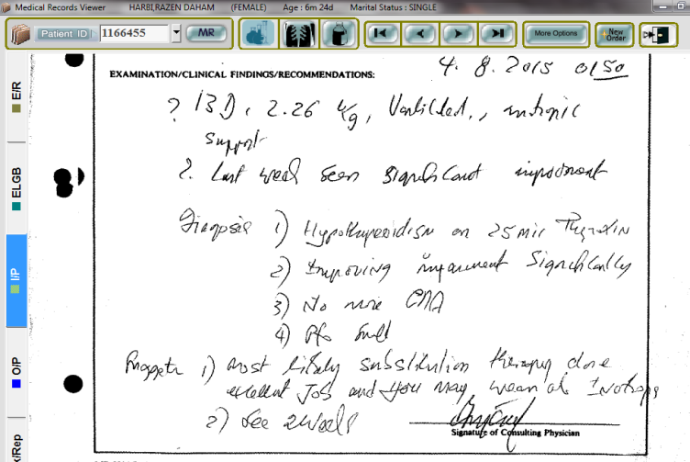
ECHO – Follow up

Slide 20
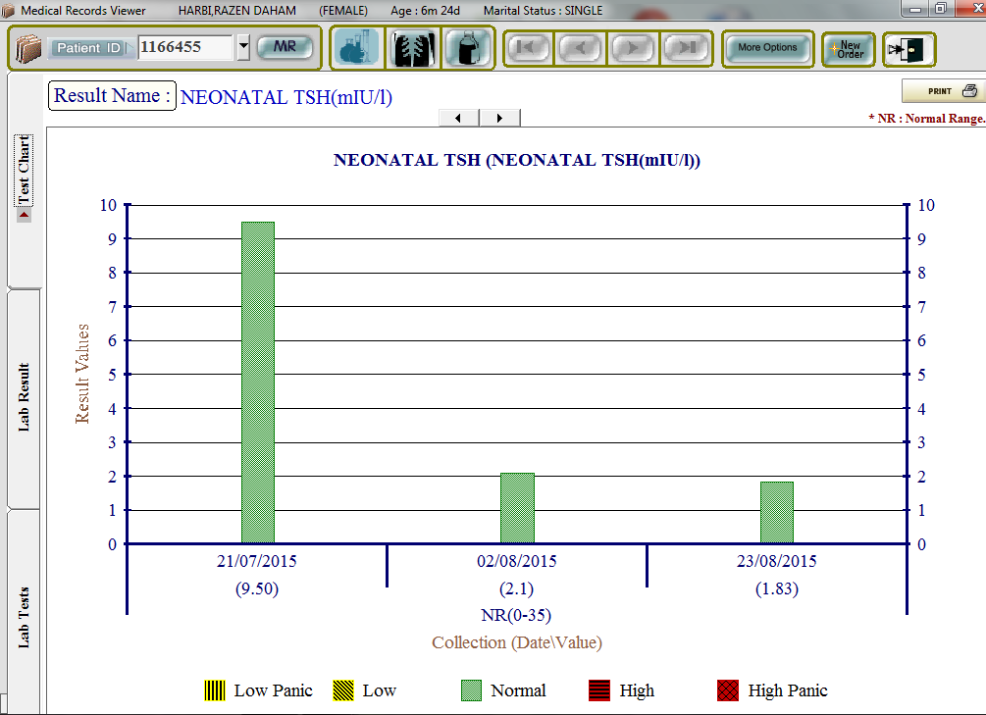
Follow up - TSH

Slide 21
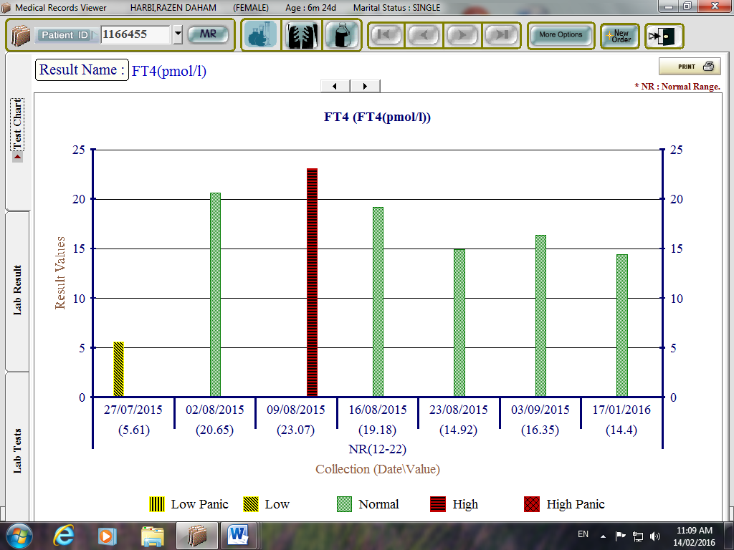
Follow up- FT4

Slide 22
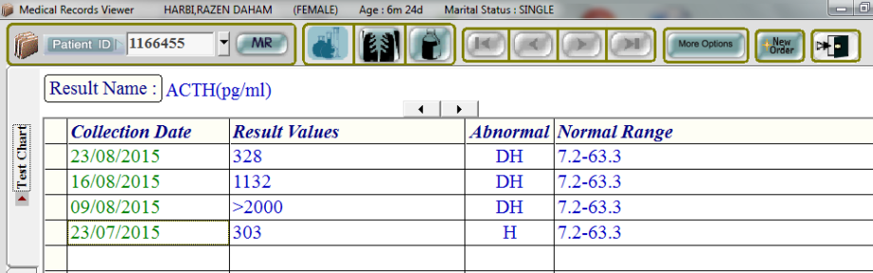
Follow up - ACTH

Slide 23
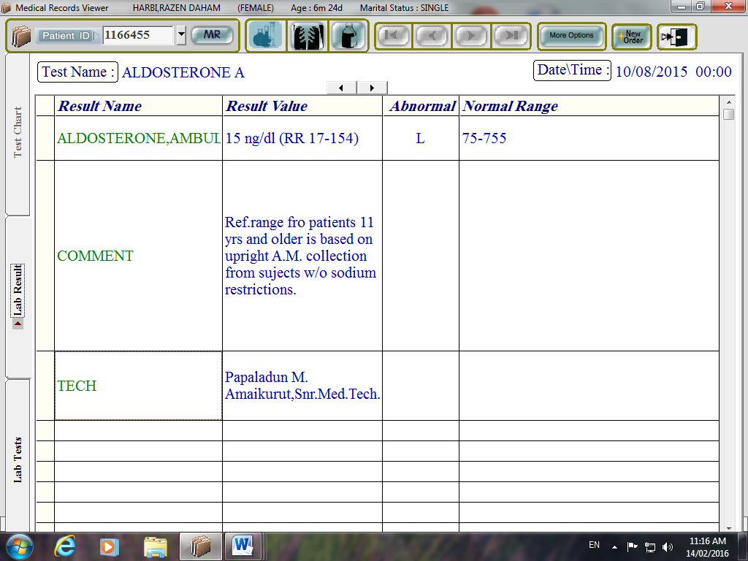
Follow up - Aldosterone

Slide 24
Investigations
Plasma Renin: 170 ng/ml/hr (RR 1.4 – 7.8)
Plasma Renin to Aldosterone Ratio: 11:1
Plasma renin to aldosterone ratio of more than 30 is suggestive of inadequate mineralocorticoid production.

Slide 25
Imaging
MRI Pituitary: normal
Thyroid U/S : normal
Thyroid Scan: normal
Adrenal U/S: normal

Slide 26
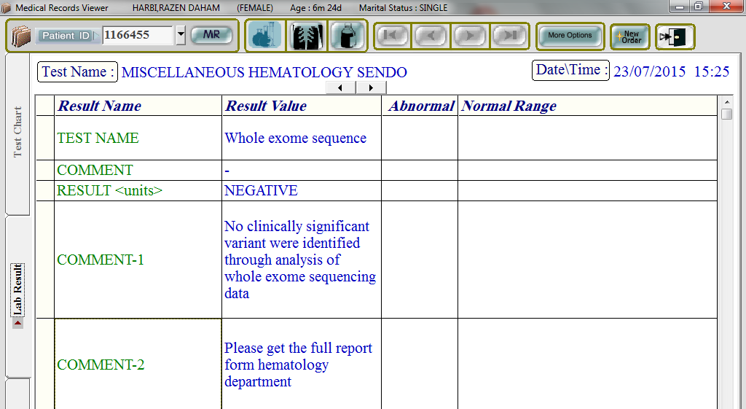
Genetic Studies
Chromosomal Karyotype: 46 XX
Whole Exome Sequence

Slide 27
Discussion
Left Ventricular Noncompaction (LVMNC):
  Affects 0.14% of pediatric population
  Etiology is heterogeneous & include a wide number of genetic causes
  It is a form of cardiomyopathy characterized by prominent left ventricular trabeculae & deep intertrabecular recesses

Slide 28
Discussion
  Can be sporadic or familial
  Familial form can be inherited as autosomal recessive , autosomal dominant or sex linked
  Can be isolated or can exist with other structural heart disease
  Can be complicated by congestive heart failure, arrhythmia, and thromboembolic events

Slide 29
Discussion
LVNC Associated Disorders
Syndromes:
  Chromosomal Abnormalities: Trisomy 21, trisomy 18 & trisomy 13
  Neuromuscular diseases
  Others: Sotos, Marfan, Noonan, etc.

Slide 30
Discussion
Inborn Errors of Metabolism:
  Barth syndrome
  Malonyl co-enzyme A decarboxylase deficiency
  Mitochondrial disorders

Slide 31
Etiology in our Case
Hypothyroidism is clearly secondary
Adrenal insufficiency is primary most likely congenital adrenal hypoplasia since both ACTH and renin are high.
Ratio of plasma renin to aldosterone (11:1) rules out mineralocorticoid deficiency
Case most likely is autosomal recessive
LVNC and cardiomyopathy are most likely related to deficiency of thyroid hormone which is an important mediator in cardiomyocyte development

Slide 32
General Management of LVNC
Evaluate for presence of complications such as heart failure, arrhythmia thromboembolism
ECG & ECHO to exclude myocarditis & coexistence of other forms of heart defects
Family history of LVNC
Evaluation for genetic syndromes
Metabolic acidosis, lactic acidosis and/or abnormal urine organic acid result would suggest inborn error of metabolism
Microarray analysis for microdeletion or microduplication syndromes
Whole exome sequence for monogenic disorders

Slide 33
Thank You

