Slide 1
Headaches (Cephalgia) in children
Dr Omer A Ahmed
DCH DTCH FRCPI FRCPCH
Consultant Paediatrician
American Hospital
Dubai, UAE….2017

Slide 2

Headache
Epidemiology
Pathogenesis/ Pathophysiology
Classification
Triggers
Clinical Evaluation
Management
Cases

Slide 3
Epidemiology
Recurrent paediatric headache is a common disorder that may affect approximately half of the population.
Recurrent headache occur in approximately 40% of children by 7 years of age and 75% of children by 15 years.
The incidence of headache increases with age

Slide 4
Epidemiology
Before puberty, male and female children experience equal headache rates, but by late adolescence, girls are twice as likely as boys to complain of recurrent headache.

Slide 5
Epidemiology
Severe headache has a prevalence of 25.3 per 1000 population for children.
The majority of children with recurrent headache do not seek medical care.

Slide 6
Pathogenesis and Pathophysiology
Pain referred to the head can arise from the following structures:
  intracranial or extracranial arteries, large intracranial veins, or venous sinuses
  cranial or spinal nerves
  basal meninges
  cranial and cervical muscles
  extracranial structures:nasal cavity, sinuses, teeth, mucous membranes, skin, and subcutaneous tissues.

Slide 7
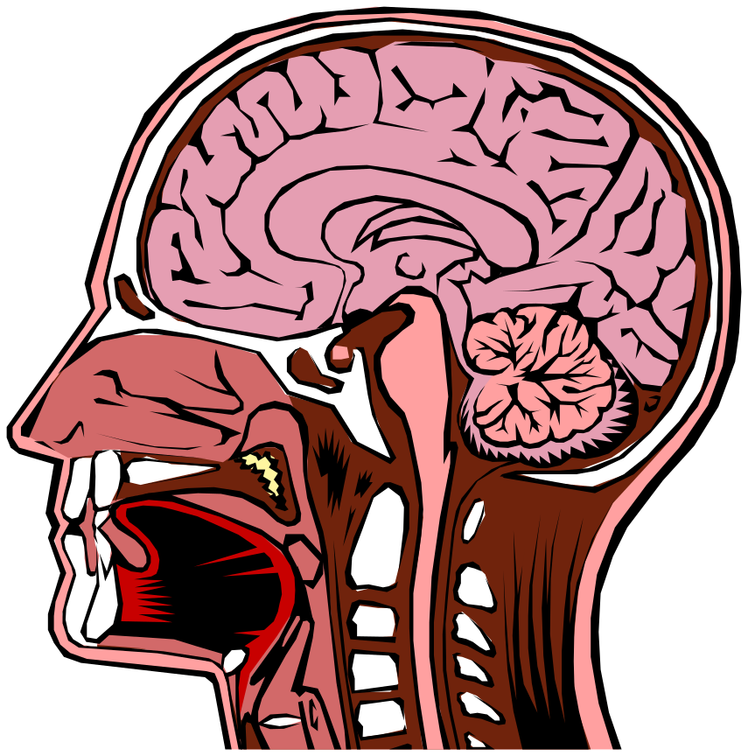
Pathogenesis and Pathophysiology
The brain: most of
the meninges overlying
the convexity, and the
bony skull are not
sensitive to pain.

Slide 8
Hypothesis
There are two major hypothesis regarding the pathogenesis of migraine.
  The vascular hypothesis proposes that vasoconstriction results in aura or focal neurologic signs and is followed by painful vasodilatation.
  The neurogenic hypothesis proposes that afferent inputs to the brainstem result in a slowly spreading cortical neuronal depression that is followed by dilation and inflammation of the cranial vasculature innervated by the trigeminal nerve.

Slide 9
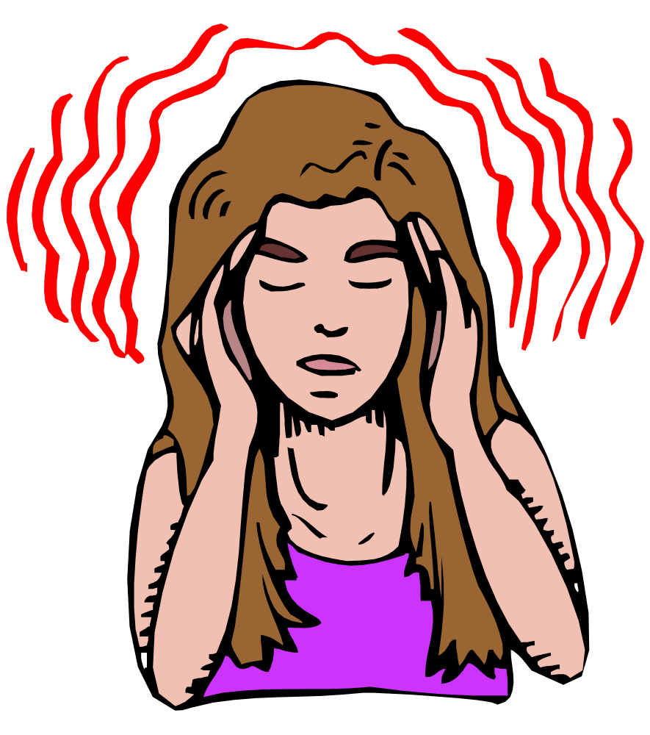
Classification
The most common types of headache are migraine with or without aura

Slide 10
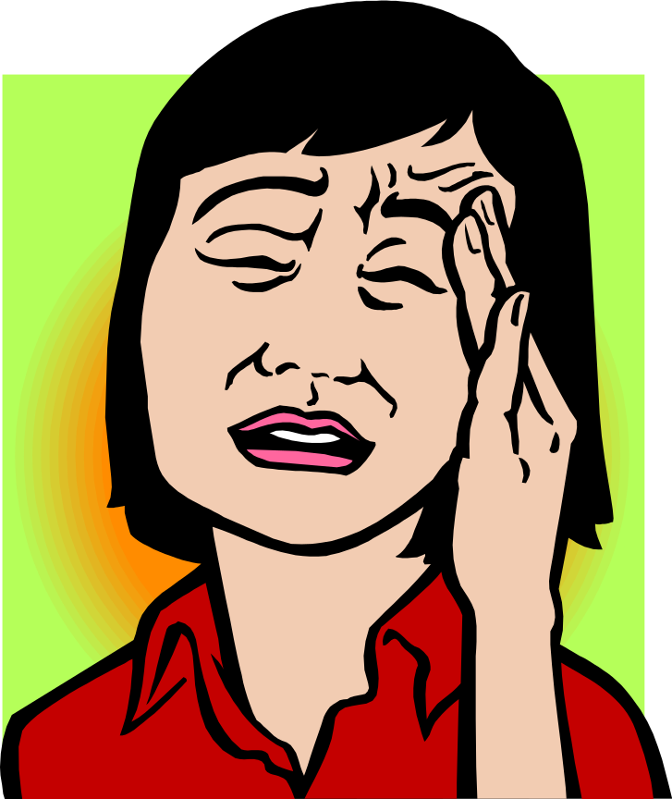
Classification
and tension-type headache

Slide 11
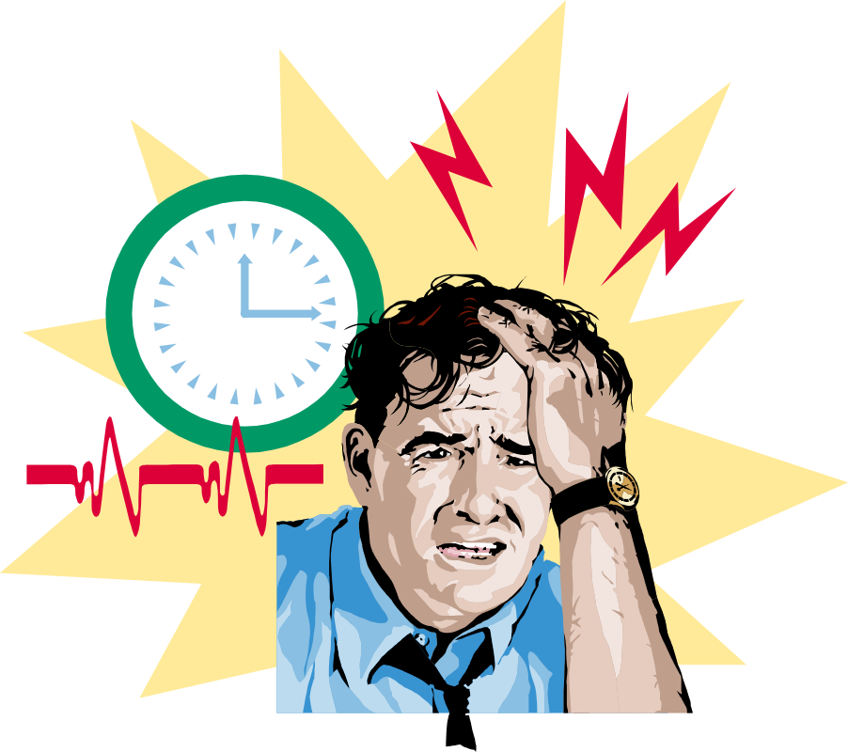
Classification
Classical migraine (migraine with aura) presents with recurrent self-limited episodes of neurological symptoms (scotomata, blurred vision, flashing lights, vertigo, paresthesias) localized to the cortex or brain stem.

Slide 12
Migraine with Aura
Classic migraine is characterized by occurrence of an aura prior to the onset of the headache that last 5 to 20 minutes.
The headache may occur immediately or after an interval of up to 60 minutes.

Slide 13
Migraine with Aura
The aura is usually visual and may manifest as photopsia (flashing lights),fortification spectra (zigzags), black dots, colored lights, scotoma (field defects), or distortions of size.

Slide 14

Classification
Migraine without aura does not present with neurological symptoms

Slide 15
Migraine without aura
Common migraine is characterized by the typical headache in the absence of an aura.

Slide 16
Paediatric Migraine: Diagnostic Criteria of Prensky
Hemicranial pain
Throbbing or pulsatile character to pain
Associated abdominal pain, nausea, or vomiting
Complete relief after rest
Visual, sensory, or motor aura
Family history of migraine in first- degree relatives

Slide 17

Classification
Tension-type headache is rare in young children, becoming more common during adolescence.
Psychosocial stress is a major factor.

Slide 18
Classification
Chronic headache: symptoms consistent with both migraine and tension-type headache. These children have higher rates of psychiatric diagnoses and greater functional disability than children with other types of headache.

Slide 19
Complicated Migraine
Is the migraine associated with a transient, focal neurologic abnormality (hemiparesis, hemianesthesia, visual field deficits, and cranial nerve palsies).

Slide 20
Cluster Headache
It is characterized by clusters of recurrent extreme, nonthrobbing deep pain in and around one eye that spreads onto the face on the affected side.
The eye usually becomes swollen and watery.
Also is characterized by facial flushing.

Slide 21
Cluster Headache
Is rare in children younger than 10 years of age
Is more common in adolescents
90% of patients having cluster headaches are male

Slide 22
Stress-Related Headache
Tension headache is diffuse, symmetrically distributed, and often described as having a “band-like” distribution around the head.

Slide 23
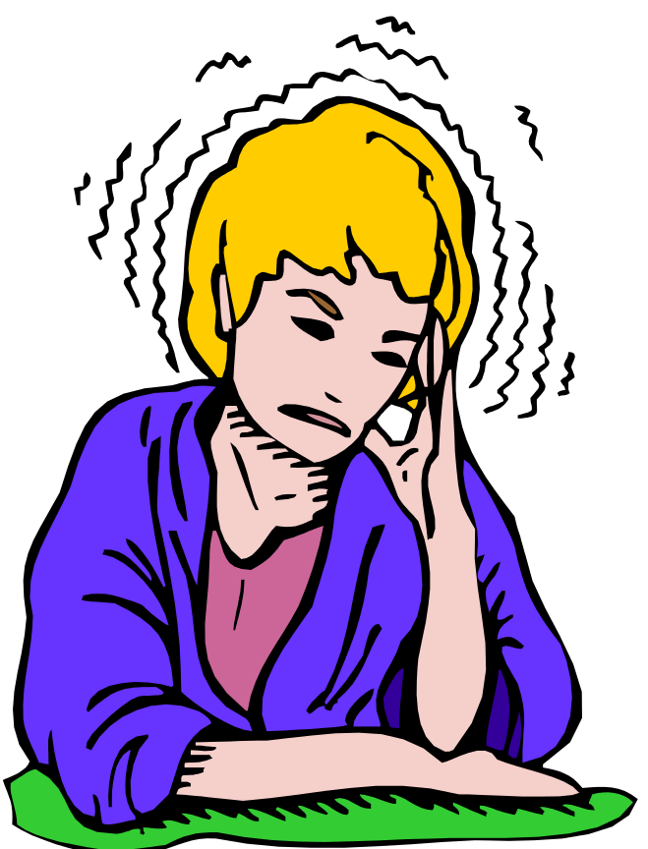
Stress-Related Headache
Although generally it is a constant ache, there may be a partially throbbing character to the pain.
Is more common in older girls.

Slide 24
Stress-Related Headache
These children usually have underlying emotional or social difficulties.
The most common causes are academic difficulties, problems with peers, and home-related stress.
Depression also may be a contributing factor.

Slide 25
Headache Due To Increased Intracranial Pressure
Expanding space-occupying lesions(mass, tumor) within the skull may cause progressively worsening headache either due to their direct expansion or by secondary obstruction of cerebrospinal fluid flow.
Hydrocephalus is the most common cause of headache due to increased ICP.

Slide 26
Headache Due To Increased Intracranial Pressure
This type of headache is worse at night or immediately after waking.
May be associated with vomiting, which may provide temporary relief of the headache.

Slide 27
Headache Due To Increased Intracranial Pressure
When ICP is suspected, the child should be investigated urgently and brain imaging performed.

Slide 28
Headache Due To Increased Intracranial Pressure
Pseudotumor cerebri is a neurologic disorder in which ICP is associated with normal findings on CT or MRI head scan.
The pathophysiologic basis involves impaired reabsorption of CSF with or without increased intracerebral blood volume.
Causes:Metabolic:(galactosaemia,hypothyroidism,obesity,menarche, prolonged steroids therapy.) Infections:( Rosela infantum,ch.OM,GB Synd.) Drugs:Tetracyc.,Nitrofur,Other:Polcyth.,Head injury,SS thromb.,Iron def Anaemia.

Slide 29
Headache Due To Increased Intracranial Pressure
S/S: papilledema, an enlarged blind spot, sixth nerve palsy, and mild ataxia.
Age Dependant

Slide 30
Potential Triggers of Headaches
Emotional stress
Changes in behavior
  Missing a meal; hypoglycemia
  Sleeping more or less than normal
Environmental factors
  Bright or flickering light
  Loud noise
  Weather change
Foods and chemicals
  Chocolate
  Nuts, peanut butter
  Hot dogs, smoked meats, spiced meats
  Chinese food, soy sauce, monosodium glutamate

Slide 31
Potential Triggers of Migraine Headaches
  Beef concentrates
  cheese
  Cola drinks and other caffeine-containing beverages
  Oranges, bananas, plums, pineapples
Drugs
  Atenolol, hydralazine, reserpine,nifedipine
  Cimetidine, H2-receptor blockers
  Oral contraceptives
  Nitrofurantoin

Slide 32
Clinical Evaluation
Detailed clinical history, family history, and review of systems
The headache history
1. Type of headache
2. Aura or premonitory symptoms
3. Age at onset and subsequent course
4. Frequency, intensity, and duration in the past month
5. Seasonality/school-related
6. Exacerbating and ameliorating factors

Slide 33
Clinical Evaluation
7. School missed/limitation of activities
8. Medication/other treatment efficacy
9. Spontaneous self-coping techniques
10. Family history of headache/role model

Slide 34
Clinical Evaluation
Headache is a symptom, not a neurologic disorder.
The most common causes of isolated headaches in an emergency department are viral illness, sinusitis, and migraine.
Environmental, behavioral, and psychosocial
variables may precipitate a headache

Slide 35

Diagnostic Evaluation
Should pay particular attention to Blood pressure, the optic fundi, pericranial muscles, cranial bruits,sinuses, teeth, temporomandibular joints, thyroid gland, integument, and neurological functioning

Slide 36
Diagnostic Evaluation
The history is the most important part of the evaluation of a child who has headaches.
A complete description of headaches should include information of length of history, aura, frequency, localization, quality of pain, duration, time of day or days of week, course over weeks or months, associated symptoms, precipitating or aggravating factors, and effect on pain medications on the headache.

Slide 37
Diagnostic Evaluation
A detailed social history is extremely important in patients who have long-standing headaches.
Neurologic symptoms such as visual and auditory disturbances, ataxia, focal weakness, seizures, personality changes, and deterioration in school performance.

Slide 38
Diagnostic Evaluation
On the basis of the history, headaches can be divided into four major types:
  Acute (due to acute systemic illness)
  Recurrent (most often due to migraine)
  Chronic nonprogressive (due to tension type headache)
  Chronic and progressive (as with a tumor)

Slide 39
Investigations
CT or MRI is indicated in patients who have symptoms of headache if there is a change in the headache pattern or focal signs or symptoms of increased ICP.

Slide 40
Management of Headache
Analgesics
  Paracetamol
  Ibuprofen
  Codeine
Combinations: Paracet/Codeine Analegisic/Antiemetic

Slide 41
Management of Headache
Antiemetics
  Promethazine
  Metoclopramide
  Chlorpromazine

Slide 42
Prophylactic Agents
Propranolol
Pizotifen
Amitrryptiline

Slide 43
Prophylactic Agents
Prophylactic medication should be considered only when the headaches are interfering with the child’s ability to function normally, such as missing significant time from school or sports activities.

Slide 44
Management Tension Headache
Simple analgesia, rest, and removal of stress.
Assessment should be directed toward identifying the predisposing, precipitating, and perpetuating factors in the child’s home and school.

Slide 45
Drug-Induced Refractory Headache
Analgesic abuse headache is the paradoxic consequence of regular, frequent analgesic use.
Patients should be encouraged to use a large dose of a simple analgesic infrequently.

Slide 46
Case No. 1
An 8 year-old girl has had eight episodes of ringing in her ears and right-sided headache within the past year. She describes the pain as pounding. She becomes nauseated and feels exhausted. She gets relief only by sleeping for 2 or 3 hours. Although her hearing is normal when she awakens, her gait is unsteady for up to 1 hour. The most likely diagnosis is:
Notes:
Complicated migraine

Slide 47
Case No. 1, Answers:
Brain tumor.
Complicated migraine.
Migraine with aura.
Tension headache.

Slide 48
Case No. 2
A 4-year-old boy has had worsening headaches for the past 6 weeks. They now occur daily, especially in the morning when he awakens. He has not attended his morning preschool for the past week and has become disinterested in playing with his friends. He stopped playing his electronic games a few days ago because he keeps “messing up.” The most likely diagnosis is:
Notes:
Brain Tumor

Slide 49
Case No. 2, Answers
Brain tumor.
Complicated migraine.
Migraine; M. with aura.
Tension headache.

Slide 50
Case No. 3
An 8-year-old third-grade boy moved to a new neighborhood and new school last month. He has complained of a band-like headache since the second week in his new school. The headaches have increased in intensity and frequency and now occur every morning. For the past two nights he has awakened from sleep complaining of pain. He has been practicing to try out for the community junior hockey league but is less confident and more clumsy on the ice than he was a year ago, and his shots are consistently wide to the right. The most likely Dx:
Notes:
Brain Tumor

Slide 51
Case 3, Answers
  Brain tumor headache
  complicated migraine
  Migraine
  migraine with aura
  Tension headache

Slide 52
Case No. 4/5
A 16-year-old girl complains of headaches that sometimes cause throbbing in one or both temples or tightness in the back of the head. The headaches last 1 to 2 hours and may be accompanied by dizziness. Ibuprofen and Paracetamol usually provide relief within 2 to3 minutes, especially if she is able to lie flat on her back. She has had headaches intermittently for more than 1 year. They typically occur almost daily for a week or two and then disappear for a month or longer. She feels fatigued and has difficulty concentrating during periods of headache. Dx:
Notes:
Tension type headache

Slide 53
Case No. 5
The divorced parents of a 13-year-old boy and a 9-year-old girl have been engaged in an acrimonious custody battle over the children for the past 6 months. About 3 months ago the boy began to experience band-like headaches, especially in the morning. He has missed school on 3 occasions during the past month because of pain and exhaustion. The girl also began to have headaches about 2 months ago. The symptoms are similar to her brother’s, but she usually complains of feeling nauseated. Both children appear to have lost weight. There is a strong maternal family history of migraine that includes the
Notes:
Tension type headache

Slide 54
Case No. 5
mother, grandmother, and an uncle. The paternal family history is significant for astrocytoma in an uncle who died at age 13 years. The most likely Dx in these two children is:
  Brain tumor headache
  complicated migraine
  Migraine
  migraine with aura
  Tension headache

Slide 55
References
1. Headache Classification Committee of the International Headache Sosiety (HIS). The
International Classification of Headache Disorder, 3rd edition. Cephalgia 2013;33:629.
2. Lewis DW, Koch T. Headach evaluation in children and adolescents: when to worry?
When to scan? Pediatr Ann 2010; 39:399.
3. Dodick DW. Clinical practice. Chronic daily headache. N Eng J Med 2006;354:158.
4. Mack KJ. An approach to children with chronic daily headache. Dev Med Child Neurol
2006;48:997
5. Lider SL. Understanding the comprehensive pediatric headache examination. Pediatr Ann
2005; 34:442.
6. Cady RK, Screiber CP. Sinus headache or Migraine? Considerations in making a
differential daignosis, Neurology 2002; 58: S 10

Slide 56
Headaches
We want to see a smile on our children.

