Slide 1
Intense Pulsed Light Alone in the Treatment of Actinic Keratosis
Omeed Memar, MD, PhD
Clinical Instructor
Northwestern Memorial Hospital
Department of Dermatology
Chicago, IL

Slide 2
Actinic Keratosis
Prevalence in U.S.A is over 57 million
1-15% can progress to SCC
Cause is thought to be DNA mutation affecting p53, viral DNA(HPV), RAS mutation

Slide 3
Diagnosis: Actinic Keratosis: the cameleon
  Dermoscopy
  Clinically
  Histologically
  Confocal Microscopy
Bcc
Seb ker
Scc
Bowens disease
Wart
SLE
Porokeratosis
Rosacea
Melasma
Eczema
Psoriasis
Lichen Planus
Lentigo
Lentigo maligna
Normal skin

Slide 4
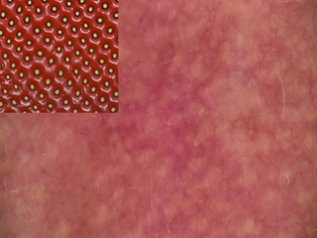
Appearance: Actinic Keratosis
Dermoscopy:
  "strawberry pattern”
  prominent follicular openings surrounded by a white halo
  pigmented AK on the face include multiple slate-gray to dark-brown dots and globules around the follicular ostia, annular-granular pattern and brown to gray pseudonetwork

Slide 5
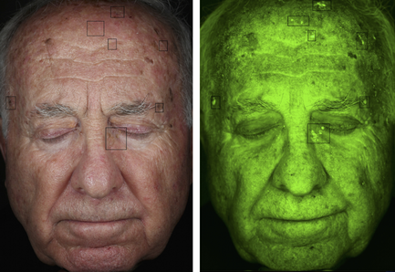
Appearance: Actinic Keratosis
Clinical
  Pre-clinical AK
  Classic AK: scaly with surrounding erythema
  Hypertrophic AK
  Atrophic AK
  Cutaneous Horn
  Lichenoid AK
  Pigmented AK
  Actinic Chelitis
  Bowenoid AK

Slide 6
Treatment: Actinic Keratosis
Field Therapy
  5-FU
  Diclofenac
  Imiquimod
  Ingenol mebutate gel
Focal Destruction
  Cryotherapy
  Acid destruction
  Laser destruction
  PDT
    Use of Levulan with different light sources, including IPL

Slide 7
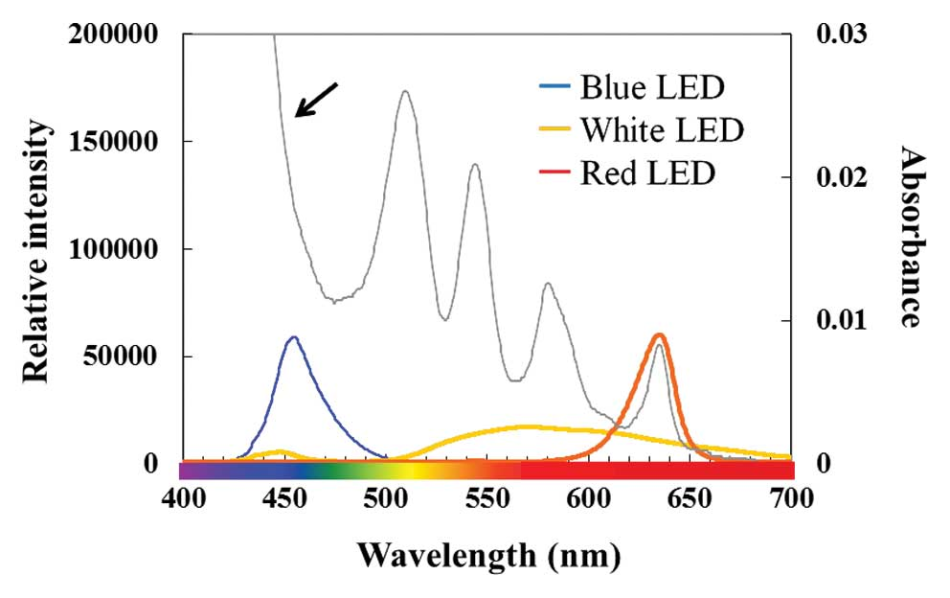
Protoporphyrin IX absorption

Slide 8
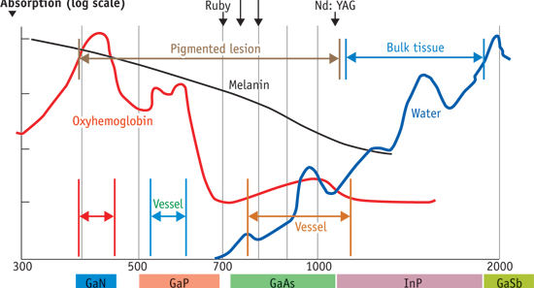
Absorption

Slide 9
Intense Pulsed Light
Intense pulsed light (IPL) is a filtered flash lamp device that emits a non-coherent polychromatic radiation (420-1500 nm)
IPL has also been used to activate photosensitizers in the treatment of photrejuvenation and actinic keratosis
In studying the effectiveness of IPL in activating different photosensitizers, a few split-face studies were conducted: IPL alone VS IPL + Levulinic Acid

Slide 10
Question?
Did IPL alone treat Actinic Keratoses?

Slide 11
Method
A literature search was done to identify information on IPL split-face photodynamic therapy studies in the treatment of actinic keratosis up to April 2016. The databases of Google Scholar and Ovid MEDLINE were searched using the Boolean string: (Intense pulsed light AND actinic keratosis).
The references were reviewed for split-face studies, where IPL had been used as a control against the contra-lateral IPL + topical aminolevulinic acid (ALA). The references cited in the papers identified were also reviewed.

Slide 12
Results
Ref | Site | Light source | Λ (nm) | Setting | frequency | # Tx | Age | # Pts | Fitzpatr type | Results
Gold et al | Face | Vasculight IPL | 550- 570 | 34j/cm2 Double pulsed 8x16mm spot | Monthly | 3 (judged 3 mo after) | 37-63 | 13 | I-IV | 53% clearance vs 85% with ALA
Tadiparthi et al |  | Lumina IPL |  |  | monthly | 5 | 65-86 | 8 | I-II | 55% clearance vs 60% with methyl-ALA
Haddad et al | face | Vasculight ESC Lumenis | 515 | 20j (1 pt) 25j (2 pts) | 1 | 1 (judged results 8 weeks after) |  | 3 | I-IV | 7% clearance

Slide 13
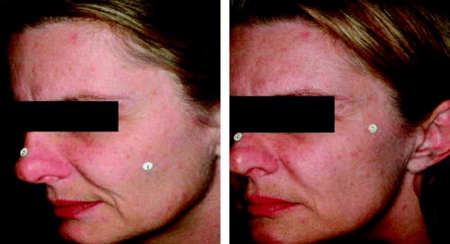
Gold et al

Slide 14
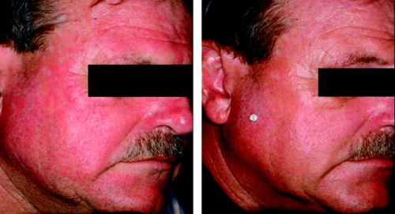
Gold et al

Slide 15
Supporting Data
Dovor et al Topical 5-aminolevulinic acid combined with intense pulsed light in the treatment of photoaging. Arch Dermatol 2005;141:1247-1252
  In treating “photoaging” IPL alone improves tactile roughness equally to IPL +ALA
Demetriou C Reversig precancerous actinic damage by mixing wavelengths (1064nm, 532 nm). J Cosmetic Laser Therapy 2011, 13:113-119
  Reversed AK with combination of Q switched 532nm and 1064nm lasers

Slide 16
Discussion
IPL is a device that targets red or brown lesions
Actinic keratoses initially present with redness and some with pigmentation
IPL alone should be studied further for effectiveness in treating actinic keratosis

