Slide 1
Effect of Rowing on
Pulmonary Functions in
Children with Down Syndrome
By
Omar Farouk F Helal PhD, PT.
Associate Professor
Physical Therapy Department
College of Applied Medical Sciences
Umm Al Qura University

Slide 2

Presentation Outline
Introduction.
  Down Syndrome.
  Etiology
  Need for the Study.
  Purposes of the Study.
Methodology.
  Patient Randomization.
  Inclusion Criteria.
  instrumentations
  Procedures.
Results.
Conclusion
Recommendations.

Slide 3
INTRODUCTION
Down Syndrome
Etiology
Need for the Study
  Purposes of the Study
Methodology
  Patient Randomization
  Inclusion Criteria
  instrumentations
  Procedures
Results
Conclusion
Recommendations
Down syndrome (DS), is the most common chromosomal abnormality, occurring in 1 of 800 live births.
Down syndrome includes a combination of birth defects, mental retardation, hypotonicity, hypermobility, an underdeveloped respiratory and cardiovascular system, pulmonary impairments, and many other health problems.

Slide 4
Children and adolescents with DS seem to have reduced lung function and a higher incidence of respiratory infections compared with healthy, age-matched controls.
They are also at risk of restrictive pulmonary disease with decreased lung volumes and a weak cough because of generalized trunk and extremity weakness.
Pulmonary problems are a primary cause of hospital admission and/or morbidity, particularly in young children with DS.
INTRODUCTION
Down Syndrome
ETIOLOGY
Need for the Study
  Purposes of the Study
Methodology
  Patient Randomization
  Inclusion Criteria
  instrumentations
  Procedures
Results
Conclusion
Recommendations

Slide 5
INTRODUCTION
Down Syndrome
Etiology
Need For The Study
  Purposes of the Study
Methodology
  Patient Randomization
  Inclusion Criteria
  instrumentations
  Procedures
Results
Conclusion
Recommendations
Poor physical activity and fitness resulting from the lower level of cardiopulmonary fitness and pulmonary problems have been reported several times in children with DS compared with healthy peers.
This can affect their abilities to work and perform activities of daily living, worsen quality of life, and a shortened life span.

Slide 6
INTRODUCTION
Down Syndrome
Etiology
Need For The Study
  Purposes of the Study
Methodology
  Patient Randomization
  Inclusion Criteria
  instrumentations
  Procedures
Results
Conclusion
Recommendations
Medical personnel working with children with DS should focus on improving their pulmonary functions and preventing pulmonary infections.
Early initiation of pulmonary therapy or exercise programs for restoration or maintenance of respiratory function should be provided.

Slide 7
INTRODUCTION
Down Syndrome
Etiology
Need for the Study
  Purposes of the Study
Methodology
  Patient Randomization
  Inclusion Criteria
  instrumentations
  Procedures
Results
Conclusion
Recommendations
The purpose of this study was to determine :
The effects of an aerobic training program for upper extremities, using a rowing ergometer, on the pulmonary functions in children with DS and to compare its effectiveness with that of a chest physical therapy program.

Slide 8
Thirty-five children with DS, 19 boys and 16 girls, participated in this study, and allocated randomly to 2 study groups:
Study group A (N=17) received a chest physical therapy program.
Study group B (N=18) received rowing ergometer
A third group C consisted of 20 children without DS ( healthy).
The post treatment results in both study groups were matched with results from this healthy group.
Introduction
Down Syndrome
Etiology
Need for the Study
  Purposes of the Study
METHODOLOGY
  Patient Randomization
  Inclusion Criteria
  instrumentations
  Procedures
Results
Conclusion
Recommendations

Slide 9
The participated children were selected according to the following criteria:
Age between 8 and 12 years,
Able to walk independently,
No associated congenital heart abnormalities,
No serious visual and/or auditory problems,
Not obese, and
Not participating in any sport activities.
Introduction
Down Syndrome
Etiology
Need for the Study
  Purposes of the Study
METHODOLOGY
  Patient Randomization
  Inclusion Criteria
  instrumentations
  Procedures
Results
Conclusion
Recommendations

Slide 10
Introduction
Down Syndrome
Etiology
Need for the Study
  Purposes of the Study
METHODOLOGY
  Patient Randomization
  Inclusion Criteria
  instrumentations
  Procedures
Results
Conclusion
Recommendations
A pulmonary Function unit was used to measure the ventilatory functions of the participating children pre and post application of treatment.
The measured parameters included : VC, FVC, FEV1 and PEFR,

Slide 11
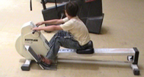
A rowing ergometer was used for providing aerobic exercise training for the children.
This rowing ergometer has 8 levels of resistance ranging from :
level 1, the least resistance, to
level 8, the most resistance.
Introduction
Down Syndrome
Etiology
Need for the Study
  Purposes of the Study
METHODOLOGY
  Patient Randomization
  Inclusion Criteria
  instrumentations
  Procedures
Results
Conclusion
Recommendations

Slide 12
Introduction
Down Syndrome
Etiology
Need for the Study
  Purposes of the Study
METHODOLOGY
  Patient Randomization
  Inclusion Criteria
  instrumentations
  Procedures
Results
Conclusion
Recommendations
A weight and height scale was used to measure the children’s weight (in kilogram) and height (in centimeter), as these data are necessary for calculations performed by Ergospirometry system.

Slide 13
A) Evaluation Procedures
Introduction
Down Syndrome
Etiology
Need for the Study
  Purposes of the Study
METHODOLOGY
  Patient Randomization
  Inclusion Criteria
  instrumentations
  Procedures
Results
Conclusion
Recommendations
VC to evaluate lung tissue dispensability;
FVC to evaluate lung size, and elastic properties of the lung;
FEV1 , evaluates the airway resistance.
PEFR, which is an effort dependent
All the measurements were done pretreatment and after 12 weeks .

Slide 14
B) Treatment Procedures
Introduction
Down Syndrome
Etiology
Need for the Study
  Purposes of the Study
METHODOLOGY
  Patient Randomization
  Inclusion Criteria
  instrumentations
  Procedures
Results
Conclusion
Recommendations
The participants in (Study Group A) received a chest physical therapy program including :
1- Breathing exercise, and
2- Postural drainage in addition to
3- Incentive spirometer training.

Slide 15
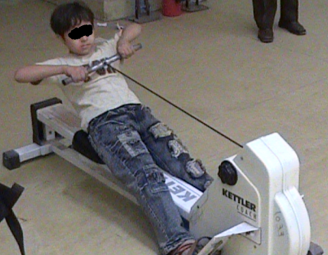
B) Treatment Procedures
The participants in (Study Group B) received an aerobic training regimen using a rowing ergometer.
Introduction
Down Syndrome
Etiology
Need for the Study
  Purposes of the Study
METHODOLOGY
  Patient Randomization
  Inclusion Criteria
  instrumentations
  Procedures
Results
Conclusion
Recommendations

Slide 16
Rowing Protocol
1. The regimen consists of 3 phases, each phase lasted 4 weeks.
2. The duration of rowing exercises in each session was 10 minutes for the first 4 weeks (phase 1) and increased 5 minutes in each successive phase until the duration in the last phase (phase 3) reach 20 minutes.
3. A warm-up for 5 minutes before starting the procedures and a cool-down for 5 minutes after finishing the procedures were included.
Introduction
Down Syndrome
Etiology
Need for the Study
  Purposes of the Study
METHODOLOGY
  Patient Randomization
  Inclusion Criteria
  instrumentations
  Procedures
Results
Conclusion
Recommendations

Slide 17
Rowing Protocol
4. The warm-up and cool-down phases consisted of stretching exercises for upper and lower extremities and thoracic mobility exercises.
5. After the warm-up period, the participants were instructed to exercise using the rowing ergometer equipment.
6. The level of resistance in the first phase ranged from 1 to 2, progressed to 2 to 3 in the second phase until reaching 3 to 4 in the final phase.
Introduction
Down Syndrome
Etiology
Need for the Study
  Purposes of the Study
METHODOLOGY
  Patient Randomization
  Inclusion Criteria
  instrumentations
  Procedures
Results
Conclusion
Recommendations

Slide 18
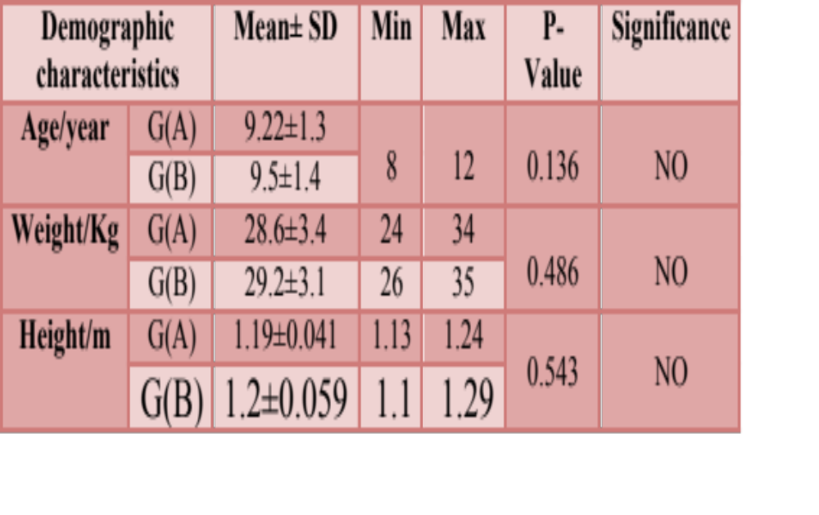
The results of this study showed no significant difference in the mean values of age, weight, and height of the participating children included in groups A and B.
Introduction
Down Syndrome
Etiology
Need for the Study
  Purposes of the Study
Methodology
  Patient Randomization
  Inclusion Criteria
  instrumentations
  Procedures
RESULTS
Conclusion
Recommendations

Slide 19
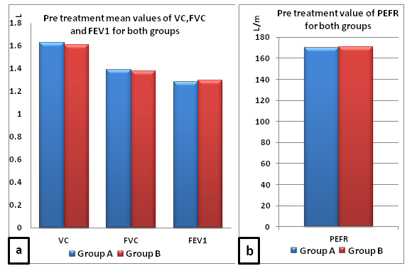
The results of this study showed no significant difference in the pretreatment mean values of VC, FVC, FEV1 and PEFR for both group A and B
Introduction
Down Syndrome
Etiology
Need for the Study
  Purposes of the Study
Methodology
  Patient Randomization
  Inclusion Criteria
  instrumentations
  Procedures
RESULTS
Conclusion
Recommendations

Slide 20
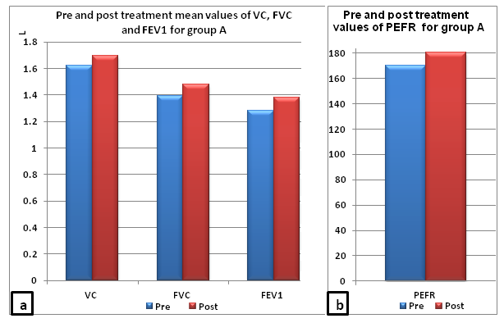
The results of this study showed a significant improvement in the all post measured parameters of group A.
Introduction
Down Syndrome
Etiology
Need for the Study
  Purposes of the Study
Methodology
  Patient Randomization
  Inclusion Criteria
  instrumentations
  Procedures
RESULTS
Conclusion
Recommendations

Slide 21
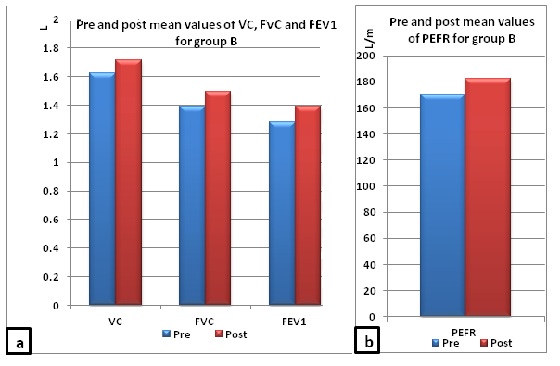
Also, the results of this study showed a significant improvement in the all post measured parameters of group B.
Introduction
Down Syndrome
Etiology
Need for the Study
  Purposes of the Study
Methodology
  Patient Randomization
  Inclusion Criteria
  instrumentations
  Procedures
RESULTS
Conclusion
Recommendations

Slide 22
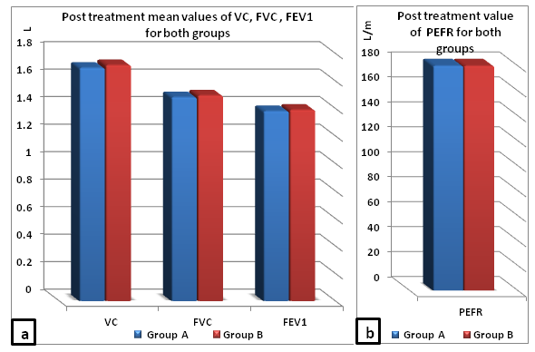
The results of this study showed no significant difference between the post treatment mean values of all parameters of both group A and B.
Introduction
Down Syndrome
Etiology
Need for the Study
  Purposes of the Study
Methodology
  Patient Randomization
  Inclusion Criteria
  instrumentations
  Procedures
RESULTS
Conclusion
Recommendations

Slide 23
Introduction
Down Syndrome
Etiology
Need for the Study
  Purposes of the Study
Methodology
  Patient Randomization
  Inclusion Criteria
  instrumentations
  Procedures
Results
CONCLUSION
Recommendations
Aerobic training with a rowing ergometer could be helpful in improving pulmonary functions in children with DS and should be considered during their rehabilitation.

Slide 24
Introduction
Down Syndrome
Etiology
Need for the Study
  Purposes of the Study
Methodology
  Patient Randomization
  Inclusion Criteria
  instrumentations
  Procedures
Results
Conclusion
RECOMMENDATIONS
Further study should be focused on the effectiveness of aerobic exercise programs using the upper extremities on pulmonary functions for children of different ages and with different pathologies, and to detect the ideal duration and intensity of the program that could be the most useful for improving pulmonary functions for children and adults with DS.

Slide 25

Thank
You

