Slide 1


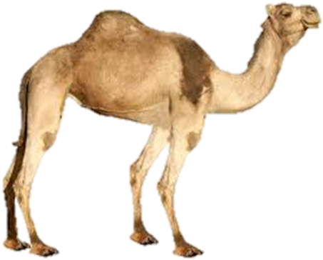

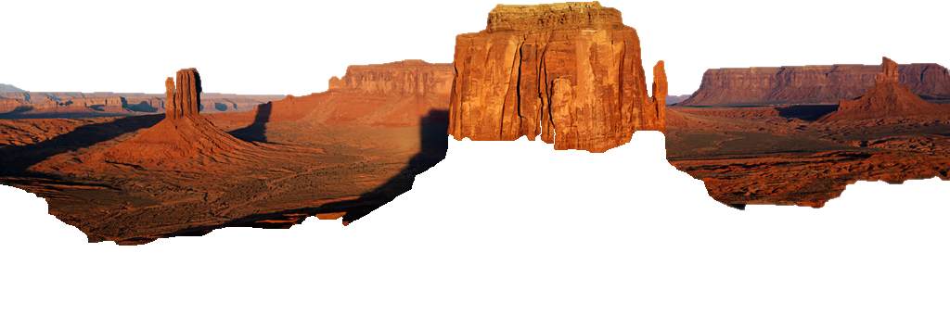

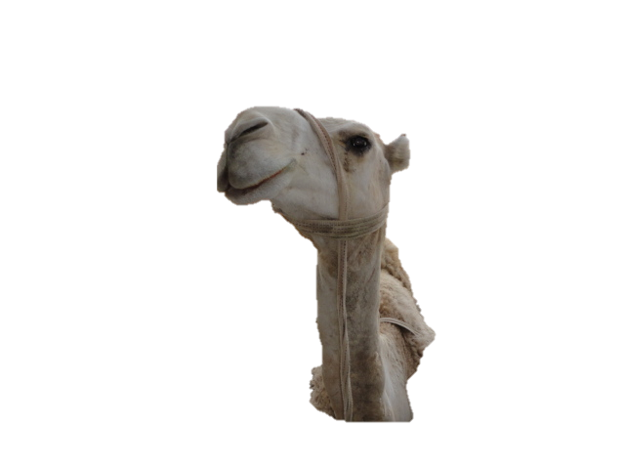
Constructing Schematic Eye
Requirements, Steps and the Obtained clinical values
A Camel - eye model
Global Veterinary Summit
August 31-September 2, 2015 Florida, USA
CAIRO UNIVERSITY
EGYPT
El-TOOKHY, Omar
欧玛尔

Slide 2
Points to be Discussed
1
Eye vs “Schematic eye”, models of Schematic eye
2
Benefits/Values of schematic eye (Social/Clinical)
3
Theory behind the Schematic eye
4
Science branches involved and their interaction.
5
What is the required data?
6
Steps: 1 (a, b& c), 2 & 3
7
Interpretations of obtained results
8
Questions?

Slide 3

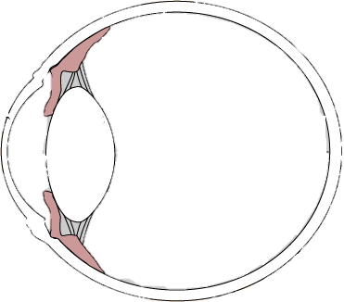




Introduction
The eye?
Eye is a homocentric system of lenses, which when combined in action form a very strong system of short focal length.
80% learning through
continuous processing
of visual info

Slide 4

Δ
Introduction
Δ
Schematic eye

Slide 5
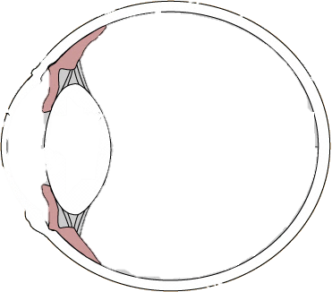
Introduction
Schematic eye
A schematic eye is a self-consistent mathematical model that represents the basic optical features of the real eye.
P’₂= (C₂*F₄*n₃)/ (F₆)
H = (t₂*d₁) / (n’*F_{t})
P_{e}= (d₂*F₅*n’)/F₆
f= n₁/F_{t}
59.25D
F₆= (F₄+ F₅) – (C_{2*}F₄*F₅)
P_{e}’= (d₂*F₄*n₄)/F₆
used for:
R&D purposes
Describe various optical characteristics of living eyes

Slide 6
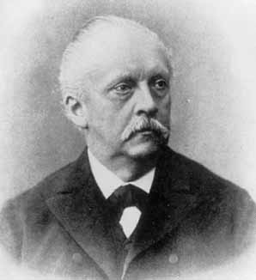
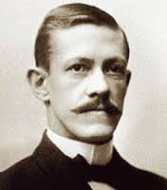
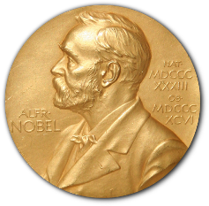
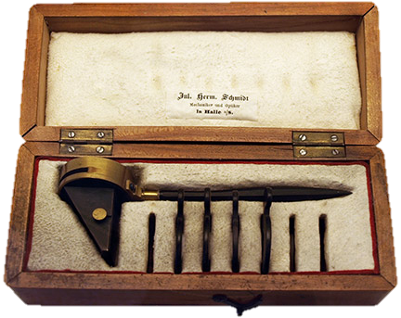
Introduction
History
1629
Huygens, The first physical model of a "real eye”
1738
Smith, described Huygens eye; 2 hemisphere, cornea& retina
1844
Moser, was the first to construct a theoretical schematic eye- inaccurate, too hyperopic
1851
Listing, developed the first accurate schematic eye
Helmholtz, developed a modified version of Listing’s eye
1821-94 germany
Tschering, published a more complex eye that contained the posterior corneal surface, he claimed to measure it first.
Gullstrand, developed a more improved schematic eye with four surface lens and extra lens complexity.
1911 sweden
  Invented slit-lamp & improved Helmholtz’s ophthalmoscope
  presented a simplified version having one corneal surface and the lens had zero thickness.
1946
Emsley, modified Gullstrand’s simplified eye with thickness of Gullstrands exact eye, and bringing change in refractive index.

Slide 7

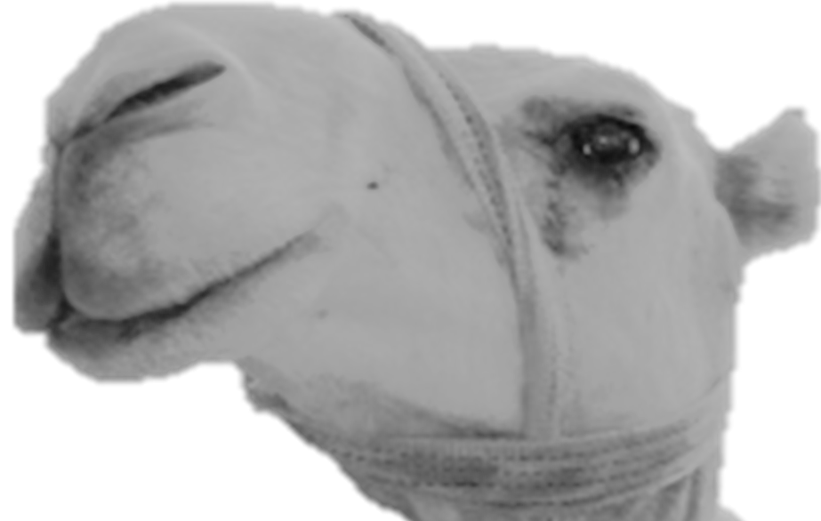
Introduction
Models of Schematic eye?
Schematic eyes have been designed for human, cow, horse, sheep, pig, dog, rabbit and rat/mice
P’₂= (C₂*F₄*n₃)/ (F₆)
H = (t₂*d₁) / (n’*F_{t})
P_{e}= (d₂*F₅*n’)/F₆
f= n₁/F_{t}
59.25D
F₆= (F₄+ F₅) – (C_{2*}F₄*F₅)
P_{e}’= (d₂*F₄*n₄)/F₆

Slide 8
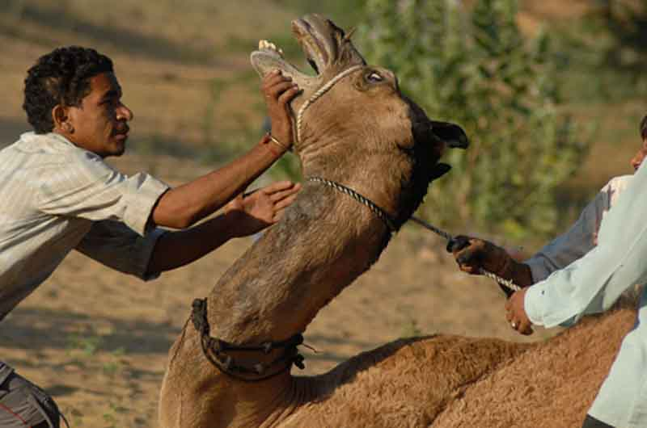
Introduction
Data on camel eyes!!!
Camels are not an easy to handle animals nevertheless to pass an ophthalmological test.
The difficulty in quieting this animal and the expensiveness of the ophthalmological instruments both have contributed to have few publications on it’s eye and it’s ocular visual characteristics.
TOO many QUESTIONS VERY little ANSWERS
Sedation was achieved by IV injection
0.2 mg/Kg Bomazine 10%,
www.viratpost.com

Slide 9

Points to be Discussed
1
1
Eye vs “Schematic eye”, models of Schematic eye
2
Benefits/Values of schematic eye (Social/Clinical)
3
Theory behind the Schematic eye
4
Science branches involved and their interaction.
5
What is the required data?
6
Steps: 1 (a, b& c), 2 & 3
7
Interpretations of obtained results
8
Questions?

Slide 10
Introduction
Values of Schematic eye?
Knowledge of the dimensions and ratios of the optical components of the camel eye provides a resource for the theoretical study of its visual capability and drawing up a schematic eye for this animal.
P’₂= (C₂*F₄*n₃)/ (F₆)
H = (t₂*d₁) / (n’*F_{t})
P_{e}= (d₂*F₅*n’)/F₆
f= n₁/F_{t}
59.25D
F₆= (F₄+ F₅) – (C_{2*}F₄*F₅)
P_{e}’= (d₂*F₄*n₄)/F₆

Slide 11
Introduction
Values of Schematic eye? Clinical
It also allows the calculations of IOL dioptric power to be deployed in the eyes of animals that have undergone cataract surgery to achieve emmetropia
P’₂= (C₂*F₄*n₃)/ (F₆)
H = (t₂*d₁) / (n’*F_{t})
P_{e}= (d₂*F₅*n’)/F₆
f= n₁/F_{t}
59.25D
F₆= (F₄+ F₅) – (C_{2*}F₄*F₅)
P_{e}’= (d₂*F₄*n₄)/F₆

Slide 12
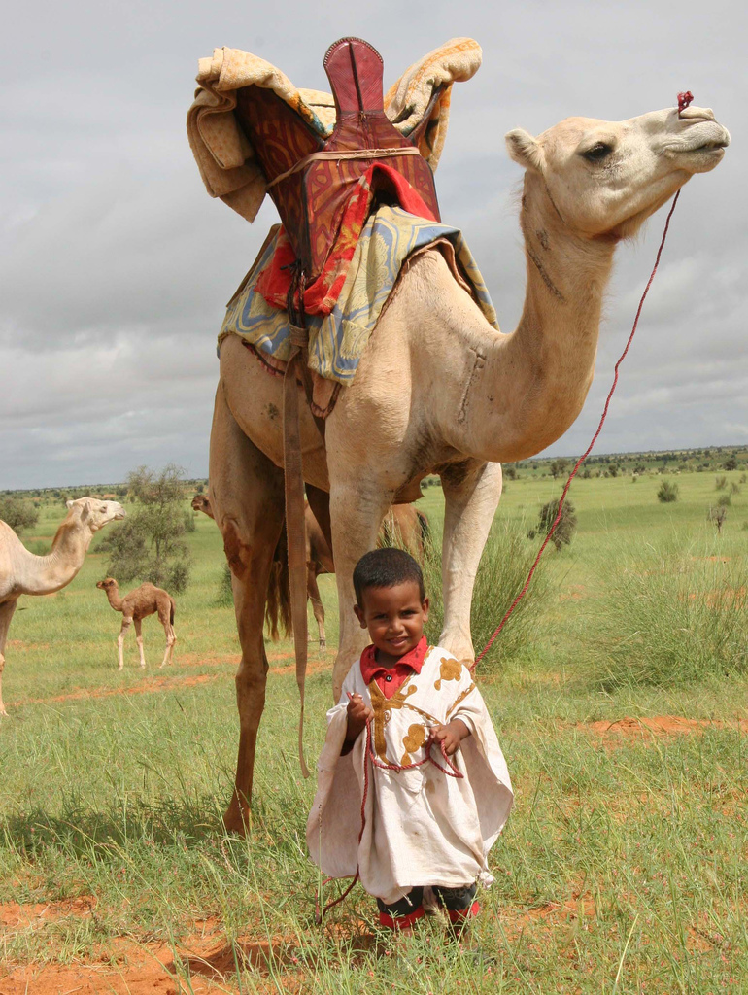
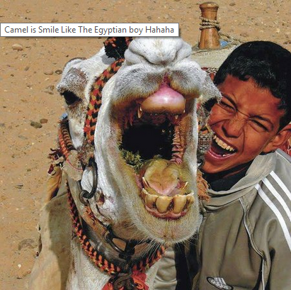
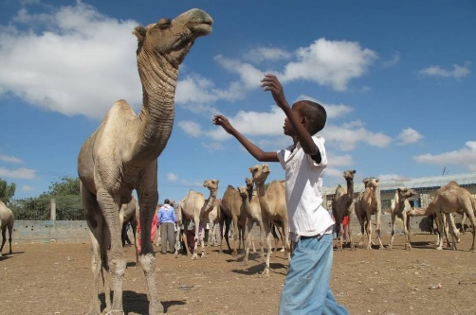
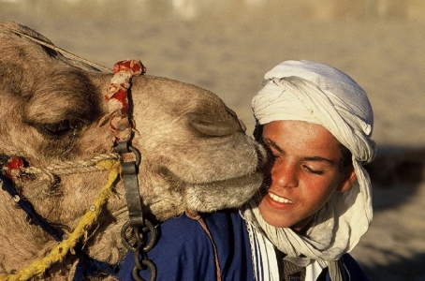
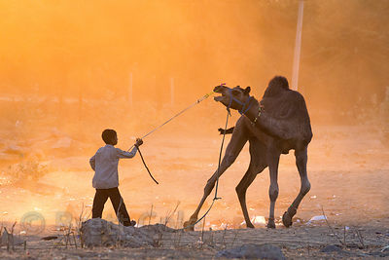
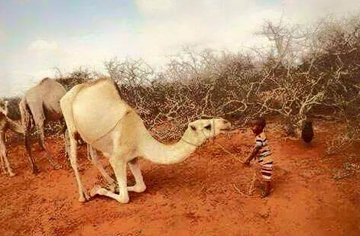
Introduction
Values of Schematic eye? Social
1- Camel sees small things too big, it’s easier to take control of it by young children than older men (RIM).
Myths related to Camel eye?

Slide 13
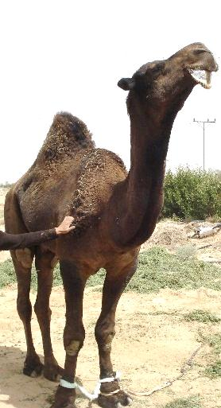
Introduction
Values of Schematic eye? Social
2- Camels are (Far-sighting), capable of seeing distant object
Myths related to Camel eye?

Slide 14

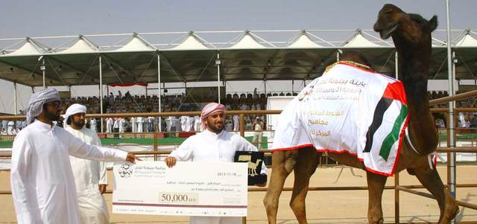
Introduction
Values of Schematic eye? Social
3- Susceptible for Envy (the evil-eye) and in the Arab world camels are considered as a Commodity and a sign of Wealth and Social rank.
Myths related to Camel eye?

Slide 15
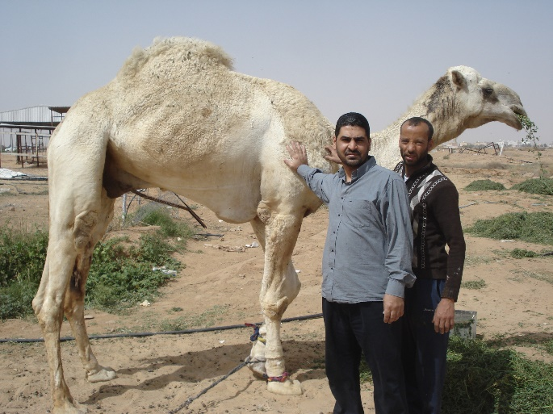
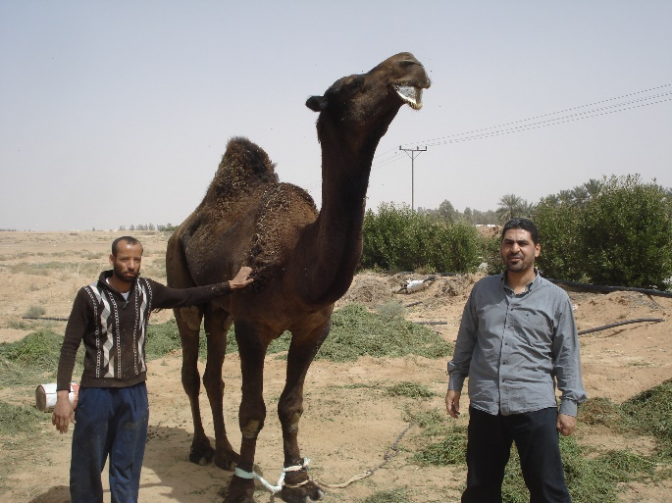
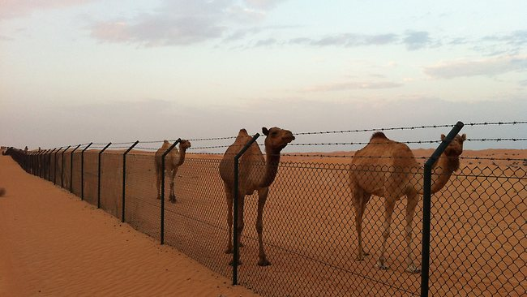
Introduction
Data on camel eyes!!!
Camels are raised in the desert with fences all around.

Slide 16
Points to be Discussed
1
1
Eye vs “Schematic eye”, models of Schematic eye
2
Benefits/Values of schematic eye (Social/Clinical)
2
3
Theory behind the Schematic eye
4
Science branches involved and their interaction.
5
What is the required data?
6
Steps: 1 (a, b& c), 2 & 3
7
Interpretations of obtained results
8
Questions?

Slide 17
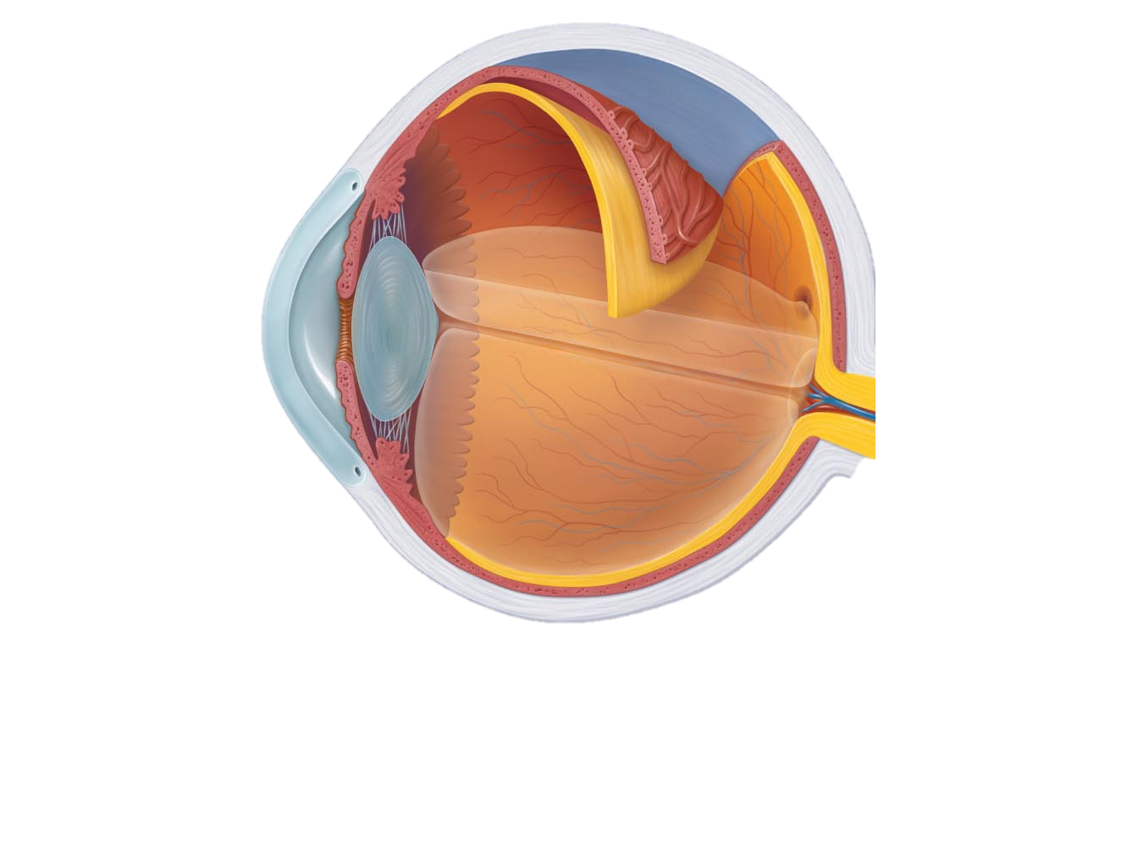
Theory behind the Schematic eye
Air
Lens
Cornea
AH
Refractive indices (n)
Air | n₁ | 1
Cornea | n₂ | 1.3775
Aqueous | n₃ | 1.3339
Lens | n₄ | 1.5178
Vitreous | n₅ | 1.3338
Vitreous

Slide 18
Points to be Discussed
1
1
Eye vs “Schematic eye”, models of Schematic eye
2
Benefits/Values of schematic eye (Social/Clinical)
2
3
3
Theory behind the Schematic eye
4
Science branches involved and their interaction.
5
What is the required data?
6
Steps: 1 (a, b& c), 2 & 3
7
Interpretations of obtained results
8
Questions?

Slide 19
Science branches involved.
From where to start
Two science branches are involved in this dilemma, Ophthalmology and Physics of optics or Optometry.
Which comes first?
Study analysis
Ophthalmology comes first through getting the normal measurements of the eye and using these values to study the corresponding Optical Physics.
Who should do this?
Ophthalmologist is the number one-man. The Optometrist’s job is to build/construct a hand-on model of the ophthalmologist-provided data.

Slide 20
Points to be Discussed
1
1
Eye vs “Schematic eye”, models of Schematic eye
2
Benefits/Values of schematic eye (Social/Clinical)
2
3
3
Theory behind the Schematic eye
4
4
Science branches involved and their interaction.
5
What is the required data?
6
Steps: 1 (a, b& c), 2 & 3
7
Interpretations of obtained results
8
Questions?

Slide 21
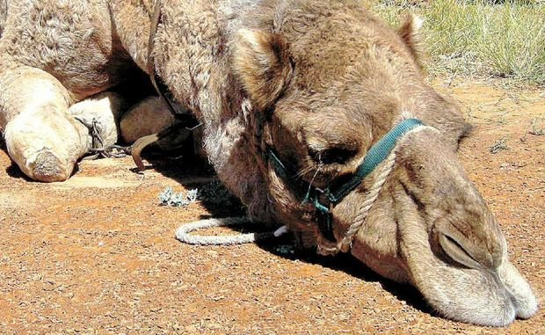
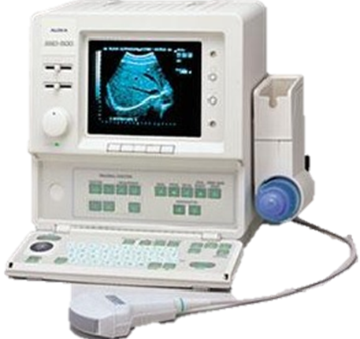
Introduction
What is needed?
Controlled/Sedated camel

Slide 22
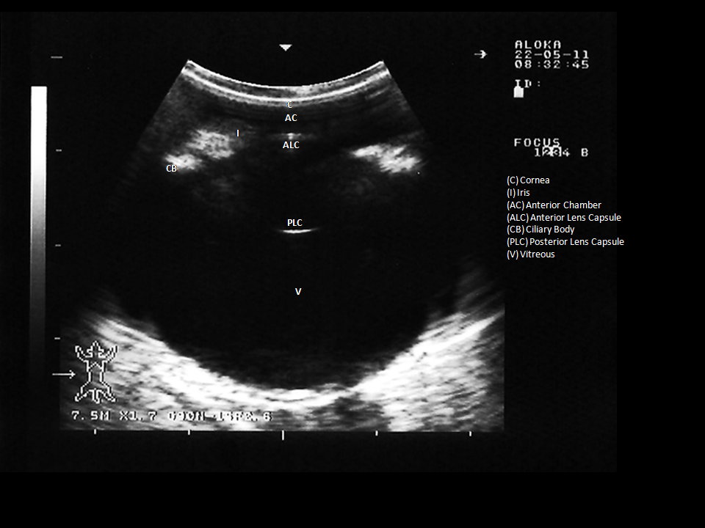
Data Required
Cornea has a thickness (layers)
Lens has a thickness…………..
Cornea has 2 surfaces
Lens has a surfaces…..Reduced/simplified model

Slide 23
Points to be Discussed
1
1
Eye vs “Schematic eye”, models of Schematic eye
2
Benefits/Values of schematic eye (Social/Clinical)
2
3
3
Theory behind the Schematic eye
4
4
Science branches involved and their interaction.
5
5
What is the required data?
6
Steps: 1 (a, b& c), 2 & 3
7
Interpretations of obtained results
8
Questions?

Slide 24
Steps
Step: 1

Slide 25
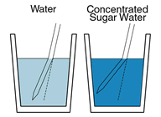
Steps
Step 1: collecting the inputs required to build the schematic model, this included constants as refractive indices, calculating the radii of curvature and the normal measurements of the ocular tissue
a
b
c

Slide 26
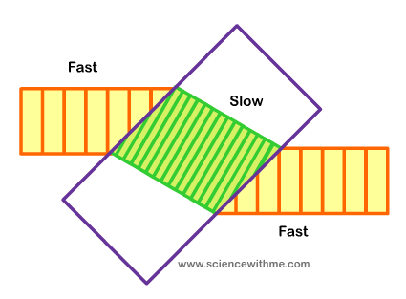
Steps: (1a) Refractive index
Air
n
Incident
θ1
θ2
Water
n’
Refracted
Refractive indices (n)
Air | n₁ | 1
Cornea | n₂ | 1.3775
Aqueous | n₃ | 1.3339
Lens | n₄ | 1.5178
Vitreous | n₅ | 1.3338
Refraction happens because of the change of the speed of light with different refractive indices

Slide 27
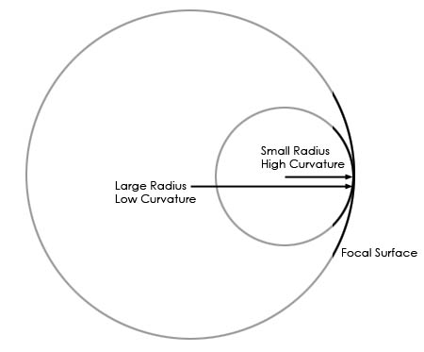
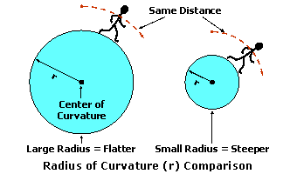
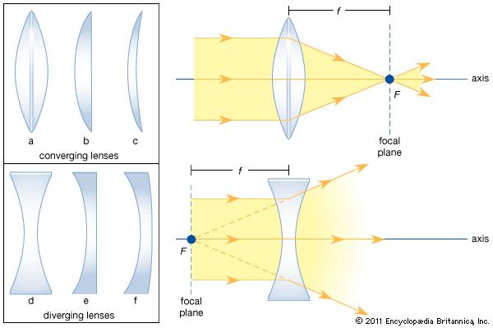
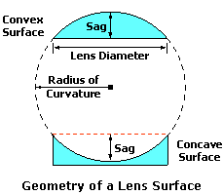
Steps: (1b) Radius of Curvature
(h)
(w)
r= (4h²+w²)/8h
r= radius of curvature, w= width, h= height

Slide 28
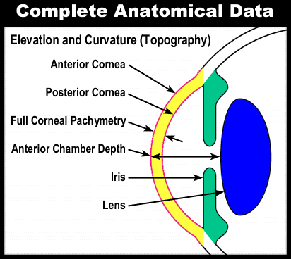
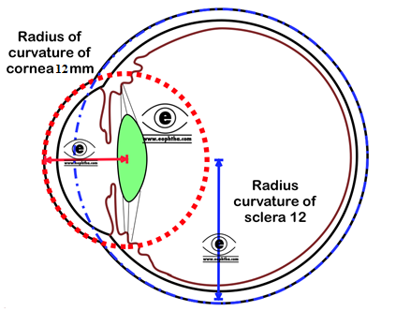
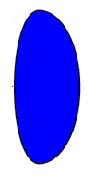
Steps: (1b) Radius of Curvature
(w)=16.5
(w)=15.9
6.25
3.65
r = (4h²+w²)/8h
Distance (h) from Anterior cornea vertex to
Posterior Cornea | t₁ | 0.9
Anterior Lens |  | 3.25
Posterior Lens | d₁ | 12.85
Retina | d₂ | 28.45
Radii of curvature |  | r
Anterior Cornea | r₁ | 12.096
Posterior Cornea | r₂ | 15.656
Anterior Lens | r₃ | 8.181
Posterior Lens | r₄ | -10.483

Slide 29
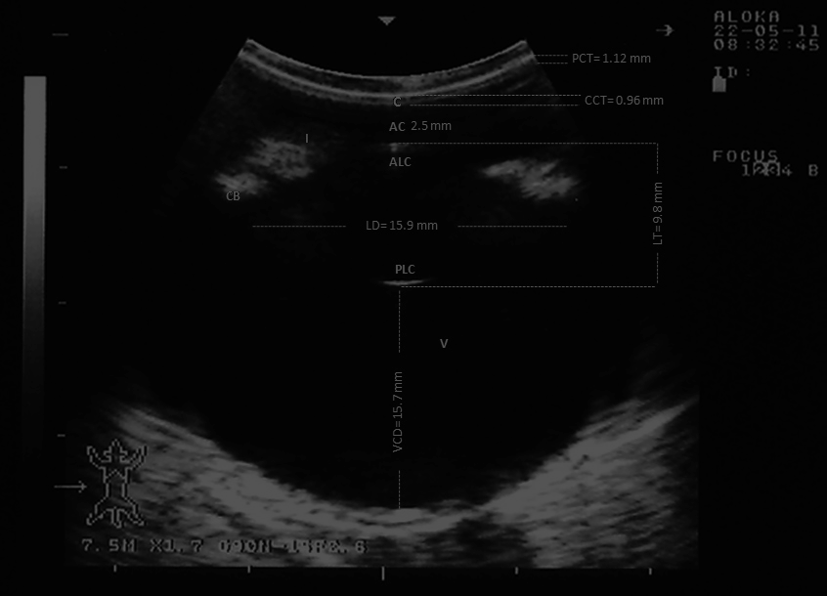
Steps: (1c) i- Corneal-Thickness
1- Ophthalmic ultrasonography

Slide 30
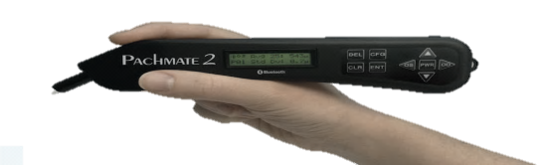
Steps: (3) i- Corneal-Thickness
2- Pachymetery for cornea thickness (ultrasonic &optical)

Slide 31
Steps: (3) i- Corneal-Thickness
3- Partial Coherence Interferometry (PCI), laser-Doppler
4- High-speed Optical Coherence Tomography (OCT)
5- MRI
6- Keratometer

Slide 32
Steps: (3) ii- Lens-Thickness
1- Ophthalmic ultrasonography

Slide 33
Steps: (3) ii- Lens-Thickness
2- High-speed Optical Coherence Tomography (OCT)
3- Purkinje Method seq. of reflections from the eye refracting surfaces
PI, PII, PIII, PIV

Slide 34
Materials and Methods
Steps
Step: 2

Slide 35
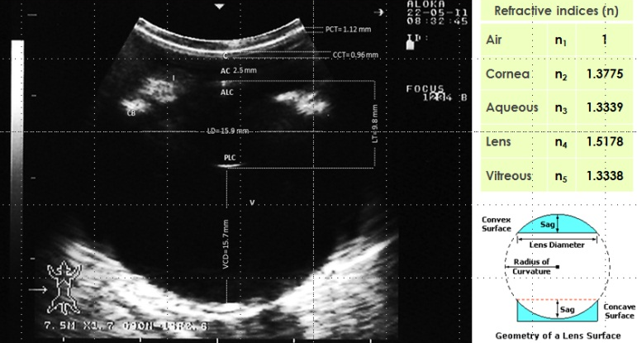
Steps
Building a theoretical/physical model based on the inputs and obtaining it’s theoretical visual properties (such as the lens power, focal distance and focal points, …etc).
F’
F
V
P
P’
V ’

Slide 36
Consider
Points to consider
1-age of animal
The dimensions of ocular tissues vary from infantile to adult animals. These changes are probably the necessary concomitant of the increase in size of the eye during growth.
2-Adaptation (no adaptation is calculated).

Slide 37
Steps
Step: 3

Slide 38
Steps
Step C: Two eye models can be developed; Full schematic/Reduced
Thick lens theory
≈
P’₂= (C₂*F₄*n₃)/ (F₆)
59.25D
H= (t₂*d₁) / (n’*F_{t})
Thin lens
P_{e}= (d₂*F₅*n’)/F₆
P_{e}’= (d₂*F₄*n₄)/F₆
f= n₁/F_{t}
F₆= (F₄+ F₅) – (C_{2*}F₄*F₅)
Notes:
Calculation of the schematic eye began with the use of thick lens theory to develop an equivalent thin lens for the cornea and for the crystalline lens.

Slide 39
Steps
Step C: Two eye models can be developed; Full schematic/Reduced
To make simple optical calculations
combining all the refractive indices into 1
P’₂= (C₂*F₄*n₃)/ (F₆)
59.25D
H= (t₂*d₁) / (n’*F_{t})
P_{e}= (d₂*F₅*n’)/F₆
P_{e}’= (d₂*F₄*n₄)/F₆
f= n₁/F_{t}
F₆= (F₄+ F₅) – (C_{2*}F₄*F₅)
all refracting surfaces into 1-power, 1-location
Notes:
To make simple optical calculations a Reduced eye, based on Gullstrand’s model, was developed that approximately matches the ocular dimensions but simplifies the calculations by combining all the refractive indices into one, and all the refracting surfaces into one power and location

Slide 40


Materials and Methods
Steps
Steps A/B/C: collecting the inputs required to build the schematic model,
1
2
3

Slide 41
Points to be Discussed
1
1
Eye vs “Schematic eye”, models of Schematic eye
2
Benefits/Values of schematic eye (Social/Clinical)
2
3
3
Theory behind the Schematic eye
4
4
Science branches involved and their interaction.
5
5
What is the required data?
6
Steps: 1 (a, b& c), 2 & 3
6
7
Interpretations of obtained results
8
Questions?

Slide 42
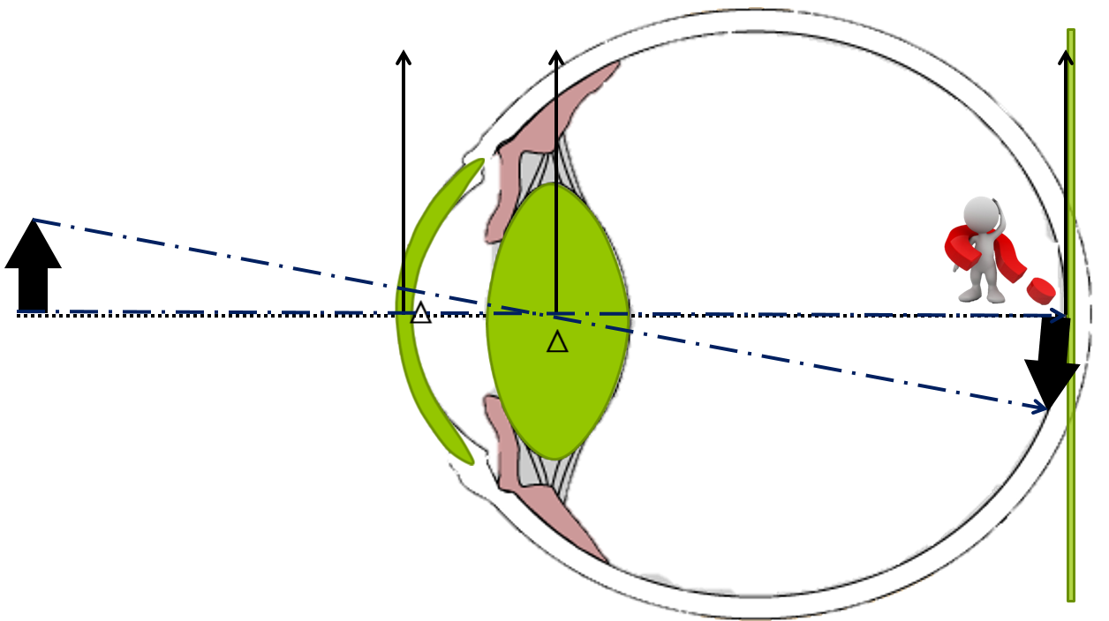
Steps
V
P
V ’
F’
F
P’
Comparing the obtained data with the measured data on live animals and interpreting the results

Slide 43
Results
Refractive power-Cornea/Lens/Eye
Powers
Anterior Cornea | 31.2087
Posterior Cornea | -2.7849
Total Cornea | 28.481
Whole Eye= 59.25
Anterior Lens | 22.4789
Posterior Lens | 17.5522
Total Lens | 37.5356

Slide 44
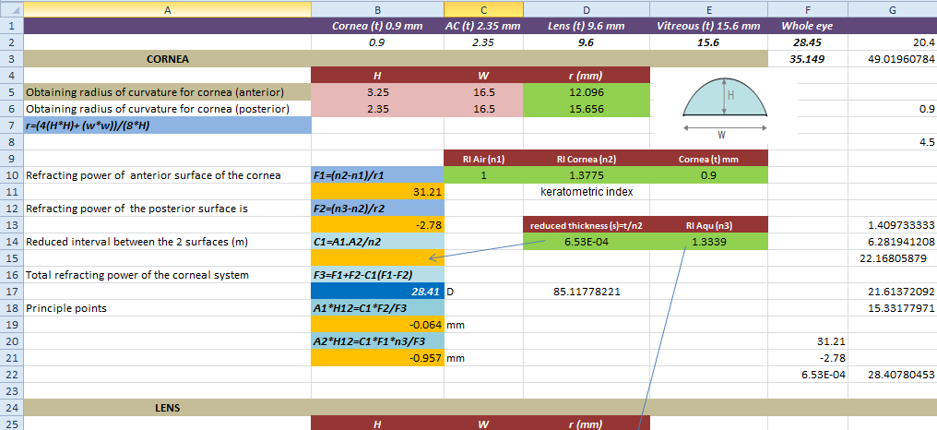

Results
Step 2: Calculations

Slide 45
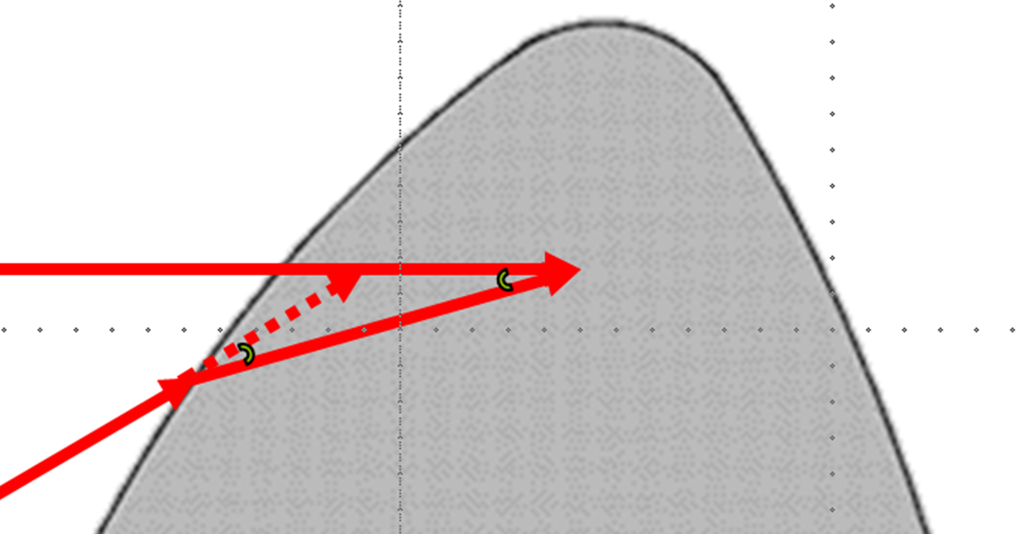
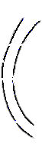
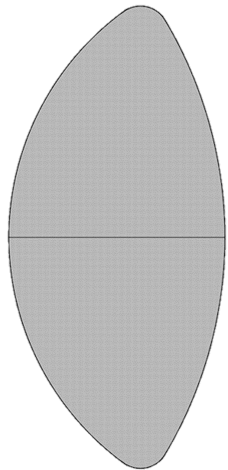
Results
Principle points 1/5
F
F’
V
P
P’
V ’
6.2mm
19.2mm
F,F’= focal points, V,V’= vertices, P,P’= principle points

Slide 46

Results
Principle points 2/5
1
What happens if the P moves forward or backward?
2
What is the value of knowing the exact mathematical P-points?
F
F’
V
P
P’
V ’

Slide 47
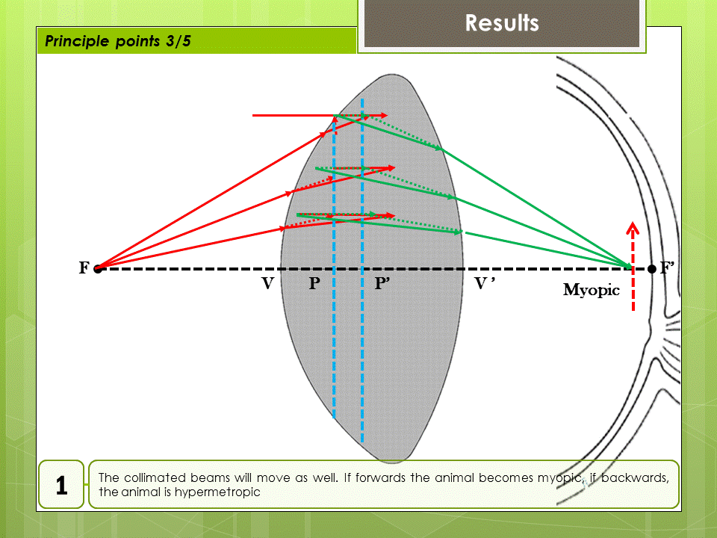

Slide 48
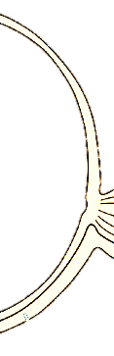
Results
Principle points 5/5
F
F’
V
P
P’
V ’
2
It confirms the location of the focal point which corresponds to the retina. The value of the retinal location has been measured by the US. If these value are correct then the image will fall exactly on the retina.

Slide 49
Results
Results
Nodal points
The front and rear nodal points have the property that a ray aimed at one of them will be refracted by the lens such that it appears to have come from the other, and with the same angle with respect to the optical axis.
F
N
F’
N’
The nodal points therefore do for angles what the principal planes do for transverse distance. If the medium on both sides of the optical system is the same (e.g., air), then the front and rear nodal points coincide with the front and rear principal points, respectively.
Anterior nodal point | N | 10.05
Posterior nodal point | N' | 11.219

Slide 50
Results
Focal points
F
F’
V
P
P’
V ’
6.2mm
19.2mm
Anterior focal point | F | -13.4208
Posterior focal point | F' | 28.0961

Slide 51
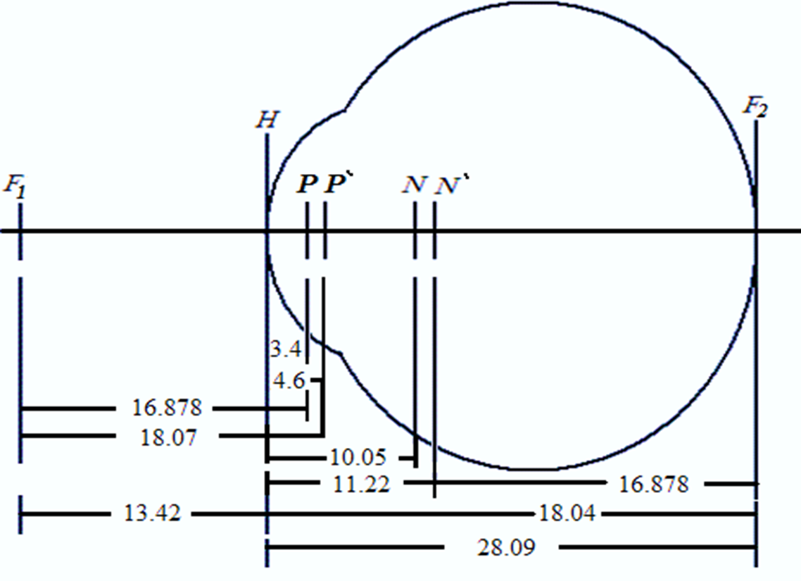
Results
Full Schematic eye
Anterior focal point | F | -13.4208
Posterior focal point | F' | 28.0961

Slide 52
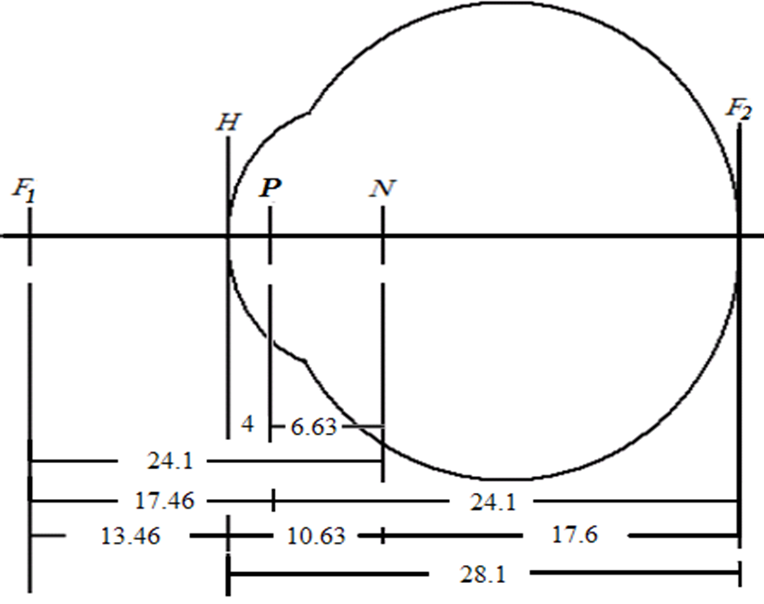
Results
Reduced eye

Slide 53
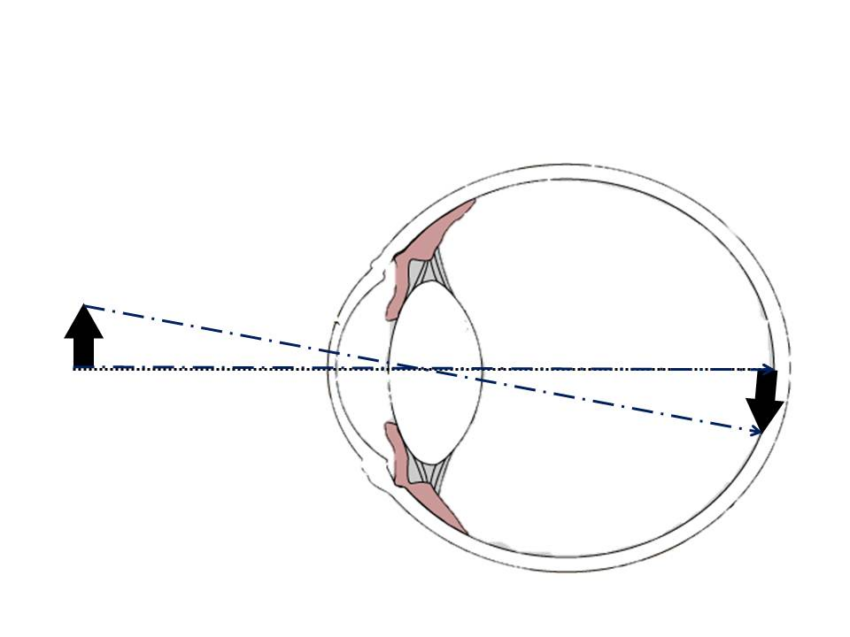
Results
RIM (Retinal Image Size/Magnification)
The retinal image size is calculated by multiplying the distance from the posterior nodel point to the retina
(17.6 mm) by the angle, in radians, subtended by the object, where 1 radian = 57.296 degree.
If the same object moves closer, the subtending angle will increase, the larger the retinal image size

Slide 54
Consider
Clinical values
Industry
Artificial IOL design to compensate visual defects.
In Human: Spectacles and contact lenses.

Slide 55
Consider
Clinical values
Surgery
For visual rehabilitation of animals suffering from cataract and/or other Refractive surgery.
LASIK

Slide 56
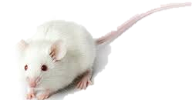


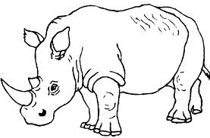

Consider
Clinical values
Optical properties of animal eye
Mice are Myopic (Optical properties of the mouse eye, Ying Geng,1,2,* Lee Anne Schery,1 Robin Sharma,1,2 Alfredo Dubra,1,3 Kamran Ahmad,1Richard T. Libby,1,3 and David R. Williams1,2,)
Rabbits can see what’s behind them. They are also however, myopic
Rhinos are myopic
Most dog breeds have good vision, but some show a genetic predisposition for myopia – such as Rottweilers
(Coren, Stanley (2004). How Dogs Think. First Free Press, Simon & Schuster. ISBN 0-7432-2232-6.)

Slide 57



Consider
Clinical values
Optical properties of animal eye
Many domestic horses (1/3) tend to have myopia, with few being far-sighted. Wild horses, however, are usually far-sighted. Giffin, James M and Tom Gore. Horse Owner's Veterinary Handbook, Second Edition. Howell Book House. New York, NY. Copyright 1998.
Sheep are hyperopic
with large RIM
Eagles, young: myopic, adult no

Slide 58
Consider
Clinical values
Optical properties of animal eye Ocular size and Lens power/accom.
The data obtained from the schematic model shows that camels with their relatively small sized-eyes compared to horse and cow necessitated the existence of an optical system with a higher dioptric power to achieve image focusing over a short focal length.
Camels has normal vision but with a great capability of lens accommodation.
Ocular size |  | diopter
Camel | 29.1 | 59.25
Horse | 41.4 | 38.5
Cow | 36

Slide 59

Consider
Clinical values
Optical properties of animal eye (RIM)
The retinal image magnification (RIM) indicates the visual acuity and inversely proportional to the lens power.
the stronger the lens, the smaller the retinal image size will become, the better the visual acuity is
RIM
Camel | 16.89
Horse | 25.9
Cow | 20.98

Slide 60
Consider
Clinical values
Optical properties of animal eye
Visual acuity and sensitivity to motion
The visual acuity of the horse, or how well it is able to see details, is around 20/33. This is slightly worse than the usual 20/20 in humans, but much better than the visual acuity of dogs (20/50), cats (20/75), and rats (20/300).^{[13]} However, it is difficult to test an animal's visual acuity, so the results may vary between studies.
Animal Eye Care. "About animal vision." Accessed March 11, 2010

Slide 61
Points to be Discussed
1
1
Eye vs “Schematic eye”, models of Schematic eye
2
Benefits/Values of schematic eye (Social/Clinical)
2
3
3
Theory behind the Schematic eye
4
4
Science branches involved and their interaction.
5
5
What is the required data?
6
Steps: 1 (a, b& c), 2 & 3
6
7
Interpretations of obtained results
7
8
Questions?

Slide 62



Constructing Schematic Eye
Requirements, Steps and the Obtained clinical values.
A Camel-eye model
CAIRO UNIVERSITY
EGYPT
59.25D
Global Veterinary Summit
August 31-September 2, 2015 Florida, USA
N= F + f’
El-TOOKHY, Omar
Prof. Surgery, Fac. Vet. Med.
omar.eltookhy@cu.edu.eg
+20 (111) 293 4411
Thank
you

