Slide 1

Jordanian icu registered nurses: are they compliant with standard infection control practices?
2nd International Conference on
Nursing & Healthcare
November 17-19 2014, Chicago USA
Omar M. AL-Rawajfah, PhD, RN

Slide 2



2nd International Conference on
Nursing & Healthcare
November 17-19 2014, Chicago USA
Acknowledgements
Authors would like to acknowledge:
  The Scientific Research Support Fund at the Jordanian Ministry of Higher Education and Scientific Research for funding this project (Grant ID: 2010/03/1).
  Deanship of Research at Al AL-Bayt University- Jordan for funding this presentation

Slide 3
2nd International Conference on
Nursing & Healthcare
November 17-19 2014, Chicago USA
Background and Significance
Prevalence of Healthcare Associated Infections (HCAIs) in intensive care units (ICUs) are much higher than other units
Assessment of adherence to infection control guidelines periodically is a high priority measure to reduce the incidence of HCRIs (CDC, 2002)
No Jordanian Studies that assess IC practice among ICU nurses at the national level

Slide 4


2nd International Conference on
Nursing & Healthcare
November 17-19 2014, Chicago USA
Study Objectives
The purpose of this national study was to assess the compliance of Jordanian ICU RNs with standard IC guidelines
Identify possible factors that affect Jordanian ICU RN compliance with IC guidelines
Identify possible differences in IC practices among RNs in different healthcare sectors in Jordan

Slide 5

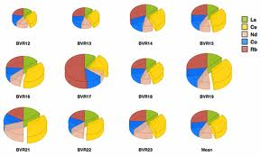
2nd International Conference on
Nursing & Healthcare
November 17-19 2014, Chicago USA
Methodology
This study used a descriptive cross-sectional design
Proportional, multistage, probability sampling was used
The sampling frame consisted of all Jordanian hospitals listed by the Ministry of Health annual statistical report
The total sampling frame consisted of 103 hospitals (29.1% were governmental, 10.7% military, 58.3% private and 1.9% university affiliated hospitals)

Slide 6
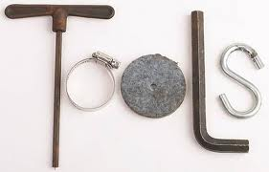


2nd International Conference on
Nursing & Healthcare
November 17-19 2014, Chicago USA
Study Instrument
The Infection Control Practices Tool (ICPT)
  29 items and uses a 5-point Likert scale
  Score ranged from 29 to 145
Reliability coefficient of the Arabic version in this study was 0.88
Three level of compliance:
  Unsafe compliance (less than the 50th percentile )
  Weak compliance (between the 50th to 75th percentiles)
  High compliance (more than 75th percentile)

Slide 7

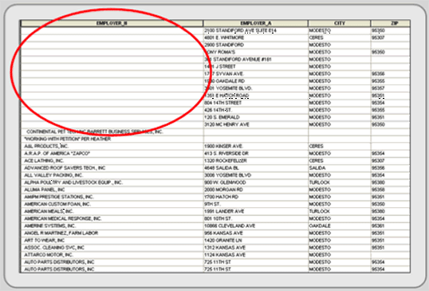
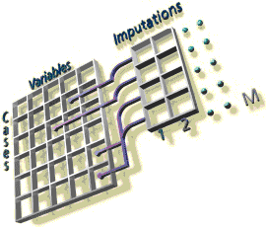
2nd International Conference on
Nursing & Healthcare
November 17-19 2014, Chicago USA
Data Analysis
We used SPSS®-PC Version 20.
Reliability coefficient of the Arabic version in this study was 0.88
Missing data for the 29 practice items ranged from 1% to 3%.
The expectation-maximization (EM) maximum likelihood algorithm was used to impute missing data for all practice items.
Cases of missing data of 20% or greater were excluded from the final analysis

Slide 8


2nd International Conference on
Nursing & Healthcare
November 17-19 2014, Chicago USA
Results
21 Hospitals participated in the study
  8 Governmental, 7 Military, 4 Private, & 2 university affiliated.
  The final sample consisted of 247 RNs from 56 critical care units.
Sample characteristics
  51% female with a mean age of 28.5 years (SD = 5.2).
  84.6% held a BSN degree with mean years of experience of 6.2 years (SD = 5.1)
  37.6% worked in medical and surgical floors and 20% worked in critical care units
  54.7% of RNs were working in general ICUs; 17.8 % worked in NICUs; only about 2.8% were working in cardiac catheterization units

Slide 9
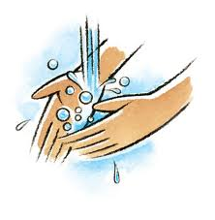

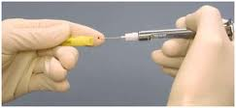
2nd International Conference on
Nursing & Healthcare
November 17-19 2014, Chicago USA
Results
The mean overall compliance level was 122.6 (SD = 13.2)
  Unsafe compliance (2.7%)
  Weak compliance (22.8%)
  High compliance (74.5% )
Important Infection Control Practices
  78.9% always washed their hands before giving care to patients
  63.2% always wash their hands before and after gloving
  24.3% always share equipments between patients without sterilization
  52.4% perform recapping always or most of the time

Slide 10
2nd International Conference on
Nursing & Healthcare
November 17-19 2014, Chicago USA
compared means compliance score in relation to selected factors
 | Yes | No or not sure
 | M (SD) | M (SD) | t (df) | p value
Receive infection control training inside the hospital | 124.3 (12.3) | 117.3 (14.6) | 3.7 (245) | < 0.001
Receive infection control training outside the hospital | 126.2 (11.7) | 121.8 (13.4) | 2.0 (244) | 0.05
Hospital offer IC education for new nurses | 123.6 (12.3) | 115.6 (16.8) | 3.2 (244) | 0.002
Received hepatitis B vaccine | 123.2 (12.5) | 119.4 (15.8) | 1.7 (245) | 0.08

Slide 11

2nd International Conference on
Nursing & Healthcare
November 17-19 2014, Chicago USA
Results
One-way ANOVA
  Total compliance scores were NOT significantly different across all types of healthcare sectors, F (3, 246) = 0.60, p < 0.70.
  The mean total IC practice score was not statistically different across all types of critical care units, F (6, 246) = 0.80, p < 0.90.

Slide 12


2nd International Conference on
Nursing & Healthcare
November 17-19 2014, Chicago USA
Discussion
Strengths of the study
  This is the first Jordanian national study that evaluated IC practices among ICU RNs.
  Inclusion of hospitals representing all health care sectors in Jordan from all geographical areas
  Proportional probability sample, results are very likely generalizable

Slide 13


2nd International Conference on
Nursing & Healthcare
November 17-19 2014, Chicago USA
Discussion
Limitations of the study
  Use of a self-report method.
  Self-report method overestimates the compliance rate with IC practices in comparison with the observation
  The use of observation would give greater insight regarding level of compliance with these guidelines

Slide 14


2nd International Conference on
Nursing & Healthcare
November 17-19 2014, Chicago USA
Discussion
Massages to healthcare sectors
  63.7% of untrained nurses worked in governmental and military hospitals
  74% of nurses with weak compliance worked in governmental and military hospitals
  Orientation and teaching programs conducted in hospitals for newly employed RNs

Slide 15


2nd International Conference on
Nursing & Healthcare
November 17-19 2014, Chicago USA
Discussion
Massages to healthcare sectors
  24.3 % always or most of the time shared equipment between patients
    The availability of IC resources such as hand washing facilities and personal protective equipment in health care facilities in Jordan represents a real challenge.
    Recent standard recommended a ratio of 0.8 to 1.0 IC-nurses per 100 occupied acute care beds as an appropriate level of IC staffing

Slide 16


2nd International Conference on
Nursing & Healthcare
November 17-19 2014, Chicago USA
Thank you……
We are ready for your important question

