Slide 1




Olivier Beauchet, MD, PhD
Professor of Geriatrics
Holder of the Dr. Joseph Kaufmann Chair in Geriatric Medicine - Faculty of Medicine, McGill University
Department of Medicine, Division of Geriatric Medicine, Sir Mortimer B. Davis Jewish General Hospital
Director, RUIS McGill Centre of Excellence on aging and chronic disease
olivier.beauchet@mcgill.ca
HIPPOCAMPAL VOLUME,
EARLY COGNITIVE DECLINE
AND GAIT VARIABILITY:
WHICH ASSOCIATION?

Slide 2


DISCLOSURE OF INTERESTS
No financial but scientist conflict of interest!
Study of age-related changes in higher levels of gait
control:
  Favorite and major research
  stream for 17 years
  Partial... and practice-oriented
  arguments
Short time period... Not an overview
but a snapshot of facts, issues, and
perspectives of interactions between
hypocampus, gait... and cognition

Slide 3

OBJECTIVES
To better understand the relationship
between cortex and gait control
To underscore that this relationship
is more complex than expected
To show the perspectives related to
the association between hippocampal
volume and gait performance

Slide 4
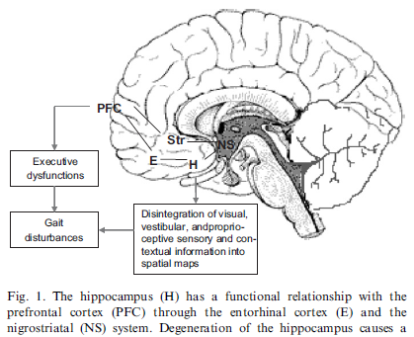
WHY THIS TOPIC?
Prominent function of hippocampus: memorization
Gait:
  Not an action performed “in
  vacuo”
  Involvement of executive
  functions (attention,
  planning, updating – PFC)
  and memory [hippocampus])
Involvement of the hippocampus in gait control, and thus in the maintaining of gait stability, still matter of debate
A better understanding of this association could have an impact in early diagnosis of dementia.
Scherder E et al. Neurosci Biobehav Rev. 2007;31:485-97

Slide 5
WHY THIS TOPIC?
Gait and cognitive (memory+++) disorders share similar health issues.
Tow related questions:
  Simple accumulation due to a high prevalence or to a causal relationship?
  Clinical applications for diagnosis?
Disorders |  | Prevalence |  | Morbi-mortality |  | Treatment |  | Causal link
GAIT |  | 20-80 % |  | Same adverse outcomes: Function decline Falls and fractures ↓ quality of life ↑ expenditures …Death |  | Symptomatic >> curative |  | Association more important than expected as a result of the normal aging
COGNITION |  | 10-50 %

Slide 6
GAIT & COGNITION // Unusual question 20 years ago!
Gait:
  Medical term to describe human bipedal locomotion
  Distinctive attribute that:
    Changes over the life span
    Due to normal aging and diseases (dementia +++)
    All changes leading to gait disorders
  Implicit, rhythmic and automatic motor behavior
  mainly controlled by spinal and subcortical regions
… Whereas
Cognition: mental explicit processes producing -
understanding language, solving problems and making
decisions controlled by cortical regions

Slide 7

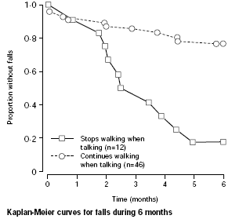
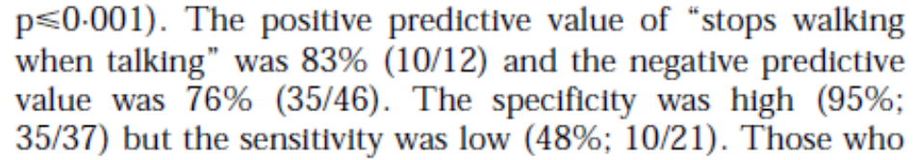
THE FAMOUS MANUSCRIPT
Results showed that:
Gait was not only an automatic
rhythmic motor task
Gait assessment while dual-tasking
underlined:
1) Involvement of cognitive
resources (attention +++),
2) Highest gait control level: cortical
(too high in older adults with
neuropsychiatric disorders)
3) An apparent good predictive
tool for risk of fall!
Log rank test: P < 0.001
Notes:
7

Slide 8
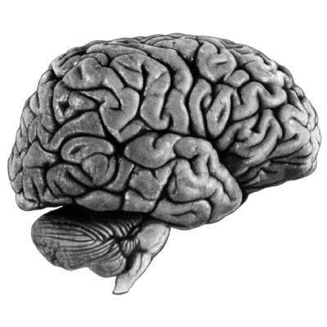
DUAL TASK PARADIGM // How does it work?
Brain: limited capacity in terms of cognitive resources
Combination of two cognitive-demanding tasks (walking & cognitive task):
overload of the brain capacity leading to share resources
Changes in performance while dual tasking:
  Interference due to competing demands for cognitive resources
  needed for both tasks
  Depending on one’s capacity to properly allocate cognitive resources
  between tasks
Sharing resources
Level of cognitive resources involvement
Walking
Cognitive-demanding task
Dual-tasking
Pashler H. Psychol Bull. 1994;116: 220-44
Notes:
8

Slide 9
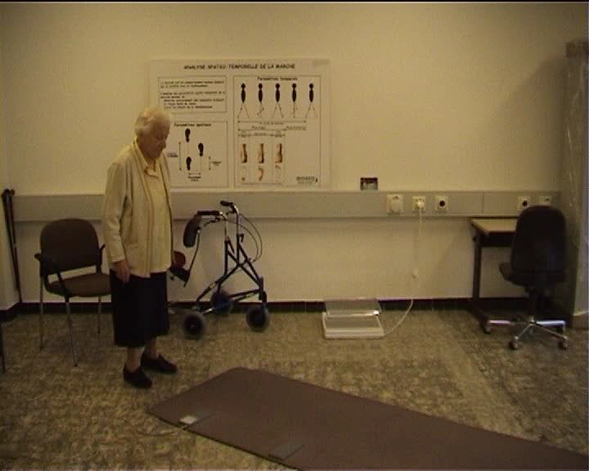
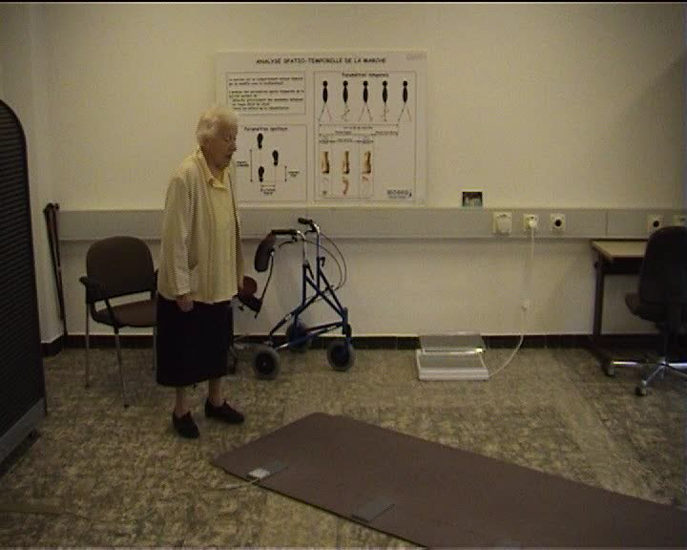
DUAL TASK PARADIGM // A clinical example
SINGLE TASK
DUAL TASK

Slide 10
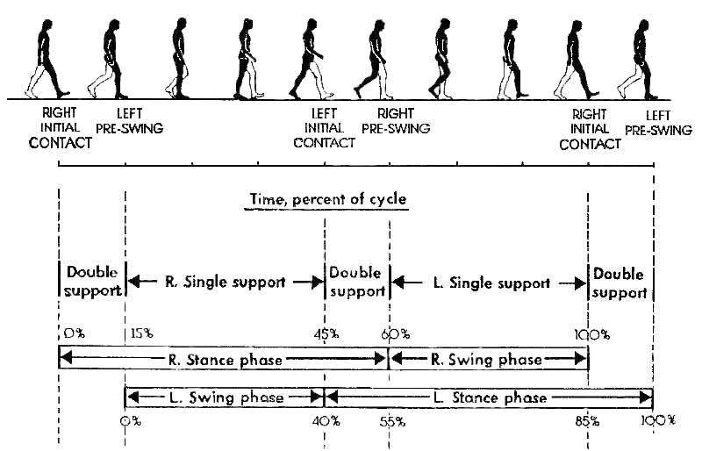
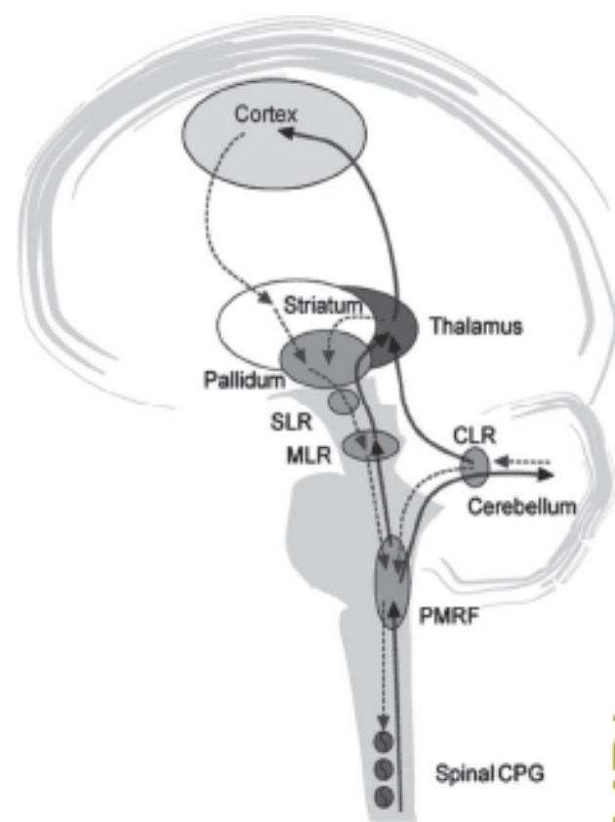
GAIT // Which control?
PARADOXICAL MOTOR BEHAVIOR
Simple execution | Complex biomechanics (dynamic balance)
« Hard » motor behavior: Automatic = Propulsion / Balance | « Flexible » motor behavior: Adaptation = Navigation
LEVELS AND TYPES OF CONTROL
 |  | CORTICAL LEVEL Initiation and adaptation of gait
SUBCORTICAL LEVEL Modulation of automatic movements |  | At steady walking, without stimulation and straight (gait propulsion condition): involvement of cortical level in gait control
SPINAL LEVEL Gait patterns generation of automatic, regular and rhythmic movements
SLR: Subthalamic locomotor region
MLR: Mesencephalic locomotor region
CLR: Cerebellar locomotor region
PMRF: Pontine and medullary reticular formations
CPG: Central pattern generators
Notes:
10
10
10
The second main question of the first part of my talk is: Why study gait variability?
In fact, there are in my mind two main clinical interests to measure gait variability:
First, it is an index of gait stability.
Second, it is a way to quantity changes in gait stability related to ageing, diseases, drugs and rehabilitations programs.
In the other hand, there is of course a fundamental interest which is to access to gait control, and more particularly higher-level of gait control.
It is important to understand that gait is a “paradoxal” or a "Mixed" motor behavior which depends on different levels of control and also different types of control.
The paradox is highlighted by the fact that although gait is a simple in term of execution, it is a complex motor behavior in term of biomechanics. In addition, gait could be defined as a hard motor behavior because of its automatic component related to locomotion, while gait is also a flexible motor behavior because of its ability to adaptation related to navigation.
In term of level of control, the simplicity and automaticity depend on a medullar and sub-cortical control, whereas the flexibility and navigation are related to the frontal lobe and thus to executive function.
Lastly, reflex and automatic movement depend on muscular contraction and movement coordination, whereas frontal lobe is the structure that produces adapted gait behavior

Slide 11
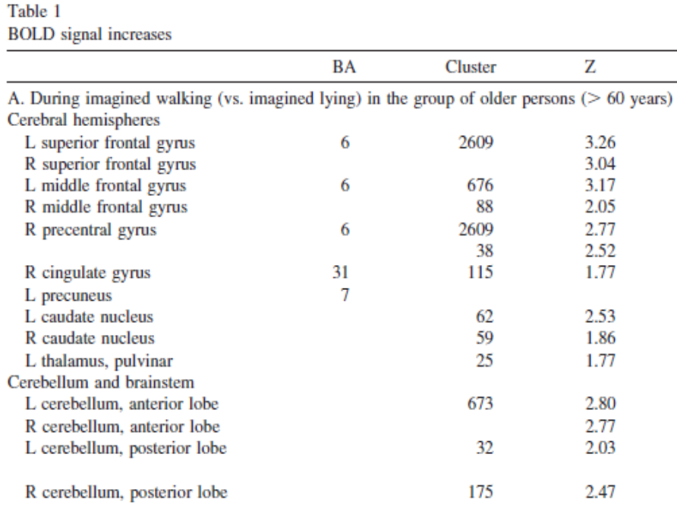
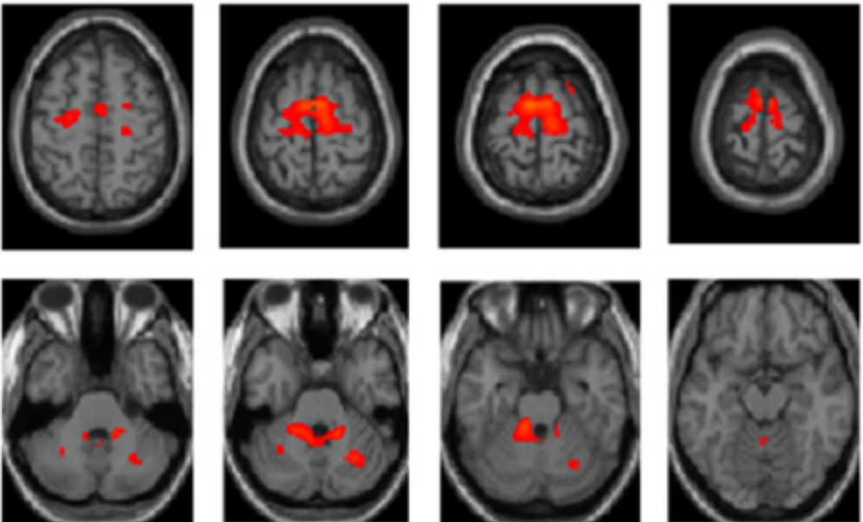

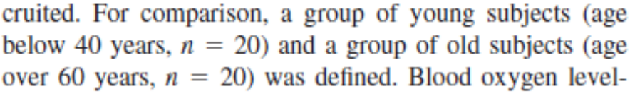
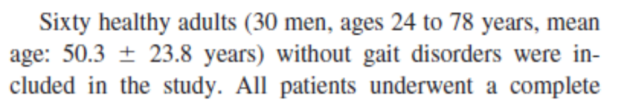
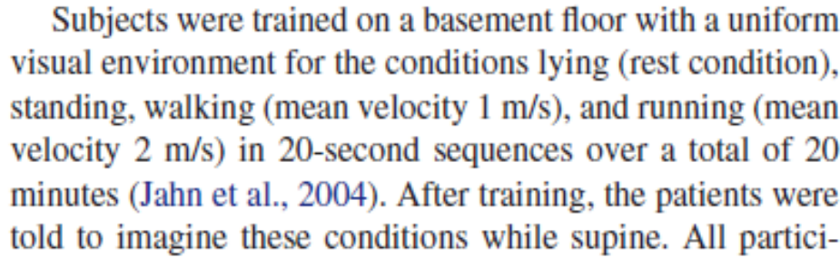
GAIT CONTROL // Functional brain imaging
Involvement of cortical level (premotor
cortex) in gait control while usual walking
No age-related change in locomotor
brain network (premotor cortex, basal
ganglia,midline cerebellum,
pontomesencephalic tegmentum)
Zwergal A et al. Neurobiol Aging. 2012;33:1073-84

Slide 12
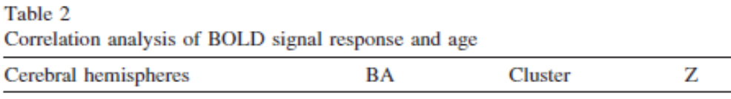
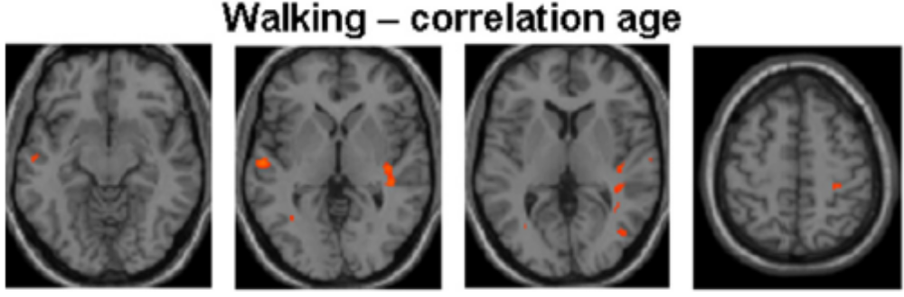
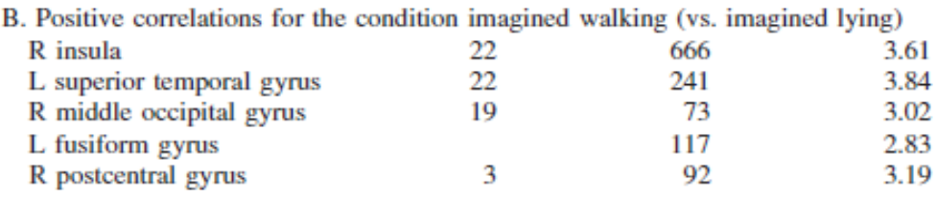
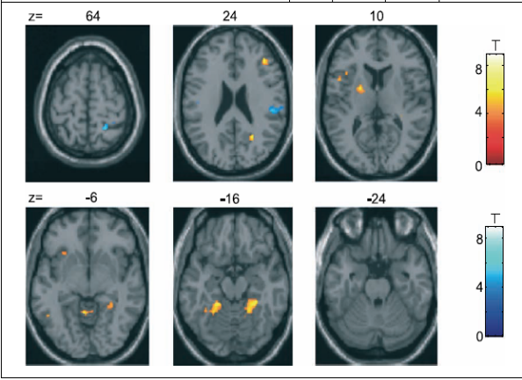
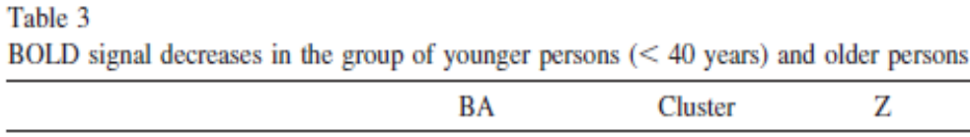
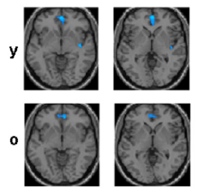
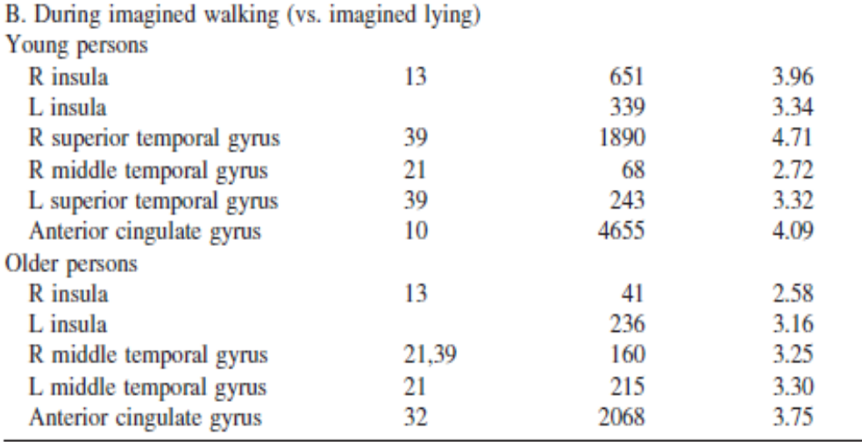
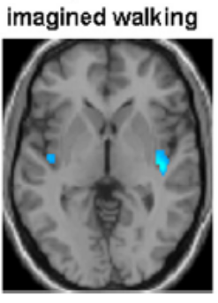
GAIT CONTROL // Functional brain imaging
More cortical activation with aging
Increase and decrease in cortical activity:
a compensatory mechanism due to age-related sensorimotor decline
Less cortical deactivation with aging
Zwergal A et al. Neurobiol Aging. 2012;33:1073-84

Slide 13
GAIT & COGNITION // Scientific questioning
Q1: Does cognition influence gait?
Q2: How cognition influences gait?
Gait-related questions:
Cognitive-related questions:
Which walking condition?
Which cognitive function?
Which gait parameter?
Which brain structure?
Q3: Do gait performances predict cognitive decline?
Q: Question

Slide 14
GAIT & COGNITION // Scientific questioning
Q1: Does cognition influence gait?
Q2: How cognition influences gait?
Gait-related questions:
Cognitive-related questions:
Which walking condition?
Which cognitive function?
Which gait parameter?
Which brain structure?
Q3: Do gait performances predict cognitive decline?
Q: Question

Slide 15
GAIT & COGNITION // Scientific questioning
Q1: Does cognition influence gait?
Q2: How cognition influences gait?
Gait-related questions:
Cognitive-related questions:
Which walking condition?
Which cognitive function?
Which gait parameter?
Which brain structure?
Q3: Do gait performances predict cognitive decline?
Q: Question

Slide 16
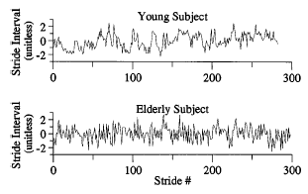
GAIT VARIABILITY // Definition
Fluctuation from stride-to-stride with time
Two ways to study gait variability:
  Magnitude: Variance calculated from standard deviation (SD) or coefficient of variation (CoV) = (SD/mean) x 100
  Variation with time: Change from one stride to the next with time, independently of variance (fractal dynamics of human gait: not random in healthy subjects)
Clinical examples with stride time:
Most important condition of measurement: steady state walking
SD=15 ms
CoV=1.9%
SD=15 ms
CoV=2.0%
Hausdorff JM et al. Hum Mov Sci. 2007;26:555-89

Slide 17
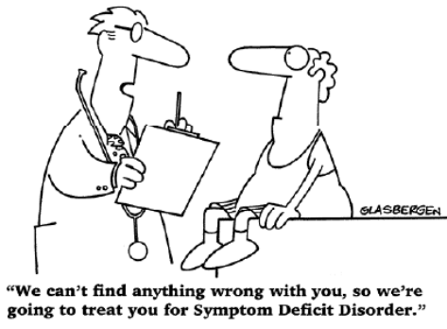
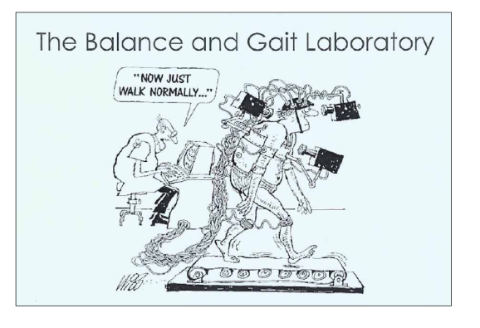
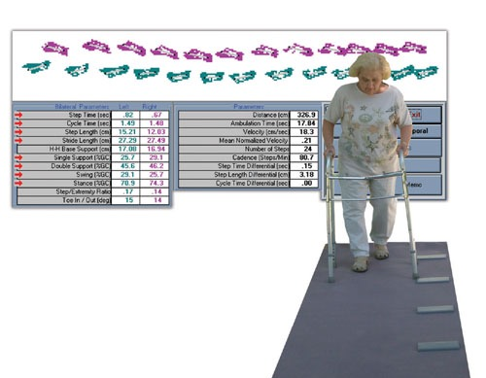
GAIT VARIABILITY // Assessment
Eyes of clinicians: ineffective and subjective !
Gait laboratory: expensive and not ecological…
User-friendly portable gait analysis systems:
  Simple and objective gait measurements
  Less technical equipment and low costs
Kressig RW et al. Aging Clin Exp Res. 2006;18:174-6

Slide 18
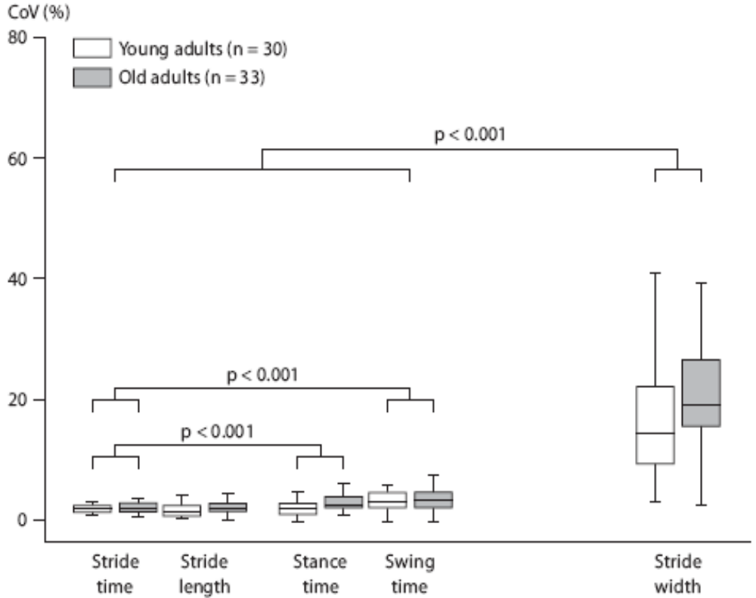

GAIT VARIABILITY // Variable or not?
Question: Should gait be variable or not?
Balance
control
Propulsion control
↓ CoV = ↑Gait stability
↑ CoV = ↑Gait stability
Beauchet O et al. Gerontology. 2010;55:702-6
Notes:
18

Slide 19
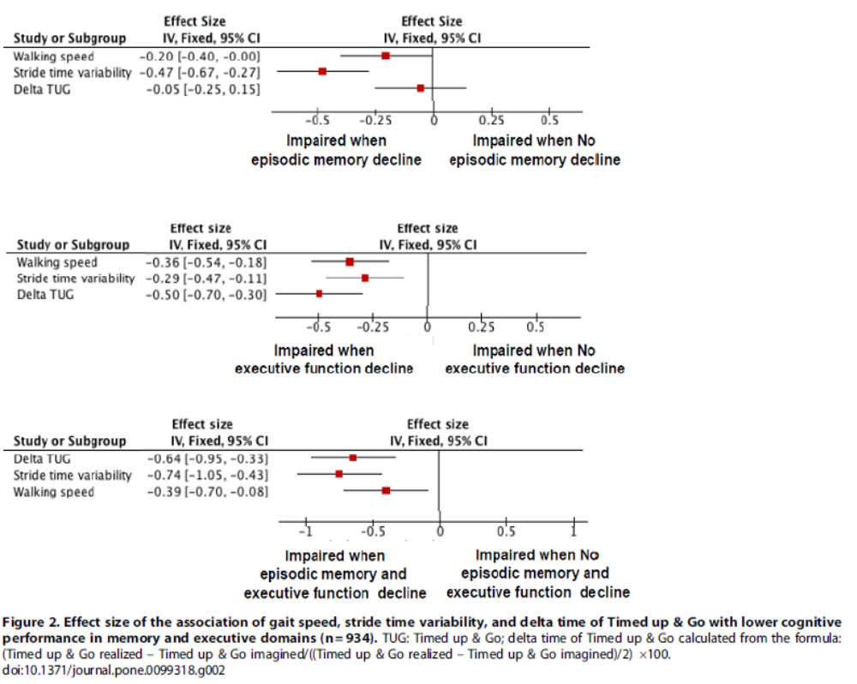
HIGH GAIT VARIABILITY // Association with cognitive decline
Beauchet O et al. PLoS One. 2014;9:e99318

Slide 20
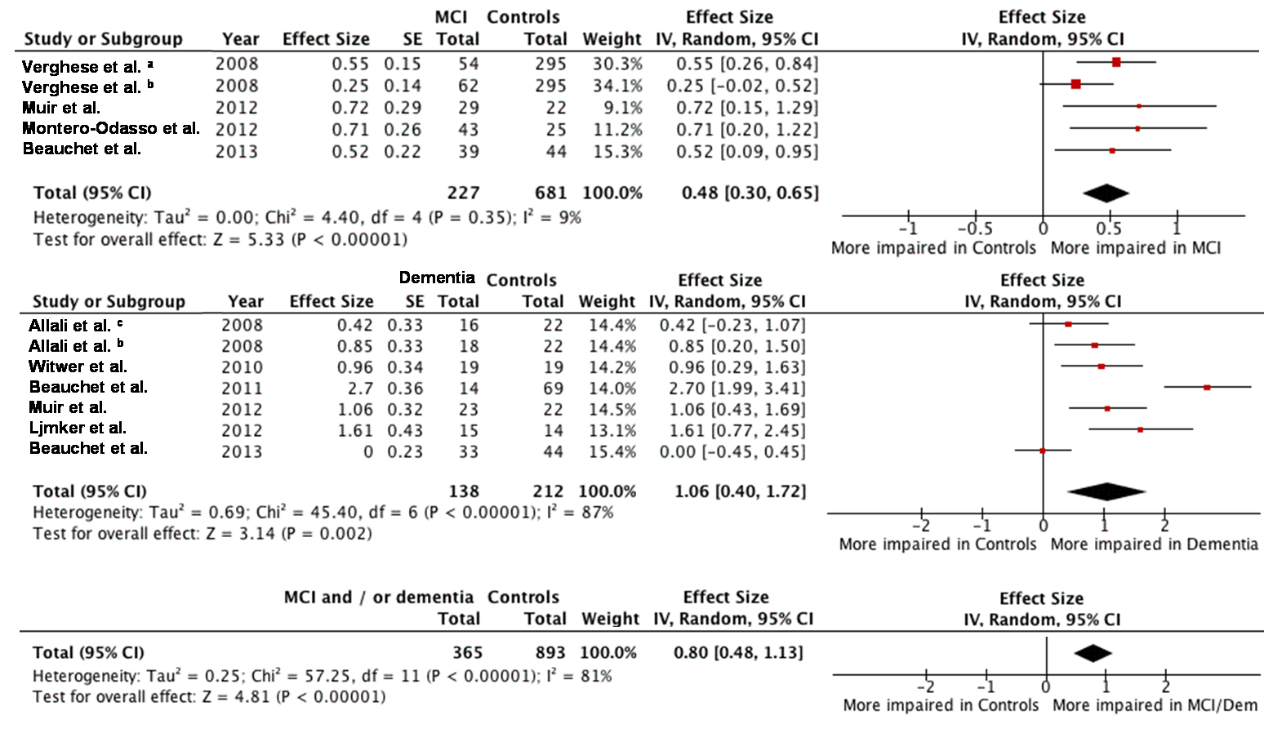
HIGH GAIT VARIABILITY // Association with cognitive decline
Beauchet O et al. PLoS One. 2014;9:e99318

Slide 21
GAIT & HIPPOCAMPUS // Is there an association?
Divergences of results:
  Some studies found a negative association
  between hippocampal volume and gait
  performance, while others did not.
  Due to studied populations and/or the type of
  spatio-temporal gait parameters examined
Need for studies involving:
  Cognitively healthy individuals (CHI) and mild
  cognitive impairment (MCI) patients
  Sensitive and specific gait markers of cortical gait
  control like gait variability

Slide 22
STUDY // Hypothesis
Facts: MCI individuals have compared to CHI:
  Greater gait variability (stride time)
  Lower hippocampal volume
Hypothesis: higher gait variability would be associated with lower hippocampal volume in MCI individuals compared to CHI.

Slide 23
STUDY // Objective
To examine the association of the hippocampal
volume with stride time, swing time and stride
width variability among individuals with any form
of MCI (i.e., amnestic or non-amnestic, and single
or multiple domains) and CHI.

Slide 24
STUDY // Methods
Participants:
  90 individuals (47 CHI and 43 MCI individuals)
  Recruited in Angers Memory Clinic (France)
  Received a full standardized medical examination,
a neuropsychological and gait assessment, and
MRI of the brain (1.5 Tesla)
Design: Cross-sectional study
Outcomes: hippocampal volume (freesufer) & coefficient
of variation (CoV = (standard deviation/mean) x 100)
of stride parameters while usual walking (GAITRite®)
Co-variates: age, sex, body mass index, number of drugs
daily taken, history of falls in the past year and walking
speed, white matter hyperintensities and total cranial volume

Slide 25
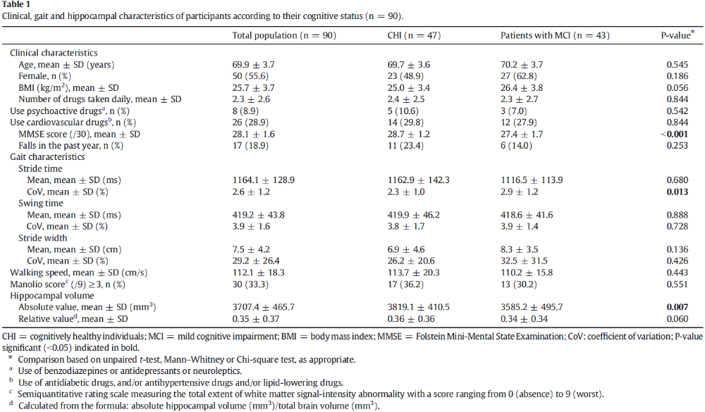
STUDY // Results

Slide 26
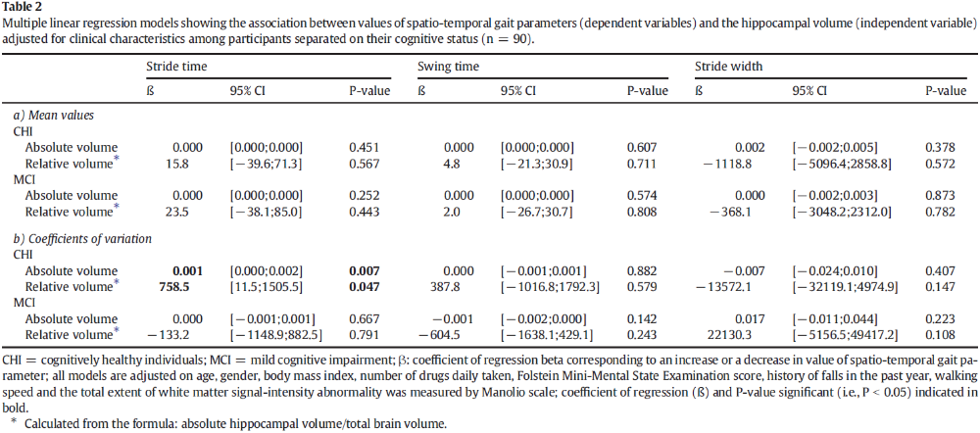
STUDY // Results
Greater (i.e., better morphological structure) hippocampal volume associated with greater (i.e., worse performance) stride time variability in CHI but not MCI

Slide 27
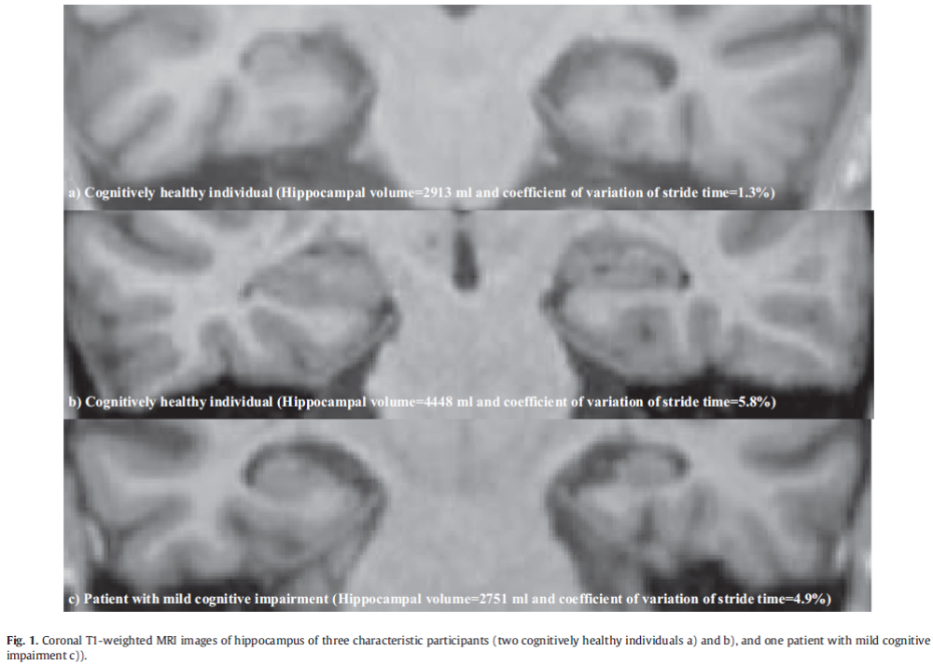
STUDY // Example
CHI: low variability & normal volume
CHI: high variability & high volume
MCI: high variability & low volume

Slide 28
STUDY // Discussion
Main result: unexpected positive association of a greater (i.e., better morphological structure) hippocampal volume with a greater (i.e., worse performance) variability in CHI, but not in MCI individuals.
Explanation:
  Greater variability in CHI:
    Highlights the role of the hippocampus in gait control during normal aging.
    Confirms the association with hippocampal volume.
    May be explained by a compensatory mechanism used to maintain physiological gait control.

Slide 29
STUDY // Discussion
Explanation:
  Greater variability in CHI:
    Underscores a non-linear association.
    Suggestion:
Hippocampal
volume
+
-
Expected association
Gait
variability
-
+
Time course of disease
CHI
MCI
DEMENTIA

Slide 30
STUDY // Discussion
Explanation:
  Greater variability in CHI:
    Underscores a non-linear association.
    Suggestion:
Hippocampal
volume
+
-
Expected association
Suggested association
Gait
variability
-
+
Time course of disease
CHI
MCI
DEMENTIA

Slide 31
STUDY // Discussion
Explanation:
  Greater variability in CHI:
    Underscores a non-linear association.
    Suggestion:
Hippocampal
volume
+
-
Expected association
Suggested association
SCI: Subjective
Cognitive
Impairment
Gait
variability
-
+
Time course of disease
CHI
SCI
MCI
DEMENTIA
All participants in the study have with memory complaint!

Slide 32
STUDY // Discussion
Limitations:
  Small number of participants
  Cross-sectional design does not afford causal inferences.
Perspectives:
  Hippocampus control gait (rhythmic stepping mechanism) during abnormal aging of cognition (early stage like SCI).
  This association may be used detected early stages of
  cognitive decline.
  The uniqueness of gait variability is that it does not rely on a complex evaluation or laboratory investigations, and thus is easy to apply in population based settings...

Slide 33

THANKS FOR
YOUR ATTENTION
olivier.beauchet@mcgill.ca

