Slide 1

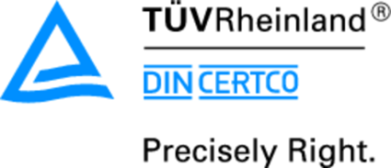




Certification Systems in the Environmental Field: Show the difference
Biopolymers & Bioplastics 2015
Aug 12-14, San Francisco, USA
DIN CERTCO, Dr. rer. nat. Oliver Ehlert
We create confidence!

Slide 2
Contents.
Introducing DIN CERTCO
What does certification mean?
Part 1: Certification in the environmental field
  Biobased Products
  Industrially and Home Compostable products
  New: Biodegradability in Soil
  Recycled content
  Forest Management and Product chain
    FSC / PEFC
  Sustainable Biomass
    REDcert
    ISCC/ISCC PLUS
  Part 2: Bioplastics around the globe
  Market data and development

Slide 3


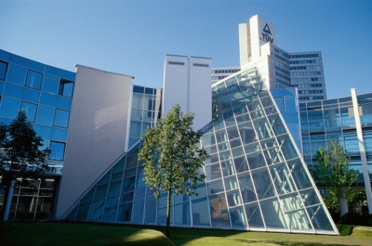
Our milestones.
1972
1995
2005
Foundation of DGWK (Deutsche Gesellschaft für Warenkennzeichnung mbH)
Renamed DIN CERTCO
Fusion with TÜV Rheinland.
DIN retains 20 % of shares .
!
For over 40 years customers and companies have placed their confidence in us. Our marks stands for safety and quality.

Slide 4

Competence and Transparency.
We create confidence – In harmony with people, technology, and environment.
We document safety and quality of new as well as certified products, persons, services and systems.
We refer to DIN, DIN EN and DIN EN ISO Standards and other publicly available specifications such as DIN SPEC or CEN/TS.
Our customers rely to our neutrality, independence as well as competence.
What we are
What we are
Accredited by DAkkS according to ISO 17065
Recognized by DIBt as “ÜZ-Stelle”
Notified Body by European Commission (0196)
Empowered by CCB as certification body for granting the KEYMARK
QM-system according to DIN EN ISO 9001
Information security-management-system according to DIN ISO/IEC 27001
Environmental manage-ment system according to DIN EN ISO 14001
Occupational safety and health manage-ment system according to OHSAS 18001

Slide 5
What does certification mean?
According to DIN EN ISO/IEC 17000 - Theoretically
First-party conformity assessment activities
Conformity assessment activity that is performed by the person or organization that provides the object (“self-declaration”)
Second-party conformity assessment activities
Conformity assessment activity that is performed by a person or organization that has a user interest in the object (e.g. testing laboratory)
Third-party conformity assessment activities
Conformity assessment activity that is performed by a person or body that is independent of the person or organization that provides the object and of user interests in that object (certification body)

Slide 6
What does certification mean?
According to DIN EN ISO/IEC 17000 - Theoretically
Certification means that an independent third party confirms in written form, that a product, system or service fulfills defined requirements.
For you - Practically
After finishing the assessment positively DIN CERTCO confirms, that your product fulfills the requirements stated in the respective certification scheme.

Slide 7
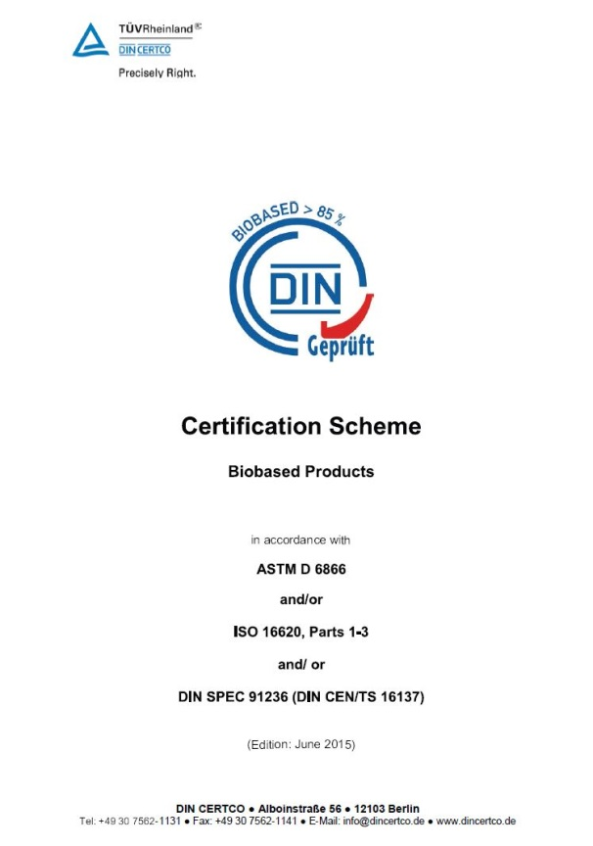
What is a Certification Scheme?
Certification Scheme
States requirements for certification and registration
Based on national or/and international standards
Is the basis for the assessment
Defines additional requirements beyond the standards
  Validity of the certificate
  Verification testing
  Extension/renewal
  Use of the mark
Shows organisational and formal aspects
Publicly available free of charge on www.dincertco.de

Slide 8
Worldwide certification services – for you!

Slide 9

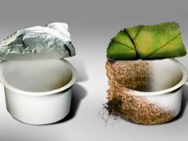
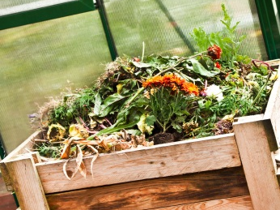
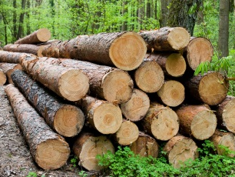
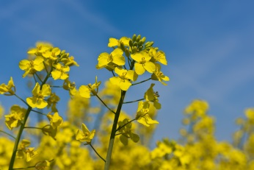



Our Services.
Biobased Products
Industrial compostable Products
Home and garden composting
FSC – Chain of Custody and Forest Management Certification
Sustainable Biomass REDcert
PEFC – Chain of Custody and Forest Management Certification
Products made of recycled materials
Sustainable Biomass ISCC / ISCC PLUS
Certification in the Environmental Fields

Slide 10


Our Services.
Biobased Products.
Materials from nature.
Bio-based products are fully or partly manufactured from natural raw materials and have a self-contained carbon cycle.
Prove that your products are made from sustainable resources.
Basis for certification.
Scope of testing.
ASTM D 6866:2012
DIN SPEC 91236:2011 (CEN/TS 16137)
ISO 16620 series (NEW!)
¹⁴C determination (proportion of biogenic carbon on total carbon)
Determination of volatile solids

Slide 11
Certification of biobased products.
Products requirements
> 50 % volatile solids (organic content)
at least 20 % ¹⁴C (biobased carbon content)
Validity: 6 years
Verification testing: 2nd and 4th year of certification

Slide 12
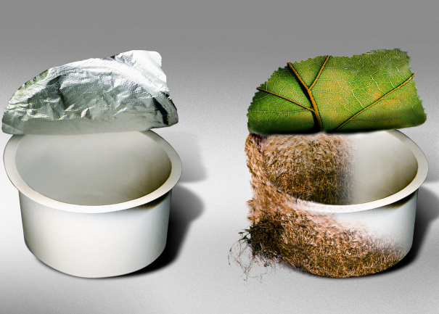
Industrially compostable products.
Proof of compostability.
Whether shopping bag, waste bag or disposable tableware - more and more products are made from biodegradable plastics.
Show consumers with our logos that you are acting in the interests of the environment and the compostability of your products were confirmed by a neutral third party.
Basis for certification.
Scope of testing.
DIN EN 13432 (mandatory)
ASTM D 6400
ISO 17088
DIN EN 14995
ISO 18606
AS 4736
Chemical Characterization
Biodegradability test
Earthworm toxicity test (AS 4736 only)
Disintegration under pilot-scale conditions
Plant toxicity test

Slide 13


Certification of Industrially compostable products.
Product requirements
≥ 90 % Biodegrabability (180 days)
≥ 90 % Disintegration (90 days)
Plant toxicity test
Chemical Characterization
Earthworm toxicity test with Eisenia fetida (AS 4736 only)
Certification
End products for direct sale to the customer
Notifications of registration
Materials (e.g. resin)
Intermediates (e.g. film)

Slide 14
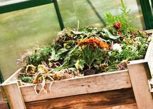
Products for home and garden composting.
With us one step ahead.
For products for home and garden composting no technical optimization is necessary. Composting can therefore take place in your own garden.
Document high quality consistently with our neutral mark and give consumers a clear decision-making and guidance.
Basis for certification.
Scope of testing.
AS 5810
Chemical Characterization
Biodegradability test
Earthworm toxicity test
Disintegration test
Plant toxicity test

Slide 15

Certification of products for home and garden composting.
Product requirements
≥ 90 % Biodegradability (360 days at 25°C)
≥ 90 % Disintegration (180 days at 25°C)
Plant toxicity test
Chemical Characterization
Earthworm toxicity test with Eisenia fetida

Slide 16
Standard development for home compostability
Australia: AS 5810
  Biodegradable Plastics – Biodegradable Plastics Suitable for home composting
USA: ASTM Committee D20.96 (ASTM WK35342):
  New Specification for Home Composting of Biodegradable Plastics
Europe: EU Packaging Directive 2015/720 dated 29 April 2015
  “The Commission should ask the European Committee for Standardization to develop a separate standard for home-compostable packaging.”
  Italy: UNI 11183
  Plastic Materials Biodegradable At Room Temperature - Requirements And Test Methods

Slide 17
Additives according DIN EN 13432.
Suitable for composting.
Customers ask frequently for conformity assessments of the harmlessness of their produced additives, e.g. printing inks, masterbatches, or other biodegradable ingredients
Show the mark for your additives being harmless for the composting process
Basis for certification.
Scope of testing
DIN EN 13432
DIN EN 14995
ISO 17088
ASTM D 6400
AS 5810
AS 4736
ISO 18606
Chemical Characterization
Ultimate biodegradability
Earthworm toxicity test
Plant toxicity test
Organic Parameters (AOX, PCDD/PCDF, PCB, if applicable)

Slide 18

Certification of Additives.
Product requirements
Non-Biodegradable Additives
Printing inks
Pigments
…
Biodegradable Additives
Masterbatches based on biodegradable materials
Colorbatches based on biodegradable materials
Biodegradable pigments
Biodegradable processing agents
Biodegradable adhesives
…

Slide 19




Compostability.
„Seedling“ | „DIN-Geprüft“ marks
Industrial compostable |  | Home compostable | Additives
EN 13432 |  | ---------------- | EN 13432
ASTM D 6400 |  | ---------------- | ASTM D 6400
ISO 17088 |  | ---------------- | ISO 17088
EN 14995 |  | ---------------- | EN 14995
---------------- | ISO 18606 | ---------------- | ISO 18606
---------------- | AS 4736 | ---------------- | AS 4736
---------------- | ---------------- | AS 5810 | AS 5810

Slide 20

New Service.
Products made of Materials biodegradable in Soil.
With us one step ahead.
For manufactured items, which have been developed for applications in or on soil (e. g. mulching films, plant pots, cords, plant clips)
Certification scheme has been developed together with experts from industry and science
Basis for certification.
Our scope of testings.
CEN/TR 15822 (DIN SPEC 1165)
Disintegration in Soil
Plant ecotoxicity test
Infrared Analysis
Chemical Characterisation
Biodegradability test in Soil

Slide 21
Certification of Products biodegradable in Soil.
Product requirements
> 90 % biodegradability (max. 2 years at max. 28°C) according ISO 17556 or ASTM D 5988
> 90 % Disintegration (12 months max. 28°C) in Soil
> 90 % Germination rate and biomass of two different plants
Chemical analysis according EN 13432, Annex A

Slide 22

Recycled content.
More than a manufacturer self-declaration.
Show that your determination of the recycled content was assessed by an independent third party.
Convince the market by using less finite ressources.
Basis for certification.
Scope of testing
DIN EN ISO 14021 – Environmental Labels and declaration
DIN EN 15343 – Recycled Plastics
Proof of Traceability
Proof of the determination of the recycled content
Confirmation that no mutagenic or toxic substances are used in the production process

Slide 23

Certification of Products made of Recycled Materials.
Requirements:
Based on DIN EN ISO 14021 and DIN EN 15343.
Can be used for self-declaration in combination with the Mobius Loop.
Relates to the system of determination of the recycled content.
Based on on-site audits to prove and fulfill the
  Requirements of traceability according to DIN EN 15343 and the
  Requirements on the determination of the recycled content according to DIN EN ISO 14021.

Slide 24
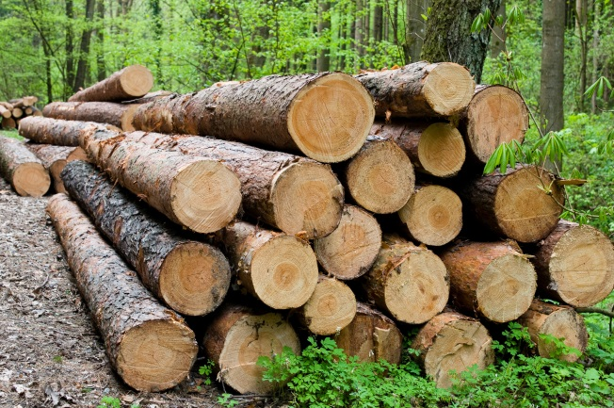

  FSC ® - Forest Management and Chain-of-Custody
For consumers it is no longer possible to inspect the sustainable cultivation of the product or derived timber products they buy – the answer is the certification of all owners of the wood, right from the forest itself along the entire production and supply chain through to the finished product
Certification according to the different FSC® Standards is possible related to
  Controlled wood
  Reclaimed material
  Multiple site
Certification is offered worldwide

Slide 25


  PEFC - Forest Management and Chain-of-Custody
To identify the products made from wood/timber from sustainable forestry independant certification marks are required.
Certification according to the applicable PEFC ST 2002:2013 for manufacturer of wood and timber products.
Certification of sustainable forest management, currently according to the German, austrian and Luxemburgian Standard. Other countries on request.

Slide 26



  Sustainable Biomass according to RED
REDcert and ISCC
RED defines sustainability requirements for Biomass to be used as biofuel or for the generation of electricity.
Different systems are available on the market depending on individual specifications.
DIN CERTCO is recognised to certify according to the systems requirements of
  ISCC
  REDcert

Slide 27
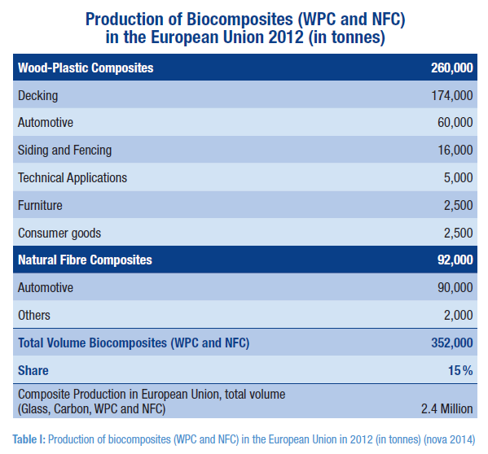
Market data, here: WPC and NFC
Courtesy of nova-Institut

Slide 28
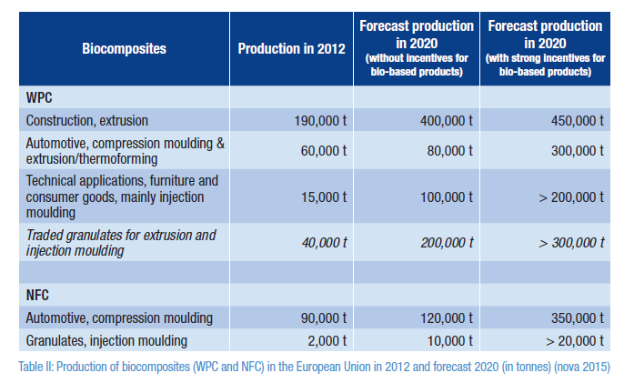
Market data, here: WPC and NFC
Courtesy of nova-Institut

Slide 29
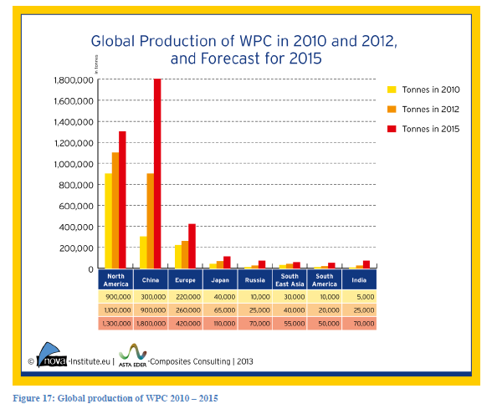
Market data, here: WPC and NFC
Courtesy of nova-Institut

Slide 30
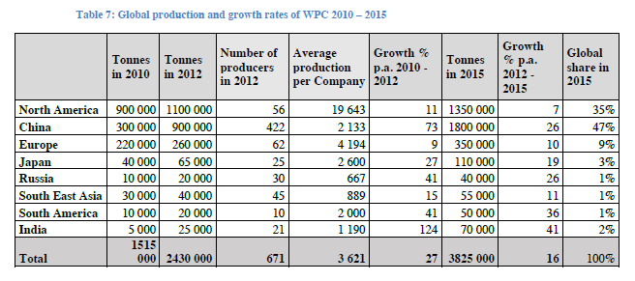
Market data, here: WPC and NFC
Courtesy of nova-Institut

Slide 31
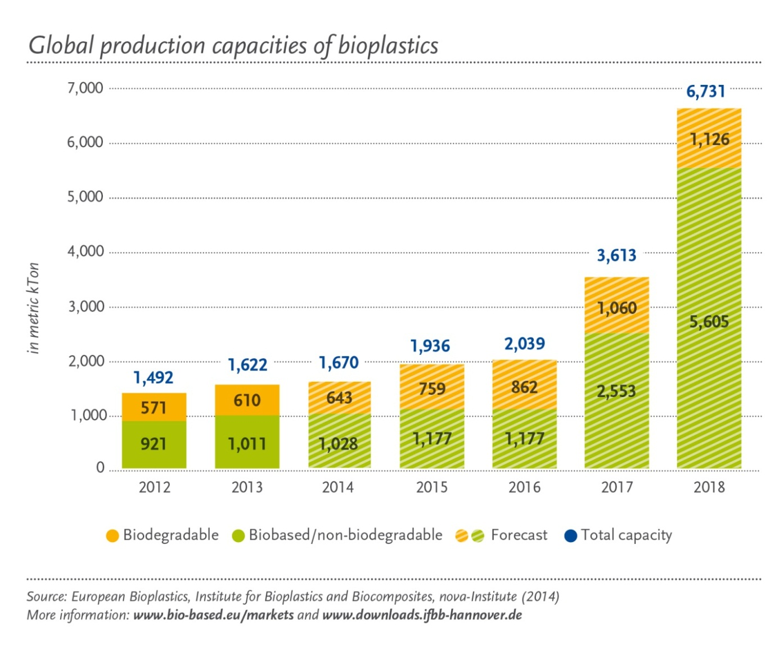
Global Production Capacities of Bioplastics.

Slide 32
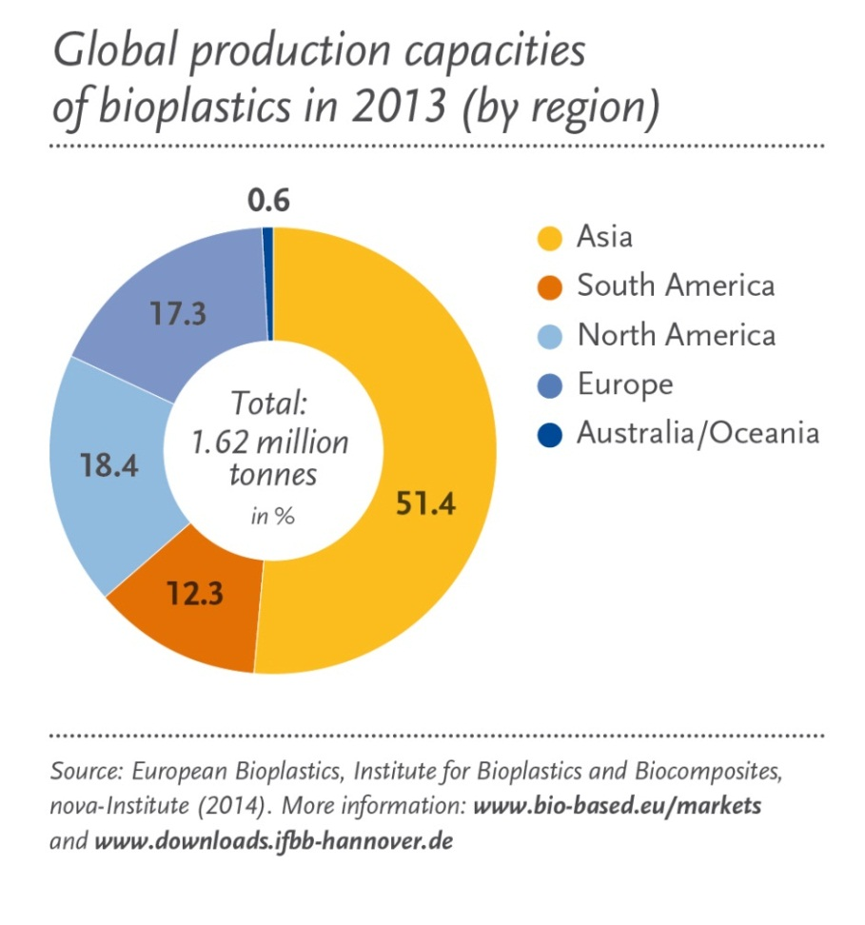
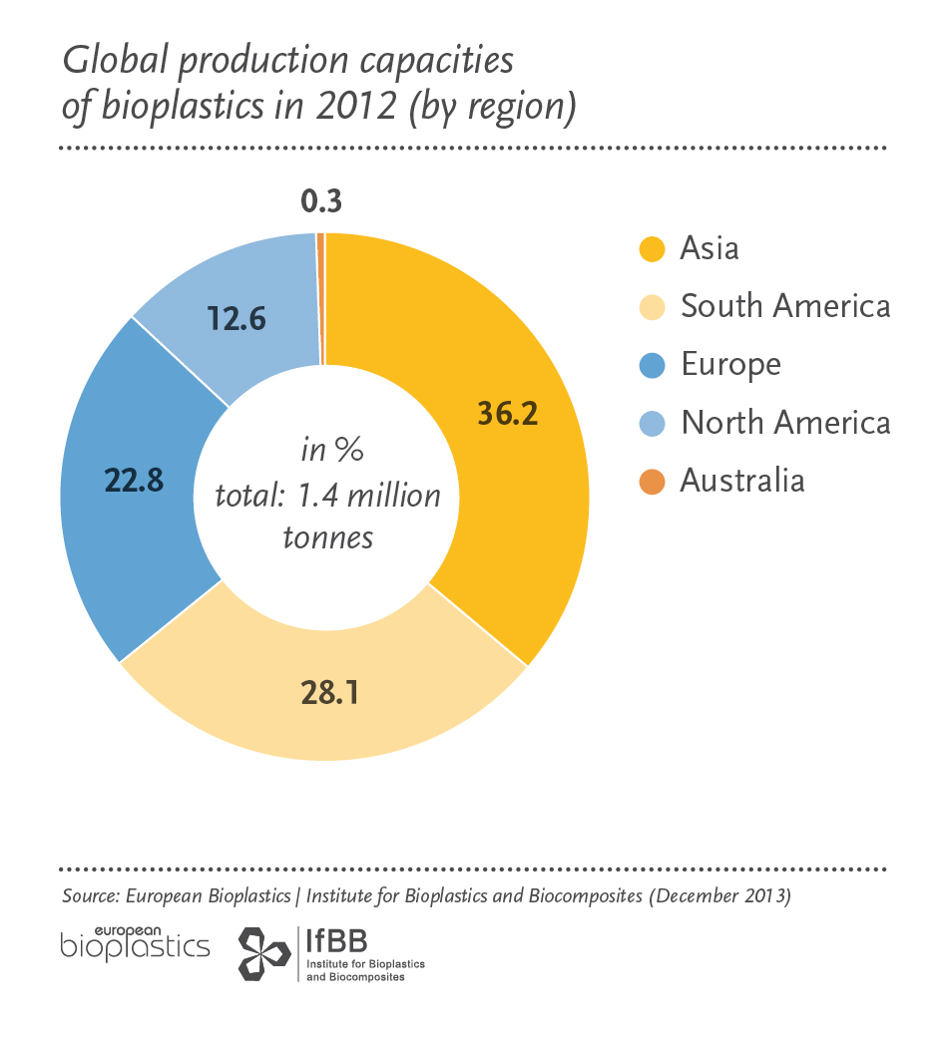
Global production capacities 2012 and 2013 by region.

Slide 33

..more reasons to choose DIN CERTCO.
Lean organization with short lead times and quick responses
High transparency regarding assessment rules, fees and existing certificates
Great activity against misuses of the certification marks

Slide 34
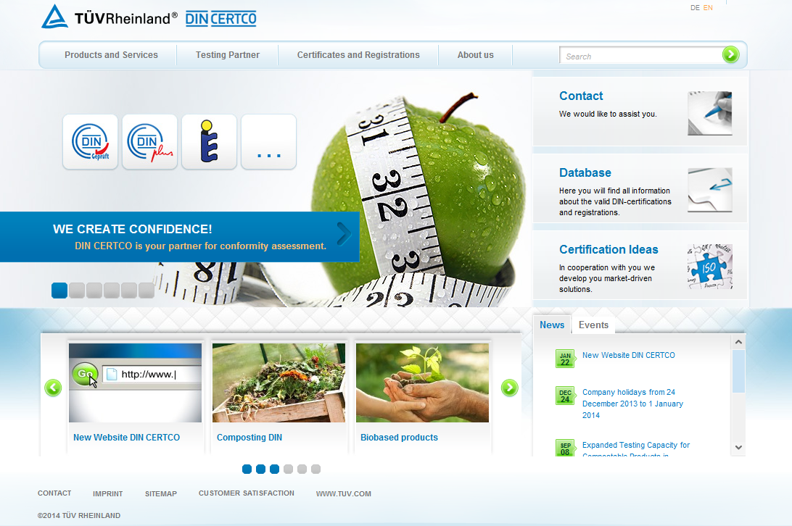
More information on www.dincertco.de
Application form
Certification
Scheme
Schedule of fees
Flyer
Certification holder
FAQ

Slide 35

Thank you for your attention!

Slide 36

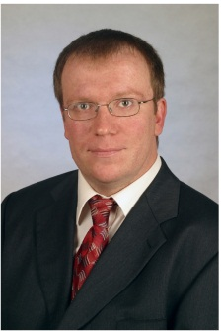
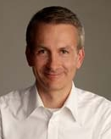
Your contact persons at DIN CERTCO.
Accentuation in the brand competition and addressing of new markets (unique feature)
Decision-making support for Operators and Customers
Highly recognized and accepted
Dr. rer. nat. Oliver Ehlert
- Product Manager -
Phone: +49 30 7562-1138
Telefax: +49 30 7562-1141
oliver.ehlert@dincertco.de
Mitarbeiter
Dipl.-Ing. Lukas Willhauck
- Sales -
Phone: +49 30 7562-1134
Telefax: +49 30 7562-1141
lukas.willhauck@dincertco.de

