Slide 1

Satellite observations of aerosol properties: from climate to air quality
Climate Change 2016, Valencia, October 24-26, 2016
© 2016 California Institute of Technology. Government sponsorship acknowledged.

Slide 2
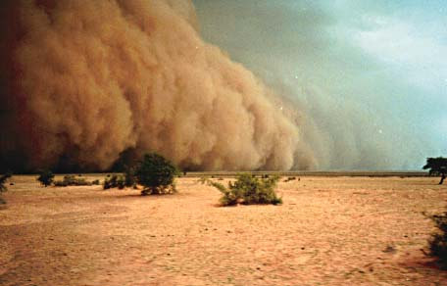
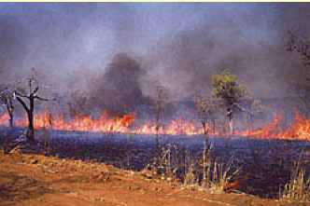
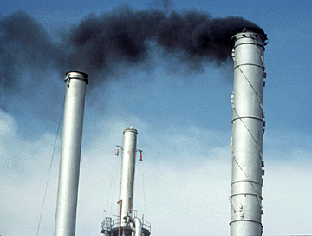
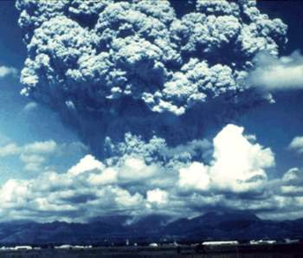
What are atmospheric aerosols?
Dust
Smoke
Pollution
Volcanic aerosol

Slide 3
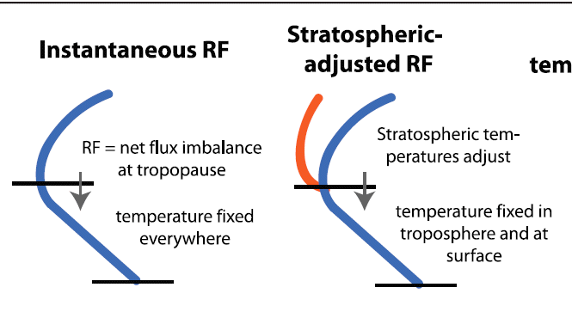

Aerosol DARF
Climate GCM (official IPCC definition):
Radiative forcing is a change in net radiative flux at the tropopause after the stratosphere comes back into equilibrium.
Differences between GHG forcing and aerosol forcing:
• The two forcings have very different spatial and temporal distributions:
  GHG operates day and night, whether clear or cloudy, and is at a maximum in the hottest, driest places on Earth.
  Aerosol forcing occurs mainly by day (except dust), and is concentrated near aerosol sources and downwind from the sources.
• Two forcing are determined differently:
  GHG forcing is well-posed problem in radiative transfer (because IR absorption is well quantified for all GHG gases).
  Aerosol forcing remains an unresolved problem because of complex spatial and temporal distribution of aerosols, and their complex chemical composition

Slide 4
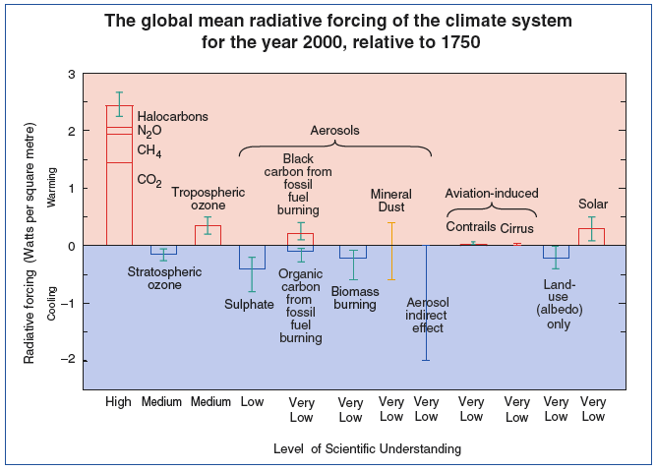
DARF – historical level of understanding
IPCC AR3, 2001 (Pre-EOS)
Aerosols contribute the largest uncertainty to the total Radiative Forcing (RF) estimate

Slide 5
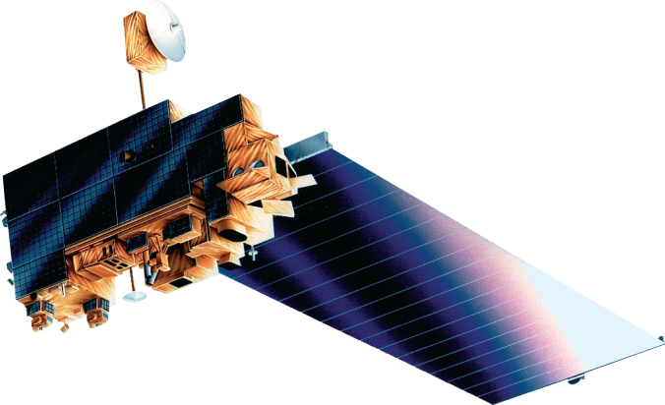
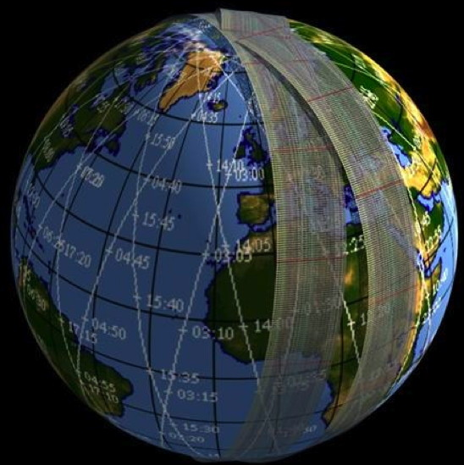
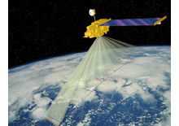
NASA climate aerosol record (satellite)
Terra
Launched in December 1999
Carries five instruments
Aerosol instruments:
  Moderate-Resolution Imaging Spectroradiometer (MODIS)
  Multi-angle Imaging SpectroRadiometer (MISR)
MODIS provides a comprehensive series of global observations every two days at spatial resolutions as fine as 250 meters. It provides data to monitor clouds and aerosols.
MISR measures the amount of sunlight scattered in different directions. Earth’s surface is successively imaged by nine cameras over a period of seven minutes. Because of its different viewing angles, MISR can differentiate between various types of clouds, particles, and surfaces.
MODIS
MISR
Notes:
Might mention that MISR has a narrower swath (400 km) compared to MODIS (2330 km), and therefore not near-daily coverage. Also, mention that MODIS is on Aqua as well.

Slide 6
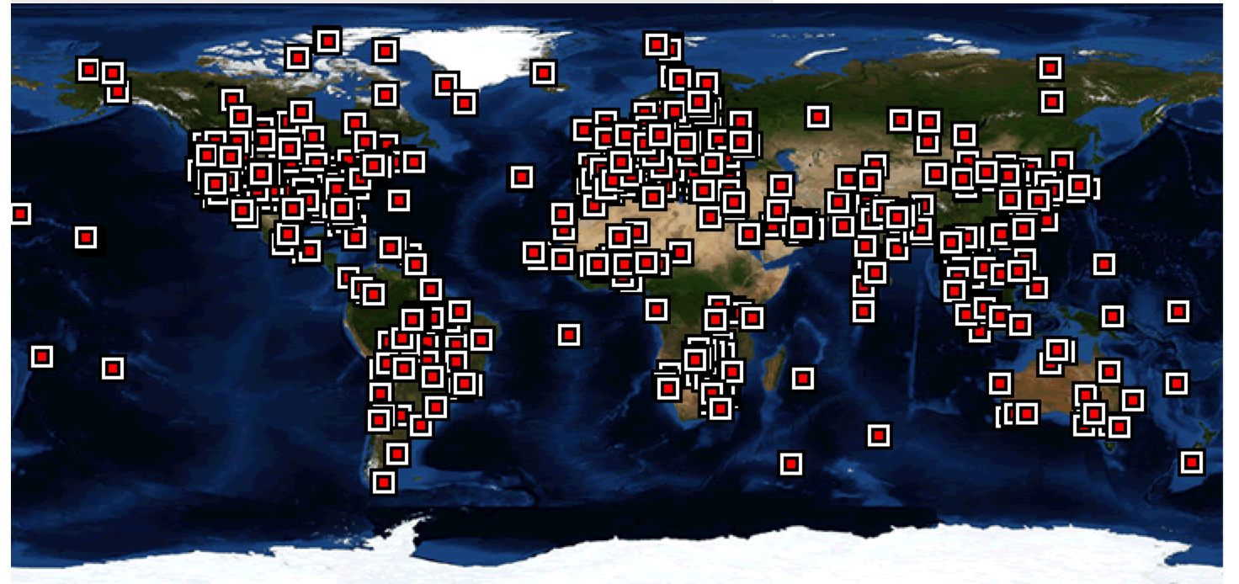
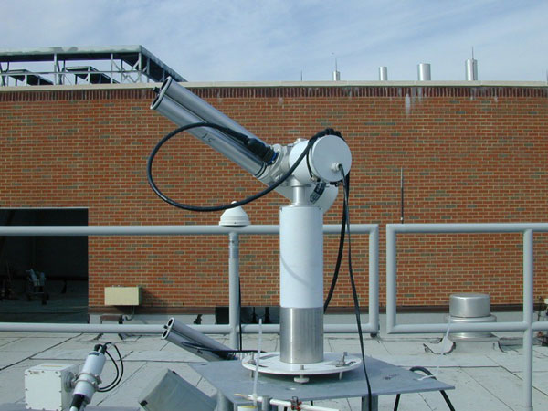
NASA aerosol ground-based monitoring
Globally: ~70-75% of MISR AOD retrievals fall within 0.05 or 20% AERONET AOD
Globally: MODIS C6 AOD fall within (-0.02–10% ocean),(+0.04+10% land)
Notes:
This slide is a little confusing. What is the point here?

Slide 7
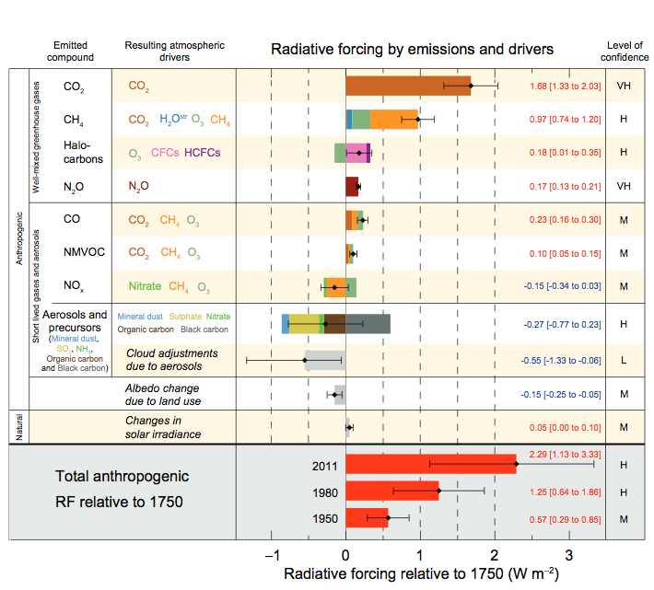
Current assessment of climate forcing
–0.35 (–0.85 to +0.15) W/m2.
IPCC AR5, 2013
Global average when compared to other uncertainties in the models
“There is high confidence that aerosols have offset a substantial portion of global mean forcing from well-mixed greenhouse gases. They continue to contribute the largest uncertainty to the total RF estimate.”
Notes:
Point out that the column is now “Level of confidence” NOT “Level of Scientific Understanding,” which it was in the previous assessments.

Slide 8
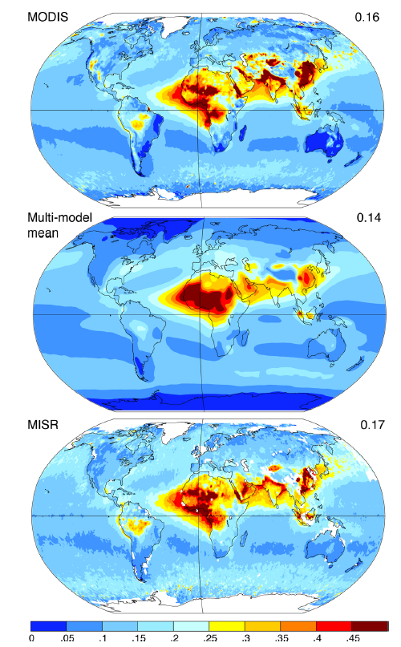
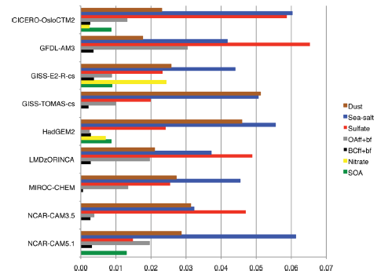
What about aerosol types?
Chemistry climate models (CCMs) reproduce present day total aerosol optical depth (AOD) relatively well
However, contributions from individual aerosol components (speciated AOD) are quite different
Shindell et al. [2013]

Slide 9
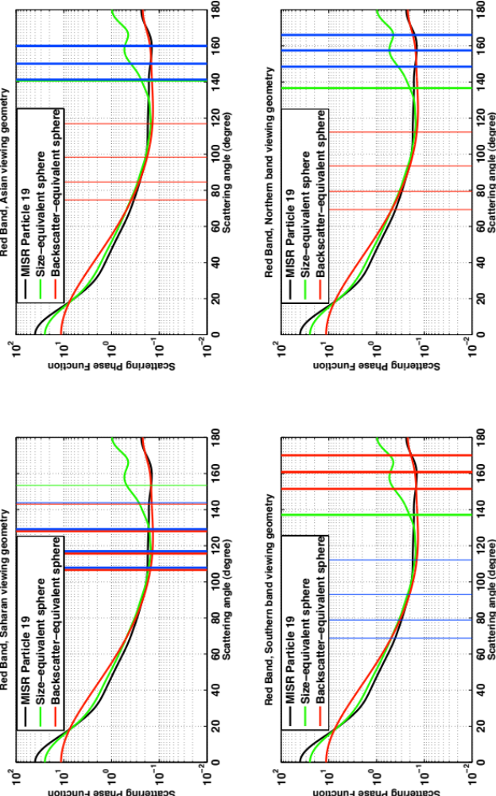
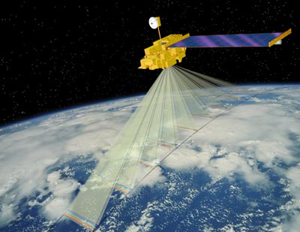
MISR aerosol type detection
Launched in December 1999 on NASA’s Terra satellite Operational from late February 2000 to present
Nine view angles at Earth surface:
70.5º forward to 70.5º backward
Nine 14-bit pushbroom cameras
275 m - 1.1 km sampling
Four spectral bands at each angle:
446, 558, 672, 866 nm
400-km swath: 9-day coverage
at equator, 2-day at poles
7 minutes to observe each scene
at all nine angles
MISR retrieves particle size and shape classes through their effect on the scattering of light
Kahn et al., 2001; Kalashnikova et al., 2005, 2013

Slide 10
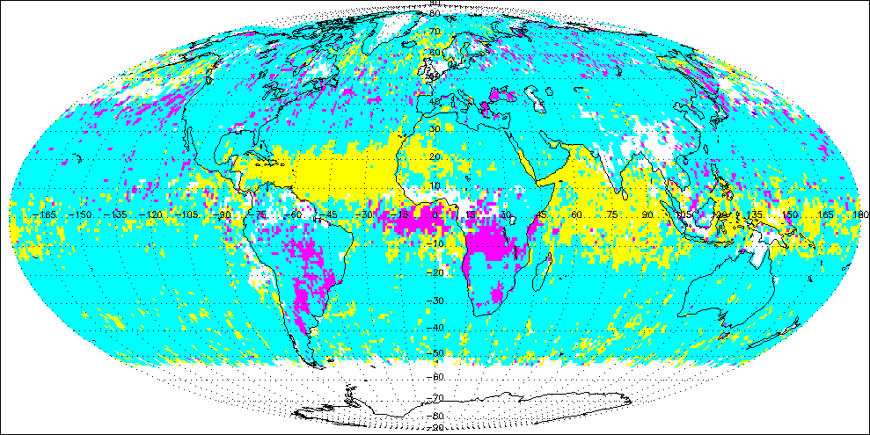
MISR separates aerosol types globally
Kahn et al., 2010
Key
Spherical Non-Absorbing
Spherical Absorbing
Non-Spherical

Slide 11
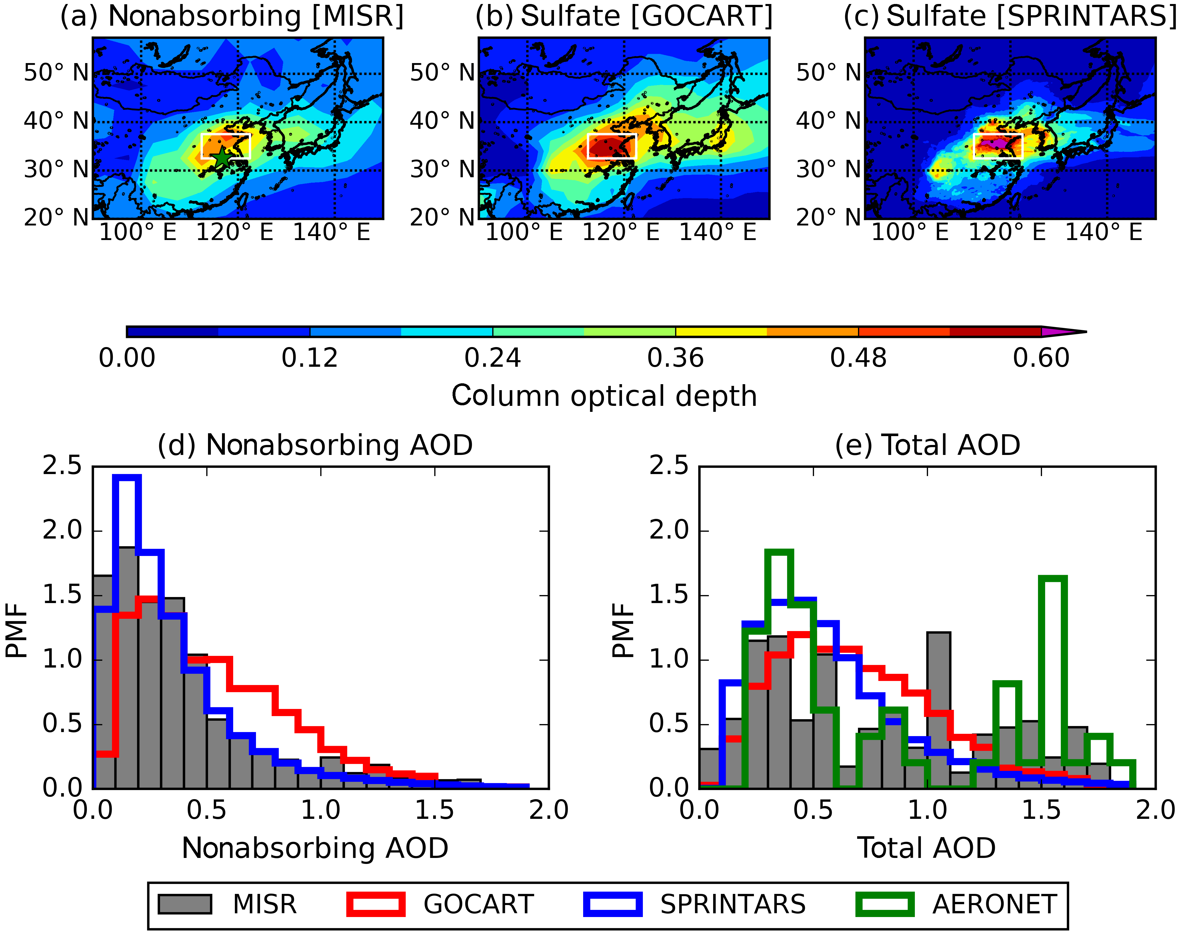
Climatology of AOD by components from MISR
Lee, H., Kalashnikova, O., Suzuki, K., Braverman, A., Garay, M. J., and Kahn, R. A.: Climatology of the aerosol optical depth by components from the MISR and chemistry transport models, Atmos. Chem. Phys. 2016.

Slide 12
Aerosols: outstanding climate questions
How are natural and anthropogenic aerosols and their impact on the radiation budget at the top, within, and at the bottom of the atmosphere changing in response to a warming climate, and how to these changes feed back to the climate system?
What regions are most susceptible to aerosol phenomena, how are different aerosol types affecting regional brightening or dimming and what impacts are regional pollution controls and emissions changes having?
What are the connections between forcing in one region and impact in another and what are the underlying transport mechanisms of different aerosol types?
What are the meteorological processes that control the distribution, transport, and deposition of aerosols?

Slide 13
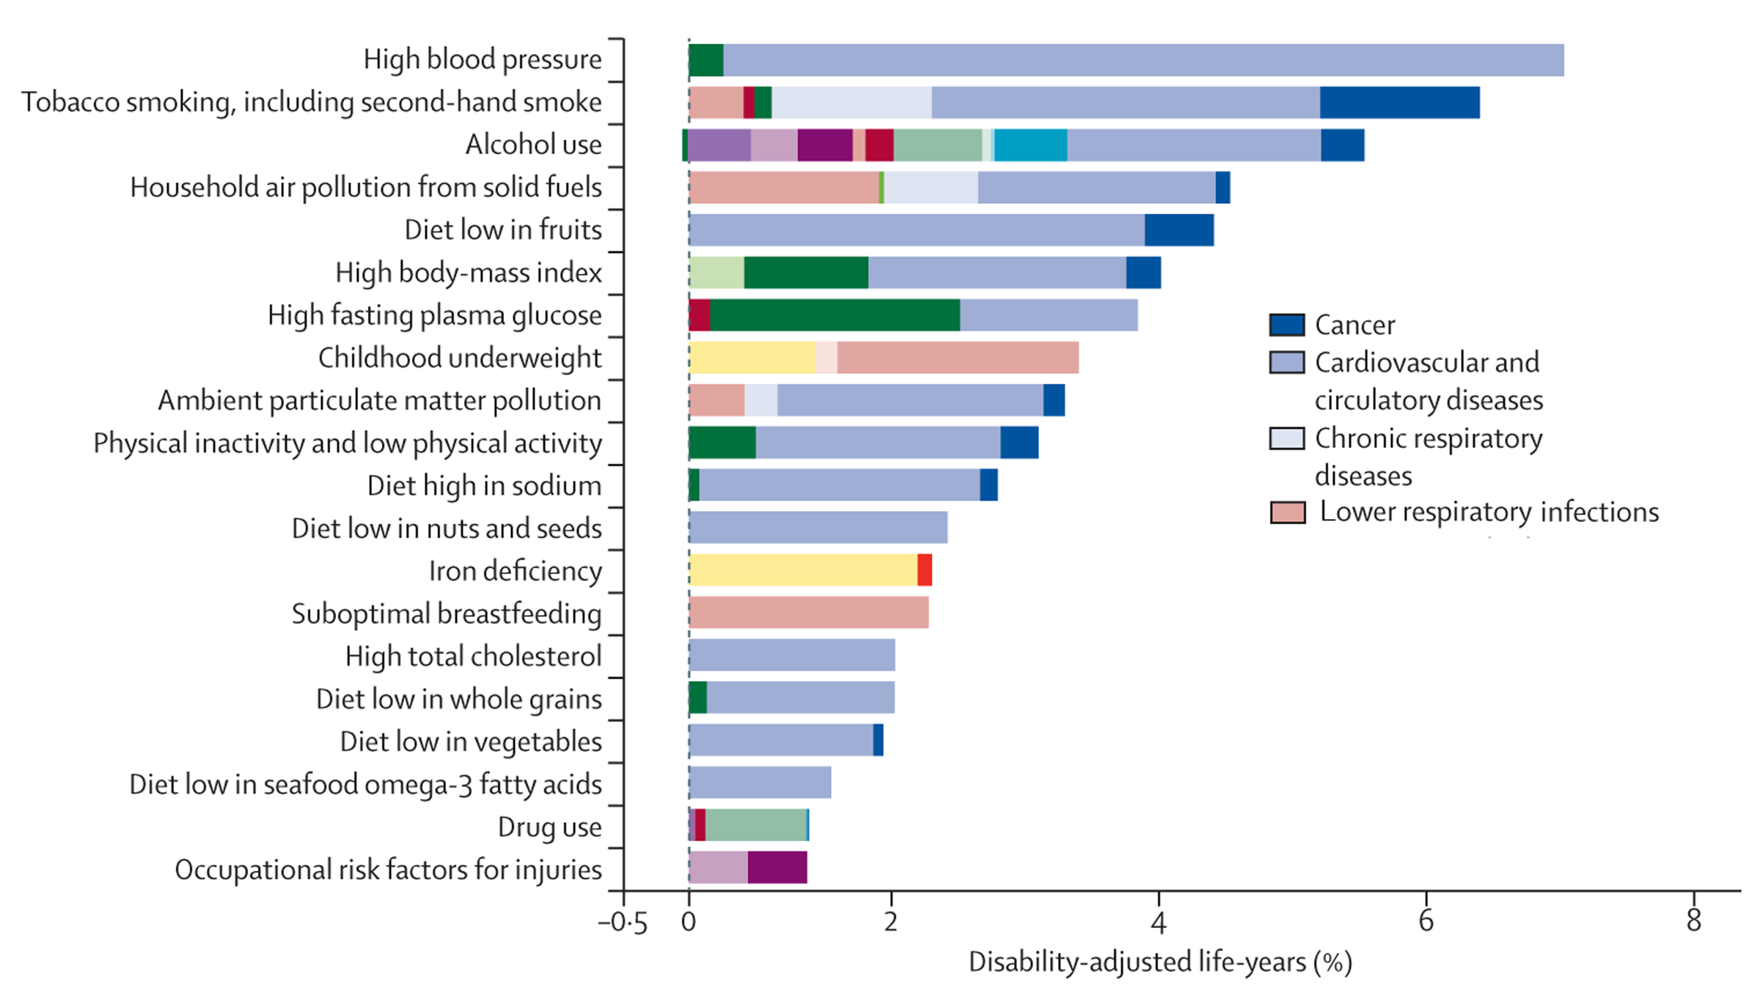
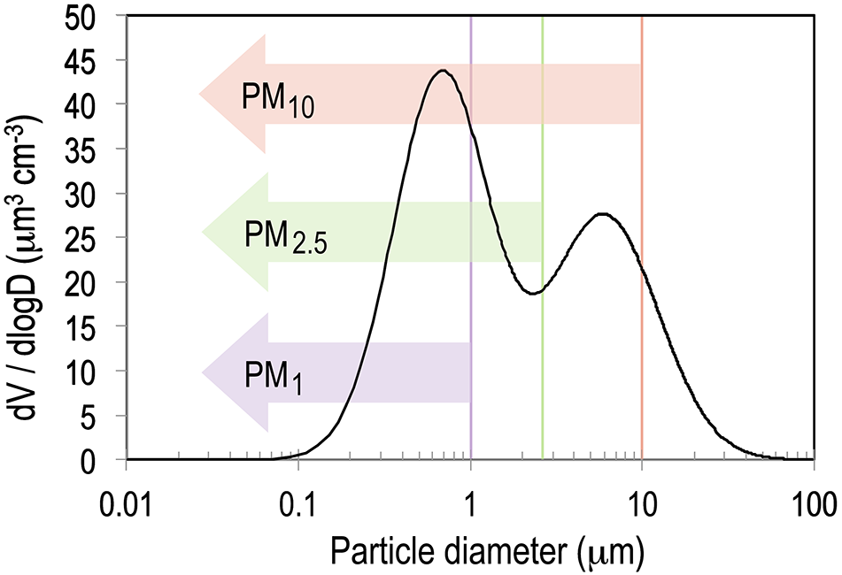
Global Burden of Disease Study 2010
13

Slide 14
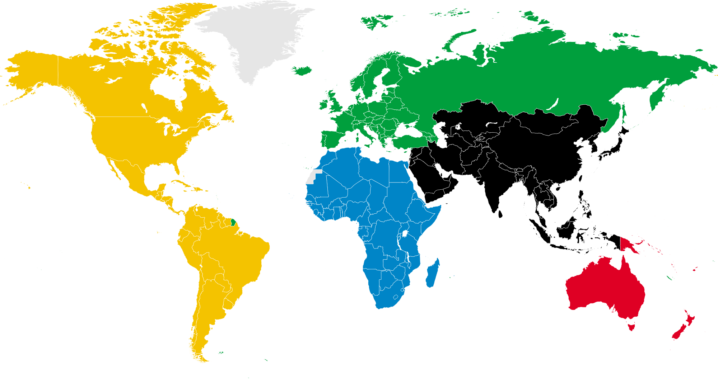
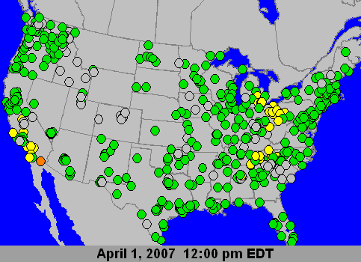
Surface PM_{2.5} mass monitors are sparse
0-3
20-30
1500
1-5
3-8
1-5
5-10
4-9
Christopher (2013)
Satellite remote sensing of aerosol amount (aerosol optical depth) may provide a useful proxy for locations without monitors both in the US and globally
14

Slide 15
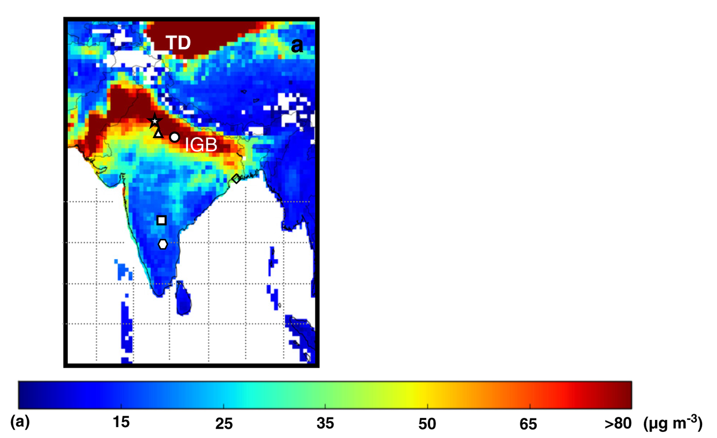
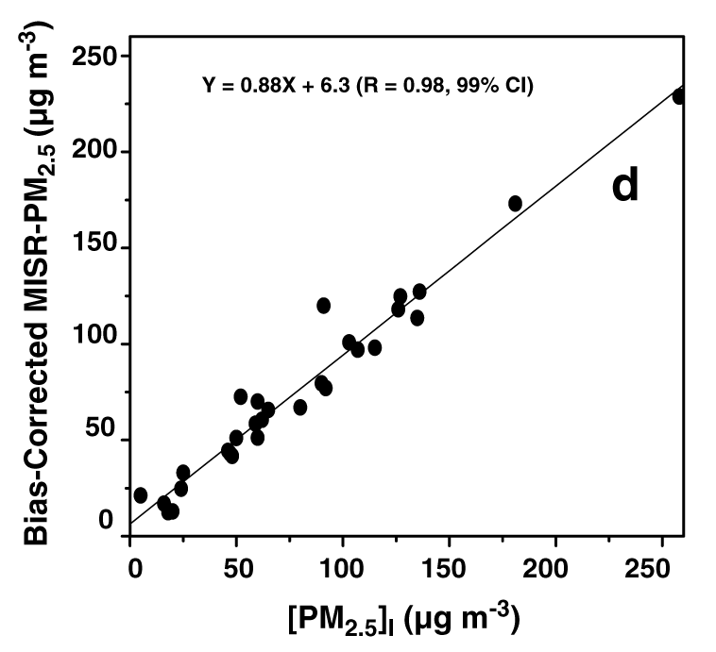
Linear conversion of AOD to PM_{2.5}
PM_{2.5} = A x η x AOD + B
is calculated from the GOES-Chem 3-D Chemical Transport Model and is a function of aerosol size, type, diurnal variation, vertical distribution, and relative humidity
A, B = correction factors are derived from surface PM_{2.5} samples
Dey et al. (2012); Liu et al., 2004, 2007; van Donkelaar et al., 2006, 2010
15

Slide 16
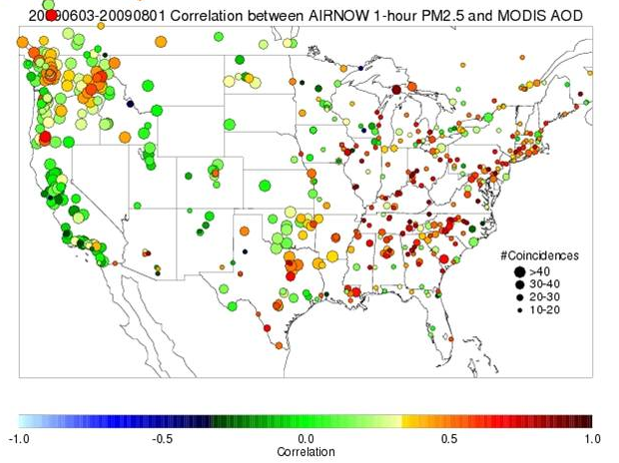

US West Coast challenge
http://www.star.nesdis.noaa.gov/smcd/spb/aq/
The US West Coast is a particular challenge for establishing the connection between AOD and PM_{2.5}
Human exposure and health applications require neighborhood resolution (~ 1 km) to resolve spatial gradients of pollution

Slide 17
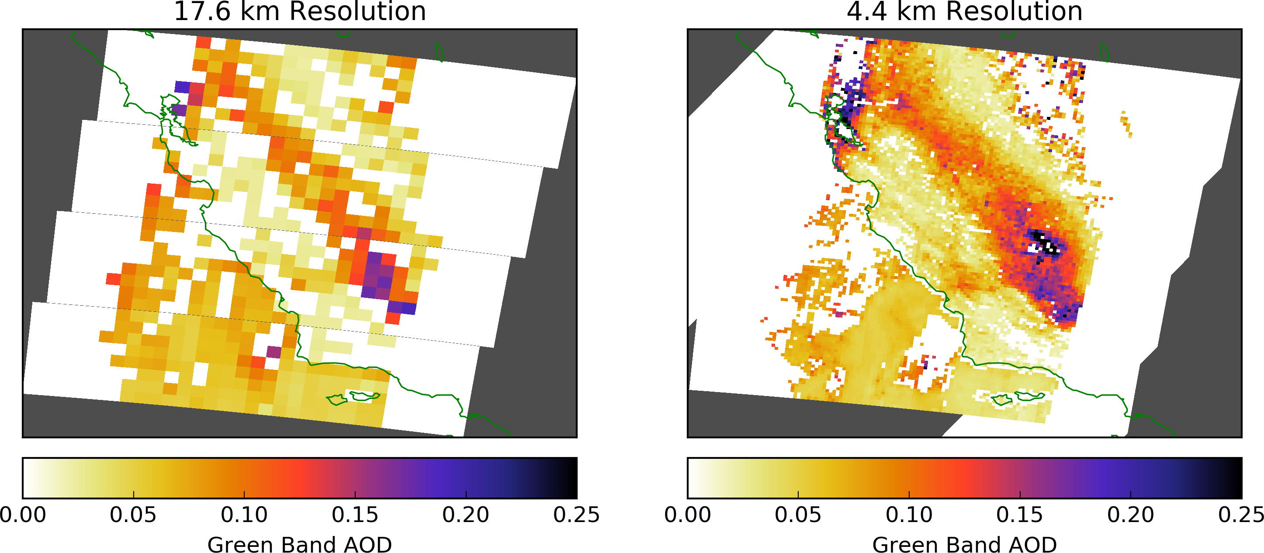
From climate to air quality (spatial resolution)
2016-02-05
Notes:
Something is missing in this slide.

Slide 18
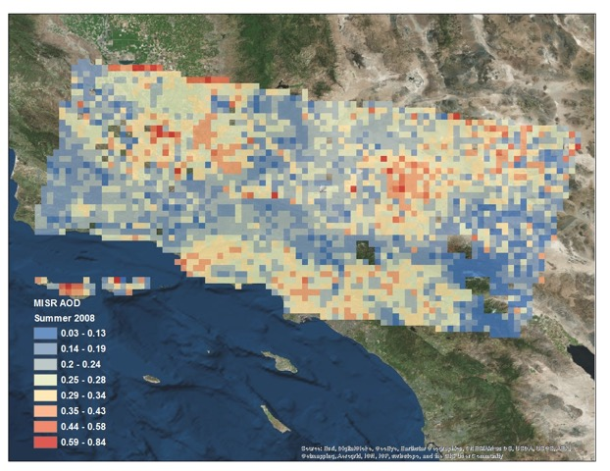
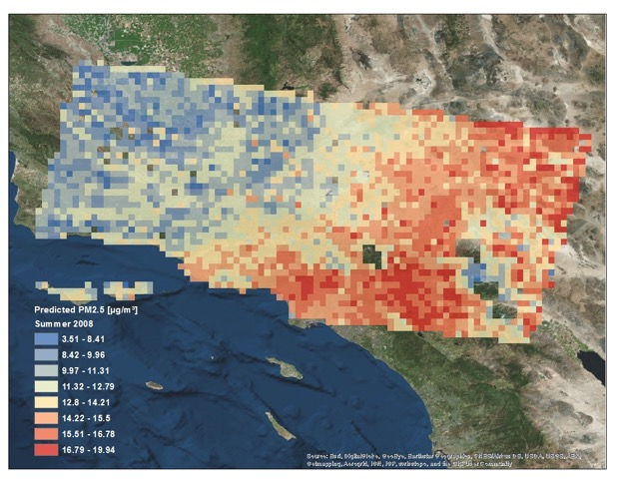
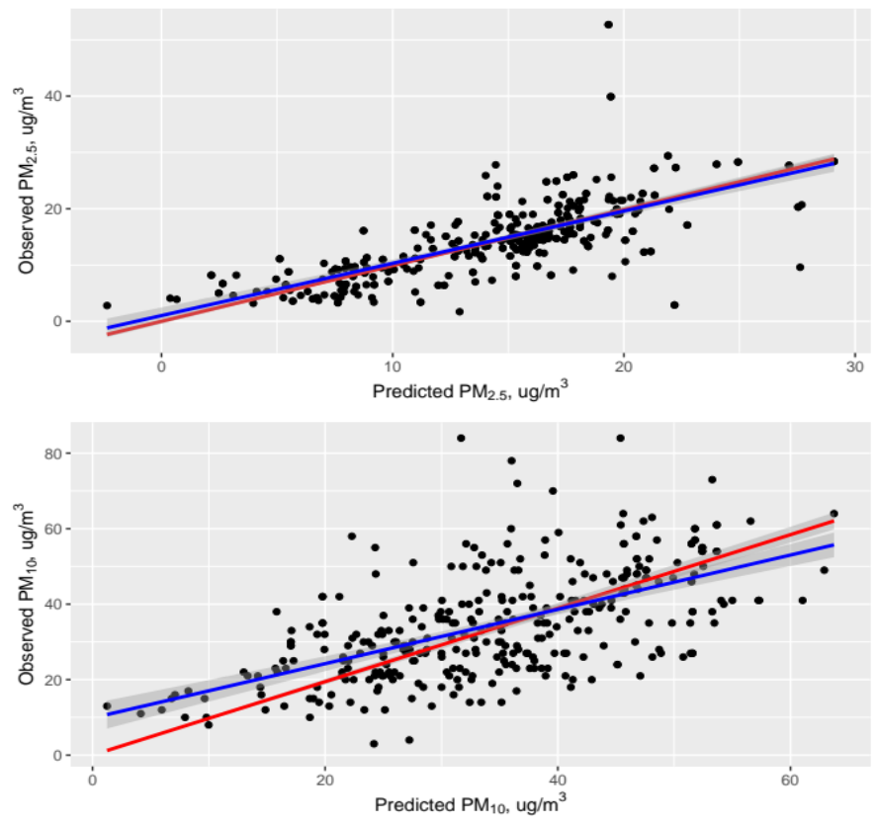
MISR-derived 4km resolution speciated PM in the greater Los Angeles area
MISR Mean AOD, Summer 2008
MISR-derived PM_{2.5}, Summer 2008
Franklin et al., RSE, in revision
MISR AOD 4.4 km product combined with surface air pollution and meteorological measurements over Southern California were used to build spatio-temporal statistical models to reliably ‘convert’ AOD to PM concentrations of various sizes and types in LA area.
Franklin et al., RSE, in review.

Slide 19
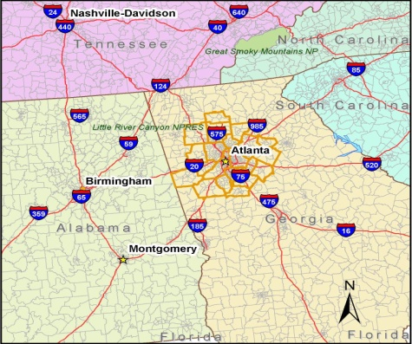
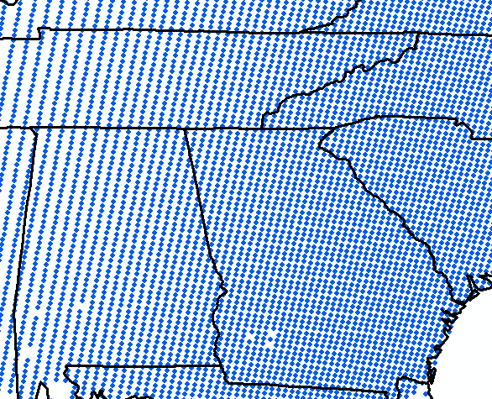
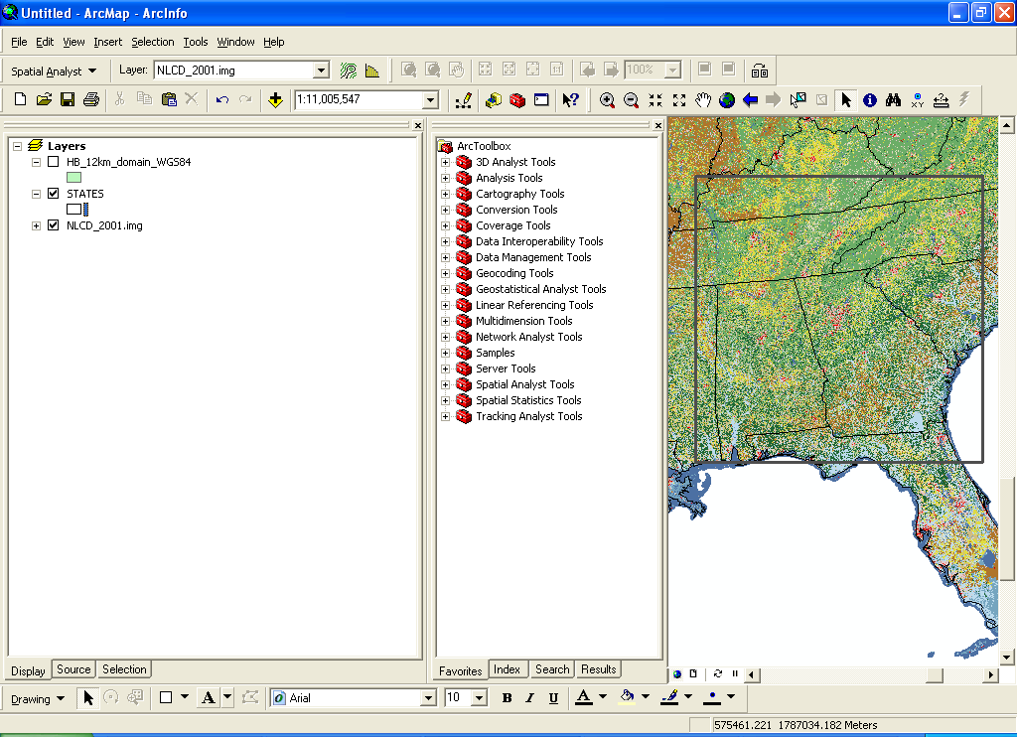
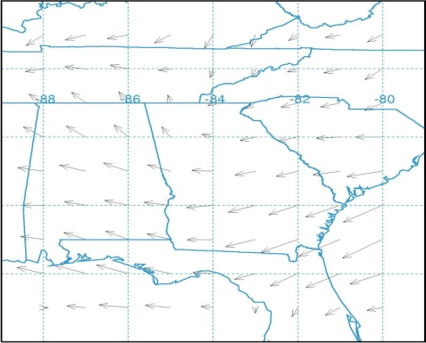
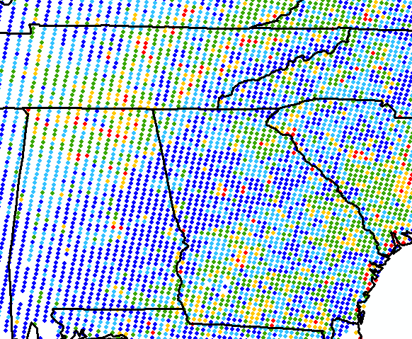
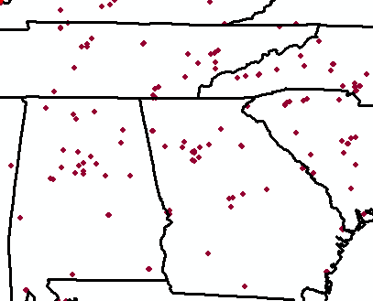
An integrated approach, combining satellites, air quality models, and surface monitors is essential
Chemical transport model provides aerosol vertical profiles to get the boundary layer fraction of total AOD.
Land use
Emissions indicators
Satellite aerosol
Satellite data, meteorology, land use, emissions indicators (e.g., population, traffic information), and EPA measurements are used as inputs to develop a statistical model to predict PM_{2.5} concentration.
Meteorology
Spatial statistical model
EPA air monitors
Surface stations are necessary for establishing accurate mappings of satellite data to PM.
Predicted PM_{2.5}
Liu (2013)

Slide 20

From climate to air quality (MAIA)
Earth Venture NASA mission:
to be launched 2020-2022
Spectropolarimetric Measurements from the Multi-Angle Imager for Aerosols:
From Climate to Air Quality

Slide 21
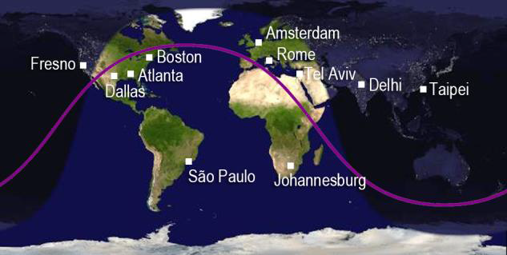


MAIA Science Objective
PI: David Diner
MAIA’s primary science objective is to associate specific types of airborne particulate matter (PM) with adverse health outcomes
Observations of major cities on five continents will provide large sample sizes to conduct statistically robust epidemiological studies
Secondary targets will also be observed to enable other types of aerosol and cloud investigations

Slide 22
MAIA Science Implementation
Fresno, CA
2012-01-06
Model-constrained retrievals
Notes:
Something is missing in this slide.

Slide 23

Questions?
Olga.Kalashnikova@jpl.nasa.gov

