Slide 1

Recycling Leather Wastes in carton Industry
Prof. : Ola A. Mohamed
Tanning materials and leather technology
National research center

Slide 2
-Leather industry is one of the oldest industries all over the world. Leather is a natural material that, has been used by man for thousands of years.
. - Leather industry is one of the polluting industries because ; generation of huge amount of liquid and solid wastes, also emits obnoxious smell.
- So research must be direct towards investigate the production of useful materials from different kinds of leather wastes.

Slide 3
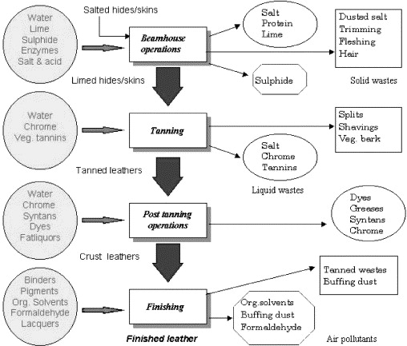
Process Flow of Leather Production
Notes:
Leather is made from a natural hide or skin and becomes a dry, stable materials after tanning, retanning, dyeing, fatliquoring and finishing

Slide 4
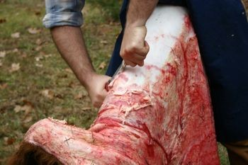

Slide 5
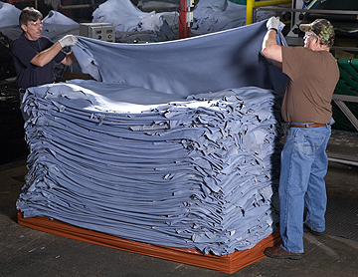

Slide 6
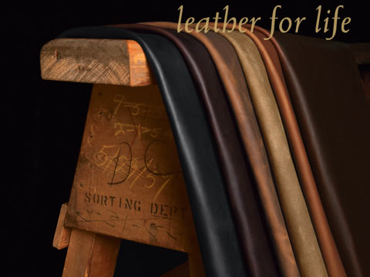

Slide 7
Solid wastes
Solid wastes generated by the leather industry of may be classified as follows:
Wastes from untanned hides/skins (trimmings, fleshing wastes).
2. Wastes from tanned leather (shaving wastes, buffing dust).
3. Wastes from dyed and finished leather (trimmings from leather).

Slide 8
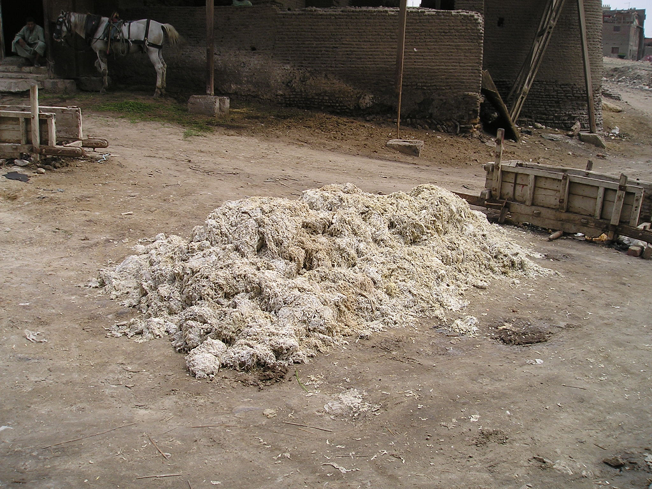

Slide 9
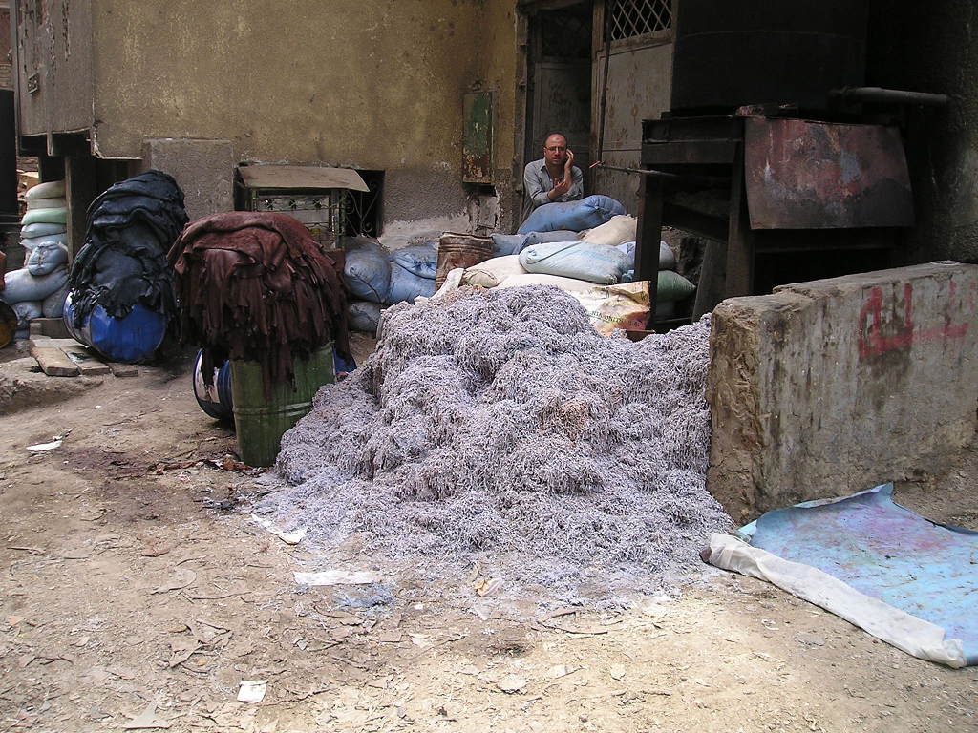

Slide 10
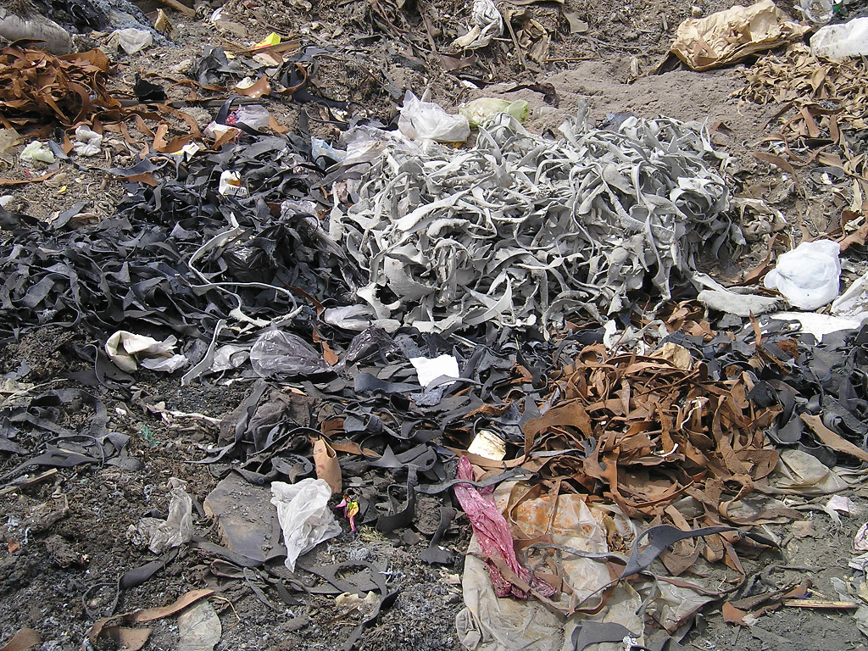

Slide 11
Table 1: waste ratios regarding the leather manufacturing process
ratio for sheep and goat | ratio for light bovine leather | ratio for heavy bovine
(t / million m² finished | (t / million m² finished leather) | (t / million finished leather)
180 | 513 | 171 | Unusable WB splits, WB shavings and WB trimmings
151.3 | 83.2 | 27.7 | Dry leather wastes (trimmings,

Slide 12
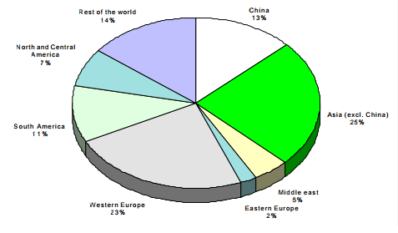
Figure 1 : wastes generated by the leather manufacturing - % of world areas

Slide 13
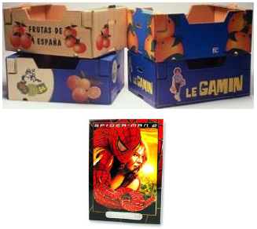
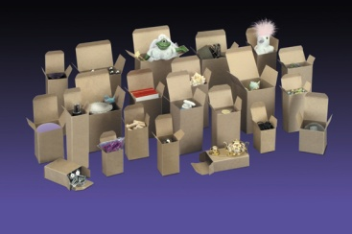
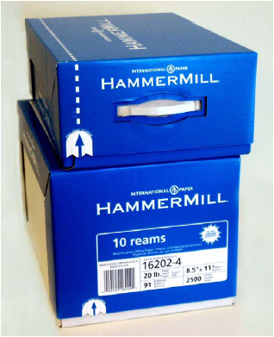
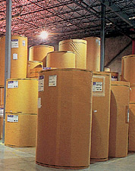
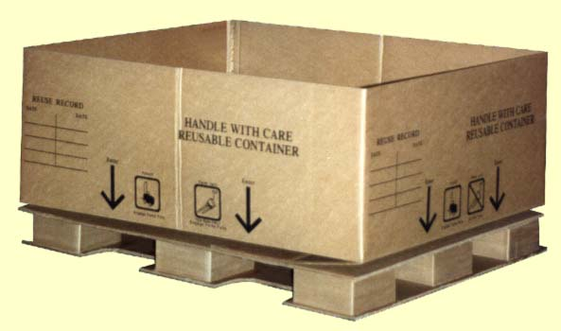
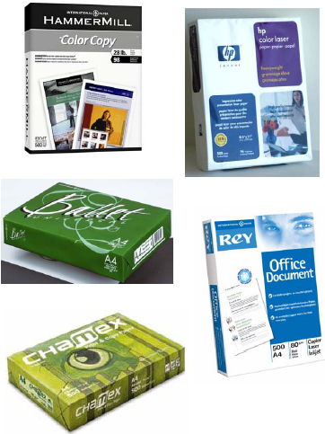
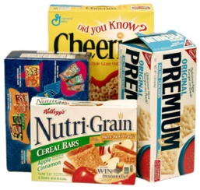
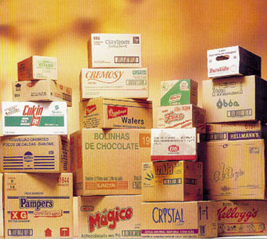
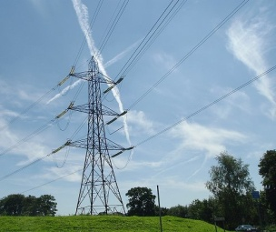
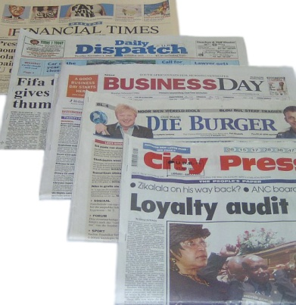
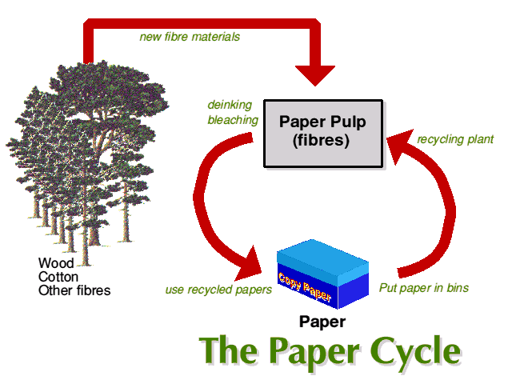
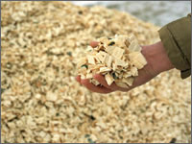

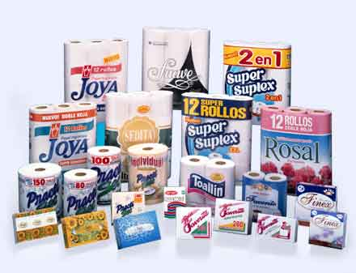
Boxboard
Containerboard
Printing and Writing Paper
The Pulp & Paper Industry
Market Wood Pulp
Newsprint
Tissue Products
Notes:
The pulp and paper industry is divided into the following sections:
Newspaper and newsprint: They include magazines and inserts.
Tissue products: Toilet tissue, facial tissue, wrapping papers and inserts.
Printing and Writing paper. This is comprised of coated and uncoated papers. There are many grades and mixtures from copy paper, kraft paper to fine heavy bond mixtures with silk fibers.
Packaging material are further broken down into Boxboard, which is single layer foldable boxing material.
The other component of packaging material is containerboard: This is any material that has multiple layers geometrically tied together.
The final section is market pulp wood. This is the raw material is used for the following:
Supplying smaller firms in the industry.
Fuel for power generation
Mixed with recycled material to make new products.
Chemicals are leached out of the material – pine chemicals

Slide 14
  - The word paper comes from the ancient Egyptian writing material called papyrus, which was woven from papyrus plants. Papyrus was produced as early as 3000 BC in Egypt, and in ancient Greece and Rome.
  - Paper was invented in Ancient China by Ts'ai Lun in AD 105 .
  - Global pulp and paper industry dominated by United States, Canada, Sweden, Finland and East Asian countries (such as Japan)
  Australasia and Latin America also have significant pulp and paper industries
  Russia and China expected to be key in the industry's growth over the next few years for both demand and supply
Notes:
Some historians speculate that paper was the key element in global cultural advancement. According to this theory, Chinese culture was less developed than the West in ancient times because bamboo, while abundant, was a clumsier writing material than papyrus

Slide 15
Paper production process
The production process can be divided into 7 sub-processes:
-Raw materials processes.
-Wood-yard.
-Fibre line.
-Chemical recovery.
-Bleaching.
-Paper production.
- products and recycling.

Slide 16
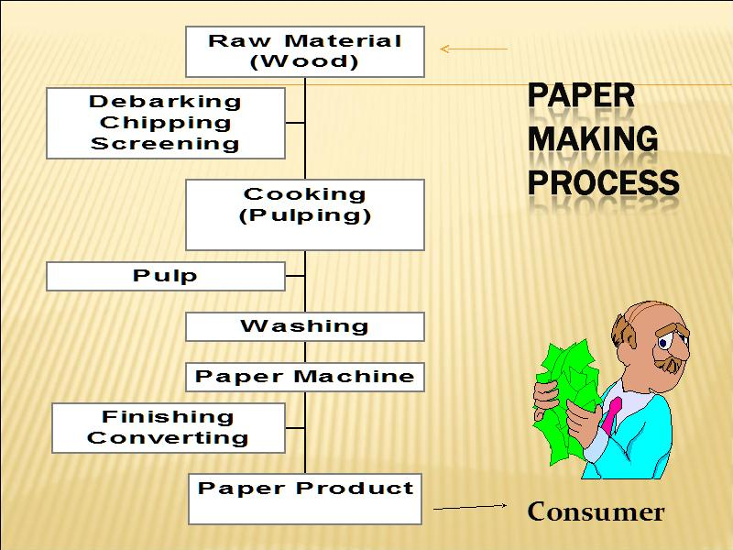

Slide 17
Dangers of Fire (United States statistic)
-Someone died in a fire every 3 hrs and someone was injured every 37 minutes.
- 401,000 home fires.  
-Residential fires caused more than $6.1billion in property damage.

Slide 18
What is a Flame Retardant?
 - A chemical added to combustible materials to render them more resistant to ignition.
- Minimizes the risk of fire starting.
 - increases the safety of lives and property.

Slide 19
The main families of flame retardants are based on compounds containing:
-Halogens (Bromine and Chlorine) .
-Phosphorus
-Nitrogen
- Minerals (based on aluminium and magnesium)
- Others (like Borax, Sb2O3 , nanocomposites)

Slide 20
-In this study, leather wastes were grinded to
nanosize, treated with flame retardants, and then
added as filler during the paper sheets formation.
-Using of these wastes help in reduce their
hazards and give an economical benefit to paper
making and an effective solution for paper firing.

Slide 21
Table 2; Physical and mechanical properties of blank paper sheet as well as the
prepared paper sheet containing different concentrations of unmodified
leather, 6, 9, and 12 %.
Type of Tests | Blank | Paper sheet with 6%UML | Paper sheet with 9% UML | Paper sheet with 12% UML
Basis weight( g/m²) | 195.55± 4.56 | 201± 3.97 | 201.16± 5.4 | 200.7± 5.09
Tear (mN.m²/g) | 0.24± 0.59 | 0.64± 0.055 | 0.70± 0.12 | 0.75± 0.17
Burst (kPa.m²/g) | 3.40± 0.22 | 3.14± 0.44 | 3.48± 1.49 | 2.98± 0.26
Thickness (µm) | 240± 7.83 | 238.8± 5.87 | 281± 28.88 | 261.8± 8.88
Air permeability (ml/S.cm².Pa) | 0.12± 0.015c | 0.19± 0.027 | 0.24± 0.029 | 0.25± 0.014
Opacity (%) | 99.41± 0.16 | 99.31± 1.03 | 99.62± 0.199 | 99.2± 0.88
Brightness | 43.61± 0.01 | 44.87± 0.65 | 45.24± 1.1 | 44.35± 2.40
Breaking length (km) | 4.35± 3.6 | 5.37± 8.63 | 5.20± 6.71 | 5.2± 9.5
Elongation (mm) | 1.87± 13.16 | 2.67± 14.70 | 2.39± 12.12 | 2.47± 17.36
E-modules (Gpa) | 6.2±3.61 | 5.44± 7.93 | 4.66± 4.1 | 4.94± 5.5

Slide 22
Table 3; Physical and mechanical properties of blank paper sheet as well as
the prepared paper sheet containing different concentrations of modified
leather (MI), 6, 9, and 12 %.
Type of Tests | Blank | Paper sheet with 6%MLI | Paper sheet with 9% ML | Paper sheet with 12% MLI
Basis weight( g/m²) | 195.55± 4.56 | 198.4± 3.84 | 193.97± 2.63 | 199.37± 2.54
Tear (mN.m²/g) | 0.24± 0.59 | 0.71± 0.06 | 0.65± 0.042 | 0.79± 0.11
Burst (kPa.m²/g) | 3.40± 0.22 | 3.28± 0.21 | 2.93± 0.27 | 2.89± 0.18
Thickness (µm) | 240± 7.83 | 259.8± 4.1 | 261.8± 3.29 | 273.4± 5.10
Air permeability (ml/S.cm².Pa) | 0.123± 0.015 | 0.243± 0.013 | 0.293± 0.013 | 2.8± 8.9
Opacity (%) | 99.41± 0.16 | 97.88± 0.143 | 99.73± 0.12 | 99.69± 025
Brightness | 43.61± 0.01 | 44.79± 0.91 | 44.68± 0.72 | 44.99± 1.08
Breaking length (km) | 4.35± 3.6 | 5.61± 0.48 | 4.5± 0.47 | 4.77± 0.48
Elongation (mm) | 1.87± 13.16 | 2.61± 0.086 | 2.46± 0.46 | 2.68± 0.69
E-modules (Gpa) | 6.2±3.61 | 5.23± 0.36 | 4.78± 0.25 | 4.3± 0.49

Slide 23
Table 4; Physical and mechanical properties of blank paper sheet as well as the
prepared paper sheet containing different concentrations of modified leather
(MII), 6, 9, and 12 %.
Type of Tests | Blank | Paper sheet with 6%MLII | Paper sheet with 9% MLII | Paper sheet with 12% MLII
Basis weight( g/m²) | 195.55± 4.56 | 200.28± 4.22 | 203.38± 3.54 | 199.37± 2.54
Tear (mN.m²/g) | 0.24± 0.59 | 0.80± 0.145 | 0.76± 0.10 | 0.712± 0.69
Burst (kPa.m²/g) | 3.40± 0.22 | 3.27± 0.16 | 3.09± 0.178 | 2.48± 1.11
Thickness (µm) | 240± 7.83 | 259.8± 4.1 | 261.8± 3.29 | 273.4± 5.10
Air permeability (ml/S.cm².Pa) | 0.123± 0.015 | 0.218± 0.18 | 0.212± 0.098 | 0.25± 0.168
Opacity (%) | 99.41± 0.16 | 99.71± 0.112 | 98.96± 0.86 | 98.91± 0.17
Brightness | 43.61± 0.01 | 45.83± 0.733 | 46.69± 0.425 | 46.65± 0.504
Breaking length (km) | 4.35± 3.6 | 5.27±8.85 | 5.41± 7.72 | 5.8± 0.48
Elongation (mm) | 1.87± 13.16 | 2.16±14.92 | 2.6± 19.13 | 2.21± 0.435
E-modules (Gpa) | 6.2±3.61 | 5.38±5.19 | 5.33± 4.26 | 4.77± 0.269

Slide 24
Table, (5) : Flame retardant and burning length of the paper sheets
Sample | Flame time (s) | Burning Length (mm)
Blank | 4 | 150
Untreated
3% | 6 | 150
6% | 7 | 150
9% | Not ignited | -
12% | Not ignited | -
Treated I
3% | 6.5 | 150
6% | 7 | 150
9% | Not ignited | -
12% | Not ignited | -
Treated II
3% | 6 | 150
6% | 8 | -
9% | Not ignited | -
12% | Not ignited | -

Slide 25
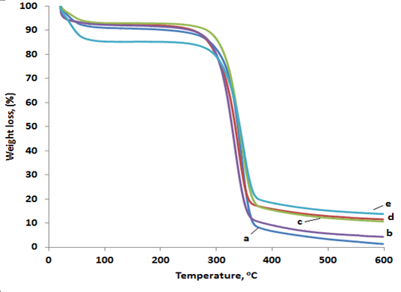
TGA of a) blank, b) 3% untreated leather, c) 6% untreated leather, d)
9% untreated leather, e) 12% untreated leather

Slide 26
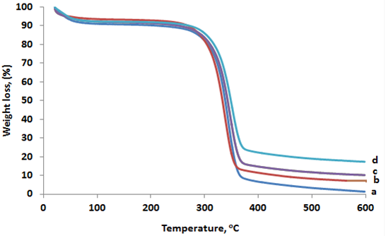
TGA of a) blank, b) 6% treated I, c) 9% treated I, d) 12% treated I

Slide 27
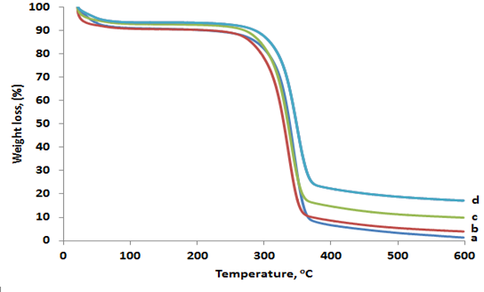
TGA of a) paper sheet as well as, b) 3% treated II, c) 6% treated II, d) 12% treated II

Slide 28
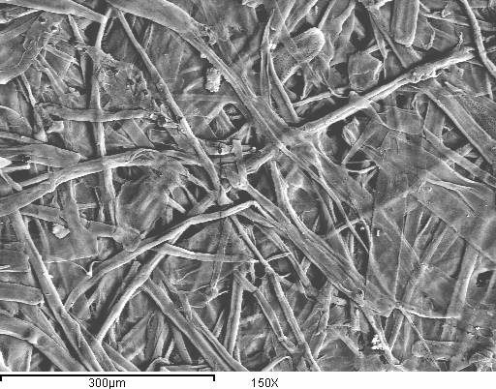
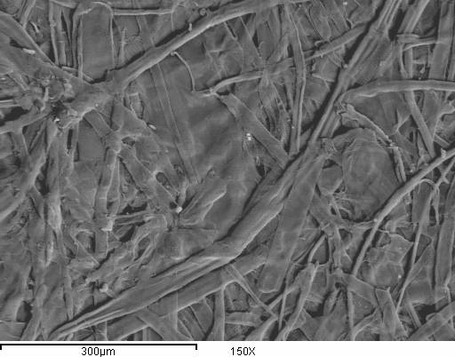
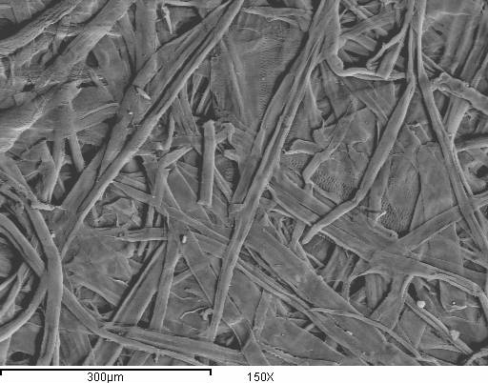
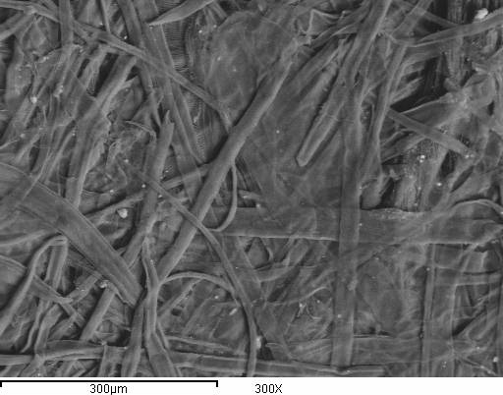
SEM images of : a) Blank paper sheet as well as paper sheet with untreated and treated
a)
b)
c)
d)

Slide 29
Conclusion:
- These results showed that the addition of leather wastes has improved significantly the flammability properties, in the same time didn’t have a bad effect on the visual, physical and mechanical properties.
-This approach can be also extended to various fields of chemistry such as polymers and rubbers.

Slide 30


