Slide 1
Knowledge And Perceptions of Young People Towards HIV/AIDS in Southern Nigeria.
Oguogho Cletus

Slide 2
“We do not believe in all those kind of disease here, we have heard about it, but it could be spiritual sickness they call AIDS in the hostital” (Respondent, 2013).

Slide 3
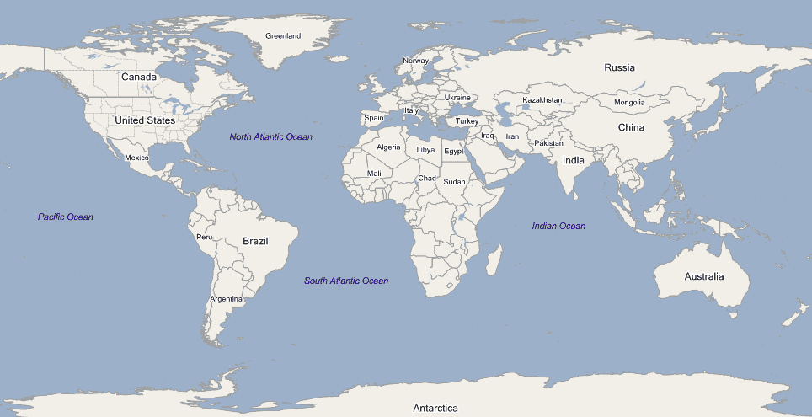
Las Vega and Nigeria
7479.6 Miles

Slide 4
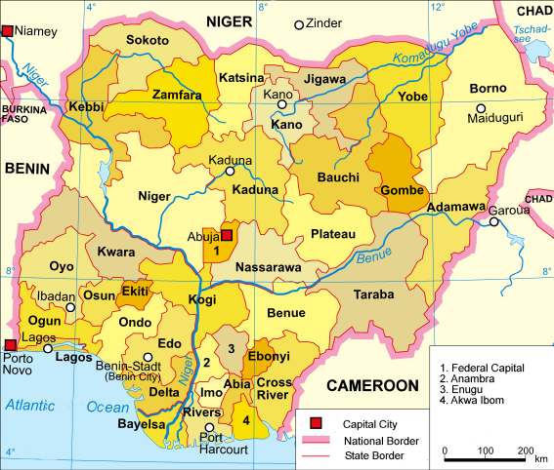
Nigeria

Slide 5
Introduction
Nigeria have the largest population in Africa with over174million.
The first case of HIV in Nigeria was diagnose in 1986
Over 210,000 Nigerians have died of AIDS.

Slide 6
Rationale.
Africa have 24.5million cases of HIV around the world.
Nigeria occupies second place in the highest number of HIV cases around the globe (over 3.1million).
Southern Nigeria is presently hosting the highest number of HIV cases in Nigeria.

Slide 7
Young people represent over 60% of New cases in Nigeria
Over 82% of people aged between 18-24 are students in Nigeria

Slide 8
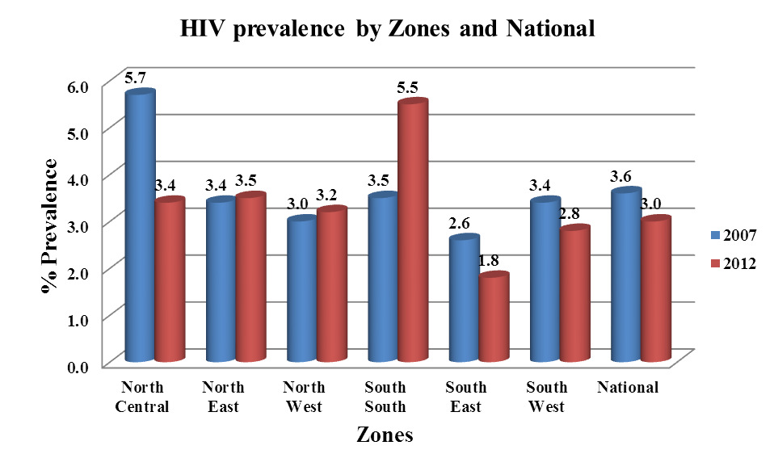

Slide 9
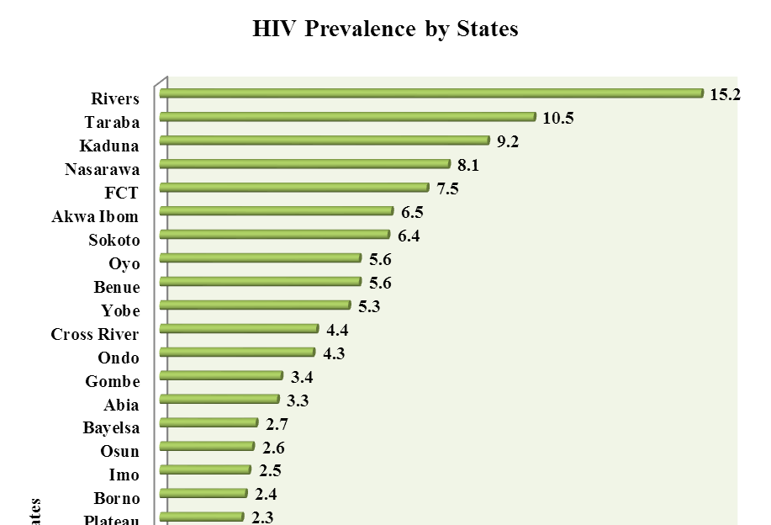
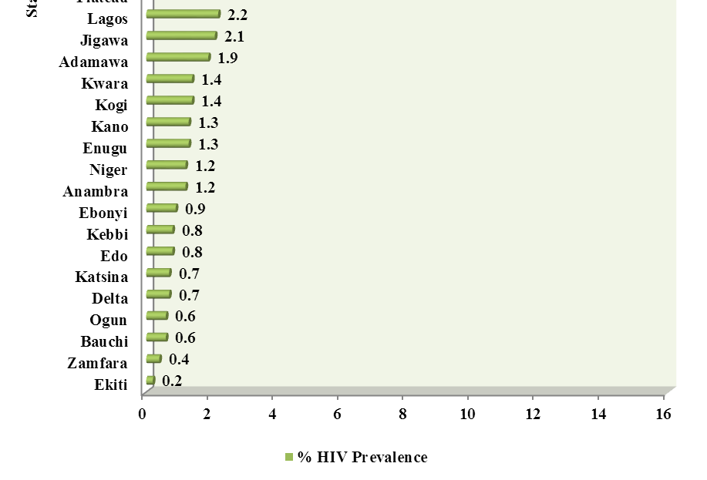

Slide 10
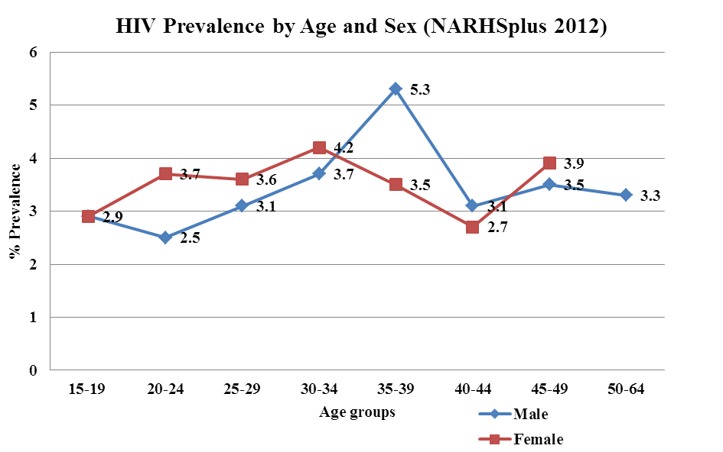

Slide 11
Factors Affecting HIV Spread
Gender Difference
Socio-economic conditions
Religion
Early Marriage, e.t.c

Slide 12
Aims/Objectives
Objectives
What perceptions and attitude towards HIV/AIDS exist among YP in southern Nigeria?
To what level are YP in Nigeria aware of HIV/AIDS?
Is there any relationship between the level of knowledge of HIV/AIDS and their sexual behaviour?

Slide 13
Aims
The aim of this study was to determine the Knowledge, perception and attitudes concerning HIV/AIDS of students in Southern Nigeria and also to assess the Needs for HIV/AIDS prevention programs at schools.
To come up with findings that would help to formulate or design proper strategy that will suit HIV/AIDS Prevention Programs.

Slide 14
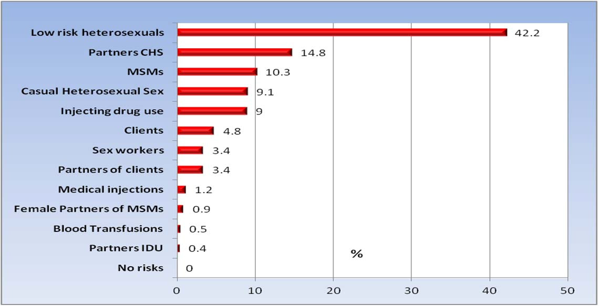
Distribution of New HIV cases in Nigeria.

Slide 15
Several reports has shown that Low Risk Perception contributes the highest new HIV cases in developing countries, including Nigeria.

Slide 16
Methodology
The design was a descriptive mix method research.
Quantitative descriptive method (Questionnaire)-used to quantify the factor of Knowledge and attitude
Qualitative descriptive method (FGD)- used to explore the perception of the same sample.
The data were collected using both quantitative and qualitative data collection instruments.
Statistical Package for the Social Sciences (SPSS version 19) was used for result analysis

Slide 17
Results
Demographic background of participants
 |  | N | %
Gender | Male | 402 | 63
 | Female | 240 | 37
Marital | Single | 628 | 96.9
 | Married | 16 | 2.5
 | Separated | 4 | 0.6
Religion | Christian | 616 | 95.1
 | Muslim | 12 | 1.9
 | Traditional | 20 | 3.1
Age limit: 18 to 24

Slide 18
The average knowledge level was quite high (73.9%) among young males and females students that were recruited in this study.
47.9% of students do not know that AIDS virus can be transmitted via oral sex. Particularly, regarding the specific modes of HIV transmission.
However, the FGD shows a very Low risk perception among the respondents.

Slide 19
Discussion
Comparing the findings of this study with other government and NGOs report on HIV/AIDs among young people in Nigeria
      Negligence
      Lack of proper evaluation of information
Relationship between the findings and the AARM theoretical framework
      Recongnising and lebelling action as risk

Slide 20

“No one has ever got close to us to discuss such a sensitive Issue. We were really at risk, but our perception towards HIV And AIDS has changed….”
(FGD respondents, 2013)

Slide 21
Limitations
The questionnaire was derived from a more comprehensive one
Self-report questions was used
The sample did not represent the whole Nigeria youths

Slide 22
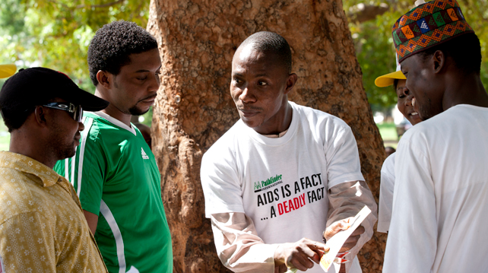
We need to make young people change their perception

Slide 23


Increase awareness
Talk about HIV/AIDS to those
most at risk

Slide 24
References
Abdool, Q. (2001). Barriers to preventing human immunodeficiency virus in women: experiences from KwaZulu-Natal, South Africa. Journal of the American Medical Women's Association; 56(4), 193-196.
Abdulraheem, I.S., & Fawole, O.I. (2009). Young people's sexual risk behaviours in Nigeria.
Journal of Adolescent Research; 24(4), 505-527.
Abdulraheem, I.S., & Fawole, O.I. (2009). Young people's sexual risk behaviours in Nigeria.
Journal of Adolescent Research, 24(4), 505-527.
Adebayo, D.O., Udegbe, I.B., & Sunmola, A.M. (2006). Gender, internet use, and sexual
behaviour orientation among young Nigerians. Cyberpsychology & Behaviour, 9(6), 742-752.
Adebiyi, A.O., Owoaje, O., & Asuzu, M.C. (2008). Relationships as determinants of
substance use amongst street children in a local government area in south-western Nigeria. South African Family Practice, 50(5), 47-47d.
Adedimeji, A. (2003): “Perception of HIV/AIDSinfection and condom use
amongundergraduates in Nigerian universities”.Department of Sociology, University of Ibadan.
Adegoke, S.O. (2010) “Effect of HIV/AIDS Awareness on Sexual Behaviour of students in
Tertiary Institutions in Nigeria”. Ilorin: University press
Ademokoya, J.A., & Ben-Stowe, J.N. (2007). Experiences of Mothers of Children with
Hearing Disability in Oyo State, Nigeria. The Social Sciences, 20(3), 293-297.
Adinma, J.I.B., Agbai, A.O., Okeke, A.O., & Okaro, J.M. (1999). Contraception in Teenage
Nigerian School girls. Advances in Contraception, 15(4), 283-291.
Adjibolosoo, S.B. (2006). Developing Civil Society: Social Order and the Human Factor
Hampshire . Burlington: Ashgate Publishing Limited.
Adu-Mireku S. (2003). Family Communication about HIV/AIDS and Sexual Behaviour
Among Senior Secondary School Students in Accra

Slide 25
Thank You

