Slide 1
About OMICS Group
OMICS Group International is an amalgamation of Open Access publications and worldwide international science conferences and events. Established in the year 2007 with the sole aim of making the information on Sciences and technology ‘Open Access’, OMICS Group publishes 400 online open access scholarly journals in all aspects of Science, Engineering, Management and Technology journals. OMICS Group has been instrumental in taking the knowledge on Science & technology to the doorsteps of ordinary men and women. Research Scholars, Students, Libraries, Educational Institutions, Research centers and the industry are main stakeholders that benefitted greatly from this knowledge dissemination. OMICS Group also organizes 300 International conferences annually across the globe, where knowledge transfer takes place through debates, round table discussions, poster presentations, workshops, symposia and exhibitions.

Slide 2
About OMICS Group Conferences
OMICS Group International is a pioneer and leading science event organizer, which publishes around 400 open access journals and conducts over 300 Medical, Clinical, Engineering, Life Sciences, Pharma scientific conferences all over the globe annually with the support of more than 1000 scientific associations and 30,000 editorial board members and 3.5 million followers to its credit.
OMICS Group has organized 500 conferences, workshops and national symposiums across the major cities including San Francisco, Las Vegas, San Antonio, Omaha, Orlando, Raleigh, Santa Clara, Chicago, Philadelphia, Baltimore, United Kingdom, Valencia, Dubai, Beijing, Hyderabad, Bengaluru and Mumbai.

Slide 3

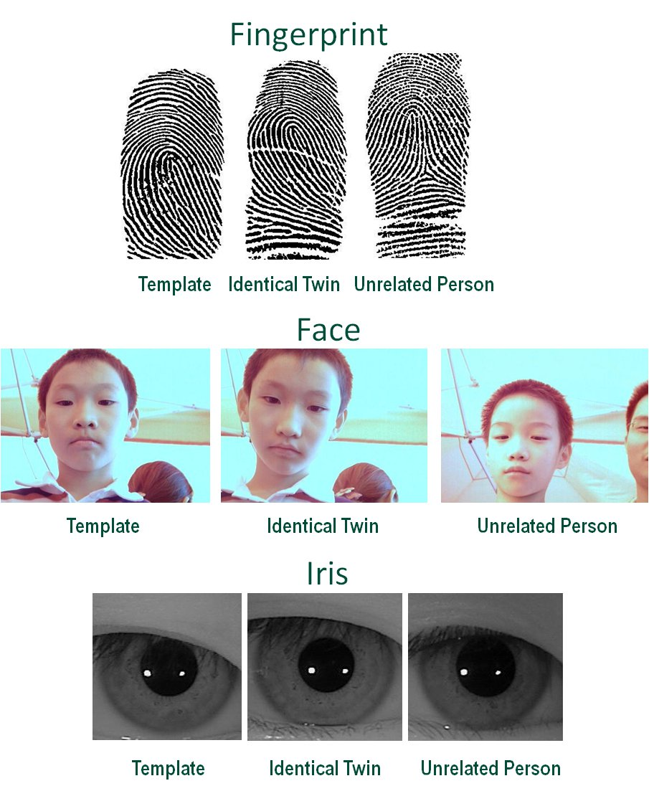
Multimodal Biometrics for Robust Fusion Systems Using Logic Gates
Numan Celik, Student Member, IEEE
Nada Manivannan, Senior Member, IEEE
Wamadeva Balachandran, Fellow, IEEE

Slide 4
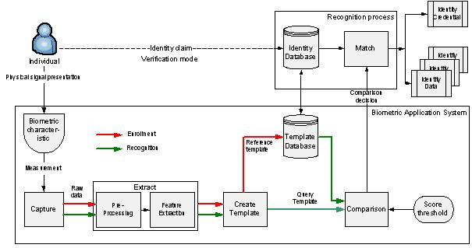
Unimodal Biometric Systems
Although some unimodal systems have made a considerable improvement in reliability and accuracy, they often suffer from problems in the enrollment processes due to non-universal biometric traits, biometric spoofing and insufficient accuracy caused by noisy data.
While the unimodal fingerprint and face biometric gives recognition rate of 94% and 90.8% respectively, the multi-modal approach was giving a recognition rate of 98% at the decision level fusion, showing an improvement in the accuracy.

Slide 5
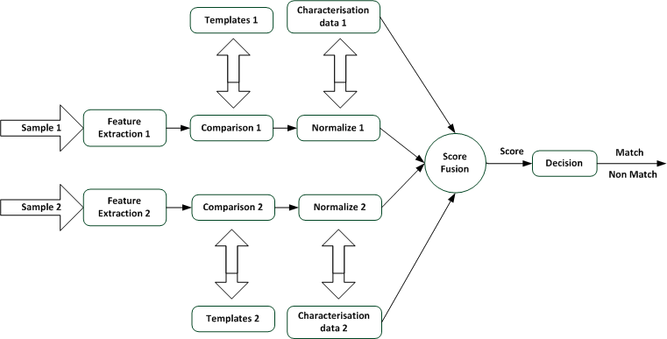
Score Level Fusion in Multimodal Biometrics
For multimodal biometric recognition systems, information is fused from different biometric traits. The process of fusion
can be done at different levels after getting raw data; broadly divided into feature-level, score/match-level,
and decision-level fusion.
In order to make the system design more robust, our proposed multimodal biometric includes fingerprint and face
recognition using logical AND operators at decision-level fusion.

Slide 6
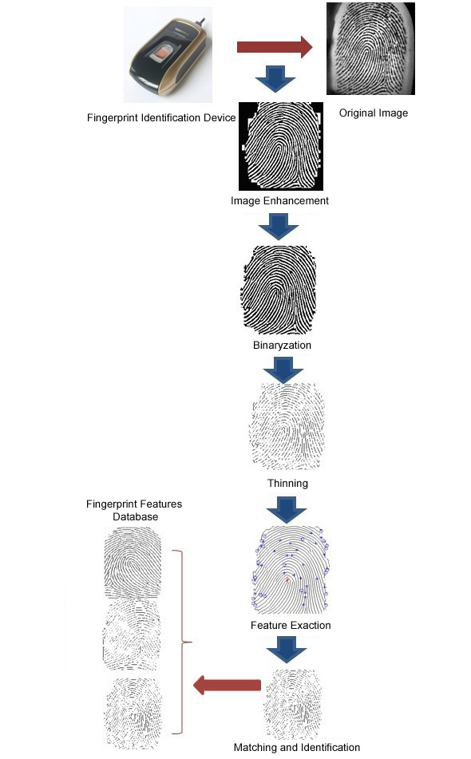
The First Modality: Fingerprint Recognition System
There are two approaches for fingerprint recognition, the minutiae-based algorithm and the image-based algorithm. Our approach is a minutiae-based algorithm in fingerprint recognition and it represents the fingerprint by its local features or points, such as terminations and bifurcations.
The proposed approach for our fingerprint recognition system comprises a basic fingerprint sensor, a feature extractor part and a minutiae matcher.
In our tests, a ZK4000 fingerprint device sensor reader was used to acquire raw images. This optical type of sensor has 280*360 pixel image sizes, and 500 dpi resolution capacity.
To deploy a feature extractor, we used a two-stage approach in this work, the pre-processing and the minutiae extraction stages. The pre-processing stage started with the Image Enhancement process using Histogram Equalization and Fourier Transform methods. Then the enhanced image was binarized using the adaptive threshold. The minutiae extraction part consisted of the thinning process, which was carried out using three thinning algorithms and also the expanded thinning operations were tested with good thinning quality in the minutiae extraction stage.

Slide 7
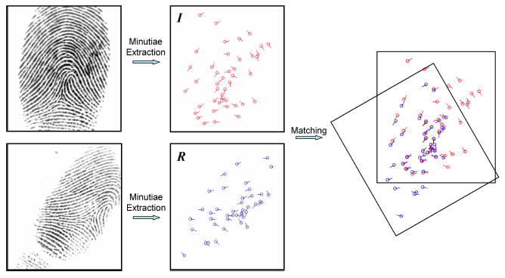
Finger RS: The Minutiae-based Matching Process
The minutiae-matching algorithm comprises comparing one set of minutiae data with another set. In most cases, this process
compares an input data set with a previously stored data set with a known identity, referred to as a template.
This algorithm also tries to align the minutiae of the input image and stored templates and finally finds the number of matched
minutiae. After the alignment, two minutiae extractions are considered to be matched if the distance and direction difference
between them are smaller than a given tolerance.

Slide 8
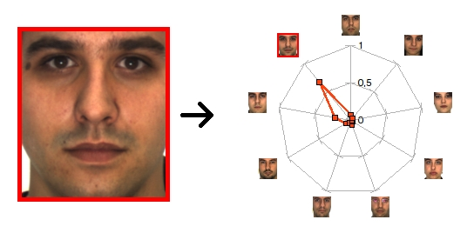
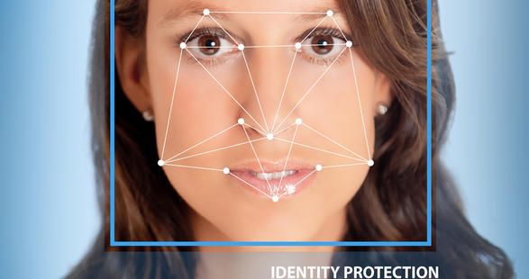
The Second Modality: Face Recognition System
In order to identify and verify the face recognition, there are various approaches [17] to operating the system: a) the holistic
approach: the face region is taken into a group as input data into the face detection system (i.e. eigenfaces, fisherfaces),
(b) the feature-based approach: local features on the face region such as nose, mouth, eyes are segmented and then used as
input data for structural classifier; and c) the hybrid approach: the human vision system perceives both local features and the
whole face region.

Slide 9
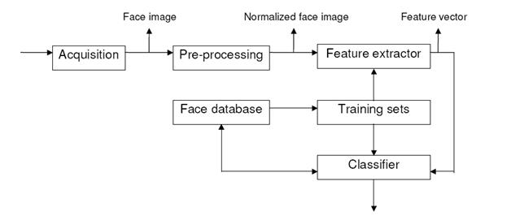
Face RS: Hollistic Approach
The holistic approach was selected and implemented to analyse and identify it through the system. The principal component
analysis technique (PCA) and its component the eigenfaces method were used.
There are six main functions in the typical recognition system. In acquisition part, the face image is taken using a high-resolution
camera and then this raw image is constructed and normalized in the pre-processing step to start the extracting process in the
next stage. The Image Normalization process was carried out to change the acquired image size to a default image size, and
for our system, it was enhanced 128*128.
A USB webcam used for the tests specified with 30 Megapixels resolution, 1.3 Megapixels CMOS Image sensor resolution,
and 1600*1200 pixels for maximum dynamic resolution to acquire the images.
After the pre-processing stage, we used a different method from the typical feature extractor module, so the training sets
should be created within this method. (HL)
After designing Eigenfaces implementation and calculating the eigenvectors and eigenvalues from the raw images,
the classifying process was carried out and determining the face step was implemented at the end of the application to verify a
person’s face as ‘accepted’ or ‘rejected’.

Slide 10
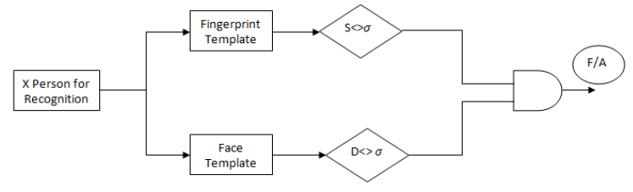
Fusion Stage: Implementation from Unimodal through Multimodal System
Our proposed fusion methodology presents a system which can represent a multimodal system using a basic logical AND
gate. This multimodal fusion concept is also formed as a decision-level fusion algorithm because of compounding a
final score (accept/reject) at the decision stage on both unimodal systems. (HL)
The final decision is made for both unimodal recognition systems as comparing threshold values with their similarity scores and
distances [16]. If the similarity score of the minutiae extraction is greater than the threshold value of acceptability, then a
HIGH (1) input comes from the fingerprint part through the logical AND operator. In the same way, if the Euclidean distance
between the eigenvectors is bigger than the reasonable threshold value of that expert, then another HIGH (1) input value comes
from the facial part through the AND gate. Otherwise, the LOW (0) result enters the AND operator as an imposter information.
At the end of the process, the logical AND operator makes the final decision as accepted or rejected according to the input
values which are coming from both unimodal systems. In conclusion, two HIGH (1) input values must come from both individual
recognition experts in order to confirm an acceptance to the user as a multimodal recognition system. (HL)

Slide 11
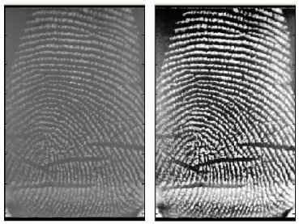
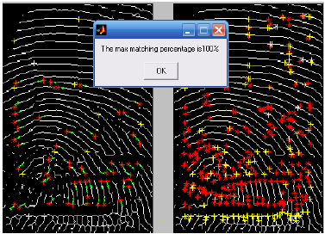
Test & Results
The proposed approach extracts ten users randomly from the fingerprint database (DB1) which includes 1440 fingerprint raw
images. The FAR and FRR results of these ten fingerprint raw images are calculated at the end of the application.
The raw image is converted to the enhanced image to give a clear binarization stage on the next step. The enhancement
process is carried out using histogram equalization. (HL)
After the image enhancement process, the raw image binarization process is implemented using the adaptive threshold
algorithm. (removing spurs and discarding spikes from the thinned image)
Many of the fingerprint image pairs resulted in correct matches. The simple minutiae matching algorithm was used in the
matching stage. This algorithm supplies the distance of the x-axis, y-origin and 𝜑𝜑 angle between two matching images.
Using the minutiae-based approach, this thesis provided us with similar positive results between 98% and 100%.

Slide 12
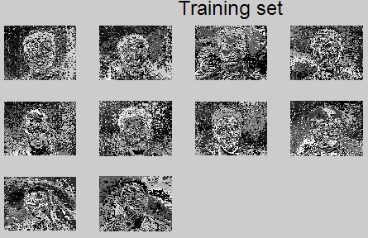
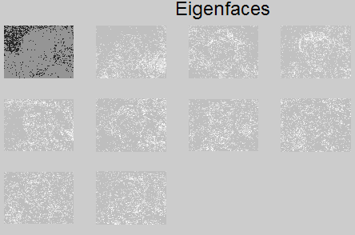
Test & Results
The face testing procedure was composed of data from ten different individuals with ten different pictures of each individual
under different facial expressions and lighting from the face database (FDB1) that includes 960 face raw images.
After calculating eigenvectors related with difference values of the mean image and input image in the formulation, the weight
values of the eigenfaces and Euclidean distances between the eigenvectors of each image were found so as to determine
whether this face is known (accepted) or unknown (rejected).

Slide 13
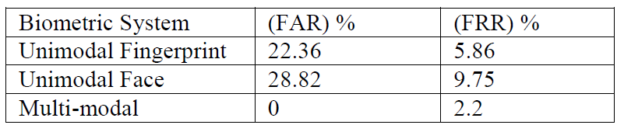
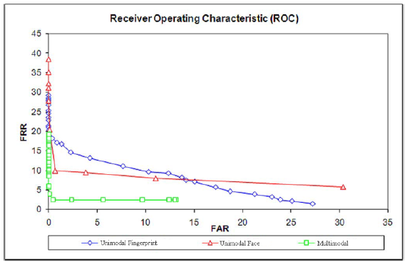
Test & Results
The value of FRR is more in the case of unimodal compared
to multi-modal technique. The value of FAR is 0% in the case
of multi-modal (AND rule is operated) compared to unimodal
technique.
When the unimodal recognition points were higher than the
threshold value, which means FRR gives a minimal value, then the
fusion score creates a logical ‘1’ and thus the system comprises
an acceptance value, otherwise it will give a rejection decision.
(Majority Vote Method)

Slide 14
Thanks for Listening
&
Your Attention
N Celik

