Slide 1


Derived Relations between Geoelectric and Hydraulic Parameters in Bara Basin, Sudan
MOHAMED, N.E., KHEIRALLA, K.M., and ABDELGALIL, M.Y.
Faculty of Petroleum and Minerals (FPM)
Al Neelain University - Sudan

Slide 2
Contents
Introduction
Main Objectives
The Study Area
- Physiography
- Geology
- Hydrogeology
Used Methods
- Basis of estimating hydraulic properties
from resistivity
- Data acquisition and interpretation
Results and Discussion

Slide 3
Introduction
Knowledge of the hydraulic parameters of subsurface aquifers is essential to determine the natural flow of the groundwater.
The hydraulic conductivity K and the transmissivity T are aquifer parameters that vary spatially due to geologic heterogeneity.
Estimation of K and T allows a quantitative prediction of the aquifer hydraulic response to recharge and pump.
Better K and T estimation obtain from testing pumping wells TPW, but expensive and time consuming.
Using surface Geoelectrical method to estimate K and T can greatly reduce the number of TPW.

Slide 4
Introduction
Relationship between aquifer hydraulic and geoelectric parameters is investigated since 1951 by Jones and Budford, that as the grain size increase, the formation factor and the intrinsic permeability also increase.
Frohlich (1974) constrained this relation for a given porosity range.
Empirical-semi empirical relations between the aquifer resistivity and its hydraulic parameters have been correlated under different geological conditions by several hydro-geophysicists as Kelly (1977), Kosinski and Kelly (1981), Frohlich and Kelly (1985), Yadav and Abolfazli (1995).
Sriniwas and Singhal (1981 and 1985) developed analytical relations between the aquifer transmissivity T and Dar-Zarrouk parameters.

Slide 5
Objectives
i.e.
We need to make these relations more general in nature and thus more applied widely in areas with diverse lithological characteristics.
So,
Bara basin, in NKS in Central Sudan, in one of the most important provinces concerning the natural resources in Sudan.
But, still encounter problems such as high GW salinities and lack of detailed GW assessment.
In the present study,
A general functional relation is derived between surface resistivity soundings and the hydraulic parameters of the western part of Bara basin.

Slide 6
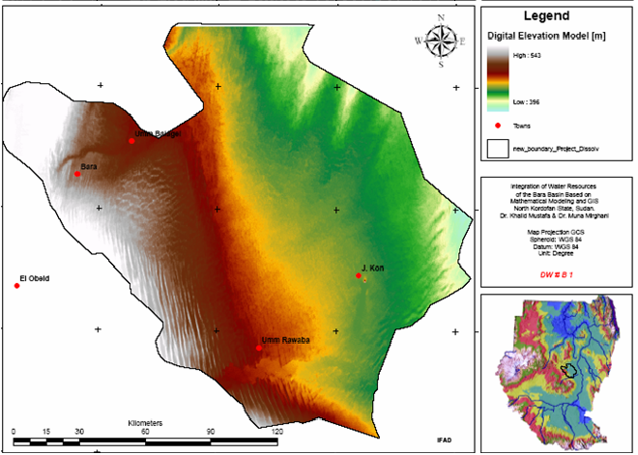
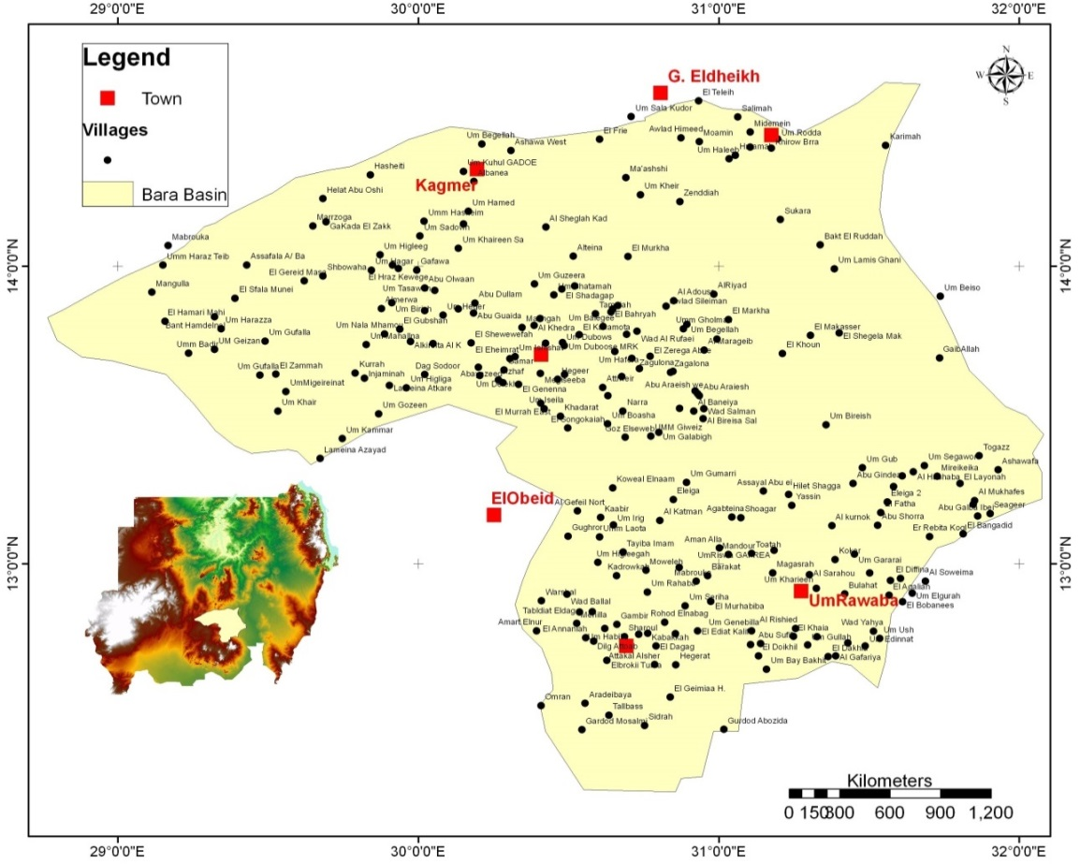
The Study Area
Physiography:
The ground surface slopes gently E and NE towards the White Nile as the perennial watercourse bounding the study area.
Figure (1): Digital Elevation Model (DEM) map of the study area.

Slide 7
The Study Area
Physiography:
The soil of NKS are three types: Sand dunes or Qoz, lighter clays or Gardoud, and heavy clays (IFAD, 2004).
The area extends over two climatic belts in the sub-Saharan region: a semi-arid zone in the north and a poor Savannah in the south.
According to Mukhtar (2006), the current total population of NKS amounts to 2,353,460 persons based on Central Bureau of Statistic (CBS) population projections (2003-2018).

Slide 8
The Study Area
Geology:
In Mid Miocene, the continental seas had covered the whole region depositing the thick horizontally bedded Nubian sandstone formation.
The volcano activity, by the End of Mesozoic, had resulted in the creation of the African Rift System with its western limb forming the White Nile (Bara–Um Ruwaba) and the Baggara troughs separated by the Nuba Mountain–Sodiri Mega Anticline, and terminated from the north by the central Africa Fault Zone (CAFZ).

Slide 9
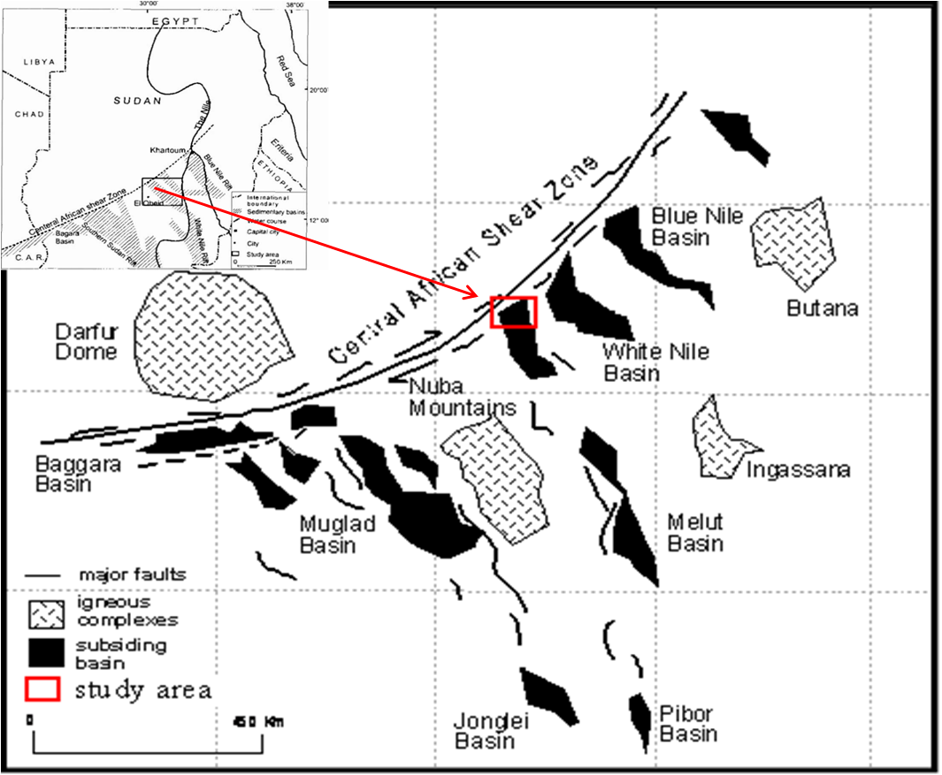
Figure (2):
Location of the study area within the Central Sudan Rift Basins, and the principal basins of the Central and Southern Sudan in relation to Central African Shear Zone (RRI, 1990).
The location of the study area is marked by the red square.

Slide 10
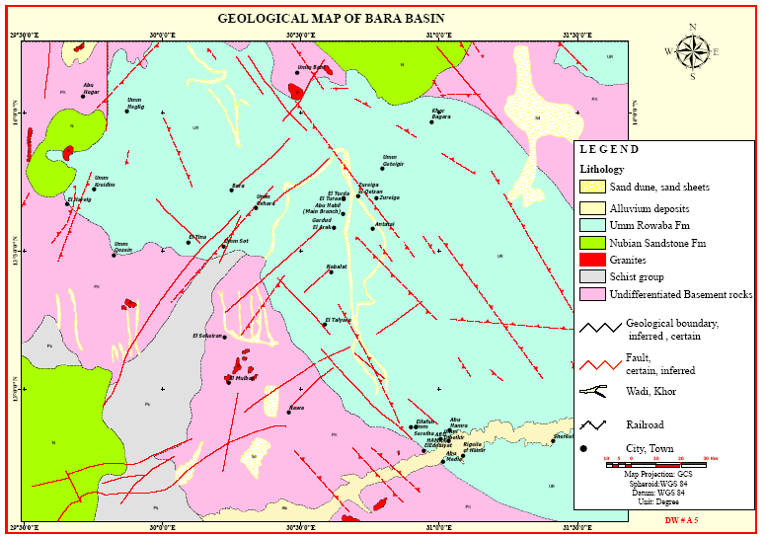

Figure (3): Geological and Structure map of Bara basin (IFAD, 2004.)

Slide 11
The Study Area
Geology:
Rodis et.al (1965) described the ground water geology in Kordofan State.
RRI and GRAS (1990) provide basic study of the geology and petroleum potential of southern, central and eastern Sudan, including Bara basin.
The main geologic formations covering NKS is itemized in Table-1:

Slide 12
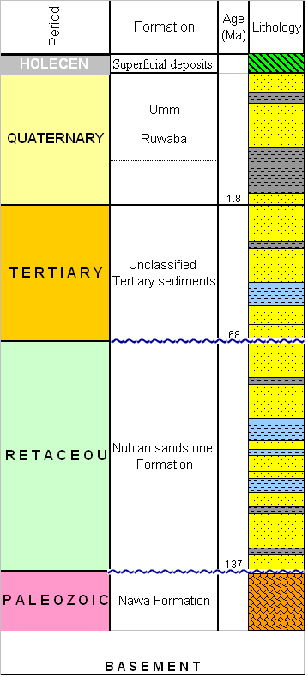
Table (1):
Main geologic formations covering NKS

Slide 13
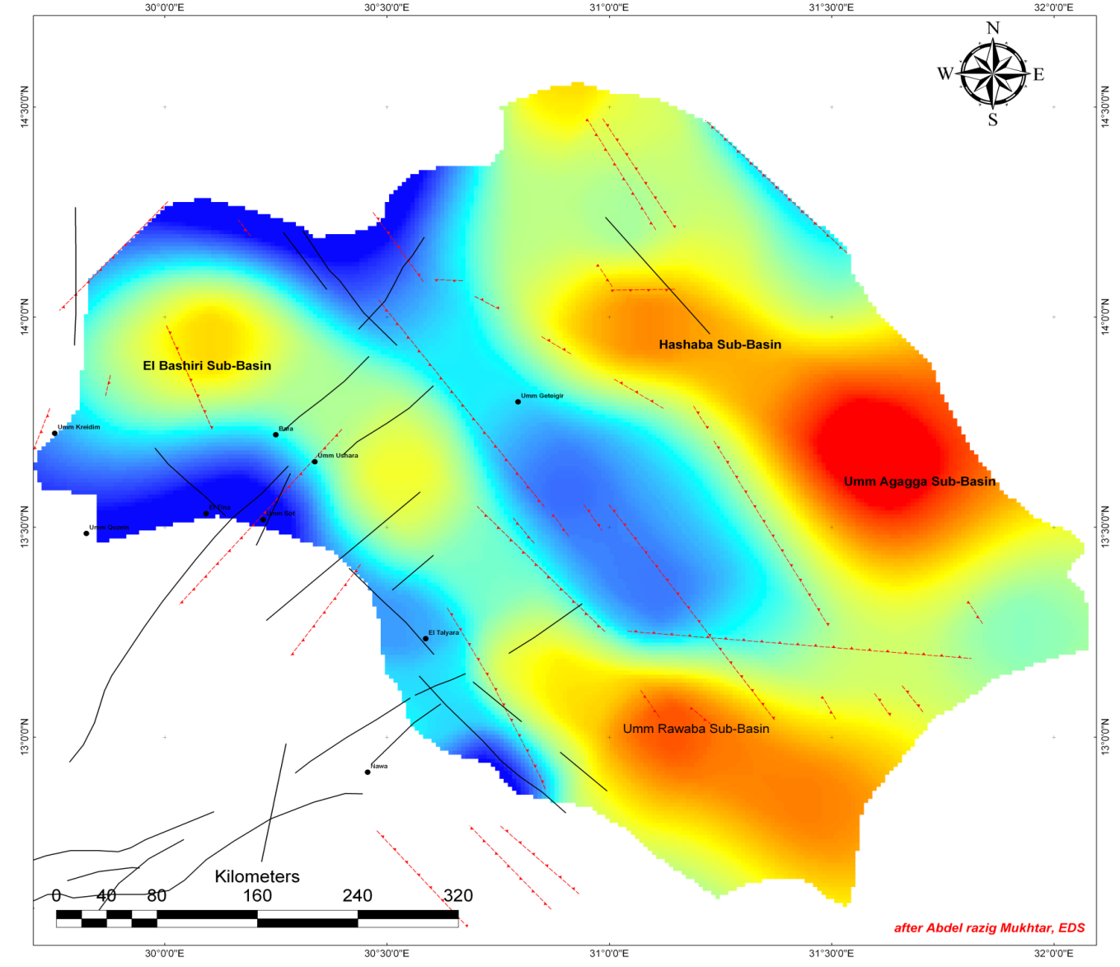
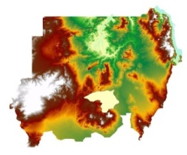

ElBashiri Sub-Basin
Hashaba Sub-Basin
Umm Aggaga Sub-Basin
Umm Ruwaba
Sub-Basin
Figure (4): Digital basement terrain model (DBTM) of Bara Basin superimpose by major NW-SE faults and minor NE-SW faults in central Sudan, dividing the basin into four former sub-basins: Hashaba, Umm Aggaga, ElBashiri and Umm Ruwaba sub-basins (after Mukhtar, 2006).
Notes:
Environmental and Development Services (EDS)

Slide 14
The Study Area
Hydrogeology:
The annual rainfall increases in amount and duration southward, and ranges from 200 mm to 450 mm.
The main GW aquifer is the sandstone layers of the Cret. Nubian sediments which extend underlying the Umm Ruwaba sediments.
GW occurs at depth from 30m to >100m below ground surface generally under free water table conditions.
Umm Ruwaba sediments are considered as the second important aquifer zone and GW occurs in the sand lenses intercalated with mostly thick clay sediments.

Slide 15
Used Methods
Basis of estimating hydraulic properties from resistivity:
The mathematical relations of the electrical transmission and groundwater flow in a conducting porous media is governed by Ohm’s law and Darcy’s law respectively, both having forms of equation:
(1)
(2)
Where j, σ, v, r, q, k, h are respectively the current density (amps per unit area), electrical conductivity (Siemens/m = reciprocal resistivity ρ in ohm.m), electrical potential (volts), distance (meters), specific discharge (discharge per unit area), hydraulic conductivity (or permeability; m/s), and the hydraulic head (m).

Slide 16
Used Methods
Basis of estimating hydraulic properties from resistivity:
The electro-hydrological similarity between these two phenomena is widely accepted (Freeze and Cherry, 1979; Fitts, 2002; Singh, 2005).
In a homogeneous and isotropic medium, both the electric current and groundwater flow satisfy the Laplace equation:
for electrical flow: (3)
and
for groundwater flow: (4)

Slide 17
Used Methods
Basis of estimating hydraulic properties from resistivity:
For a point current source, the solution of equation (3 &4) in a semi-infinite, homogeneous medium (hemispherical earth):
for electrical flow is: (5)
and
for hydraulic flow is: (6)

Slide 18
Used Methods
Basis of estimating hydraulic properties from resistivity:
Transmissivity of an aquifer of saturated thickness b, is then expressed by
(7)
Such that the laplacian equation becomes:
(8)
Generally, since larger connected pores make better flow features for both water & electric current, it is expected that there should be some relation between electrical and hydraulic parameters (Singh, 2005).

Slide 19
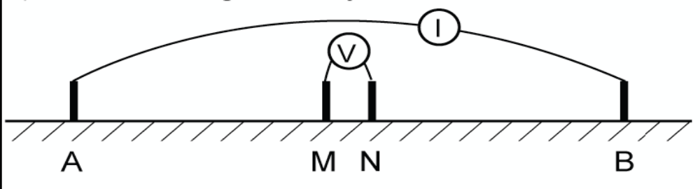
Used Methods
Data acquisition and interpretation:
Thirty five vertical electrical soundings (VES) were carried out in ElBashiri and Umm Ruwaba sub-basins by IFAD 2004 using:
  Schlumberger electrode spreading
  Maximum current electrode separation (AB) up to 1.8 km.
  Most VESs were conducted nearby existing boreholes for
  correlation purposes.
  VES interpretation using IX1D computer-assisted program.
  This estimates for each VES the layers thickness and their true resistivity values.
Figure (5): Schlumberger configuration

Slide 20
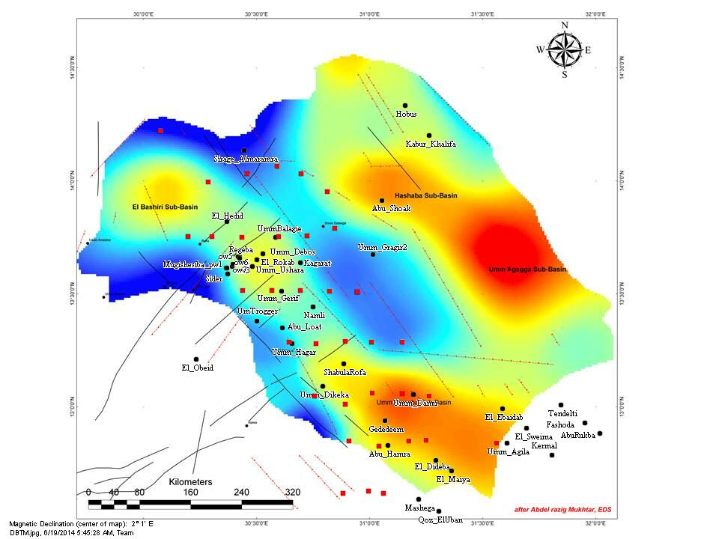


A B
Figure (6): Locations of VES are shown in red squares and the pumping wells are shown in black circles. AB is the geoelectric section across selected VESs.

Slide 21
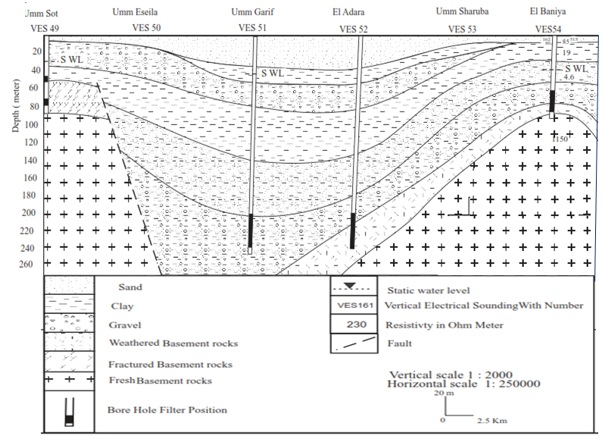
A B
Figure (7): Cross section shows the stratigraphy along a number of electrical soundings (VES) and the adjacent boreholes wells (IFAD, 2004).

Slide 22
Table (2): Based on VES results and wells calibration (from WES 2004) in the area, the following resistivity ranges and the corresponding lithologies are adopted for this study:
Lithology |  | Resistivity (Ω.m)
Running Qooz sands |  | 50 – 300
Surface clay, sand, gravel |  | 30 – 160
Subsurface mudstones (saturated) |  | 5 – 30
Subsurface Sandstone (saturated) |  | 10 – 100
Fractured basement (saturated) |  | 10 – 80
Fresh Basement Complex |  | > 300

Slide 23
Used Methods
Data acquisition and interpretation:
  From the true resistivity data, it was possible to compute, for every VES, the following (Singhal et al., 1998).:
  the longitudinal resistivity: (9)
  the transverse resistivity: (10)
Where h_{i} and ρ_{i} are layer thickness and resistivity respectively

Slide 24
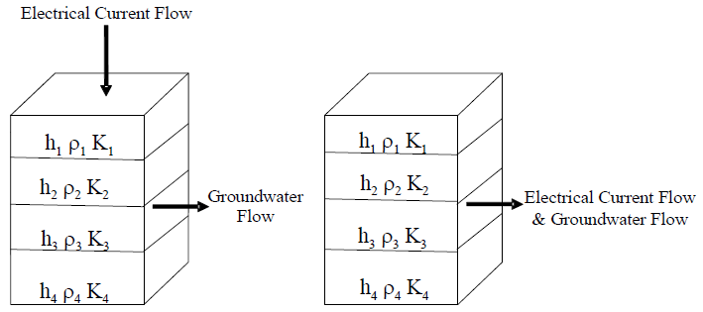
Figure (8): Layered model showing transverse and longitudinal current flow.

Slide 25
Used Methods
Data acquisition and interpretation:
  Archie’s Law (1942) relates the layer resistivity derived from geoelectric field curve to pore water resistivity and the porosity of the porous skeleton:
  (11)
  where F is the resistivity formation factor which is constant for pure sands, ρ_{o}, is the resistivity of the saturated rock at each sounding position, ρ_{w} is the water resistivity and Φ is the formation porosity, a and m are empirically derived constants related to rock type.

Slide 26
Used Methods
Data acquisition and interpretation:
  The modified aquifer resistivity (ρ`) includes the changes in aquifer material and the interconnected pores tortuosity. The modification factor is a ratio of average aquifer water resistivity and aquifer water resistivity for each VES .
  (12)
According to Singal and SiriNiwas (1985), Where ρ` is the modified aquifer resistivity, ρ_{w} is average water resistivity, and ρ_{w} is the water resistivity.

Slide 27
Used Methods
Data acquisition and interpretation:
Transmissivity (T) is computed from the transverse resistance (R) or using the modification factor as:
(13)
Where k is the hydraulic conductivity, σ is the electrical conductivity, and R is the transverse resistance,
and,
and,

Slide 28
Results and Discussion
The study area consists of a maximum 5 layers where the aquifer thickness is highly variable.
The water level and the electrical conductivity data of 17 pumping wells (WES, 2004) in the vicinity of the study area were collected to determine the formation factor.
St. No. | VES No. | Formation Factor | Hydraulic Conductivity (m/d) | St. No. | VES No. | Formation Factor | Hydraulic Conductivity (m/d)
1 | 15 | 4.802 | 0.031 | 9 | 33 | 2.064 | 0.12
2 | 16 | 3.822 | 0.031 | 10 | 51 | 3.2844 | 2.2
3 | 17 | 4.187 | 0.19 | 11 | 52 | 2.025 | 0.86
4 | 28 | 6.604 | 3 | 12 | 53 | 2.025 | 0.86
5 | 27 | 6.35 | 3 | 13 | 126 | 2.592 | 0.86
6 | 29 | 2.706 | 0.067 | 14 | 127 | 1.2865 | 1
7 | 31 | 1.208 | 0.52 | 15 | 128 | 1.411 | 2.3
8 | 32 | 2.352 | 0.12 | 16 | 129 | 2.108 | 3.3
Table (3): K from TPW and F from resistivity data

Slide 29
Results and Discussion
Three types of empirical relations have been established between(Fig.9).:
  hydraulic conductivity (k) and formation factor (F),
  hydraulic conductivity (k) and modified aquifer resistivity (ρ'),
  and the relation between transmissivity (T) and transverse resistance(R_{T}).
  These relations are restricted to unconsolidated sediments where the aquifer is anisotropic due to sediments layering.

Slide 30
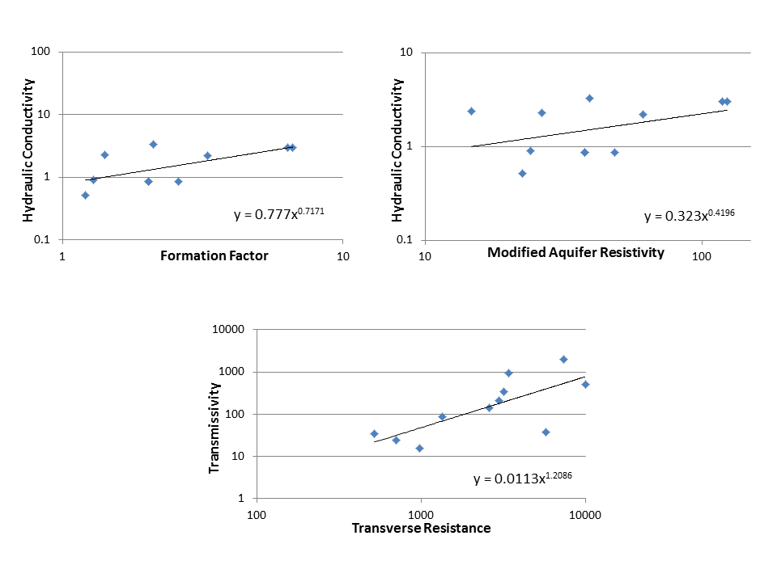
Results and Discussion
Figure (9): Empirical relations between hydraulic conductivity and formation factor, hydraulic conductivity and modified aquifer resistivity, and transmissivity and transverse resistance.

Slide 31
Results and Discussion
(14)
(15)
(16)
The three empirical math. relations between K and F, K and ρ_{mod} , and T and R_{T} .
The calculated T and K values from equations (16 & 7) are generally close to the measured values from TPW in the area.

Slide 32
Results and Discussion
Table (4): Results of vertical electrical soundings (VES) and pumping test for the study area.
EVALUATED PARAMETERS | WELL 13 | WELL 11 | WELL 14 | WELL 37 | WELL 4 | WELL 18 | WELL 23 | WELL 24 | WELL 22 | WELL 17 | 0w5 | AVERAGE
 | Aldibeba | AbuHamra | UmDamu | UmmDikeka | AbuLoat | Sider | Umm Gerif | Kaggarat | ElHadid | UmDebos | ow5
Aquifer thickness (b) in m | 26 | 66 | 98 | 45 | 95 | 70 | 70 | 20 | 70 | 33 | 64 | 59.8
Transmissivity (T) in m²/d | 20.3 | 0.6 | 613 | 11 | 5.2 | 445 | 35.7 | 35.7 | 176 | 445 | 445 | 203
Hydraulic Conductivity (k) in m/d | 0.031 | 0.19 | 3 | 0.52 | 0.12 | 2.2 | 0.86 | 0.86 | 1 | 2.3 | 3.3 | 1.31
Water Resistivity (ρ_{w}) in Ω.m | 10.2 | 12.7 | 7.9 | 13.2 | 20.8 | 14 | 12.3 | 12.3 | 24.1 | 24.1 | 16.1 | 15.3
Formation Factor | 3.8 | 4.2 | 6.3 | 1.2 | 2.4 | 3.2 | 2.6 | 2.1 | 1.3 | 1.4 | 2.2 | 2.8
Modified Aquifer Resistivity (ρ`) in Ω.m | 71.3 | 78.1 | 118.4 | 22.5 | 44 | 61.3 | 48.3 | 37.8 | 24 | 26.3 | 39.3 | 52
Modified Aquifer Conductivity (σ`) in S/m | 0.01403 | 0.0128 | 0.00845 | 0.04444 | 0.0227 | 0.0163 | 0.0207 | 0.0265 | 0.0417 | 0.038 | 0.0254 | 0.0246
Transverse Resistivity (ρ_{T}) | 292.85 | 87 | 49.84 | 173.11 | 91.06 | 42.25 | 142.67 | 25.93 | 48.869565 | 35.15 | 158.6522 | 104.3
Longitudinal Resistivity (ρ_{L}) | 89.48 | 67.9 | 27.41 | 27.13 | 34.01 | 31.34 | 40.45 | 12.06 | 7.28 | 10.9 | 13.24 | 32.84
Modified Transverse Resistance (R`) | 12685.2 | 7711.5 | 7316.6 | 3332.8 | 7058.6 | 3589.8 | 13751.6 | 714.1 | 689.6 | 496 | 3344.4 | 5517.3
Calculated Transmissivity (T) in m²/d | 16.8 | 37.13 | 947 | 139 | 14.1 | 208 | 508.9 | 33.8 | 15.7 | 23.7 | 342.1 | 208
Calculated Hydraulic Conductivity (k) in m/d | 0.6462 | 0.5626 | 3 | 3.0889 | 0.1484 | 2.9714 | 7.27 | 1.69 | 0.2243 | 0.7182 | 5.34 | 2.3

Slide 33
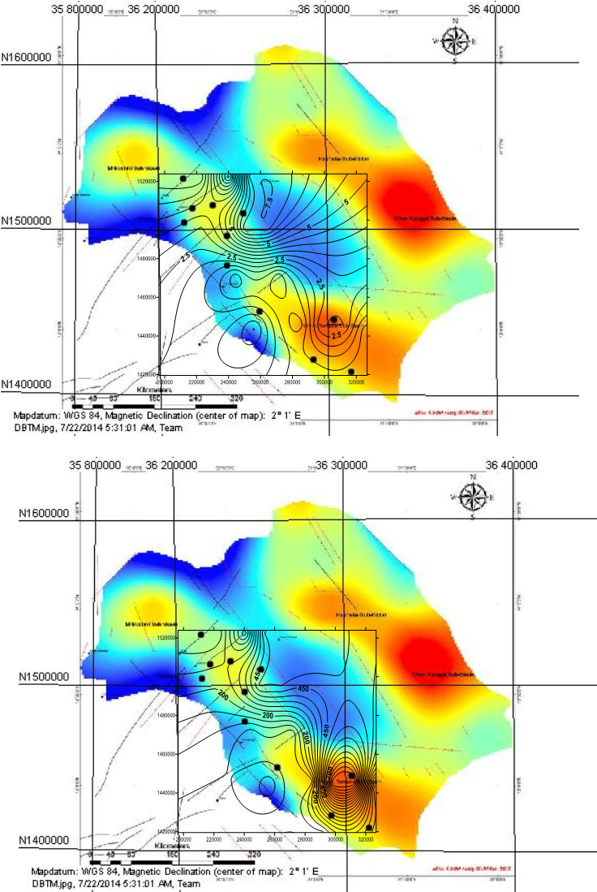
Results and Discussion
Figure (10): Calculated hydraulic conductivity contour map of the study area.

Slide 34
Results and Discussion
Figure (11): Calculated transmissivity contour map of the study area.

Slide 35
Results and Discussion
The calculated hydraulic parameters using the relations derived from the geoelectric data compared to TPW data in this study:
This study improve the reliability of the geoelectrical methods can be used, for qualitative measurements as well as for quantitative estimates of aquifer properties.
This derivation technique reduces additional disbursements for pumping tests and offers an alternative approach for estimating the hydraulic characteristics of an alluvial aquifer.
 | TPW Data | Derived Calculations
Hydraulic conductivity (K) | 0.031 - 3.3 m/d avrg: 1.31 m/d | 0.15 – 7.3 m/d avrg: 2.3 m/d
Transmissivity (T) | 11 – 613 m²/d avrg: 203 m2/d | 14 – 947 m²/d avrg: 208 m2/d

Slide 36
thank you
for
your attention.

Slide 37



Slide 38
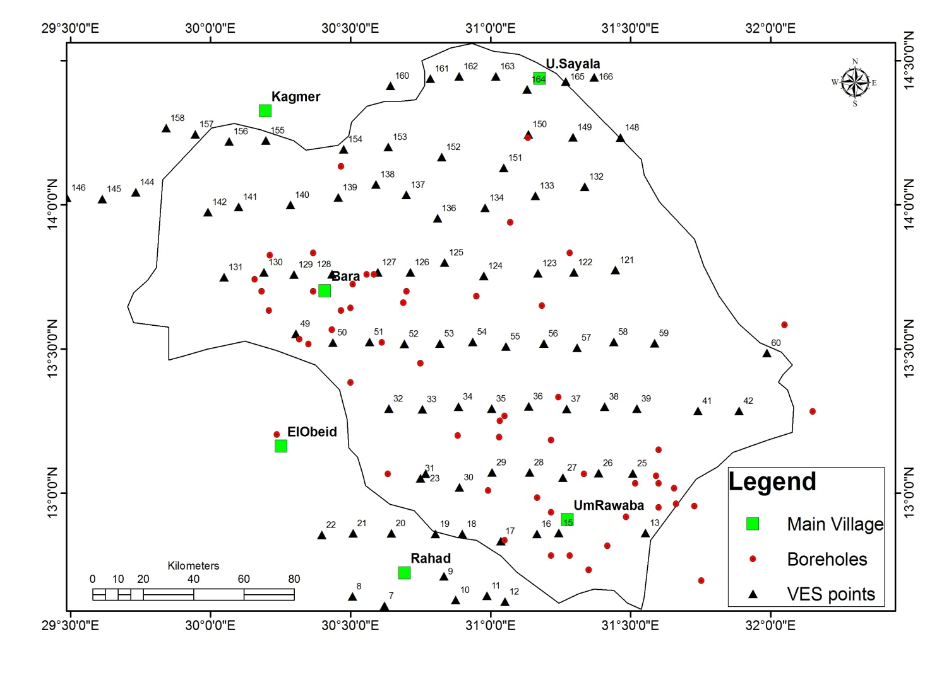
Figure (): Shows the location map of vertical electrical sounding (VESES), and boreholes locations

Slide 40
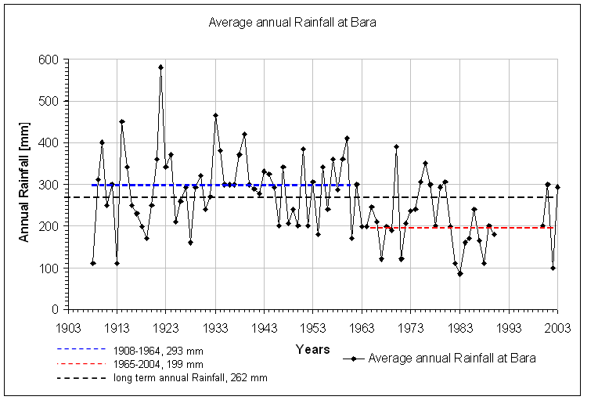
Average annual rainfall at Bara town

Slide 41
Year | Dec. | Nov. | Oct. | Sept. | Aug. | July | June | May | Apr. | Mar. | Feb. | Jan. | Description
367.5 | 0.0 | 0.2 | 10.7 | 56.8 | 132.6 | 120.6 | 32.9 | 12.4 | 1.3 | 0.0 | 0.0 | 0.0 | Average Rainfall mm
982.6 (1946) | 0.0 | 15.0 | 67.0 | 161.5 | 425.6 | 397.0 | 141.0 | 72.0 | 25.0 | 0.0 | 0.0 | 0.0 | Maximum Rainfall mm
66.4 (1984) | 0.0 | 0.0 | 0.0 | 2.0 | 10.5 | 22.0 | 16.0 | 12.0 | 3.9 | 0.0 | 0.0 | 0.0 | Minimum Rainfall mm
117.0 | 0.0 | 1.7 | 12.4 | 34.0 | 67.9 | 63.4 | 27.0 | 15.8 | 4.1 | 0.0 | 0.0 | 0.0 | St.Dev.
30.0 | 0.0 | 0.0 | 0.0 | 4.0 | 10.0 | 13.0 | 3.0 | 0.0 | 0.0 | 0.0 | 0.0 | 0.0 | Rainy Days No.
26.8 36.7 19.5 | 22.5 30.8 14.1 | 25.6 33.8 17.5 | 28.7 36.1 21.2 | 27.6 33.7 21.5 | 26.6 31.3 21.8 | 28.1 33.9 22.8 | 30.7 37.2 24.2 | 31.5 39.0 24.0 | 29.6 38.2 21.0 | 27.0 35.6 18.2 | 22.8 31.0 14.5 | 22.0 30.5 13.5 | Temperatures Mean Maximum Minimum
42.0 | 31.0 | 30.0 | 48.0 | 65.0 | 73.0 | 64.0 | 50.0 | 36.0 | 25.0 | 21.0 | 27.0 | 32.0 | Mean Relative Humidity
78.0 | 94.0 | 90.0 | 80.0 | 69.0 | 55.0 | 56.0 | 65.0 | 76.0 | 83.0 | 91.0 | 91.0 | 91.0 | Sunshine %
12.7 | 7.0 | 8.5 | 14.5 | 21.6 | 24.0 | 22.0 | 17.8 | 12.6 | 7.6 | 5.7 | 5.5 | 6.2 | Vapour Pressure [Mbs]
2.3 | 2.5 | 2.5 | 2.2 | 1.9 | 2.2 | 2.8 | 2.8 | 2.5 | 2.2 | 2.5 | 2.8 | 2.5 | Wind Velocity [m/s]
6.3 | 5.6 | 6.4 | 6.2 | 5.2 | 4.6 | 5.5 | 6.8 | 7.6 | 7.3 | 7.5 | 6.8 | 5.8 | Evapotranspiration [mm/d]
2,288.2 | 173.6 | 192.0 | 192.2 | 156.0 | 142.6 | 170.5 | 204.0 | 235.6 | 219.0 | 232.5 | 190.4 | 179.8 | Evapotranspiration [mm/m]
Climatological Data (1912-1993), Umm Ruwaba Station-Abu Habil Basin.
SOURCES: Crop Ecology & Genetic Resources Unit, Plant Production & Protection Division, FAO, North Kordofan Rural Development Project-(IFAD). And Metrological Departments, Umm Ruwaba & Khartoum.

