Slide 1
CT Scan – Automatic Tube Current Modulation
Purna Chander Reddy Nimma
Principal Clinical SME
Notes:
Good morning everyone.This is purna chander Reddy, i post graduated from manipal international university in Medical imaging technology. presently I am working in Sutherland healthcare solutions as a principal clinical subject matter expert consultant. Today I am here to present about CT Scan Automatic Tube current modulation which I published in ijpbs jornal.

Slide 2
Agenda
Introduction
Radiation Hazards
Factors Influencing Dose In CT Scan
Dose Comparison
ATCM Principle
Aim Of The Study
Material & Methods
Study Design
Study Sample
Sample Size
Ethical Considerations
Informed Consent
Results
Discussion
Conclusion
Reference
Notes:
Before going in detail lets have a look on agenda..

Slide 3
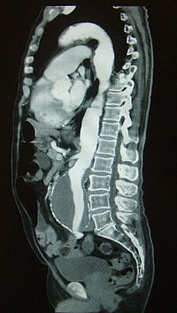
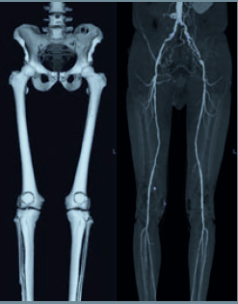
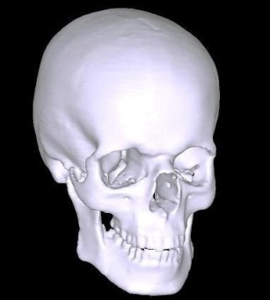
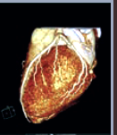
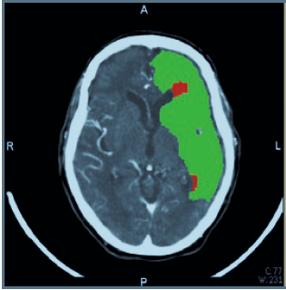
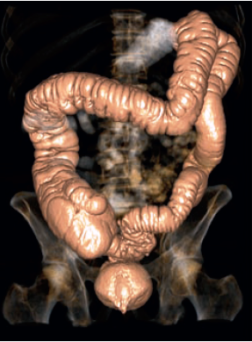
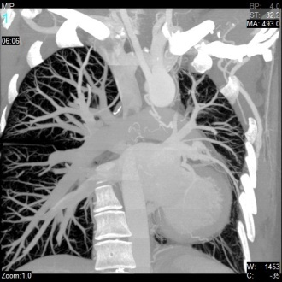
Introduction
What is Radiation?
  Radiation is the energy in the form of Electro- Magnetic waves or particulate matter travels through material or space.
The radiation doses from CT Scanner examination are among
the highest dose in diagnostic radiology.
Radiation dose become the major issue due to its effects.
Notes:
before entering in to the streamline we go through the introduction part. as we all know

Slide 4
Introduction
Ionizing Radiation
Alpha
Beta
Gamma
X-rays
Non-Ionizing Radiation
Infrared
Visible light
Microwaves
Ultraviolet

Slide 5
Introduction
Benefits
Radiology
Nuclear Medicine
Risks
Somatic effects
Genetic effects
Radiotherapy

Slide 6
Radiation Hazards
Non Stochastic(Somatic effects) - effecting same generation
Stochastic effects(Genetic effect)- effecting next generation.
Teratogenic Effects - Effects that may be observed in offspring who were exposed during embryonic development.
Notes:
radiation hazards mainly categorized in to 3 types.

Slide 7
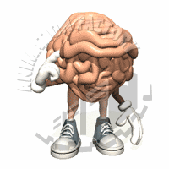
How To Reduce The Dose?
Automatic Tube Current Modulation

Slide 8
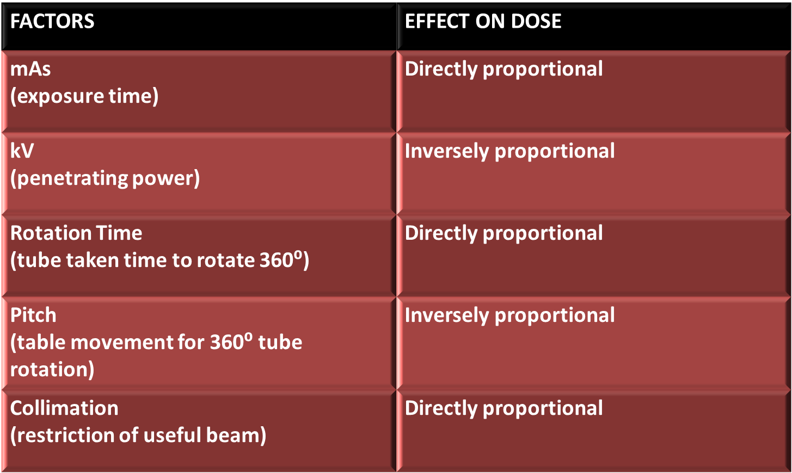
Factors Influencing Dose In CT Scan

Slide 9
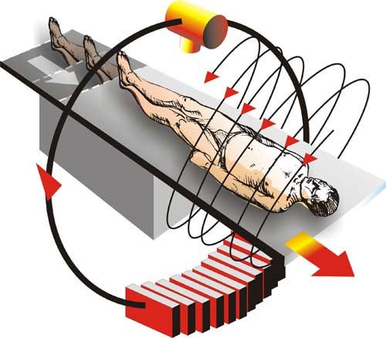
Dose Comparison

Slide 10
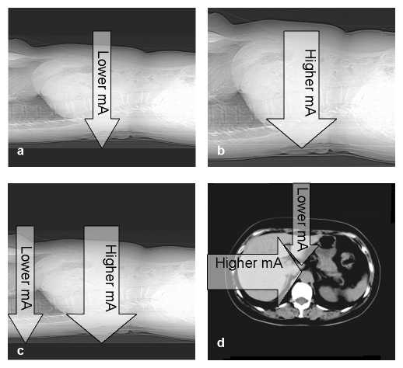
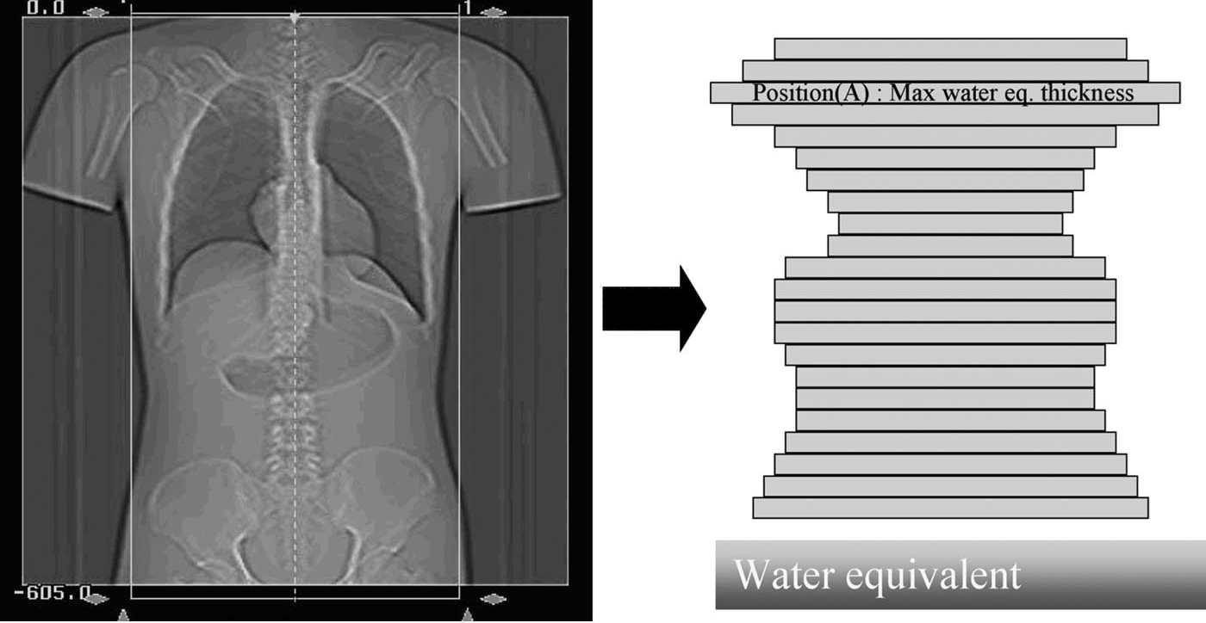
ATCM Principle
Adjustment of Tube Current to accommodate the patient contour and composition.

Slide 11

Aim
To compare the dose difference and state the significance of Automatic Tube Current Modulation (ATCM) in abdominal MDCT examination while maintaining optimum image quality for diagnosis

Slide 12

Material & Methods
Philips (Brilliance) 64 row MDCT
Output Capacity-60KW
KV-80, 120,140
MA- A.800mA –
B. Dose modulated mA
Anode storage capacity-8MHU
INCLUSION CRITERIA
Age 20 to 80 years, both genders
Advised CT Scan abdomen by respective clinician for clinical condition.
EXCLUSION CRITERIA
Larger body matrix, children, Critical patients.

Slide 13
Study Design
Study Design
Case study design using qualitative techniques of in-depth interviews and observations
Study Sample
Advised CT Scan abdomen by respective clinician for clinical condition.
Sample Size
There were forty adult patients in our study including 27 Males and 13 Females.
Divided into four groups depends upon body mass index. i.e.,
    Group-A underweight with BMI less then18.5
    Group-B normal weight with BMI 18.5-24.9
    Group-C overweight with BMI 25-29.9
    Group-D obesity with BMI of 30 or greater.

Slide 14
Ethical Considerations
Informed voluntary written consent was obtained from the participants for the study.
Information collected used only for research purpose .
The study was approved by the institutional ethical committee.

Slide 15
Informed Consent
Serial Number :
Hospital Number :
Name :
Age :
Sex :
I ……………………. hereby voluntarily give consent to Mr. PURNA CHANDER REDDY for taking Computed Tomographic Scan (CT Scan) of my Abdomen for studying the Automatic Tube Current Modulation, which will be used for the dissertational study. I have been explained about the procedure in the language that I understand and I am aware that I can refuse unconditionally.
Signature of the Individual
Place:
Date:

Slide 16
Results
The varying in mAs values according to ACS for different body counter of the patients was observed.
  Group A resulted in estimations of dose saving in range of 10-27 %.
  Group B 8.1-36.6 %,
  Group C 8.3-33.4%,
  Group D 5.7-19 % with application of ATCM Technique.
The overall radiation output results for forty patients ; least is 5.7% and highest is 36.6%.
According my study statistics shows there is no correlation between BMI and the estimated dose savings.

Slide 17
Discussion
The standard protocol setting is giving same radiation dose output for every patient who is going for CT scan examination.
There are various factors being used for CT image acquisition like mA, KVP, m As(1dr roshan Livingstone) and they are fixed in standard protocol. These fixed factors should not be used in every patient as they have different body habitus and body contours (synthia teaching manual).
Fixed factors not only degrade image quality in the case of obese patients but are also giving excess radiation dose in the case of thin patients(chap bell). Image quality is mainly depends upon number of transmitted photons which are detected by the detector (teaching manual).

Slide 18
Discussion
Decrease in photon number lead to statistical noise that is due to quantum mottle. This can be overcome in two ways that is by increasing the mA or increasing the mAs. But according to justification of laws increase in exposure time results in increasing patient dose twice as well as increases scanning time for the particular region(synthia teaching manual).
So the other option left is to change the mA to get the optimum image quality and decrease the radiation dose at the same time (denis tack).
In modern modalities manufacturers’ implemented Automatic Exposure Control system (AEC), which permit empirical adjustment of radiological technique factors according to size of the patient (from dr roshan 13). According to them we should enter weight and height of the

Slide 19
Conclusion
The use of Automatic Tube Current Modulation (angular dose modulation and z-axis dose modulation) helps in
Radiation Dose reduction Up to 36.6% was achieved with acceptable diagnostic image quality.
Reduces overall irradiation time.
Helps in reduce stochastic and genetic effects.
Helps in not only reduce the patient dose as well as occupational dose.
Scan duration is less compare to standard protocol so we can save the time at clinical side.

Slide 20
Reference
1.A Comparison of radiation doses using weight-based protocol and dose modulation techniques for patients undergoing biphasic abdominal computed tomography examinations. Livingstone RS, Dinakaran PM, Cherian RS, Eapen A. Journal, The official journal of Association of Medical Physicists of India,Year-2009, Volume- 34,issue- 4,page- 217-222.
2. Automatic tube current modulation technique for multidetector CT, it is effective with a 64-detector CT? Yoshinori Funama , Kazuo Awai, Masahiro Hatemura, Masamitchi Shimamura, Yumi Yanaga, Seitaro Oda and Yasuyuki Yamashita. Journal, Radiological physics and technology, publisher springer Japan.Year-january2008, volume-1, number-1, pages- 33-37.
3. Scanning beyond anatomic limits of the thorax in chest CT: findings, radiation dose, and automatic tube current modulation. AJR Am J Roentgenoel Campbell J, Kalra Mk, Rizzo S, Maher MM, Sheppard JA.Year-Dec2005, volume-185, number-6, pages- 1525-30.
4. Mulkens TH, Bellinck P, Baeyaert M, Ghysen D, Van Dijck X, Mussen E, et al. Use of an automatic exposure control mechanism for dose optimisation in multidetectorrow CT examinations: Clinical evaluation. Radiology 2005;237:21323.
5. Nakayama Y, Awai K, Funama Y, Hatemura M, Imuta M, Nakaura T, et al. Abdominal CT with low tube voltage: Preliminary observations about radiation dose,contrast enhancement, image quality, and noise. Radiology 2005;237:945-51.
6. Brenner DJ, Hall EJ. Computed tomography: An increasing source of radiation exposure. N Engl J Med 2007;357:2277-784.

Slide 21
Reference
7. Rehani MM, Berry M. Radiation doses in computed tomography: The increasing doses of radiation need to be controlled. BMJ 2000;320:593-4.
8. McCollough CH, Zink FE. Performance evaluation of a multi-slice CT system. Med Phys 1999; 26:2223-30.
9. Hidajat N, Maurer J, Schroder RJ, Wolf M, Vogl T, Felix R. Radiation exposure in spiral computed tomography: Dose distribution and dose reduction. Invest Radiol 1999; 34:51-7.
10. Brenner D, Elliston C, Hall E, Berdon W. Estimated risks of radiation-induced fatal cancer from pediatric CT. AJR Am J Roentgenol 2001;176:289-96.
11. Brenner DJ, Elliston CD. Estimated radiation risks potentially associated with full body CT screening. Radiology 2004; 232:735-8.
12. Brenner DJ. Radiation risks potentially associated with low-dose CT screening of adult smokers for lung cancer. Radiology 2004; 231:440-5.
13. Yoshinaga S, Mabuchi K, Sigurdson AJ, Doody MM, Ron E. Cancer risks among radiologists and radiologic technologists: Review of epidemiologic studies. Radiology 2004;233:313-21.
14. Wagner LK. Overconfidence, overexposure, and overprotection. Radiology 2004;233:307-8. 15. Hart D, Hillier MC, Wall BF. Doses to patients from medical x-ray examinations in the UK - 2000 review. Chilton, NRPBW14 2002.

Slide 22
Reference
16. McCollough CH, Bruesewitz MR, James M, Kofler T Jr. Dose reduction and dose management tools: Overview of available options1. RadioGraphics 2006;26:503-12.
17. Tack D, Maertelaer VD and Gevenois PA. Dose reduction in multidetector CT using attenuation-based online tube current modulation. AJR Am J Roentgenol 2003;181:331-4.
18. Rizzo S, Kalra M, Schmidt B, Dalal T, Suess C, Flohr T, et al. Comparison of angular and combined automatic tube current modulation techniques with constant tube current CT of the abdomen and pelvis. AJR Am J Roentgenol 2006;186:673-9.
19. Huda W, Nickoloff EL, Boone JM. Overview of patient dosimetry in diagnostic radiology in the USA for the past 50 years. Med Phys 2008;35:5713-28.
20. European Commission. European guidelines on quality criteria for computed tomography. Brussels, Belgium: Report EUR 16262 EN 1999.
21. Kalra MK, Prasad S, Saini S, Blake MA, Varghese J, Halpern EF, et al. Clinical comparison of standard- dose and 50% reduced-dose abdominal CT : Effect on image quality. AJR Am J Roentgenol 2002;179:1101-6.
22. ACR. Computed Tomography Accreditation program: Phantom testing criteria. 1891, Preston White Drive, Reston VA20191.
23. Wade JP, Weyman JC, Goldstone KE. CT standard protocols are of limited value in assessing actual patient dose. Br J Radiol 1997;70:1146-51.

Slide 23
Reference
23. Wade JP, Weyman JC, Goldstone KE. CT standard protocols are of limited value in assessing actual patient dose. Br J Radiol 1997;70:1146-51.
24. Tsapaki V, Aldrich JE, Sharma R, Staniszewska MA, Krisanachinda A, Rehani M, et al. Dose reduction in CT while maintaining diagnostic confidence: Diagnostic eference levels at routine head, chest, and abdominal CT-IAEA-coordinated research project. Radiology 2006;240:828-34.
25. Goddard CC, Al-Farsi A. Radiation doses from CT in the Sultanate of Oman. BJR 1999;72:1073-7.
26. Van der Molen AJ, Veldkamp WJ, Geleijns J. 16-slice CT: Achievable effective doses of common protocols in comparison with recent CT dose surveys. Br J Radiol 2007;80:248-55.
27. Brix G, Nagel HD, Stamm G, Veit R, Lechel U, Griebel J, et al. Radiation exposure in multi-slice versus singleslice spiral CT: Results of a nationwide survey. Eur Radiol 2003;13:1979-91.
28. Shrimpton PC, Hillier MC, Lewis MA, Dunn M. Doses from computed tomography examinations in the UK - 2003 review. Report NRPB-W67. [Published on 2005 March].

Slide 24
Thank You

