Slide 1
Catastrophic antiphospholipid syndrome and Sarcoidosis
A Case Report
Nova Thomas John, MBBS ¹; Madhavi Gorusu, MD ² Katrina Collins ³ and Joseph Digiuseppe, MD, Phd⁴
¹Starling Physicians Division of Hospital medicine; ² Starling Physicians Dept of Hematology-oncology;
^{3,4} Department of pathology &laboratory medicine, Hartford hospital, Hartford CT 06102, USA

Slide 2
Conflict of interests
The authors declare that there is no conflict of interests

Slide 3
Key Points
Brief Overview
Case presentation
Diagnosis
Treatment

Slide 4
Brief Overview
Catastrophic antiphospholipid syndrome (CAPS) is a potentially life-threatening systemic autoimmune disease
Most severe variant of the classic APS; <1% of patients with Antiphospholipid syndrome (APS)
Characterized by histopathologic and clinical evidence of simultaneous widespread small vessel microthrombi → inflammatory cytokine storm → multi-organ failure; laboratory confirmation of high antiphospholipid antibody titers.

Slide 5
Brief Overview
Sarcoidosis is a systemic inflammatory disorder characterized by granulomatous inflammation of various organs.
Although the association of APS and Sarcoidosis may be explained by shared immune dysregulation, cases with concurrent sarcoidosis and APS are extremely rare with only 11 previously reported cases in literature from inception until May 31, 2017.
Here, we present the 12th reported case, presenting with digital gangrene and review the literature on CAPS.

Slide 6
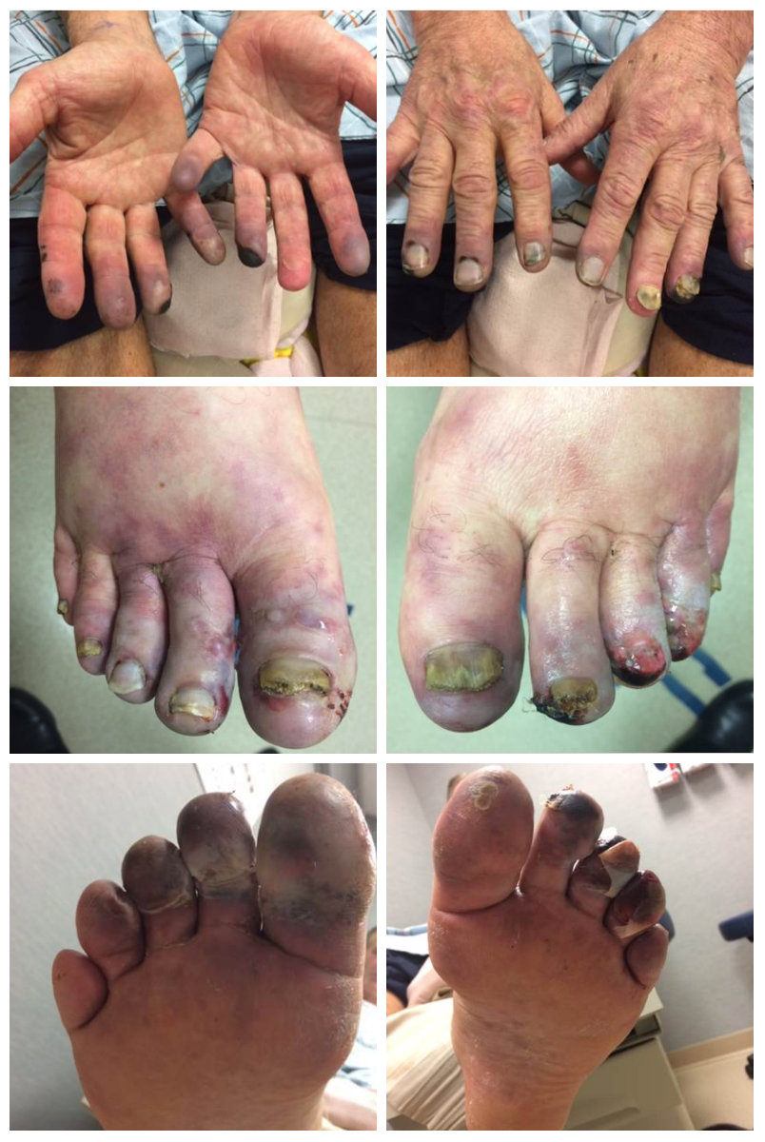
Case presentation
65-year-old Caucasian gentleman
Acute onset
Excruciating pain, bluish discoloration, numbness of multiple fingers and toes
Skin ulceration and gangrene of digits
Rapidly progressive worsening over 10-14 days prior to admission.

Slide 7
Hospital course
Started on IV unfractionated Heparin drip due to concern for thrombo-embolic shower or microvascular thrombotic event due to arteritis or autoimmune process
CTA abdomen pelvis with bilateral lower extremity runoff no evidence of any major plaques or ulcerated lesions in ascending, thoracic or abdominal aorta
Transthoracic Echocardiogram was unremarkable for intramural thrombus or endocarditis
Diagnostic angiography with intra arterial nitroglycerin challenge → Assess circulation in the extremities

Slide 8
Rheumatologic serologic workup
Component Latest Ref Range | Day 1
Cardiolipin IgA Antibody <20 U/mL | 2
Cardiolipin IgG Antibody <20 U/mL | <2
Cardiolipin IgM Antibody <20 U/mL | 34 (H)
Beta-2 Glycoprotein Ab, IgA <20 U/mL | 2
Beta-2 Glycoprotein Ab,IgG <20 U/mL | 2
Beta-2 Glycoprotein Ab,IgM <20 U/mL | 34 (H)
ANA Screen Negative | Negative
Scl-70 Antibody <1.0 AI | <0.2
RNA Polymerase III Antibody <20 | <20
Sm/RNP Antibody <1.0 AI | <0.2
Sm (Smith) Antibody <1.0 AI | <0.2
Rheumatoid factor <14 IU/ml | 207 (H)
DNA (ds) Antibody Screen | Negative
Component Latest Ref Range | Day 2
Myeloperoxidase Antibody <1.0 AI | <0.2
Proteinase III Antibody <1.0 AI | <0.2
Complement C3 90-180mg/dL | 174
Complement C4 16-47mg/dL | 23
Hepatitis B Surface Antibody | Negative
Hepatitis B Surface Antigen | Negative
Hepatitis C Antibody | Negative
Quantiferon TB | Indeterminate
SPEP/UPEP Immunofixation | Normal
Factor II Prothrombin mutation | Negative
Factor 5 Leiden gene mutation | Negative
ESR <20mm/hr | 45 (H)
CRP 0-0.49 mg/dL | 0.57(H)

Slide 9
Treatment
Pulse dose steroids solumedrol 250 mg IV Q 6 hours x 3 days --> 1mg/kg of prednisone per day
Peripheral vasodilation with bilateral stellate ganglion blocks
Systemic vasodilator therapy with nifedipine
Gabapentin for neuropathic pain
Antiplatelet therapy with aspirin, clopidogrel and statin
VATS assisted thoracic T1, T2, T3 sympathectomies→ Help improve microvascular perfusion to digital vessels→ relieve pain and prevent further necrosis.

Slide 10
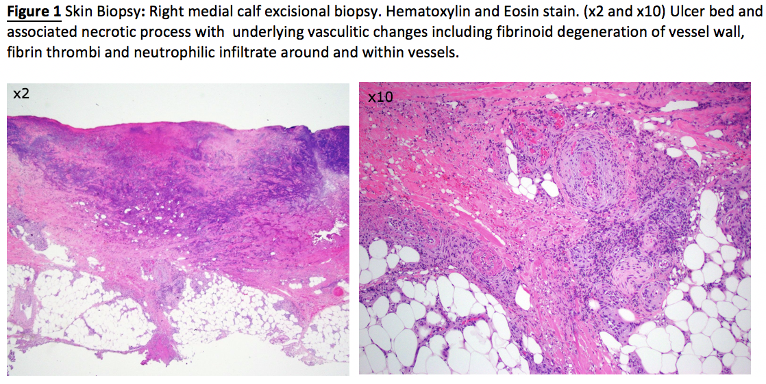
Diagnosis Small vessel vasculitis

Slide 11
Post hospital follow up
Ultimately discharged on Aspirin, Clopidogrel, oral prednisone (60mg/daily) and Azathioprine therapy for primary small vessel vasculitis.
Followed up with vascular surgery, podiatry, pain management and rheumatology as outpatient.
He completed B-cell depletion therapy with two cycles of Rituximab infusion as outpatient for presumed small vessel vasculitis.

Slide 12
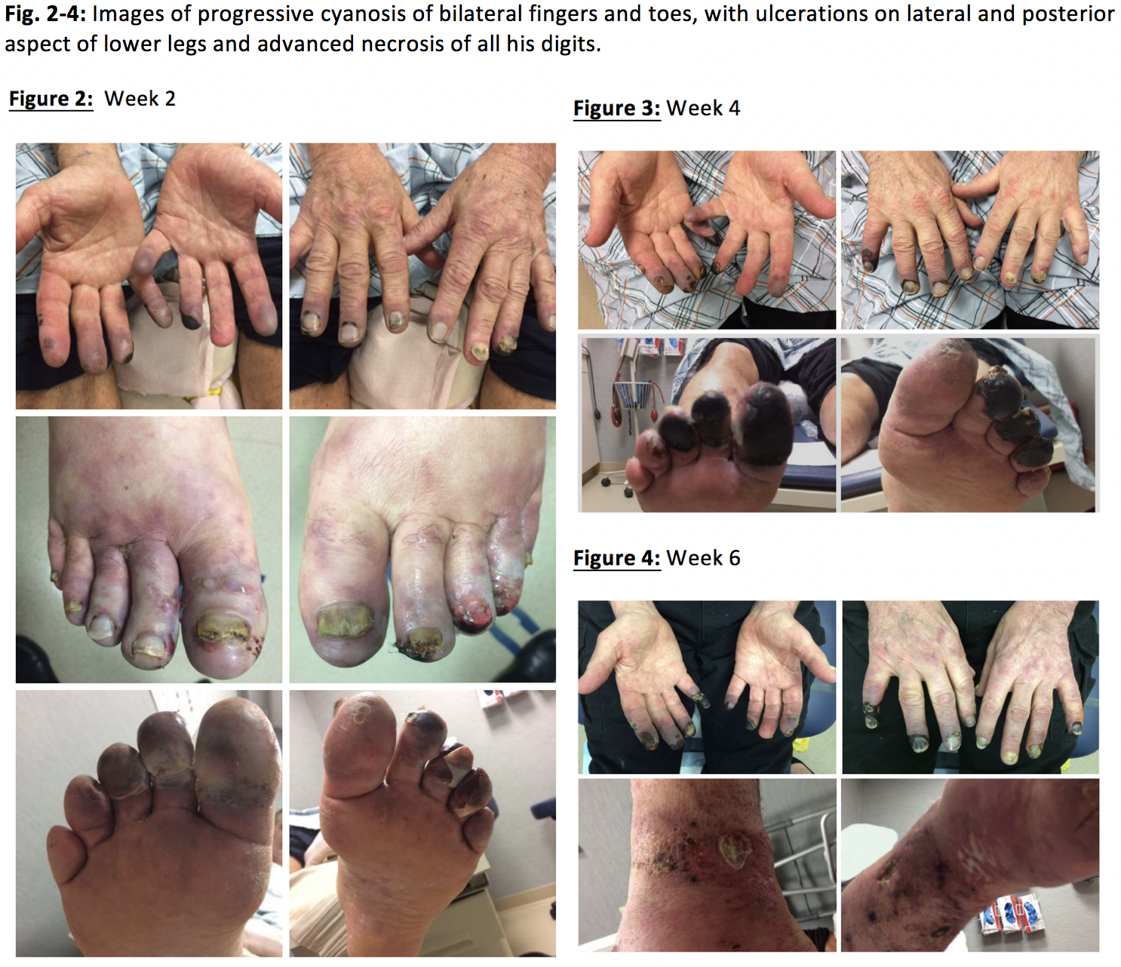
Hospital course
6 weeks later, rehospitalized with worsening symptoms.
Initiated treatment with IV unfractionated Heparin and therapeutic plasma exchange for clinical picture most consistent with probable catastrophic antiphospholipid syndrome variant (CAPS).

Slide 13
Hospital course
Plasma exchange aborted mid-treatment during the third out of five planned exchanges
Line sepsis with Methicillin sensitive Staphylococcus aureus bacteremia→ treated with IV cefazolin x 4 weeks. IJ removed.
Continued on anticoagulation, steroids with the addition of Hydroxychloroquine therapy, and Trimethoprim/sulfamethoxazole for PCP prophylaxis.
Levels of IgM aCL and beta-2 glycoprotein Ab Pre & Post-treatment with Ritximab and TPE

Slide 14
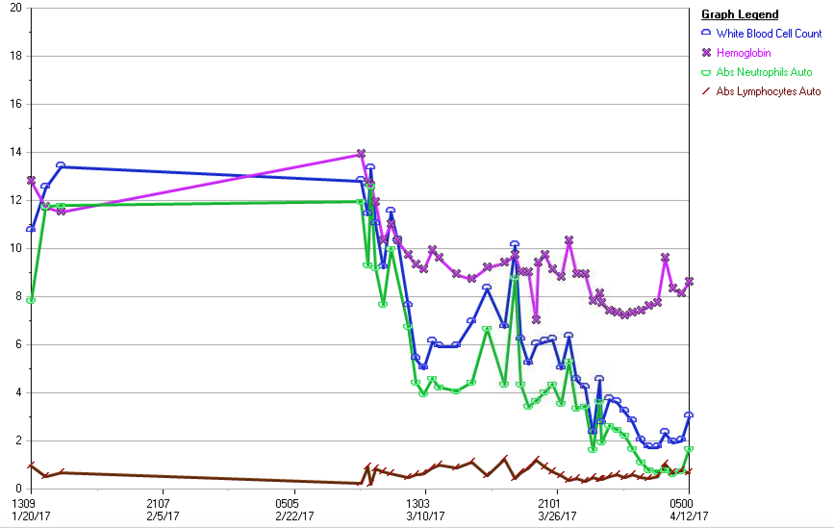
Hospital course
Acute onset pancytopenia, absolute neutropenia and lymphopenia.
Flow cytometry was negative for PNH and G6PD level negative.
Bone marrow biopsy→ cellular marrow with trilineage hematopoiesis, decreased myeloid: erythroid ratio. Also revealed non-necrotizing epithelioid granulomas.
Drug related cytopenias presumed due to Sulphamethoxazole/Trimethoprim and/or Hydroxychloroquine

Slide 15
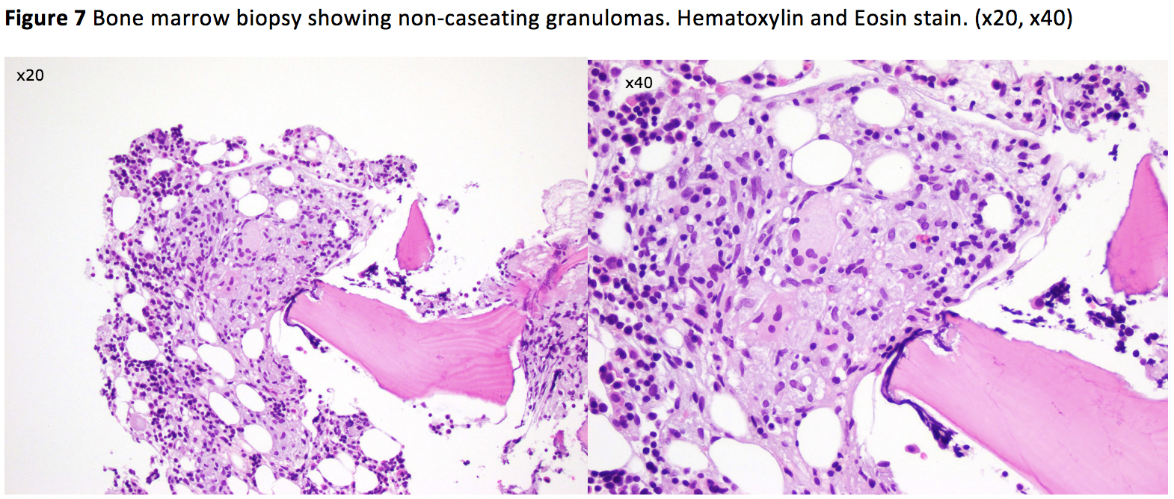
Sarcoidosis of bone marrow
Serum Angiotensin-converting enzyme (ACE) level was elevated at 95 U/L (Normal Range: 9-67 U/L).

Slide 16
Catastrophic Antibody Syndrome
Diagnostic challenge
Classification criteria
Clinical manifestations
General approach to treatment
Treatment strategies
Unique Association with sarcoidosis
conclusions

Slide 17
Diagnostic challenge
CAPS is a challenging systemic disease requiring a high index of clinical suspicion as outcomes are poor without prompt recognition and early initiation of targeted multimodal treatment.
Need for collaborative team approach
In 1992, Dr. Ronald Asherson first defined this condition as a “widespread coagulopathy strongly related to antiphospholipid antibodies (aPL), but totally distinct and separate from any of the other recognized inherited/acquired coagulopathies”
Given the rarity of this lethal variant of APS, it is crucial to study this disease in a more systematic manner.

Slide 18
Classification criteria
In 2000→International CAPS Registry (by the European Forum on Antiphospholipid Antibodies)>380 published cases from all over the world. Lead to establishment of preliminary criteria for classification and guidelines for management of CAPS.
In 2002-2005 → Preliminary classification criteria for CAPS were proposed in 2002 by Asherson, validated in 2005.
In 2014 →" Task Force on Catastrophic Antiphospholipid” developed at the 14th International Congress on Antiphospholipid Antibodies to discuss the challenges in the diagnosis, management of CAP, identify areas of future research.

Slide 19
Classification criteria
Criteria
1. Evidence of involvement of three or more organs, systems, and/or tissues
2. Development of manifestations simultaneously or in less than a week
3. Confirmation by histopathology of small vessel occlusion in at least one organ or tissue*
4. Laboratory confirmation of the presence of antiphospholipid antibodies (lupus anticoagulant, anticardiolipin antibodies, and/or anti-beta2-glycoprotein I antibodies) **
Classification
Definite catastrophic antiphospholipid syndrome
Requires all four criteria
Probable catastrophic antiphospholipid syndrome
All four criteria, except for only two organs, systems, and/or sites of tissue involvement or
All four criteria, except for the laboratory confirmation at least six weeks apart due to the early death of a patient never tested for aPL before the catastrophic APS or
Criteria 1, 2, and 4 above or
1, 3, and 4 and the development of a third event in more than a week but less than a month, despite anticoagulation
*Vasculitis may coexist, but significant thrombosis must be present as well. ** “Positive aPL” twice 12 weeks apart as per updated Sapporo APS classification criteria [2006]

Slide 20
Clinical manifestations
Organ affected by microthrombosis
Cytokine storm
Systemic inflammatory response syndrome (SIRS)
Small vessel occlusion
Extensive tissue necrosis
>50% rise in serum creatinine, proteinuria (>0.5g/day), severe hypertension (BP>180/100 mmHg), or a combination. Rarely, renal infarction.
Acute respiratory distress syndrome, Pulmonary embolism, alveolar hemorrhage
Hypertensive encephalopathy, ischemic encephalopathy, stroke, cerebral venous thrombosis
Unstable angina, myocardial infarction, Valvular disease causing regurgitation, thrombotic valve lesions with sterile lesions, intracardiac thrombi
Livedo reticularis, acrocyanosis, purpura, ecchymosis, splinter hemorrhages, necrosis resulting in ulcerations.

Slide 21
General approach to treatment
Treatment strategies are directed at addressing thrombotic events and suppressing the inflammatory response due to cytokine cascade.
Identify any precipitating factor or concomitant autoimmune disorder. In >50% CAPS cases, precipitating factors can be identified:
  Infection (46.7%)
  Malignancy (17.6%)
  Surgery (16.8%)
  Sub-therapeutic anticoagulation (10.9%)
Exclusion of other syndromes that can simultaneously target multiple organs, and in particular the microvasculature of these organs like TMA, HUS/TTP or DIC.

Slide 22
Treatment strategies
Anticoagulation
Systemic Glucocorticoids
Plasma exchange
Novel therapy
In patients with SLE
Statins
IV unfractionated Heparin for treatment in the acute setting and transition to oral anticoagulation with warfarin goal INR 2.0-3.0
Methylprednisolone 1 gm intravenously daily for three days followed by oral or parenteral therapy with the equivalent of 1 mg/kg of prednisone per day
Shown in observational studies and in the CAPS registry to improve mortality used for 3-5 consecutive days with or without IVIG, to rapidly remove aCL antibodies.
In resistant/refractory CAPS, Rituximab (B-cell depletion anti-CD20 monoclonal antibody) or Eculizumab (anti-C5 monoclonal antibody) may be effective
Anti-inflammatory, anticoagulant, and immunoregulatory effects
Hydroxychloroquine → reduce the risk of an initial thrombotic event in patients with or without aPL.
Cyclophosphamide added in patients with SLE with CAPS

Slide 23
Brief overview of Sarcoidosis
Sarcoidosis is a systemic inflammatory disorder of unknown cause
Characterized by granulomatous inflammation of various organs, most frequently lungs (90%), mediastinal, peripheral lymph nodes, liver, spleen, eyes, adrenal, pleural and skin.
Extra pulmonary sarcoidosis involving the bone and bone marrow have been infrequently reported and usually is a post-mortem finding.
The most frequent hematologic abnormality secondary to sarcoidosis with bone marrow involvement is anemia and leucopenia-lymphopenia.

Slide 24
Unique association of CAPS with Sarcoidosis
Although the chest radiograph was within normal limits, this does not rule out lung involvement. In such cases, the ACE level maybe helpful.
Both CAPS and Sarcoidosis may be associated with various autoimmune disorders.
If a sarcoidosis patient has a thrombotic event, APS should be considered, especially in the absence of other risk factors.

Slide 25
Conclusions
Catastrophic APS is a rare variant <1% of APS patients
This potentially life-threatening systemic autoimmune disease requires high clinical awareness for early diagnosis and multidisciplinary collaborative treatment strategy.
First line “Triple therapy” of CAPS (anticoagulation, glucocorticoids, plasma exchange) and/or IVIG →improved patient outcomes, overall decline in mortality rate from 53% to 33% in the last decade.

Slide 26
Day of discharge
White count gradually improved to 3.0 with absolute neutrophil count of 1650 from a nadir of 640, after discontinuation of Bactrim and HCQ. Bactrim was switched to Atovaquone for PCP prophylaxis and slow steroid taper begun.
Heparin drip was bridged to Coumadin with goal INR 2.0-3.0 after multiple partial toe amputations of gangrenous digits by Podiatry.
Antiplatelet therapy was tapered to Aspirin 162mg/day and Plavix discontinued.
Patient made excellent recovery with multidisciplinary care and progressed towards discharge home.

Slide 27
References
Nayer A, Ortega LM, Catastrophic antiphospholipid syndrome: a clinical review. J Nepropathol. 2014 Jan;3(1):9-17.
Galli M, Treatment of the antiphospholipid syndrome. Auto Immun highlights. 2013 Dec 22;5(1):1-7.
Aguiar CL, Erkan D, Catastrophic antiphospholipid syndrome: how to diagnose a rare but highly fatal disease. They Adv Musculoskelet Dis. 2013 Dec;5(6):305-14.
El-Shereef RR, El-Abedin Z, Abdel Aziz R, Talat I, Saleh M, Abdel-Samia H, Sameh A, Sharha M, Catastrophic Antiphospholipid Syndrome. Case Rep Rheumatol 2016 Jun 7
Kazzaz NM, McCune WJ, Knight JS, Treatment of catastrophic antiphospholipid syndrome. Curr Opin Rheumatol 2016 May;28(3):218-27
Rodriguez-Pinto I, Espinosa G, Cervera R, Catastrophic antiphospholipid syndrome: The current management approach. Best Pract Res Clin Rheumatol 2016 Apr;30(2):239-249
Costedoat CN, Arnaud L, Saadoun D, Chastre J, Leroux G, Cacoub P, Armoura Z, Piette JC, Catastrophic antiphospholipid syndrome Rev Med Interne. 2012 Apr;33(4):194-9
Asheron RA, The catastrophic antiphospholipid (Asherson's) syndrome. Autoimmun Rev. 2006 Dec;6(2):64-7.
Halil Y, Gulsum EP, Tuncer K, Sabriye D, Bone marrow involvement in sarcoidosis: an analysis of 50 bone marrow samples. Haematologia, Vol. 32, No.4, pp, 419-425 (2002)
Adeline C, Jose RS, Joana C, Bernardo F, Orlando G, A patient with sarcoidosis and antiphospholipid syndrome. European Journal of Internal medicine 19 (2008) e80-e81
Jay P, Kunal B, Kumkum P, Alzbeta S, Joseph G, Girish N, A rare presentation of venous thromboembolic disease in the setting of cardiopulmonary sarcoidosis. Pulm vascular disease, Oct 2014, Vol 146, No.4.
Rand JH, Wu XX, Quinn AS, et al. Hydroxychloroquine protects the annexin A5 anticoagulant shield from disruption by antiphospholipid antibodies: evidence for a novel effect for an old antimalarial drug. Blood. 2010;115(11):2292-2299.
Ruiz-Irastorza G, Cuadrado MJ, Ruiz-Arruza I, et al. Evidence- based recommendations for the prevention and long-term management of thrombosis in antiphospholipid antibody- positive patients: report of a task force at the 13th International Congress on antiphospholipid antibodies. Lupus. 2011;20(2): 206-218.
Wendy Lim, Antiphospholipid syndrome. Updates in Aggressive Thrombotic disease. Hematology 2013

Slide 28
Thank you!

