Slide 1
Lupus nephritis masquerading as Hemophagocytic lymphohistiocytosis
Nova Thomas John, MBBS ¹; Madhavi Gorusu, MD ² Katrina Collins ³ and Joseph DiGiuseppe, MD, PhD⁴
¹Starling Physicians Division of Hospital Medicine; ² Starling Physicians Dept of Hematology-Oncology;
^{3,4} Department of Pathology & Laboratory Medicine, Hartford Hospital, Hartford CT 06102, USA

Slide 2
Conflict of Interest
The authors declare that there is no conflict of interests.

Slide 3
Brief overview of HLH
Hemophagocytic Lymphohistiocytosis (HLH), also known as hemophagoctic syndrome (HS) and the related macrophage activation syndrome are aggressive, life-threatening clinical syndromes
The International Histiocyte Society formally adopted the name of HLH in 1998 and defined criteria for its diagnosis, which were updated in 2004.
Estimated incidence us 1 in 50,000 live births. Most frequently affects children and rarely adults.
Can occur as a familial primary form or secondary HLH triggered due to infectious, malignancies, autoimmune diseases, drugs.

Slide 4
Brief overview of HLH
Characterized by excessive immune activation of T-Cells and macrophages triggering an inflammatory cytokine hypersecretion
Clinically, patients present with prolonged unexplained fever, pancytopenia, hepatosplenomegaly, liver function abnormalities, coagulopathy and hyperferritinemia.
The pathognomic feature is presence of macrophages phagocytosing hematopoetic cells (erythrocytes, leucocytes, platelets and their precursors) in bone marrow, spleen and/or lymph.

Slide 5
Brief overview of SLE
Systemic Lupus erythrematosus (SLE) is a systemic autoimmune disorder involving multiple visceral organs.
Lupus related hemophagocytic syndrome is rare with prevalence estimated between 0.9% and 4.6%.
As in the case reported here, it poses significant diagnostic challenges due to the overlap in clinical findings.
Co-existence of HLH may lead to delay in diagnoses of underlying SLE due to common manifestations of cytopenias in both.

Slide 6
Case presentation
A 20-year-old African American female with history depression presented with complaints of generalized diffuse muscle aches, pains, fatigue ongoing for last three weeks.
Accompanied by watery diarrhea in the last one week. 3-4 episodes/day of non bloody loose stool which was self-limiting.

Slide 7
Case presentation
Review of systems:
  Denies nausea, vomiting, abdominal pain.
  Denies fever, chills, night sweats or weight loss.
  Denies joint swelling or skin rash
She noted no recent travel or exposure to sick contacts.
Medications:
  Recently started on Zoloft for depression and suicidal ideation.
  Using over the counter Ibuprofen for aches and pains in the last 24 hours.

Slide 8
Physical Examination
Vitals at presentation : Tmax 102.1ºF, pulse 103, respiratory rate 18, blood pressure 132/64 mm Hg , saturating 100% on room air.
On physical examination, she was non-toxic appearing.
Eyes were remarkable for pallor but were anicteric.
Right posterior cervical adenopathy.
Heart rate and rhythm was normal. Grade 3/6 systolic murmur.
Lungs were clear.
Her abdomen was soft, non-tender without hepatosplenomegaly.
Skin exam was without rashes or lesions. She had no signs of joint synovitis.
Neurologic exam was non focal.

Slide 9
Diagnosis
Laboratory data | Value on admission | Reference range
White Blood Cell | 3.0 (L) | 4.0-11.0 10³/uL
Hemoglobin | 11.8 | 11.7-15.7 g/dL
Hematocrit | 34.1 (L) | 35.0-47.0 %
MCV | 81 | 80-100 fL
MCH | 28.1 | 26.0-34.0 pg
MCHC | 34.6 | 30.0-36.0 g/dL
Platelet Count | 122 (L) | 150-450 10³/uL
Abs Neutrophils | 1.76 (L) | 2.00-7.50 10³/uL
Abs Lymphocyte | 1.15 (L) | 1.50-4.50 10³/uL
Abs Monocytes | 0.11 (L) | 0.20-1.50 10³/uL
Abs Eosinophils | 0.00 | 0.00-0.70 10³/uL
Prothrombin Time | 11.1 | 9.4-12.2 seconds
INR | 1.0
aPTT | 38 (H) | 25-36 seconds
Laboratory data | Value on admission | Reference range
Sodium | 128 (L) | 136-145 mmol/L
Potassium | 4.1 | 3.4-5.3 mmol/L
Chloride | 95 (L) | 98-107 mmol/L
CO2 | 19 (L) | 22-33 mmol/L
BUN | 35 (H) | 8-21 mg/dL
Creatinine | 1.3 (H) | 0.4-1.1 mg/dL
Glucose | 101 | 65-99 mg/dL
Calcium | 7.3 (L) | 8.7-10.5 mg/dL
Ionized Calcium | 1.04 (L) | 1.17-1.33 mmol/L
Albumin | 1.6 (L) | 3.5 - 5.0 g/dL
Bilirubin Total | 0.2 | 0.2-1.0 mg/dL
Bilirubin Direct | <0.2 | 0-0.2 mg/dL
AST | 270 (H) | 9-45 U/L
ALT | 79 (H) | 10-50 U/L
ALKP | 96 | 32-122 U/L

Slide 10
Diagnosis
Clean catch urinalysis revealed large proteinuria and microscopic hematuria.
Ultrasound abdomen showed increased echogenicity of right renal cortex, suggest underlying medical renal disease. No calcification, mass or hydronephrosis. No gross hepatic or gallbladder abnormality.

Slide 11
Diagnosis
Table: Infectious work-up
Laboratory data | Result
HIV 1/2 Ag/Ab | Negative
Cytomegalovirus DNA, Quant PCR | Not detected
CMV IgG & IgM Antibody | Negative
Mononucleosis Screen | Negative
Epstein-Barr virus DNA, Quant PCR | Negative
Toxoplasma IgG & IgM | Negative
Parvovirus B19 DNA qualitative, PCR | Not detected
Ehrilichia Blood Smear | No Anaplasma or Ehrlichia morulae seen.
Lyme Antibody screen w/ Reflex Western Blot | Negative
Blood smear Malaria/Babesiosis | Negative
Syphilis RPR titer | Negative
Acute Hepatitis Panel | Negative for Hep A,B or C
Blood cultures | Sterile after 5 days
Urine culture | Pseudomonas aeruginosa 10,000 col/mL
Stool culture | Negative for Salmonella, Shigella, Campylobacter and E.Coli 0157.

Slide 12
Diagnosis
Peripheral smear review: anisopoikilocytosis with elongated forms. However, neither spherocytes or schistocytes were significantly increased to suggest autoimmune or microangiopathic hemolysis.
Bone marrow aspirate and biopsy performed showed aspicular aspirate and hypocellular marrow on biopsy. No tumor or granulomas identified.
Peripheral flow cytometry was not suggestive of lymphoid or myeloid neoplasia.

Slide 13
Hospital course
At this point, her presentation was presumed to be secondary to a viral syndrome and she was discharged home.
Five days after discharge, she presented again with on-going fevers upto 105ºF and myalgias.
Repeat laboratory workup revealed severe pancytopenia, transaminitis and hyperferritinemia.

Slide 14
Additional serologic workup
Laboratory data | Result | Reference range
Ferritin | 17248 (H) | 15- 150 μg/L
Triglyceride | 440 (H) | <150 mg/dL
Fibrinogen | 261 | 148- 435 mg/dL
High Sensitivity D-Dimer | 3431 (H) | <230 ng/mL
Lactic Acid | 0.6 | 0.5-2.2 mmol/L
GGT (Gamma glutamyl trans) | 102 (H) | 7-32 U/L
LDH | 1139 (H) | 120- 260 U/L
Haptoglobulin | <10 (L) | 30- 200 mg/dL
Reticulocyte Count | 0.5 (L) | 0.7-2.0%
Absolute reticulocyte count | 16.4 (L) | 30.0-100.0 10³/μL
Reticulocyte Index | 0.3 (L) | 1.0-2.0 %
Laboratory data | Result | Reference range
Iron | 45 (L) | 59-151 μg/dL
Total Iron Binding Capacity | 145 | 100- 400 μg/dL
Iron saturation | 31 | 20- 50 %
Vitamin B12 | 699 | 243- 894 pg/mL
Folate | 12.2 | >7.2 ng/mL
Vitamin D, 25-OH | <5 (L) | 30- 100 ng/mL
Erythrocyte Sedimentation Rate | 45 (H) | <20 mm/hr
C-Reactive Protein | 0.20 | 0-0.49 mg/dL
PTH, Intact | 73 (H) | 15-65 pg/mL
TSH, Highly sensitive | 2.43 | 0.27- 4.20 mIU/L
Free T4 | 1.15 | 0.8- 1.90 ng/dL
Cortisol, Random serum | 21.2 | μg/dL

Slide 15
Autoimmune serological workup
Laboratory data | Result | Reference range
ANA Screen | Mitotic spindle Ab Present | Negative
dS DNA Antibody | 58 (H) | 0-4 IU/mL
Glomerular basement membrane Ab | <1.0 | <1.0
Myeloperoxidase Antibody (p-ANCA) | <1.0 | <1.0
Proteinase-3 Antibody (c-ANCA) | <1.0 | <1.0
ASO screen | Positive | Negative
ASO Titer | 200 | ASO IU/mL
Complement C3 | 59 (L) | 90-180 mg/dL
Complement C4 | 12 | 10-40 mg/dL
Direct Coombs:
Polyspecific Ahg | Positive | Negative
IgG Direct Coombs | Positive | Negative
Anti C3 Direct Coombs | Negative | Negative

Slide 16
Diagnosis
2D Echocardiogram was unremarkable without evidence of endocarditis.
Computerized tomography (CT) chest, abdomen and pelvis with contrast to rule out occult malignancy showed mildly prominent hilar, mediastinal and axillary adenopathy
Due to severe hypoalbuminemia, a 24 hour urine protein collection done showed 5848 mg/1700cc urine in 24 hr period.
Differential diagnosis at this point included lupus nephritis and thrombotic microangiopathy given elevated LDH, low Haptoglobin and hemolytic anemia.
Infectious disease, Hematology-oncology, Rheumatology and Nephrology services were consulted.

Slide 17
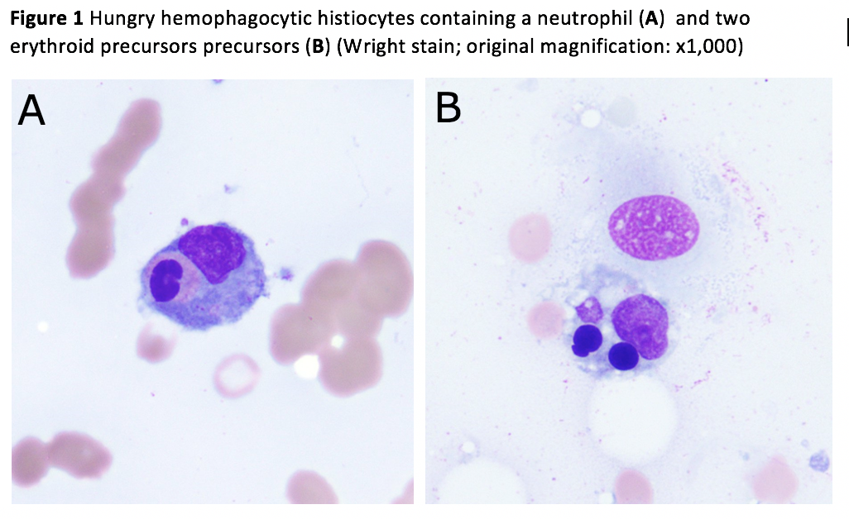
Bone marrow biopsy
Initial bone marrow biopsy did not have adequate spicules on the aspirate, hence, repeat bone marrow biopsy performed revealed HLH.
Started on high dose intravenous dexamethasone therapy in addition to Atovaquone for Pneumocystis prophylaxis

Slide 18
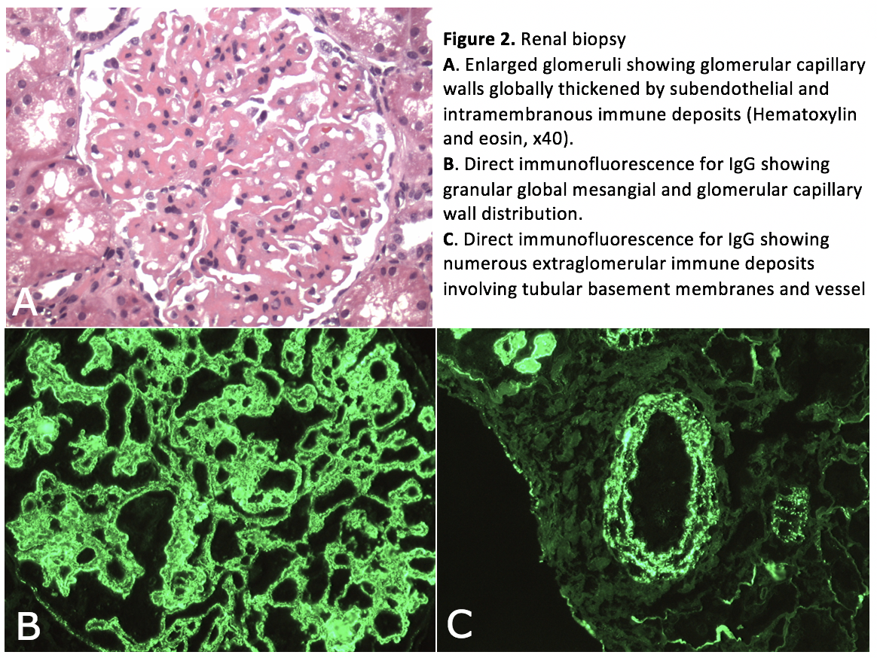
Renal biopsy
Diffuse proliferative and membranous glomerulonephritis, consistent with lupus nephritis class IV+V (associated with HLH). Mild to moderate activity and minimal chronicity.
Immunosuppressive therapy with Mycophenolate mofetil was initiated for SLE in addition to oral Prednisone on discharge.

Slide 19
Therapeutic response

Slide 20
Therapeutic response

Slide 21
Hospital course
Additional special testing showed decreased Natural Killer (NK) cell function and elevated Soluble IL-2 receptor Alpha.
She continued routine outpatient follow-up with Nephrology, Hematology and Rheumatology clinics.
Hydrochloroquine was later added to her therapeutic regimen.
Special testing
Special tests | Result | Reference range
Soluble IL 2 receptor alpha CD 25 | 2119 | <1033pg/mL
NK cell, functional | 3 | Decreased Activity: <7 LU30 Normal Activity: 7-125 LU30 Increased Activity: >125 LU30

Slide 22
Diagnostic Criteria for HLH
A molecular diagnosis consistent with HLH-associated gene: Pathologic mutations of PRF1, UNC13D, Munc18-2, Rab27a, STX11, SH2D1A, or BIRC4 OR
B. At least five of the eight criteria listed below are fulfilled: Fever ≥38.3° C for 7 days or more Splenomegaly Cytopenias affecting at least two of three lineages in the peripheral blood Hemoglobin <9 g/dL (in infants <4 weeks: hemoglobin <10 g/dL) Platelets <100,000/μL Neutrophils <1000/μL Hypertriglyceridemia (fasting > 265 mg/dL) or hypofibrinogenemia (< 150 mg/dL) Hemophagocytosis in BM, spleen, lymph nodes, or liver Decreased or absent NK cell activity Ferritin ≥500 μg/mL Elevated soluble CD25 (soluble IL-2 receptor α) >2400 IU/ml
BM, Bone marrow; HLH, hemophagocytic lymphohistiocytosis; IL-2, interleukin-2; NK,natural killer.
Additionally, in the case of familial HLH, no evidence of malignancy should be apparent.

Slide 23
Discussion
Our patient was diagnosed with HLH fulfilling 6 out of the 8 diagnostic criteria including fever, pancytopenia, hyperferritinemia, hypertriglyceridemia, hemophagocytosis in BM, decreased NK cell activity and elevated CD 25 level.
Underlying primary diagnosis of Lupus nephritis was suspected in view of cytopenia, Positive ANA, dS-DNA Ab, low complement, Direct coombs positive and confirmed on renal biopsy, fulfilling the American College of Rheumatology (ACR) and the Systemic Lupus International Collaborating Clinics (SLICC) classification criteria for SLE.
According to 2012 SLICC criteria, a patient is classified as having SLE if he or she has biopsy-proven nephritis compatible with SLE in the presence of ANAs or anti-dsDNA antibodies.

Slide 24
Conclusions
Adult HLH may rarely masquerade as initial clinical manifestation of Systemic Lupus Erythematosus.
Estimated prevalence of HLH secondary to SLE is rare between 0.9-4.6%.
This case highlights the diagnostic challenge that may lead to delay in diagnosis of acute lupus hemophagocytic syndrome since clinical symptoms also found in immune competent patients with infections.

Slide 25
Conclusions
In patients presenting with unexplained prolonged fever, cytopenias, abnormal liver function and elevated ferritin levels, should prompt clinicians to perform immunologic testing for SLE in setting of HLH to avoid diagnostic and therapeutic delays.
Treatment of secondary HLH is not well standardized but generally is aimed at treating the underlying condition. In HLH due to SLE, corticosteroids and immunosuppressive agents have had favorable success.

Slide 26
Acknowledgments
Columbia Consultation Diagnostic Laboratories for microscopic and immunofluorescence testing and processing of the renal biopsy specimen.

Slide 27
References
A.K.Rahal, J.Fernandez, C.Dakhil, “Undiagnosed Sytemic Lupus Erythematosus Presenting as Hemophagocytic Lymphohistiocytosis”, Case Reports in Rheumatology, Volume 2015
D.Gupta, S.Mohanty, D.Thakral, A.Bagga, N.Wig, D.K.Mitra, “ Unusual Association of Hemophagocytic Lymphohistiocytosis in Systemic Lupus Erythematosus: Cases reported at Tertiary Care Centre”, Am J Case Rep, 2016; 17: 739-744
Egues Dubuc CA, Uriarte Ecenarro M, Meneses Villalba C, Aldasoro Caceres V, Hernando Rubio I, Belzunegui Otano J., “Hemophagocytic Syndrome as the Initial Manifestation of Systemic Lupus Erythematosus”, Reumatol Clin. 2013; 10 :321-324
Anna H, Sujin P, Dean G, Agnes Y.Y L, Luke Y.C C, Hemophagocytic syndromes (HPSs) including hemophagocytic lymphohistiocytosis (HLH) in adults: A systematic scoping review. Blood Reviews 30 (2016) 411-420
Gritta EJ, Hemophagocytic syndromes. Blood Reviews (2007) 21, 245–253
Manuel R-C, Pilar B-Z, Armando L-G, Munther A K, Xavier B, Adult haemophagocytic syndrome. The Lancet Vol 383 April 26, 2014
Pierre-Edouard G, Ilaria SB, Laurent AC, Nathalie C, Julien CE, Clinical spectrum and therapeutic management of systemic lupus erythematosus-associated macrophage activation syndrome: A study of 103 episodes in 89 adult patients . Autoimmunity Reviews 16 (2017) 743–749

Slide 28
Thank you!

